Slide 1



Strategic and Operational
Management
MGM 630 (part one)
Lecture 3
Prepared by
Dr. Ahmad AL-Naimi

Slide 2

Lecture
LECTURE OUTLINE
03
3.1 The PESTEL Framework (- Political Factors - Economic Factors- Sociocultural Factors -Technological Factors - Ecological Factors- Legal Factors).
3.2 Industry Structure and Firm Strategy: The Five Forces Model; (- Competition in the Five Forces Model -The Threat of Entry -The Power of Suppliers -The Power of Buyers -The Threat of Substitutes -Rivalry among Existing Competitors -A Sixth Force: The Strategic Role of Complements).
3.3 Changes over Time: Industry Dynamics.
3.4 Performance Differences within the Same Industry: Strategic Groups; (-The Strategic Group Model -Mobility Barriers).
3–2

Slide 3
Lecture
LEARNING OBJECTIVES
03
1. Generate a PESTEL analysis to evaluate the impact of external factors on the firm.
2. Apply Porter’s five competitive forces to explain the profit potential of different industries.
3. Explain how competitive industry structure shapes rivalry among competitors.
4. Describe the strategic role of complements in creating positive-sum co-opetition.
5. Appraise the role of industry dynamics and industry convergence in shaping the firm’s external environment.
6. Generate a strategic group model to reveal performance differences between clusters of firms in the same industry.
3–3

Slide 4
Lecture
External Analysis: Industry Structure, Competitive Forces, and Strategic Groups
03
3.1. The PESTEL Framework
A firm’s external environment consists of all the factors that can affect its potential to gain and sustain a competitive advantage. By analyzing the factors in the external environment, managers can mitigate threats and leverage opportunities. One common approach to understanding how external factors impinge upon a firm is to consider the source or proximity of these factors. For example, external factors in the firm’s general environment are ones that managers have little direct influence over, such as macroeconomic factors (e.g., interest or currency exchange rates).
3–4

Slide 5
Lecture
External Analysis: Industry Structure, Competitive Forces, and Strategic Groups
03
In contrast, external factors in the firm’s task environment are ones that managers do have some influence over, such as the composition of their strategic groups (a set of close rivals) or the structure of the industry. We will now look at each of these environmental layers in detail, moving from a firm’s general environment to its task environment. Following along in Exhibit 3.1, we will be working from the out erring to the in erring.
3–5

Slide 6
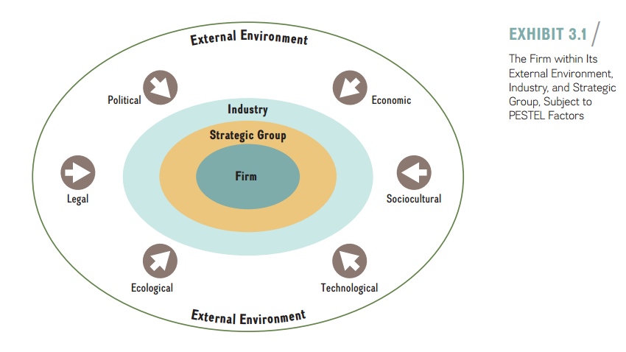
3–6

Slide 7
Lecture
External Analysis: Industry Structure, Competitive Forces, and Strategic Groups
03
The PESTEL model groups the factors in the firm’s general environment into six segments:
■ Political
■ Economic
■ Sociocultural
■ Technological
■ Ecological
■ Legal
3–7

Slide 8
Lecture
External Analysis: Industry Structure, Competitive Forces, and Strategic Groups
03
- political Factors:
Political factors result from the processes and actions of government bodies that can influence the decisions and behavior of firms. While political factors are located in the firm’s general environment, where firms traditionally wield little influence, companies nevertheless increasingly work to shape and influence this realm. They do so by applying nonmarket strategies—that is, through lobbying, public relations, contributions, litigation, and so on, in ways that are favorable to the firm.
3–8

Slide 9
Lecture
External Analysis: Industry Structure, Competitive Forces, and Strategic Groups
03
- Economic Factors:
Economic factors in a firm’s external environment are largely macroeconomic, affecting economy-wide phenomena. Managers need to consider how the following five macro-economic factors can affect firm strategy:
■ Growth rates.
■ Levels of employment.
■ Interest rates.
■ Price stability (inflation and deflation).
■ Currency exchange rates.
3–9

Slide 10
Lecture
External Analysis: Industry Structure, Competitive Forces, and Strategic Groups
03
Growth rates. The overall economic growth rate is a measure of the change in the amount of goods and services produced by a nation’s economy. Strategists look to the real growth rate, which adjusts for inflation. This real growth rate indicates the current business cycle of the economy—that is, whether business activity is expanding or contracting.
3–10

Slide 11
Lecture
External Analysis: Industry Structure, Competitive Forces, and Strategic Groups
03
levels of Employment. Growth rates directly affect the level of employment. In boom times, unemployment tends to be low, and skilled human capital becomes a scarce and more expensive resource. In economic downturns, unemployment rises. As more people search for employment, skilled human capital is more abundant and wages usually fall.
3–11

Slide 12
Lecture
External Analysis: Industry Structure, Competitive Forces, and Strategic Groups
03
Interest rates. Another key macroeconomic variable for managers to track is real interest rates—the amount that creditors are paid for use of their money and the amount that debtors pay for that use, adjusted for inflation.
price Stability. Price stability—the lack of change in price levels of goods and services—is rare. Therefore, companies will often have to deal with changing price levels, which is a direct function of the amount of money in any economy.
Currency Exchange rates. The currency exchange rate determines how many dollars one must pay for a unit of foreign currency. It is a critical variable for any company that buys or sells products and services across national borders.
3–12

Slide 13
Lecture
External Analysis: Industry Structure, Competitive Forces, and Strategic Groups
03
- Sociocultural Factors:
Sociocultural factors capture a society’s cultures, norms, and values. Because sociocultural factors not only are constantly in flux but also differ across groups, managers need to closely monitor such trends and consider the implications for firm strategy. In recent years, for example, a growing number of U.S. consumers have become more health conscious about what they eat. This trend led to a boom for businesses such as Chipotle, Subway, and Whole Foods. At the same time, traditional fast-food companies McDonald’s and Burger King, along with grocery chains such as Albertsons and Kroger, have all had to scramble to provide healthier choices in their product offerings.
3–13

Slide 14
Lecture
External Analysis: Industry Structure, Competitive Forces, and Strategic Groups
03
- Technological Factors:
Technological factors capture the application of knowledge to create new processes and products. Major innovations in process technology include lean manufacturing, Six Sigma quality, and biotechnology. The nanotechnology revolution, which is just beginning, promises significant upheaval for a vast array of industries ranging from tiny medical devices to new-age materials for earthquake-resistant buildings. Recent product innovations include the smartphone, computer tablets, and high-performing electric cars such as the Tesla Model S. Recent service innovations include social media and online search engines that respond to voice commands.
3–14

Slide 15
Lecture
External Analysis: Industry Structure, Competitive Forces, and Strategic Groups
03
- Ecological Factors:
Ecological factors involve broad environmental issues such as the natural environment, global warming, and sustainable economic growth. Organizations and the natural environment coexist in an interdependent relationship. Managing these relationships in a responsible and sustainable way directly influences the continued existence of human societies and the organizations we create. Managers can no longer separate the natural and the business worlds; they are inextricably linked.
3–15

Slide 16
Lecture
External Analysis: Industry Structure, Competitive Forces, and Strategic Groups
03
- Legal Factors:
Legal factors include the official outcomes of political processes as manifested in laws, mandates, regulations, and court decisions—all of which can have a direct bearing on a firm’s profit potential. In fact, regulatory changes tend to affect entire industries at once. Many industries in the United States have been deregulated over the last few decades, including airlines, telecom, energy, and trucking, among others.
3–16

Slide 17
Lecture
External Analysis: Industry Structure, Competitive Forces, and Strategic Groups
03
3.2. Industry Structure and Firm Strategy: The Five Forces Model
Michael Porter developed the highly influential five forces model to help managers understand the profit potential of different industries and how they can position their respective firms to gain and sustain competitive advantage. By combining theory from industrial organization economics with hundreds of detailed case studies, Porter derived two key insights that form the basis of his seminal five forces model:
3–17

Slide 18
Lecture
External Analysis: Industry Structure, Competitive Forces, and Strategic Groups
03
1. Rather than defining competition narrowly as the firm’s closest competitors to explain and predict a firm’s performance, competition must be viewed more broadly, to also encompass the other forces in an industry: buyers, suppliers, potential new entry of other firms, and the threat of substitutes.
2. The profit potential of an industry is neither random nor entirely determined by industry-specific factors. Rather, it is a function of the five forces that shape competition: threat of entry, power of suppliers, power of buyers, threat of substitutes, and rivalry among existing firms.
3–18

Slide 19
Lecture
External Analysis: Industry Structure, Competitive Forces, and Strategic Groups
03
Competition In The Five Forces Model
Because the five forces model has especially powerful implications for strategy and competitive advantage, we will explore it in some detail. We start with the concept of competition. The first major insight this model provides is that competition involves more than just creating economic value; firms must also capture a significant share of it or they will see the economic value they create lost to suppliers, customers, or competitors. Firms create economic value by expanding as much as possible the gap between the value (V) the firm’s product or service generates and the cost (C) to produce it. Economic value thus equals V minus C. To succeed, creating value is not enough. Firms must also be able to capture a significant share of the value created to gain and sustain a competitive advantage.
3–19

Slide 20
Lecture
External Analysis: Industry Structure, Competitive Forces, and Strategic Groups
03
As Exhibit 3.2 shows, Porter’s model identifies five key competitive forces that managers need to consider when analyzing the industry environment and formulating competitive strategy:
1. Threat of entry.
Power of suppliers.
3. Power of buyers.
4. Threat of substitutes.
5. Rivalry among existing competitors.
3–20

Slide 21
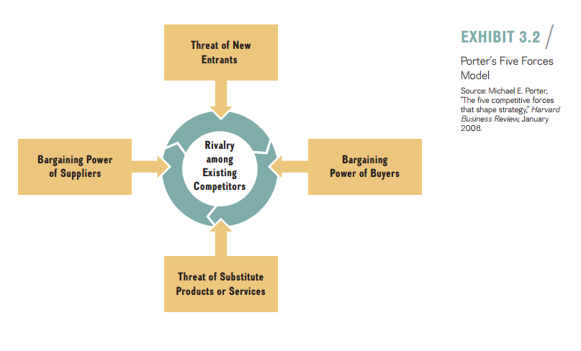
3–21

Slide 22
Lecture
External Analysis: Industry Structure, Competitive Forces, and Strategic Groups
03
1. The Threat of Entry:
The threat of entry describes the risk that potential competitors will enter the industry. Potential new entry depresses industry profit potential in two major ways:
1. With the threat of additional capacity coming into an industry, incumbent firms may lower prices to make entry appear less attractive to the potential new competitors, which would in turn reduce the overall industry’s profit potential, especially in industries with slow or no overall growth in demand. 2. The threat of entry by additional competitors may force incumbent firms to spend more to satisfy their existing customers. This spending reduces an industry’s profit potential, especially if firms can’t raise prices.
3–22

Slide 23
Lecture
External Analysis: Industry Structure, Competitive Forces, and Strategic Groups
03
Of course, the more profitable an industry, the more attractive it is for new competitors to enter. There are, however, a number of important barriers to entry that raise the costs for potential competitors and reduce the threat of entry. Entry barriers, which are advantageous for incumbent firms, are obstacles that determine how easily a firm can enter an industry. Incumbent firms can benefit from several important sources of entry barriers:
3–23

Slide 24
Lecture
External Analysis: Industry Structure, Competitive Forces, and Strategic Groups
03
■ Economies of scale.
■ Network effects.
■ Customer switching costs.
■ Capital requirements.
■ Advantages independent of size.
■ Government policy.
■ Credible threat of retaliation.
3–24

Slide 25
Lecture
External Analysis: Industry Structure, Competitive Forces, and Strategic Groups
03
2. The power of Suppliers
The bargaining power of suppliers captures pressures that industry suppliers can exert on an industry’s profit potential. This force reduces a firm’s ability to obtain superior performance for two reasons: Powerful suppliers can raise the cost of production by demanding higher prices for their inputs or by reducing the quality of the input factor or service level delivered. Powerful suppliers are a threat to firms because they reduce the industry’s profit potential by capturing part of the economic value created.
3–25

Slide 26
Lecture
External Analysis: Industry Structure, Competitive Forces, and Strategic Groups
03
To compete effectively, companies generally need a wide variety of inputs into the production process, including raw materials and components, labor (via individuals or labor unions, when the industry faces collective bargaining), and services. The relative bargaining power of suppliers is high when
■ The suppliers’ industry is more concentrated than the industry it sells to.
■ Suppliers do not depend heavily on the industry for a large portion of their revenues.
3–26

Slide 27
Lecture
External Analysis: Industry Structure, Competitive Forces, and Strategic Groups
03
■ Incumbent firms face significant switching costs when changing suppliers.
■ Suppliers offer products that are differentiated.
■ There are no readily available substitutes for the products or services that the suppliers offer.
■ Suppliers can credibly threaten to forward-integrate into the industry.
3–27

Slide 28

Lecture
External Analysis: Industry Structure, Competitive Forces, and Strategic Groups
03
3. The power of Buyers
In many ways, the bargaining power of buyers is the flip side of the bargaining power of suppliers. Buyers are the customers of an industry. The power of buyers concerns the pressure an industry’s customers can put on the producer’s margins in the industry by demanding a lower price or higher product quality. When buyers successfully obtain price discounts, it reduces a firm’s top line (revenue). When buyers demand higher quality and more service, it generally raises production costs. Strong buyers can therefore reduce industry profit potential and a firm’s profitability. Powerful buyers are a threat to the producing firms because they reduce the industry’s profit potential by capturing part of the economic value created.
3–28

Slide 29
Lecture
External Analysis: Industry Structure, Competitive Forces, and Strategic Groups
03
The power of buyers is high when
■ There are a few buyers and each buyer purchases large quantities relative to the size of a single seller.
■ The industry’s products are standardized or undifferentiated commodities.
■ Buyers face low or no switching costs.
■ Buyers can credibly threaten to backwardly integrate into the industry.
3–29

Slide 30
Lecture
External Analysis: Industry Structure, Competitive Forces, and Strategic Groups
03
In addition, companies need to be aware of situations when buyers are especially price sensitive. This is the case when:
■ The buyer’s purchase represents a significant fraction of its cost structure or procurement budget.
■ Buyers earn low profits or are strapped for cash.
■ The quality (cost) of the buyers’ products and services is not affected much by the quality (cost) of their inputs.
3–30

Slide 31
Lecture
External Analysis: Industry Structure, Competitive Forces, and Strategic Groups
03
4. The Threat of substitutes
Substitutes meet the same basic customer needs as the industry’s product but in a different way. The threat of substitutes is the idea that products or services available from outside the given industry will come close to meeting the needs of current customers.
A high threat of substitutes reduces industry profit potential by limiting the price the industry’s competitors can charge for their products and services. The threat of substitutes is high when:
■ The substitute offers an attractive price-performance trade-off.
■ The buyer’s cost of switching to the substitute is low.
3–31

Slide 32
Lecture
External Analysis: Industry Structure, Competitive Forces, and Strategic Groups
03
5. rivalry among existing competitors
Rivalry among existing competitors describes the intensity with which companies within the same industry jockey for market share and profitability. It can range from genteel to cut-throat. The other four forces—threat of entry, the power of buyers and suppliers, and the threat of substitutes—all exert pressure upon this rivalry, as indicated by the arrows pointing toward the center in Exhibit 3.2. The stronger the forces, the stronger the expected competitive intensity, which in turn limits the industry’s profit potential.
3–32

Slide 33
Lecture
External Analysis: Industry Structure, Competitive Forces, and Strategic Groups
03
The intensity of rivalry among existing competitors is determined largely by the following factors:
■ Competitive industry structure.
■ Industry growth.
■ Strategic commitments.
■ Exit barriers.
3–33

Slide 34
Lecture
External Analysis: Industry Structure, Competitive Forces, and Strategic Groups
03
Competitive Industry Structure. The competitive industry structure refers to elements and features common to all industries. The structure of an industry is largely captured by
■ The number and size of its competitors.
■ The firms’ degree of pricing power.
■ The type of product or service (commodity or differentiated product).
■ The height of entry barriers.
3–34

Slide 35
Lecture
External Analysis: Industry Structure, Competitive Forces, and Strategic Groups
03
Industry Growth. Industry growth directly affects the intensity of rivalry among competitors. In periods of high growth, consumer demand rises, and price competition among firms frequently decreases. Because the pie is expanding, rivals are focused on capturing part of that larger pie rather than taking market share and profitability away from one another. The demand for knee replacements, for example, is a fast-growing segment in the medical products industry.
3–35

Slide 36
Lecture
External Analysis: Industry Structure, Competitive Forces, and Strategic Groups
03
Strategic Commitments. If firms make strategic commitments to compete in an industry, rivalry among competitors is likely to be more intense. We defined strategic commitments(in Chapter 2) as firm actions that are costly, long-term oriented, and difficult to reverse. Strategic commitments to a specific industry can stem from large, fixed cost requirements, but also from non-economic considerations.
3–36

Slide 37
Lecture
External Analysis: Industry Structure, Competitive Forces, and Strategic Groups
03
Exit Barriers. The rivalry among existing competitors is also a function of an industry’s exit barriers, the obstacles that determine how easily a firm can leave that industry. Exit barriers comprise both economic and social factors. They include fixed costs that must be paid regardless of whether the company is operating in the industry or not.
3–37

Slide 38
Lecture
External Analysis: Industry Structure, Competitive Forces, and Strategic Groups
03
A Sixth Force: The Strategic role of Complements
As valuable as the five forces model is for explaining the profit potential and attractiveness of industries, the value of Porter’s five forces model can be further enhanced if one also considers the availability of complements.
3–38

Slide 39
Lecture
External Analysis: Industry Structure, Competitive Forces, and Strategic Groups
03
A complement is a product, service, or competency that adds value to the original product offering when the two are used in tandem. Complements increase demand for the primary product, thereby enhancing the profit potential for the industry and the firm. A company is a complement or to your company if customers value your product or service offering more when they are able to combine it with the other company’s product or service. Firms may choose to provide the complements themselves or work with another company to accomplish this.
3–39

Slide 40
Lecture
External Analysis: Industry Structure, Competitive Forces, and Strategic Groups
03
For example, in the smartphone industry, Google complements Samsung. The Korean high-tech company’s smartphones are more valuable when they come with Google’s Android system installed. At the same time, Google and Samsung are increasingly becoming competitors. With Google’s acquisition of Motorola Mobility, the online search company is planning to launch its own line of smartphones and Chromebooks. This development illustrates the process of co-opetition, which is cooperation by competitors to achieve a strategic objective. Samsung and Google cooperate as complementary to compete against Apple’s strong position in the mobile device industry, while at the same time Samsung and Google are increasingly becoming competitive with one another.
3–40

Slide 41
Lecture
External Analysis: Industry Structure, Competitive Forces, and Strategic Groups
03
3.3 Changes over Time: Industry Dynamics
Although the five-forces-plus-complements model is useful in understanding an industry’s profit potential, it provides only a point-in-time snapshot of a moving target. With this model (as with other static models), one cannot determine the changing speed of an industry or the rate of innovation. This drawback implies that managers must repeat their analysis over time in order to create a more accurate picture of their industry. It is therefore important that managers consider industry dynamics.
3–41

Slide 42
Lecture
External Analysis: Industry Structure, Competitive Forces, and Strategic Groups
03
Industry structures are not stable over time. Rather, they are dynamic. Since a consolidated industry tends to be more profitable than a fragmented one firms have a tendency to change the industry structure in their favor, making it more consolidated through horizontal mergers and acquisitions. Having fewer competitors generally equates to higher industry profitability. Industry incumbents, therefore, have an incentive to reduce the number of competitors in the industry. With fewer but larger competitors, incumbent firms can mitigate the threat of strong competitive forces such as supplier or buyer power more effectively.
3–42

Slide 43
Lecture
External Analysis: Industry Structure, Competitive Forces, and Strategic Groups
03
3.4 Performance Differences within the Same Industry: Strategic Groups
In further analyzing the firm’s external environment to explain performance differences, we now move to firms within the same industry. As noted earlier in the chapter, a firm occupies a place within a strategic group, a set of companies that pursue a similar strategy within a specific industry in their quest for competitive advantage. Strategic groups differ from one another along important dimensions such as expenditures on research and development, technology, product differentiation, product and service offerings, pricing, market segments, distribution channels, and customer service.
3–43

Slide 44
Lecture
External Analysis: Industry Structure, Competitive Forces, and Strategic Groups
03
To explain differences in firm performance within the same industry, the strategic group model clusters different firms into groups based on a few key strategic dimensions. Even within the same industry, firm performances differ depending on strategic group membership. Some strategic groups tend to be more profitable than others. This difference implies that firm performance is determined not only by the industry to which the firm belongs, but also by its strategic group membership.
3–44

Slide 45
Lecture
External Analysis: Industry Structure, Competitive Forces, and Strategic Groups
03
- The Strategic Group Model
To understand competitive behavior and performance within an industry, we can map the industry competitors into strategic groups. We do this as shown:
■ Identify the most important strategic dimensions such as expenditures on research and development, technology, product differentiation, product and service offerings, pricing, market segments, distribution channels, and customer service.
3–45

Slide 46
Lecture
External Analysis: Industry Structure, Competitive Forces, and Strategic Groups
03
■ Choose two key dimensions for the horizontal and vertical axes, which expose important differences among the competitors. The dimensions chosen for the axes should not be highly correlated.
■ Graph the firms in the strategic group, indicating each firm’s market share by the size of the bubble with which it is represented.
The strategic group mapping in Exhibit 3.5 provides some additional insights:
3–46

Slide 47
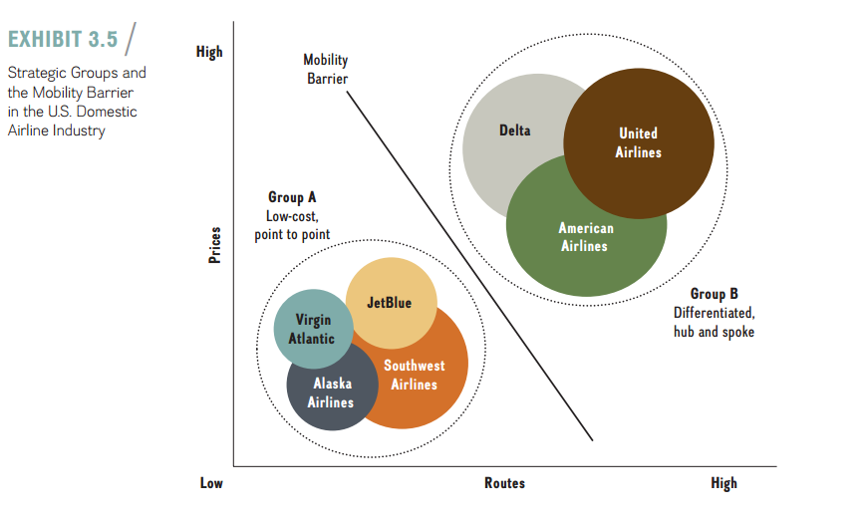
3–47

Slide 48
Lecture
External Analysis: Industry Structure, Competitive Forces, and Strategic Groups
03
- Mobility Barriers
Although some strategic groups tend to be more profitable and therefore more attractive than others, mobility barriers restrict movement between groups. These are industry-specific factors that separate one strategic group from another. The two groups identified in Exhibit 3.5 are separated by the fact that offering inter-national routes necessitates the hub-and-spoke model. Frequently, the international routes tend to be the remaining profitable routes left for the legacy carriers; albeit the up-and-coming Persian Gulf region carriers, in particular Emirates, Etihad Airways, and Qatar Airways, are beginning to threaten this profit sanctuary.
3–48

Slide 49

References
Strategic management, third edition, 2017 By Frank t. Rothaermel
Georgia Institute of Technology.
3–49

Slide 50



Thank You

