Slide 1





Organizational Behavior
Prepared by Dr. Walid K. El Leithy
Lecture 1
PMG 671
Organizational Behavior

Slide 2


Chapter
01
Organizational Behavior
Stephen P. Robbins & Timothy A. Judg

Slide 3



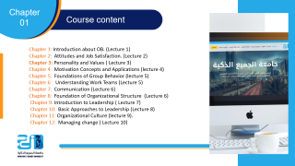

Chapter
01
Course content
Chapter 1: Introduction about OB. (Lecture 1)
Chapter 2: Attitudes and Job Satisfaction. (Lecture 2)
Chapter 3: Personality and Values ( Lecture 3)
Chapter 4 : Motivation Concepts and Applications (lecture 4)
Chapter 5: Foundations of Group Behavior (lecture 5)
Chapter 6 : Understanding Work Teams (Lecture 5)
Chapter 7: Communication (Lecture 6)
Chapter 8: Foundation of Organizational Structure (Lecture 6)
Chapter 9: Introduction to Leadership ( Lecture 7)
Chapter 10: Basic Approaches to Leadership (Lecture 8)
Chapter 11: Organizational Culture (lecture 9).
Chapter 12: Managing change ( Lecture 10)

Slide 4
Chapter
01
What is OB?
A field of study that investigates the impact that individuals, groups, and structure have on behavior within organizations, for the purpose of applying such knowledge toward improving an organization’s effectiveness.

Slide 5
Chapter
01
What is OB?
In other words, Organizational behavior is the study of human behavior in Organizations and the application of knowledge about how, individuals, and groups act and react in an organization, in order to reach and accomplish the highest quality of performances, and dominant results.

Slide 6
Chapter
01
OB Main Concern
Why do people behave a certain way in an organizational environment? What factors affect job performance, employee interaction, job commitment, leadership and managerial styles?
Individuals have studied this topic for decades in order to find ways of increasing organizational performance.

Slide 7
Chapter
01
OB History As A Science
While Organizational Behavior as a field of academic study wasn’t fully recognized by the American Psychological Association (APA) until the 1970’s, it’s roots go back to the late 1920’s when the Hawthorne Electric Company set up a series of experiments designed to explore how changes in environment and design changed the productivity of their employees.

Slide 8
Chapter
01
OB History As A Science
Their various studies, conducted between the years of 1924 and 1933, were broad and measured over large periods of time. The studies included the effect of various types of breaks (lots of small breaks, a few long ones, etc.) on productivity, productivity in isolation, and productivity in varying levels of light. The most famous finding resulting from the of the Hawthorne Studies is what is now called the Hawthorne Effect, the change in behavior of a test subject when they know they’re being observed.

Slide 9
Chapter
01
The importance of Interpersonal
Skills
Until the late 1980s, Business Schools Curricula emphasized the technical aspects of Management, focusing on Economics, Accounting, Finance and so on.
Starting from the early 1990s, Business Schools realized the importance of understanding human behavior and the its role in determining a manager’s effectiveness.

Slide 10
Chapter
01
The importance of Interpersonal
Skills
Understanding OB helps determine manager effectiveness
  Technical and quantitative skills are important
  But leadership and communication skills are CRITICAL
Organizational benefits of skilled managers
  Lower turnover of quality employees
  Higher quality applications for recruitment
  Better financial performance

Slide 11
Chapter
01
Why is it important to Managers
To Understand OB
Findings from organizational behavior’s body of research can be used by executives and Human Relations professionals better understand a business’ culture, how that culture may facilitate or hinder productivity and employee retention, and how to best evaluate candidates skill set and personality during the hiring process.

Slide 12
Chapter
01
Why is it important to Managers
To Understand
Managers need an understanding of organizational behavior because a large part of their job has to do with exactly that. Organizational behavior is the study of how people behave while in groups and as individuals. Much of what a manager does has to do with trying to get people to work as effectively as possible. It can involve trying to motivate an individual worker or it can involve trying to understand how to get workers who are part of a team to interact with one another in such a way that they are able to work more efficiently and effectively.

Slide 13
Chapter
01
OB Objectives
To determine the motivation level of employees.
To encourage the people, to work enthusiastically in the organization.
To create an environment for the development of effective leadership.
To develop effective group behavior among the employees.
To identify the reasons for conflict and to resolve the conflict.

Slide 14
Chapter
01
OB Objectives
To find out the reasons for frustration and reduce or eliminate the reasons.
To increase the moral of employees of the organization.
To maintain the organizational environment favorable for the work.
To find out the ways for effective organizational development.

Slide 15
Chapter
01
What Managers Do
They get things done through other people.
Management Main Activities:
  Make decisions
  Allocate resources
  Direct activities of others to attain goals

Slide 16
Chapter
01
Management Functions According
to Fayol:
Henry Fayol in the early part of the twentieth century wrote that all managers perform five management functions; Planning, Organizing, Commending, Coordinating and Controlling. Today we have condensed these functions into four: Planning, Organizing, Leading and Controlling.

Slide 17
Chapter
01
Management Functions According
to Fayol:
Control
Plan
Lead
Organize

Slide 18
Chapter
01
Management Functions:
Plan
Plan
Control
Lead
Planning
A process that includes defining goals, establishing strategy, and developing plans to coordinate activities.
As managers advance, they do this function more often.
Organize

Slide 19
Chapter
01
Management Functions:
Organize
Control
Plan
Lead
Organizing
Determining what tasks are to be done, who is to do them, how the tasks are to be grouped, who reports to whom, and where decisions are to be made.
Organize

Slide 20
Chapter
01
Management Functions:
Lead
Control
Lead
Leading
A function that includes motivating employees, directing others, selecting the most effective communication channels, and resolving conflicts.
It is about PEOPLE!
Plan
Organize

Slide 21
Chapter
01
Management Functions:
Control
Control
Controlling
Monitoring performance, comparing actual performance with previously set goals, and correcting any deviation.
Lead
Lead
Organize

Slide 22
Chapter
01
Mintzberg’s Managerial Roles
Henry Mintzberg undertook a careful study of five executives to determine what they mainly do on their jobs. Mintzberg identified that managers perform ten different highly interrelated roles or set of behaviors. These ten roles can be separated under three groups of behavior:
  Interpersonal
  Informational
  Decisional

Slide 23
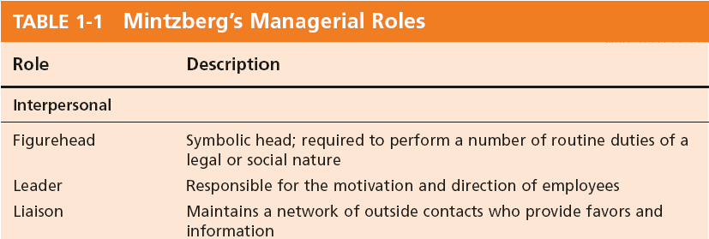
Chapter
01
Mintzberg’s Managerial Roles:
Interpersonal

Slide 24
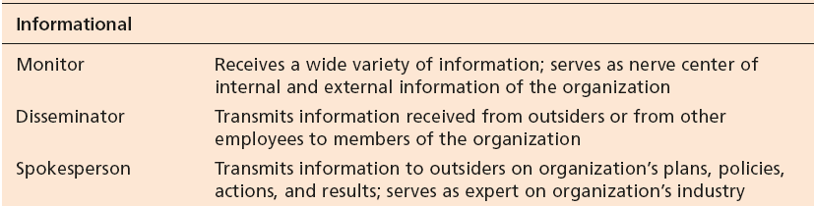
Chapter
01
Mintzberg’s Managerial Roles:
Informational

Slide 25
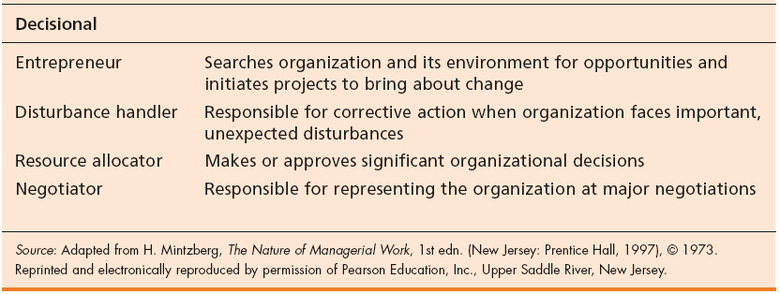
Chapter
01
Mintzberg’s Managerial Roles:
Decisional

Slide 26
Chapter
01
Katz’s Essential Management Skills
Another way of considering what managers do is to look at the skills or competencies they need to achieve their goals. According to Katz, researchers have identified a number of skills that differentiate effective from ineffective managers as follows:
Technical Skills
  The ability to apply specialized knowledge or expertise.
Human Skills
  The ability to work with, understand, and motivate other people, both individually and in groups.

Slide 27
Chapter
01
Katz’s Essential Management Skills
Conceptual Skills
  The mental ability to analyze and diagnose complex situations.

Slide 28
Chapter
01
Luthans’ Study of Managerial Activities
Four types of managerial activity:
  Traditional Management
      Decision-making, planning, and controlling.
  Communication
      Exchanging routine information and processing paperwork.

Slide 29
Chapter
01
Luthans’ Study of Managerial Activities
  Human Resource Management
      Motivating, disciplining, managing conflict, staffing and training.
  Networking
      Socializing, politicking, and interacting with others.

Slide 30
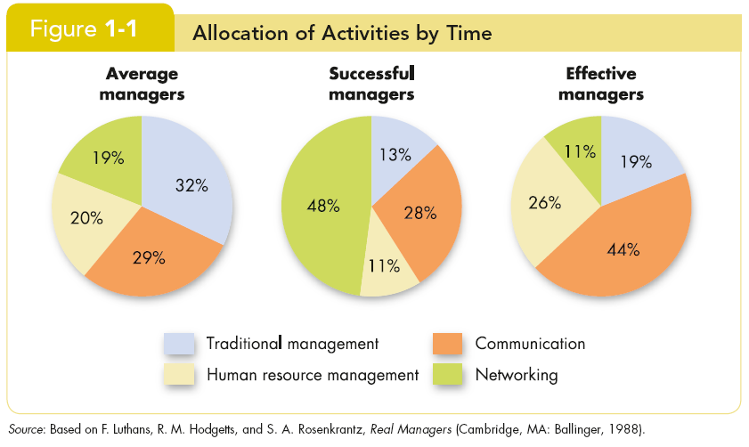
Chapter
01
Successful vs. Effective Allocation
by Time
Are the managers who are most effective the ones who get promoted the fastest?

Slide 31
Chapter
01
Successful vs. Effective Allocation
by Time
Managers who promoted faster (were successful) did different things than did effective managers (those who did their jobs well).

Slide 32
Chapter
01
Contributing Disciplines
Many behavioral sciences
have contributed to the
development of
Organizational
Behavior.
Psychology
Social Psychology
Sociology
Anthropology

Slide 33
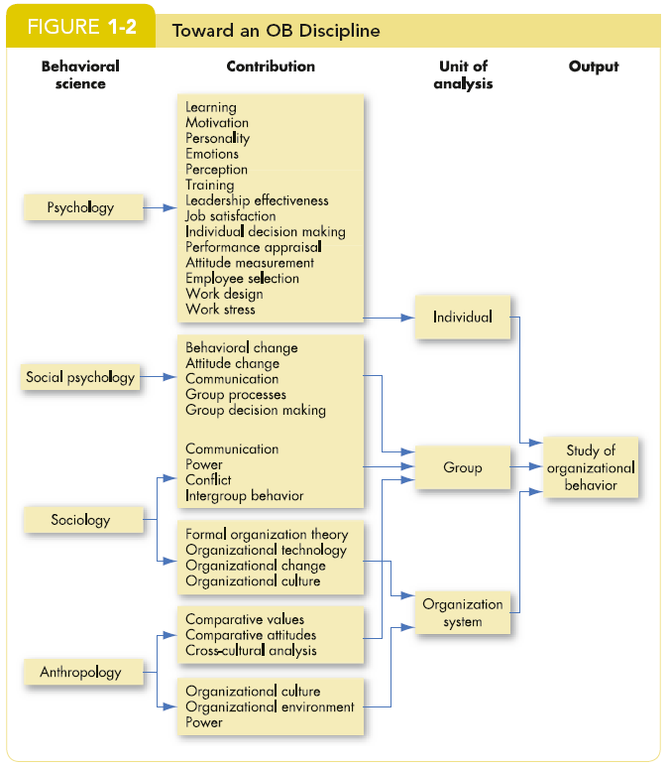
Chapter
01
Contributing Disciplines

Slide 34
Chapter
01
Psychology
The science that seeks to measure, explain, and sometimes change the behavior of humans and other animals.
Unit of Analysis:
  Individual
Contributions to OB:
  Learning, motivation, personality, emotions, perception.

Slide 35
Chapter
01
Psychology
  Training, leadership effectiveness, job satisfaction.
  Individual decision making, performance appraisal attitude measurement.
  Employee selection, work design, and work stress.

Slide 36
Chapter
01
Social Psychology
Social psychology is an area within psychology that blends concepts from psychology and sociology and that focuses on the influence of people on one another.
Unit of Analysis:
  Group
Contributions to OB:
  Behavioral change
  Attitude change

Slide 37
Chapter
01
Social Psychology
  Communication
  Group processes
  Group decision making

Slide 38
Chapter
01
Sociology
The study of people in relation to their fellow human beings.
Units of Analysis:
  Organizational system
  Group
Contributions to OB:
  Group dynamics
  Work teams

Slide 39
Chapter
01
Sociology
  Communication
  Power
  Conflict

Slide 40
Chapter
01
Anthropology
The study of societies to learn about human beings and their activities.
Units of Analysis:
  Organizational system
  Group
Contributions to OB:
  Organizational culture
  Organizational environment

Slide 41
Chapter
01
Anthropology
  Comparative values
  Comparative attitudes
  Cross-cultural analysis

Slide 42
Chapter
01
Challenges and Opportunities for OB
Responding to Globalization
  Increased foreign assignment.
  Working with people from different cultures.

Slide 43
Chapter
01
Challenges and Opportunities for OB
Managing Workforce Diversity
The people in organizations are becoming more demographically heterogeneous :
  Embracing diversity.
  Changing demographics.
  Implications: stop treating everyone alike!

Slide 44
Chapter
01
Challenges and Opportunities for OB
Improving Quality and Productivity
Improving Customer Service
Improving People Skills
Stimulating Innovation and Change
Working in Networked Organizations
Helping Employees Balance Work-Life Conflicts

Slide 45
Chapter
01
Challenges and Opportunities for OB
Creating a Positive Work Environment
Improving Ethical Behavior

Slide 46
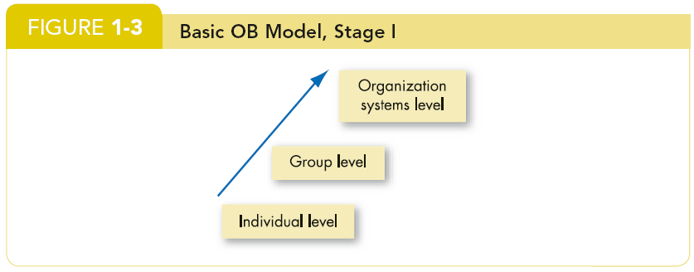
Chapter
01
Developing an OB Model
A model is an abstraction of reality: a simplified representation of some real-world phenomenon.
  Our OB model has three levels of analysis.
  Each level is constructed on top of the prior level.

Slide 47
Chapter
01
Types of Study Variables
  Independent (X)
  The presumed cause of the change in the dependent variable (Y).
  This is the variable that OB researchers manipulate to observe the changes in Y.
Dependent (Y)
  This is the response to X (the independent variable).
  It is what the OB researchers want to predict or explain.
  The interesting variable!

Slide 48
Chapter
01
Interesting OB Dependent Variables
Productivity
  Transforming inputs to outputs at lowest cost. Includes the concepts of effectiveness (achievement of goals) and efficiency (meeting goals at a low cost).
Absenteeism
  Failure to report to work – a huge cost to employers.
Turnover
  Voluntary and involuntary permanent withdrawal from an organization.

Slide 49
Chapter
01
Interesting OB Dependent Variables
Deviant Workplace Behavior
  Voluntary behavior that violates significant organizational norms and thereby threatens the well-being of the organization and/or any of its members.
Organizational Citizenship Behavior (OCB)
  Discretionary behavior that is not part of an employee’s formal job requirements, but that nevertheless promotes the effective functioning of the organization.

Slide 50
Chapter
01
Interesting OB Dependent Variables
Job Satisfaction
  A general attitude (not a behavior) toward one’s job; a positive feeling of one's job resulting from an evaluation of its characteristics.

Slide 51
Chapter
01
The Independent Variables
The independent variable (X) can be at any of these three levels in this model:
Individual
  Biographical characteristics, personality and emotions, values and attitudes, ability, perception, motivation, individual learning, and individual decision making.
  Group
  Communication, group decision making, leadership and trust, group structure, conflict, power and politics, and work teams.

Slide 52
Chapter
01
The Independent Variables
  Organization System
  Organizational culture, human resource policies and practices, and organizational structure and design.

Slide 53
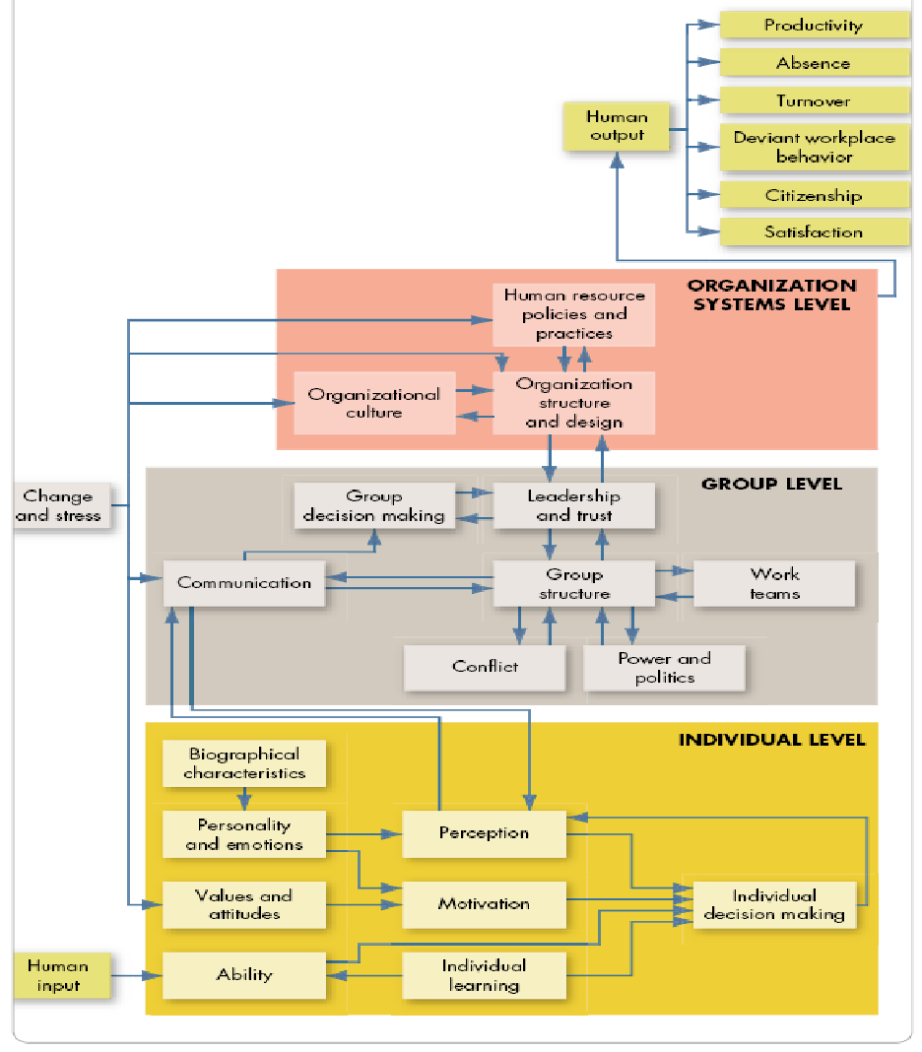
Chapter
01
OB MODEL
Dependent Variables (Y)
Independent Variables (X)
Three Levels

Slide 54
Chapter
01
Summary and Managerial Implications
  Managers need to develop their interpersonal skills to be effective.
  OB focuses on how to improve factors that make organizations more effective.
  The best predictions of behavior are made from a combination of systematic study and intuition.
  Situational variables moderate cause-and-effect relationships—which is why OB theories are contingent.

Slide 55
Chapter
01
Summary and Managerial Implications
  There are many OB challenges and opportunities for managers today.
  The textbook is based on the contingent OB model.

Slide 56
Chapter
01
  Thank you

