Slide 1

Introduction to Economics
Chapter 3:
The consumer behaviour
Prepared by
Dr Myriam ZORGUI

Slide 2
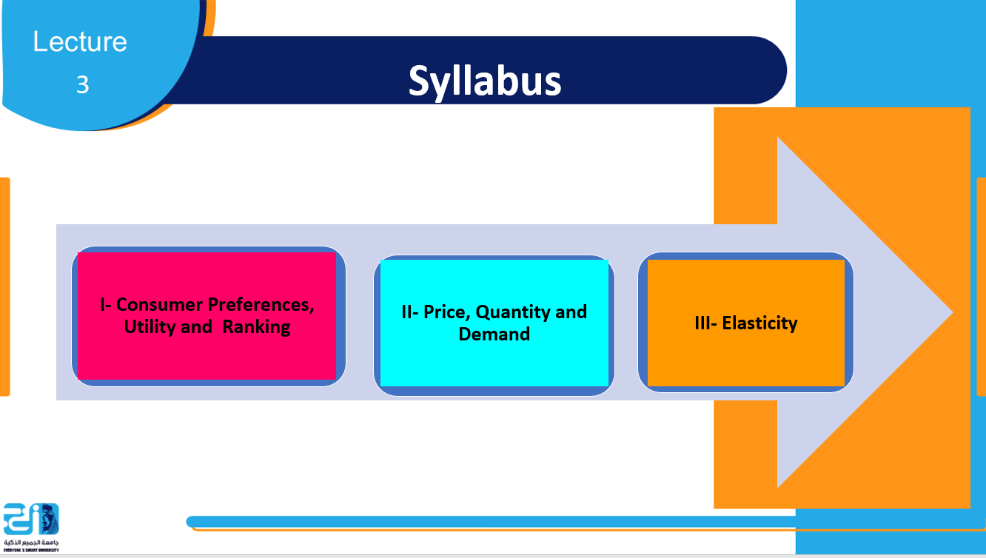

Slide 3
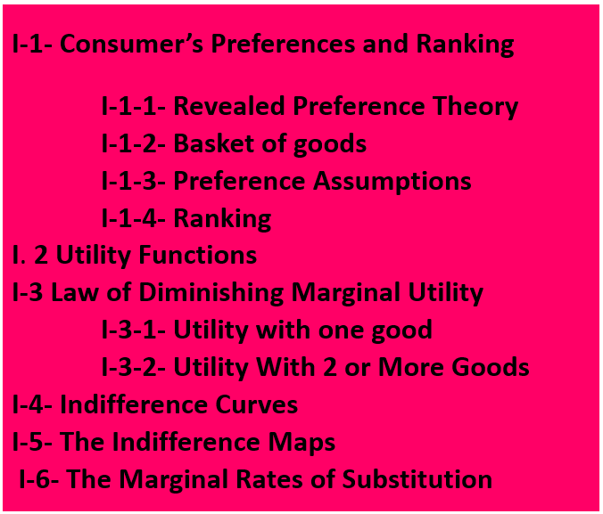

Slide 4

I-1- Consumer Preferences, Utility and Ranking -1-
I-1-1- Revealed Preference Theory:
The Revealed Preference Theory in Economics, is a theory, introduced by the American Economist Paul Samuelson in 1938, and it holds that consumers' preferences can be revealed by what they purchase under different circumstances, particularly under different income and price circumstances.
It’s represented by a specific combination of goods and services.

Slide 5

I-1- Consumer Preferences, Utility and Ranking -2-
I-1-2- Basket of goods:
The basket of goods represents the value of a specific group of products and services.
The basket includes a variety of products from different categories — food and beverages, clothing, housing, transportation, education, medical expenses, and other items.
Each group of products has its own weight in the basket.

Slide 6

I-1- Consumer Preferences, Utility and Ranking -3-
I-1-3- Preference Assumptions
      Preferences are complete
A consumer can always rank preferences:
A is preferred to B: A> B
b) B is prefered to A: B > A
c) A consumer is indifferent between A and B: A ≈ B

Slide 7
I-1- Consumer Preferences, Utility and Ranking -4- -3-
      Choices are transitive: If
      A is preferred to B: A> B
      B is preferred to C: B> C A is preferred to C:
      A> C
      More is better:
      A consumer always prefers having more of a good

Slide 8

I-1- Consumer Preferences, Utility and Ranking -5-
I-1-4- Ranking
Ordinal Ranking: baskets are ordered or compared to each other without any quantitative information or intensity of preference .
The ordinal numbers tell the order of how things are set, they show the position or the rank of something.
ie: I like dogs more than cats.
Cardinal Ranking: baskets are quantitatively compared.
The cardinal numbers are used for counting.
  ie: “I like dogs ten times more than cat

Slide 9

I-2-Utility -1-
Utility is the pleasure or satisfaction obtained from a good or service.
Utility: a number that represents the level of satisfaction that the consumer derives from consuming a specific quantity of a good

Slide 10
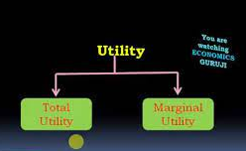

I-2-Utility -2-
I-2-1- The total utility:
Total Utility (TU) is the total amount of satisfaction that you get from consuming a product.
I-2-2- The marginal utility:
Marginal Utility (MU) is the change in total utility obtained by consuming one additional (marginal) unit of a good or service.

Slide 11
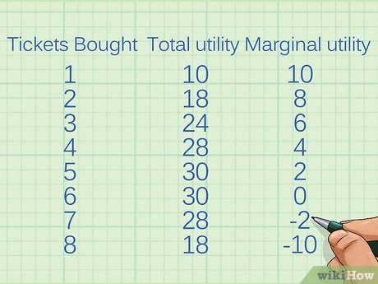
I-2-Utility -3-
Exemple:

Slide 12
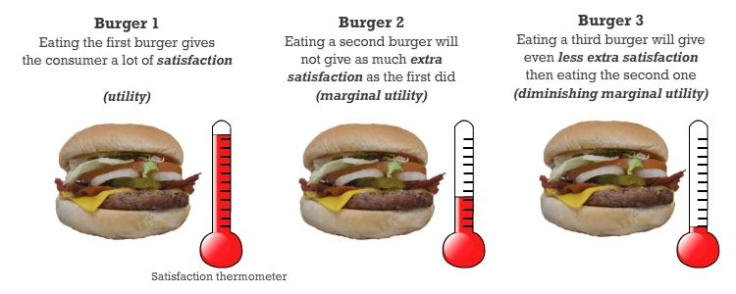
I-3 Law of Diminishing Marginal Utility -1-
I-3-1- Utility with one good
The marginal utility of a good declines as more of it is consumed in a given time period.

Slide 13
I-3 Law of Diminishing Marginal Utility -2-
I-3-2- Utility With 2 or More Goods
Utility and 1 good can be measured on a 2 dimensional graph,
• Utility and 2 goods must be measured on a 3 dimensional graph
• Here Marginal Utility uses the ceteris paribus assumption: how does utility change when 1 good changes, everything else held constant?

Slide 14
I-3 Law of Diminishing Marginal Utility -3-
As long as the marginal utility is positive, the consumer receives additional satisfaction and total utility increases.
Additional quantities of a good yield increasingly smaller increments of satisfaction.

Slide 15
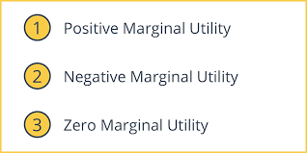
I-3 Law of Diminishing Marginal Utility -4-
An absolute measure of utility is not possible because the perception of satisfaction differs among individuals.
Diminishing marginal utility is a common experience.
It is a sufficient basis for economic predictions of consumer behavior.

Slide 16
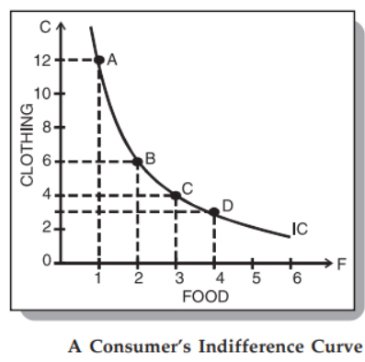
I-4- Indifference Curves -1-
An Indifference Curve is a curve that represents all the combinations of goods that give the same satisfaction to the consumer.
Since all the combinations give the same amount of satisfaction, the consumer prefers them equally. Hence the name indifference curve.
Indifference Curve: points connected on a graph representing different quantities of two goods, points between which a consumer is indifferent
Indifference Curve is the locus of various points showing different combinations of two goods providing equal utility to the consumer.

Slide 17
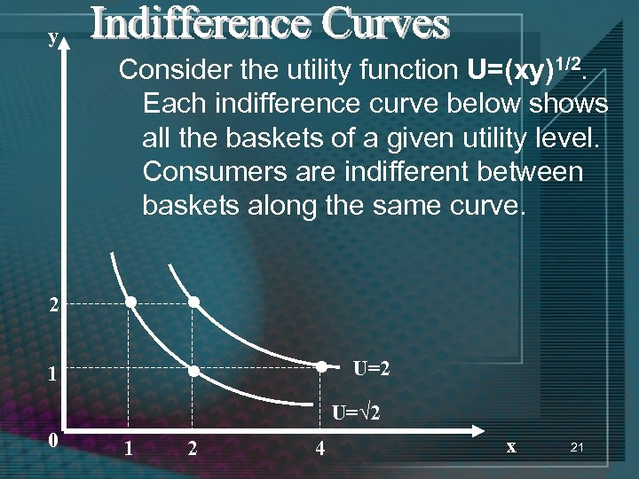
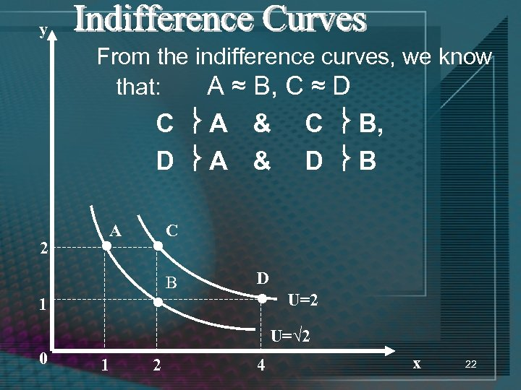
I-4- Indifference Curves -2-
Example:

Slide 18

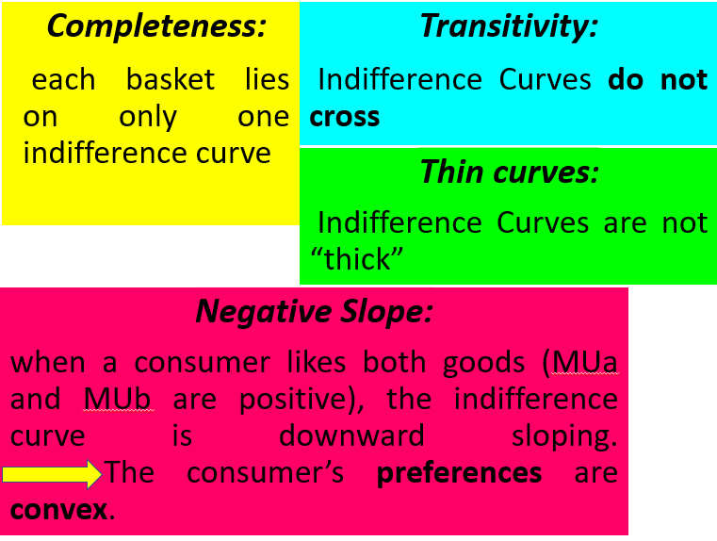
I-4- Indifference Curves -3-
I-4-1- Properties of Indifference curves:

Slide 19
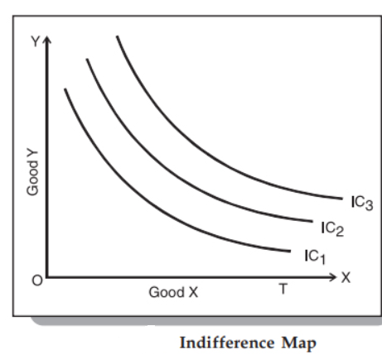
I-5- Indifference Maps -1-
An Indifference Map is a set of Indifference Curves.
It depicts the complete picture of a consumer’s preferences.
We know that a consumer is indifferent among the combinations lying on the same indifference curve. However, it is important to note that he prefers the combinations on the higher indifference curves to those on the lower ones.
This is because a higher indifference curve implies a higher level of satisfaction.
All combinations on IC1 offer the same satisfaction, but all combinations on IC2 give greater satisfaction than those on IC1.

Slide 20


I-6- The Marginal Rate of Substitution -1-
The Marginal Rate of Substitution (MRS) is the change (loss) in one good needed to offset the change (gain) in another good,
In this case, MRS is the trade-off (loss) of y for a small increase in x

Slide 21
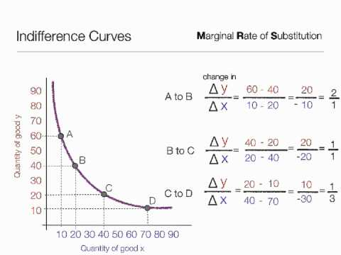
I-6- The Marginal Rate of Substitution -2-
Example:

Slide 22
I-6- The Marginal Rate of Substitution -2-
The Marginal Rate of Substitution of x for y
MRSxy = ∆Y/ ∆X
x is gained, so how much y must be given up alternately,
if x is given up, how much y can we get?
The MRS is equal to the SLOPE of the indifference curve (slope of the tangent to the indifference curve).

Slide 23
I-6- The Marginal Rate of Substitution -3-
All along an individual’s indifference curve, an individual consumes different baskets of goods while remaining at the same utility
The individual is willing to SUBSTITUTE (to use something or someone instead of another thing) one good for another.
An individual must be compensated by an increase in one good if the other good decreases

Slide 24
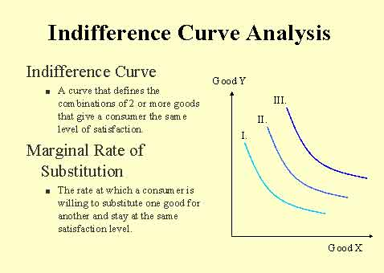
I-6- The Marginal Rate of Substitution -4-

Slide 25
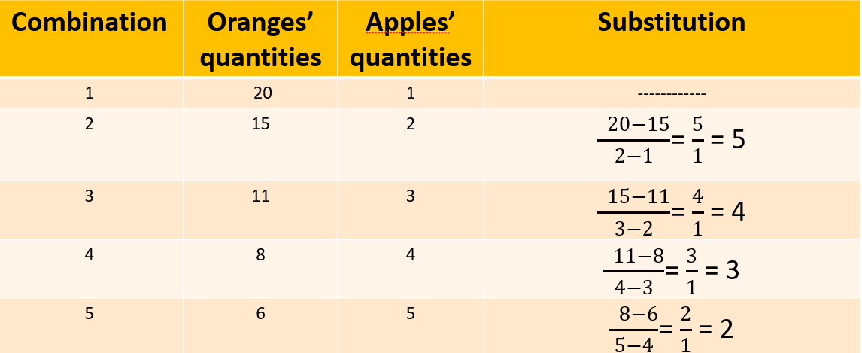

I-6- The Marginal Rate of Substitution -5-

Slide 26
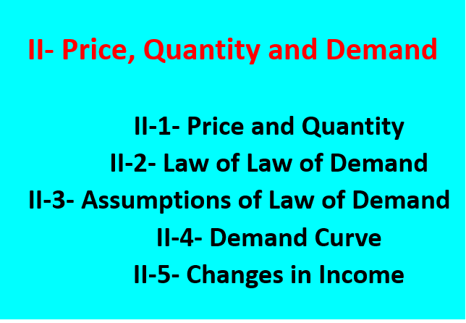
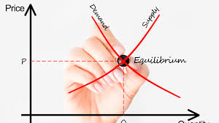

Slide 27
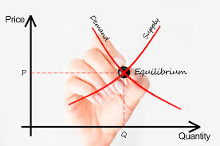
II- 1- Price and Quantity
Many forces determine how much we are willing to buy.
Economists focus on the relationship between price and quantity rather than trying to explain all the forces at once.
This is the ceteris paribus (all other things equal) assumption.

Slide 28

II-2- Law of Demand
The concepts of marginal utility and ceteris paribus explain the downward slope of the demand curve.
With given income, tastes, expectations, and prices of other goods and services, people are willing to buy additional quantities of a good only if its price falls.

Slide 29
II-2- Law of Demand
The higher the marginal utility, the more you are willing to pay.
Diminishing marginal utility explains why price must decrease in order for you to continue to buy a good or service.
According to the law of demand, the quantity of a good demanded in a given time period increases as its price falls, ceteris paribus.

Slide 30
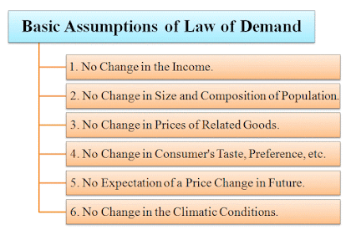
II-3- Assumptions of Law of Demand

Slide 31
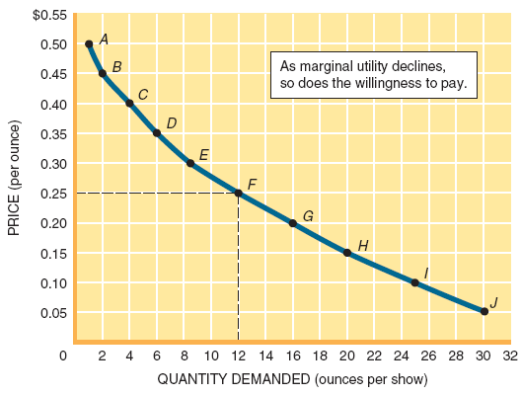
II-4- Demand Curve
The Demand curve represents the quantities of a good a consumer is willing and able to buy at alternative prices in a given time period, ceteris paribus.

Slide 32
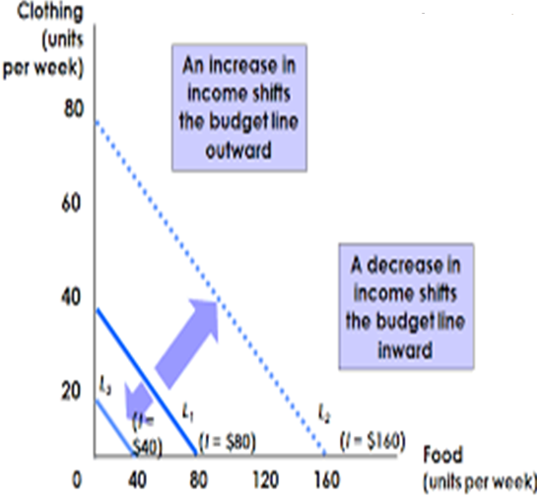
II-5- Changes in Income
Income is a determinant of demand.
We illustrate income changes with shifts
of the demand curve.

Slide 33

III- Elasticity
III-1- Price Elasticity
III-2- Elastic versus Inelastic Demand
III-2-1- Elastic Demand
III-2-2- Inelastic Demand
III-2-3- Unitary Elastic Demand

Slide 34


III- Elasticity
III-1- Price Elasticity of Demand
The response of consumers to a change in price is measured by the price elasticity of demand.
The price elasticity of demand is the percentage change in quantity demanded divided by the percentage change in price.
Notes:
أن منحنى الطلب سالب الميل أي ينحدر من أعلى إلى أسفل ومن اليسار إلى اليمين، ويعكس ميل المنحنى السالب قانون الطلب، أي العلاقة العكسية بين سعر السلعة والكمية المطلوبة منها مع بقاء العوامل الأخرى ثابتة.

Slide 35
III- Elasticity
The price of popcorn goes up 20% and the quantity demanded goes down 10%.
The price elasticity of demand is:
percentage change in
quantity demanded
–10%
(E)
=
=
=
– 0.5
percentage change
20%
in price

Slide 36

III- Elasticity
III-2- Elastic versus Inelastic Demand
Demand can be elastic, inelastic, or unitary elastic
III-2-1- Elastic Demand: Consumer response is large relative to the change in price.
III-2-2- Inelastic Demand: Demand is inelastic if the absolute value of E is less than 1.
In this case, consumers are not very responsive to price changes.

Slide 37

III- Elasticity
III-2-3- Unitary Elastic Demand:
Demand is unitary elastic if the absolute value of
E equals 1.
The percentage change in quantity demanded is equal to
the percentage change in price.
To know more about Elasticity, you can watch this video:
To know more about Elasticity, you can watch this video:
https://study.com/learn/lesson/price-elasticity-demand-overview-formula.html

Slide 38


Slide 39
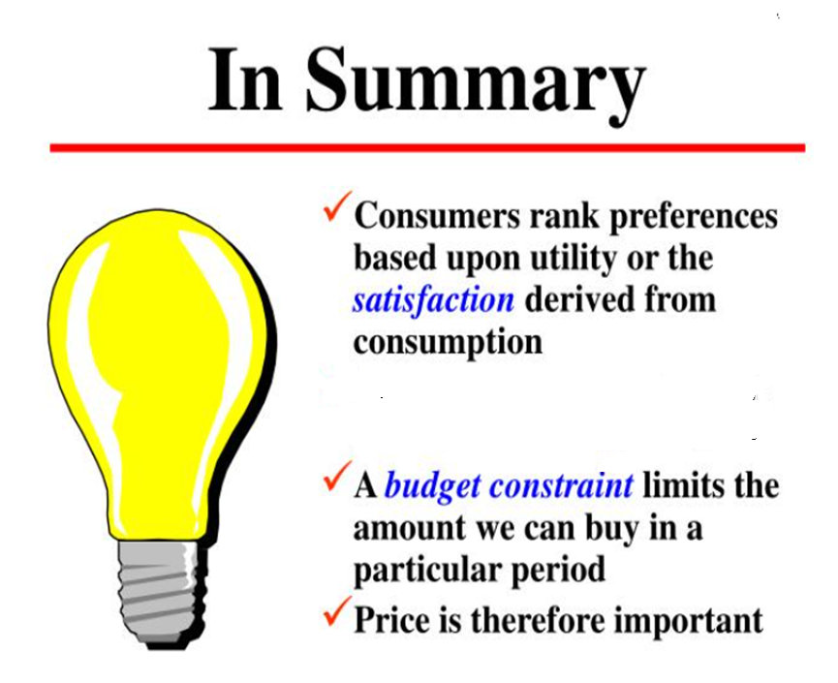
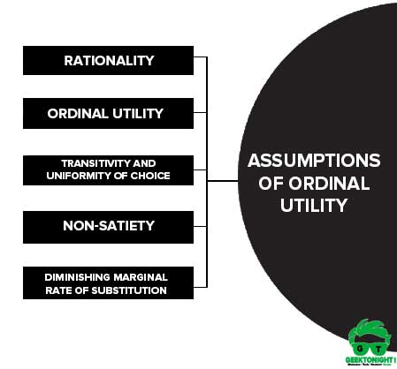

Slide 40
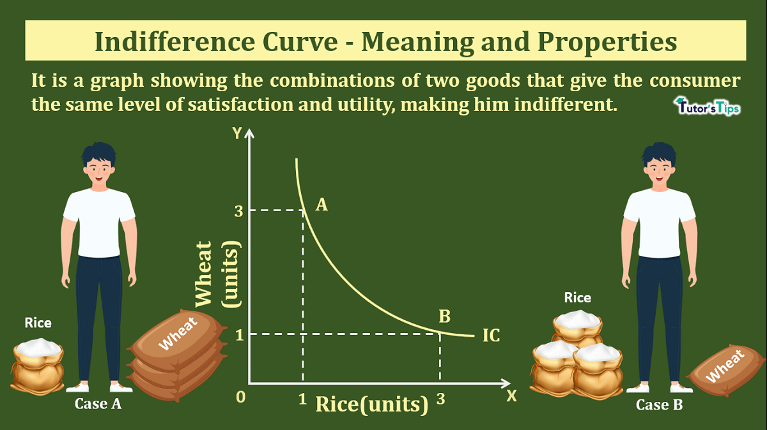

Slide 41
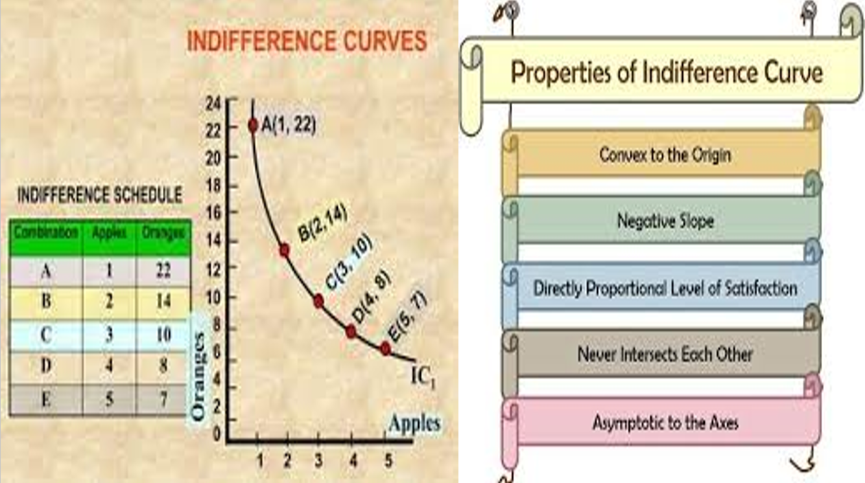

Slide 42
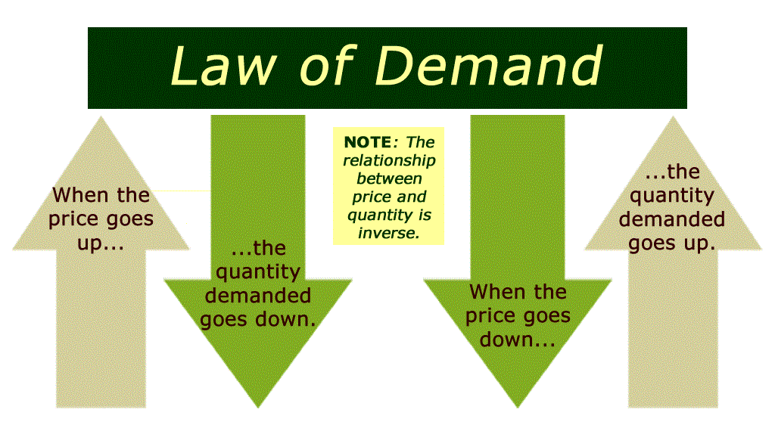

Slide 43
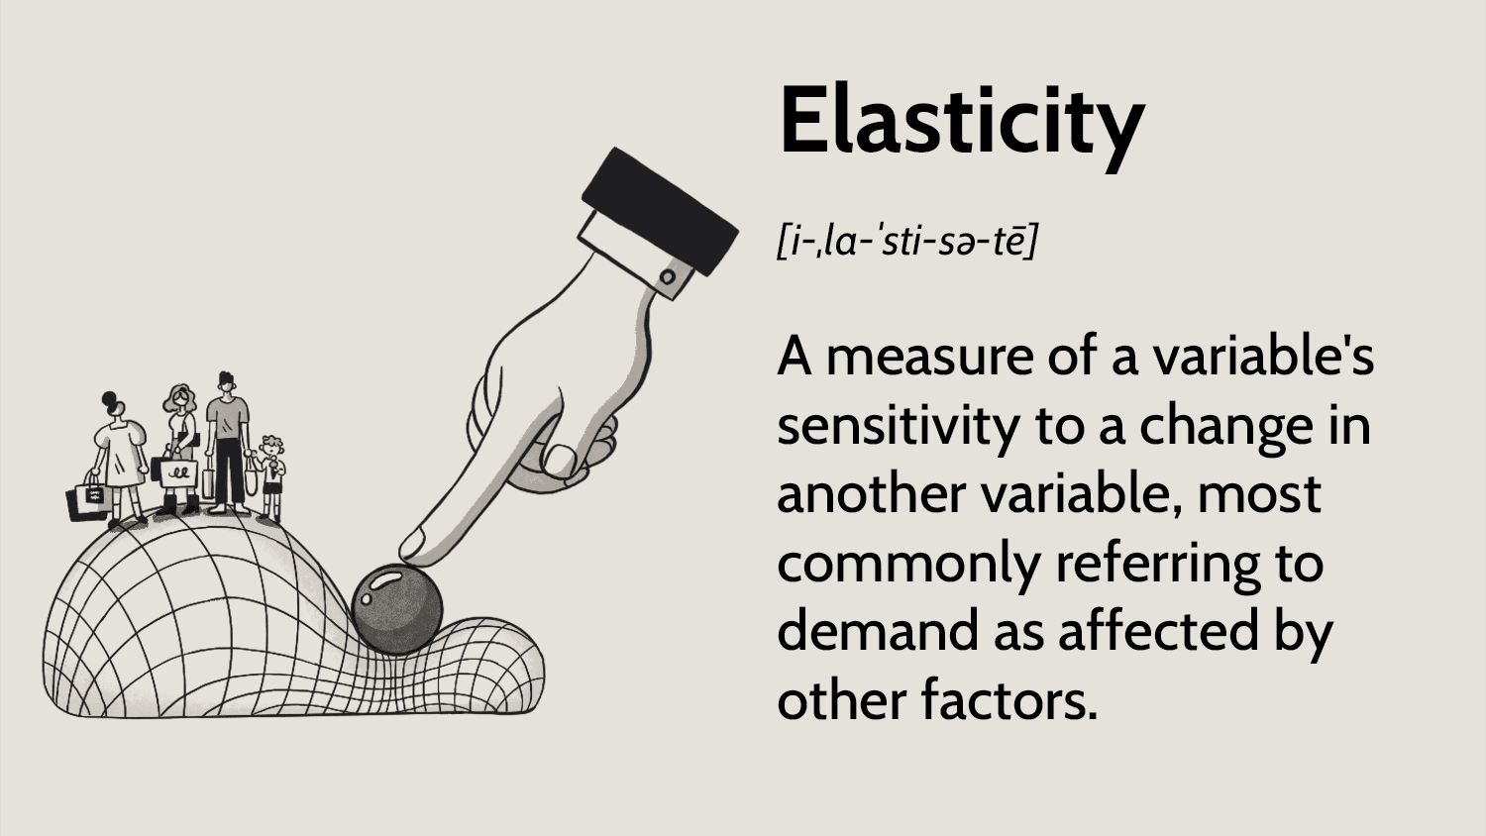

Slide 44
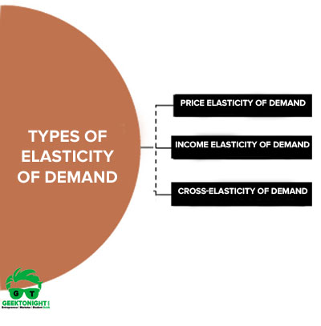
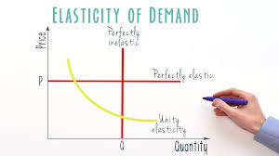

Slide 45
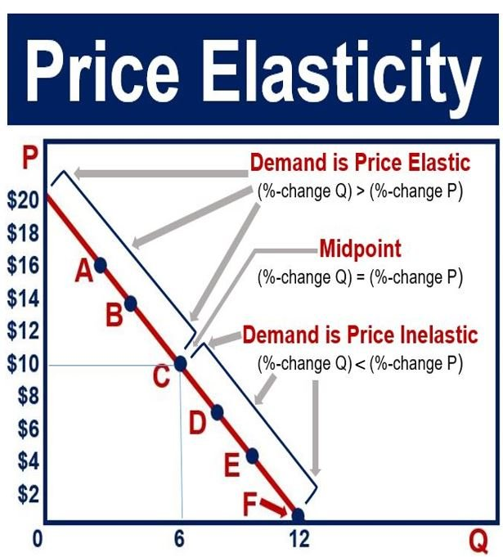

Slide 46


