Slide 1




IT111 - Introduction to Information Technology
Bachelor of Science in Information Technology
Eng. Eman Hamdy
Lecture 4 - Data Storage (CONTINUE)

Slide 2


Lecture
Objectives
04
Name several general properties of storage systems.
Describe the two most common types of hard drives and what they are used for today.
Discuss the various types of optical discs available and how they differ from each other.
Identify some flash-memory-based storage devices and media and explain how they are used today.
List at least three other types of storage systems.
Summarize the storage alternatives for a typical personal computer.
Name several general properties of storage systems.
Describe the two most common types of hard drives and what they are used for today.
Discuss the various types of optical discs available and how they differ from each other.
Identify some flash-memory-based storage devices and media and explain how they are used today.
List at least three other types of storage systems.
Summarize the storage alternatives for a typical personal computer.
IT111 - Introduction to Information Technology
Lecture 04– Learning Outcome
Eng. Eman Hamdy

Slide 3

Storage System Characteristics
Lecture
04
Consist of a storage device and a storage medium
  Device: DVD drive, flash memory card reader, etc.
  Medium: DVD disc, flash memory card, etc.
  Medium is inserted into the device to be used.
IT111 - Introduction to Information Technology
Eng. Eman Hamdy

Slide 4
Storage System Characteristics
Lecture
04
Can be internal, external, or remote.
Are nonvolatile.
Logical file representation: The user’s view of the way data is stored.
Physical file representation: The actual physical way the data is stored on the storage media as viewed by the computer.
Storage technologies:
  Magnetic (conventional hard drives).
  Optical (optical discs).
  Electrons (flash memory media).
IT111 - Introduction to Information Technology
Eng. Eman Hamdy

Slide 5
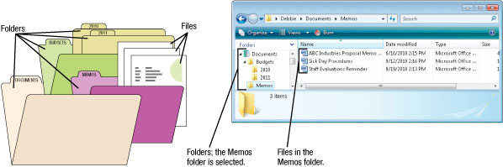
Logical vs. Physical Representation
Lecture
04
File: Anything stored on a storage medium, such as a program, document, digital image, or song.
Filename: Name given to a file by the user.
Folder: Named place on a storage medium into which files can be stored.
IT111 - Introduction to Information Technology
Eng. Eman Hamdy

Slide 6
Lecture
Storage devices
04
Storage devices, although classified as I/O devices, can store large amounts of information to be retrieved at a later time. They are cheaper than main memory, and their contents are nonvolatile—that is, not erased when the power is turned off. They are sometimes referred to as auxiliary storage devices. We can categorize them as either magnetic or optical.
IT111 - Introduction to Information Technology
Eng. Eman Hamdy

Slide 7
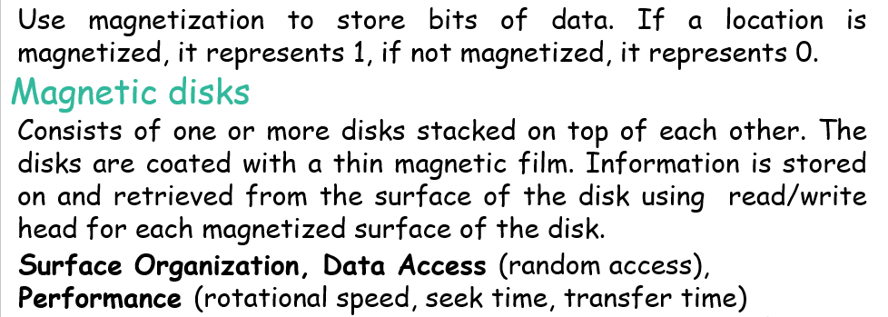
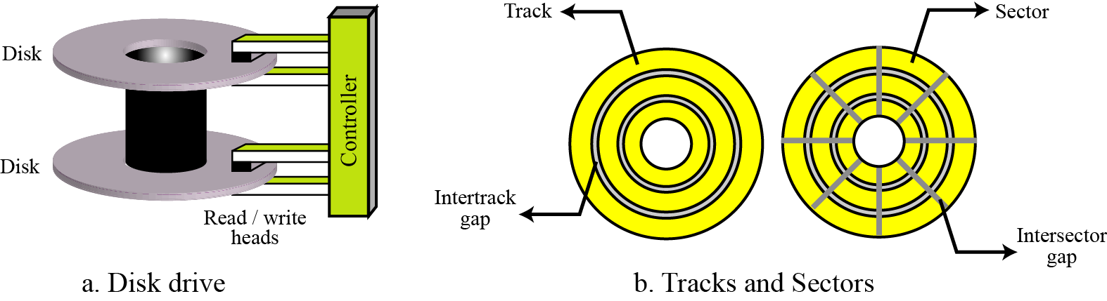
Lecture
Magnetic storage devices
04
IT111 - Introduction to Information Technology
Eng. Eman Hamdy

Slide 8
Lecture
Magnetic storage devices
04
A magnetic disk
IT111 - Introduction to Information Technology
Eng. Eman Hamdy

Slide 9
Lecture
Magnetic storage devices
04
Data access. A magnetic disk is considered a random-access device. In a random-access device, a data item can be accessed randomly without the need to access all other data items located before it. However, the smallest storage area that can be accessed at one time is a sector. A block of data can be stored in one or more sectors and retrieved without the need to retrieve the rest of the information on the disk.
IT111 - Introduction to Information Technology
Eng. Eman Hamdy

Slide 10
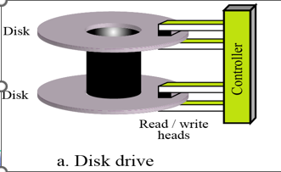
Lecture
Magnetic storage devices
04
Performance. The performance of a disk depends on several factors, the most important being the rotational speed, the seek time, and the transfer time.
rotational speed defines how fast the disk is spinning.
b) The seek time defines the time to move the read/write head
to the desired track where the data is stored.
c) transfer time defines the time to move data from the disk to the CPU/memory.
IT111 - Introduction to Information Technology
Eng. Eman Hamdy

Slide 11
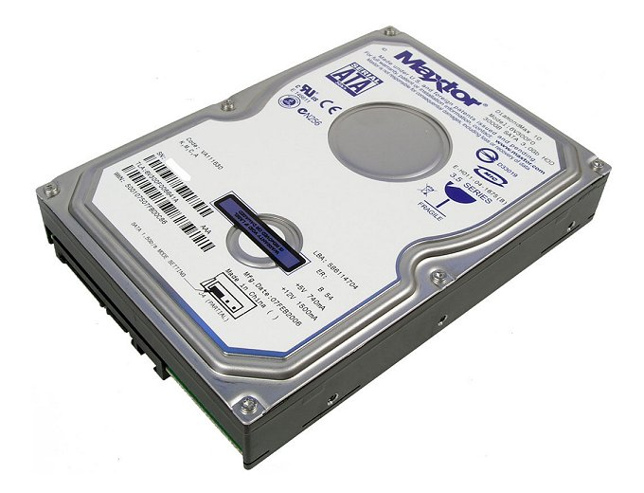
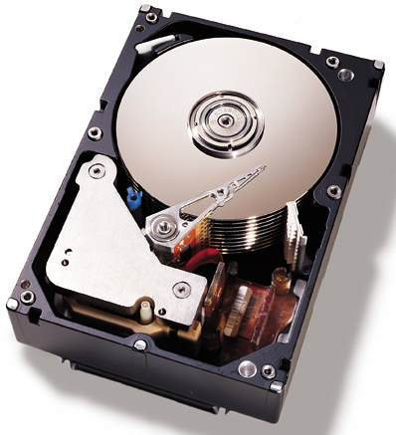
Lecture
Magnetic storage devices
04
IT111 - Introduction to Information Technology
Eng. Eman Hamdy

Slide 12
Hard Drives
Lecture
04
Hard drive: Used to store most programs and data.
  Can be internal and external.
  Can be encrypted.
Magnetic hard drives:
  Use metal hard disks.
  Read/write heads magnetize particles to represent the data’s 0s and 1s.
Solid-state drives (SSDs):
  Use flash memory technology.
  Use less power and have no moving parts.
  Particularly appropriate for portable computers.
IT111 - Introduction to Information Technology
Eng. Eman Hamdy

Slide 13
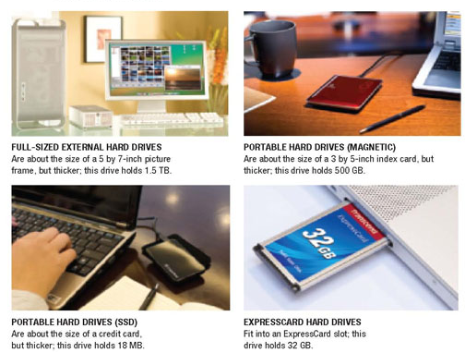
Lecture
External Hard Drives
04
IT111 - Introduction to Information Technology
Eng. Eman Hamdy

Slide 14
Lecture
Hard Drive Speed and Caching
04
Disk access time: Total time that it takes for a hard drive to read or write data.
  Consists of seek time, rotational delay, and data movement time.
Disk cache: Dedicated part of RAM is used to store additional data adjacent to data retrieved during a disk fetch to improve system performance.
IT111 - Introduction to Information Technology
Eng. Eman Hamdy

Slide 15
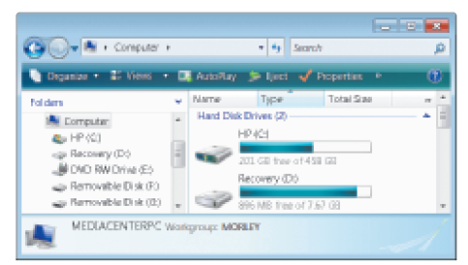
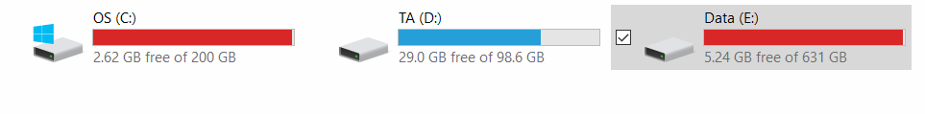
Lecture
04
Partitioning and File Systems
Partitioning: Logically divides the physical capacity of a single drive into separate areas, called partitions.
  Partitions function as independent hard drives.
  Increase efficiency (smaller drives use smaller clusters).
Partitions used to:
  Create a recovery partition.
  Create a new logical drive for data.
  Create a dual boot system.
IT111 - Introduction to Information Technology
Eng. Eman Hamdy

Slide 16
Lecture
04
Optical Discs
Optical discs: store data optically (using laser beams).
  Divided into sectors like magnetic discs but use a single spiral track (groove).
  Data is stored in 0s and 1s.
  Pits and lands are used to represent 1s and 0s.
Can be:
  Read-only: Surface is molded or stamped to represent the data.
  Recordable or rewritable: The reflectivity of a surface is changed by a laser.
IT111 - Introduction to Information Technology
Eng. Eman Hamdy

Slide 17
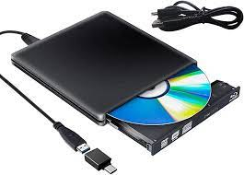
Lecture
Optical Drives
04
Optical drives: Designed for type of disc: CD, DVD, or Blu-Ray Disc (BD):
  Can be read-only, recordable, or rewritable.
  Can support single or dual-layer discs.
Burning: Recording data onto a disc:
  CD discs: Use infrared lasers; hold 650 MB.
  DVD discs: Use red lasers; hold 4.7 GB (single-layer).
  BD discs: Use blue-violet lasers; hold 25 GB (double-layer).
  A standard single-layer Blu-ray disc can hold up to 25 GB of data, while a dual-layer Blu-ray disc can hold up to 50 GB of data. The additional layer provides more space for storing high-definition video, audio, and
Can be internal or external drives:
  External drives typically USB.
IT111 - Introduction to Information Technology
Eng. Eman Hamdy

Slide 18
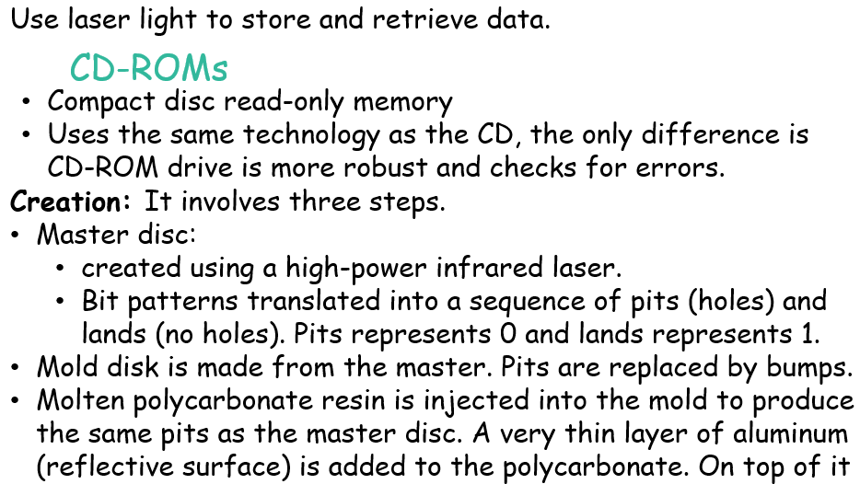
Lecture
04
Optical Storage devices
IT111 - Introduction to Information Technology
Eng. Eman Hamdy

Slide 19
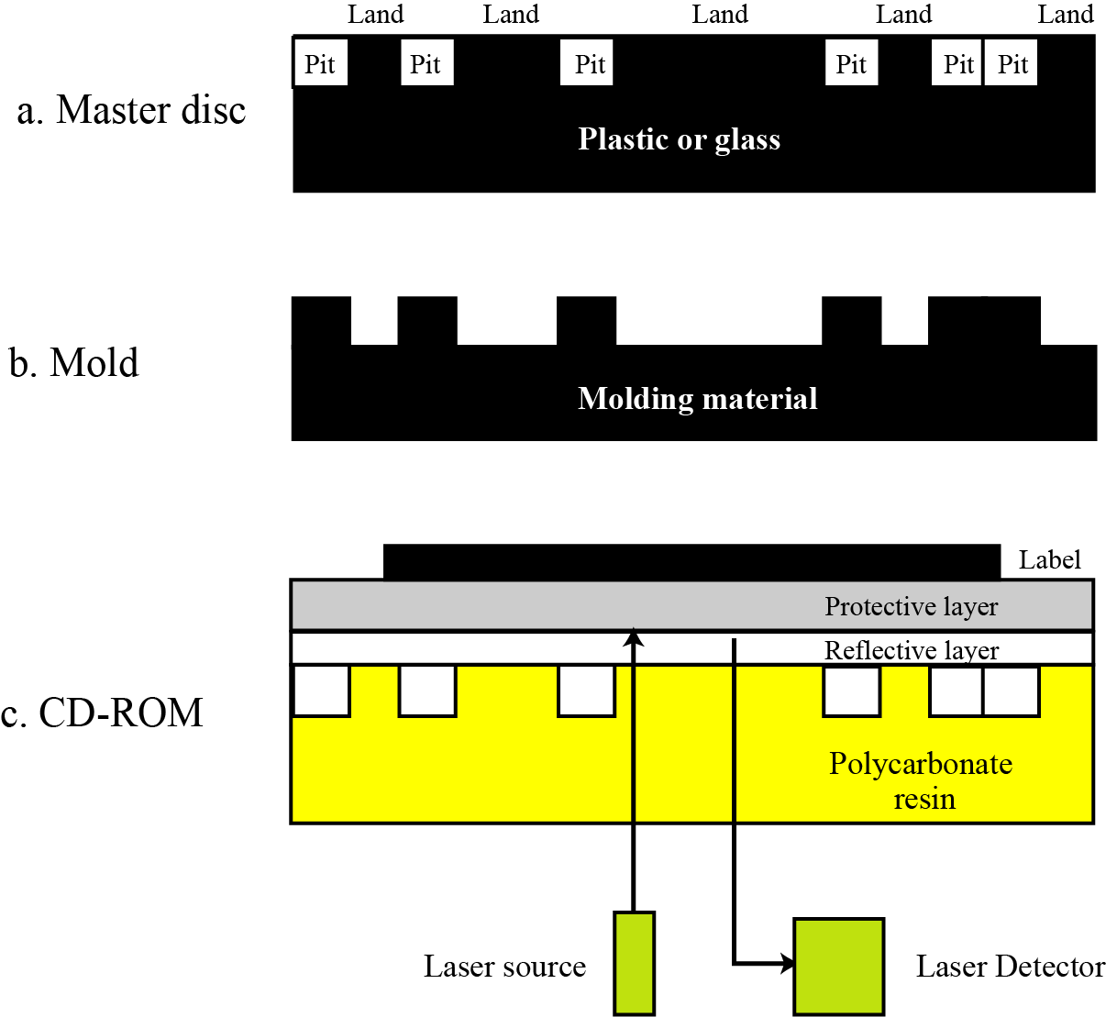
Lecture
04
Optical storage devices
Creation and use of CD-ROMs
IT111 - Introduction to Information Technology
Eng. Eman Hamdy

Slide 20

Read-Only Discs
Lecture
04
Read-only disc: Can be read from, but not written to, by the user.
  CD-ROM (compact disc read-only memory).
  DVD-ROM (digital video disc read-only memory).
  BD-ROM (Blu-Ray disc read-only memory).
Normally come pre-recorded:
  Software programs.
  Clip art and other graphics.
  Music.
  Movies.
  Games (UMD, Wii, Xbox, etc..)
IT111 - Introduction to Information Technology
Eng. Eman Hamdy

Slide 21
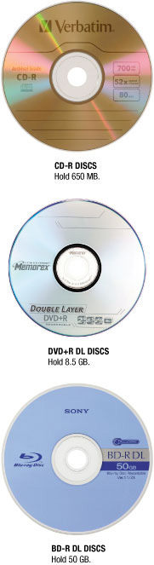
Recordable Discs
Lecture
04
Recordable disc: Can be written to, but cannot be erased and reused
  CD-R discs.
  DVD-R/DVD+R discs; can be dual-layer.
  BD-R; can be dual-layer.
  Used for back up, sending large files to others, creating custom music CDs, storing home movies, etc.
IT111 - Introduction to Information Technology
Eng. Eman Hamdy

Slide 22
Rewritable Discs
Lecture
04
Rewritable disc: Can be recorded on, erased, and overwritten just like magnetic discs.
  CD-RW.
  DVD-RW.
  BD-RE; can be dual layer.
Use phase-change technology:
  Heating and cooling process is used to change the reflectivity of the disc.
  Can be changed back to erase the disc.
IT111 - Introduction to Information Technology
Eng. Eman Hamdy

Slide 23
Flash Memory Systems
Lecture
04
Chip-based storage medium:
  No moving parts so more resistant to shock and vibration, require less power, make no sound.
  Solid-state storage system.
Most often found in the form of:
  Flash memory cards.
  USB flash drives.
  Solid-state drives(SSD).
Very small and so are very appropriate for use with digital cameras, digital music players, GPS devices, notebook computers, mobile devices, etc.
IT111 - Introduction to Information Technology
Eng. Eman Hamdy

Slide 24
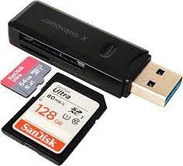
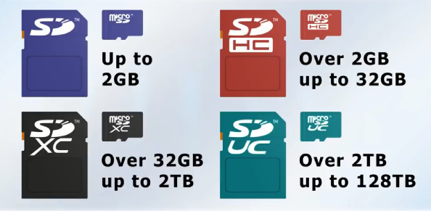
Flash Memory Cards
Lecture
04
Flash memory card: A small card containing one or more flash memory chips, controller chips, and metal contacts to connect the card to the device or reader that it is being used with.
  CompactFlash.
  Secure Digital (SD).
  Secure Digital High Capacity (SDHC).
  Secure Digital Extended Capacity (SDXC).
  MultiMedia Card (MMC).
  xD Picture Card.
  Memory Stick.
Read by flash memory card reader.
IT111 - Introduction to Information Technology
Eng. Eman Hamdy

Slide 25
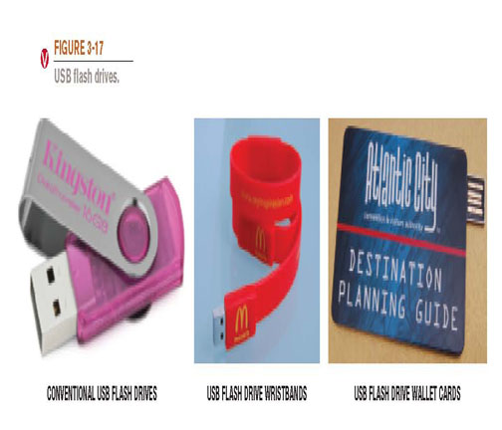
USB Flash Drives
Lecture
04
USB flash drives: Consist of circuite board, memory chips and controller.
  Typically, portable drives that connect to and are powered by a USB port.
  Also called USB flash memory drives, thumb drives, jump drives.
IT111 - Introduction to Information Technology
Eng. Eman Hamdy

Slide 26
Other Types of Storage Systems
Lecture
04
  Online storage or cloud storage: Accessed via the Internet:
    Via Web sites (Flickr, Facebook, Google Docs, etc.).
    Via online storage sites (Box.net, SkyDrive, etc.).
IT111 - Introduction to Information Technology
Eng. Eman Hamdy

Slide 27
Smart Cards
Lecture
04
Smart card: Credit card-sized piece of plastic that contains some computer circuitry (processor, memory, and storage).
  Stores small amount of data (about 64 KB or less).
  Commonly used to store prepaid amounts of digital cash or personal information.
  Smart card readers are built into or attached to a computer, keyboard, vending machine, or other device.
  Can be used in conjunction with encryption and other security technologies.
IT111 - Introduction to Information Technology
Eng. Eman Hamdy

Slide 28
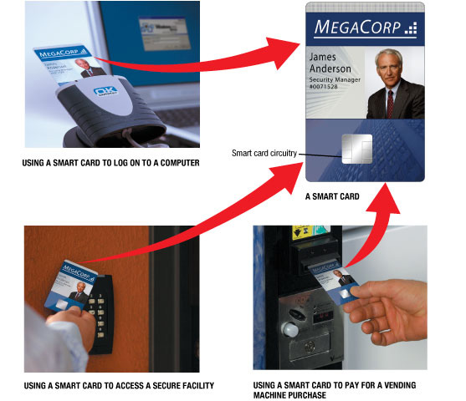
Smart Cards
Lecture
04
IT111 - Introduction to Information Technology
Eng. Eman Hamdy

Slide 29
Holographic Storage
Lecture
04
Holographic storage: Store data as holograms.
  Emerging type of 3D storage technology.
  Uses two green laser beams to store data in three dimensions:
    Reference beam.
    Signal beam.
  Potential initial applications for holographic data storage systems include:
    High-speed digital libraries.
    Image processing for medical, video, and military purposes.
    Any other applications in which data needs to be stored or retrieved quickly in large quantities but rarely changed.
IT111 - Introduction to Information Technology
Eng. Eman Hamdy

Slide 30
Evaluating Your Storage Alternatives
Lecture
04
Factors to consider:
  Speed.
  Compatibility.
  Storage capacity.
  Convenience.
  Portability.
Most users require:
  Hard drive.
  DVD or BR drive.
  Flash memory card reader.
  USB port connecting USB devices.
IT111 - Introduction to Information Technology
Eng. Eman Hamdy

Slide 31
Review
Lecture
04
Hard Drives (Magnetic , SSD).
Optical Discs.
Flash Memory Cards.
USB Flash Drives.
Remote storage:
  Online storage or cloud storage.
IT111 - Introduction to Information Technology
Eng. Eman Hamdy

Slide 32

Thank you

