Slide 1

Secure Operating systems
by Dr. Hesham Abou Elfetouh
Lecture 5

Slide 2

Introduction
In Previous Lecture you learned:
Types of Malware
Relocation Base/Bounds Registers and Tagged Architecture
The difference between types of Malware
The Virus Effects
The Virus Signatures
Protected Memory and Address
Buffer Overflows
Cross Site Scripting (XSS) Attacks
The memory corruption defenses
Validating input syntax

Slide 3
Lecture
05
Lecture 5 TOPICS
This chapter covers the following topics and concepts:
Programs security
Controls for Security
Operating System Controls for Security

Slide 4
Lecture 5 GOALS
When you complete this chapter, you will be able to:
Know What is “Program security”
Explain the Basic approaches to having secure programs
Illustrate how to control security of programs during their development and maintenance

Slide 5
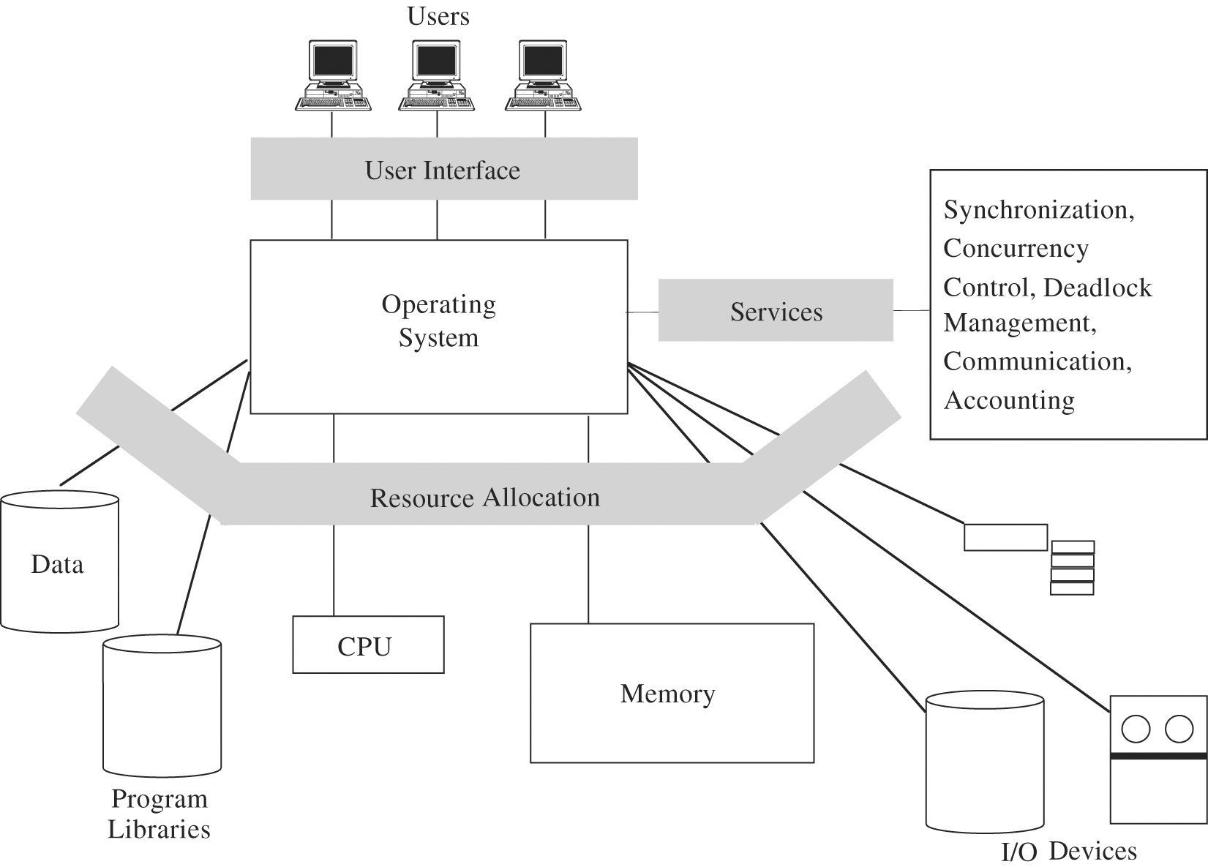
Overview of an OS Functions

Slide 6
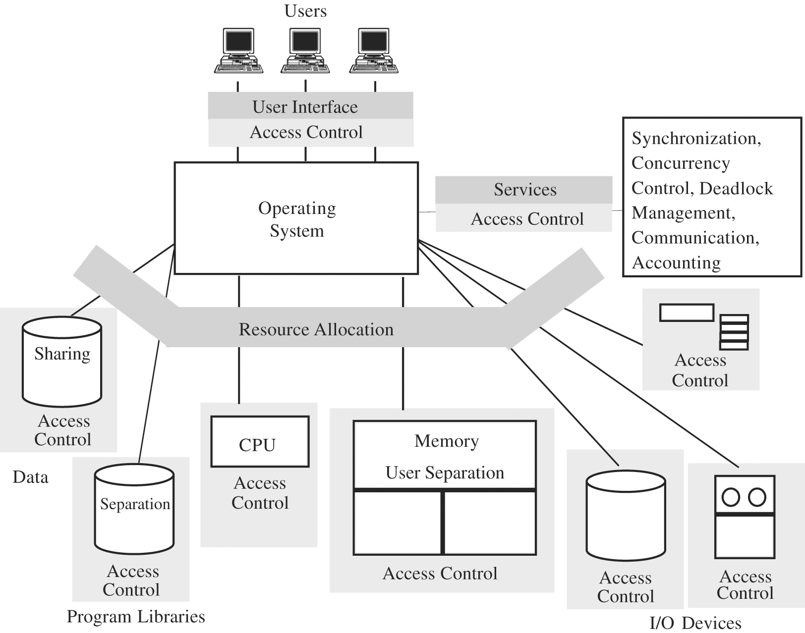
Security Functions of a Trusted OS

Slide 7
Programs security:
Program is secure if we trust that it provides/enforces:
  Confidentiality
  Integrity
  Availability

Slide 8
What is “Program security?”
Depends on who you ask
  user - fit for his task
  programmer - passes all “his” tests
  manager - conformance to all specifications
Developmental criteria for program security include:
  Correctness of security & other requirements
  Correctness of implementation
  Correctness of testing

Slide 9
Fault tolerance terminology:
  Error - may lead to a fault
  Fault - cause for deviation from the intended function
  Failure - system malfunction caused by fault
Note:
Faults - seen by „insiders” (e.g., programmers)
  Failures - seen by „outsiders” (e.g., independent testers, users)
Error/fault/failure example:
  Programmer’s indexing error, leads to buffer overflow fault
  Buffer overflow fault causes system crash (a failure)
Two categories of faults :
  Permanent faults
  Transient faults – can be much more difficult to diagnose

Slide 10
Basic approaches to having secure programs:
  1) Judging s/w security by fixing program faults
    Red Team / Tiger Team tries to crack s/w
      If programs withstands the attack => security is good
  2) Judging s/w security by testing program behavior
    Run tests to compare behavior vs. requirements (think testing or Ss/w engg)
    Important: If a flaw detected as a failure (an effect), look for the underlying fault (the cause)
        Recall: fault seen by insiders, failure – by outsiders
      If possible, detect faults before they become failures

Slide 11
    Any kind of fault/failure can cause a security incident
    => we must consider security consequences for all kinds of detected faults/failures
      Even inadvertent faults / failures
        Inadvertent faults are the biggest source of security vulnerabilities exploited by attackers
    Testing only increases probability of eliminating faults

Slide 12
  3) Judging s/w security by program security analysis
    Best approach to judging s/w security
    Analyze what can go wrong
      At every stage of program development!
        From requirement definition to testing
      After deployment
        Configurations / policies / practices

Slide 13
Controls for Security
How to control security of programs during their development and maintenance
Outline:
  Introduction
  Developmental controls for security
  Operating system controls for security
  Administrative controls for security
  Conclusions

Slide 14
Introduction
„Better to prevent than to cure”
Preventing security flaws
  We have seen a lot of possible security flaws
  How to prevent (some of) them?
  Software engineering concentrates on developing and maintaining high-quality s/w
    We’ll take a look at some techniques useful specifically for developing/ maintaining secure s/w

Slide 15
Three types of controls for security (against program flaws):
    Developmental controls
    OS controls
    Administrative controls

Slide 16
b. Developmental Controls for Security
Nature of s/w development
  Collaborative effort
  Team of developers, each involved in ≥ 1 of stages:
    Requirement specification
        Regular req. specs: „do X”
        Security req. specs: „do X and nothing more”

Slide 17
    Design
    Implementation
    Testing
    Documenting at each stage
    Reviewing at each stage
    Managing system development thru all stages
    Maintaining deployed system (updates, patches, new versions, etc.)
Both product and process contribute to overall quality
— incl. security dimension of quality

Slide 18
Developmental Controls for Security
Fundamental principles of s/w engineering
  Modularity
  Encapsulation
  Info hiding

Slide 19
1) Modularity
    Modules should be:
      Single-purpose - logically/functionally
      Small - for a human to grasp
      Simple - for a human to grasp
      Independent – high cohesion, low coupling
        High cohesion – highly focused on (single) purpose
        Low coupling – free from interference from other modules
  Modularity should improve correctness
    Fewer flaws => better security

Slide 20
Developmental Controls for Security
2) Encapsulation
  Minimizing info sharing with other modules
    => Limited interfaces reduce # of covert channels
  Well documented interfaces
  „Hiding what should be hidden and showing what should be visible.”

Slide 21
3) Information hiding
  Module is a black box
    Well defined function and I/O
  Easy to know what module does but not how it does it
  Reduces complexity, interactions, covert channels, ...
  => better security

Slide 22
Developmental Controls for Security
Many techniques for building solid software
  Peer reviews
  Hazard analysis
  Testing
  Good design
  Risk prediction & mangement
  Static analysis
  Configuration management
  Additional developmental controls

Slide 23
Developmental Controls for Security (5)
1) Peer reviews - three types
  Reviews
      Informal
      Team of reviewers
      Gain consensus on solutions
      before development
  Walk-throughs
      Developer walks team through code/document
      Discover flaws in a single design document
  Inspection
      Formalized and detailed
      Statistical measures used
Various types of peer reviews can be highly effective

Slide 24
Developmental Controls for Security (6)
2) Hazard analysis
  = systematic techniques to expose
  potentially hazardous system states,
  incl. security vulnerabilities
  Components of HA
    Hazard lists
    What-if scenarios – identifies non-obvious hazards
    System-wide view (not just code)
    Begins Day 1
    Continues throughout SDLC (= s/w dev’t life cycle)
  Techniques
    HAZOP – hazard and operability studies
    FMEA – failure modees and effects analysis
    FTA – fault tree analysis

Slide 25
Developmental Controls for Security (7)
3) Testing – phases:
  Module/component/unit testing of indiv. modules
  Integration testing of interacting (sub)system modules
  (System) function testing checking against requirement specs
  (System) performance testing
  (System) acceptance testing – with customer against customer’s requirements — on seller’s or customer’s premises
  (System) installation testing after installation on customer’s system
  Regression testing after updates/changes to s/w
Types of testing
  Black Box testing – testers can’t examine code
  White Box / Clear box testing – testers can examine design and code, can see inside modules/system

Slide 26
Developmental Controls for Security
4) Good design
  Good design uses:
    Modularity / encapsulation / info hiding
    Fault tolerance
    Consistent failure handling policies
    Design rationale and history
    Design patterns
i. Using modularity / encapsulation / info hiding
  - as discussed above

Slide 27
Developmental Controls for Security
ii. Using fault tolerance for reliability and security
  System tolerates component failures
  System more reliable than any of its components
    Different than for security, where system is as secure as its weakest component
Fault-tolerant approach:
  Anticipate faults (car: anticipate having a flat tire)
    Active fault detection rather than pasive fault detection
    (e.g., by use of mutual suspicion: active input data checking)
  Use redundancy (car: have a spare tire)
  Isolate damage
  Minimize disruption (car: replace flat tire, continue your trip)

Slide 28
Developmental Controls for Security (11)
4) Good design – cont.2
iii. Using consistent failure handling policies
  Each failure handled by one of 3 ways:
    Retrying
      Restore previous state, redo service using different „path”
        E.g., use secondary code instead of primary code
    Correcting
      Restore previous state, correct sth, run service using the same code as before
    Reporting
      Restore previous state, report failure to error handler, don’t rerun service
Example — How fault-tolerance enhances security
  If security fault destroys important data (availability in CIA), use f-t to revert to backup data set

Slide 29
Developmental Controls for Security (12)
4) Good design – cont.3
iv. Using design rationale and history
  Knowing it (incl. knowing design rationale and history for security mechanisms) helps developers modifying or maintaining system
v. Using design patterns
  Knowing it enables looking for patterns showing what works best in which situation

Slide 30
Developmental Controls for Security
Value of Good Design
  Easy maintenance
  Understandability
  Reuse
  Correctness
  Better testing
  => translates into (saving) BIG bucks !

Slide 31
Developmental Controls for Security (14)
5) Risk prediction & management
  Predict and manage risks involved in system development and deployment
    Make plans to handle unwelcome events should they occur
  Risk prediction/mgmt are esp. important for security
    Bec. unwelcome and rare events can have security consequences
  Risk prediction/mgmt helps to select proper security controls (e.g., proportional to risk)

Slide 32
Developmental Controls for Security (15)
6) Static analysis
  Before system is up and running, examine its design and code to locate security flaws
    More than peer review
  Examines
    Control flow structure (sequence in which instructions are executed, incl. iterations and loops)
    Data flow structure (trail of data)
    Data structures
  Automated tools available

Slide 33
Developmental Controls for Security (16)
7) Configuration management
  = process of controling system modifications during development and maintenance
  Offers security benefits by scrutinizing new/changed code
Problems with system modifications
  One change interefering with other change
    E.g., neutralizing it
  Proliferation of different versions and releases
    Older and newer
    For different platforms
    For different application environments (and/or customers categories)

Slide 34
Developmental Controls for Security (17)
Reasons for software modification
  Corrective changes
    To maintain control of system’s day-to-day functions
  Adaptive changes
    To maintain control over system’s modifications
  Perfective changes
    To perfect existing acceptable system functions
  Preventive changes
    To prevent system’s performance degradation to unacceptable levels

Slide 35
Developmental Controls for Security (21)
8) Additional developmental controls
  8a) Learning from mistakes
    Avoiding such mistakes in the future enhances security
  8b) Proofs of program correctness
    Formal methods to verify pgm correctness
    Logic analyzer shows that:
      initial assertions about inputs...
      ... through implications of pgm statements...
      ... lead to the terminal condition (desired output)
    Problems with practical use of pgm correctness proofs
      Esp. for large pgms/systems
    Most successful for specific types of apps
      E.g. for communication protocols & security policies
Even with all these developmental controls (1-8) –
still no security guarantees!

Slide 36
Administrative Controls for Security (2)
1) Standards and guidelines for program development
  Capture experience and wisdom from previous projects
  Facilitate building higher-quality s/w (incl. more secure)
  They include:
    Design S&G – design tools, languages, methodologies
    S&G for documentation, language, and coding style
    Programming S&G - incl. reviews, audits
    Testing S&G
    Configuration mgmt S&G
2) Security audits
  Check compliance with S&G
  Scare potential dishonest programmer from including illegitimate code (e.g., a trapdoor)

Slide 37
Administrative Controls for Security (3)
3) Separation of duties
  Break sensitive tasks into ≥ 2 pieces to be performed by different people (learned from banks)
  Example 1: modularity
    Different developers for cooperating modules
  Example 2: independent testers
    Rather than developer testing her own code

Slide 38
c. Operating System Controls for Security
Developmental controls not always used
OR:
Even if used, not foolproof
=> Need other, complementary controls, incl. OS controls
Such OS controls can protect against some program flaws

Slide 39
Operating System Controls for Security
Trusted software
– code rigorously developed an analyzed so we can trust that it does all and only what specs say
  Trusted code establishes foundation upon which untrusted code runs
    Trusted code establishes security baseline for the whole system
  In particular, OS can be trusted s/w

Slide 40
Operating System Controls for Security
Key characteristics determining if OS code is trusted
  1) Functional correctness
    OS code consistent with specs
  2) Enforcement of integrity
    OS keeps integrity of its data and other resources even if presented with flawed or unauthorized commands
  3) Limited privileges
    OS minimizes access to secure data/resources
    Trusted program s must have „need to access” and proper access rights to use resources protected by OS
    Untrusted program s can’t access resources protected by OS
  4) Appropriate confidence level
    OS code examined and rated at appropriate trust level

Slide 41
Operating System Controls for Security
Similar criteria used to establish if s/w other than OS can be trusted
Ways of increasing security if untrusted programs present:
  Mutual suspicion
  Confinement
  Access log
1) Mutual suspicion between programs
  Distrust other program s – treat them as if they were incorrect or malicious
    program protects its interface data
      With data checks, etc.

Slide 42
Operating System Controls for Security
2) Confinement
  OS can confine access to resources by suspected program
  Example 1: strict compartmentalization
    program can affect data and other program s only within its compartment
  Example 2: sandbox for untrusted program s
  Can limit spread of viruses

Slide 43
Operating System Controls for Security
3) Audit log / access log
  Records who/when/how (e.g., for how long) accessed/used which objects
    Events logged: logins/logouts, file accesses, program ecxecutions, device uses, failures, repeated unsuccessful commands (e.g., many repeated failed login attempts can indicate an attack)
  Audit frequently for unusual events, suspicious patterns
  It is a forensic measure not protective measure
    Forensics – investigation to find who broke law, policies, or rules (a posteriori, not a priori)

Slide 44
Summary
What is “Program security”
Basic approaches to having secure programs
Controls for Security
Developmental Controls for Security
Administrative Controls for Security
Operating System Controls for Security

