Slide 1


Flutter & Dart Complete Guide
Prepared by Eng. Yousef Salah Kassem
DAFL 3
State Management
Lecture 1

Slide 2
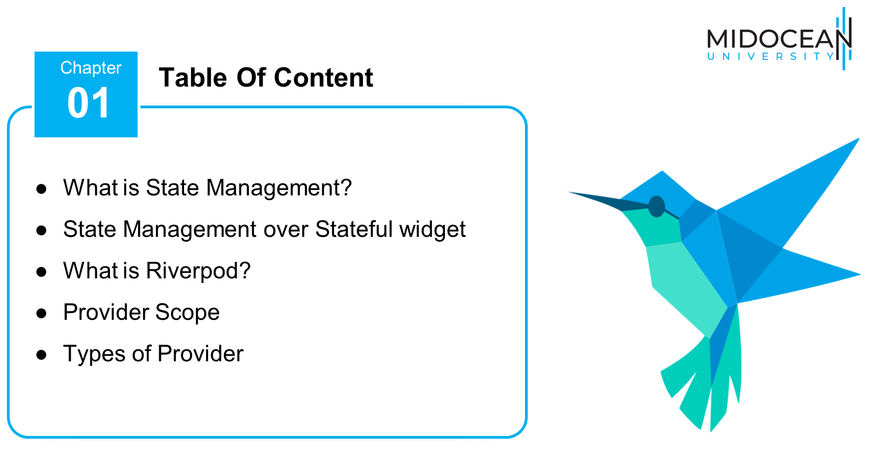

Slide 3



Slide 4
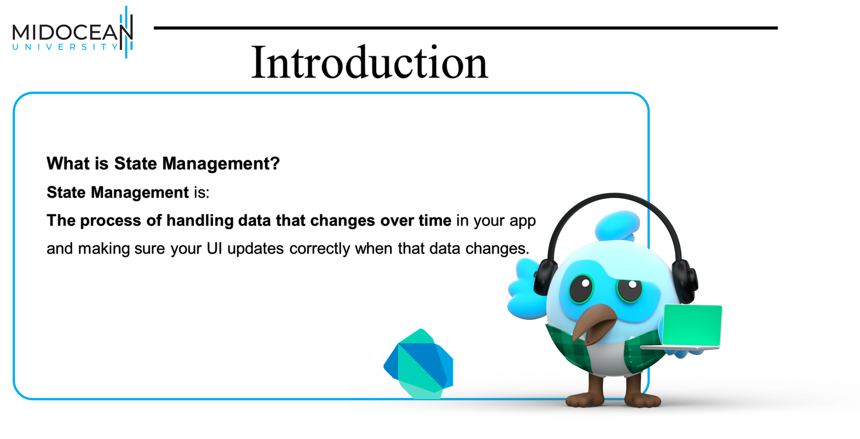

Slide 5
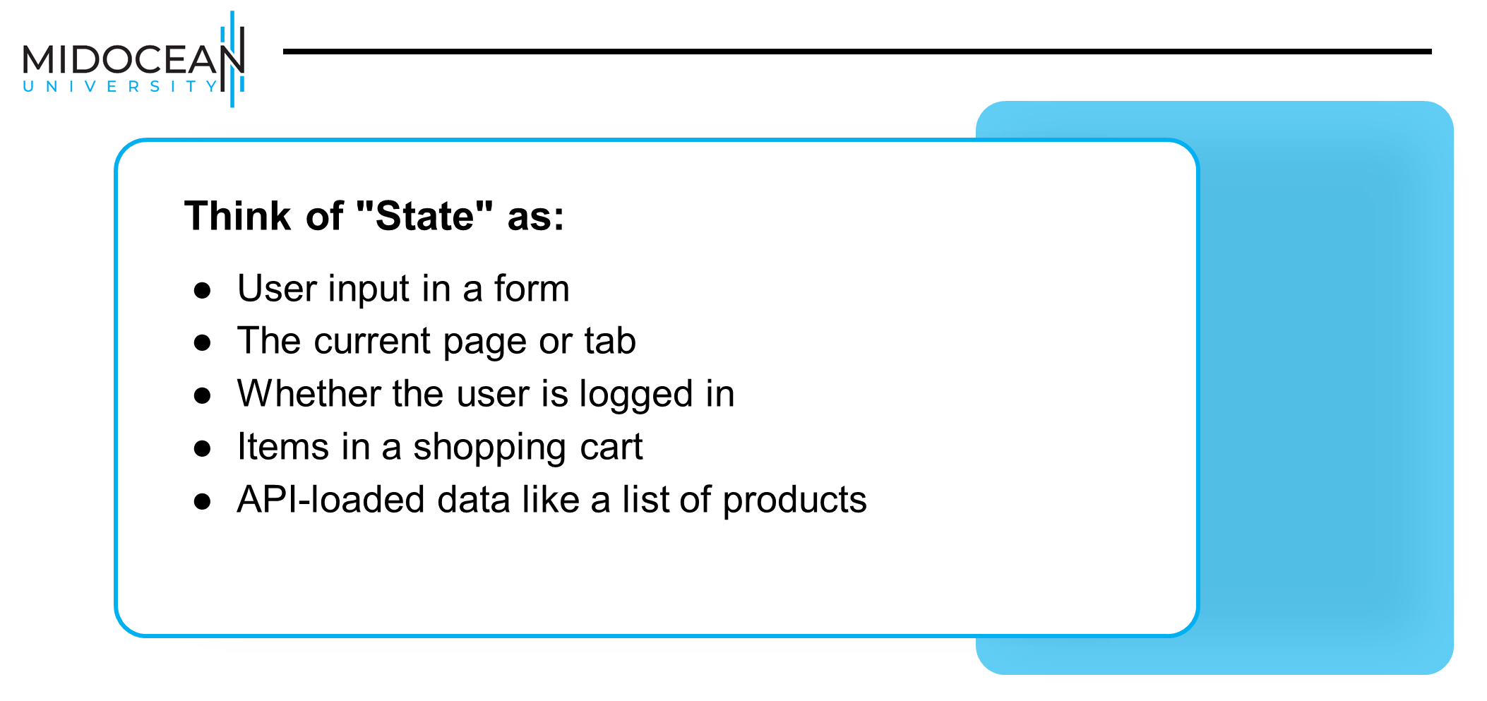

Slide 6
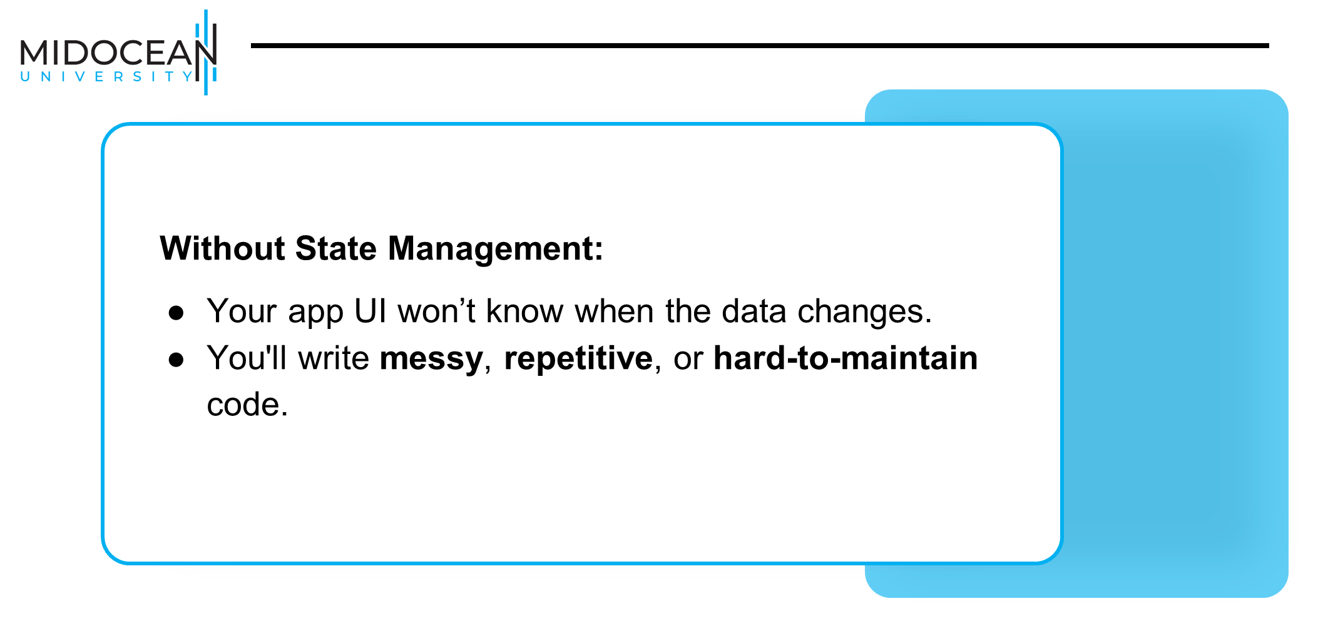

Slide 7
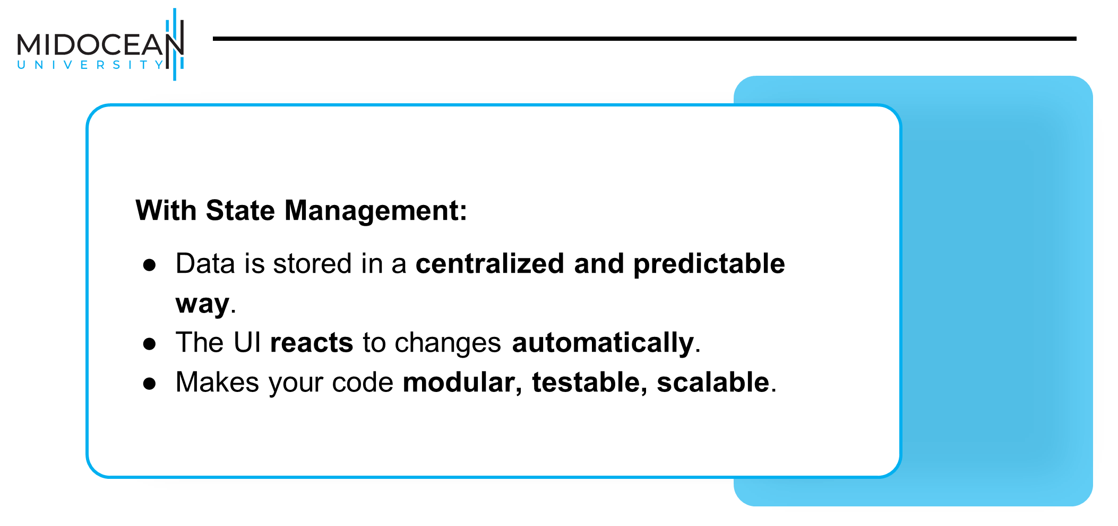

Slide 8


Slide 9
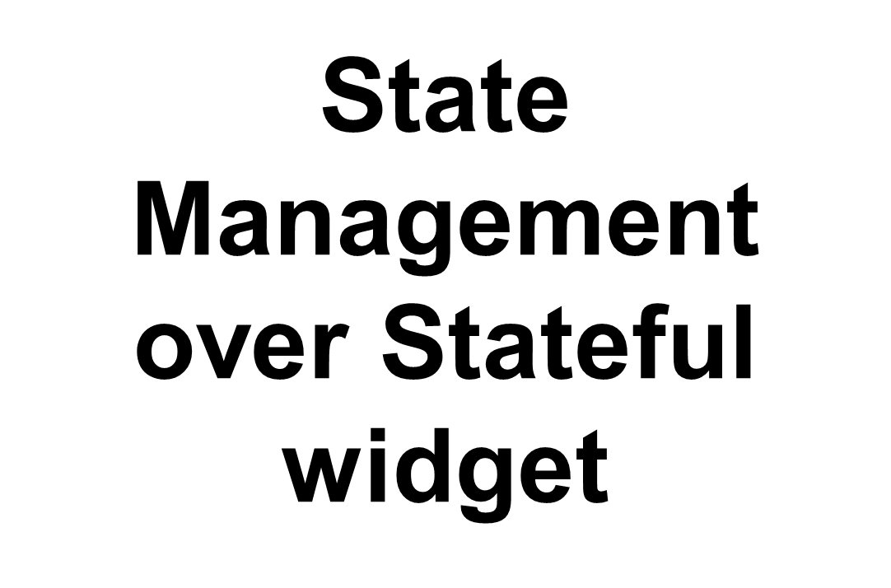

Slide 10


Slide 11


Slide 12
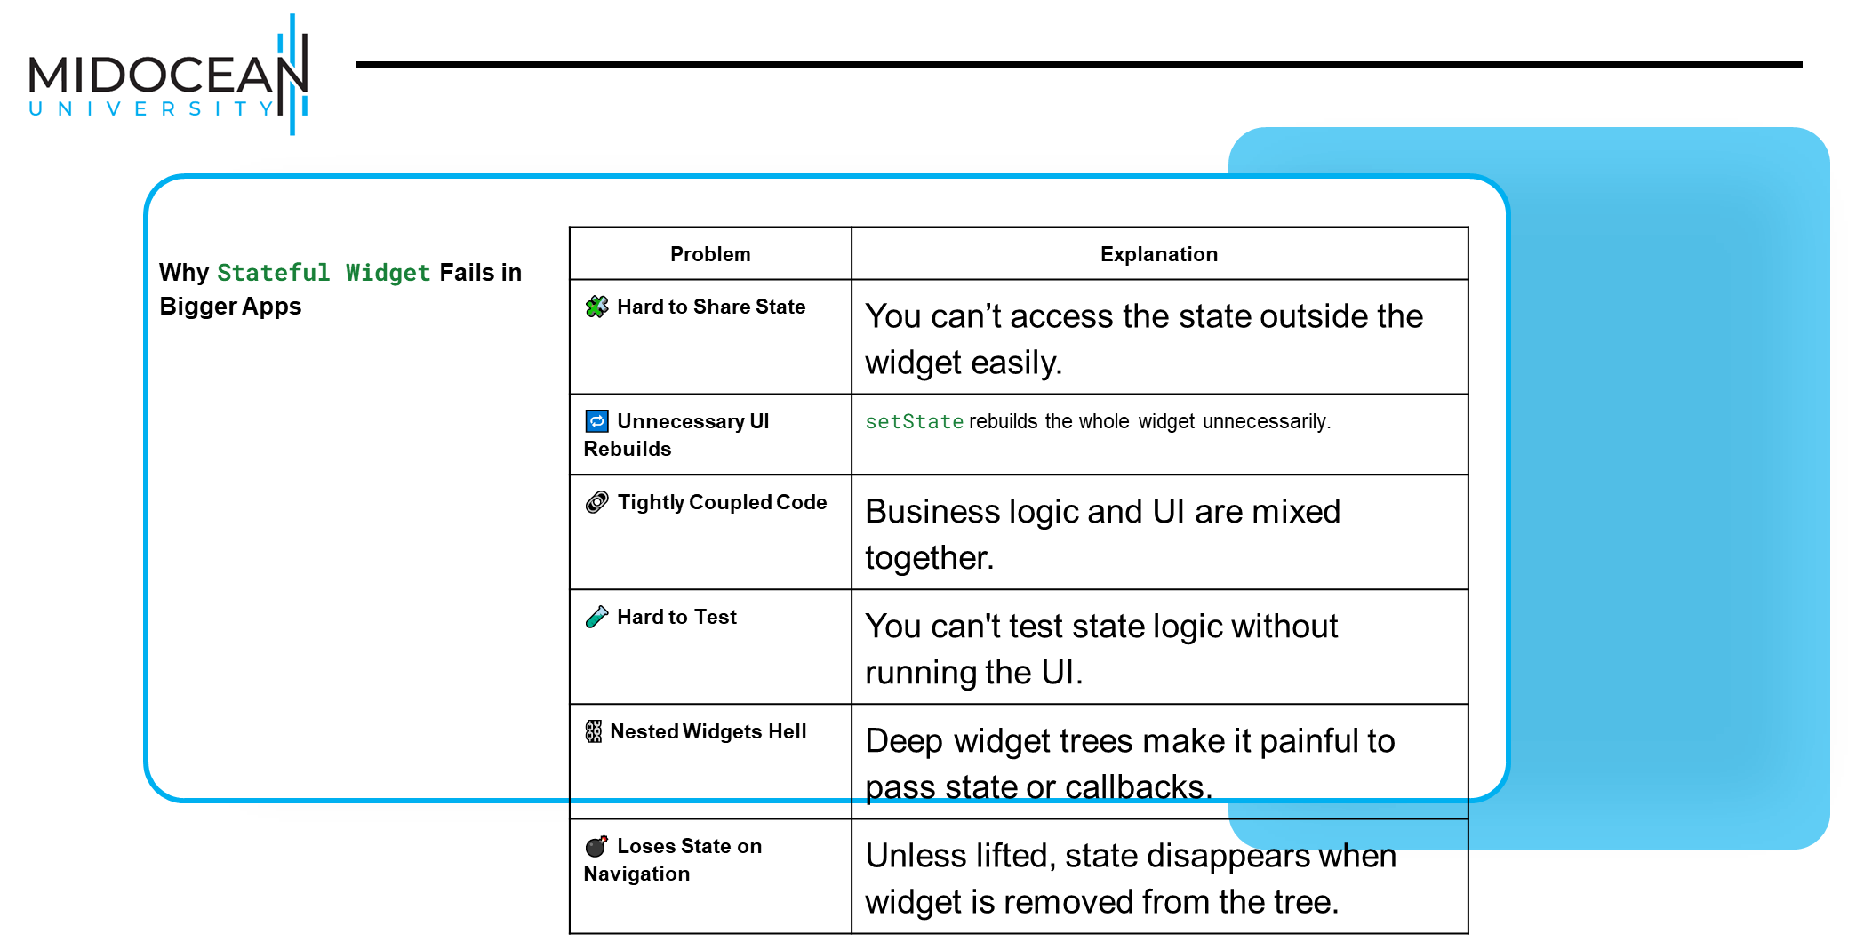

Slide 13


Slide 14


Slide 15


Slide 16
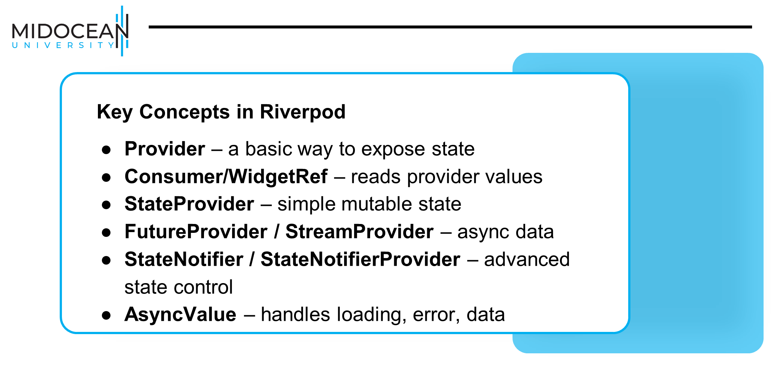

Slide 17


Slide 18
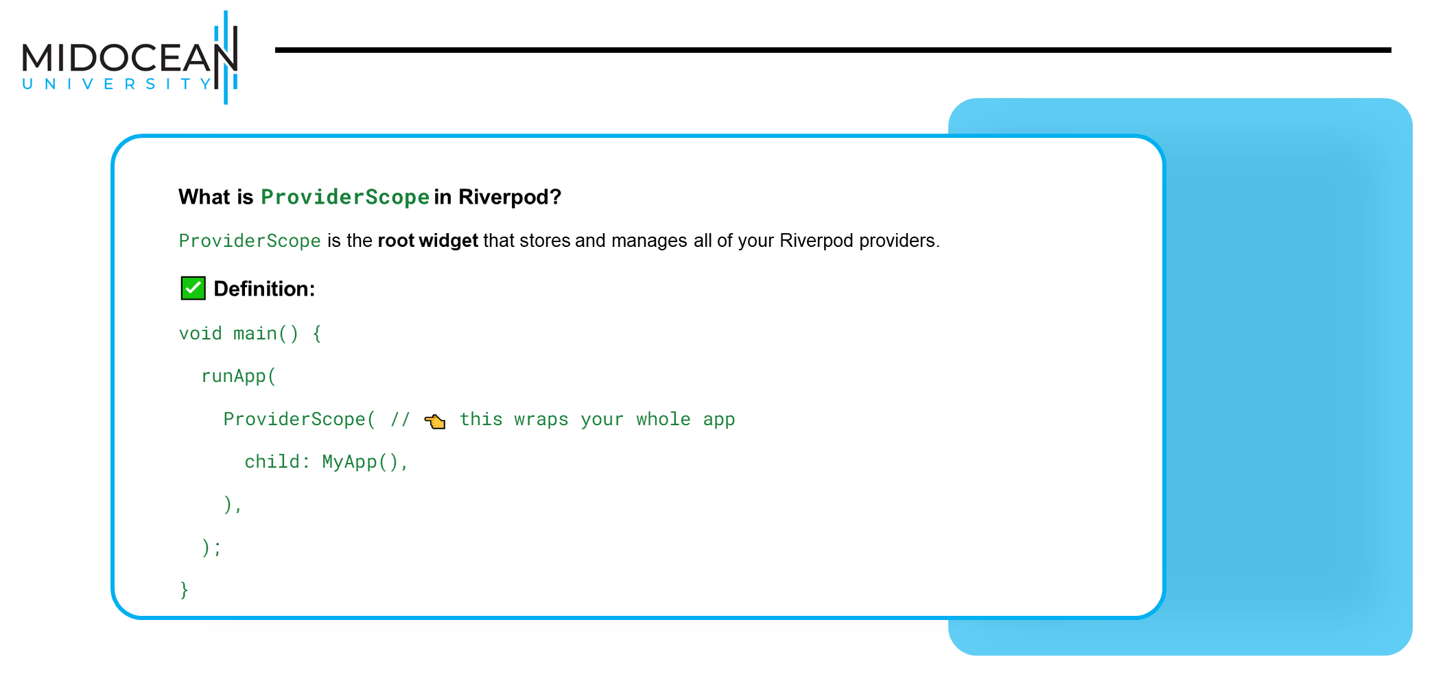

Slide 19


Slide 20
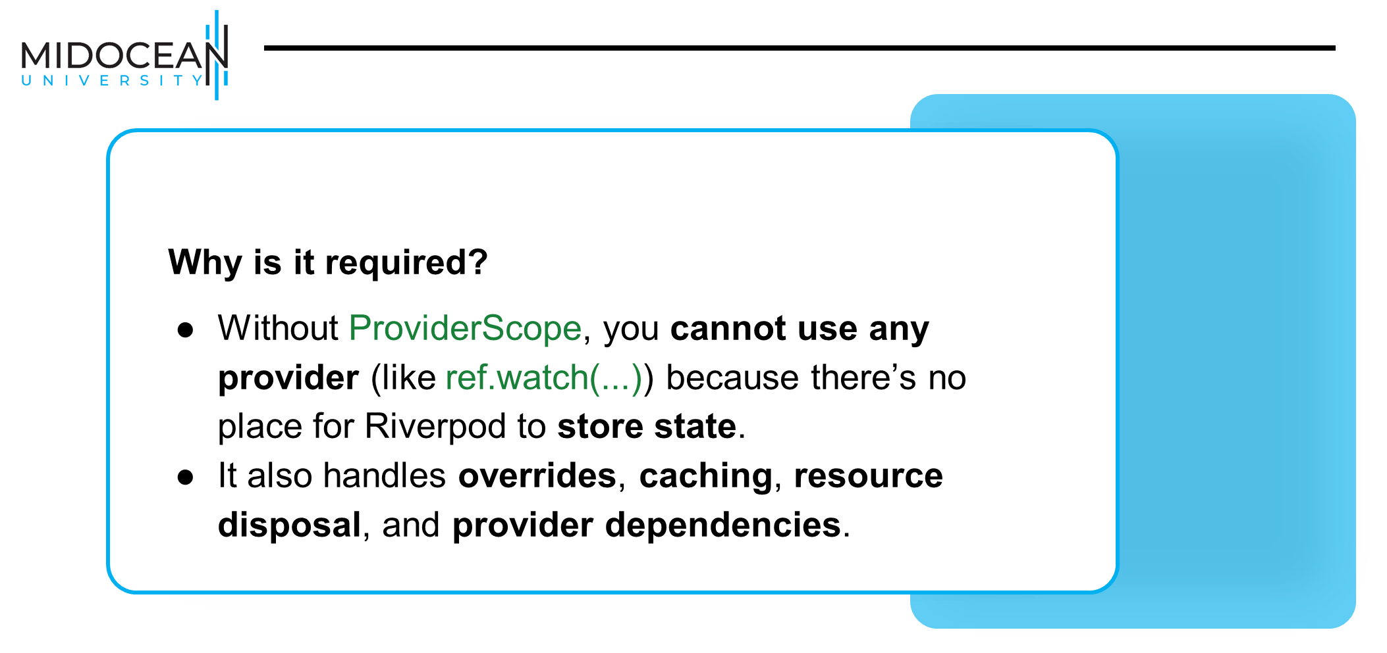

Slide 21
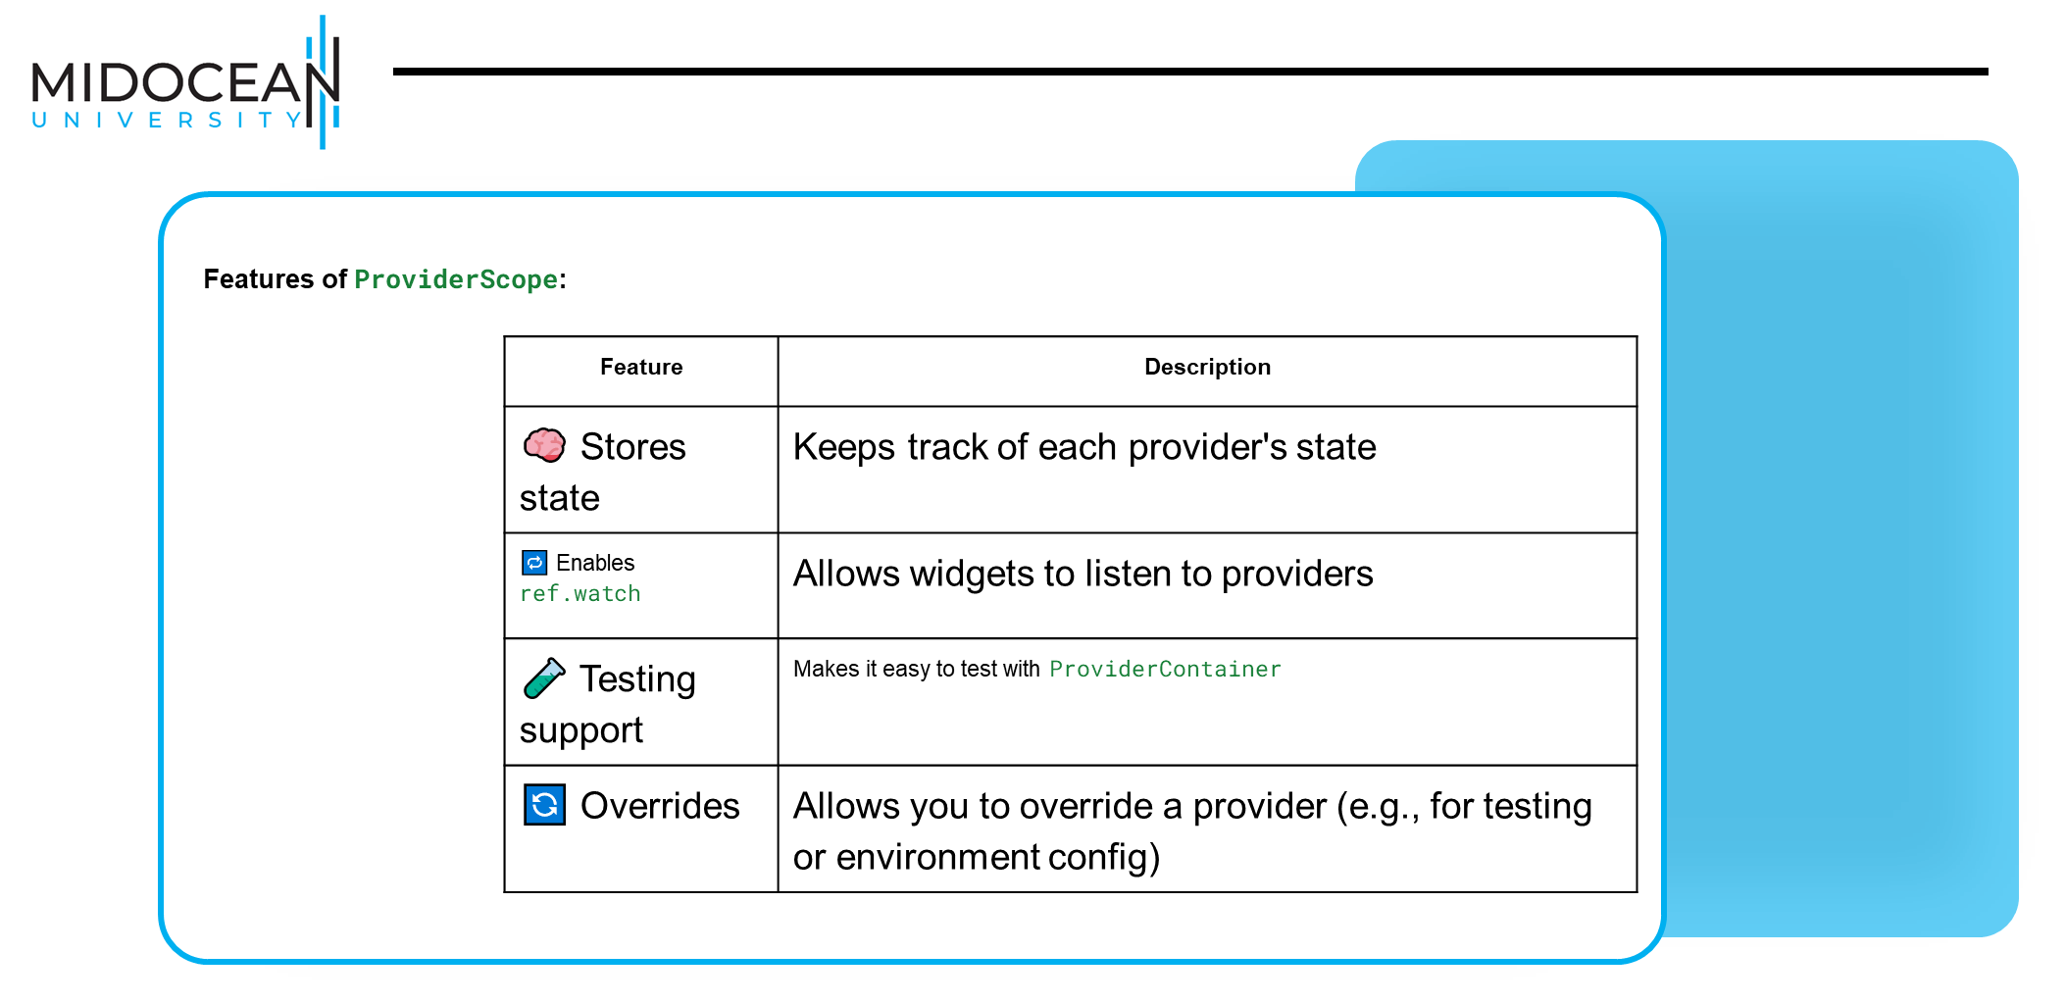

Slide 22
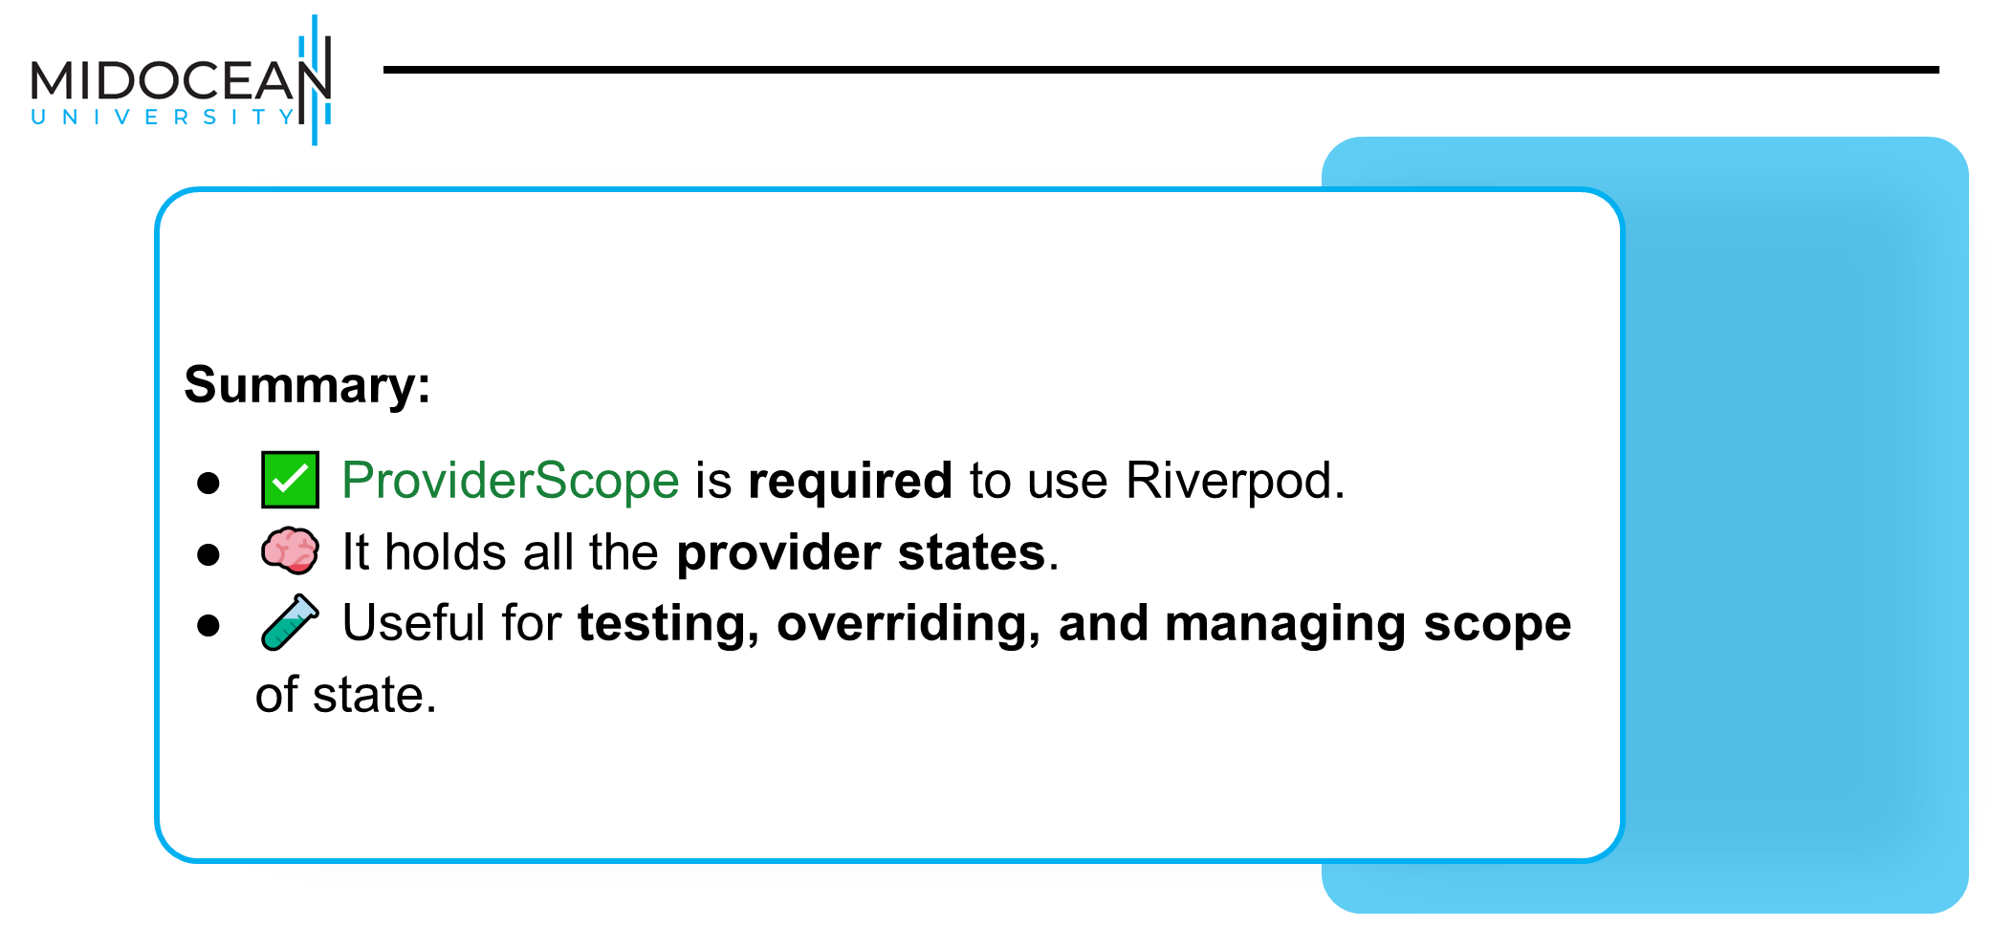

Slide 23
Types of Provider

Slide 24


Slide 25


Slide 26


Slide 27
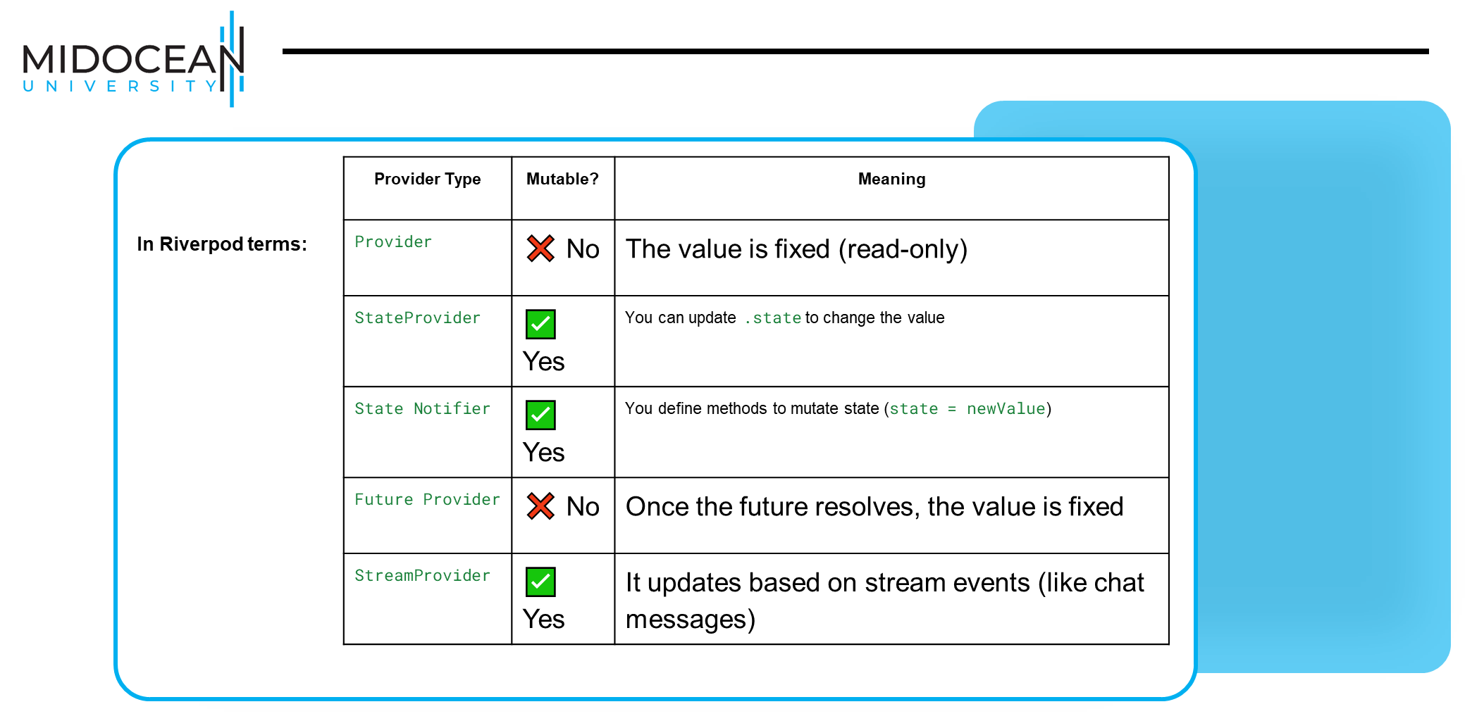

Slide 28
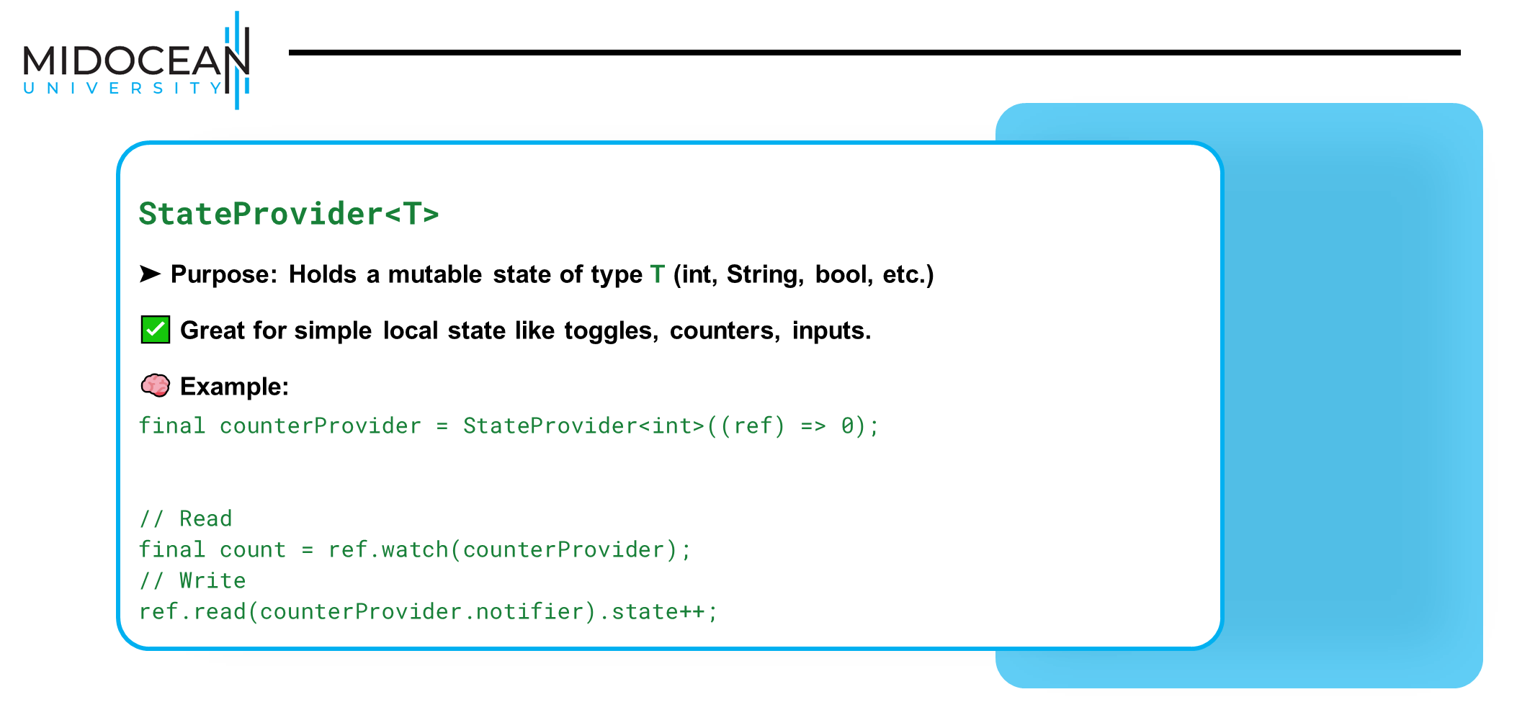

Slide 29
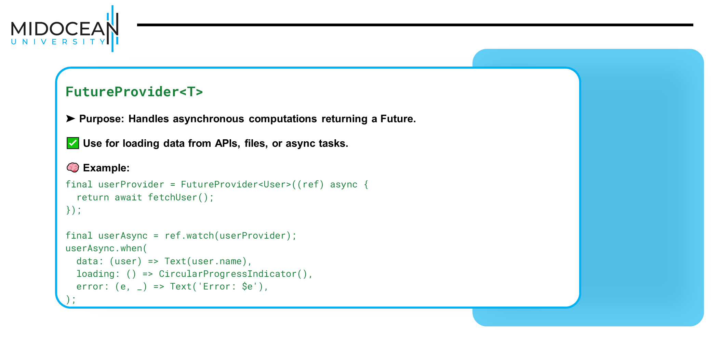

Slide 30


Slide 31


Slide 32


Slide 33


Slide 34
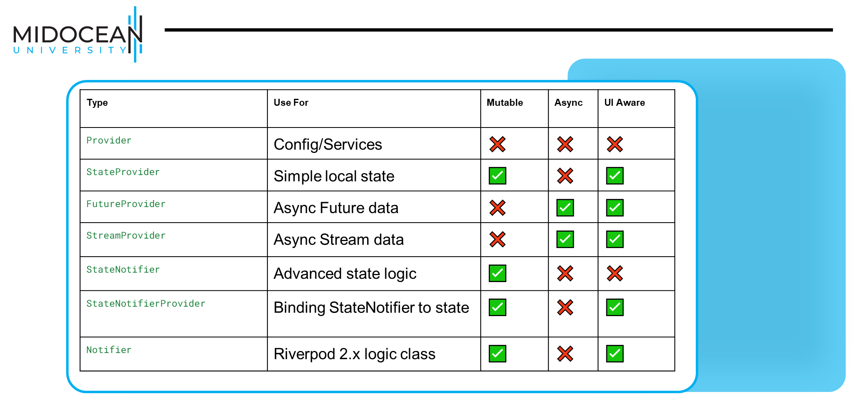

Slide 35


Slide 36
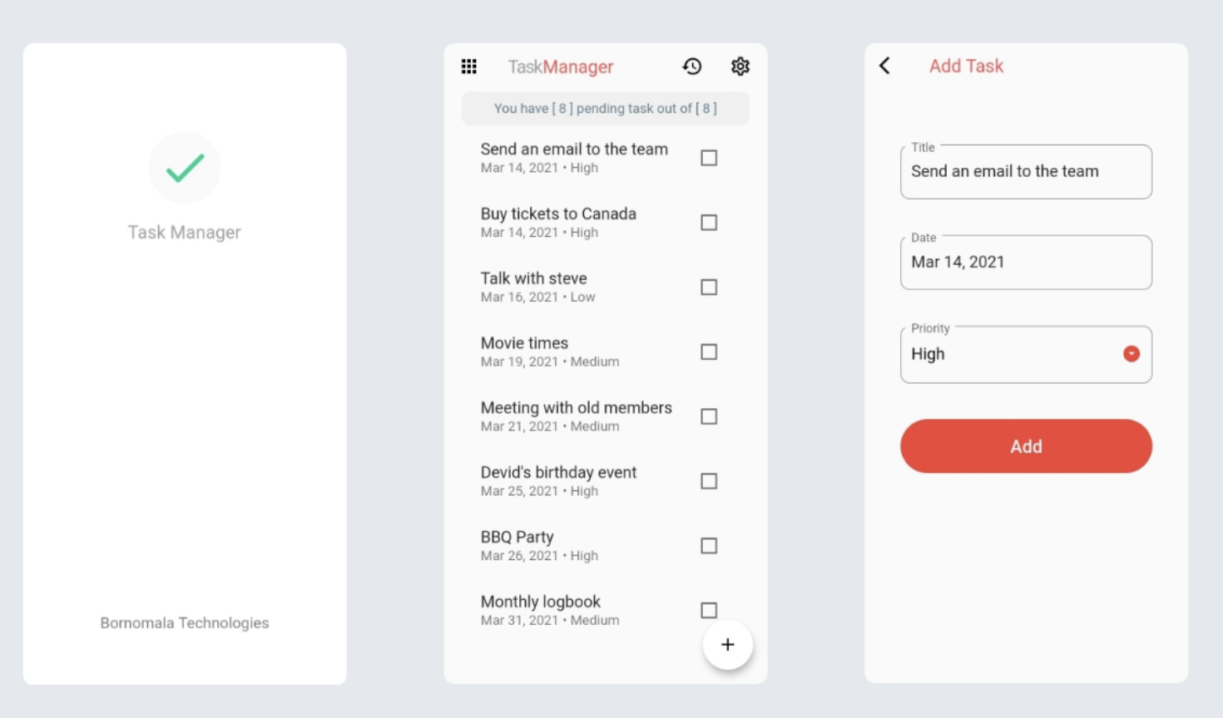

Slide 37
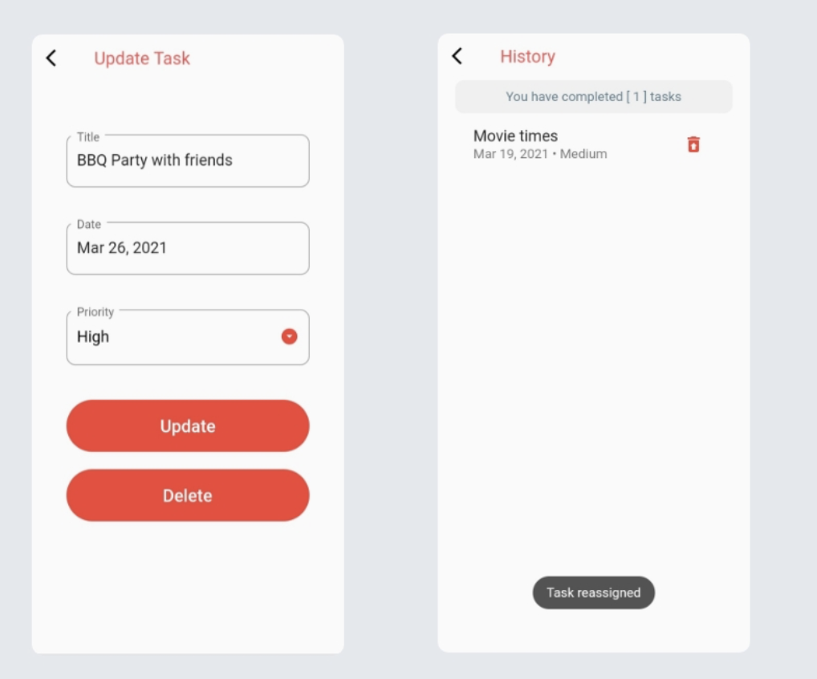

Slide 38



Thank You

