Slide 1


Marketing Management
MGM612
Prepared by Dr. Magdy Al-haj
  Lecture - 1-

Slide 2



Marketing Management & Marketing Function
Lecture 1
Marketing Management
MGM612
Prepared by
Dr. Magdy Al-haj
www.midocean.ae

Slide 3






Learning Outcomes
Marketing Management
What is Marketing?
What is Marketing?
Marketing Management Tasks
Explain the marketing functions

Slide 4


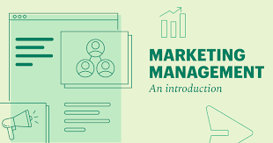
Chapter
1
Marketing Management
www.midocean.ae

Slide 5

Chapter
1
What is Marketing?
Marketing is the delivery of customer satisfaction at a profit.
Marketing is an organizational function and a set of processes for creating, communicating, and delivering value to customers and for managing customer relationships in ways that benefit the organization and its stakeholders.
Marketing is a social and managerial process by which individuals and groups obtain what they need and want through creating and exchanging products and value with others.
www.midocean.ae

Slide 6
Chapter
1
The Goal of Marketing is:
To attract new customer by promising superior value, and to keep current customers by delivering satisfaction.
Success dependent upon marketing functions
Many people think of marketing only as selling and advertising.
Selling and advertising are only the tip of the marketing ice-berg.
Marketing is one of 4 key core functions that are central to all organizations.
www.midocean.ae

Slide 7
Chapter
1
Why Study Marketing?
Plays an important role in society
Vital to business survival, profits and growth
Offers career opportunities
Affects your life every day
Better-informed consumers
Demand for customer satisfaction
www.midocean.ae

Slide 8
Chapter
1
Marketing Defined
Marketing is the process by which companies create value for customers and build strong customer relationships to capture value from customers in return.
‘Marketing is the management process that identifies, anticipate and satisfies customer requirements profitably’
‘The right product, in the right place, at the right time, and at the right price’
www.midocean.ae

Slide 9
Chapter
1
Marketing Defined
Marketers act as the customers’ voice within the firm and marketers are responsible for many more decisions than just advertising or sales:
  Analyze industries to identify emerging trends.
  Determine which national and international markets to enter or exit.
  Conduct research to understand consumer behavior.
  Design integrated marketing mixes – products, prices, channels of distribution, and promotion programs.
www.midocean.ae

Slide 10
Chapter
1
Marketing Defined cont. ….
To explain marketing definition, we examine the following important terms :
  Needs, wants, and demands
  Products and services
  Value, satisfaction and quality
  Exchange, transactions, and relationships
  Markets
www.midocean.ae

Slide 11
Chapter
1
Needs, Wants, and Demands
Needs:
The most basic concept underlying marketing is that of human needs.
Human needs are states of felt deprivation.
Human have many complex needs:
  Physical needs for food, clothing, warmth, and safety
  Social needs or belonging and affection
  Individual needs for knowledge and self – expression
www.midocean.ae

Slide 12
Chapter
1
Needs, Wants, and Demands cont. ..
Wants:
Want are the form taken by human needs as they are shaped by culture and individual personality.
People have almost unlimited wants but limited resources.
They want to choose products that provide the most value and satisfaction for their money.
Demands:
When backed by buying power, wants become demands.
Consumers view products as bundles of benefits and choose products that give them the best bundle for their money.
www.midocean.ae

Slide 13
Chapter
1
Products and Services
Product:
Anything that can be offered to a market to satisfy a need or want.
The concept of product is not limited to physical objects – anything capable of satisfying a need can be called a product.
Services:
In addition to tangible goods, products also include services, which are activities or benefits offered for sale that are essentially intangible and do not result in the ownership of anything.
www.midocean.ae

Slide 14
Chapter
1
Values, Satisfaction, and Quality
Values:
Customer value is the difference between the values the customer gains from owning and using a product and the costs of obtaining the products.
Customers often do not judge product value and costs accurately or objectively. They act on perceived value.
Satisfaction:
Customer satisfaction depends on a product’s perceived performance in delivering value relative to a buyer’s expectation.
If the product’s performance falls short of the customer’s expectations, the buyer is dissatisfied.
www.midocean.ae

Slide 15
Chapter
1
Values, Satisfaction, and Quality
Quality:
Customer satisfaction is closely linked to quality.
Quality has a direct impact on product performance.
Quality can be defined as “freedom from defects”.
TQM programs designed to constantly improve the quality of products, services, and marketing processes.
www.midocean.ae

Slide 16
Chapter
1
Exchange, Transactions, and Relationships
Exchange
The act of obtaining a desired object from someone by offering something in return
Transaction
A trade between two parties that involves at least two things of value, agreed – upon conditions a time of agreement, and a place of agreement.
Relationship marketing :
The process of creating, maintaining, and enhancing strong, value – laden relationships with customers and other stakeholders
www.midocean.ae

Slide 17
Chapter
1
Markets
The set of all actual and potential buyers of a product or service
Communication
Originally a “market” was a place where buyers and sellers gathered to exchange goods (such as a village square).
Industry
(a collection of sellers)
Products / Services
Market
(a collection of buyers)
Money
Information
A simple marketing system
www.midocean.ae

Slide 18
Chapter
1
Marketing Management
The analysis, planning, implementation, and control of programs designed to create, build, and maintain beneficial exchanges with target buyers for the purpose of achieving organizational objectives.
www.midocean.ae

Slide 19
Chapter
1
What is Marketing Management?
Marketing management is the art and science of choosing target markets and getting, keeping, and growing customers through creating, delivering, and communicating superior customer value.
www.midocean.ae

Slide 20
Chapter
1
Marketing Management Tasks
Developing marketing strategies
Capturing marketing insights
Connecting with customers
Building strong brands
Shaping market offerings
Delivering value
Communicating value
Creating long-term growth
www.midocean.ae

Slide 21
Chapter
1
Marketing management process
Analysis/Audit - where are we now?
Objectives - where do we want to be?
Strategies - which way is best?
Tactics - how do we get there?
Implementation - Getting there
Control - Ensuring arrival
www.midocean.ae

Slide 22
Chapter
1
Marketing Management Involves
Demand Management :
The organization has a desired level of demand for its products. At any point in time, There may be no demand, adequate demand, irregular demand, or too much demand, and marketing management must find ways to deal with these different demand states.
Building Profitable Customer Relationships :
Beyond designing strategies to attract new customers and create transactions with them, companies now are striving to retain current customers and build lasting customer relationships.
www.midocean.ae

Slide 23
Chapter
1
Marketing management philosophies
The role that marketing plays within a company varies according to the overall strategy and philosophy of each firm.
There are five alternative concepts under which organizations conduct their marketing activities:
  Production concept
  Product concept
  Selling concept
  Marketing concept
  Societal marketing concepts
www.midocean.ae

Slide 24
Chapter
1
Production Concept
The philosophy that consumers will favor products that are available and highly affordable and that management should therefore focus on improving production and distribution efficiency.
www.midocean.ae

Slide 25
Chapter
1
Product Concept
The philosophy that consumers will favour products that offer the most quality, performance, and innovative features.
www.midocean.ae

Slide 26
Chapter
1
Selling Concept
The idea that consumers will not buy enough of the organization’s products unless the organization undertakes a large – scale selling and promotion effort.
www.midocean.ae

Slide 27
Chapter
1
Marketing Concept
The marketing management philosophy that holds that achieving organizational goals depends on determining the needs and wants of target markets and delivering the desired satisfactions more effectively and efficiently than competitors do.
www.midocean.ae

Slide 28
Chapter
1
The selling and Marketing Concepts Contrasted
Starting point
Focus
Means
Ends
Existing products
Selling
and promoting
Profits through sales volume
Factory
The selling concept
Customer
needs
Integrated marketing
Profits through customer satisfaction
Market
The marketing concept
www.midocean.ae

Slide 29
Chapter
1
Societal Marketing Concept
The idea that the organization should determine the needs, wants, and interests of target markets and deliver the desired satisfactions more effectively and efficiently than competitors in a way that maintains or improves the consumer’s and society’s well – being.
www.midocean.ae

Slide 30
Three Considerations Underlying The Societal Marketing
Chapter
1
Society
(Human welfare)
Societal marketing concept
Consumers
(Want satisfaction)
Company
(Profits)
www.midocean.ae

Slide 31
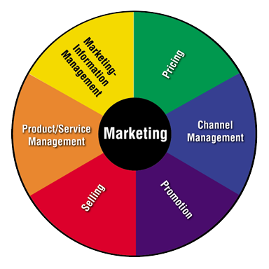
Chapter
1
What Are the Marketing Functions?
Interrelated activities working together to get products from producers to customers
  Product/Service management
  Marketing information management
  Pricing
  Channel management
  Promotion
  Selling
www.midocean.ae

Slide 32
Chapter
1
Product/Service Management
Obtains, develops, maintains, and improves product/service mix
Plans, directs, and controls a product’s life cycle
Generates ideas for new products
Improves or updates existing products
Removes products from the market
Importance of Product/Service Management
Helps to determine the business’s image/brand
Must offer products that customers want and need
www.midocean.ae

Slide 33
Chapter
1
Marketing-Information Management
Gathers, accesses, synthesizes, evaluates, and disseminates information
Importance of Marketing-Information Management
Prevents guessing
Helps businesses to:
  Learn about their customers
  Predict the future
  Find out if customers are satisfied
www.midocean.ae

Slide 34
Chapter
1
Pricing
Determines and adjusts prices to:
  Maximize return
  Meet customers’ perceptions of value
Importance of Pricing
Affects how well a product will sell
Impacts how much profit the business will make
Must set prices customers are willing to pay
Helps decide when to adjust prices
Must cover costs
www.midocean.ae

Slide 35
Chapter
1
Channel Management
Identifies, selects, monitors, and evaluates sales channels
Puts products in the customers’ hands
Importance of Channel Management
Gets products from producers to customers
Makes products available when and where customers want to buy
Determines which channel members should do
www.midocean.ae

Slide 36
Chapter
1
Promotion
Communicates information about goods, services, images, and/or ideas to achieve a desired outcome
Informs, persuades, or reminds customers about a business and/or its products
Uses a variety of methods to communicate with customers
Importance of Promotion
Helps create the business’s image
Tells customers about products
Generates product demand
www.midocean.ae

Slide 37
Chapter
1
Selling
Determines client needs and wants
Responds through planned, personalized communication
Influences purchase decisions
Enhances future business opportunities
Provides customers with the products they want
Importance of Selling
Involves contact with customers
Meets customers’ needs
Sells customers the most appropriate products
Benefits businesses, customers, and society
www.midocean.ae

Slide 38

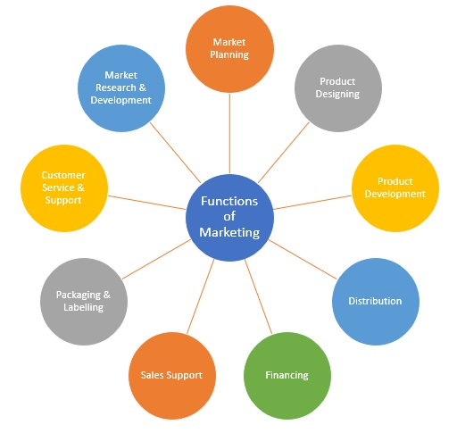
Chapter
1
Marketing Functions’ Important Roles
www.midocean.ae
www.midocean.ae

Slide 39
Chapter
1
Marketing challenges in the new century
Growth Of Non-profit Marketing
Attracting new customers and Working with smaller budgets
The Information Technology Boom
Rapid Globalization& Expanding into international markets
The Changing World Economy
Managing data complexity
The Call For More Ethics And Social Responsibility
www.midocean.ae

Slide 40

01
Thank You
www.midocean.ae

