Slide 1



Project Business
Analysis
PMG 461 – MGM461
Lecture 3
Eliciting Requirements from Stakeholders
Prepared by
Eng. Ahmed Hussein, MBA, PfMP©, PMP©, CMP APMG

Slide 2

Lecture
What we will cover
03
Who are stakeholders, and the role of the business Analyst in Stakeholders Management
Analyzing Stakeholders needs, expectations, and level of interest/influence
Developing Stakeholders Engagement Approach
3 – 2

Slide 3


Who are stakeholders, and the role of the business Analyst in Stakeholders Management
Lecture
03
3 – 3

Slide 4
Lecture
What is Stakeholder Management?
03
Stakeholders Management (Engagement) is one of the key knowledge areas within Project Management.
Stakeholder management( engagement) is forming and maintain relationships with stakeholders and influencing them in order to achieve an objective.”
Stakeholder management (engagement) requires two-way communication and incorporation of feedback to:
  Build and sustain appropriate levels of commitment to the objective.
  Identify and mitigate resistance.
3 – 4

Slide 5
Role of the Business Analyst in Stakeholder Management
Lecture
03
The Project Manager has the ultimate responsibility for stakeholder management in the project.
The Business Analyst plays a critical role in stakeholder managers as she/he are the ones who spend most of the time with stakeholders.
The Business Analyst contributes to:
  Identifying Stakeholders and their needs
  Analyzing Stakeholders
  Recommending engagement approaches
  Executing some activities in the engagement approach
  Monitoring Stakeholders Engagement throughout the project
3 – 5

Slide 6
Lecture
Stakeholder Management Process
03
Develop Stakeholder Management Strategies
Review/Revise Stakeholder’s Management Strategies
Identify Stakeholders
Analyze Stakeholders
Identify Key Stakeholders
Define needs, requirements, concerns and issues, level of commitment, interests, power/influence, resistance
Decide Techniques to involve the stakeholders in requirements, design implementation, and acceptance
Implement the strategies and monitor results, and if needed, adjust your strategies
3 – 6

Slide 7
Lecture
When is Stakeholders Management done?
03
Stakeholder Management starts as soon as the objective is agreed and continues until the objective has been achieved.
A stakeholder engagement approach is developed during planning and should include:
  Identification, Analysis & how to Monitoring, what we will do to support the project and deal with any issues
  Key Messages to stakeholders around business rationale and benefits
  Roles and Responsibilities
3 – 7

Slide 8
Lecture
Key Artifacts in Stakeholder Management
03
Stakeholder Register
Identification, Analysis and Map
Stakeholder Management Plan
Communication Plan
Stakeholder Engagement Plan
3 – 8

Slide 9
Why is Stakeholders Management Important?
Lecture
03
Stakeholders are crucial to achieving your objective(s).
Neglect them and they will actively work against you.
Manage them well and they will actively promote you and your objective(s).
Anonymous
3 – 9

Slide 10
Poorly Managed Stakeholders can have a Negative Impact on the project
Lecture
03
Find faults
Be overly controlling
Reassign resources
Start a competing project
Spread negative rumors
Delay approvals
Provide little support
Terminate the project
3 – 10

Slide 11
Lecture
Who is a Stakeholder?
03
A Stakeholder is anyone who has an interest in, or may be affected by, the issue under consideration’.
Or anyone affected by the project or who may be in a position to influence it.
A Stakeholder can be a person, group, or an organization
3 – 11

Slide 12
Lecture
Stakeholders Classification
03
Customers
Partners
Suppliers
Regulators
Employees
Project Manager
Project Team
Owners
Competitors
Managers
Stakeholders will have a variety of understandings, expectations and levels of commitment
3 – 12

Slide 13
Lecture
What do Stakeholders provide?
03
Requirements
Solutions
Risk Identification
Champion the change
Review and accept outputs and deliverables
3 – 13

Slide 14
Lecture
Identifying Stakeholders
03
Start by Asking:
Who are the stakeholders?
What does each stakeholder expect from the objective/project?
What do we expect from each stakeholder for the project?
What are their interests and position for the project?
Who can support us? Who will resist the project?
3 – 14

Slide 15

Lecture
Tools to Identify Stakeholders
03
Brainstorming
Review Charters/Documents
Review Organization Structure
Sponsor and other experts
Similar Past projects
3 – 15

Slide 16
Lecture
Stakeholder Register
03
“A document including the identification, assessment, and classification of stakeholders.”
Contains:
  Identification Information: name, organizational position, location, role in project, contact information, …etc.
  Assessment information: major requirements, main expectations, potential influence in project or phase with most interest; and
  Stakeholder classification: Internal/External, supporter/neutral/resistor, etc.
3 – 16

Slide 17
Lecture
Stakeholder Register
03
# | Stakeholder Name | Title (or Role) | Contact details | Category (Internal/ External) | Expectations | Requirements | Level of Influence | Level of Interest
1
2
3
4
5
6
7
3 – 17

Slide 18
Lecture
Analyzing Stakeholders
03
3 – 18

Slide 19
Lecture
Understanding your Stakeholders
03
Needs, Requirements, Expectations
Interest? Positive or Negative?
What level of Power or influence do they have on my objective/project?
Motivation?
What do they want?
Who can they influence?
Who influences them?
How to win them?
How will you manage/engage them throughout the project
3 – 19

Slide 20
Lecture
Analyzing Stakeholders
03
Determine roles, needs, expectations, interests, knowledge, expectations, and influence for all potential stakeholders &
Identify potential impact or support each stakeholder could generate (power-interest)
Assess how key stakeholders are likely to react or respond to various situations.
3 – 20

Slide 21
Stakeholder Power
(Influence) vs. Interest Map
Lecture
03
Those with high decision-making authority
Lacks availability or interest to be actively engaged
Usually difficult to have consistent touch points
Do whatever is needed to keep them satisfied
Ex. Regulators, government authorities,…
High
Keep Satisfied
Actively Engage
Business Owners and other executives with high decision-making authority
Easy to identify
Can terminate or support the project
Easy to engage through Setting up consistent communications
Ex. sponsors
Power
They aren’t (and don’t expect to be) significantly involved
They my not be even aware of your project/objective, and are not interested
Know who they are
Monitor them and be aware if they move into other quadrants
ex. Departments not involved in your objective
Monitor
Keep Informed
May be impacted by the objective but have little influence or power
May want more of your time than you can give them
Find efficient ways to communicate and keep them informed (email updates, presentations, campaigns,..)
Ex. End users
Low
High
Interest
3 – 21

Slide 22
Lecture
03
High
Keep Satisfied
Actively Engage
You place stakeholders in the appropriate quadrant based on their current realistic situation, and not where you want them to be.
E
D
B
Power
Monitor
Keep Informed
C
A
Low
High
Interest
3 – 22

Slide 23
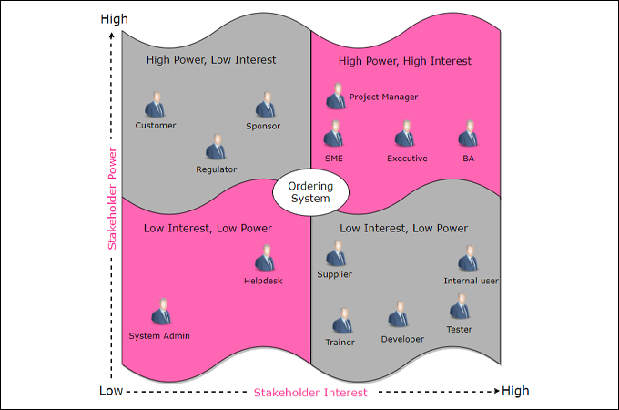
Lecture
Stakeholder Analysis Example
03
3 – 23

Slide 24
Lecture
Developing Stakeholders Management Approach
03
3 – 24

Slide 25

Lecture
Planning Stakeholders Management
03
Develop appropriate management strategies for effectively engaging stakeholders during different phases of the
objective/project.
Source: The PMI Guide to Business Analysis. Project Management Institute, Project Management Institute Inc., 2017
3 – 25

Slide 26
Lecture
10 principles for engaging stakeholders (1 / 2)
03
Communicate
Consult, early and often
Empathize with them
Plan how you will engage them
Relationships are key
3 – 26

Slide 27
Lecture
10 principles for engaging stakeholders (2 / 2)
03
Make it simple for them to understand
Consider it part of managing risks
Be willing to compromise
Understand what are your objectives clearly
Take Responsibility for engaging stakeholders
3 – 27

Slide 28
Lecture
Stakeholder Engagement Strategies
03
Promotional
Focus on Project Objectives (Asserting our preferences)
Defensive
Assertive
What is the right Strategic Posture with the stakeholder?
Neutral (passive)
Accommodate
Focus on Stakeholders
(Accommodating theirs)
Collaborate
Consult
3 – 28

Slide 29
Lecture
Stakeholder Engagement Strategies
03
Ask and Decide:
To what extent do you want to engage with each stakeholder?
Inform
Explain
Consult
Involve
Collaborate
Partner
3 – 29

Slide 30
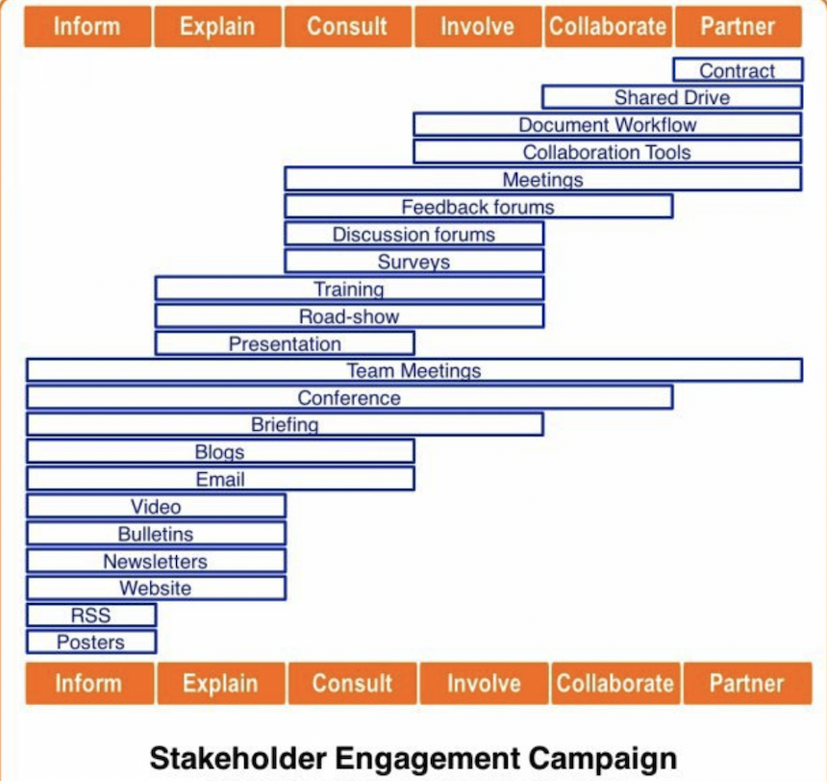
Lecture
Sample Stakeholders Engagement Channels
03
3 – 30

Slide 31
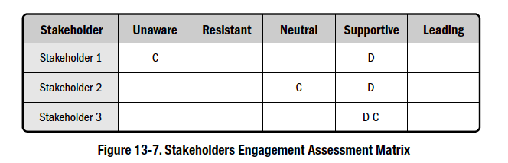
Lecture
Stakeholders Engagement Matrix
03
Defines current and desired engagement level for all stakeholders for successful project completion.
Engagement levels:
  Unaware
  Resistant
  Neutral
  Supportive
  Leading
C = Current engagement level D = Desired engagement level
Source: The PMI Guide to Business Analysis. Project Management Institute, Project Management Institute Inc., 2017
3 – 31

Slide 32
Lecture
Stakeholder Management Plan
03
“A plan that defines the strategies required to effectively engage stakeholders in decisions and execution based on the analysis of their needs, interests, and potential impact.”
Provides:
  Desired and Current engagement levels of key stakeholders
  Actions and activities to be performed to move the stakeholders from the current engagement levels to the desired engagement levels (as meetings, emails, workshops, campaigns, etc…)
3 – 32

Slide 33
Stakeholder Management Plan
(can be part of the Stakeholder Register)
Lecture
03
# | Stakeholder Name | Influence | Interest | Current Engagement | Desired Engagement | Actions
1 |  |  |  | Unaware | Supportive | Meeting, training, campaign, workshop,….
2 |  |  |  | Neutral | Leading
3 |  |  |  | Resisting | Neutral
4
5
6
7
3 – 33

Slide 34
Lecture
Monitoring Engagement
03
Take Corrective Action
Assess Engagement
Measure and Report Progress
Implement Engagement Plan
3 – 34

Slide 35




Lecture
Documents used for Assessment
03
Minutes of Stakeholder Meetings
Formal/Informal Review
Status Reports
Issues Log, comments, approvals, emails
Presentations/ Trainings and attendees
3 – 35

Slide 36
Lecture
Look for…
03
Level of attendance
meetings, training sessions, workshops
Level Absenteeism
for team members
Level of participation
in meetings and workshops
On time delivery
for inputs, feedback, tasks from stakeholders
3 – 36

Slide 37
Lecture
Stakeholder Engagement Matrix
03
The Engagement Matrix is a spreadsheet to track engagement and understanding of the project stakeholders.
Paints a picture of the level of commitment, involvement and understanding within the stakeholder group.
It allows us to target activities for individuals if they are not “where we want them to be”
Stakeholder | Objectives / Interests | Desired Engagement | Current Engagement | Differentaial | Action Steps | Responsible
John Doe (Client) | Provides money and resources. Wishes a professional project management. | 3 | 1 | -2
Roger Waters (Project Manager) | Provides his technical Know-How. | 2 | 4 | +2
Jane Brown (Resident) | Will boycott the project and stop if possible. | 4 | 4 | 0
3 – 37

Slide 38
Lecture
Key Points
03
Business Analyst contributes to all activities in stakeholder management
A Stakeholder is anyone who has an interest in, or may be affected by, the project
We develop a stakeholders management plan to engage stakeholders during different project phases
We analyze stakeholders based on level of power/influence and level of interest on the project
Stakeholders engagement is done through communication channels that help build buy-in and commitment.
Stakeholders could be internal/external, individuals, groups, or organizations
3 – 38

Slide 39

For Discussion Panel and Next Lecture:
Reading, Chapter 6. from textbook
“Business Analysis” by James Cadle, Malcolm Eva, Keith Hindle, Debra Paul, 2nd edition
Think of the following scenario:
  You are working on a project to open a new branch for a bank
  Who are the stakeholders?
  What is their level of influence and interest (stakeholder matrix)
  How will you engage them
Lecture
03
For Discussion Panel and Next Lecture
3 – 39

Slide 40



Thank You

