Slide 1


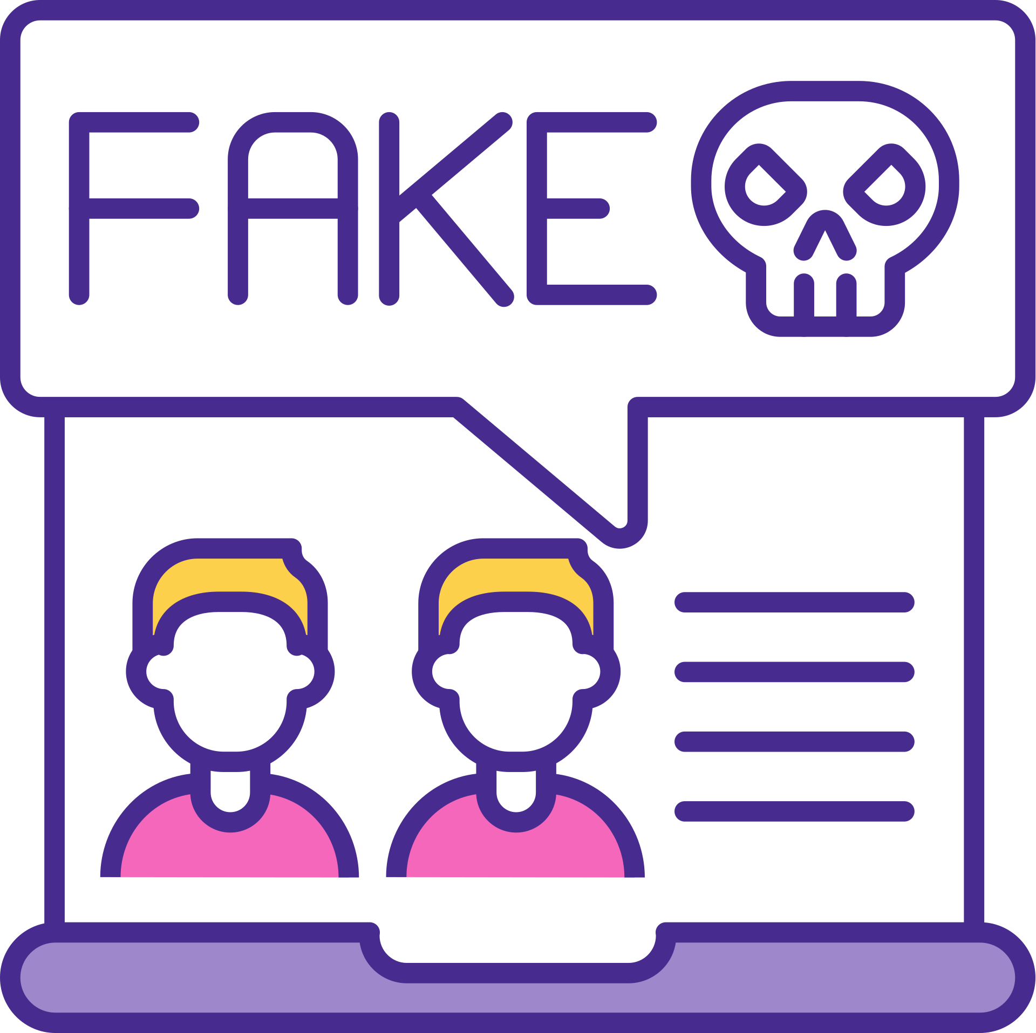

AI in Detecting inappropriate and misleading content on E-commerce Platforms
Presented by :
Zakia Alghamdi - Wiam Alharbi

Slide 2


Introduction
Why is the topic important?
What is the problem?
Why is it worth studying?

Slide 3

Problem Statement
  Growth of fake and misleading reviews
  Negative impact on customer trust
  Difficulty of detecting Arabic misleading content
  Limitations of manual moderation

Slide 4


Detect misleading Arabic reviews
Improve content moderation
Build an intelligent analysis tool
Objectives

Slide 5


Related Work
Focus on English reviews
Limited Arabic research
Identified research gap

Slide 6
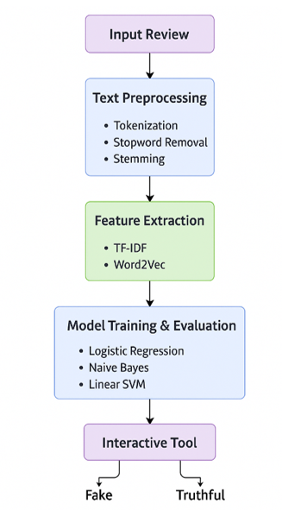
Proposed Approach

Slide 7


Models & Techniques
TF-IDF and Word2Vec
Logistic Regression
Naive Bayes
Linear SVM

Slide 8
Results
  High detection accuracy
  Naive Bayes achieved best performance
  Effective misleading review detection

Slide 9
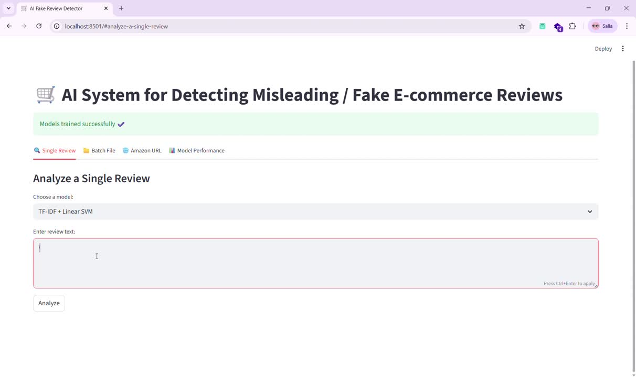

Slide 10
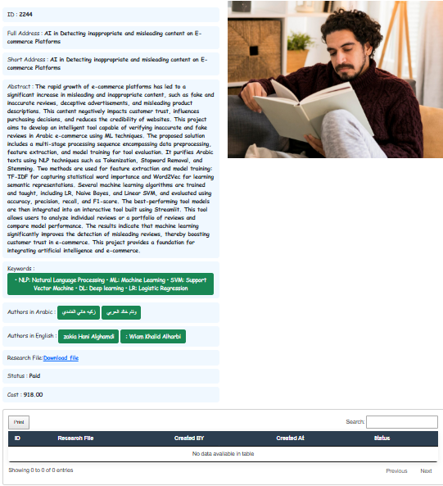
Publication

Slide 11


Conclusion
Successful detection of misleading reviews
Supports e-commerce trust
Practical AI-based solution

Slide 12

Future Work
Use deep learning models
Integrate with e-commerce platforms
Expand datasets and languages

Slide 13


Thank you

