Slide 1


Internet and Information Technology
ITC202
Lecture 9 - Microsoft office: Power Point
Prepared by
Dr. Eng. Youssef Ntefeh

Slide 2
Course Topics
History of computing.
Introduction to information technology.
System and application software
MS Word.
MS Excel.
MS PowerPoint.
Common web services and tools.

Slide 3
Purpose of Presentations
Support a verbal communication
  Includes graphics, images, sounds, animations that enhance the presenter's message

Slide 4
Creating a Presentation
Must define the message you want to communicate
  Is the purpose to inform, persuade, and/or prepare the audience?
Understand your audience and what your objective is for the presentation
  What’s in it for the audience?

Slide 5
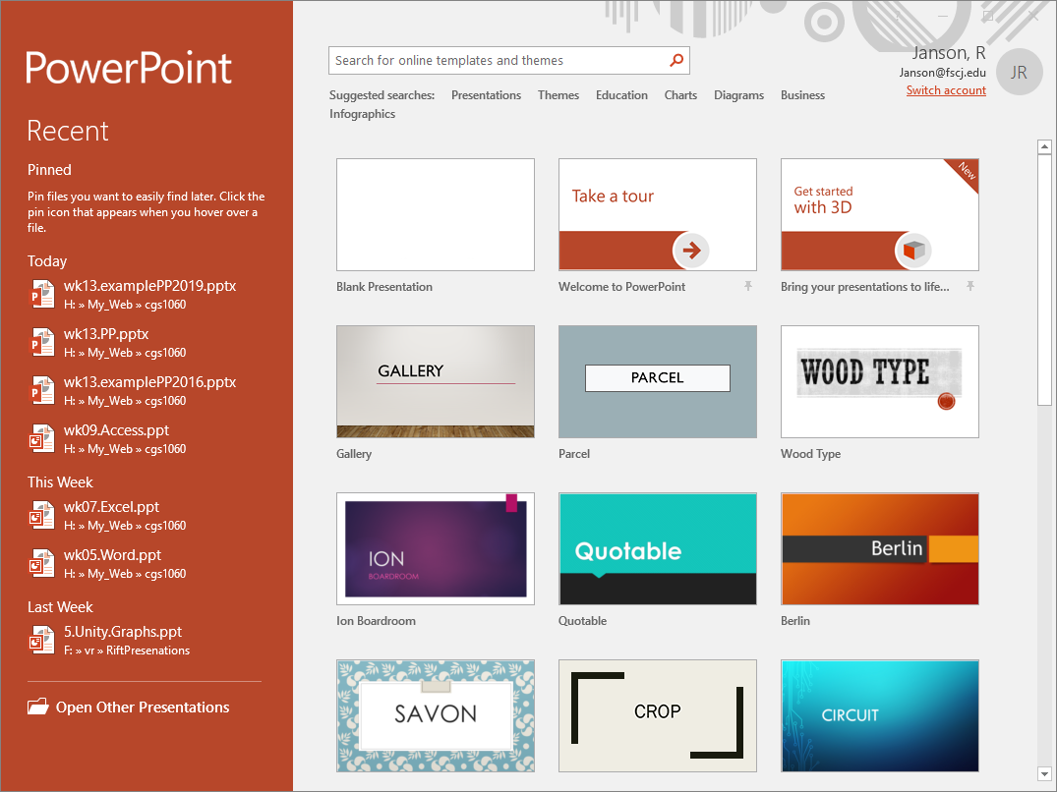
Blank is default
Start by selecting a category

Slide 6
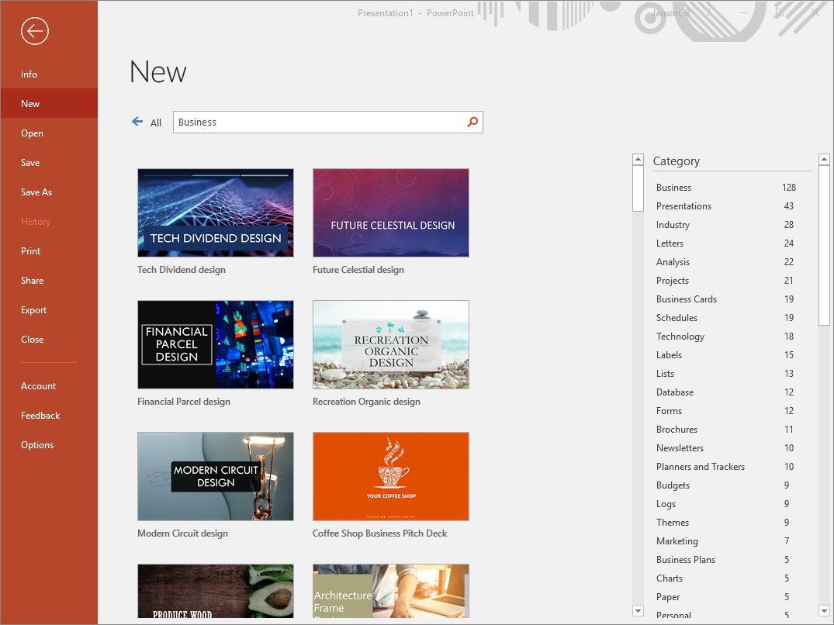
Then select a presentation or…

Slide 7
Creating a Presentation
Thumbnail of each slide shown on left
  Change to Outline view (View, Outline) to see full text of each slide
Move between slides by:
  PageUp/PageDown keys
  Click on slide in outline
  Use scroll bar on right

Slide 8
Deleting Slides
Select it in left pane
  Press Delete key
Right click in left pane
  From short cut menu, select Delete Slide

Slide 9
Printing
Just like all other apps but more control over what is printed
  Slides or Notes or Handouts
Handouts lets you print many thumbnail views to a page
Can print in “grayscale” (i.e. shades of black and white)
  Saves on colored ink

Slide 10
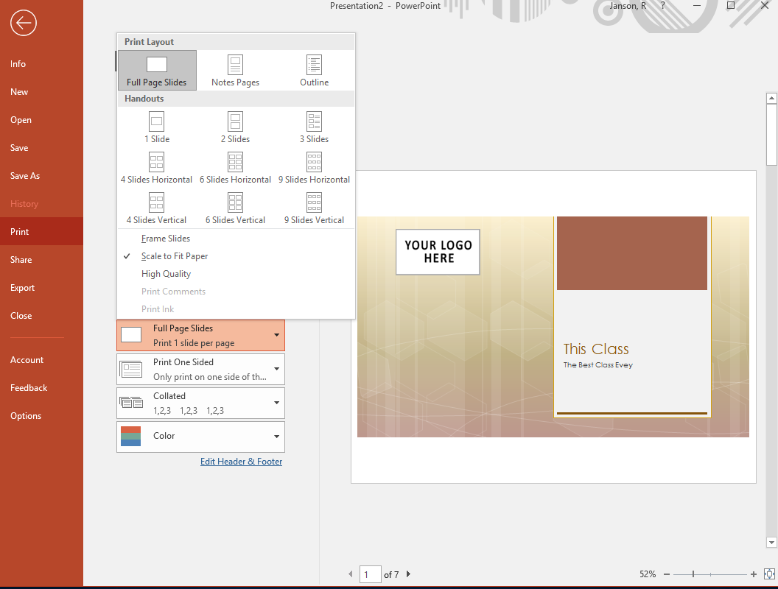
Default is one slide per page – that’s a lot of paper!

Slide 11
Handouts is better for printing

Slide 12
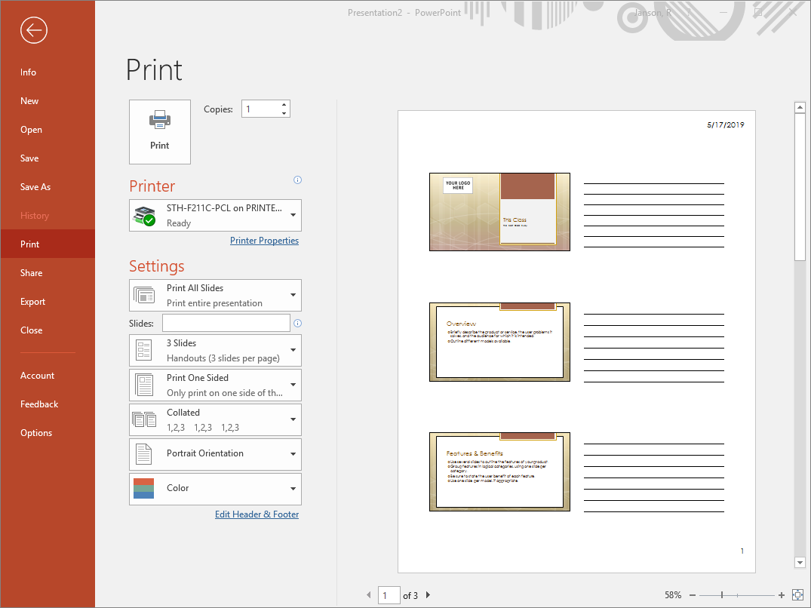

Slide 13
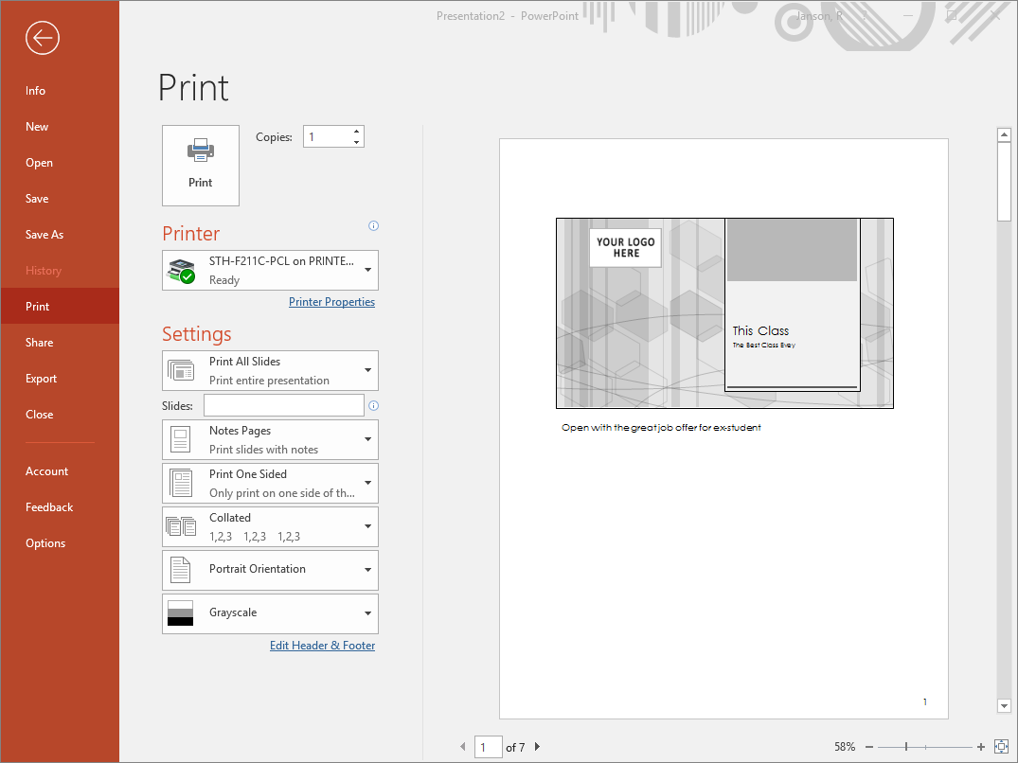

Slide 14
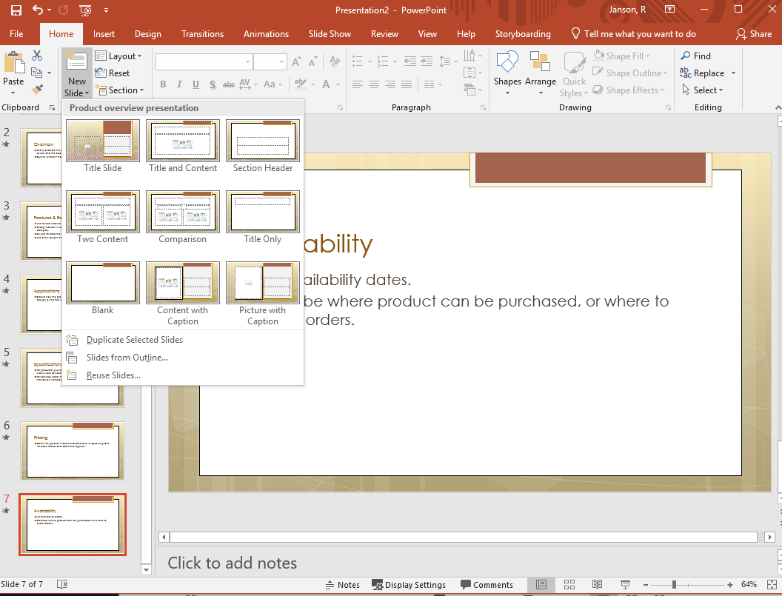
To add a slide: move to slide to add after
On Home ribbon, display new slide menu, pick Layout type or Duplicate selected slide

Slide 15
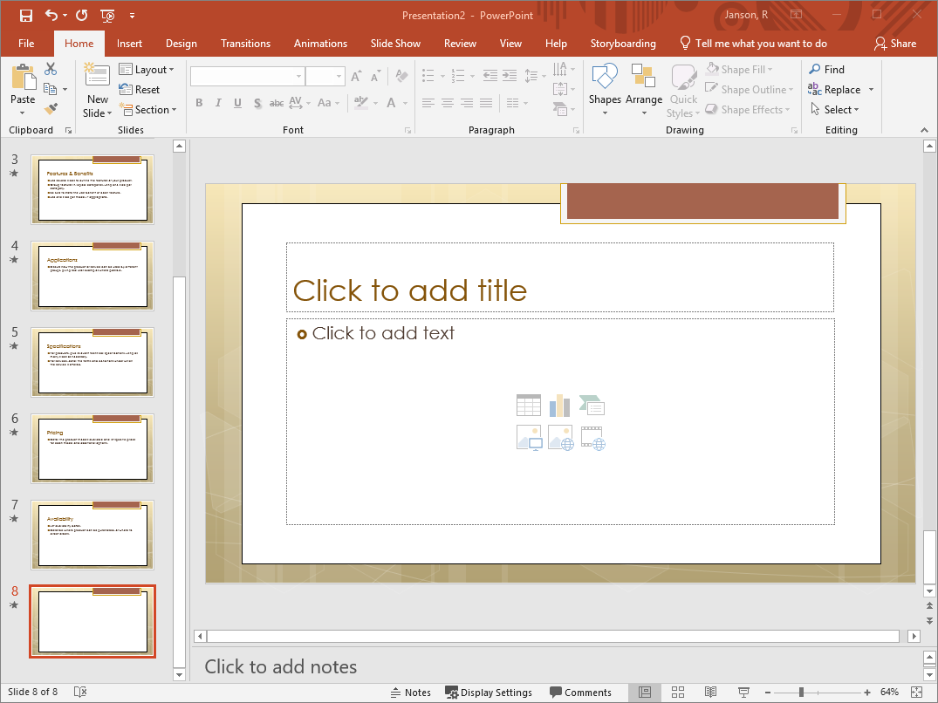
New slides contain “Placeholders”
Placeholders hold the slide’s content and come with text that doesn’t show up in the left pane

Slide 16
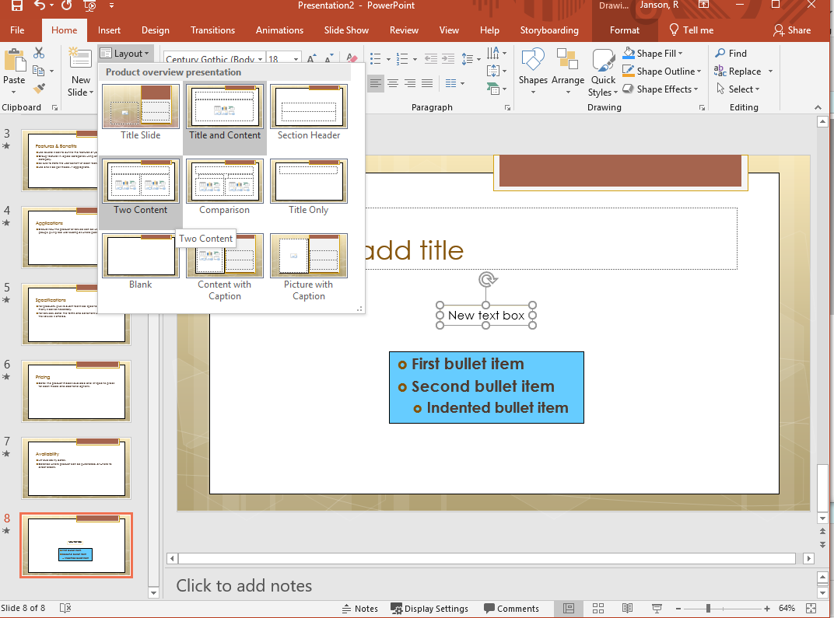
You can change the layout of the slide

Slide 17
Themes
Different from a Template
Just defines fonts and colors
  No content suggestions
Can be used as the basis of a new presentation or applied to an existing one

Slide 18
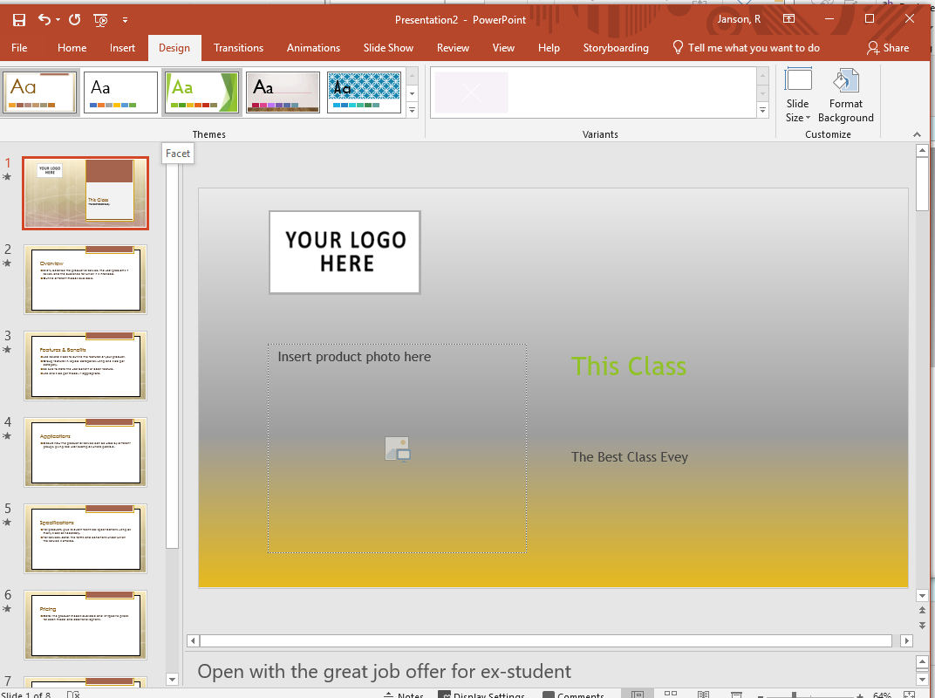
Click Design tab and then choose a Theme

Slide 19
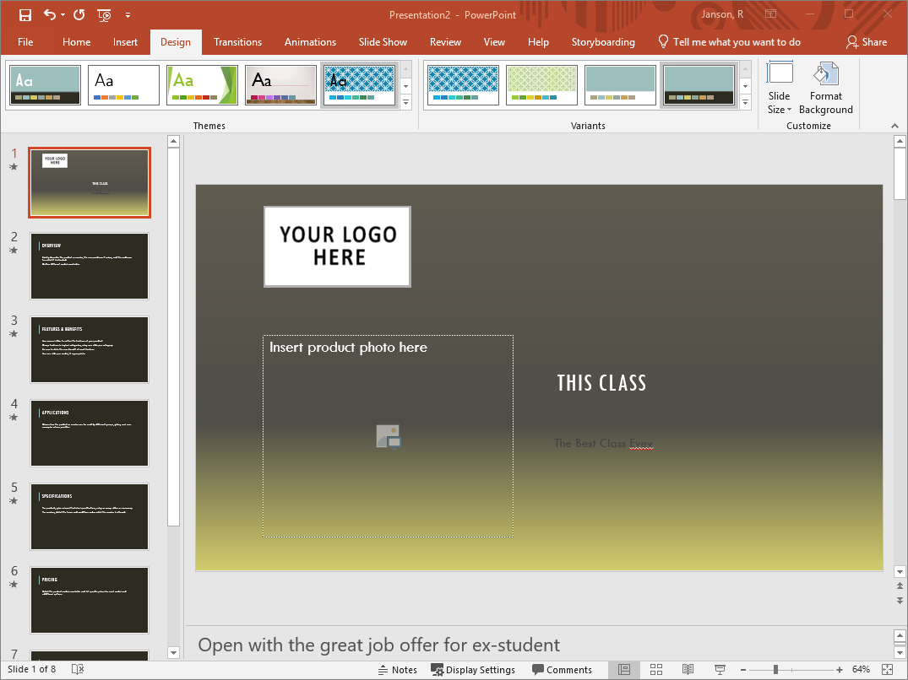
There are even variants on a theme

Slide 20
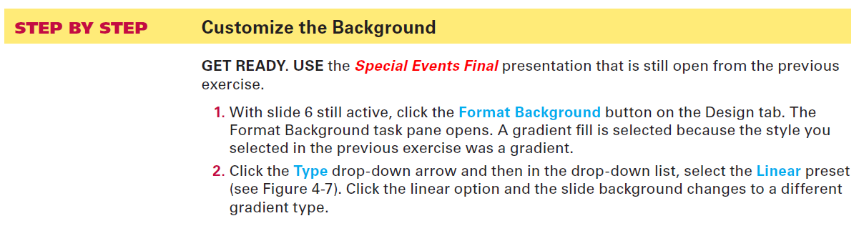
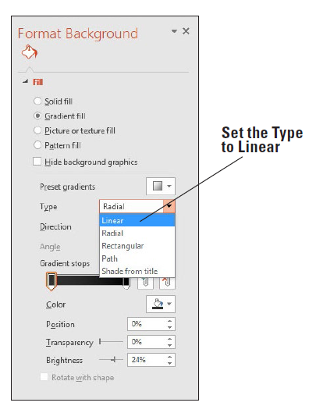
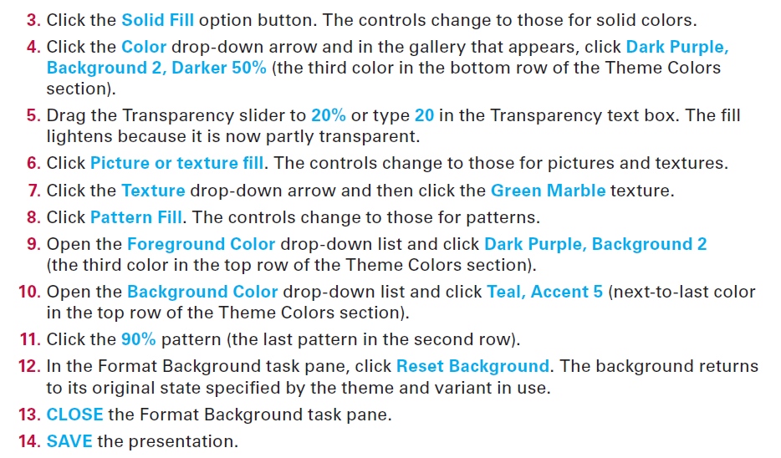

Slide 21
Transitions and Text Animation
Control
  How slides are shown
  How text is displayed
Click Transitions, then select one in Transition to This Slide
To control text
  Click Animations
  Select text
  Choose one

Slide 22
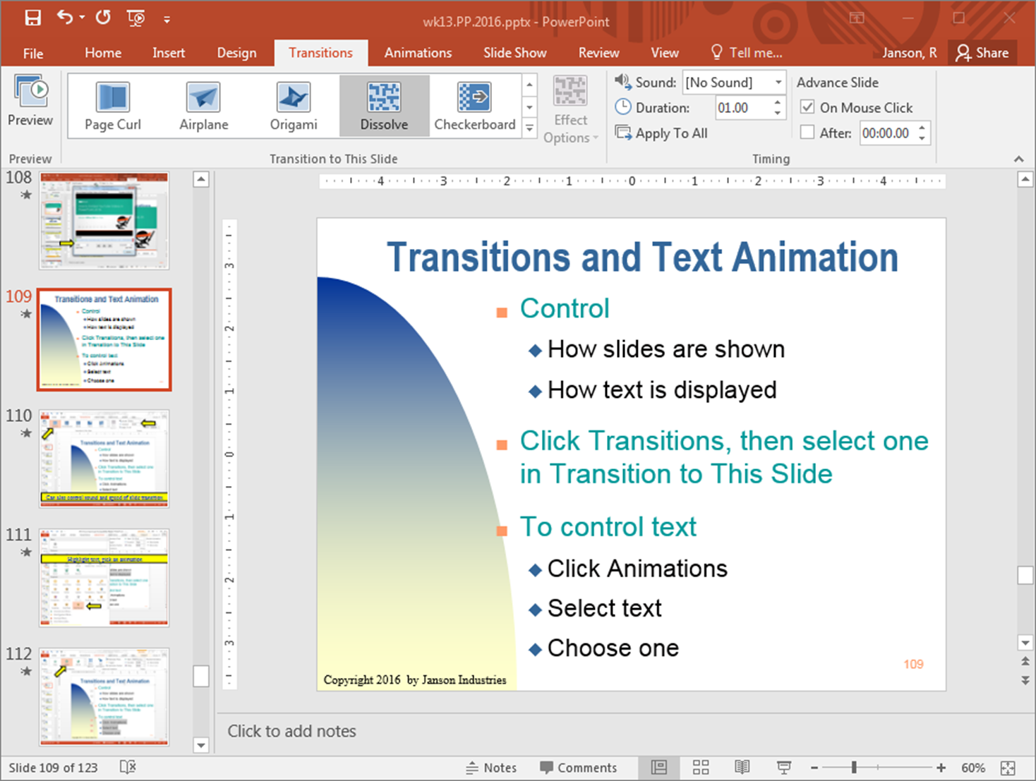
Can also control sound and speed of slide transition

Slide 23
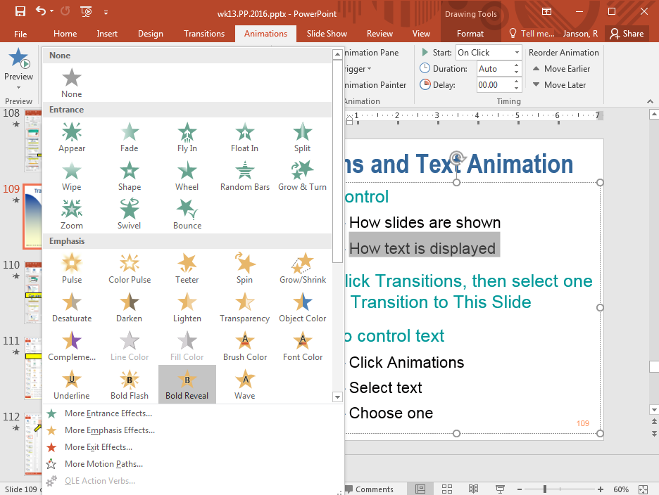
Highlight text, click Animations tab, pick an animation

Slide 24
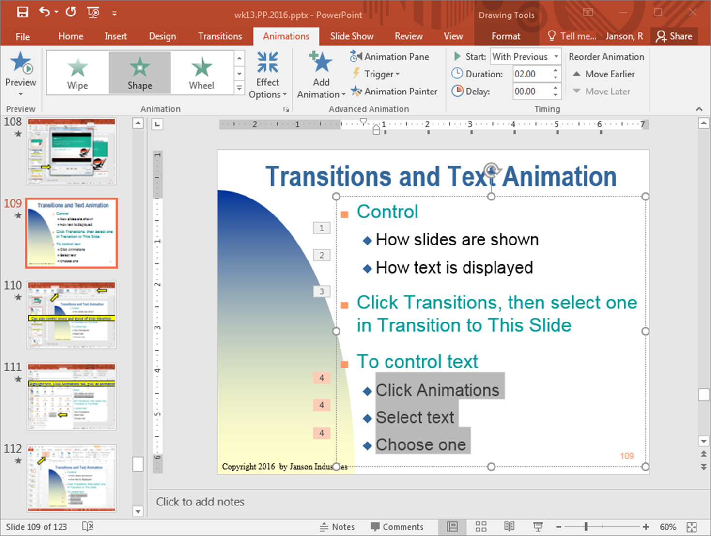

Slide 25
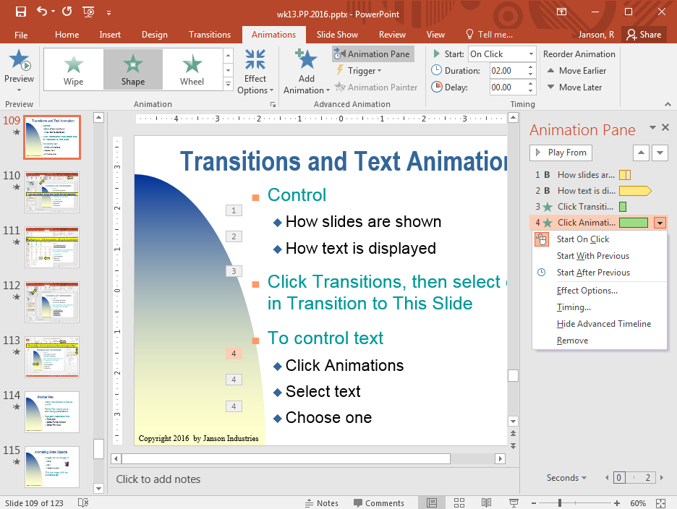
To modify, click an animation then Animation Pane

Slide 26
Rules of Effects/Animations
Use sparingly:
  too many are distracting
Should add to the content/ message of the presentation
Can be used to spice up a dull or long presentation

Slide 27


Graphics
Use when better than words
Or to make presentation more interesting
Too many graphics can be distracting

Slide 28
Graphics
Just like Word & Excel you can insert and manipulate images:
  Pictures
  Clip Art
  Smart Art
  Shapes
  Symbols
With PP you are more likely to insert Smart Art
  Org charts
  Diagrams

Slide 29
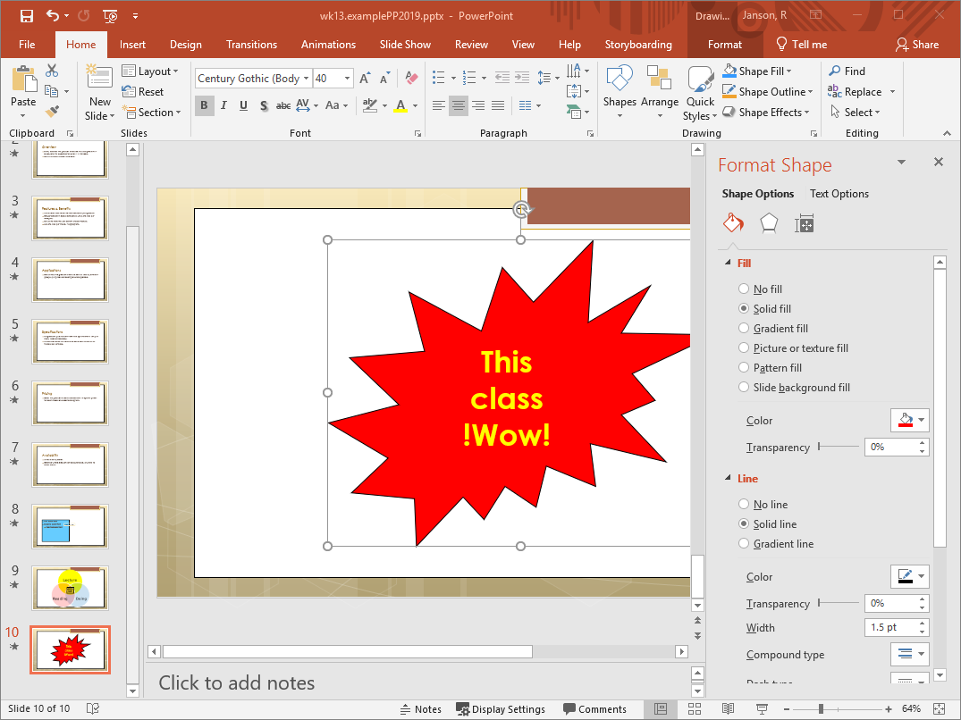
Lots of other shapes available

Slide 30
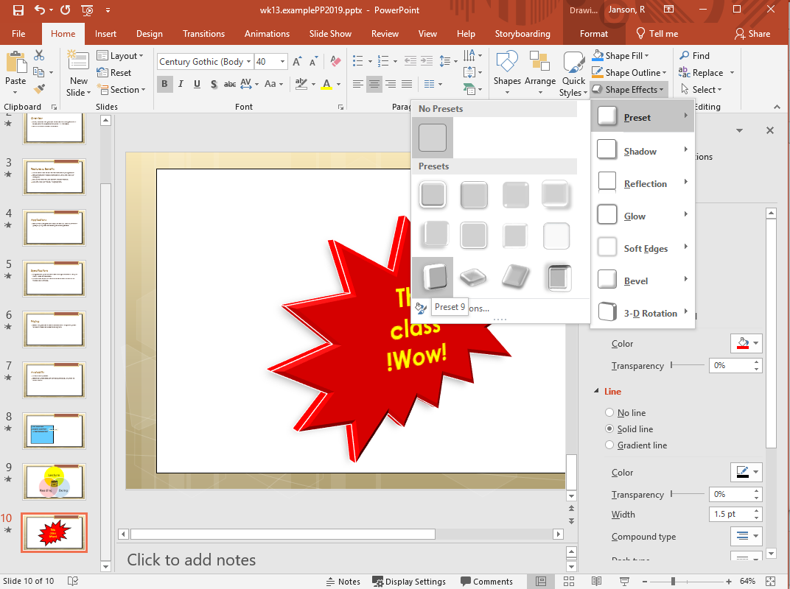
And shape effects

Slide 31
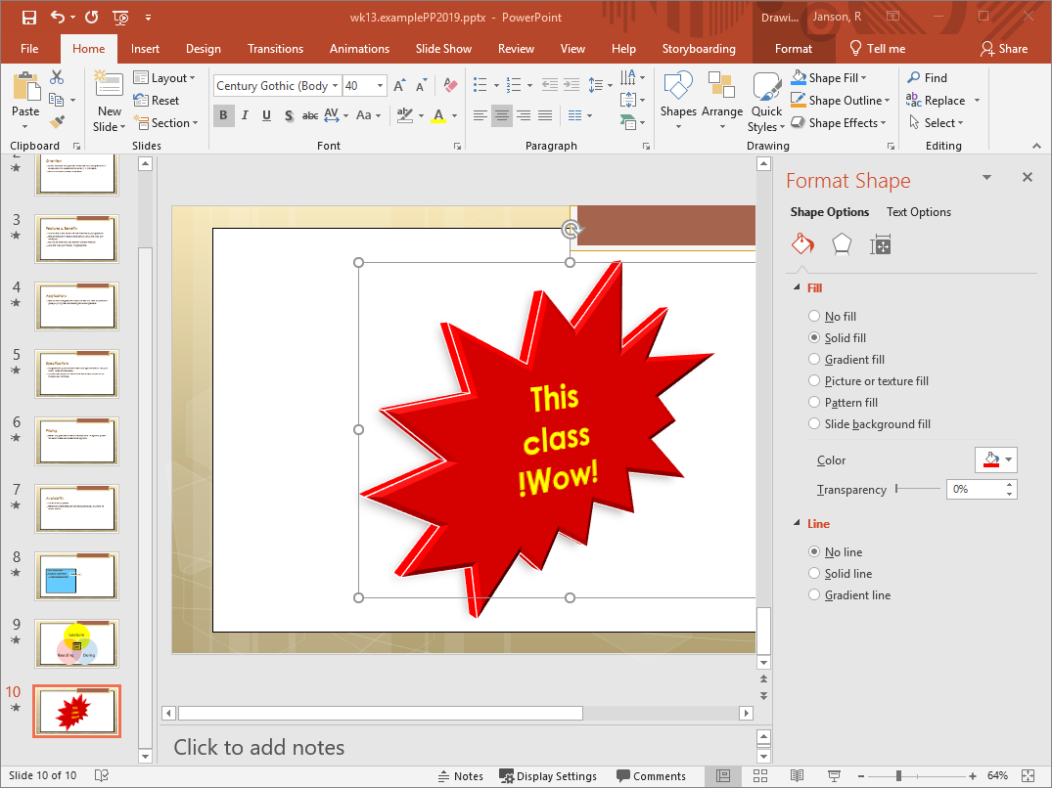

Slide 32
Working With Shapes
To get a shape, may merge or overlay other shapes
When overlaying, can move objects
  Forward or back
  To the front or back
    Do this by right clicking and specifying front/back options
For example, want to create a donut shape

Slide 33
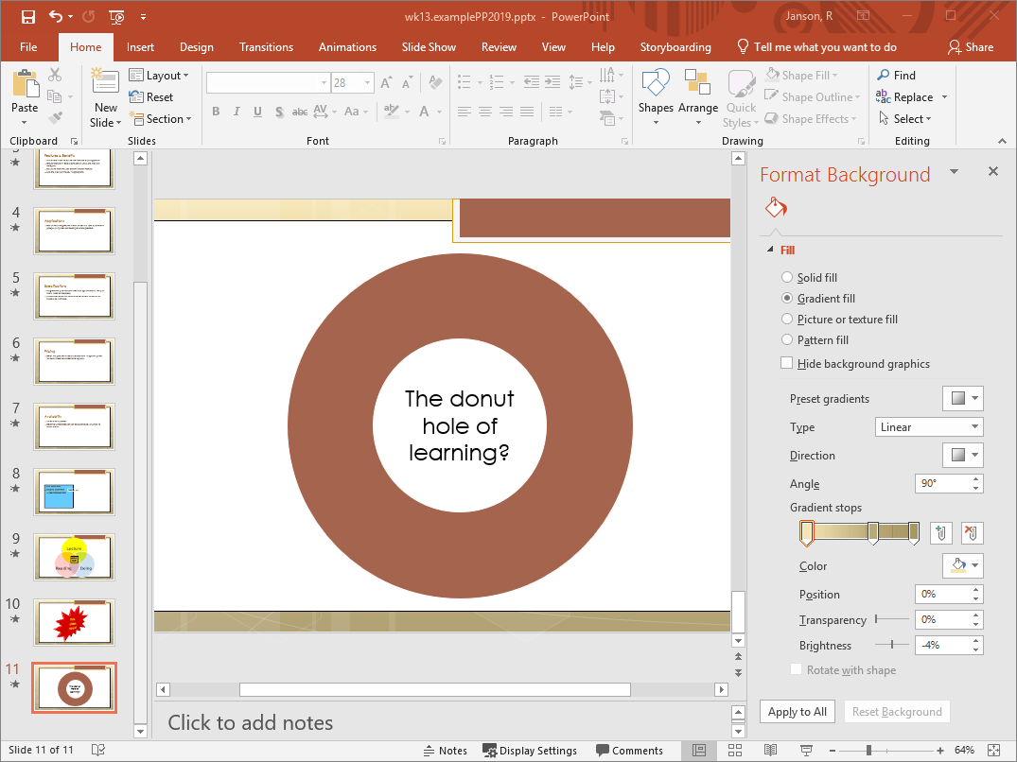
Inserted a circle with brown fill, then a smaller circle with white fill, then text box. Each added shape lays on top of the previous shapes

Slide 34
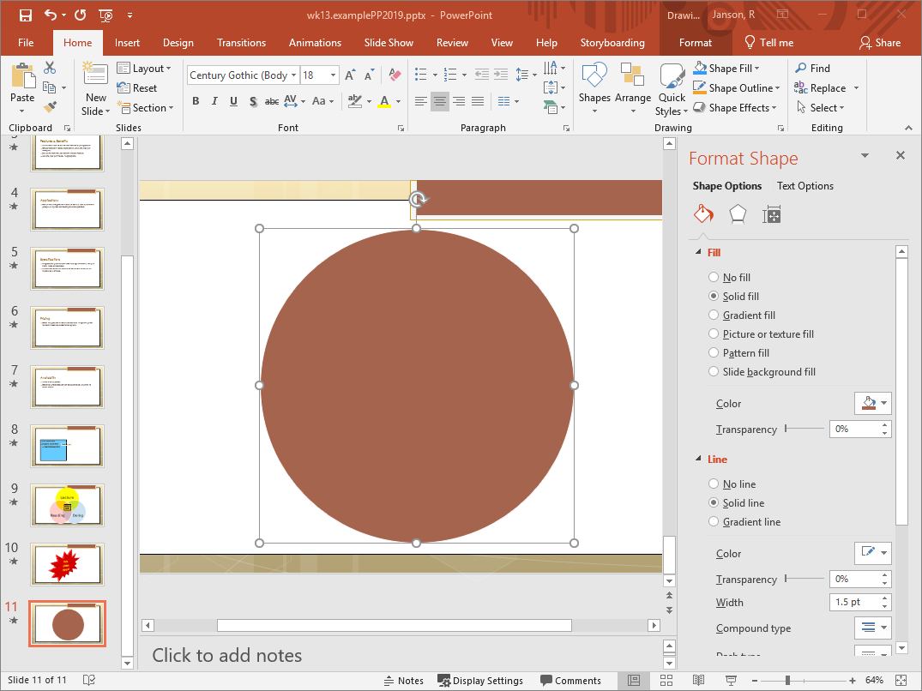
If circle brought to front all others hidden

Slide 35
Formatting Text
Can be changed just like other apps
  Select the text
  Use Home ribbon to specify
  Or use the appropriate dialog box

Slide 36
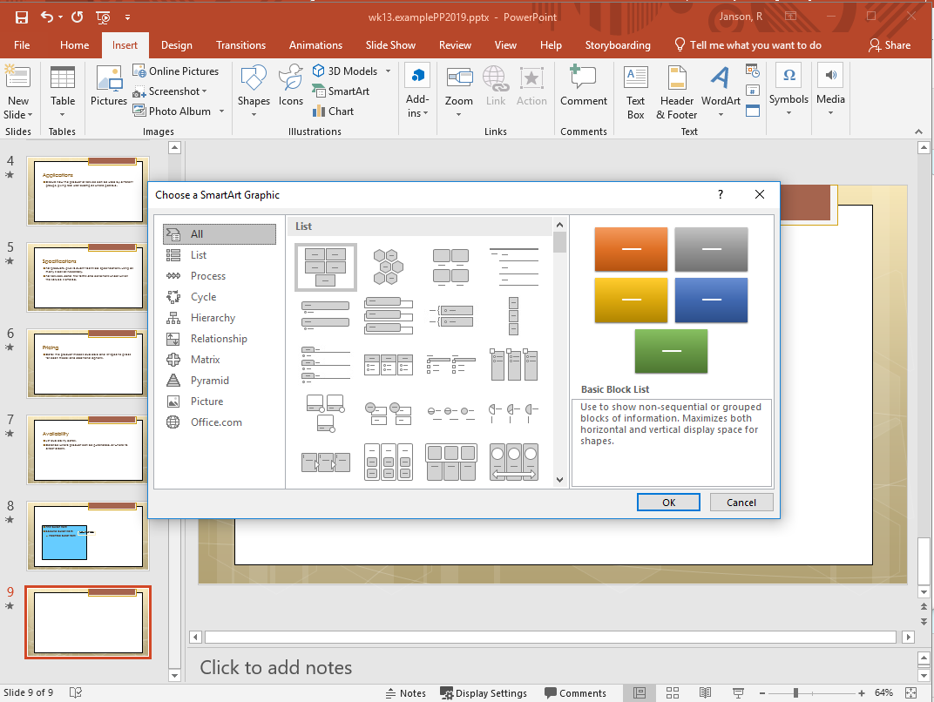
Click Insert tab and then Smart Art

Slide 37
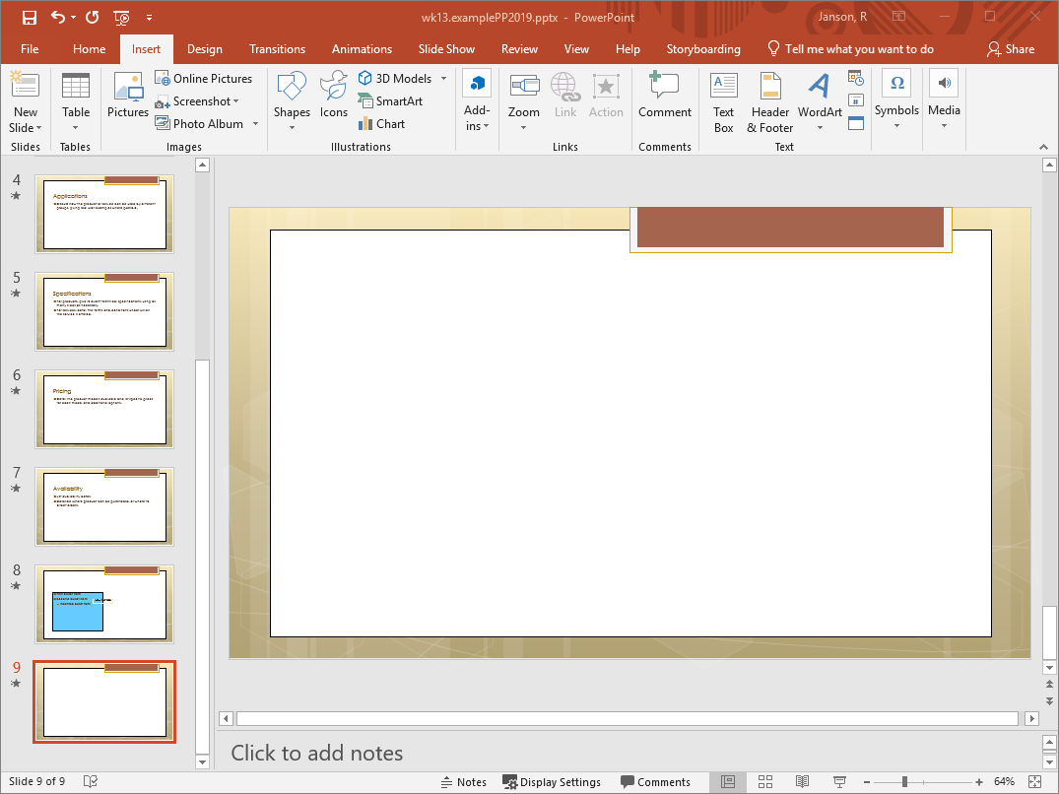
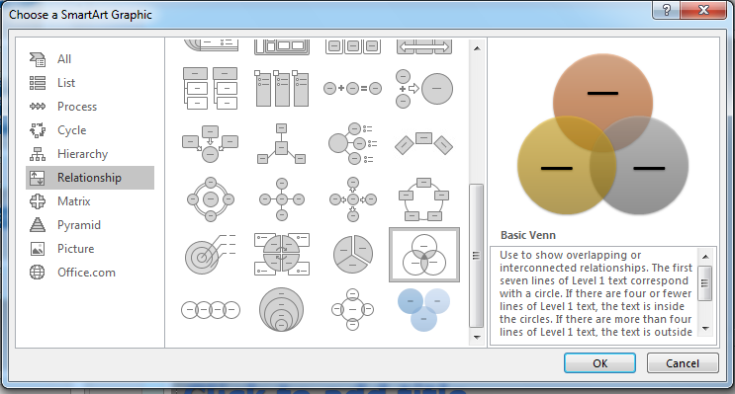
Choose a category or scroll through all and pick a graphic, then click OK

Slide 38
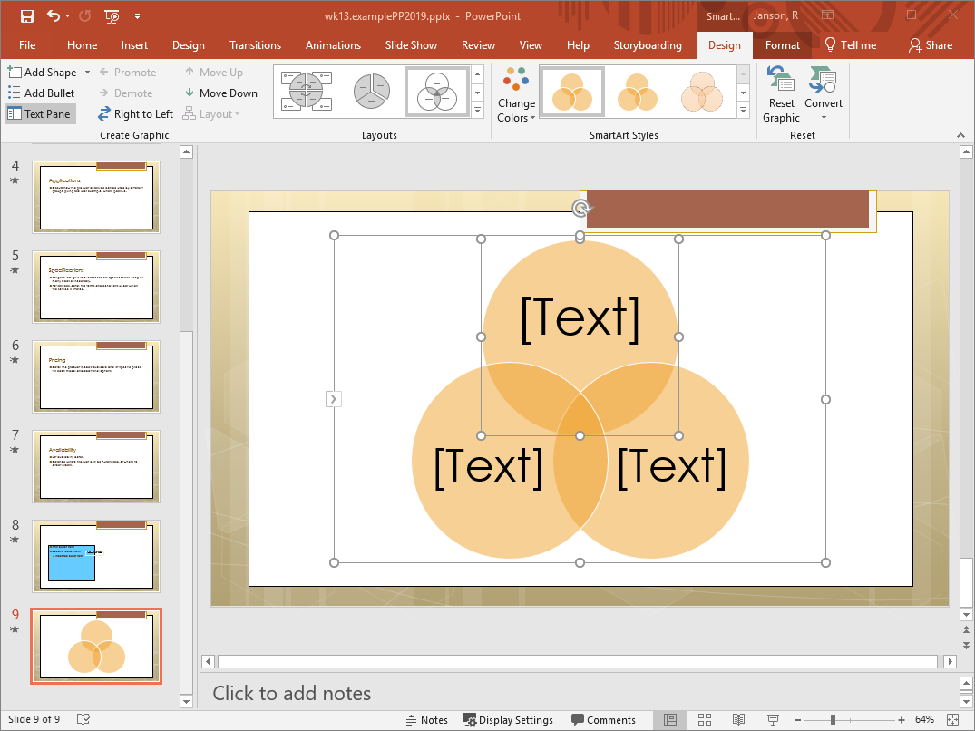
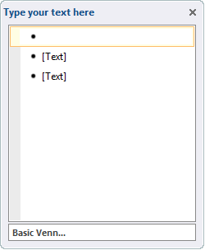
This diagram has 3 circles each with a text box
Circles can be manipulated by right clicking and selecting Format Shape
Can make the entire diagram bigger, change colors, insert text (but not move the text)

Slide 39

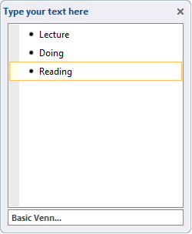
Enter text in window and PP will size to fit
Also change text by double clicking and typing

Slide 40
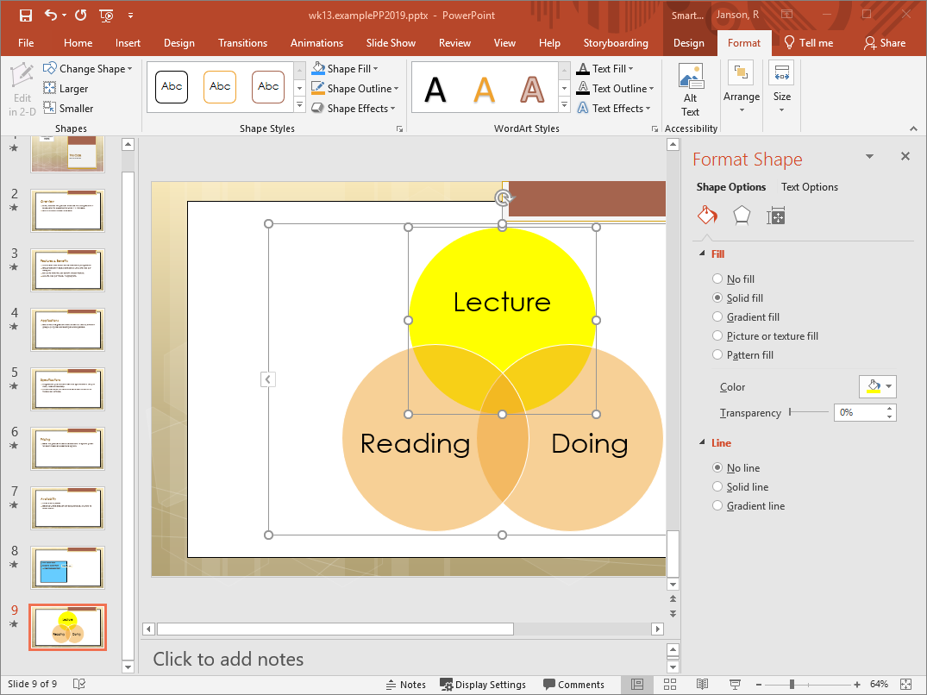
A variety of formatting options

Slide 41
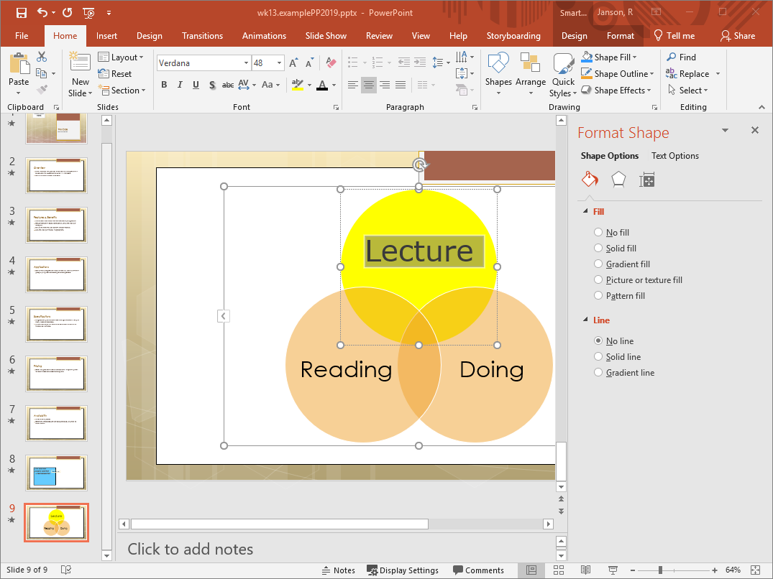
Can also make changes via the Home ribbon

Slide 42
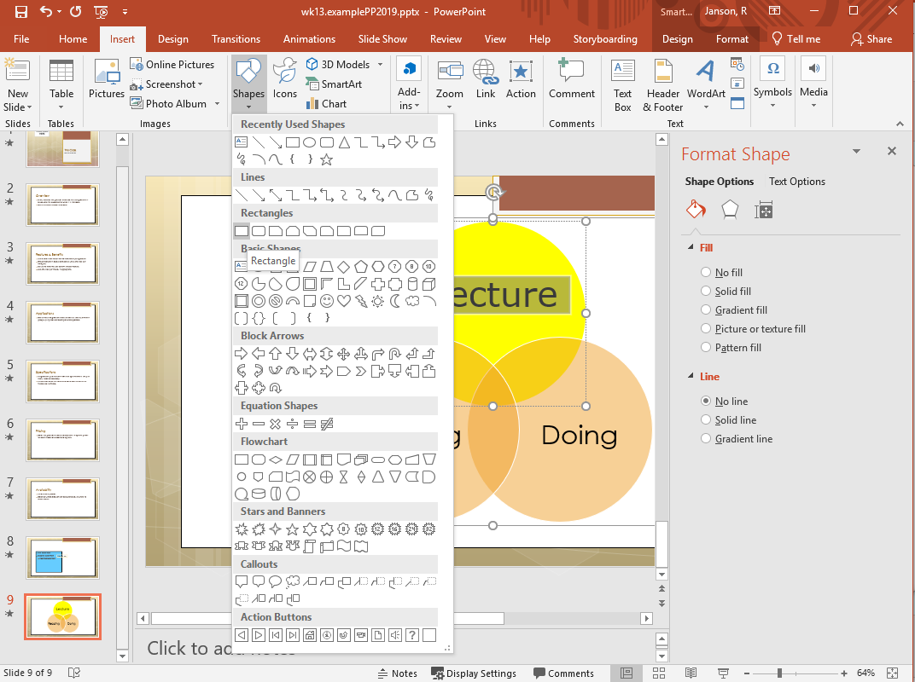
Can add shapes

Slide 43
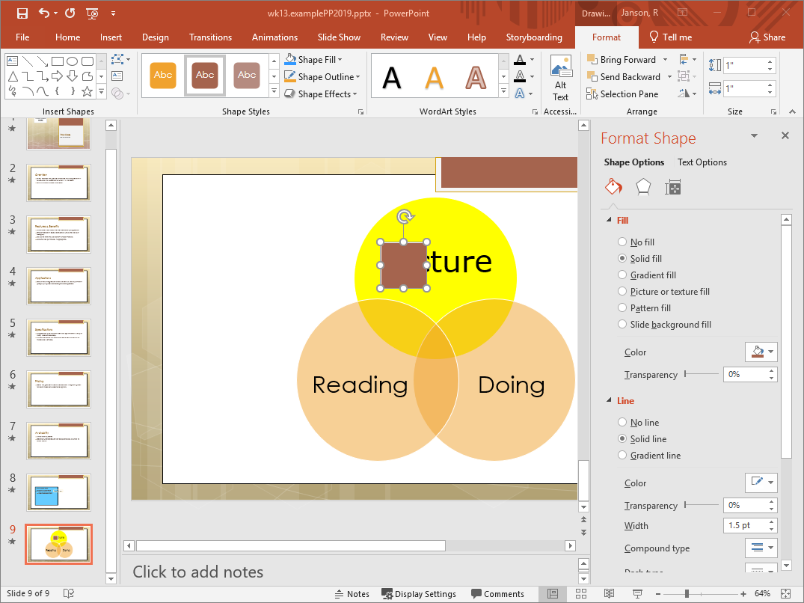

Slide 44
Manipulating Shapes
Resize just like images
Rotate with “white arrow circle handle” at top of selected shape
Change color
Can insert text, but limited control over where in appears
  Often best to add a textbox

Slide 45
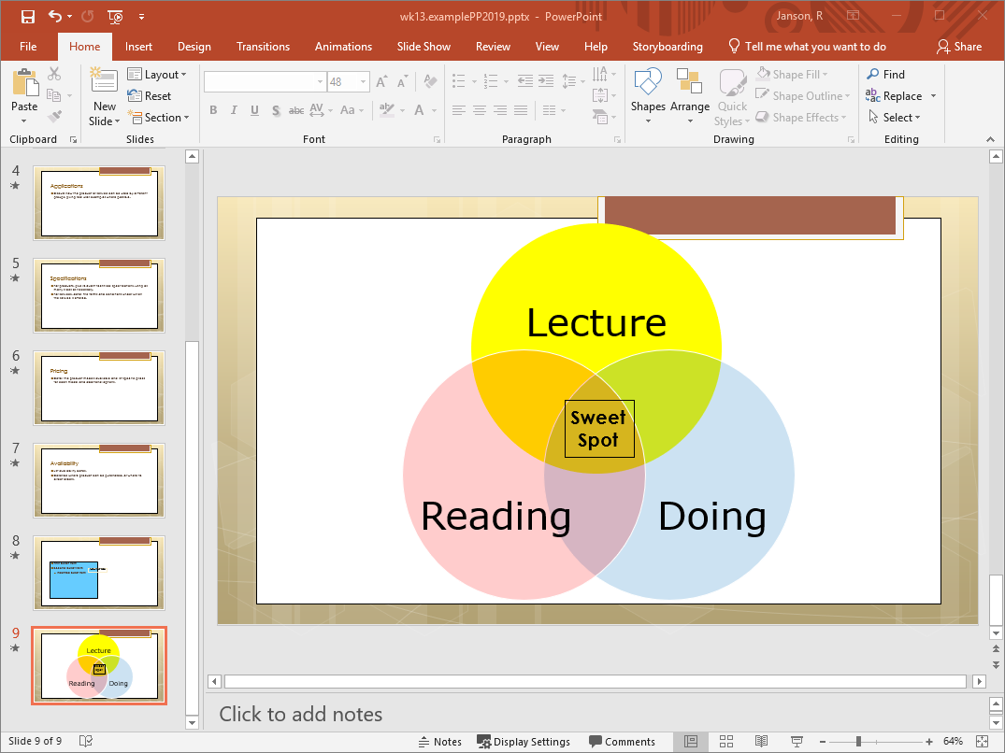
Does the graphic support the message?
Did the shape add to the message?

Slide 46
عندما تخسر الشركة رأس المال الاجنبي
عند فشل الخطة التسويقية
عند فشل الإدارة المالية
Plan A
Plan B
Plan C

Slide 47
Plan D
Plan D
Plan C
Plan D
عندما تم زيادة رأس المال
عندما تفلس الشركة
عند خسارة رأس المال
عند فشل الحملة التسويقية
عند مواجهة منافسة قوية

Slide 48

كتابي الأول

Slide 49
2
1

Slide 50
4
3

Slide 51


Slide 53
العنصر 1
العنصر 2
العنصر 3
العنصر 4

Slide 55
hello

Slide 56
فكرة 1
فكرة 3
فكرة 2

Slide 57

Reference

