Slide 1

Project Management Technologies
Prepared by Lecturer Waseem Tabbaa
Chapter 8
PMG 312
S3 - Developing project scope
Ch. 8 - Activity estimating

Slide 2

Chapter
08
Introduction
Chapter 8 Activity estimating.............................................. 117
Introduction ..............................................................................117
What to estimate? .....................................................................118
Dealing with the estimating vernacular......................................118
Cost estimating............................................................................119
Material cost...............................................................................119
Miscellaneous costs.....................................................................119
Total project estimate................................................................ 120
An estimate for digging a hole.................................................... 120
Definitional process.................................................................... 122
High-level estimates .................................................................. 122
Estimate creation........................................................................ 124
Expert judgment estimating........................................................ 125
Analogous estimating ................................................................. 126
Heuristic estimating ................................................................... 126
Delphi technique estimating ...................................................... 127
Parametric estimating ................................................................. 128
Phased estimating......................................................................... 129
Effort distribution estimating (top-down).................................... 131
Bottom-up estimating................................................................... 133
Estimating components................................................................. 134
Human resource component......................................................... 135
Work unit direct cost component.................................................. 136
Miscellaneous direct expenses....................................................... 136
Reserve accounts ........................................................................... 136
Overhead ....................................................................................... 137
Profit................................................................................................ 137
Total project estimate..................................................................... 137
Estimating checklist ......................................................................... 138
Summary.......................................................................................... 138
References ....................................................................................... 140

Slide 3
Chapter
08
Introduction
One of the common questions a PM often gets is “how much do you think this project will cost and how long will it take?”. There are many factors that come into play regarding time and cost estimation.
This chapter will explore some of the typical procedural approaches for creating a project time and cost estimate, but be aware that estimating is an art form as much as a mechanical process or scientific formula.
Every industry has its unique methods of producing their project estimates. It is also important to point out that the large majority of projects do not meet their original estimates, so this suggests that the processes utilized have shortcomings. In reality, most estimates are overrun (Verzuh 2005, 168). Some of this is caused by a poor process to start with and some is related to subsequent ineffective management of the project which in effect causes the overrun. As project management methods have matured over time, estimates are now matched more closely to the actual outcome, yet significant variances still remain.
The process of estimating the accurate project outcome is complex for many reasons. The most obvious of these involves translating a vaguely defined goal requirement into an equivalent work time. Tightly embedded into that view is the variability of human productivity for the defined tasks.
Finally, wrap all of this around the organizational process complexities and we have at least a high-level global perspective. To understand the role of estimating in the project life cycle, envision how an accurate estimate can improve the overall stability of the work process. If this can be accomplished, the project can move along in a reasonable fashion since events can be efficiently prescheduled. Conversely, a poor estimate places the project team under stress in dealing with unplanned resource variance issues, accelerating work activities, and placating unhappy customers. Since one of the management goals for a project is to complete the defined effort on time and budget, an accurate estimate represents one of the core elements to support that goal.

Slide 4
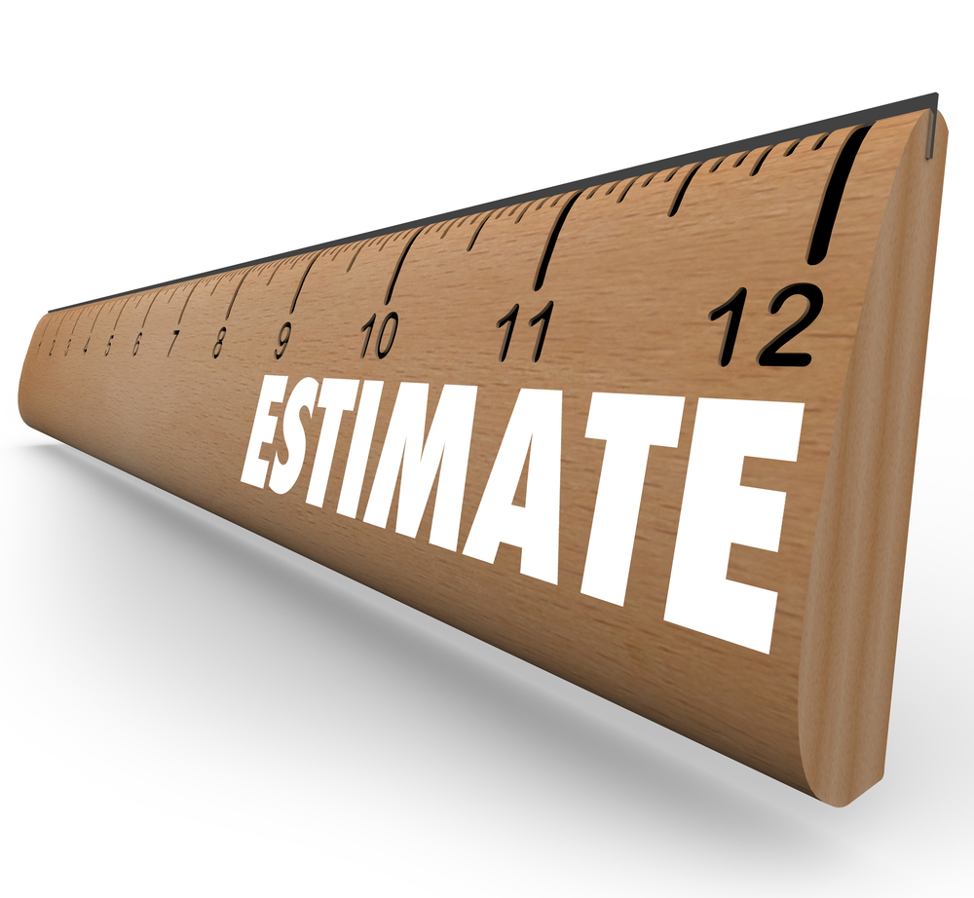
Chapter
08
What to estimate?
Although this question seems trite, think about what the term estimate suggests. we will focus on this term only from the perspective of a project time or cost estimate.
Even within this limited view, the specific perspective of the term varies based on one’s perspective.
To further explain this we need to look at the various forecasting and terms associated with this vocabulary term.

Slide 5
Chapter
08
Dealing with the estimating vernacular
Let us use the following scenario to help explain this point. Imagine a senior manager saying “how long do you estimate this project?” It is assumed in this case that he is talking about a calendar view of the effort. Alternatively, if a technician was asked to estimate the time to accomplish some defined task that he might respond with 7 days or 50 hours. What does this response mean? If a team leader was asked the same question, it may have a similar answer but embedded in each of these responses is a different view of the question.
Let us see if these differences can be explained by reviewing what each organizational level views as a time estimate. The following perspectives are typical:
  Senior manager—calendar date
  Performing worker—how many work days for him personally to complete the work
  Team leader—how many work days for his group to complete under some assumption of resource availability
Placing this scenario into a more vocabulary-oriented structure, we are talking about combinations of the following three variables:
  Elapsed time—calendar cycle time
  Work—amount of total work required
  Duration—number of work days based on resources allocated
Note for each response above, the view is different, yet each could be perfectly accurate. Confusion over these terms is quite common and something worth to be aware of in conversations.

Slide 6

Chapter
08
Cost estimating
Creation of a project cost estimate contains multiple components and layers. The basic direct work unit estimating cost drivers are primarily linked to the associated labor work component, associated materials, and other miscellaneous costs allocated to that work unit.
Cost estimates within the work unit are essentially the defined labor rate times the quantity of that resource for the duration of the work.
So, if the estimate were to be 5 days and we allocate two resources to the task, the total labor resource work effort is 80 hours assuming that the assigned resources work 8 hours each day.
If the assumption is an average labor rate of $20 per hour, then the calculated direct cost for that work unit would be 80 × $20 or $1600.
Note the number of times the term “assume” is used in this description.
Any error in these assumptions would obviously affect the accuracy of the estimate. Nevertheless, this set of variables represents the basic mechanics for work unit direct cost estimating. The more accurate the assumptions, the more accurate the result will be.

Slide 7
Chapter
08
Material cost
Even though the project estimating process is often thought of as a human labor idea, there are other cost components to deal with.
For instance, for some project types material cost is more significant than labor. In that situation, recognition of material requirements in the work unit must be accounted for in an estimate.
Recognize that many organizations have a specialized functional group which handles material procurement and storage in support of project needs. This means that raw material for a project may be combined with other project’s material and in fact may be purchased for multiple projects over time.
For this basic reason, timing and pricing of project material is more complex than it appears on the surface if one is concerned about timing of the expenditure.
It is beyond our scope to delve deeply into these mechanics and in fact they vary across industries and companies. Regardless, we do need to recognize that this element is additive to the work unit cost.
Also recognize that the billed material cost may be greater than the net cost of the purchased item because of additional allocated costs attached based on various handling expenses. So, a $100 part might be billed to the project as a $200 item.
In any case, this discussion assumes that an item’s cost value is available from the procurement function and that will simply be included as a factor in the work unit cost estimate.

Slide 8

Chapter
08
Miscellaneous costs
A cost component deals with other miscellaneous costs. In most cases, this will be the minority component, but its impact on the budget and other aspects needs to be understood.
Examples of this category are office supplies, business lunches, project shared items (copy machine leases), and the likes.
This resource class estimate may simply be added to the total project cost, but the more ideal scenario is to recognize all expenses at the root source.
Allocating such expenses at the top level essentially hides the impact from analysis. The goal for all cost estimates should be to link the work unit in which the resource is utilized.

Slide 9
Chapter
08
Total project estimate
As each of the individual resource and other cost items are estimated in their respective work units, a total direct project estimate is derived.
The goal for this activity is to generate accurate estimates for each work unit’s labor, material, and expense dollar costs.
However, we also need to recognize that other less direct organizational level variables will be added to these direct cost values.
For example, various types of overhead charges would be added to the project, and buffer, values related to estimated time overruns are often added to the base time and cost values.
Finally, if the project is being produced for an external buyer, an additional profit value would be added. So, envision the total project estimate as MLOP—material, labor, overhead, and profit.

Slide 10
Chapter
08
Definitional process
We first started off by defining the level of work. From this came a calculation of duration based on allocated resources.
Finally, based on various factors, resource allocation most notably, a calendar or elapsed time could be estimated. All of these issues are symptomatic of the estimating role.
The estimating process should be accomplished at the work unit level and from this collection an overall schedule is derived. However, in many cases, the project's desired completion date is defined first and the project is supposed to find a way to fit the work into that time frame.
This upside-down approach to estimating is all too often the scenario dealt with by the Project Manager. The model planning process defines that cost and schedule be derived from scope-related work units and defined resource allocations.
From these steps, an overall time and cost schedule can be defined. Take special note of the sequence that eventually produces the final plan.
Please you have to read about
“High-level estimates” Page (122-124).

Slide 11
Chapter
08
Estimate creation
As defined earlier, the correct starting point for the estimating process is a reasonable understanding of the project goal and related work requirements.
The model approach to this process is through a WBS with a hierarchy of defined Work and Planning Packages of reasonable size. This decomposition process defined the existence of work units with a definition of that work. From this specification, we need to produce a direct time and cost estimate to accomplish that requirement. There are many techniques and factors involved in producing such estimates.
Creating work and duration estimates is not only a science but also an art. It is a science because the estimator often utilizes historical data, mathematical formulas, and statistics to determine the effort required for a work unit.
However, it involves art because each situation is somewhat different and the ability to customize the value requires skill that is obtained through study, observation, and experience with projects (Baca 2007, 135).
We will describe different project estimating techniques that can be used to develop various project time- and cost-related forecast values.
Essentially in every project estimating situation, the process is designed to determine the level of human resource required and then evolve from that to compute the resulting work, schedule, and cost for the activity or overall project. In this process, the lower-level work unit estimates then become basic building blocks to create the project schedule and budget.

Slide 12
Chapter
08
Estimate creation
The specific estimating techniques reviewed here include:
  Expert judgment
  Analogous
  Heuristic
  Delphi
  Parametric
  Phased
  Effort distribution (top-down)
  Bottom-up
None of these techniques is optimal to use for every case, and in most situations, multiple approaches will be used to confirm a specific derived value. Each method has a role and capability depending on specific needs and project phases. The proper choice deals with the knowledge available, the stage of the project, and the accuracy required.

Slide 13
Chapter
08
Estimating techniques
Expert judgment
Delphi
Analogous
Heuristic
Parametric
High Accuracy & Details
Bottom-up
Top-down
Phased
Low Accuracy & Details
Perception
Fact

Slide 14
Chapter
08
Expert judgment estimating
Expert judgment is a very popular technique for making both high- and low-level work unit estimations.
In most cases, this method will generate a high-level estimate and the accuracy is always questionable.
For improved accuracy, multiple estimating techniques should be utilized for validation comparison.
If significant estimate differences are encountered, a better-defined scope is needed until the required accuracy level is obtained.
There are three main advantages to using expert judgment as an estimating technique:
  It requires little data collection and simply uses experience from past projects (Snell 1997a).
  It has sufficient flexibility to be adapted to the conditions of the current project.
  It provides the user’s desire for a quick answer because the expert will have a ready knowledge set from which to derive the estimate.
However, there are also significant drawbacks to consider when using this technique.
  The estimate provided by the expert will not be any better than the objectivity and expertise of that expert (Snell 1997a). An accurate estimate requires an expert that has extensive experience dealing with the type of task or project being estimated.
  The estimates made by experts can be biased which produces a value with no easy way to verify the logic of creation or potential accuracy.
  The expert may be basing their estimate on personal memory of past projects that do not fit the current situation.
This method is rated as high in usage but is often based on an inaccurate base of information.

Slide 15
Chapter
08
Analogous estimating
Analogous estimating has similar traits to expert estimating in that the technique is based on prior experiences with and data from similar types of projects.
However, in this case, the comparison is based more on data and less on raw scope definition. This process would typically produce a reasonable estimate so long as the new project is very similar to the older comparison ones.
Definitional parameters for this type of estimating technique often use measures of scale such as size, weight, and complexity from a past task to make the estimate (Callahan 2008). When using analogous estimating, the estimator also needs to factor in any differences between the new work being estimated and the previous item used for comparison. Examples of added complexity factors include any new technology that is now being utilized or perceived changes in the complexity of the task or project (Callahan 2008).
Analogous estimating is best used in the early phases of a project before significant details are available. This method provides quick and easy estimates for projects or tasks that are basically stable from past models; however, Baca (2007, 136) suggests that the results are often not very accurate. To generate appropriate accuracy, care must be taken to properly compare the previous effort used with the current one. Also, to derive the correct forecasting measures, the estimation environment should match the expertise of the estimator (PMI 2001).

Slide 16
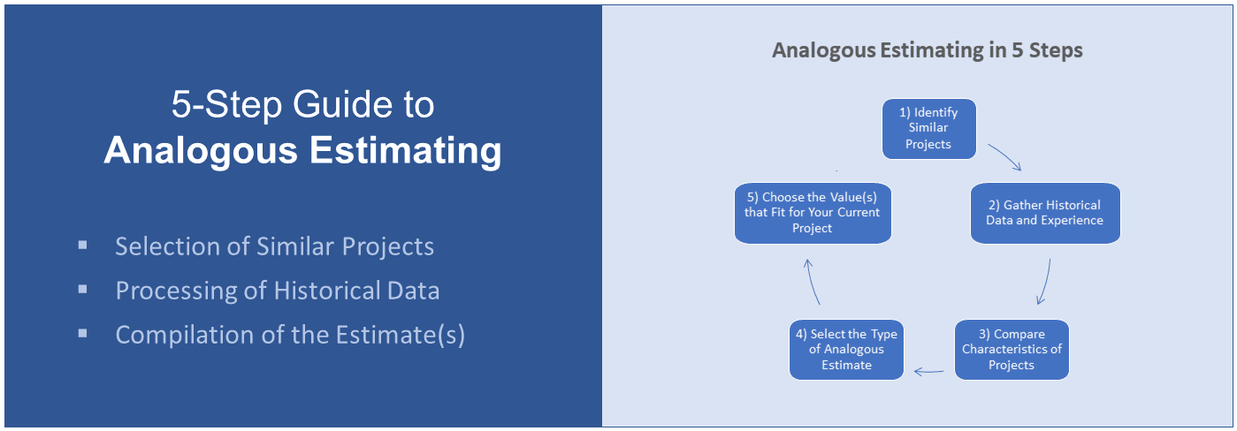
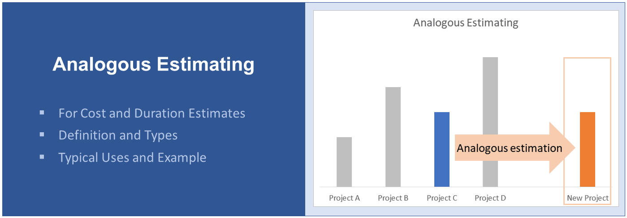
Chapter
08
Analogous estimating

Slide 17
Chapter
08
Heuristic estimating
A heuristic estimate is called a “rule-of-thumb” estimate. These “rules of thumb” are based on empirical parameters derived from past experiences. So, in that sense heuristic estimating is also based on analogous data and expert judgment, except in this case, the estimate is translated into a mathematical-type expression. Expert judgment estimating has to be performed by the expert, whereas heuristics can be transferred to others who are capable of manipulating the defined relationships (Mind Tools 2008).
The major benefit of using simple heuristics is that estimating the process can be performed by many others and does not require a high expertise level. In many situations, the heuristic estimate is not expected to be highly accurate and thus should only be used in situations where the inherent risks are considered minimal (Mind Tools 2008).

Slide 18
Chapter
08
Delphi technique estimating
The Delphi technique is another variety of expert judgment estimating. It is most effective when making high-level estimates in the early stages of projects where there are many unknowns and a single expert would bring too much bias to the solution.
The Delphi technique involves the following sample steps to reach a convergent estimate:
  Each expert provides input without collaboration with others.
  Results are tabulated and returned to the group for evaluation. In some cases, there is a discussion regarding logic for estimates.
  The process repeats with both time estimates and logic for the estimate.
  This process recurs until the group results converge toward a single-valued answer.
There are two main advantages to using Delphi technique as an estimating technique:
  Since this technique seeks estimates from multiple participants, it tends to remove bias and politics that can occur when an estimate is based on only one expert’s judgment.
  Group meetings also allow experts to discuss issues or assumptions that may impact their estimates.
However, there are also significant drawbacks to consider when using this technique.
  One of the main drawbacks of this type of technique is the amount of time it can take for the panel of experts to reach a consensus. Larger numbers of experts will increase the number of iterations required and therefore the time it takes to reach a final estimate.
  Another potential issue is the experience level of the panel. If the panel is made up of individuals that are not very experienced, the estimate will often not be as accurate. It is also important to make sure that strong facilitators are available to guide the group and keep them focused on the topic.

Slide 19
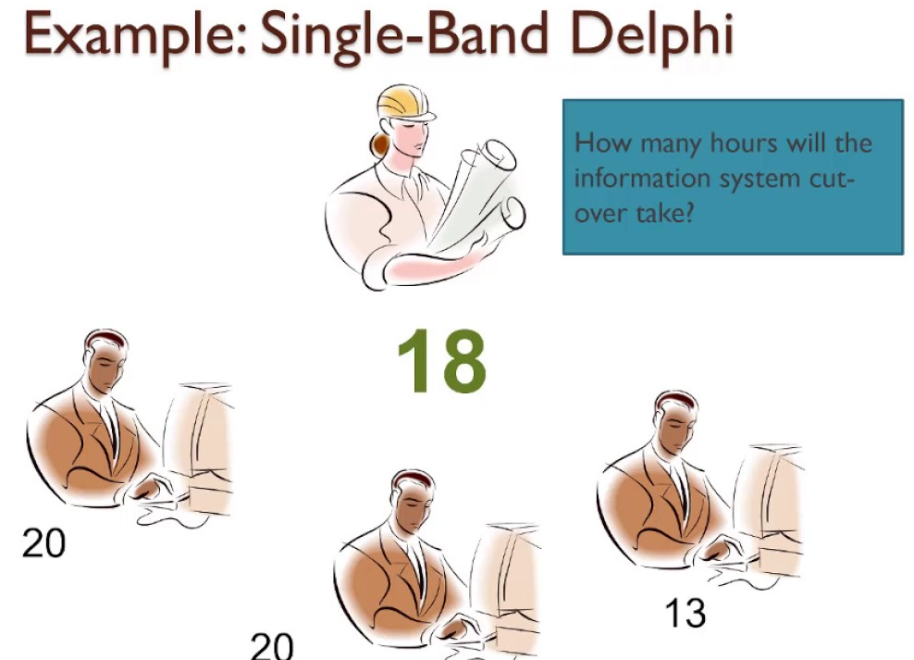
Chapter
08
Delphi technique estimating
The central idea of Delphi is to anonymously share the estimates made by others along with their basic rationale. The next iteration would allow the group to think about other views and possibly adjust their estimates. This is essentially a consensus-building process.

Slide 20
Chapter
08
Parametric estimating
According to the PMBOK® Guide, parametric estimating is a technique that uses statistical relationships between historical data and resulting work levels (PMI 2008, 150).
Parameters based on size, functions, footage, or other scope-related values can be statistically modeled to produce time and cost estimates for the related work.
Given the mathematical sophistication of a parametric estimating model, these are often computer-based statistical relationships.
The process of creating a formal parametric model involves collecting data from many past similar efforts and from this producing a statistical regression-type model that quantifies the impact of each relevant variable.
Parametric techniques are most useful in the early stages of a project when only aggregate data are available.
These estimates are normally considered the order of magnitude in accuracy because they may lack detailed requirement precision (Kwak and Watson 2005).
The parametric technique can also be applied to any situation in which sufficient historical data are available and the project model is stable.
From historical data, cost-estimating relationships (CERs) can be derived statistically to correlate with resulting work estimates.

Slide 21
Chapter
08
Parametric estimating
Project characteristics can include functions, physical attributes, and performance specifications.
Cost-estimating relationships (CERs) are based on two different types of variable relationships.
One such type is based on an independent variable used to predict the cost of the dependent variable. This type is called a cost-to-cost relationship.
The majority of cost-estimating relationships (CERs) relationships are linear which would mean that a single value of the independent variable would be associated with a single output-dependent time, cost, or resource variable.
The development of a valid parametric estimating technique requires considerable data collection and analysis. For that reason, they do not proliferate.
High-technology environments change so rapidly that the models are often obsolete before they can be validated.
The main advantage of parametric estimating is that it provides the estimator with a quick estimate that is based on a limited amount of data.
This approach also provides the estimator with an understanding of the major cost drivers of the project.
In a fully developed parametric estimating model, CER relationships from historical projects provide interesting insights into the impact of key elements such as design changes, schedule changes, and other such factors.
A final subtle point from this approach is to recognize that parametric model estimates will be consistent, although wrong.
However, the consistency attribute allows an orderly correction over time as new data are collected.

Slide 22
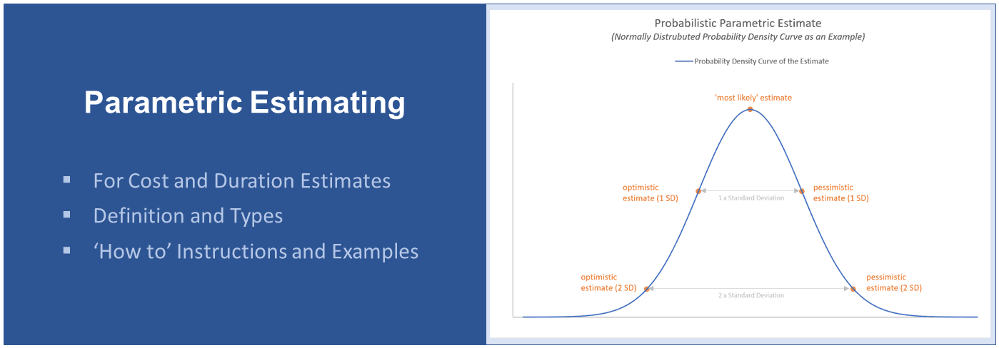
Chapter
08
Parametric estimating

Slide 23
Chapter
08
Phased estimating
Phased estimating involves an incremental approach to the process.
In this case, a promising project will be given the approval to move into a particular phase with a defined rough order of magnitude schedule and budget.
Emerging from that phase, the project is reassessed and the estimating process is repeated for the next defined phase.
As each phase progresses, the project has to earn its way to the next one and the estimating variability range decreases as more project definition occurs.
Each defined decision point, which is called a phase gate or kill point, involves a management review process to determine how the next phase will be approved, with the options to either continue with the existing plan, redefine the project scope, or terminate the project.
According to Verzuh, the performance baseline should be considered reset at each phase gate and the project will essentially be redefined for all future gates.
There are a series of definitional steps to follow in terms of using phased estimating to produce an estimate for cost and schedule:
  Break the product development life cycle into phases. Each phase will be considered a sub-project.
  For the first phase of the life cycle, detailed estimates are made for the cost and duration. Associated with this is an order-of-magnitude planning estimate for the total project life cycle. With these two plans, the project is approved to initiate the next phase.
  When a phase is completed, a management decision is made regarding whether to continue with the next phase and under what conditions.
  If the project is approved to continue, a detailed estimate is created for that phase and an order of magnitude, the estimate is produced for all subsequent phases based on current information.
  This iterative process continues until the project is either completed or terminated.

Slide 24
Chapter
08
Phased estimating
This plan and move forward approach is also called the rolling wave technique.
Another vocabulary term for this is progressive elaboration (i.e., each wave adds a detailed definition to the next wave).
There are three main definitional components that each active phase gate should contain.
  First, the next active phase must specify its required deliverables and each subsequent phase will have its deliverable.
  Second, each review gate should have a defined measurable set of success criteria. These criteria are used to evaluate whether the project should proceed to the next phase or be terminated.
  The final item involves the specific overall project goal definition, which may change as the project definition unfolds. The number of phase gates utilized depends on the size and complexity of the effort.
When the project scope is well-defined, fewer phase gates are required. Project teams should try to consistently use the same gates at consistent points for similar projects as this will help one to improve the iteration and review processes.
The main benefit of using the phased rolling wave estimating approach is that it allows the effort to move forward quicker with less pre-definition and it recognizes that early extensive requirements definition in an uncertain world may be a waste of time.
On the other side, this approach requires much more monitoring from the management and the future goal predictability is low in regards to the classic early requirements waterfall approach. This management approach will appeal more to those who do not believe in the effectiveness of an early requirements definition process; however, we must recognize that many management groups will not feel comfortable with these more vague-management look- forward-iterative-goal techniques.
From a project team management approach, it is important to recognize that there is more potential to meet these short-term phase goals, whereas the longer-term full estimate approach can lead to situations where the team has no chance to be successful because of missed estimates at the beginning (Verzuh 2005, 174).
The Project Manager must recognize these strategy tradeoffs when selecting project estimating and management approaches.

Slide 25
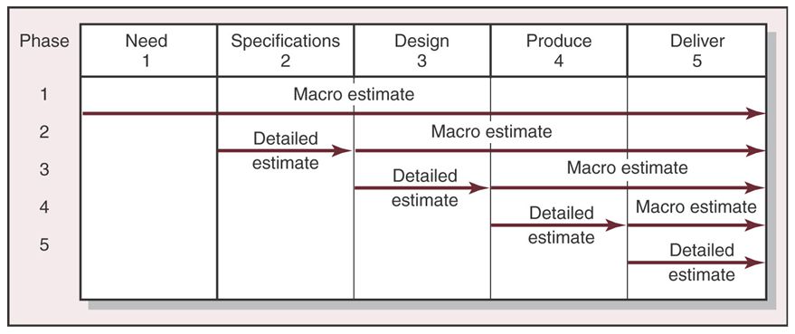
Chapter
08
Phased estimating

Slide 26
Chapter
08
Effort distribution estimating (top-down)
This method estimates the project as a whole and then apportions the total estimate into high-level groupings based on a historical resource or cost distribution pattern. An approach such as this assumes that the overall project will tend to segment into consistent predefined groupings, so identifying the aggregate estimate is the best method to define the life cycle components. Once the high-level value is derived, the effort allocation distribution formula is used to assign a percentage-based allocation to lower levels in the structure. Normally this type of allocation would only go to one or two levels below the top of the WBS. Historical data from similar past projects are typically used to determine the effort breakdown percentages for each phase and the summary activities within a phase (Horine 2005).
This technique works reasonably well in organizations using a common methodology for similar types of projects, along with good historical data. The method also works well with the phased estimating technique in that the historical data provide reasonable estimates for future phases with a similar definition.
One hazard in using a top-down estimating approach as a driver for the effort allocation values is that an aggregate estimating error is proliferated through all defined segments.
Another drawback is that the technique uses historical data to define the apportioning formula (Verzuh 2005, 176). If the projects are not technically similar, these values can provide erroneous results that are once again proliferated through the life cycle.

Slide 27
Chapter
08
Effort distribution estimating (top-down)
To illustrate the apportionment mechanics, imagine that a project’s goal is to design and deploy a new car model. Assume that there are five standard phases planned for this effort and an estimated overall budget of $2,500,000.
Defined phases include Initiation, Planning, Design, Construction, and Deployment.
The Construction phase is further decomposed into three subgroup activities—frame, exterior, and interior.
Past projects indicate the following resource breakdown across the phases:
  Initiation = 10%
  Planning = 15%
  Design = 15%
  Construction = 40%
  Deployment = 20%
Activities within the Construction phase typically consume resources in the ratio:
  Frame = 14%
  Exterior = 13%
  Interior = 13%
Using these values, the Construction phase would receive 40% of the
estimated budget which would compute to $1,000,000 (i.e., 0.40 * $2,500,000).
Within the Construction phase, the framework activity would be estimated to cost $350,000 (0.14 * $2,500,000).
Assuming that the effort distribution technique was being applied along with the phased estimating technique, these estimates could be updated at each phase review point.
The original allocation estimate for the Initiation phase was $250,000 (0.10 * $2,500,000), but the actual cost was $300,000, which is 20% higher than the plan.

Slide 28
Chapter
08
Effort distribution estimating (top-down)
From this result, the overall cost estimate would then be revised by 20% to $300,000, so the new estimate for the Construction phase will increase from $1,000,000 to $1,200,000, and the estimate for building the frame will increase from $350,000 to $420,000.
The key issue in these comparison methods is how to handle dynamic estimate changes of this type.
The standard control model uses a fixed baseline value for comparison, whereas this technique has approved budget changes within the life cycle.
This variability of approval changes what is considered to be the classical control process of planned versus actual.
Some organizations will allow this and others will hold the original value constant and pressure the project team to take corrective action to stay on the initial plan.
Selection from these two methods will have to deal with local management control philosophy issues beyond the estimating methods outlined here.
Be aware that the example used here is not necessarily a good one since the target product would be very expensive to curtail once it is into construction, but in a radical case that could happen.
The normal use would be to test a project goal with less construction involved before making a decision to commit to the full effort.
It is common to either build a prototype or to just execute a plan to some key decision gate.
That said, recognize that it is a good management strategy to review project status and continually evaluate the cost versus defined benefits.
If a project has wandered outside of its value envelope it should be canceled. All project management approaches can use this approach regardless of how the budget is approved.

Slide 29
Chapter
08
Bottom-up estimating
This technique is considered by experts to be the most accurate of all the techniques described here.
The estimating mechanics for this process are directly linked to the WBS work packages.
Based on this view, the total project consists of a collection of relatively small work units that can be estimated reasonably well by the performing organizations.
In most cases, the estimating method used would be expert judgment given that the individuals who will actually be doing these moderate-sized work units would provide the values.
Once the full collection of individual work package estimates is complete, they are rolled up in the WBS structure to generate higher-level aggregations.
From a statistical point of view, each of these estimates would be subject to a range of estimating errors; however, over the full set of work units, the errors should somewhat compensate.
As a result, the total estimate is now based on aggregated views of the work to be done and made by individuals who understand that work better than anyone else.
There may be cultural issues surrounding this process that can mitigate the accuracy, but technically this method has the best chance of producing an accurate representation of the required work.

Slide 30
Chapter
08
Bottom-up estimating
Figure 8.1 shows an annotated WBS with duration and cost estimates for work units. Note how the estimates roll upward into the total project.
This is the essence of the bottom-up estimating approach. As you can see, this involves having a fully developed scope definition translated into a somewhat annotated WBS before it will function as described.
The bottom-up approach also has the advantage of greater involvement from the organizational units which will be performing the work, so there is an improved potential for buy-in and commitment to the estimate by the work teams.
It is not hard to imagine the feeling that a work group might have when an external estimator creates a work estimate and says “this is how long it should take you,” when compared with the work group coming up with that same value. The concept of commitment is clearly on the side of the latter approach.
The main disadvantage of this method is the time required to produce the individual estimates and involve the breadth of individuals needed for the process.
Another subtle problem that often comes with this process is excessive padding of the estimate to be sure the time is not exceeded.
External estimators do not have this motive, but internal groups often view a time or cost overrun as a negative event. In some cases, the estimate may also be padded to cover potential variances from perceived risk for the activity (Johnson 2007, 224).

Slide 31
Chapter
08
Bottom-up estimating
However, realize that the proper goal of work unit estimating is to derive estimates that do not have excessive padding but represent reasonable values for the activity, and risk issues should be handled through other processes that will be discussed later in a future chapter.
In order to ensure reasonable estimates, some cross-checking between the estimating source and the Project Manager is required.
The model philosophy is to isolate padding into separate groupings and not spread extra resources across all WBS work units.
Recognize from the process outlined here that the bottom-up technique is not possible to use as an early estimation technique to decide whether a project idea has merit. First, there are no low-level work units defined yet and even if some level of detail exists, the time required to evaluate each is prohibitive.

Slide 32
Chapter
08
Estimating components
The estimating requirement for a project has multiple perspectives. The root mechanic of estimating involves the work required to complete a unit of work and the support resources associated with that work. From this perspective, the estimating mechanics would produce a time and cost result. So long as the requirement for the work is reasonably well defined, the basic set of mechanics outlined here seems logical on the surface.
We still need to keep in mind the basic estimating vocabulary terms for work, duration. If someone wants to know the estimated time and cost of a project, the work unit level estimates lay at the core.
In addition, the higher-level component issues outlined in next slides essentially add to this core view. As we combine all of these pieces together, we are then able to define a project estimate that will fit any of the stakeholder requirements. This basically means that estimates can be sorted into work units, major groups, or total project views.
The new estimating components described in next slides constitute the various aspects of the estimating process beyond the work package.

Slide 33
Chapter
08
Human resource component
Let us assume that work can be accurately estimated for either a lowlevel work unit or even the total project. If we then examine the issue of allocating planned work to those work units, we find a major source of estimating error.
To assume that the defined work will be executed by a predefined quantity and quality of labor, at the exact time, and with the exact planned skill is a very unlikely event.
Clearly, this aspect of translating raw work into a duration estimate is prone to significant error. In fact, in many cases, this will be the major source of estimating error.
The successful Project Manager needs to do everything within reason to ensure that the human resources defined in the plan are allocated to the project as defined.
Work estimating errors may exist, but often will not be as great as that which will exist without careful resource management oversight.
Think of it this way. If a perfect forecast is predicted but only half of the planned resources arrive on schedule, is it now reasonable to believe that the schedule would be doubled? Similar but more complex to forecast results would occur with resource skill differences.
A second source of human estimating occurs from what is defined here as bleed off.
That estimating element comes from competing demands for the allocated resource.
Some measure of the net productivity of the individual is required to properly estimate how much of a whole resource actually gets allocated to the project.
It is common to find that a full-time project resource is only actively working on direct project tasks 70% of the work day.
If the original estimating assumption was higher, this also leads to a significant estimating error.

Slide 34
Chapter
08
Work unit direct cost component
Estimating mechanics for cost budgeting require that the work estimate be translated to cost via the items allocated to that work unit. For example, an assumed labor rate value translates human labor time into direct labor cost. Second, defined materials for the work unit are added to the cost.
Finally, any other miscellaneous cost items are then added to complete the direct cost estimate for the work unit. Labor and material estimates will be accurate if the values used represent the actual values at execution time. Obviously, significant errors can occur if this is not the case.
In some organizations, the funding source for a project can be very complex. Funds can be allocated from multiple sources and apportioned, or even allocated for different phases.
One of the most common fund groupings is tactical versus capital funds. For example, employee expenses might be funded from the tactical funds while equipment charges could be funded from the capital fund. In this mode, a $100,000 item of equipment might be amortized over 5 years and thus shown in the project budget as an allocated cost of $20,000 per year.
Similarly, allocating material costs to the project can also be complex if the material is purchased for multiple projects in bulk and storage handling or procurement overhead is added to the net purchase price.
Suffice to say the cost side of bulk-type material will be more complicated to estimate than direct purchase items used only by a single project.

Slide 35
Chapter
08
Miscellaneous direct expenses
The third direct cost category involves miscellaneous charges to various work units. In the typical project these involve business travel, office expenses, support equipment, miscellaneous charges, and other support costs that are often not directly related to producing the defined output.
Reserve accounts:
  Project cost and time plans should include reserves for risk, management (unknown/unknowns), and scope change. Ideally, the plans should clearly show allocations for each of these and they each represent an estimate in their own right. Risk assessment is an estimating process designed to create an appropriate reserve for this class of work, but the other two categories are left to define as an experience-based estimate. In any case, time and cost estimates for these three reserve-type costs groupings are additive to the overall project direct estimates. Each of these has the potential to expand the initial planned time and cost of the project.
Overhead:
  Overhead occurs as a result of the project being supported by the mother organization. The project staff is paid and supported by this organization.
  In addition to the direct salaries shown as labor rate, additional employee costs are incurred by the organization for medical benefits, retirement, and other support factors.
  The key point is employees cost more than their visible direct salary and that needs to be recognized in the project estimate.
  A second form of less clear overhead comes from the overall organization. This is sometimes called “G&A” and represents the General and Administrative aspects of organizational overhead.
  Physical facilities, general management, support personnel, and a host of other costs external to the project are examples of this category. This cost line item will appear external to the direct project cost categories, but must also be recognized as additive to the total estimate.
Profit:
  Normally profit would not be shown in a cost estimate unless the project was being performed under contract as a vendor to an external buyer. In that case, this amount is added much like overhead.

Slide 36
Chapter
08
Estimating checklist
When computing the total project cost, it is important to recognize that all of the components outlined here should be recognized. Many technical Project Managers will not like to see the higher-level component costs since they decrease the net value of the project. But all of these are real for an ongoing organization. Failure to properly include any one of these components will result in a numerical overrun of the plan and reflect negatively on the project team performance.
The checklist below represents a set of questions that should be reviewed as part of the work estimating process. This example illustrates how a formal checklist can help ensure a more standardized approach to the estimating process. An organization wishing to ensure compliance to such an approach will require a formal signoff by the estimator.
A sample set of estimating background questions to review follows:
  Have you established a formal, documented data collection process for the project?
  Do you have sufficient requirements definition for the project, including management areas? A fully decomposed WBS is the desired case.
  Do you have historical information, including costs, from previous similar projects?
  Have you identified all sources of costs to your project (i.e., different types of labor, materials, supplies, equipment, etc.)?
  Do you have justifiable reasons for selecting your estimating methods, models, guides, and software?
  Have you considered risk issues in your plan?
  Do your estimates cover all tasks in the WBS?
  Do you understand your project’s funding profile, that is, how much funding will be provided and at what intervals? How sure is the funding assumption?
  Do you know what level of accuracy is needed for the estimate?
  Do you have a process for keeping records of your project activity for future efforts?

Slide 37
Chapter
07
Summary
In this chapter, we have looked at the general topic of estimating project time and cost.
Individuals who can successfully deliver accurate estimates are extremely valuable to the organization because an accurate project estimate facilitates a more orderly project task execution and has a similar impact on internal resource management.
To the contrary, an organization that is not able to do this well is left with a very chaotic environment, which leads to negative results for project completion and the related goal achievement.
This process has been described as one consisting of both art and science which means that it is not one that can be completely described by a checklist or a math model.
Rather, it is a combination of all such approaches. Certainly one of the goals prior to estimating is to create a detailed WBS with well-defined work units.
From this base, it is feasible to achieve forecast cost accuracy in the range 5−10%. This same level of definition accuracy can occur at the individual work unit level for time, cost, and human labor requirements.
We conclude this topic keeping in mind the terms work, duration, and elapsed time.
Procedures for estimating time and cost are closely tied to these terms and their different meanings. Also the point in time when an estimate is required and to what level of accuracy are important issues in estimating method selection.
Always preface an estimate with some measure of accuracy range confidence.
This activity is a major part of the Project Manager’s life and equally important to career success.

Slide 38
Chapter
07
QUESTIONS
Review questions
  What are the major techniques for work unit estimating?
  What are some of the major considerations in selecting an estimating method?
  If a Work Package has an estimate of 240 hours, what is the appropriate duration estimate for the activity given two resources and a standard work calendar? What assumptions are you making with this value?
  Using the concept of “profile estimating” if the planning phase required 300 hours and it historically consumed 25% of the life cycle, what would be the overall estimate for the project?
  Assume a roofing contractor finds that it requires 10 hours of labor per square foot to install a new roof. Use this relationship to estimate future similar jobs. What type of estimating method is this? What is a potential advantage of using this technique?
  Theoretically, what is the most accurate estimating technique? When your boss asks you early in the project for an estimate why is this method not applied?
  What is a ROM estimate? What is the hazard of providing such an estimate?
  Assume that work estimates are defined for all work packages in a fully developed WBS. What needs to be added to this estimate to produce a total project estimate?
  How are items such as risk and task variances dealt with in the estimating process?

Slide 39
Chapter
07
QUESTIONS
In-class question
  1. Assume that you were assigned a project that was unlike previous projects. Comment on some techniques to provide both an initial estimate and then a more detailed one.
  2. Same question as number 1, except the company has no internal skills for this job and you are going to be primarily a contract coordinator. How would you estimate the time and cost of this effort?
  3. You have made your first presentation to management regarding the project and they are generally very unhappy with the estimates shown for the plan. What is your strategy to deal with this issue?
  4. If you were the PM charged with developing a plan to get astronauts to Mars, how would you go about providing an initial estimate for this effort?

Slide 40
Chapter
07
References
Baca, C. M. 2007. Project Management for Mere Mortals. Boston, MA: Addison-Wesley.
Callahan, S. 2008. Project Estimating—Fact or Fiction? http://www.performanceweb. org/CENTERS/PM/media/project-estimating.html (accessed April 9, 2008).
Horine, G. 2005. Absolute Beginner’s Guide to Project Management. Indianapolis, IN: Que Publishing.
Johnson, T. 2007. PMP Exam Success Series: Certification Exam Manual. Carrollton: Crosswind Project Management, Inc.
Kwak, Y. and R. Watson. 2005. Conceptual Estimating Tool for Technology-Driven Projects: Exploring Parametric Estimating Techniques. http://home.gwu.edu/~kwak/Para_#Esr_Kwak_Watson.pdf (accessed April 10, 2008).
Mind Tools. 2008. Heuristic Methods: Using Rules of Thumb. http://www.mindtools.com/pages/article/newTMC_79.htm (accessed April 12, 2008).
Project Management Institute (PMI). 2001. Practice Standard for Work Breakdown Structures. Newtown Square, PA: Project Management Institute.
Project Management Institute (PMI). 2008. A Guide to the Project Management Body of Knowledge, 4th ed. Newtown Square, PA: Project Management Institute.
Snell, D. 1997a. Expert Judgment. http://www.ecfc.u-net.com/cost/expert.htm (accessed April 10, 2008).
Snell, D. 1997b. Wideband Delphi Technique. http://www.ecfc.u-net.com/cost/delph.htm (accessed April 10, 2008).
Verzuh, E. 2005. The Fast Forward MBA in Project Management. Hoboken, NJ: John Wiley & Sons.

Slide 41
Chapter
07
Thank You
The End..
Thank You

