Slide 1




Mathematics 3 – MAT132
Mathematics 3
Lecture 5
MAT 132
Calculus for Fourier Series
Prepared by
Dr. Israa Lewaa

Slide 2
Lecture
05
Lecture Objectives
Chapter Objectives
Revision for some integration Rules
Integration of Basic Trigonometric Functions
Integration for other functions with Trigonometric Functions
definite Integration
Extra Practice

Slide 3
Lecture
05
Basic Rules of Integration
Chapter Objectives
Revising some main rules in the integration

Slide 4
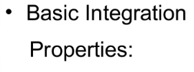
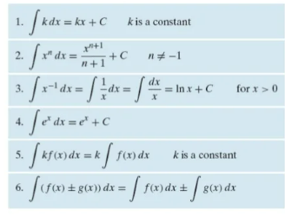
Lecture
07
Basic Rules of Integration
2- Rules of Integration

Slide 5
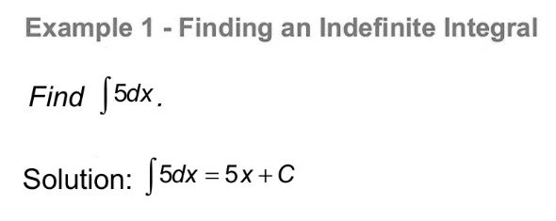
Lecture
04
Example
Example

Slide 6
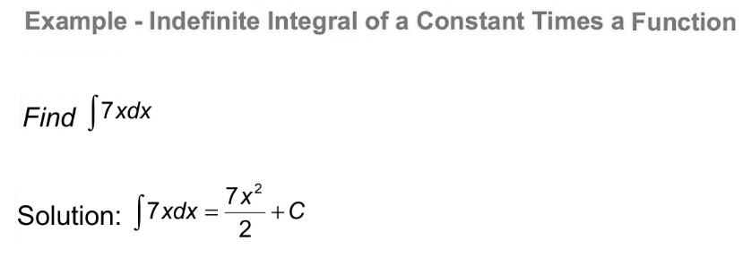
Lecture
07
Example
Example

Slide 7
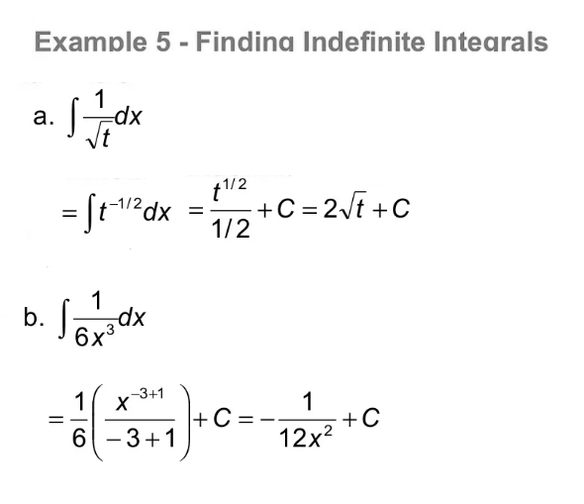
Lecture
07
Example
Example

Slide 8
Lecture
05
Basic Rules in Integration
Chapter Objectives
Important Notes for Trigonometric Functions

Slide 9
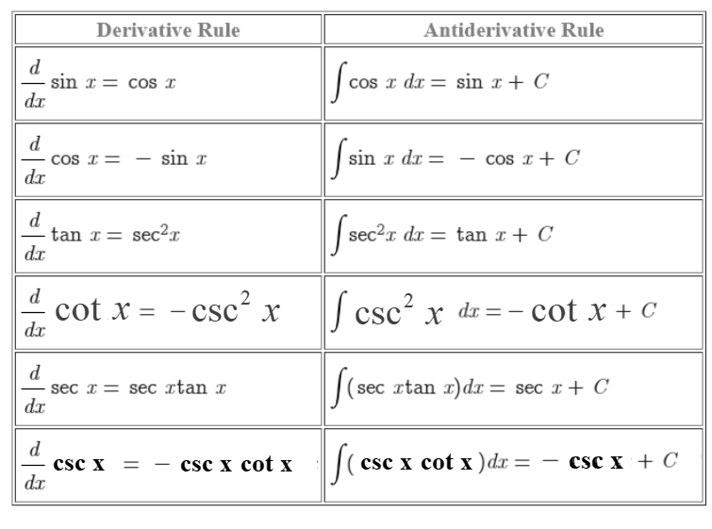
Lecture
05
Integration Rules
Chapter Objectives

Slide 10
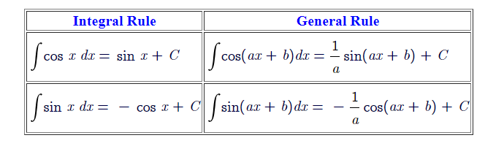
Lecture
05
Important Rules
Chapter Objectives

Slide 11
Lecture
05
Extra Practice
Chapter Objectives
Extra Practice for different ideas in Integration !!!!!

Slide 12
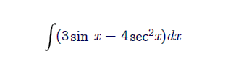
Lecture
05
Extra Practice – Example 1
Chapter Objectives
Integrate the following function:

Slide 13
Lecture
05
Example 1 Solution
Chapter Objectives

Slide 14
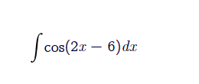
Lecture
05
Extra Practice – Example 2
Chapter Objectives
Integrate the following function:

Slide 15
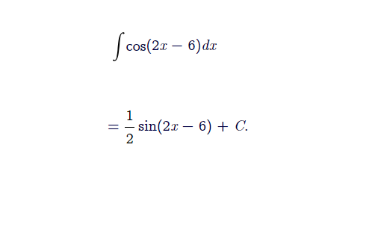
Lecture
05
Example 2 Solution
Chapter Objectives

Slide 16
Lecture
05
Extra Practice – Example 3
Chapter Objectives
Integrate the following function:

Slide 17
Lecture
05
Example 3 Solution
Chapter Objectives

Slide 18
Lecture
05
Extra Practice – Example 4
Chapter Objectives
Integrate the following function:

Slide 19
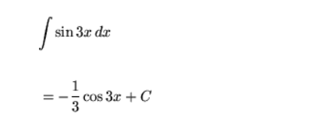
Lecture
05
Example 4 Solution
Chapter Objectives

Slide 20

Lecture
05
Extra Practice – Example 5
Chapter Objectives
Integrate the following function:

Slide 21
Lecture
05
Example 5 Solution
Chapter Objectives

Slide 22
Lecture
05
Extra Practice – Example 6
Chapter Objectives
Integrate the following function:

Slide 23
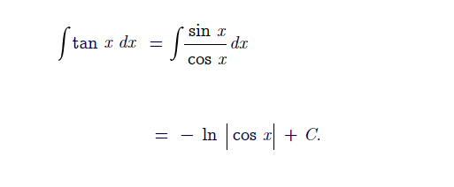
Lecture
05
Example 6 Solution
Chapter Objectives

Slide 24

Lecture
05
Extra Practice – Example 7
Chapter Objectives
Integrate the following function:

Slide 25
Lecture
05
Example 7 Solution
Chapter Objectives

Slide 26
Lecture
05
Extra Practice – Example 8
Chapter Objectives
Integrate the following function:

Slide 27
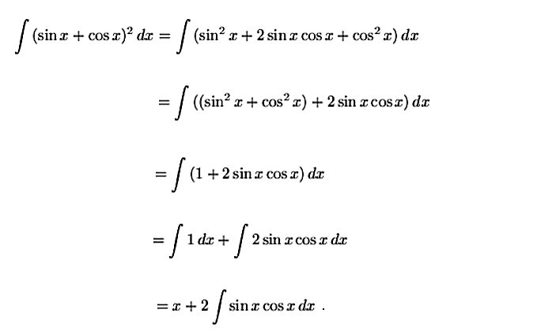
Lecture
05
Example 8 Solution
Chapter Objectives

Slide 28

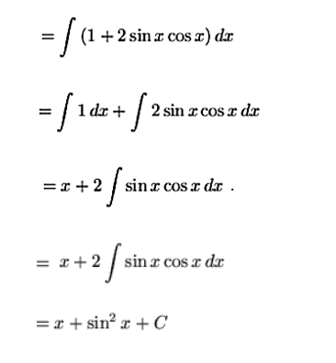
Lecture
05
Example 8 Solution
Chapter Objectives

Slide 29

Lecture
05
Extra Practice – Example 9
Chapter Objectives
Integrate the following function:

Slide 30
Lecture
05
Example 9 Solution
Chapter Objectives

Slide 31
Lecture
05
Example 9 Solution
Chapter Objectives

Slide 32

Lecture
05
Extra Practice – Example 10
Chapter Objectives
Integrate the following function:

Slide 33
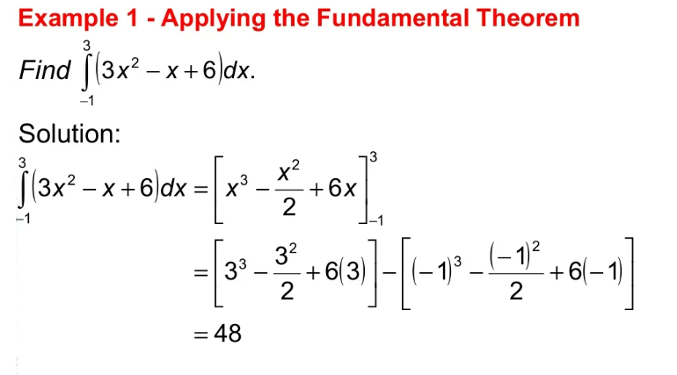
Lecture
07
Example 10 Solution
Example

Slide 34

Lecture
08
Extra Practice – Example 11
Example 1 - Definite Integration
Integrate the following function:

Slide 35
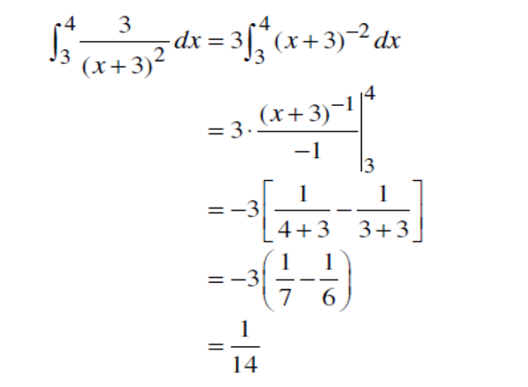
Lecture
08
Example 11 Solution
Example 1 Solution

Slide 36
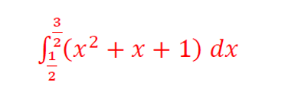
Lecture
08
Extra Practice – Example 12
Example
Integrate the following function:

Slide 37
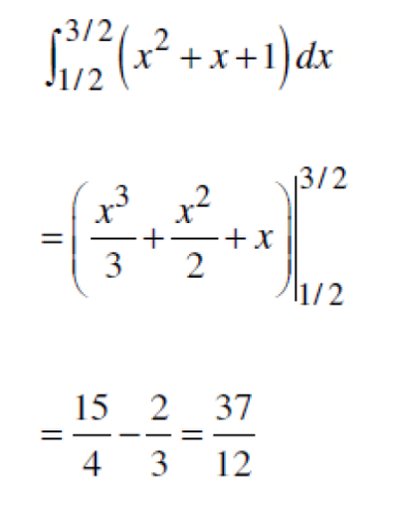
Lecture
08
Example 12 Solution
Example

Slide 38

Lecture
08
Extra Practice – Example 13
** EXTRA PRACTISE
Integrate the following function:

Slide 39
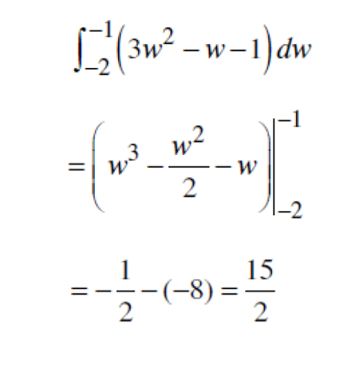
Lecture
08
Example 13 Solution
** EXTRA PRACTISE

Slide 40
Lecture
05
Lecture Summary
Chapter Objectives
Revision for some integration Rules
Integration of Basic Trigonometric Functions
Integration for other functions with Trigonometric Functions
Definite Integration
Extra Practice

Slide 41



Thank You

