Slide 1



Project Risk
&Supply Chain Risk
Prepared by
Dr. Manal El-Sayed
PMG 663
Lecture Introduction

Slide 2



دكتوراه الإدارة العامة من كلية الاقتصاد والعلوم السياسية - جامعة القاهرة.
أستاذ الإدارة بجامعة ميد أوشن.
مستشار التطوير الإداري والمؤسسي.
خبير وطني في مجال الاستشارات المؤسسية
عضو هيئة التدريس بالجامعة المصرية الصينية.
محكم بالعديد من المجلات الدولية.
مدرب الموارد البشرية لدى العديد من الجهات الهامة بقطاع البترول وغيرها.

Slide 3

Chapter
Intro
Course Objectives
To understand risk management definition
To understand Risk identification and assessment − techniques and tools & Development and justification of risk-driven management decisions.
To understand supply chain risk management, vulnerability and develop risk response strategies
Developing an understanding of basic principles of Risk management processes, procedures & Risk analysis techniques.
To understand how implementation of supply chain risk management strategies can be effective by industry based real world case studies and scenarios illustrating macro and micro-level risks, and approaches to their management.

Slide 4

Chapter
Learning Outcomes
To understand the concept of risk, uncertainty & risk parameters in the context of commercial
management.
Analyze risk assessment and mitigation strategies in specific situations
Describe supply chain risk management strategies to implement and monitor appropriate management techniques relevant to specific situations
To develop a capacity to critically review the principles and applications of risk and vulnerability management in the context of commercial environments

Slide 5

What Is a Project?
What Is a Risk?
Types of Project Risk
Supply chain management
Supply Chain Risk Management (SCRM)
Risk in Supply chain

Slide 6

Section Topics:
Plan Risk Management
Identify Risks
Perform Qualitative Risk Analysis
Perform Quantitative Risk Analysis
Plan Risk Responses
Monitor and Control Risks
Chapter
Introduction

Slide 7
Chapter
التنفيذ
المراقبة والمتابعة
تخطيط
Introduction
الإغلاق
إعداد
Initiating
Executing
Monitoring
&
Controlling
Planning
Closing
Plan Risk Management
Identify Risks
Perform Qualitative Risk Analysis
Perform Quantitative Risk Analysis
Plan Risk Responses
Monitor and
Control Risks

Slide 8




Chapter
- A supply chain consists of
Introduction
Supplier
Manufacturer
Distributor
Retailer
Customer
Upstream
Downstream
- aims to Match Supply and Demand, profitably for products and services
SUPPLY SIDE
DEMAND SIDE
- achieves
+
+
+
+
+
=
The right
Product
The right
Price
The right
Store
The right
Quantity
The right
Customer
The right
Time
Higher
Profits

Slide 9
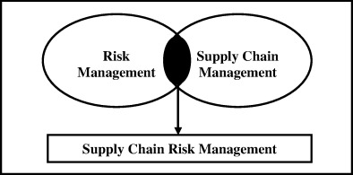
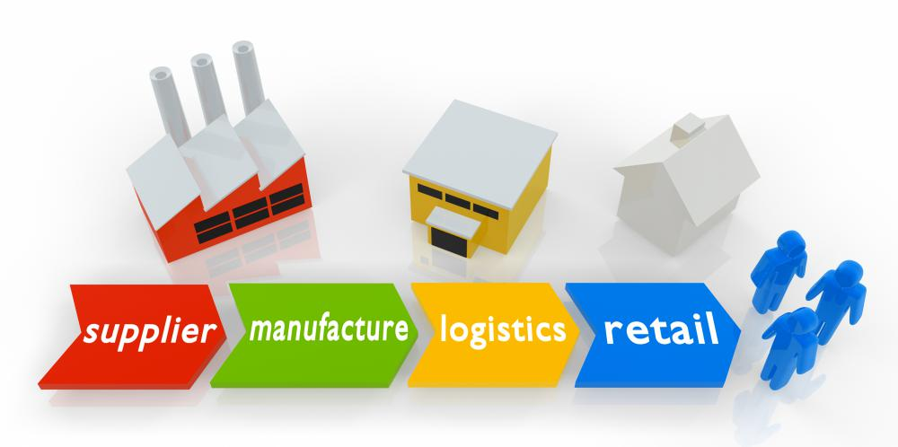
Chapter
Supply Chain Risk Management (SCRM)
Introduction
_ the risk in the end-to-end supply chain

Slide 10
Global Supply-Chain Issues
Chapter
Introduction
PRODUCT
LINE DIVERSITY
MARKET
CONCENTRATION
PRODUCTION
DISPERSION
Techno-
logy / dev-
elopment
Custo-
mer
Parts /
Components
Inbound
supply
Marketing
/retailing
Assembly
Physical
distribution
Shorter product
life cycles
Concentrated
demand
Price erosion
Product / model
proliferation
Global sourcing
Focused factories

Slide 11


Thank You

Slide 12
Chapter
Introduction

Slide 13
Chapter
Introduction

Slide 14
Chapter
Introduction

Slide 15
Chapter
Introduction

Slide 16
Chapter
Introduction

