Slide 1



Digital Content Direction
Prepared by Dr. Sherihan Mohamed
DGM 733
Lecture 7

Slide 2




Lecture 7
Lecture 6 Conclusion:
Remember the last Lecture we talk about:
(Audiences and Target Audiences)
* Key Concepts of Audience Research.
* Audience Trends in an Era of Media Convergence.
* Identifying and Reaching Target Audience.
* Audience Analytics.
* Conclusion.
* References.

Slide 3

Social Media in Content Production
Lecture 7

Slide 4

Lecture 7
Lecture Outlines:
(Social Media in Content Production)
* Which Platform Should a Content Producer Use? When? Why?
* Social Media Monitoring/Listening.
* Social Media Strategy.
* Conclusion.
* References.

Slide 5

Lecture 7
Digital Content Direction
Which Platform Should a Content Producer Use? When? Why?

Slide 6


These are not easy questions to answer, not least because social media is dynamic.
The nature and number of platforms, the technology and the devices that support them, and the formats that work best on them, are in continual flux.

Slide 7
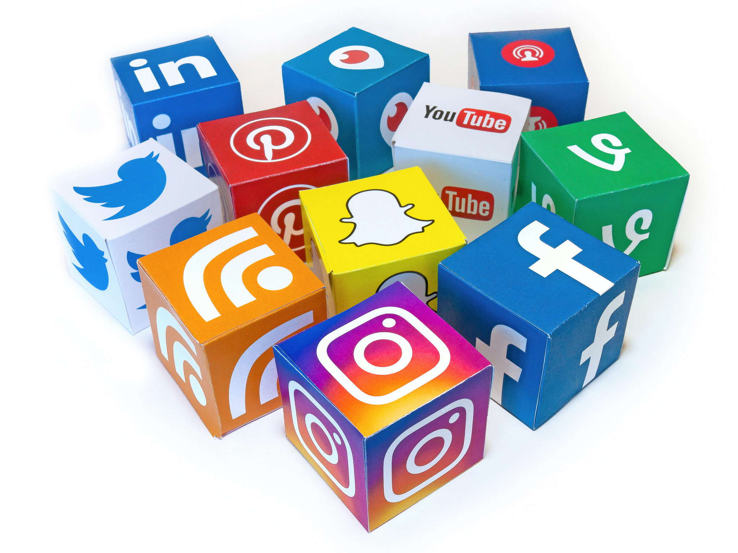
TikTok and Snapchat base their content on the ephemeral and the pictorial. Instagram and Pinterest too are largely visual in terms of how they communicate. YouTube is a video streaming platform. Facebook, LinkedIn, Reddit and Twitter use a combination of visual and text-based content, perhaps more closely akin to traditional journalism than other channels.

Slide 8

Some forms of social media, such as blogs and podcasts, are relatively passive, in that they require users to search for content on whichever blogging or podcasting platform they use.

Slide 9

Others, such as Facebook, Instagram and Twitter, are more active and are inherently dialogic: if you have the app, you will have content suggestions sent to you 24/7.

Slide 10

In recent years, we’ve seen the rise of platforms such as TikTok and Snapchat, which deal in very short, ephemeral pictures and video, and the reduced screen size of devices such as the Apple Watch.

Slide 11
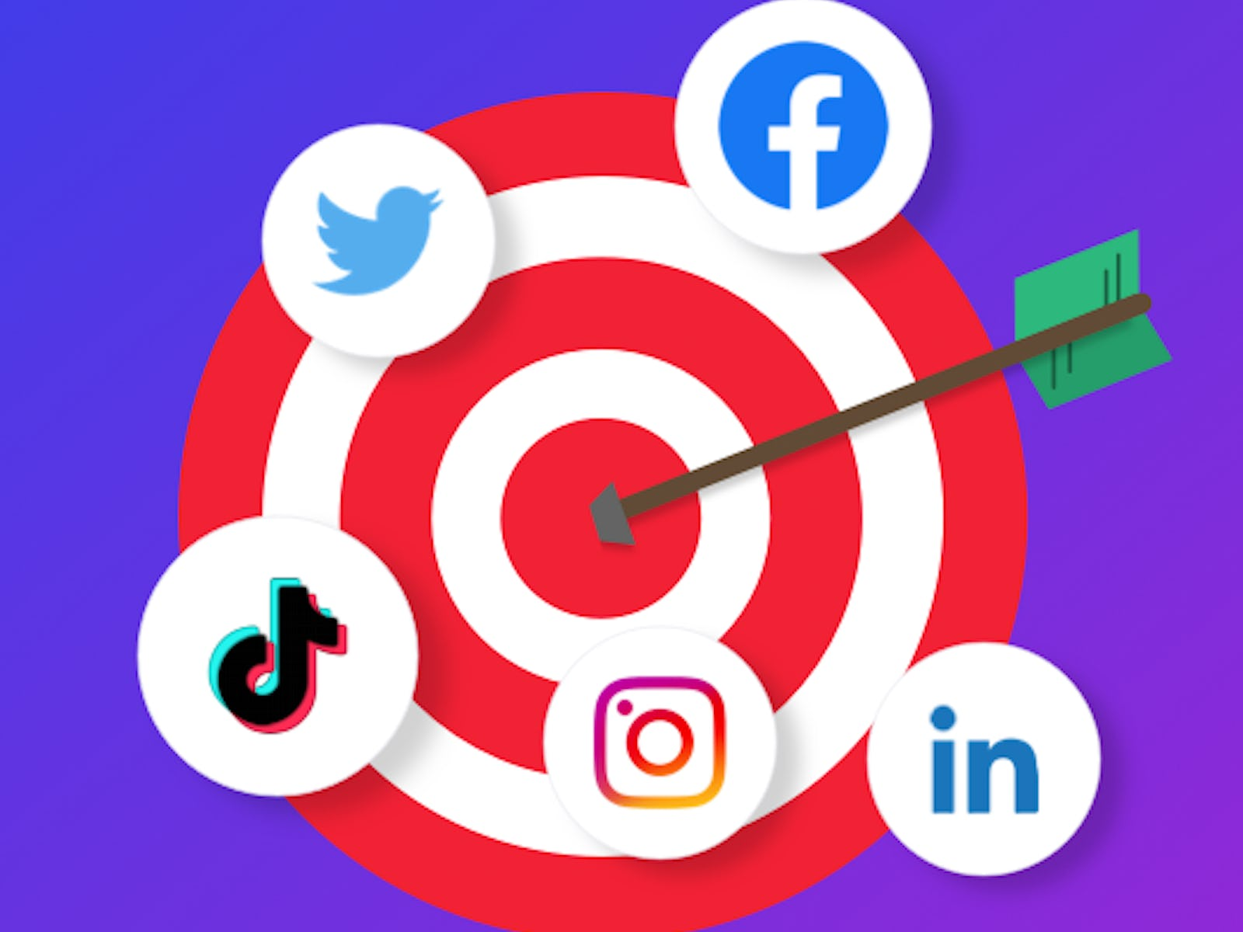
These platforms have led, in part, to the rise of what is termed ‘glance journalism’, that is journalism that can be consumed in one brief look at a small screen. the speed at which this kind of ultra-brief news is consumed makes platforms such as Facebook and Twitter seem voluminous and in terms of how much content they provide for the user.

Slide 12
Over time, platforms will change as they compete for audience share and to remain relevant in the face of changing technology and the rise of new competitors. As such, any recommendation in terms of exactly what kind of content to produce and why on any platform is likely self-defeating as the key to understanding and working in the social media space is adaptability and a willingness to embrace change, not necessarily knowledge of any particular platform.

Slide 13
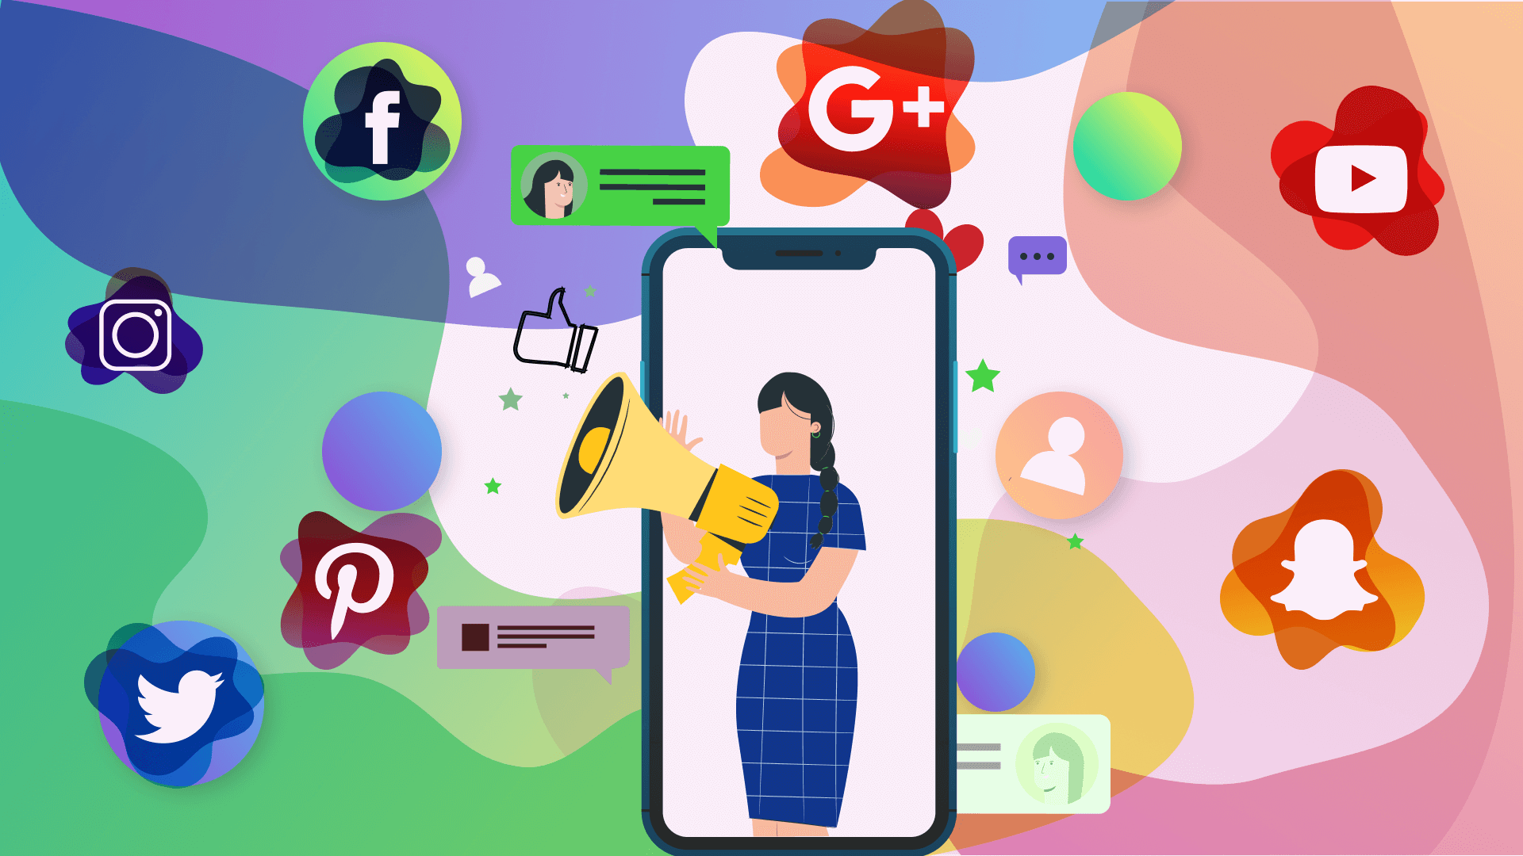
There is no one size, one time ‘how to’ answer; what is needed is a metacognitive overview approach to social media that acknowledges its dynamism, is committed to understanding the modality and functionality of each platform and how the demographic makeup of each coincides with a content producer’s target audience(s).

Slide 14

Research into the behaviour of those audiences, their wants and preferences is essential, and possible, thanks to the analytics derived from and provided by social media channels.

Slide 15

The major issue that all content producers face when using social media is how to separate the reliable from the unreliable. This is where social media analytics become essential. Choosing which analytics to monitor and via which platform, however, can be confusing.

Slide 16

It is important to spend time researching the various options in order to make sure the features and the kind of analytics on offer by a platform or tool, are a good fit for your social media strategy.

Slide 17
Lecture 7
Digital Content Direction
Social Media Monitoring/Listening

Slide 18
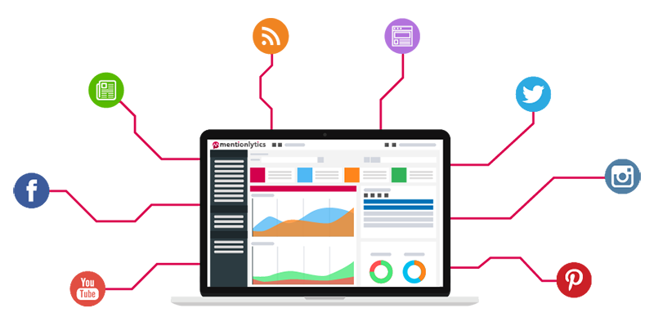
The phrases ‘social media monitoring’ and ‘social media listening’ are used somewhat interchangeably to describe the process of gathering, analysing and acting in response to social media analytics. Yet they are different processes, or two parts of the same process. Let’s take a look at both terms.

Slide 19
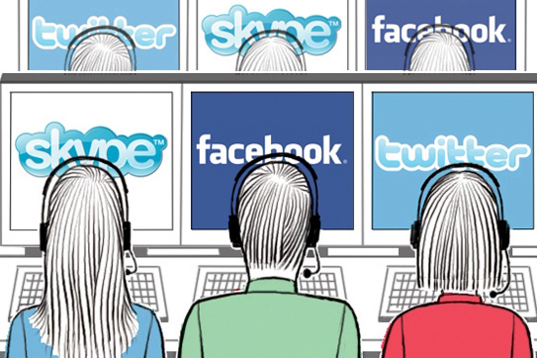
‘Social media monitoring’ encompasses the use of analytics to track likes, clicks, numbers of shares, sentiment, keywords usage, how long users stay on a page, geographical demographics and so forth.

Slide 20

This is a data gathering process and one that is very useful in determining such factors as, the reach of and response to a campaign or post, audience size, age group, and location.

Slide 21
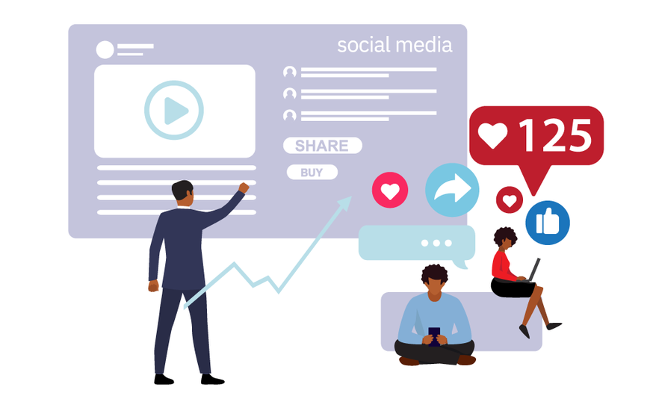
It is important that it is structured carefully and intentionally as good monitoring is comprehensive, in that it looks for mentions not only within a brand’s own social media streams, but also on the web more widely; powerful analytical information may not always be where we expect.

Slide 22

Social media monitoring is often described as the first stage of social media listening, which takes those analytics and works out what to do next, how to maximise opportunities and respond to crises and reputational issues. Such listening might reveal the effectiveness, or otherwise of particular platforms, the existence of unexpected audiences, or that a particular post is going viral.

Slide 23

Social media listening maximises the usefulness of analytics, by using them not simply as a snapshot of a particular campaign, post of or issue, but as a tool that that allows for the monitoring of trends and for forward thinking and planning.

Slide 24

Social media management apps, such as Hootsuite (insights.hootsuite.com), Buffer (buffer.com), Loomly (Loomly.com) and Sendible (sendible.com), to name a few of the more popular options, allow users to schedule and post to multiple social media accounts, and to monitor various platform analytics, from one central dashboard.

Slide 25

This is especially useful for organisations running campaigns across various social media channels who want to be able to compare how each is faring as part of their social listening strategy.

Slide 26

Knowing an organisation or a client’s social media strategy and what they hope to achieve from it is key to identifying the kind of social media listening platform that will work best for their needs and budget.

Slide 27

It pays, also, to stay abreast of developments in this field as differing clients may have different monitoring needs and perhaps, as importantly, information that may only previously have been available through a pay for service platform may now be free elsewhere.

Slide 28
Lecture 7
Digital Content Direction
Social Media Strategy

Slide 29
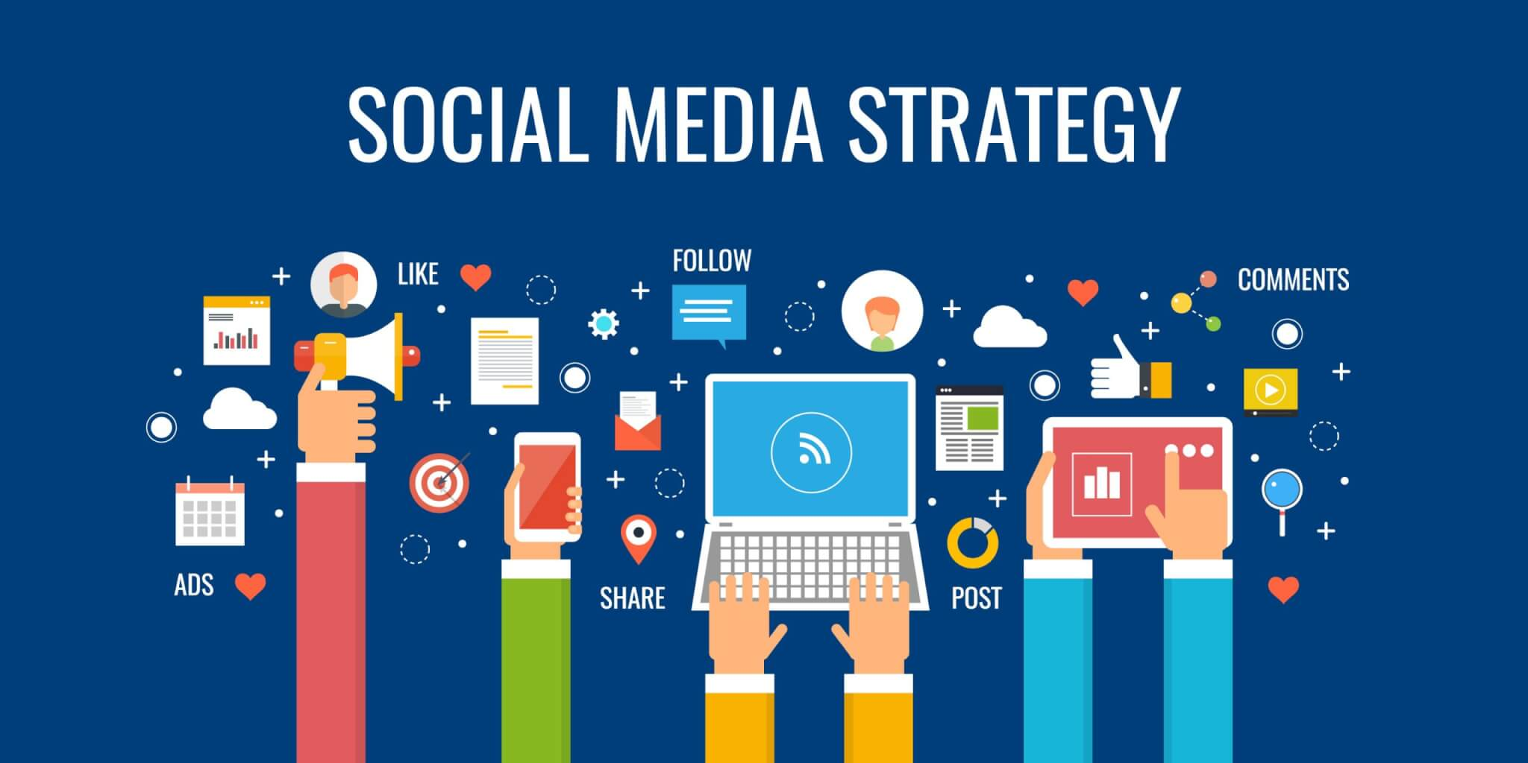
How do your social media sites and platforms work together to support your aims?
Each platform offers a different set of affordances. It’s important these are clearly understood, so that each might be used appropriately.

Slide 30
For instance, podcasts, YouTube accounts and blogs should be viewed as storehouses of information. These platforms are Not dialogically proactive; users must actively seek out content stored on them.
Conversely, platforms such as Twitter, LinkedIn, Facebook and Instagram post directly into a user’s app and so can be used as a shop window to promote content housed on more passive platforms.

Slide 31

Understanding what kind of content to post and when is essential, but social media success requires producers to do more than post in the right format and at the most opportune time.

Slide 32

Social media works best when it is viewed as social and dialogical; as a conversation, not just a selling opportunity. Making every post about you and your news/products will not endear you to your audience, nor the wider field in which you work.

Slide 33
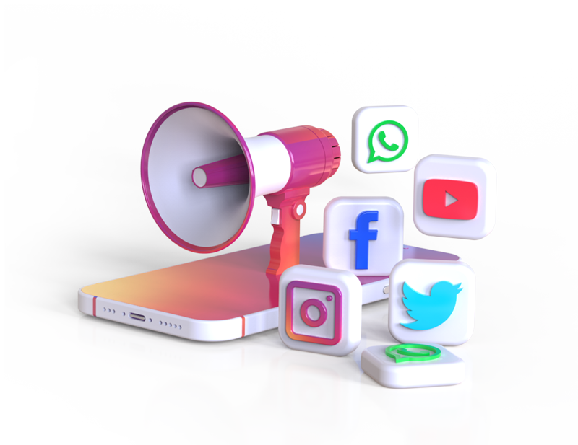
Simply A social media strategy is a well-thought-out plan that indicates when, how, and what content to share on multiple socials of a brand. It helps you use resources efficiently and reach your target audience.

Slide 34
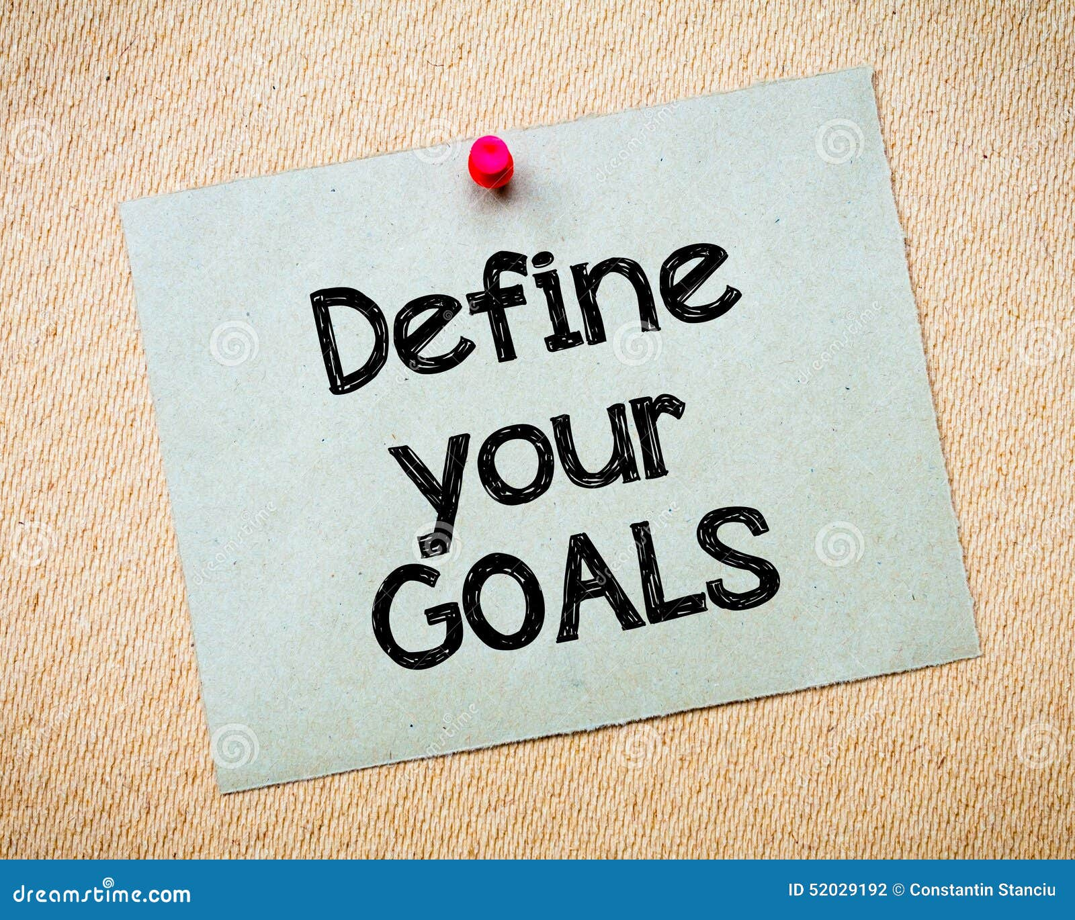
Steps to Create a Social Media Strategy:
1- Define your goals
If you want to develop a winning strategy, determine your primary objectives. Together with metrics, they will help you evaluate the success of your strategy.

Slide 35

2. Research your target audience
Before creating an offer, you should understand your audience and know what they want to see on socials. After researching your target market.

Slide 36
3. Conduct competitive analysis
Since 58.4% of the world population now uses social platforms, the odds are that your rivals already have profiles on Instagram, Facebook, and Twitter. So you should create appealing profiles to attract followers. Your competitors will help you develop a successful strategy. To take advantage of your rivals, conduct a competitor analysis to reveal their strengths and weaknesses.

Slide 37

4. Run social media audit
A social media audit is the process of a business reviewing its key metrics to assess the performance of its social media strategy. The audit covers every social media channel and environment, sentiment, challenges, and opportunities for each of them. Once you finish the audit, you’ll understand the desires of your target audience.

Slide 38
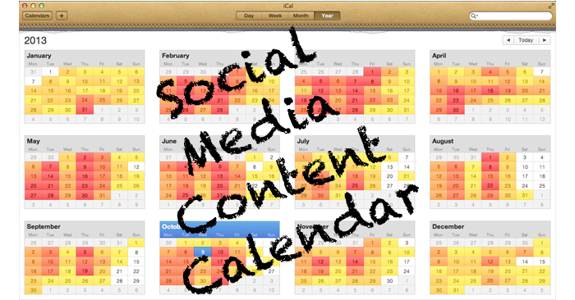
5. Develop a social media content calendar
Social media calendar is an outline of your upcoming publishings on socials, organized by date. You can create a calendar manually with a spreadsheet or leverage a special tool.

Slide 39
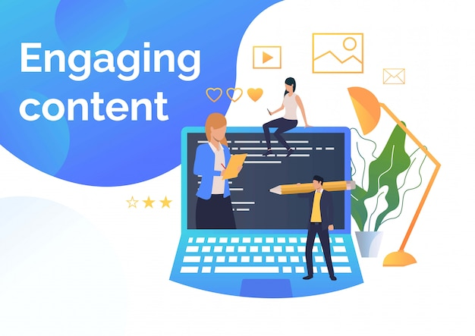
6. Create engaging content
Having a huge social media audience doesn’t guarantee your business' success. If you struggle to generate the interest of your target audience and gain attention on socials, you should create engaging content.

Slide 40
7. Leverage social media management software
Social media management tools empower you to handle several social media from one place, build relationships with followers, and develop an editorial calendar to publish posts on time. In addition to increased engagement, such platforms enable you to track and analyze social performance.

Slide 41
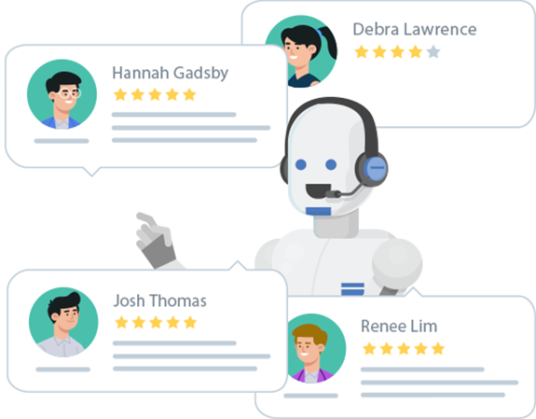
8. Provide support with chatbots
According to statistics, bot-only chats receive an 87.58% satisfaction rate. Chatbots imitate human conversation and allow your company to provide 24/7 support.
Once social media users have inquiries, they can send you a direct message and receive an instant auto reply on common questions.

Slide 42

9. Use advertising to expand the reach
Companies should run ads on social media to expand their reach, generate new leads, drive traffic to their websites, and increase sales volume and revenues.

Slide 43
10. Analyze social media metrics and adjust your strategy
Creating a profitable social media strategy is challenging, so it can’t be perfect on the first try. However, you can always improve it. To do it, look at the performance metrics to see what’s missing in your strategy. Pay attention to reach, engagement, impressions, conversions, referrals, and response rate.

Slide 44
Lecture 7
Lecture Outlines:
(Social Media in Content Production)
* Which Platform Should a Content Producer Use? When? Why?
* Social Media Monitoring/Listening.
* Social Media Strategy.

Slide 45


Lecture 7
Lecture References:
* Jenkins, H., Ford, S., & Green, J. (2013), Spreadable media: Creating value and meaning in a networked culture, New York University Press.
* Jay Daniel Thompson & John Weldon (2022), Content Production for Digital Media: An Introduction, Springer Nature Singapore.

Slide 46


Thank You

Slide 47

Digital Content
Direction
Lecture 7
DGM 733
Prepared by:
Dr. Sherihan Mohamed

