Slide 1


Understanding Project Communication
Chapter 1
ESU
CMM201
PROJECT COMMUNICATION

Slide 2
What will we learn?
Understand why people communicate by looking at two different communication theories that focus on communication as a way people handle uncertainty.
Evaluate the impact of the quality as well as the quantity of communication in a project.
See the connection between effective communication and stakeholder trust

Slide 3
Section 2
Exploring Communication Theories
Uncertainty and Effective communication
Lecture
Section 1
Introduction to Project communication
Improvement of project communication stages

Slide 4
Section One
Introduction to Project Communication

Slide 5
Introduction to Project Communication
Good communication skills separate good project managers from the rest of the pack, and separate successful projects from unsuccessful ones.
Research from the Project Management Institute (PMI) and other sources shows that project communication has a significant impact on project budgets and project success.
In 2013, PMI published an in-depth report on “The Essential Role of Communications” in project management, with conclusions derived from the organization’s annual, global Pulse of the Profession® survey.

Slide 6
Introduction to Project Communication
This report revealed how impactful project communications are:
Effective communication to all stakeholders is “the most crucial success factor in project management.”
7.5 percent of every dollar spent on a project is at risk due to ineffective communication.
Half of all unsuccessful projects fall short due to ineffective communication.
High-performing organizations create project communications management plans for nearly twice as many projects as low-performing organizations.

Slide 7
Introduction to Project Communication
This report revealed how impactful project communications are:
High-performing organizations also perform significantly better at delivering the message in a timely manner, with sufficient detail and clarity, using nontechnical language, through appropriate communication channels/media.

Slide 8
Section One
Improvement of project communication stages

Slide 9
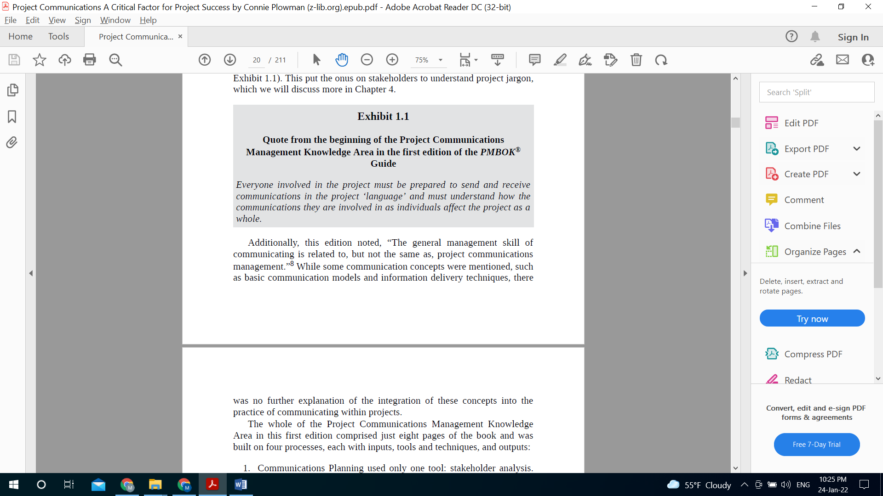
Improvement of Project communication stages
STAGE ONE

Slide 10
Improvement of Project communication stages
STAGE ONE
The whole of the Project Communications Management Knowledge Area was built on four processes, each with inputs, tools and techniques, and outputs:
Communications Planning used only one tool: stakeholder analysis.
This process included ways to access information in between planned communications, and also acknowledged the need to build in review and revision of the communication plan.

Slide 11
Improvement of Project communication stages
STAGE ONE
The whole of the Project Communications Management Knowledge Area in this first edition comprised just eight pages of the book and was built on four processes, each with inputs, tools and techniques, and outputs:
Information Distribution was simply what the name of the process implies: the distribution of information about the project to stakeholders.
Performance Reporting included status reports (current status), progress reports (what has been done so far), and forecasts (what to expect for the rest of the project).
Administrative Closure was the documentation and dissemination of information around the end of each phase of the project and the project as a whole.

Slide 12
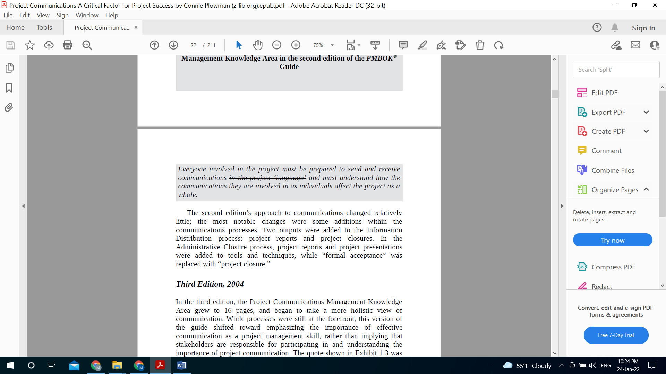
Improvement of Project communication stages
STAGE TWO

Slide 13
Improvement of Project communication stages
STAGE TWO
The second edition’s approach to communications changed relatively little; the most notable changes were some additions within the communications processes.
Two outputs were added to the Information, Distribution process: project reports and project closures. In the Administrative Closure process, project reports and project presentations were added to tools and techniques, while “formal acceptance” was replaced with “project closure.”

Slide 14
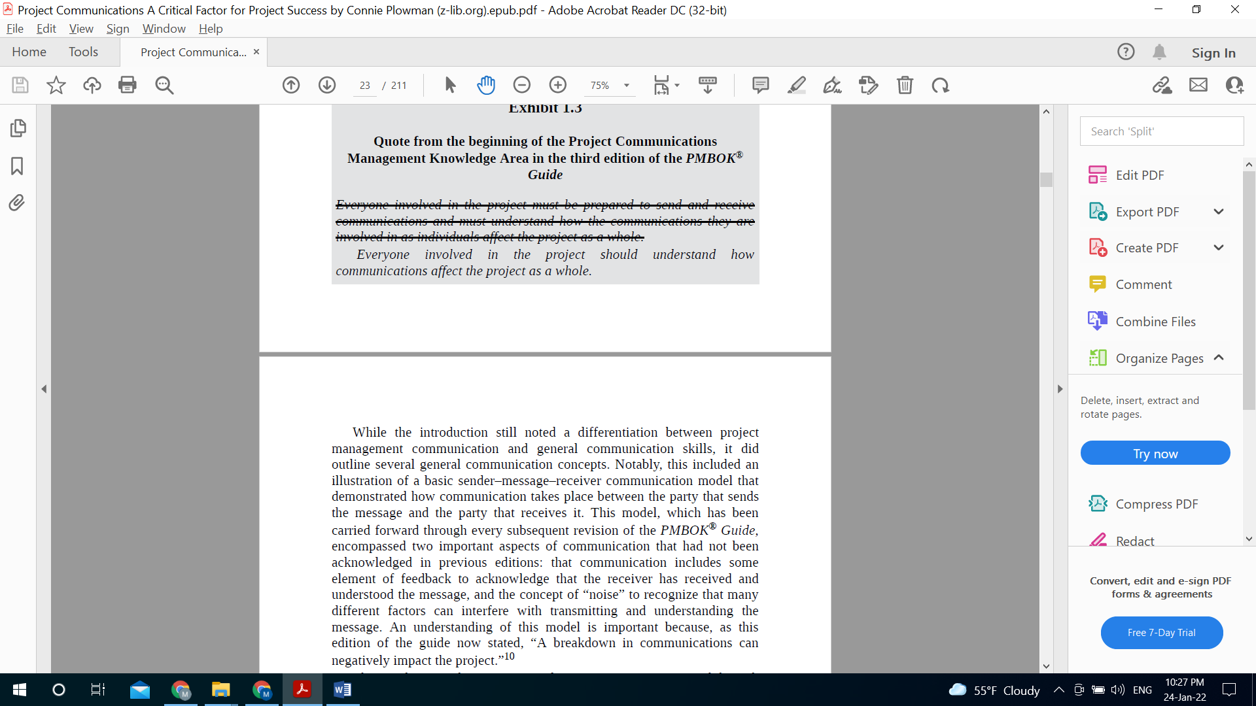
Improvement of Project communication stages
STAGE THREE

Slide 15
Improvement of Project communication stages
STAGE THREE
This model encompassed two important aspects of communication that had not been acknowledged in previous editions:
Communication includes some element of feedback to acknowledge that the receiver has received and understood the message, and the concept of “noise” to recognize that many different factors can interfere with transmitting and understanding the message.
An understanding of this model is important because, as this edition of the guide now stated, “A breakdown in communications can negatively impact the project.”

Slide 16
Improvement of Project communication stages
STAGE THREE
This model encompassed two important aspects of communication that had not been acknowledged in previous editions:
This emphasis on the importance of communication was carried through in major changes to the processes in the Project Communications Management Knowledge Area in the third edition.
The Administrative Closure process was removed and replaced with the Manage Stakeholders process, which focused on communication as a means to “satisfy the requirements of and resolve issues with project stakeholders,” and suggested the connection between good stakeholder management and project success.

Slide 17
Improvement of Project communication stages
STAGE THREE
This model encompassed two important aspects of communication that had not been acknowledged in previous editions:
Changes were also made to the remaining three processes in the knowledge area. These changes broadened the scope of what can affect communication planning, such as enterprise environmental factors (conditions outside the control of the project team, but which can affect the project) and organizational process assets (the knowledge bases and practices of the organization that may be used within the project).
The changes also reflected the desired outcome of project communication—to identify and then meet the informational needs of stakeholders, which is an important factor in project success.

Slide 18
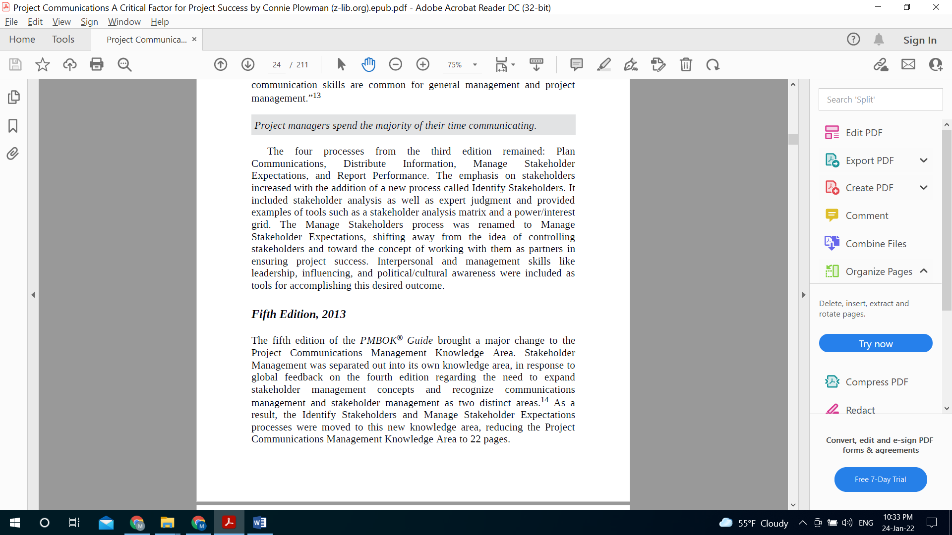
Improvement of Project communication stages
STAGE FOUR

Slide 19
Improvement of Project communication stages
STAGE FOUR
The four processes from the third edition remained:
Plan Communications, Distribute Information, Manage Stakeholder Expectations, and Report Performance.
The emphasis on stakeholders increased with the addition of a new process called Identify Stakeholders.
It included stakeholder analysis as well as expert judgment and provided examples of tools such as a stakeholder analysis matrix and a power/interest grid. The Manage Stakeholders process was renamed to Manage Stakeholder Expectations, shifting away from the idea of controlling stakeholders and toward the concept of working with them as partners in ensuring project success.
Interpersonal and management skills like leadership, influencing, and political/cultural awareness were included as tools for accomplishing this desired outcome.

Slide 20
Improvement of Project communication stages
STAGE FIVE
Stakeholder Management was separated out into its own knowledge area, in response to global feedback on the fourth edition regarding the need to expand stakeholder management concepts and recognize communications management and stakeholder management as two distinct areas.
The three processes that remained in the communications knowledge area were renamed to eliminate confusion and to focus on three key elements:
Plan Communications Management.
Manage Communications (changed from Distribute Information) added an emphasis on the need to ensure that stakeholders understand project communications and have opportunities for further information or clarification.
Control Communications (changed from Report Performance) emphasized the need for a smooth flow of information among all stakeholders.

Slide 21
Improvement of Project communication stages
STAGE FIVE
This process shifted the focus from simply producing reports on how the project is progressing, to ensuring that those reports adequately meet stakeholder needs.
Key Concepts for Project Communications Management, which provides definitions, as well as general concepts about how information is exchanged and how miscommunication can be avoided.
Trends and Emerging Practices in Project Communications Management, which looks at recent developments such as the inclusion of stakeholders in project reviews and meetings, and the increasing use of social media and other technology to communicate in projects.
Tailoring Considerations, which includes considerations to apply communication strategies to each unique project.

Slide 22
Section Two
Exploring communication theories

Slide 23
Exploring communication theories
Communication and uncertainty
When it comes to communication theory, uncertainty affects the person rather than the project. An individual evaluates uncertainty based on the perception of how it will affect him or her. Perceived consequences can span a wide spectrum.
Just as project teams use risk management techniques to address the uncertainties in a project, individuals use communication to address the uncertainties in their lives. Think about the initiation of a project. The project team attempts to address many of the uncertainties about the project (for example, estimating cost, schedule, scope, and regulatory or environmental impacts) through project planning and risk identification activities.

Slide 24
Exploring communication theories
Uncertainty Reduction Theory
Uncertainty reduction theory (URT), the older and more well-known of the two theories we will review, defines uncertainty as “having a number of possible alternative predictions or explanations.” This theory presumes that people always try to reduce or make sense of uncertainty from a cognitive, information-based perspective.
“Making sense of something means increasing your ability to accurately predict or explain it, often by reducing the number of alternative explanations—hopefully to one.” Information acquisition, including communication, is the primary means by which people deal with uncertainty.

Slide 25
Exploring communication theories
Uncertainty Reduction Theory
Two of the main principles of URT can help us understand how uncertainty motivates people to communicate in the context of a project.
The first of these principles states that, “Efforts to reduce uncertainty are linked to the likelihood of future interactions and reward potential of the other person.” Generally, people are more motivated to reduce uncertainty about another person or situation based on how much influence (both positive and negative) they have over us. A team member who feels that impressing the project manager is beneficial to his status in the organization may ask questions to ensure he is completing his work to expectations.
A project manager who does not feel that a particular stakeholder has much influence over the project may put little effort into communicating about the project with that stakeholder.

Slide 26
Exploring communication theories
Uncertainty Reduction Theory
Two of the main principles of URT can help us understand how uncertainty motivates people to communicate in the context of a project.
The second principle of URT we will review here explains that people reduce uncertainty through knowledge acquisition. There are three main strategies people use to do this:
Passive: Observing other people without actually interacting with them.
Active: Using indirect methods to collect information about the other person (e.g., conducting an internet search, or asking others about them).
Interactive: Seeking information through direct contact with the person (a face-to-face conversation, phone call, e-mail, etc.)

Slide 27
Exploring communication theories
Uncertainty Reduction Theory
Two of the main principles of URT can help us understand how uncertainty motivates people to communicate in the context of a project.
The second principle of URT we will review here explains that people reduce uncertainty through knowledge acquisition. There are three main strategies people use to do this:
Interactive: Seeking information through direct contact with the person (a face-to-face conversation, phone call, e-mail, etc.)
The interactive strategy is the one we most often use day-to-day while doing work on a project. Most planned communication in a project is meant to share information with various stakeholders, thereby increasing their knowledge (and decreasing their uncertainty) about the project. However, planned communications do not always address all stakeholder uncertainties. These unaddressed concerns are often the motivation for stakeholders to reach out to the project team for information (interactive strategy).

Slide 28
Exploring communication theories
Uncertainty Reduction Theory
Disadvantage
However, they can also motivate stakeholders to use passive and active strategies to observe or talk to others about the project, potentially making inaccurate assumptions or spreading negative attitudes or misinformation.

Slide 29
Exploring communication theories
Uncertainty Management Theory
It builds on the work of URT but broadens the impact of uncertainty beyond the cognitive realm to the emotional realm. This addition of the emotional aspect helps explain why, in practice, people do not always attempt to reduce uncertainty.
UMT states that “uncertainty exists when details of situations are ambiguous, complex, unpredictable, or probabilistic; when information is unavailable or inconsistent; and when people feel insecure in their own state of knowledge or the state of knowledge in general.”

Slide 30
Exploring communication theories
Uncertainty Management Theory
Do they view uncertainty as a threat or as an opportunity?
According to Dale Brashers, one of the main developers of the theory, people can respond differently to uncertainty based on both objective evaluation and subjective reaction:
The person will appraise the likelihood of different outcomes (how likely it is that something will happen or not happen), and how relevant those outcomes will be to them (if this does happen, how will it affect me?).
This is similar to the first principle of URT that we shared—motivation to reduce uncertainty is based on the influence and reward potential of the other person. However, UMT broadens this to the relevance of the situation, not just the individual with whom you are communicating. It’s also similar in concept to the way that risk analysis is performed, evaluating the significance of the risk by analyzing its probability and impact.

Slide 31
Exploring communication theories
Uncertainty Management Theory
Do they view uncertainty as a threat or as an opportunity?
According to Dale Brashers, one of the main developers of the theory, people can respond differently to uncertainty based on both objective evaluation and subjective reaction:
The person subjectively experiences an emotional reaction to the uncertainty that is either positive, negative, or neutral. This is the primary way that UMT differs from URT. A person reacts positively if the uncertainty could be beneficial, or if they tend toward optimism.
A person reacts negatively if they perceive danger, and may even panic if the reaction is extreme. Neutral reactions generally occur if the person sees the uncertainty as irrelevant or inconsequential.
Finally, it is possible for a person to react both positively and negatively if they perceive both threat and opportunity — think of skydiving or gambling.

Slide 32
Exploring communication theories
Uncertainty Management Theory
In Projects
A stakeholder’s appraisal of and emotional reaction to uncertainty can help explain the communication actions they take (or do not take):
Stakeholders may seek information to gain knowledge, or to reinforce or disprove what they already know or believe. They may also seek social support from others as a means to cope with uncertainty.
In a project, this can take a positive form when team members share expertise and collaborate to solve a problem or complete a deliverable on time. It could also manifest negatively, as when stakeholders vent frustrations about the project because they are not well-informed of the project status, or because the last project that affected them did not deliver the intended results.

Slide 33
Exploring communication theories
Uncertainty Management Theory
In Projects
A stakeholder’s appraisal of and emotional reaction to uncertainty can help explain the communication actions they take (or do not take):
Team members may also avoid information as a means to shield themselves “from information that is overwhelming and distressing.”
Avoidance can be conscious or unconscious; mechanisms include direct avoidance, withdrawal, or discounting/discrediting negative information.

Slide 34
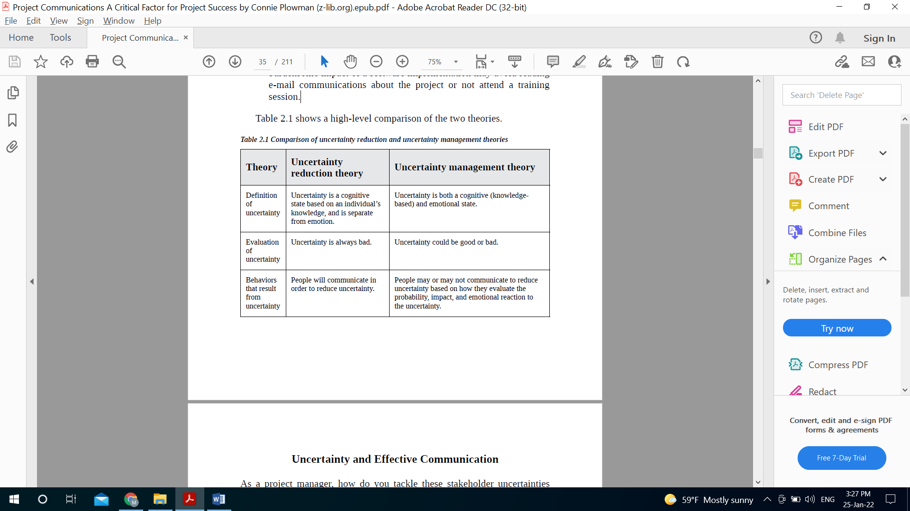

Slide 35
Section Two
Uncertainty and Effective communication

Slide 36
Uncertainty and Effective communication
Aspects of Effective communication
As a project manager, how do you tackle these stakeholder uncertainties that can impact your project? Through communication! Specifically, by communicating enough (quantity) and by communicating well (quality).
Let’s look at both of these aspects.
Quantity of Communication
People can’t act on, or react to, information they do not have. If information is a primary way to reduce or manage uncertainty, lack of communication limits stakeholders’ ability to make sense of the situation and make decisions about how to think, feel, and act. Often they fill in the gaps with assumptions, or they may speak negatively about the project out of frustration.

Slide 37
Uncertainty and Effective communication
Aspects of Effective communication
As a project manager, how do you tackle these stakeholder uncertainties that can impact your project? Through communication! Specifically, by communicating enough (quantity) and by communicating well (quality).
Let’s look at both of these aspects.
The more they are invested in or affected by the project, the more they are likely to make assumptions and share those assumptions with peers, such as spreading gossip or rumors. Quantity of information does not necessarily mean sending more e-mails —most workers already feel like their inboxes are flooded. However, you do need to ensure information is available to people when and how they need it. We will address ways to do this in the next two chapters, where we discuss audience communication preferences, and basic guidelines and considerations for project communications.

Slide 38
Uncertainty and Effective communication
Aspects of Effective communication
As a project manager, how do you tackle these stakeholder uncertainties that can impact your project? Through communication! Specifically, by communicating enough (quantity) and by communicating well (quality).
Let’s look at both of these aspects.
Another aspect to consider is that communication is not all verbal; in fact, much of it is not. A significant amount of meaning is communicated through physical cues (facial expressions and body language) and voice (tone, inflection, and other vocal cues outside of the words themselves).
This means that communications you are delivering through methods that use only text or voice will have reduced effectiveness.

Slide 39
Uncertainty and Effective communication
Aspects of Effective communication
As a project manager, how do you tackle these stakeholder uncertainties that can impact your project? Through communication! Specifically, by communicating enough (quantity) and by communicating well (quality).
Let’s look at both of these aspects.
Virtual teams especially can be impacted by this. When there is limited face-to-face interaction, even via methods such as video calls, teams can struggle to develop an effective approach to working together because the opportunities to reduce uncertainty are decreased. If the vast majority of the team’s interactions are, in fact, virtual, the team will need to work harder to compensate for the lack of nonverbal communication.

Slide 40
Uncertainty and Effective communication
Aspects of Effective communication
Quality of Communication
Listen to the example

Slide 41
Uncertainty and Effective communication
Aspects of Effective communication
Quality of Communication
High-quality communication gets your message across clearly and effectively.
Quality communication requires that the person sending the message must make sure that the message he or she wants to send is accurately received. One way to do this is to be clear and specific about what you are communicating. If you need a task completed by 3 p.m. tomorrow, don’t just say “tomorrow afternoon.”

Slide 42
Uncertainty and Effective communication
Aspects of Effective communication
Quality of Communication
When communicating an assignment or request, provide as much SMART information as you can:
Specific
Measurable
Attainable
What is the scope of what needs to be done? Make sure the assignment is clearly defined.
How will you determine completion/success? State any metrics or parameters for measuring and tracking progress.
Is what you are asking attainable in the parameters given? Ask for feedback on this from the team member(s) involved.

Slide 43
Uncertainty and Effective communication
Aspects of Effective communication
Quality of Communication
When communicating an assignment or request, provide as much SMARTinformation as you can:
Relevant
Time bonded
Have you tied the task to the overall project goals? Ensure team members involved understand why this task is important.
What is the deadline for this task? Be as precise as you can.

Slide 44
Uncertainty and Effective communication
Aspects of Effective communication
Quality of Communication
Limit your vocab
Another way to communicate clearly is to limit your use of vocabulary that is not universally understood, a.k.a. jargon. Project management uses a lot of technical terminology; just a few examples are “critical path,” “free float,” and “lag,” not to mention acronyms like EVM, LOE, and RACI. Be conscious that many stakeholders and even team members who are new to project management may not understand these terms.

Slide 45
Uncertainty and Effective communication
Aspects of Effective communication
Quality of Communication
Get Feedback
A third way to ensure quality of communication is to seek feedback from the receiver to verify that they understood what you intended to communicate. You can consider feedback a means of quality assurance in your communications.

Slide 46
Thank you

