Slide 1

Data Types and Input-Output Operations
Prepared by Dr. Hamada I. AbdulWakel
Lecture 2
CYB550
Programming Foundations In Python

Slide 2

Lecture 2
CONTACT ME ON
ESU email:
  hamada@esu.ac.ae
  (Subject name: "Python Foundations Course: Question")
Discussion Schedule.
  Will be announced by ESU.

Slide 3
Lecture 2
GRADING
Assessment tasks:
  Assignments.
  Quizzes. (4 points * 10 lectures).
  Midterm. 20 points.
  Final exam. 40 points.

Slide 4
Lecture 2
RECAP: LECTURE ONE
Problem solving is a process of information processing.
Converting information processing into algorithm.
Python programming language.
Requirements for python.

Slide 5
Lecture 2
MODULE OBJECTIVES
Describing the basic phases of software development.
Dealing with input and output operations in python.
Knowing the data types and using variables.
Constructing arithmetic expressions.

Slide 6
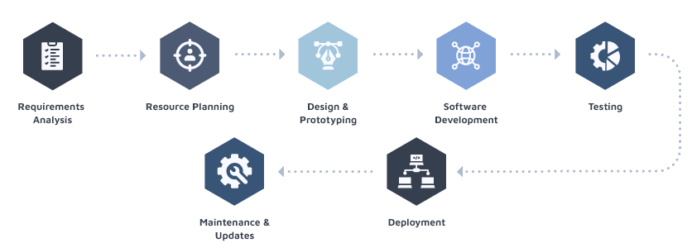
Lecture 2
THE SOFTWARE DEVELOPMENT PROCESS
Software development: process of planning and organizing a program.
Software Development Life Cycle (SDLC).

Slide 7
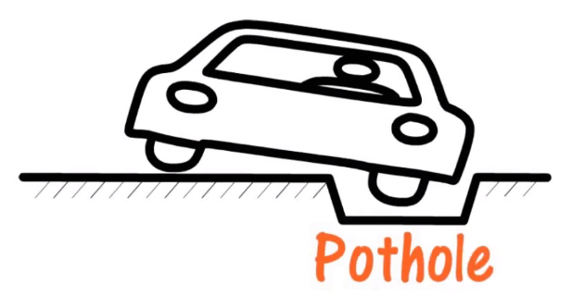
Lecture 2
SDLC APPROACHES: THINK & SOLVE
Notes:
Analysis and design may produce a prototype of a system for coding, and then back up to earlier phases to fill in more details after some testing

Slide 8
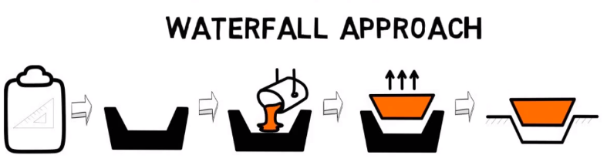
Lecture 2
SDLC APPROACHES: THINK & SOLVE
Cont'd
Notes:
Analysis and design may produce a prototype of a system for coding, and then back up to earlier phases to fill in more details after some testing

Slide 9
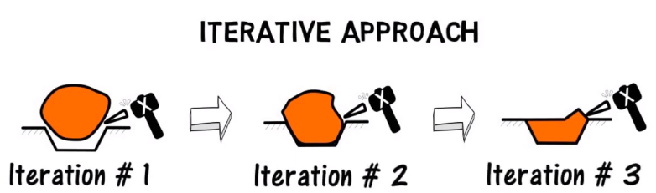
Lecture 2
SDLC APPROACHES: THINK & SOLVE
Cont'd
Notes:
Analysis and design may produce a prototype of a system for coding, and then back up to earlier phases to fill in more details after some testing

Slide 10
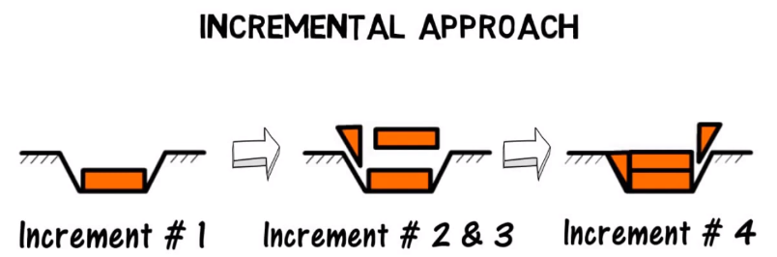
Lecture 2
SDLC APPROACHES: THINK & SOLVE
Cont'd
Notes:
Analysis and design may produce a prototype of a system for coding, and then back up to earlier phases to fill in more details after some testing

Slide 11
Lecture 2
SDLC APPROACHES
There are different approaches that could be followed:
  The Waterfall Model.
  The iterative Model.
  The incremental Model.
Notes:
Analysis and design may produce a prototype of a system for coding, and then back up to earlier phases to fill in more details after some testing

Slide 12
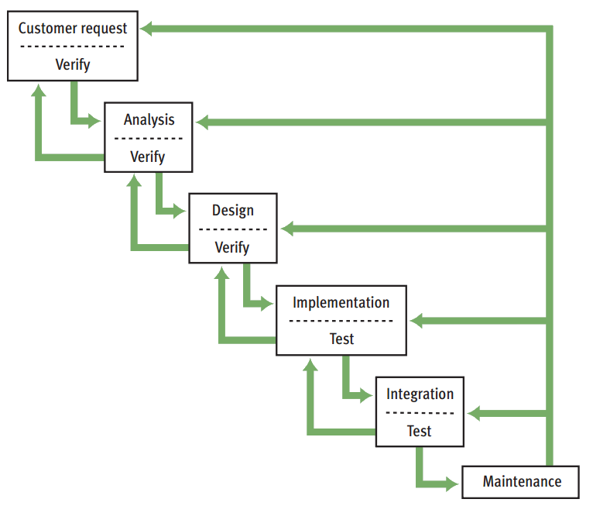
Lecture 1
SDLC APPROCAHES: WATERFALL MODEL
Notes:
Programs rarely work as hoped the first time they are run
Must perform extensive and careful testing

Slide 13
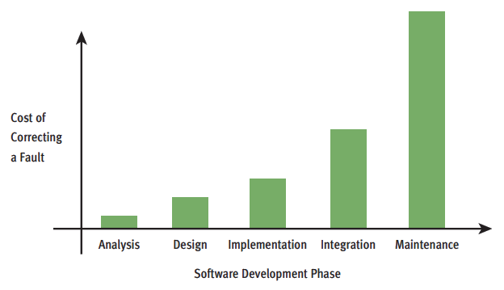
Lecture 1
COST OF CORRECTING A FAULT

Slide 14
Lecture 2
CASE STUDY: INCOME TAX CALCULATOR
Each year nearly everyone with an income faces the unpleasant task of computing his or her income tax return.
Notes:
Analysis and design may produce a prototype of a system for coding, and then back up to earlier phases to fill in more details after some testing

Slide 15
Lecture 2
CASE STUDY: INCOME TAX CALCULATOR
REQUEST & ANALYSIS
Cont'd
The customer requests a program that computes a person’s income tax.
  Gross income required.
  Flat tax rate 20%.
  $10000 standard deduction.
  For each dependent, there is a $2000 deduction.
Enter the gross income: 150000.00
Enter the number of dependent: 3
The income tax is $26800.00
Notes:
Analysis and design may produce a prototype of a system for coding, and then back up to earlier phases to fill in more details after some testing

Slide 16
Lecture 2
CASE STUDY: INCOME TAX CALCULATOR
DESIGN
Cont'd
An English-style algorithm is called Pseudocode.
- Input the gross income and number of dependents.
- Computer the taxable income using the formula
Taxable income = gross income – 10000 - (2000 * number of dependent)
- Compute the income tax using the formula
Tax = taxable income * 0.20
- Print the tax
Notes:
Analysis and design may produce a prototype of a system for coding, and then back up to earlier phases to fill in more details after some testing

Slide 17
Lecture 2
CASE STUDY: INCOME TAX CALCULATOR
IMPLEMENTATION
Cont'd
Python code later
Notes:
Analysis and design may produce a prototype of a system for coding, and then back up to earlier phases to fill in more details after some testing

Slide 18
Lecture 2
CASE STUDY: INCOME TAX CALCULATOR
TESTING
Cont'd
Error types:
  Syntax error: occurred due to the mistakes while typing or do not follow the syntax of the specified programming language.
  Run-time error: When the program is running, and it is not able to perform the operation.
  Logical error: an error that leads to an undesired output.
May use a test suite to test if program is correct.
Notes:
Analysis and design may produce a prototype of a system for coding, and then back up to earlier phases to fill in more details after some testing

Slide 19
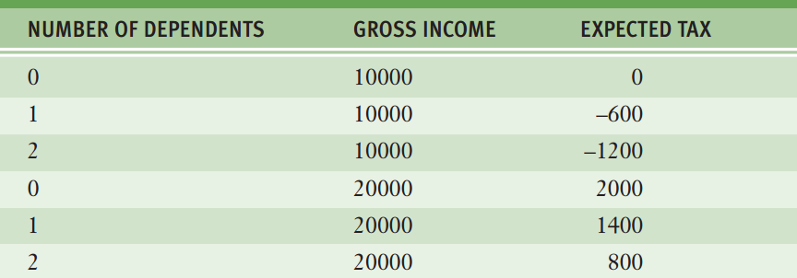
Lecture 2
CASE STUDY: INCOME TAX CALCULATOR
TESTING
Cont'd
Notes:
Analysis and design may produce a prototype of a system for coding, and then back up to earlier phases to fill in more details after some testing

Slide 20
Lecture 2
DISPLAYING OUTPUTS IN PYTHON
Almost all programs have solutions that needed to be displayed to the user through outputting data from the program.
  Use the print() function.
    help(print)
    print("Hello", "Ahmed")
    print("Hello", "Ahmed", sep="000")
    Print("Hello", "Ahmed", end="1111")
Notes:
Analysis and design may produce a prototype of a system for coding, and then back up to earlier phases to fill in more details after some testing

Slide 21
Lecture 2
VARIABLES IN PYTHON
print("In 2007.")
print("Micaela paid $120,000 for her house.")
print("Micaela' house at 24 East Maple Street.")
Notes:
Analysis and design may produce a prototype of a system for coding, and then back up to earlier phases to fill in more details after some testing

Slide 22
Lecture 2
VARIABLES IN PYTHON
print("In 2007.")
print("Aly paid $120,000 for her house.")
print("Aly' house at 24 East Maple Street.")
Notes:
Analysis and design may produce a prototype of a system for coding, and then back up to earlier phases to fill in more details after some testing

Slide 23
Lecture 2
VARIABLES IN PYTHON
Cont'd
Person_name = "Ahmed"
print("In 2007.")
print(Person_name + " paid $120,000 for her house.")
print(Person_name + " house at 24 East Maple Street.")
Notes:
Analysis and design may produce a prototype of a system for coding, and then back up to earlier phases to fill in more details after some testing

Slide 24
Lecture 2
VARIABLES IN PYTHON
Cont'd
Person_name = "Ahmed"
Money = "120000"
print("In 2007.")
print(Person_name + " paid $" + Money + " for her house.")
print(Person_name + " house at 24 East Maple Street.")
Notes:
Analysis and design may produce a prototype of a system for coding, and then back up to earlier phases to fill in more details after some testing

Slide 25
Lecture 2
VARIABLES IN PYTHON
Cont'd
Person_name = "Ahmed"
Money = "120000"
print("In 2007.")
print(Person_name + " paid $" + Money + " for her house.")
Person_name = "Aly"
print(Person_name + " house at 24 East Maple Street.")
Notes:
Analysis and design may produce a prototype of a system for coding, and then back up to earlier phases to fill in more details after some testing

Slide 26
Lecture 2
DATA TYPES IN PYTHON
Python is a type-less language.
  X = 10
  X = "Hello world"
The variable name refers to the memory location where its value store.
  I = 10 J = 10
  print (id(I), id(J))
Notes:
Analysis and design may produce a prototype of a system for coding, and then back up to earlier phases to fill in more details after some testing

Slide 27
Lecture 2
DATA TYPES IN PYTHON
Cont'd
A variable name must begin with either a letter or an underscore (_)
It contains any number of letters, digits, or other underscores.
Variable names are case sensitive;
  WEIGHT = 50
  Weight = 50.
Variable name could be unicode, means you can have س as a variable name.
Notes:
Analysis and design may produce a prototype of a system for coding, and then back up to earlier phases to fill in more details after some testing

Slide 28
Lecture 2
DATA TYPES IN PYTHON
Cont'd
Main data types:
  Strings. A set of characters enclosed by " "
  Numbers. A number written without ""
  Booleans. True or False value.
  List.
  Tuple.
  Dictionary.
Use type(var_name) to know variable type.
Notes:
Analysis and design may produce a prototype of a system for coding, and then back up to earlier phases to fill in more details after some testing

Slide 29
Lecture 2
STRING DATA TYPE IN PYTHON
A string literal is a sequence of characters enclosed in single or double quotation marks.
  Examples:
    Name = "Hamada"
    Name = str("Ibrahim")
    Desc = ' ' ' Hello I'm from "Egypt" ' ' '
    On python shell: """ test test"""
  Strings are Immutable
    text[2] = 'x' not supported
Notes:
Analysis and design may produce a prototype of a system for coding, and then back up to earlier phases to fill in more details after some testing

Slide 30
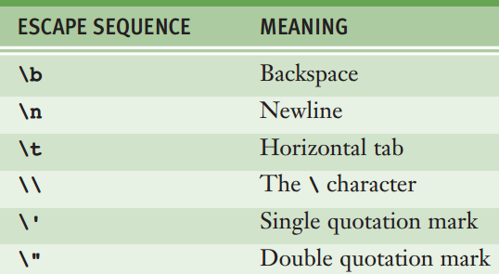
Lecture 2
STRING DATA TYPE IN PYTHON
Cont'd
Escape sequences are characters used to express special characters as literals.
Notes:
Analysis and design may produce a prototype of a system for coding, and then back up to earlier phases to fill in more details after some testing

Slide 31
Lecture 2
STRING DATA TYPE IN PYTHON
Cont'd
A string functions:
  Use + and * with strings
  text.lower() vs. text.upper()
  text.isupper() vs. text.islower()
  len(text)
  text[0] vs. text[0:3]
Notes:
Analysis and design may produce a prototype of a system for coding, and then back up to earlier phases to fill in more details after some testing

Slide 32
Lecture 2
STRING DATA TYPE IN PYTHON
Cont'd
A string functions:
  text.index("a") vs. index("asd")
  text.replace("old", "new")
  print(text.lower().islower())
  print("subtext" in "text")
Notes:
Analysis and design may produce a prototype of a system for coding, and then back up to earlier phases to fill in more details after some testing

Slide 33
Lecture 2
STRING DATA TYPE IN PYTHON
Cont'd
A string functions:
  var.isalnum() vs. var.isalpha() vs. var.isdigit()
  chr(65) vs. ord('A')
Notes:
Analysis and design may produce a prototype of a system for coding, and then back up to earlier phases to fill in more details after some testing

Slide 34
Lecture 2
NUMERIC DATA TYPE IN PYTHON
Python’s int data type consists of the integers from (–2³¹) to (2³¹ – 1).
When the value of an integer exceeds these limits, Python automatically uses the long (L) data type to represent it.
Python uses floating-point numbers to represent real numbers.
Complex numbers (e.g., 3 + 2j) are also supported.
Notes:
Analysis and design may produce a prototype of a system for coding, and then back up to earlier phases to fill in more details after some testing

Slide 35
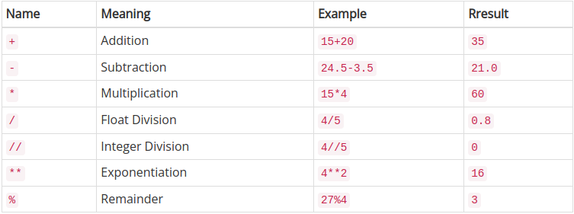
Lecture 2
NUMERIC DATA TYPE IN PYTHON
Cont'd
Notes:
Analysis and design may produce a prototype of a system for coding, and then back up to earlier phases to fill in more details after some testing

Slide 36
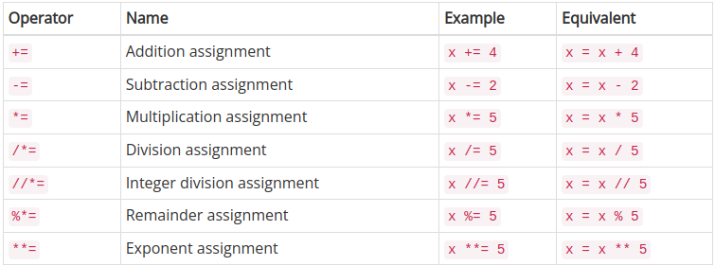
Lecture 2
NUMERIC DATA TYPE IN PYTHON
Cont'd
Notes:
Analysis and design may produce a prototype of a system for coding, and then back up to earlier phases to fill in more details after some testing

Slide 37
Lecture 2
NUMERIC DATA TYPE IN PYTHON
Cont'd
Numeric functions:
  bin(50), oct(50), hex(50)
  int(0x32)
  abs(-5)
  pow(2, 3)
  max(4, 5)
  min(4, 5)
  round(3.7)
Notes:
Analysis and design may produce a prototype of a system for coding, and then back up to earlier phases to fill in more details after some testing

Slide 38
Lecture 2
COMMENTS IN PYTHON
A comment is a piece of program text that the interpreter ignores but that provides useful documentation to programmers.
  Using # symbol.
  """ …... """
Notes:
Analysis and design may produce a prototype of a system for coding, and then back up to earlier phases to fill in more details after some testing

Slide 39
Lecture 2
ASSIGNMENT STATEMENT IN PYTHON
Variables receive their initial values and can be reset to new values with an assignment statement.
  Variable defining/initializing
  Variable references.
  <var_name> = <expr>
Notes:
Analysis and design may produce a prototype of a system for coding, and then back up to earlier phases to fill in more details after some testing

Slide 40
Lecture 2
EXPRESSIONS IN PYTHON
Expressions provide an easy way to perform operations on data values to produce other data values.
An arithmetic expression consists of operands and operators.
  Operators:
    -, *, /, +
Notes:
Analysis and design may produce a prototype of a system for coding, and then back up to earlier phases to fill in more details after some testing

Slide 41
Lecture 2
EXPRESSIONS IN PYTHON
Cont'd
Rule of priority, that is some operator has highest priority than others.
  ()
  **
  Unary operator
  *, /, %
  +, -
Rule of associativity, evaluate expression of similar priority from left to right.
  Ex: 2+5-1
Notes:
Analysis and design may produce a prototype of a system for coding, and then back up to earlier phases to fill in more details after some testing

Slide 42
Lecture 2
GETTING INPUTS IN PYTHON
Almost all programs interact with the user through giving data to the program to process it and display other data.
  Use the input() function.
    input()
    input("Enter your name: ")
    name = input("Enter your name: ")
    Age = int(input("Enter your Age: "))
Notes:
Analysis and design may produce a prototype of a system for coding, and then back up to earlier phases to fill in more details after some testing

Slide 43
Lecture 2
SIMPLE CALCULATOR IN PYTHON
Num1 = input("Enter the first number: ")
Num2 = input("Enter the second number: ")
Result = Num1 + Num2
print(Result)
Notes:
Analysis and design may produce a prototype of a system for coding, and then back up to earlier phases to fill in more details after some testing

Slide 44
Lecture 2
CASE STUDY: INCOME TAX CALCULATOR
IMPLEMENTATION
Try to implement it!!!
Notes:
Analysis and design may produce a prototype of a system for coding, and then back up to earlier phases to fill in more details after some testing

Slide 45
THANK YOU

