Slide 1

Introduction to Cryptography
Prepared by Dr. Mohammad Alkhatib
Associate Professor
Major: Information Security
Lecture #10: User Authentication

Slide 2

Module 3
Topics to be covered
User Authentication Methods
Password Authentication & Vulnerabilities
Countermeasures
Password Cracking or Guessing
Password Selection Techniques
Token-Based Authentication
Biometric Authentication
Remote User Authentication

Slide 3
Module 3
User Authentication
Importance
Authentication Process
Fundamental building block and primary line of defense
Basis for access control and user accountability
Identification step
    Presenting an identifier to the security system
Verification step
    Presenting or generating authentication information that corroborates the binding between the entity and the identifier

Slide 4
Module 3
User Authentication Methods
The four means of authenticating user identity are based on
something the individual knows
password, PIN, answers to prearranged questions
something the individual possesses (token)
smartcard, electronic keycard, physical key
something the individual is (static biometrics)
fingerprint, retina, face
something the individual does (dynamic biometrics)
voice pattern, handwriting, typing rhythm

Slide 5
Module 3
Password Authentication
Widely used line of defense against intruders:
  User provides name/login and password
  System compares password with the one stored for that specified login
The user ID:
  Determines that the user is authorized to access the system
  Determines the user’s privileges
  Used in discretionary access control

Slide 6
Module 3
Password Vulnerabilities
offline dictionary attack
specific account attack
popular password attack
password guessing against single user
workstation hijacking
exploiting user mistakes
exploiting multiple password use
electronic monitoring

Slide 7
Module 3
Passwords Vulnerabilities
Offline dictionary attack: Typically, strong access controls are used to protect the system’s password file. However, experience shows that determined hackers can frequently bypass such controls and gain access to the file. The attacker obtains the system password file and compares the password hashes against hashes of commonly used passwords. If a match is found, the attacker can gain access by that ID/password combination.
• Specific account attack: The attacker targets a specific account and submits password guesses until the correct password is discovered.
• Popular password attack: A variation of the preceding attack is to use a popular password and try it against a wide range of user IDs. A user’s tendency is to choose a password that is easily remembered; this unfortunately makes the password easy to guess.
• Password guessing against single user: The attacker attempts to gain knowledge about the account holder and system password policies and uses that knowledge to guess the password.

Slide 8
Module 3
Passwords Vulnerabilities
Workstation hijacking; The attacker waits until a logged-in workstation is unattended.
• Exploiting user mistakes: If the system assigns a password, then the user is more likely to write it down because it is difficult to remember. This situation creates the potential for an adversary to read the written password. A user may intentionally share a password, to enable a colleague to share files, for example.
• Exploiting multiple password use. Attacks can also become much more effective or damaging if different network devices share the same or a similar password for a given user.
• Electronic monitoring: If a password is communicated across a network to log on to a remote system, it is vulnerable to eavesdropping. Simple encryption will not fix this problem, because the encrypted password is, in effect, the password and can be observed and reused by an adversary

Slide 9
Module 3
Countermeasures
Controls to prevent unauthorized access to password file
Intrusion detection measures
Rapid reissuance of compromised passwords
Account lockout mechanisms
Policies to inhibit users from selecting common passwords
Training in and enforcement of password policies
Automatic workstation logout
Policies against similar passwords on network devices

Slide 10
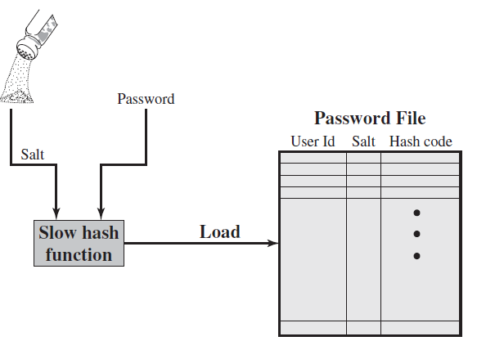
Module 3
Use of Hashed Passwords
Creating a password

Slide 11
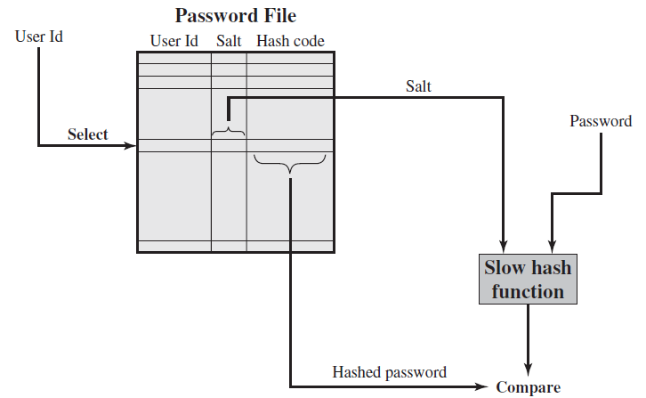
Module 3
Use of Hashed Passwords
Verifying a password

Slide 12
Module 3
Use of Hashed Passwords
Password is combined with a fixed-length salt value
Password and salt value serve as inputs to a hashing algorithm to produce a fixed-length hash code
Hashed password is then stored, together with a plaintext copy of the salt
Why the salt value?
  Prevents duplicate passwords from being visible
  Increases the difficulty of offline dictionary attacks
  Nearly impossible to find out the use of same password on many systems

Slide 13
Module 3
Password Cracking or Gussing
Dictionary attacks
  Develop a large dictionary of possible passwords and try each against the password file
  Each password must be hashed using each salt value and then compared to stored hash values
Rainbow table attacks
  Pre-compute tables of hash values for all salts
  A mammoth table of hash values
  Can be countered by using a sufficiently large salt value and a sufficiently large hash length

Slide 14
Module 3
Password File Access Control
It can block offline guessing attacks by denying access to encrypted passwords
  Make available only to privileged users
  Shadow password file
  A separate file from the user IDs where the hashed passwords are kept
Vulnerabilities
  Weakness in the OS that allows access to the file
  Accident with permissions making it readable
  Users with same password on other systems
  Access from backup media
  Sniff passwords in network traffic

Slide 15
Module 3
User Password Choices
Short passwords
  A study on 54 machines reveals that almost 3% of the passwords were three characters or fewer in length
Guessable passwords
  A study shows that after collecting 14000 encrypted passwords, nearly one-fourth of the passwords were guessed

Slide 16
Module 3
Password Selection Techniques
User education
Importance of using hard to guess passwords
Computer generated passwords
users have trouble remembering them
Reactive password checking
system periodically runs its own password cracker to find guessable passwords
Proactive password checking
Eliminate guessable passwords while allowing the user to select a password that is memorable
Provide guidelines for selecting strong passwords
System checks if the password is allowable, and if not, rejects it

Slide 17
Module 3
Proactive Password Checking
Rule enforcement
  Specific rules that passwords must compatible to use
Password cracker
  Compile a large dictionary of passwords not to use (Two problems: space and time)

Slide 18
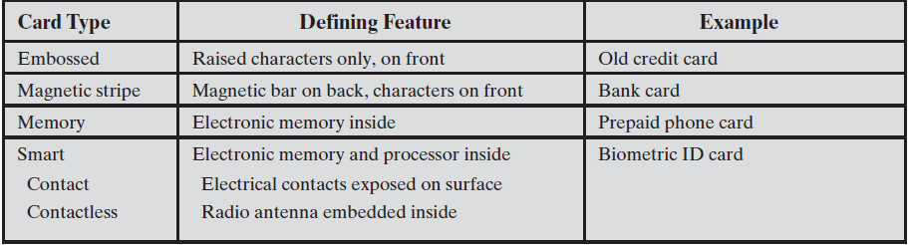
Module 3
Token-Based Authentication
Objects that a user possesses for the purpose of user authentication are called tokens

Slide 19
Module 3
Memory Cards
Store but do not process data
Most common is the magnetic stripe card
Include an internal electronic memory
Used alone for physical access
Provides significantly greater security when combined with a password or PIN
Drawbacks:
  Requires a special reader
  Loss of token
  User dissatisfaction

Slide 20
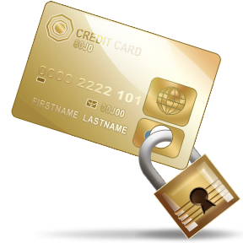
Module 3
Smart Cards
Physical characteristics:
  Include an embedded microprocessor
  A smart token that looks like a bank card
  Can look like calculators, keys, small portable objects
Interface:
  Manual interfaces include a keypad and display for interaction
  Electronic interfaces communicate with a compatible reader/writer

Slide 21
Module 3
Smart Cards
Contain:
  An entire microprocessor
    Processor
    Memory
    I/O ports
Typically include three types of memory:
  Read-only memory (ROM)
    Stores data that does not change during the card’s life
  Electrically erasable programmable ROM (EEPROM)
    Holds application data and programs
  Random access memory (RAM)
    Holds temporary data generated when applications are executed

Slide 22
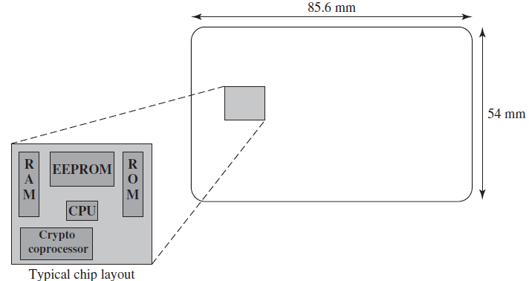
Module 3
Smart Cards

Slide 23
Module 3
Biometric Authentication
Attempts to authenticate an individual based on unique physical characteristics
Based on pattern recognition
Is technically complex and expensive when compared to passwords and tokens
Physical characteristics used include:
  Facial characteristics
  Fingerprints
  Hand geometry
  Retinal pattern
  Iris
  Signature
  Voice

Slide 24
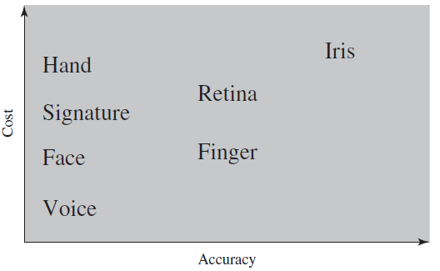
Module 3
Cost and Accuracy

Slide 25
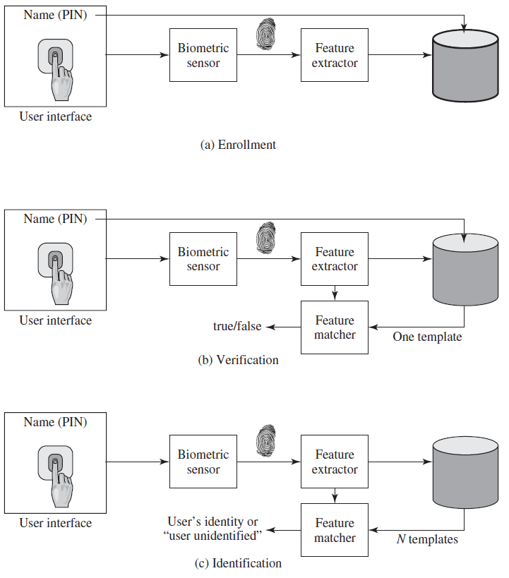
Module 3
Operations

Slide 26


Module 3
Remote User Authentication
Authentication over a network, the Internet, or a communications link is more complex
  Additional security threats such as:
    Eavesdropping, capturing a password, replaying an authentication sequence that has been observed
Generally rely on some form of a challenge-response protocol to counter threats

