Slide 1

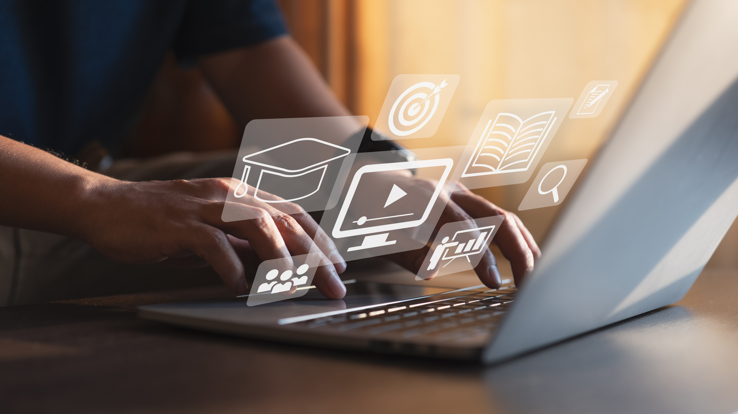

Digital Content Direction
Prepared by Dr. Sherihan Mohamed
DGM 733
Revision Lecture

Slide 2
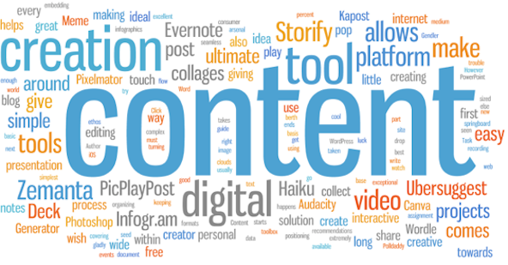


Digital Content: Purpose and Goals
Lecture 1

Slide 3


Lecture 1
Lecture Outlines:
* Digital Content: A Closer Look
* Who Creates Digital Content?
* Content Creators
* Web 2.0 and Convergence Culture
* Conclusion
* References

Slide 4

Digital Content: production media
Lecture 2

Slide 5

Lecture 2
Lecture Outlines:
* Digital Journalism: the line between ‘Producer’ and ‘Consumer’
* What is ‘Journalism’? Who Are ‘Journalists’?
* Digital Journalism: Key Features
* New Journalistic Identities
* Journalists on Social Media
* Conclusion
* References

Slide 6
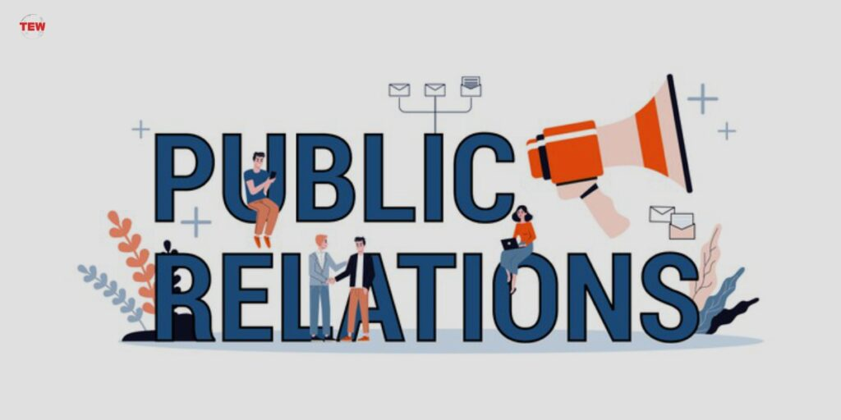
Digital Content: production media
Lecture 3

Slide 7

Lecture 3
Lecture Outlines:
* Public Relations: What Is PR?
* Copywriting, Editing and Other Essentials.
* Risk and Crisis Management.
* Convergence and SMIs.
* Who Are SMIs?
* Conclusion
* References

Slide 8
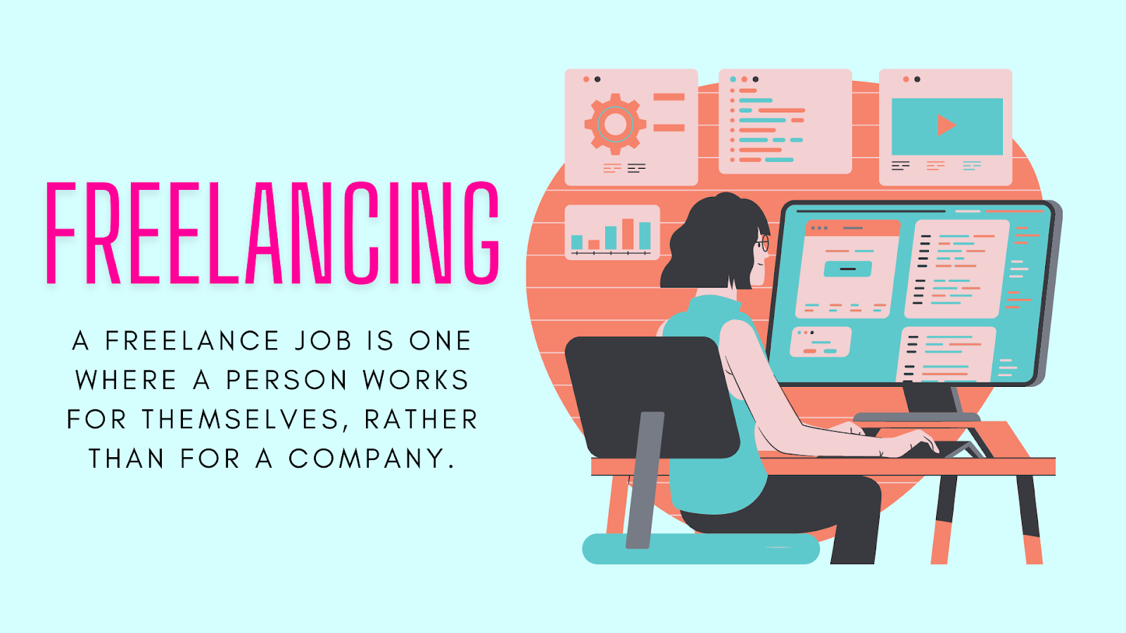
Digital Content: production media
Lecture 4

Slide 9

Lecture 4
Lecture Outlines:
* What Is Freelancing?
* Understanding Freelancers.
* Benefits and Drawbacks of Being a Freelancer.
* Types of Freelancers.
* Conclusion
* References

Slide 10

Digital Content: production media
Lecture 5

Slide 11
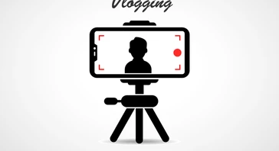
Digital Content: production media
Lecture 5

Slide 12

Lecture 5
Lecture Outlines:
(Podcasting)
* What Are Podcasts?
* Types of Podcasts.
* Why Podcasts?
(Vlogging)
* Vlogs: Definition and a Brief History.
* Why Vlogging?
* Who Are the Vloggers?
* Conclusion
* References

Slide 13

Audiences and Target Audiences
Lecture 6

Slide 14

Lecture 6
Lecture Outlines:
(Audiences and Target Audiences)
* Key Concepts of Audience Research.
* Audience Trends in an Era of Media Convergence.
* Identifying and Reaching Target Audience.
* Audience Analytics.
* Conclusion.
* References.

Slide 15

Social Media in Content Production
Lecture 7

Slide 16
Lecture 7
Lecture Outlines:
(Social Media in Content Production)
* Which Platform Should a Content Producer Use? When? Why?
* Social Media Monitoring/Listening.
* Social Media Strategy.
* Conclusion.
* References.

Slide 17
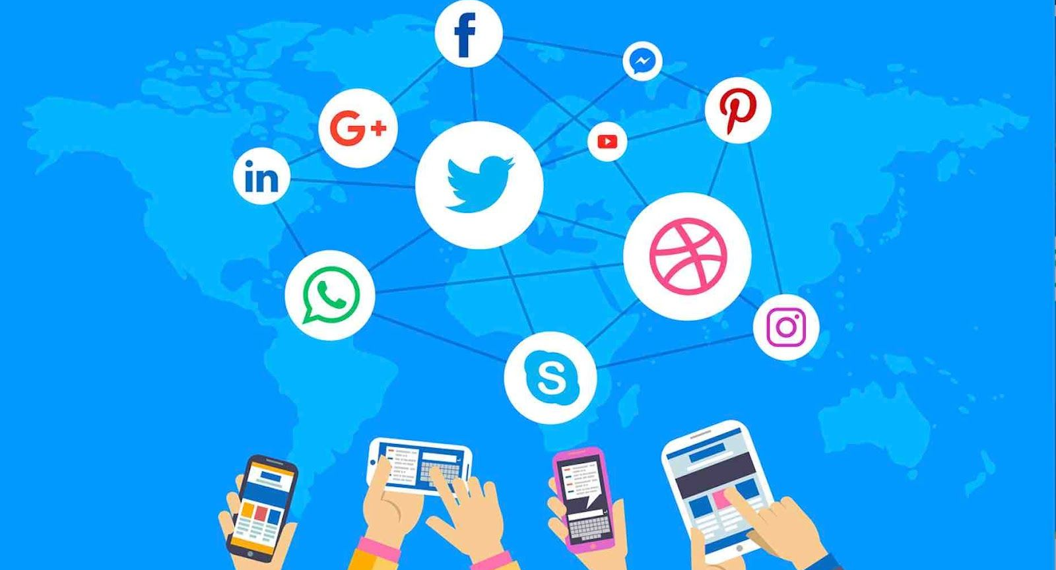
Social Media in Content Production
Lecture 8

Slide 18

Lecture 8
Lecture Outlines:
(Social Media in Content Production)
* From direct contact to distributed media.
* A more participatory media environment for many.
* Why Are You on Social Media?
* Sorting Out Fact from Fiction.
* Conclusion.
* References.

Slide 19

Online Community Management
and Content Moderation
Lecture 9

Slide 20

Lecture 9
Lecture Outlines:
(Online Community Management)
* What Are Online Communities?
* Online Community Managers.
* Who’s Who in the Online Community?
* Conclusion.
* References.

Slide 21

Online Community Management
and Content Moderation
Lecture 10

Slide 22

Lecture 10
Lecture Outlines:
(Content Moderation)
* Content Moderators.
* Content Producers.
* Responding to Hostility, Misinformation and Disinformation.
* Resources for Community Managers and Content Moderators.
* Conclusion.
* References.

Slide 23


Thank You

Slide 24

Digital Content
Direction
Revision Lecture
DGM 733
Prepared by:
Dr. Sherihan Mohamed

