Slide 1


Software Engineering
Prepared by Dr. Yasser Abdelhamid
IT 382
Software Engineering
Lecture 5

Slide 2

Lecture Outline
Agile software development
Agile methods
Principles of Agile methods
Problems with agile methods
When to use agile
Extreme programming
midocean.edu.km

Slide 3
Rapid software development
Rapid development and delivery is now often the most important requirement for software systems
Businesses operate in a fast –changing requirement and it is practically impossible to produce a set of stable software requirements
Software has to evolve quickly to reflect changing business needs

Slide 4
Agile methods
Dissatisfaction with the overheads involved in software design methods of the 1980s and 1990s led to the creation of Agile methods.
  Focus on the code rather than the design
  Are based on an iterative approach to software development
  Are intended to deliver working software quickly and evolve quickly to meet changing requirements.

Slide 5
Agile methods
The aim of agile methods is to reduce overheads in the software process (e.g. by limiting documentation) and to be able to respond quickly to changing requirements without excessive rework.

Slide 6
Agile Manifesto
We are uncovering better ways of developing software by doing it and helping others do it.
  Working software over comprehensive documentation
  Customer collaboration over contract negotiation
  Responding to change over following a plan

Slide 7
principles of agile methods
Customer involvement
Incremental delivery
People not process
Embrace change
Maintain simplicity

Slide 8
Customer involvement
Customers should be closely involved throughout the development process. Their role is providing and prioritizing new system requirements and to evaluate the iterations of the system.

Slide 9
Incremental delivery
The software is developed in increments with the customer specifying the requirements to be included in each increment.

Slide 10
People not process
The skills of the development team should be recognized and exploited. Team members should be left to develop their own ways of working without prescriptive processes.

Slide 11
Embrace change
Expect the system requirements to change and so design the system to accommodate these changes.

Slide 12
Maintain simplicity
Focus on simplicity in both the software being developed and in the development process.
Wherever possible, actively work to eliminate complexity from the system.

Slide 13
When Agile is Suitable?
Small or medium-sized product for sale.
Where there are not a lot of external rules and regulations that affect the software.
Agile method applicability
Custom system development within an organization (not distributed)
There is commitment from the customer to become involved in the development process

Slide 14
Problems with agile methods
keeping the interest of customers
Suitability of team members
Multiple stackholders
Extra work for maintaining simplicity
Contracts

Slide 15
keeping the interest of customers
It can be difficult to keep the interest of customers who are involved in the process.

Slide 16
Suitability of team members
Team members may be unsuited to the intense involvement that characterizes agile methods.

Slide 17
Multiple stackholders
Prioritizing changes can be difficult where there are multiple stakeholders.

Slide 18
Extra work for maintaining simplicity
Maintaining simplicity requires extra work.

Slide 19
Contracts
Contracts may be a problem as with other approaches to iterative development.

Slide 20
When to use agile
Is it important to have a very detailed specification and design before moving to implementation?
Is an incremental delivery strategy, where you deliver the software to customers and get rapid feedback from them, realistic?
How large is the system that is being developed?
What type of system is being developed?
What is the expected system lifetime?
What technologies are available to support system development?
How is the development team organized?
Are there cultural or organizational issues that may affect the system development?
How good are the designers and programmers in the development team?
Is the system subject to external regulation?

Slide 21
Is it important to have a very detailed specification and design before moving to implementation?
If so, you probably need to use a plan-driven approach.

Slide 22
Is an incremental delivery strategy, where you deliver the software to customers and get rapid feedback from them, realistic?
If so, consider using agile methods.

Slide 23
How large is the system that is being developed?
Agile methods are most effective when the system can be developed with a small co-located team who can communicate informally.
this may not be possible for large systems that require larger development teams so a plan-driven approach may have to be used.

Slide 24
What type of system is being developed?
Plan-driven approaches may be required for systems that require a lot of analysis before implementation (e.g. real-time system with complex timing requirements).

Slide 25
What is the expected system lifetime?
Long-lifetime systems may require more design documentation to communicate the original intentions of the system developers to the support team.

Slide 26
What technologies are available to support system development?
Agile methods rely on good tools to keep track of an evolving design

Slide 27
How is the development team organized?
Plan-driven is appropriate if the development team is distributed or if part of the development is being outsourced, then you may need to develop design documents to communicate across the development teams.

Slide 28
Are there cultural or organizational issues that may affect the system development?
Traditional engineering organizations have a culture of plan-based development, as this is the norm in engineering.

Slide 29
How good are the designers and programmers in the development team?
It is sometimes argued that agile methods require higher skill levels than plan-based approaches in which programmers simply translate a detailed design into code

Slide 30
Is the system subject to external regulation?
If a system must be approved by an external regulator (e.g. the FAA approve software that is critical to the operation of an aircraft) then you will probably be required to produce detailed documentation as part of the system safety case.

Slide 31
Extreme programming

Slide 32
Extreme programming
Perhaps the best-known and most widely used agile method.
Extreme Programming (XP) takes an ‘extreme’ approach to iterative development.
  New versions may be built several times per day;
  Increments are delivered to customers every 2 weeks;
  All tests must be run for every build and the build is only accepted if tests run successfully.

Slide 33
XP and agile principles
Incremental development is supported through small, frequent system releases.
Customer involvement means full-time customer engagement with the team.
Pair programming, collective ownership.
Change supported through regular system releases.
Maintaining simplicity through constant refactoring of code.

Slide 34
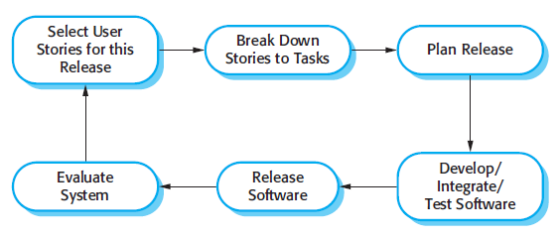
The extreme programming release cycle

Slide 35
Extreme programming practices
Incremental planning
Small releases
Simple design
Test-first development
Refactoring
Pair programming
Collective ownership
Continuous integration
Sustainable pace
On-site customer

Slide 36
Incremental planning
Requirements are recorded on story cards and the stories to be included in a release are determined by the time available and their relative priority. The developers break these stories into development ‘Tasks’.

Slide 37
Small releases
The minimal useful set of functionality that provides business value is developed first.
Releases of the system are frequent and incrementally add functionality to the first release.

Slide 38
Simple design
Enough design is carried out to meet the current requirements and no more.

Slide 39
Test-first development
An automated unit test framework is used to write tests for a new piece of functionality before that functionality itself is implemented.

Slide 40
Refactoring
All developers are expected to refactor the code continuously as soon as possible code improvements are found.
This keeps the code simple and maintainable.

Slide 41
Pair programming
Developers work in pairs, checking each other’s work and providing the support to always do a good job.

Slide 42
Collective ownership
The pairs of developers work on all areas of the system, so that no islands of expertise develop, and all the developers take responsibility for all the code. Anyone can change anything.

Slide 43
Continuous integration
As soon as the work on a task is complete, it is integrated into the whole system. After any such integration, all the unit tests in the system must pass.

Slide 44
Sustainable pace
Large amounts of overtime are not considered acceptable as the net effect is often to reduce code quality and medium-term productivity

Slide 45
On-site customer
A representative of the end-user of the system (the customer) should be available full time for the use of the XP team.
In an extreme programming process, the customer is a member of the development team and is responsible for bringing system requirements to the team for implementation.

Slide 46
Requirements scenarios
In XP, a customer or user is part of the XP team and is responsible for making decisions on requirements.
User requirements are expressed as scenarios or user stories.
These are written on cards and the development team break them down into implementation tasks. These tasks are the basis of schedule and cost estimates.
The customer chooses the stories for inclusion in the next release based on their priorities and the schedule estimates.

Slide 47
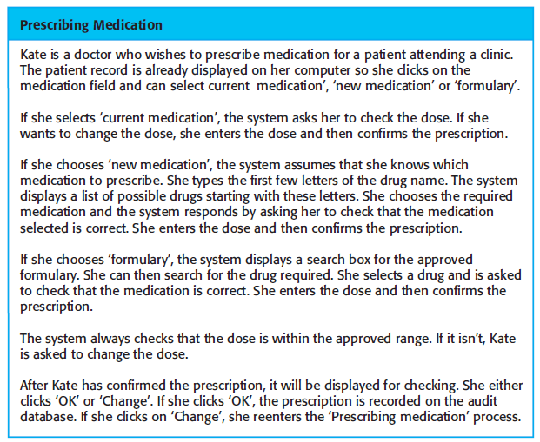
Example:
A ‘prescribing medication’ story

Slide 48
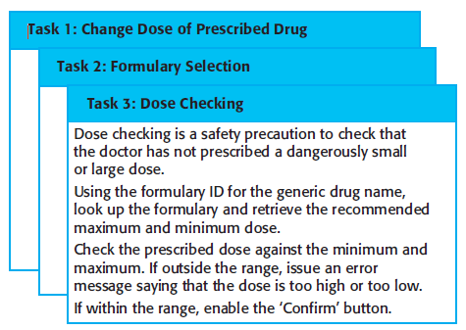
Examples of task cards for prescribing medication

Slide 49
Refactoring

Slide 50
Refactoring
Programming team look for possible software improvements and make these improvements even where there is no immediate need for them.
This improves the understandability of the software and so reduces the need for documentation.
Changes are easier to make because the code is well-structured and clear.
However, some changes requires architecture refactoring and this is much more expensive.

Slide 51
Examples of refactoring
Re-organization of a class hierarchy to remove duplicate code.
Tidying up and renaming attributes and methods to make them easier to understand.
The replacement of inline code with calls to methods that have been included in a program library.

Slide 52
Summary
Agile methods are incremental development methods that focus on rapid development, frequent releases of the software, reducing process overheads and producing high-quality code. They involve the customer directly in the development process.
The decision on whether to use an agile or a plan-driven approach to development should depend on the type of software being developed, the capabilities of the development team and the culture of the company developing the system.
Extreme programming is a well-known agile method that integrates a range of good programming practices such as frequent releases of the software, continuous software improvement and customer participation in the development team.
midocean.edu.km

Slide 53


Thank You

