Slide 1


Human Resource
Management
Prepared by Dr. Sahar Ahmed
Performance Management and Appraisal
HRM 611
Lecture 7

Slide 2

Chapter
Performance Management and Appraisal
7
The purpose of this chapter is to show you how to conduct performance management and appraisal. The main topics we cover include the performance amanagement process, appraisal methods, appraisal performance problems and solutions, performance management, and the appraisal interview.
Notes:
Previous Chapters explained selecting, training, and developing employees. After employees have been on the job for some time, you should appraise their performance.

Slide 3

Chapter
7
LEARNING OUTCOMES
Define performance management and discuss how it differs from performance appraisal.
Set effective performance appraisal standards.
Describe the appraisal process.
Develop, evaluate, and administer at least four performance appraisal tools.
Explain and illustrate the problems to avoid in appraising performance.
Discuss the pros and cons of using different raters to appraise a person’s performance.

Slide 4
Why Appraise Performance?
Chapter
7
Why Appraise Performance?
1
Is basis for pay and promotion decisions.
2
Plays an integral role in performance management.
3
Helps in correcting deficiencies and reinforcing good performance.
4
Is useful in career planning.
Notes:
Appraisals have several purposes that relate both to the appraised employee and the organization.

Slide 5
Basic Concepts in Performance
Management and Appraisal
Chapter
7
Performance Appraisal
Performance Management
Setting work standards, assessing performance, and providing feedback to employees to motivate, correct, and continue their performance.
An integrated approach to ensuring that an employee’s performance supports and contributes to the organization’s strategic aims.
Notes:
Every manager needs some way to appraise employees’ performance. If employees’ performance is good, you’ll want to reinforce it, and if it’s bad, you’ll want to take corrective action.
Performance appraisal means evaluating an employee’s current and/or past performance relative to his or her performance standards.

Slide 6
Chapter
7
Key differences between performance management and
traditional appraisals
Timing: Performance management is continuous, while traditional appraisals are periodic.
Focus: Performance management is goal-oriented and emphasizes development, while traditional appraisals often focus on past performance evaluation.
Involvement: Performance management involves ongoing feedback and coaching, while traditional appraisals rely primarily on annual reviews.

Slide 7
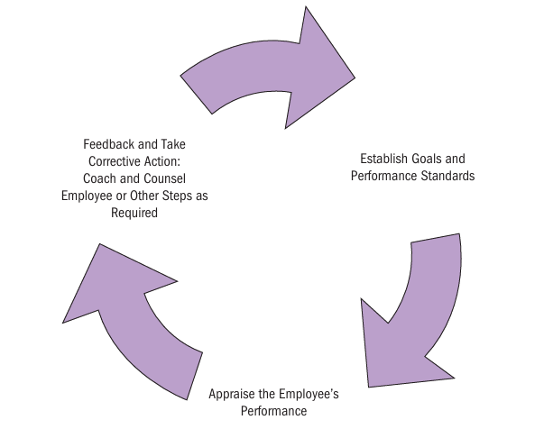
Chapter
The Performance Appraisal Cycle
7
Setting Performance Standards: Clearly defined expectations and goals are established for each employee.
Assessing Performance: Employee performance is evaluated against the set standards.
Providing Feedback: Regular feedback is given to employees to address performance gaps and recognize achievements.

Slide 8
Chapter
Effective Performance Management System
7
Effective Performance Management System
Requires collaboration between employees and supervisors: setting goals, reviewing results, assessing needs, and future planning.
Differs from performance appraisals, which are one-sided evaluations by supervisors focused on the past with minimal employee input.
Utilizes performance feedback, a two-way conversation for employee improvement.
Utilizes past performance data to set goals for the present and future.

Slide 9
Chapter
Designing the Appraisal Tool
7
What to Measure?
Work output (quality and quantity)
Personal competencies
Goal (objective) achievement
How to Measure?
Generic dimensions
Actual job duties
Behavioral competencies
Notes:
The manager generally conducts the actual appraisal using a predetermined and formal tool like one or more of those described next. The two basic questions in designing the actual appraisal tool are what to measure and how to measure it.

Slide 10
Chapter
Defining Employee Goals and Performance Standards
7
Clear and well-defined goals are essential for effective performance management. Employees need to understand how their performance will be evaluated and what is expected of them.
Managers typically use goals, standards, or competencies as performance benchmarks. Goals are specific, measurable, attainable, relevant, and time-bound (SMART) objectives aligned with the company's overall strategy. They provide a clear direction for employees and a measurable way to track progress.
Standards define the expected level of performance for a specific job or task.
Competencies focus on the skills, knowledge, and abilities required to perform a job effectively
Notes:
The evidence suggests that participatively set goals do not consistently result in higher performance than assigned goals, nor do assigned goals consistently result in higher performance than participatively set ones.

Slide 11
Chapter
Setting SMART Objectives
7
Specific, and clearly state the desired results.
Measurable in answering “how much.”
Attainable, and not too tough or too easy.
Relevant to what’s to be achieved.
Timely in reflecting deadlines and milestones.
Notes:
Setting SMART goals assures that a performance appraisal is based on useful, specific, and effective goals.

Slide 12
Chapter
SMART Objective Example
7
Objective: Increase website traffic by 20% by the end of the quarter.
Specific: because it clearly defines what is to be achieved (increase website traffic) and by how much (20%).
Measurable: because it quantifies the desired outcome (20% increase in website traffic). Progress can be tracked using website analytics tools.
Achievable: because it is a realistic and attainable target. The 20% increase is a reasonable based on historical traffic data and current marketing efforts.
Relevant: because it aligns with the overall business objective of increasing website visitors and generating leads.
Notes:
Setting SMART goals assures that a performance appraisal is based on useful, specific, and effective goals.

Slide 13
Chapter
Competencies and Talent Management
7
Beyond goals and standards, assessing employees based on their competencies (skills, knowledge, abilities) and how they apply those skills (behaviors) offers a comprehensive performance evaluation.
By pinpointing essential competencies, organizations can identify and develop top talent aligned with strategic goals.
Competency-based approaches, often using tools like skills matrices, help match employee capabilities to job requirements, uncover development needs, and inform talent management decisions.
Notes:
Setting SMART goals assures that a performance appraisal is based on useful, specific, and effective goals.

Slide 14
Who Should Do the Appraisal?
Chapter
7
Immediate supervisor
Self-rating
Potential Appraisers
Peers
Subordinates
Rating
committee
360-degree feedback
Notes:
Traditionally, the employee’s direct supervisor appraises his or her performance. However, other options are available and used.
PEER APPRAISALS With more firms using self-managing teams, appraisal of an employee by his or her peers peer appraisal is popular.
RATING COMMITTEES A rating committee is usually composed of the employee s immediate supervisor and three or four other supervisors.
SELF-RATINGS Some employers obtain employees self-ratings, usually in conjunction with supervisors ratings.
APPRAISAL BY SUBORDINATES Many employers have subordinates rate their managers, usually for developmental rather than for pay purposes.
360-degree feedback, the employer collects performance information all around an employee from his or her supervisors, subordinates, peers, and internal or external customers generally for developmental rather than pay purposes.

Slide 15
Chapter
Who Should Do the Appraisal?
7
Peer appraisals: Involving coworkers in the evaluation process can provide valuable insights into an employee's interpersonal skills, teamwork, and overall contribution to the team.
Rating committees: A panel of supervisors can offer a more comprehensive view of an employee's performance, reducing the impact of individual biases.
Self-appraisals: While employees tend to rate themselves higher, self-appraisals can provide valuable insights into their perceptions of their performance and career goals.
Subordinate feedback: Upward feedback can offer valuable information about a manager's leadership style and effectiveness.
Notes:
Setting SMART goals assures that a performance appraisal is based on useful, specific, and effective goals.

Slide 16
New approach to Performance Evaluation- 360 degree
New approach incorporates feedback from various sources:
Subordinates: They offer insights into a manager's leadership style and interpersonal skills, helping the organization identify high-potential employees and address leadership development needs. However, this feedback can be influenced by internal politics or personal conflicts.
Customers: Their unbiased perspective is crucial, especially in service-oriented companies. Their feedback directly impacts the organization's bottom line and identifies areas for employee development and reward.
Self-Evaluation: allows employees to participate in their development process and provide a more holistic view of their performance. They can offer specific examples and insights that supervisors might miss. These combined perspectives are called 360-degree feedback systems.

Slide 17
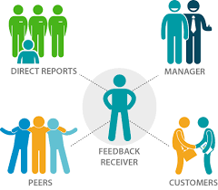
360 Evaluation

Slide 18

360-degree feedback systems
Benefits:
Multiple Perspectives: Provides a well-rounded view of an employee's performance.
Reduced Bias: Balances individual viewpoints and reduces supervisor bias.
Employee Development: Helps identify areas for improvement and growth
Challenges:
Time and Cost: Collecting and analyzing data from multiple sources can be time-consuming and expensive.
Diminishing Returns: Collecting excessive data can be overwhelming and provide little additional value.
Careful Implementation: Requires clear planning and alignment with the organization's strategy to avoid confusion and conflict.

Slide 19
Performance Appraisal Methods
Chapter
7
Appraisal Methodologies
1
Graphic rating scale
6
Narrative forms
2
Alternation ranking
7
Behaviorally anchored rating scales (BARS)
3
Paired comparison
8
Management by objectives (MBO)
4
Forced distribution
9
Computerized and Web-based performance appraisal
5
Critical incident
10
Merged methods
Notes:
Appraising performance requires choosing an appraisal tool, form, or methodology that provides an effective means for comparing a subordinate’s actual performance to the standards for his or her job.
The graphic rating scale is the simplest and most popular method for appraising performance. lists traits or performance dimensions (such as communication or teamwork ) and a range of performance values
Alternation Ranking Method Ranking employees from best to worst on a trait or traits is another option.
The paired comparison method helps make the ranking method more precise. For every trait (quantity of work, quality of work, and so on), you pair and compare every subordinate with every other subordinate.

Slide 20
Performance Evaluation Measures
Absolute: Evaluates employees against job standards, regardless of others. (e.g., Did the salesperson meet their sales quota?)
Relative: Compares employees to each other, often ranking them. (e.g., Who was the top salesperson?)
Relative Measures: Pros and Cons
Pros:
  Identify top performers for rewards and promotions.
  Can motivate competition and improvement.
Cons:
  Skewed results if all employees perform similarly (everyone ranked low/high).
  Ignores individual improvement if compared to a static group.

Slide 21
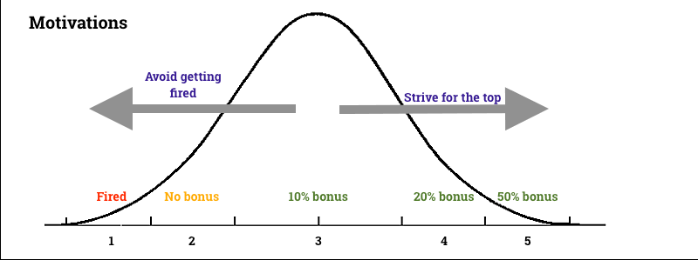
Forced Ranking Example

Slide 22
Forced Ranking: A Specific Relative Measure
Involves placing employees into performance level categories (e.g., top 20%, middle 70%, bottom 10%).
Pros:
  Clearly differentiates performance levels.
  Provides data for compensation decisions.
  Discourages inflated reviews or leniency.
Cons:
  Can be arbitrary and unfair.
  May lead to low morale and lawsuits.
  Not suitable for all cultures (better for results-driven environments).

Slide 23
Alternation Ranking
This method ranks employees from best to worst on specific traits. It helps differentiate between top and bottom performers but can be challenging for larger groups.

Slide 24
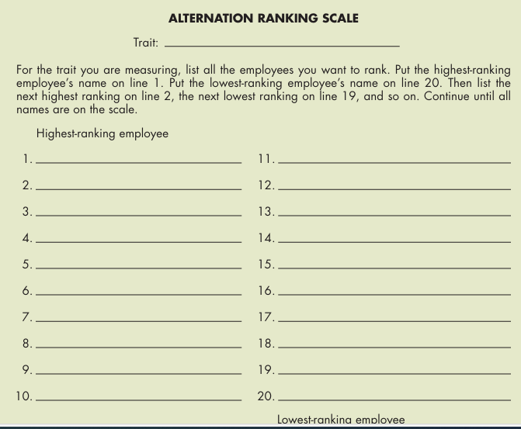
Alternation Ranking Example

Slide 25
Paired Comparison
This method compares employees pairwise on specific traits. It is more time-consuming but can provide a more detailed analysis.

Slide 26
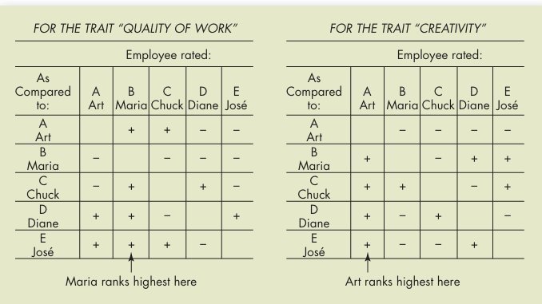
Paired Comparison Example

Slide 27
Performance Evaluation Methods
Graphic Rating Scales: A popular tool, these scales involve rating employees on various aspects like traits, behaviors, or results. Imagine a scale from 1 (low) to 5 (high) for punctuality.

Slide 28
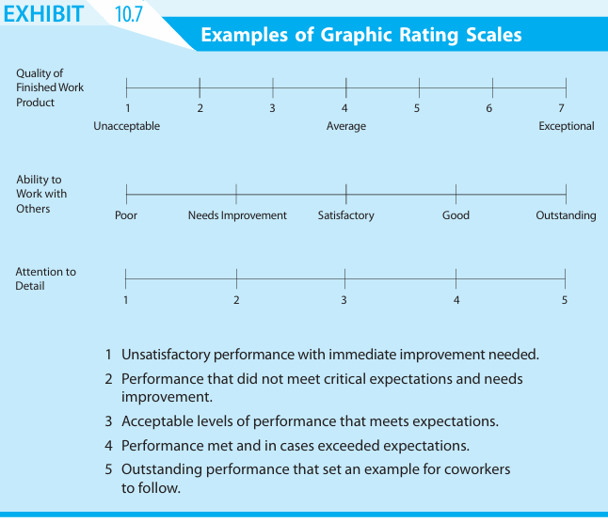
Graphic Rating Scales example

Slide 29
Performance Evaluation Methods
Behaviorally Anchored Rating Scales (BARS): These go beyond simple scales by providing specific descriptions of behavior at different levels. Imagine examples of "always greets customers with a smile" (high) vs. "rarely interacts with customers" (low) for a retail employee.

Slide 30
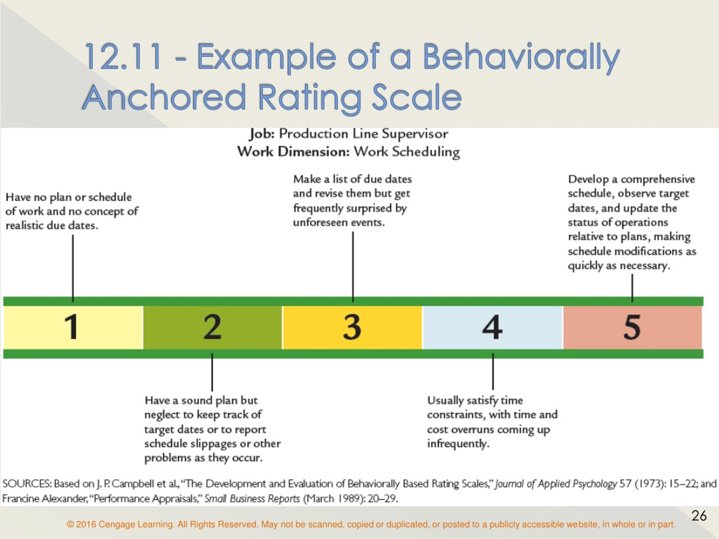
BARS Example

Slide 31
Performance Evaluation Methods
Objectives-Based Measures (MBO): This approach ties performance feedback to predetermined, negotiated work objectives. Imagine a manager and employee jointly setting goals for increasing sales within a specific timeframe.
Critical Incident Measures: This method focuses on specific examples of outstanding or problematic employee behavior during the evaluation period. Imagine a manager noting a salesperson's exceptional handling of a difficult customer complaint.

Slide 32
Chapter
Management by Objectives (MBO)
7
A comprehensive and formal organization wide goal-setting and appraisal program requiring:
  Setting of organization’s goals
  Setting of departmental goals
  Discussion of departmental goals
  Defining expected results (setting individual goals)
  Conducting periodic performance reviews
  Providing performance feedback
Notes:
Employers use management by objectives (MBO) for one of two things. Many use it as the primary appraisal method. Others use it to supplement to a graphic rating or other appraisal method. MBO generally refers to the comprehensive and formal organizationwide goal-setting and appraisal program.

Slide 33
Using MBO
Chapter
7
Potential Problems with MBO
Setting unclear objective
Time-consuming appraisal process
Conflict with subordinates over objectives
Notes:
In using MBO, it is best to keep the guidelines for goal setting (SMART, specific, and so on) in mind. Setting objectives with the subordinate sometimes turns into a tug-of-war, with the supervisor pushing for higher quotas and the subordinate pushing for lower ones.
The more that is known about the job and the person’s ability, the more confident a supervisor can be about setting standards.

Slide 34

TABLE Important Advantages and Disadvantages of Appraisal Tools
Tool | Advantages | Disadvantages
Graphic rating scale | Simple to use; provides a quantitative rating for each employee. | Standards may be unclear; halo effect, central tendency, leniency, bias can also be problems.
BARS | Provides behavioral “anchors.” BARS is very accurate. | Difficult to develop.
Alternation ranking | Simple to use (but not as simple as graphic rating scales). Avoids central tendency and other problems of rating scales. | Can cause disagreements among employees and may be unfair if all employees are, in fact, excellent.
Forced distribution method | End up with a predetermined number or % of people in each group. | Employees’ appraisal results depend on your choice of cutoff points.
Critical incident method | Helps specify what is “right” and “wrong” about the employee’s performance; forces supervisor to evaluate subordinates on an ongoing basis. | Difficult to rate or rank employees relative to one another.
MBO | Tied to jointly agreed-upon performance objectives. | Time-consuming.
Notes:
Use the right appraisal tool—or combination of tools. Each has its own pros and cons. For example, the ranking method avoids central tendency but can cause bad feelings when employees’ performances are in fact all “high.” Table summarizes each tool’s pros and cons.

Slide 35
Choosing the Right Tool
Performance evaluation methods are not mutually exclusive. Organizations can combine them, but it's important to avoid a cumbersome or overly complex system.
The chosen methods should align with the overall goals of the performance management system and the organization's strategic objectives.

Slide 36
Chapter
Computerized and Web-Based Performance Appraisal Systems
7
Allow managers to keep notes on subordinates.
Notes can be merged with employee ratings.
Software generates written text to support appraisals.
Allows for employee self-monitoring and self-evaluation.
Electronic Performance Monitoring (EPM) Systems
  Use computer network technology to allow managers access to their employees’ computers and telephones.
  Managers can monitor the employees’ rate, accuracy, and time spent working online.
Notes:
Employers increasingly use computerized or Web-based performance appraisal systems that enable them to keep computerized notes on subordinates during the year. The notes can then be merged with ratings of employees on several performance traits. The software then generates written text to support each part of the appraisal. Most appraisal software combines several of the basic methods such as graphic ratings plus critical incidents or BARS.
Electronic performance monitoring (EPM) systems use computer network technology to allow managers access to their employees’ computers and telephones. They allow managers to monitor the employees’ rate, accuracy, and time spent working online.

Slide 37
Dealing with Performance Appraisal Problems
Chapter
7
Potential Rating Scale Appraisal Problems
Unclear standards
Halo
effect
Central tendency
Leniency or strictness
Bias
Notes:
Graphic-type rating scales in particular are susceptible to several problems: unclear standards, halo effect, central tendency, leniency or strictness, and bias.

Slide 38
Chapter
7
Best Practices for Fair and Effective Appraisals
Clear and Objective Standards: Develop clear performance expectations and use specific criteria for evaluation.
Rater Training: Provide training to managers on appraisal methods, bias awareness, and effective feedback delivery.
Multiple Raters: Gather feedback from various sources (peers, subordinates, customers) to reduce bias.
Regular Feedback: Provide ongoing feedback throughout the year, not just during formal appraisals.
Focus on Development: Use appraisals as a tool for employee growth and improvement, rather than solely for evaluation.
Legal Compliance: Ensure that appraisal processes comply with all relevant employment laws and regulations
Notes:
Employers increasingly use computerized or Web-based performance appraisal systems that enable them to keep computerized notes on subordinates during the year. The notes can then be merged with ratings of employees on several performance traits. The software then generates written text to support each part of the appraisal. Most appraisal software combines several of the basic methods such as graphic ratings plus critical incidents or BARS.
Electronic performance monitoring (EPM) systems use computer network technology to allow managers access to their employees’ computers and telephones. They allow managers to monitor the employees’ rate, accuracy, and time spent working online.

Slide 39
Choosing the Right Appraisal Tool
Chapter
7
Criteria for Choosing an Appraisal Tool
Accessibility
Ease-of-use
Employee acceptance
Accuracy
Notes:
In practice, employers choose an appraisal tool based on several criteria. Accessibility and ease-of-use are probably first. Employers (and supervisors) prefer to avoid the push-back from employees who resist certain appraisal methods. For other employers, accuracy is a great concern.

Slide 40
Chapter
7
The Appraisal Interview: A Critical Conversation
Preparation
Give employees advance notice: This allows employees to reflect on their performance and prepare questions.
Review performance data: Compare the employee's performance against established standards and previous appraisals.
Schedule a private and uninterrupted meeting: This creates a conducive environment for open and honest communication.
Conducting the Appraisal Interview
Reinforcing strengths: Acknowledging and appreciating employee accomplishments.
Addressing weaknesses: Providing constructive feedback and developing improvement plans.
Setting goals: Establishing clear expectations for future performance.
Open communication: Encouraging employee input and feedback.
Notes:
Employers increasingly use computerized or Web-based performance appraisal systems that enable them to keep computerized notes on subordinates during the year. The notes can then be merged with ratings of employees on several performance traits. The software then generates written text to support each part of the appraisal. Most appraisal software combines several of the basic methods such as graphic ratings plus critical incidents or BARS.
Electronic performance monitoring (EPM) systems use computer network technology to allow managers access to their employees’ computers and telephones. They allow managers to monitor the employees’ rate, accuracy, and time spent working online.

Slide 41
Chapter
7
The Appraisal Interview: A Critical Conversation
Handling Difficult Conversations:
Appraisal interviews often involve delivering negative feedback, which can be challenging for both managers and employees. It's important to:
Focus on behavior, not personality: Describe specific actions or behaviors rather than making personal attacks.
Use "I" statements: Express concerns without blaming the employee.
Listen actively: Understand the employee's perspective and respond empathetically.
Create an action plan: Develop a clear plan for improvement, including specific goals and timelines.
Notes:
Employers increasingly use computerized or Web-based performance appraisal systems that enable them to keep computerized notes on subordinates during the year. The notes can then be merged with ratings of employees on several performance traits. The software then generates written text to support each part of the appraisal. Most appraisal software combines several of the basic methods such as graphic ratings plus critical incidents or BARS.
Electronic performance monitoring (EPM) systems use computer network technology to allow managers access to their employees’ computers and telephones. They allow managers to monitor the employees’ rate, accuracy, and time spent working online.

Slide 42
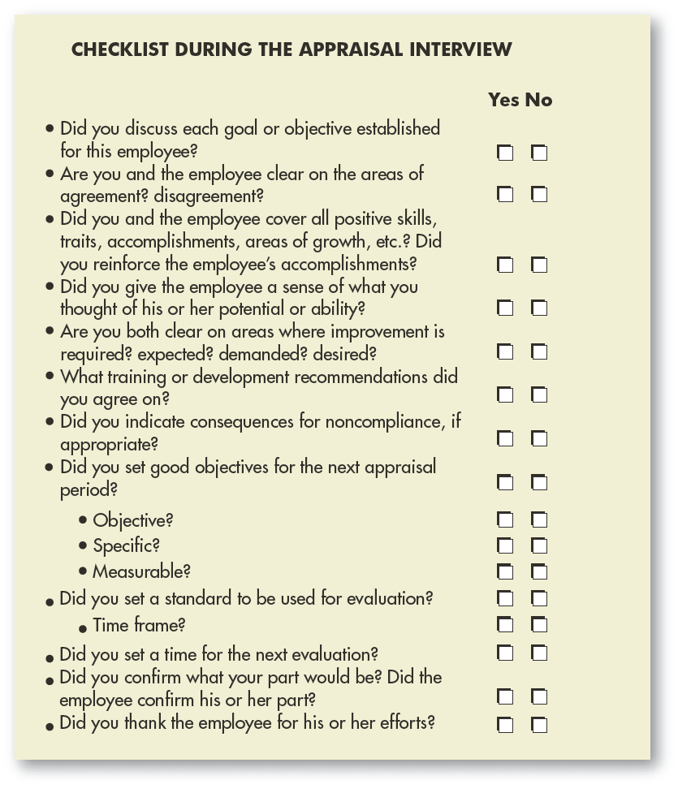
Chapter
FIGURE
Checklist During
Appraisal Interview
7
Notes:
Figure provides a checklist to help managers cover all the appraisal interview bases.

Slide 43
CHAPTER SUMMARY
Performance management is an ongoing cycle that encompasses setting clear performance expectations, providing continuous feedback and coaching, conducting regular performance evaluations, and using these insights to guide development plans.
Performance feedback plays a central role in this process. By offering specific, constructive feedback, managers can help employees understand their strengths and weaknesses, identify areas for improvement, and adjust their behaviors to achieve better results.
A Roadmap for Success:
Collaborative Design & Strategic Alignment: Involve managers in the design process and ensure the system is tightly linked to the organization's strategy.
Fair and Objective Evaluations: Establish clear performance standards using a combination of absolute (rating) and relative (ranking) measures when appropriate.

Slide 44
CHAPTER SUMMARY
  The chapter discussed various evaluation methods (Ranking and rating methods)
Common Appraisal Problems:
Subjectivity and Bias
Leniency or Strictness
Central Tendency
Halo Effect
Legal Issues
Guideline for managers in conducting an effective evaluation interview

Slide 45
Designing an Effective Performance Management System
Purpose and Use: What's the main goal of the system? Is it for employee development, informing rewards and compensation, boosting motivation, ensuring legal compliance, or HR planning (or a combination)? It's crucial to define the purpose upfront to avoid conflicting goals and ensure data collection supports them all.
Employee Development: The system should identify skill and performance gaps to guide training and development programs. Performance feedback should provide information to fuel these programs, and desired outcomes from training should be incorporated back into the performance management system. This creates a two-way loop for improvement.

Slide 46
Designing an Effective Performance Management System
Rewards and Compensation: Decisions like salary, promotions, and bonuses often rely on performance data. Employees must trust the performance feedback system for these decisions to be seen as fair. An unfair system can lead to a perceived unfairness in compensation as well.
Motivation: A formal process for acknowledging and praising employees can reinforce positive behaviors and outcomes. The system should clearly communicate expectations and allow employees to express their desired job assignments and responsibilities.
Legal Compliance: Documentation of performance deficiencies is crucial for defending against claims of unfair dismissal or discrimination. Data showing consistent, unacceptable performance strengthens the organization's defense against such charges.

Slide 47
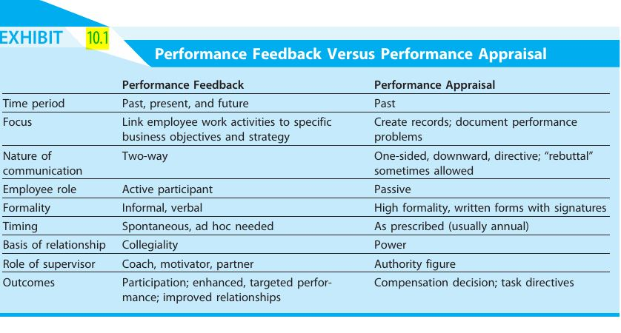

Slide 48


Thank You

