Slide 1


Health Law and Ethics
Prepared by Dr. Aya Mohamed
MHA 633
Ethical Guidance and Theories
Lecture 4

Slide 2

In the previous Lecture: Duties and Responsibilities of Physician and Patient
Chapter
02
Duties and responsibilities of physician
Patients Bill of Rights
Patients Rights
Patients Responsibilities
Unethical Acts
Punishment & Disciplinary Action

Slide 3

Chapter
Ethical Guidance and Theories
03
Sources of Ethical Guidance
Ethical Decision-Making Frameworks
5 A’s of Ethical Decision Making

Slide 4
Chapter
Ethical Guidance and Theories
03
Sources of Ethical Guidance
Ethical Decision-Making Frameworks
5 A’s of Ethical Decision Making
Ethical justification
Ethical theories and principles as lenses
Ethics in Islam
What is Islamic Bioethics?

Slide 5

Sources of Ethical Guidance
Professional Codes
Formal sets of ethical standards from medical boards or associations.
Guidelines
Recommendations from expert bodies to inform clinical best practices.
Legislation
Laws regulating patient rights and healthcare delivery.
Institutional Policies
Organizational ethics frameworks shaping day-to-day clinical behavior.

Slide 6



Ethical Decision-Making Frameworks
Identify Ethical Issues
Recognize conflicts or dilemmas affecting patient care.
Gather Information
Collect facts about the patient's condition and context.
Consider Principles
Apply beneficence, autonomy, justice, and non-maleficence.

Slide 7


Ethical Decision-Making Frameworks
Identify Ethical Issues
Recognize conflicts or dilemmas affecting patient care.
Gather Information
Collect facts about the patient's condition and context.
Consider Principles
Apply beneficence, autonomy, justice, and non-maleficence.
Explore Options
Evaluate possible actions and their ethical implications.
Make a Decision
Choose the best course respecting ethics and patient needs.

Slide 8
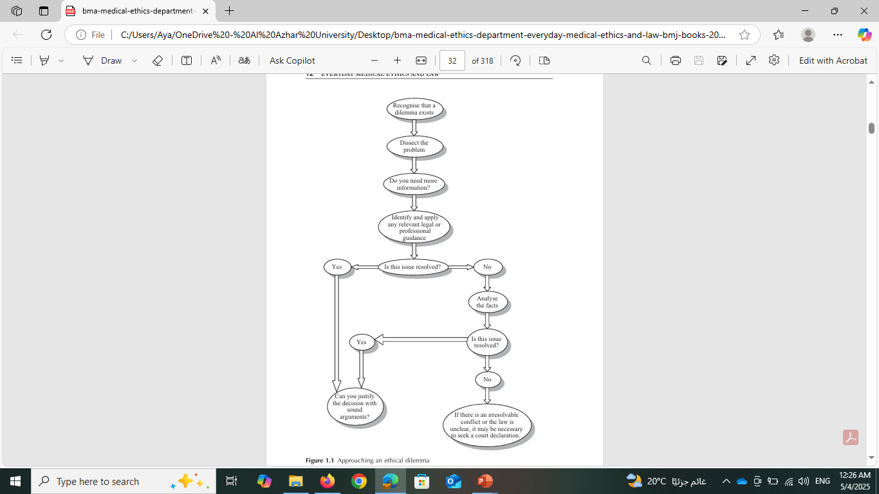
Ethical Decision-Making Frameworks
Identify Ethical Issues
Recognize conflicts or dilemmas affecting patient care.
Gather Information
Collect facts about the patient's condition and context.
Consider Principles
Apply beneficence, autonomy, justice, and non-maleficence.
Explore Options
Evaluate possible actions and their ethical implications.
Make a Decision
Choose the best course respecting ethics and patient needs.

Slide 9
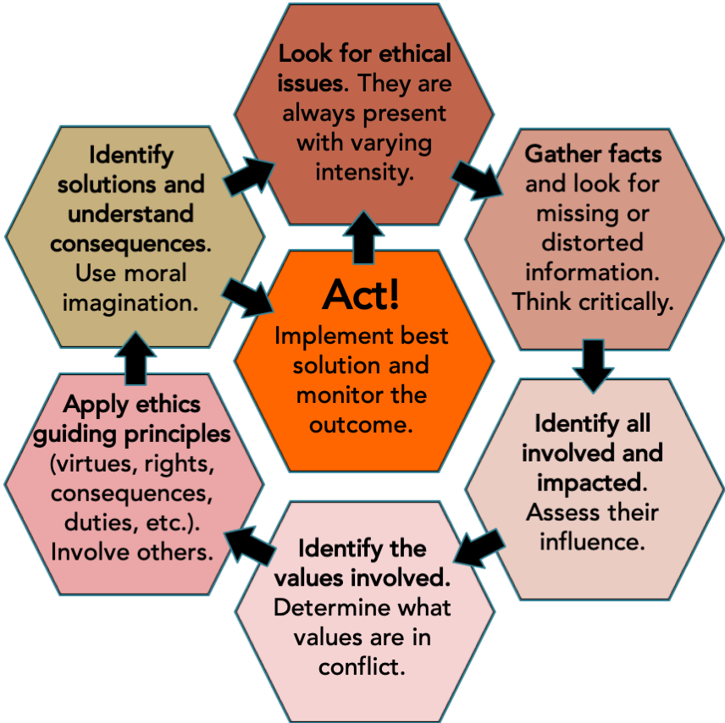
A Framework for Ethical Decision-Making

Slide 10
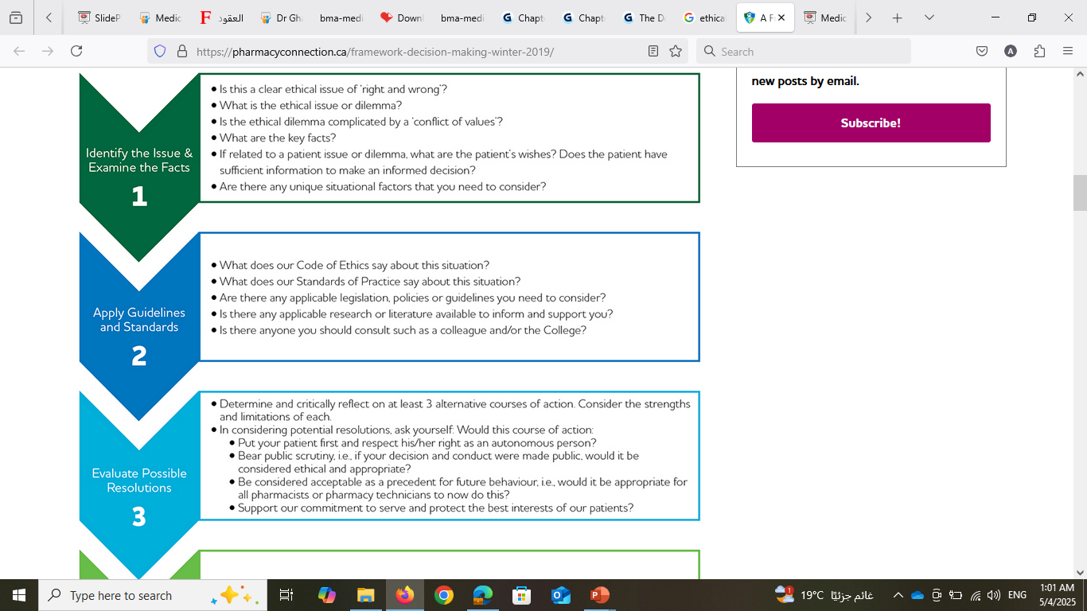
A Framework for Ethical Decision-Making

Slide 11
A Framework for Ethical Decision-Making

Slide 12
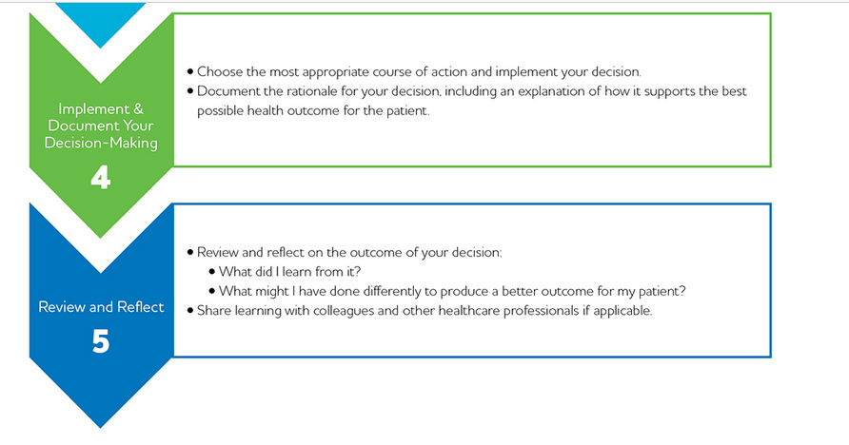
A Framework for Ethical Decision-Making

Slide 13
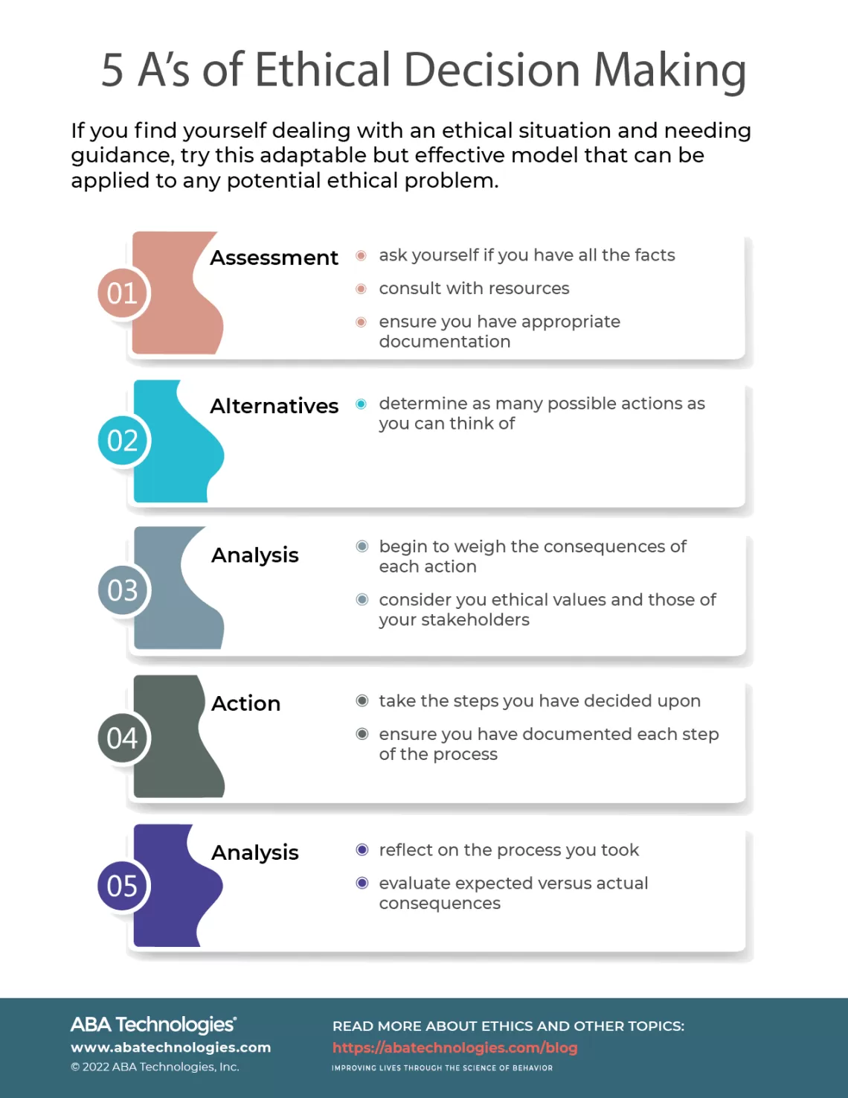

Slide 14
Ethical justification
In ethics, the support/reasons ultimately come from moral values, principles and theories:
“I think we should do X because A and B are really important values”
“Y wouldn’t be appropriate because it violates principles A and B”

Slide 15
Ethical justification
In ethics, the support/reasons ultimately come from moral values, principles and theories:
“I think we should do X because A and B are really important values”
“Y wouldn’t be appropriate because it violates principles A and B”
“X would be the right thing to do because of our obligation to do A”
Jonathan Breslin, 2006

Slide 16
Ethical theories and principles as lenses
“Doing bioethics well requires appeal to the insights provided by multiple theories…
the metaphor of lenses provides a more accurate and a more productive understanding of the role of theories in bioethics…”
(Sherwin, The Politics of Women’s Health, 205).
Notes:
lenses: readily switched for a different view, can be layered; some provide clearer perceptions of problems than others, but can gain different understandings by trying different options; challenge = seeking out best lenses for problem at hand

Slide 17
Ethical theories and principles as lenses
“Doing bioethics well requires appeal to the insights provided by multiple theories…
the metaphor of lenses provides a more accurate and a more productive understanding of the role of theories in bioethics…”
(Sherwin, The Politics of Women’s Health, 205).
lenses: readily switched for a different view, can be layered; some provide clearer perceptions of problems than others, but can gain different understandings by trying different options;
challenge = seeking out best lenses for problem at hand
Notes:
lenses: readily switched for a different view, can be layered; some provide clearer perceptions of problems than others, but can gain different understandings by trying different options; challenge = seeking out best lenses for problem at hand

Slide 18
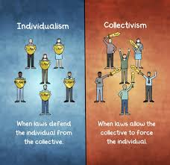
General characteristics of western philosophies
Secularism: people are free to practice their religion but no particular religious guidance to right & wrong
Individualism: It’s all about I, me and myself!
  The individual and nuclear family structure are the societal building block.
  The individual's interest is what should come first (vs. more collective extended family ethics in our region)

Slide 19
Schools of thought in moral reasoning
  Utilitarianism:
  the value of an action is determined by its utility; all actions should be directed toward achieving the greatest happiness for the greatest number of people.
Utilitarianism …………. Consequences

Slide 20
Schools of thought in moral reasoning
  Utilitarianism:
  the value of an action is determined by its utility; all actions should be directed toward achieving the greatest happiness for the greatest number of people.
  Deontology:
  actions are judged based upon inherent right-making characteristics or principles rather than on their consequences. Emphasis on duty, rules and regulations, principles and moral obligations which govern one's right action
Utilitarianism …………. Consequences

Slide 21
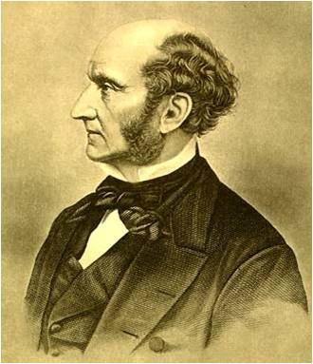
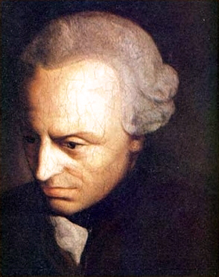
Schools of thought in moral reasoning
  Utilitarianism:
  the value of an action is determined by its utility; all actions should be directed toward achieving the greatest happiness for the greatest number of people.
  Deontology:
  actions are judged based upon inherent right-making characteristics or principles rather than on their consequences. Emphasis on duty, rules and regulations, principles and moral obligations which govern one's right action
Deontology ………………. Non Consequences
Utilitarianism …………. Consequences

Slide 22
Schools of thought in moral reasoning (cont.)
  Feminist ethics (Ethics of Care) commitment to correcting male biases (e.g. women’s subordination is morally wrong) and that the moral experience of women is as worthy of respect as that of men.

Slide 23
Schools of thought in moral reasoning (cont.)
  Feminist ethics (Ethics of Care) commitment to correcting male biases (e.g. women’s subordination is morally wrong) and that the moral experience of women is as worthy of respect as that of men.
  Casuistry: The greatest confidence in our moral judgments resides not at the level of theory, where we endlessly disagree, but rather at the level of the case, where our intuitions often converge without the benefit of theory.

Slide 24
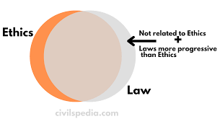
Schools of thought in moral reasoning (cont.)
  Virtue ethics: It emphasizes the virtues, or moral character
A patient should not comply with a “don’t smoke” advice from a smoking doctor!

Slide 25
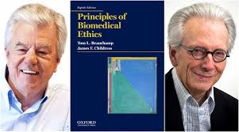
Schools of thought in moral reasoning (cont.)
  Principlism:
    Autonomy: respect humans' ability to choose,
    Beneficence: Do Good for others,
    Nonmaleficence (Do No Harm), &
    Justice

Slide 26
Ethics in Islam… not a separate entity!
Religious Practice
Ethics

Slide 27
Ethics in Islam… not a separate entity!
Religious Practice
Ethics
Economy
Law

Slide 28
How should Muslims decide their acts?
And I (Allâh) created not the jinn and mankind except that they should worship Me (Alone). وَمَا خَلَقْتُ الْجِنَّ وَالإِنْسَ إِلا لِيَعْبُدُونِ (الذاريات56 )
Worship in Islam includes:
  To follow the orders of Allah and His Prophet Mohamed (PBUH)

Slide 29
How should Muslims decide their acts?
And I (Allâh) created not the jinn and mankind except that they should worship Me (Alone). وَمَا خَلَقْتُ الْجِنَّ وَالإِنْسَ إِلا لِيَعْبُدُونِ (الذاريات56 )
Worship in Islam includes:
  To follow the orders of Allah and His Prophet Mohamed (PBUH)
  “And whosoever does not judge by what Allâh has revealed, such are the Kâfirûn (i.e. disbelievers - of a lesser degree as they do not act on Allâh’s Laws” (5: 44); “And whosoever does not judge by that which Allâh has revealed, such are the Zâlimûn (polytheists and wrong-doers - of a lesser degree)” (5: 45); “And whosoever does not judge by what Allâh has revealed (then) such (people) are the Fâsiqûn [the rebellious i.e. disobedient (of a lesser degree)” (5: 47)

Slide 30
Goals of Islamic Regulations
The five purposes of Sharia are to preserve persons:
Religion;
Soul;
Mind;
Wealth; &
Progeny.

Slide 31
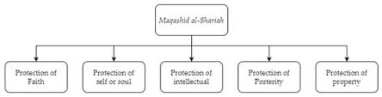
Goals of Islamic Regulations
The five purposes of Sharia are to preserve persons:
Religion;
Soul;
Mind;
Wealth; &
Progeny.
All Islamic legislations came to achieve these goals.

Slide 32
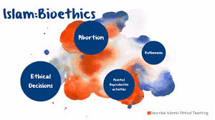
What is Islamic Bioethics?
It is the methodology of
  defining, analysing and resolving the ethical issues that arise in healthcare practice, or research;
  based on the Islamic moral and legislative sources (Koran, Sunna & Ijtihad); and
  aims at achieving the goals of Islamic morality (i.e. preservation of human’s religion, soul, mind, wealth & progeny )
Notes:
who is an adult and in full possession of his/her faculties so that he/she is able to make a sound decision by himself/herself;

Slide 33
Islamic Principles & Maxims Applicable in Medicine
The principle of Intention (Qasd): Each action is judged by the intention behind it
The principle of Certainty (Yaqeen): Certainty cannot be removed by doubt
The principle of Injury/Harm (Dharar):

Slide 34
Islamic Principles & Maxims Applicable in Medicine
The principle of Intention (Qasd): Each action is judged by the intention behind it
The principle of Certainty (Yaqeen): Certainty cannot be removed by doubt
The principle of Injury/Harm (Dharar):
  Injury should be relieved; An individual should not harm others or be harmed by others
  - An injury is not relieved by inflicting or causing a harm of the same degree
  - Prevention of harm has priority over pursuit of a benefit of equal worth
  - the lesser harm is committed

Slide 35
Islamic Principles & Maxims ...cont.
4. The principle of Hardship (Mashaqqat): Difficulty calls forth ease, Necessity (Dharuraat) legalizes the prohibited
5. The principle of - Custom or precedent (Urf):

Slide 36
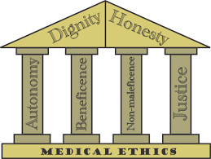
Islamic Principles & Maxims ...cont.
4. The principle of Hardship (Mashaqqat): Difficulty calls forth ease, Necessity (Dharuraat) legalizes the prohibited
5. The principle of - Custom or precedent (Urf):
Custom is recognized as a source of law on which legal rulings are based unless contradicted specifically by text from the main legislative sources, i.e. Koran and Sunna.

Slide 37
Conclusion
There is no fully adequate moral theory which can singly explain all ethical or moral dilemmas and none of them also can singly explain all ethical or moral dilemmas.

Slide 38
Conclusion
There is no fully adequate moral theory which can singly explain all ethical or moral dilemmas and none of them also can singly explain all ethical or moral dilemmas.
None of them taken singly has the attributes of a good ethical theory: clear, coherent, complete, comprehensive, simple, practicable, and able to explain and justify. In practice more than one theory may have to be combined to solve a specific ethical issue.
Kasule, O.H. (2005) Medical Ethics from Maqasid Al Shari’at. Journal of ISHIM, 4, 1-12. https://www.ishim.net/ishimj/jishim4_7_8/Vol4No7/kasule.doc

Slide 39
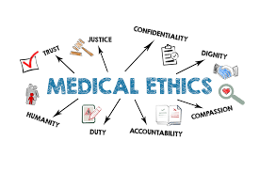
Chapter
Ethical Guidance and Theories
03
Sources of Ethical Guidance
Ethical Decision-Making Frameworks
5 A’s of Ethical Decision Making
Ethical justification
Ethical theories and principles as lenses
Ethics in Islam
What is Islamic Bioethics?

Slide 40



Thank You

