Slide 1


Financial Risk Management
Prepared by Dr. Walaa Mohamed
PMG 633
Market Risk (Part 2)
Continuing Financial Instruments & Trading
Introductory lecture
Lecture Six

Slide 2

Chapter Outline
6.2 Basics of Financial Instruments
6.3 Trading

Slide 3
Equities (also called shares or stocks)
Equity securities represent ownership in a firm and include common stock, preferred stock, and warrants
  Common stock is a residual claim on a firm’s assets. Common stock dividends are paid only after interest is paid to debtholders and dividends are paid to preferred stockholders. Furthermore, in the event of firm liquidation, debtholders and preferred stockholders have priority over common stockholders and are usually paid in full before common stockholders receive any payment. Common shareholders participate in the business of the company by voting their shares for or against proposals presented to them by the company’s board of directors, who the shareholders elect.
  Preferred stock is an equity security with scheduled dividends that typically do not change over the security’s life and must be paid before any dividends on common stock may be paid. Generally, preferred shareholders have no voting rights.
  Warrants are similar to options in that they give the holder the right to buy a firm’s equity shares (usually common stock) at a fixed exercise price prior to the warrant’s expiration.
Shareholders, in most cases, receive dividends from the company’s profits. However, some companies do not pay dividends. Instead, they rely on the company’s rapidly growing business prospects to entice new stock investors to drive the stock value higher. Examples of these types of companies are early-stage technology firms that rarely pay dividends.
The market price of a share represents the market’s perception of a company’s current value and the value of its projected earnings. The market price of shares will fluctuate as the market adjusts its valuation of the company in response to new information about the company.

Slide 4
Private equity refers to buying and managing old well-established companies not publicly traded on a stock exchange. The hope is to acquire distressed old companies that have suffered from lackluster management or lagging profitability and turn them around to make them more profitable.
Venture capital (VC) is a type of funding that provides funds to that is provided by firms or funds to promising startup, early-stage, and emerging companies which are not yet public that have been deemed to have high growth potential or which have demonstrated high growth (in terms of number of employees, annual revenue, scale of operations, etc.). Venture capital firms or funds invest in these early-stage companies in exchange for an ownership stake (equity). Venture capitalists take on the risk of financing risky start-ups in the hopes that some of the companies they support will become successful. Because startups face high uncertainty, VC investments have high rates of failure. The start-ups are usually based on an innovative technology or business model, and they are usually from high technology industries, such as information technology (IT), clean technology or biotechnology.
Angel investor is wealthy individual investor focused on financing promising startup business ventures in exchange for equity. Unlike a venture capital firm that uses an investment fund, angel investors use their own wealth.

Slide 5
Pooled investment vehicles are mutual funds, trusts, depositories, and hedge funds, that issue securities that represent shared ownership in the assets that these entities hold
Mutual funds are pooled investment vehicles in which investors can purchase shares, either from the fund itself (open-end funds) or in the secondary market (closed-end funds)
Types of Mutual Funds
Money Market Funds
Bond Mutual Funds
Stock Mutual Funds
Hybrid/Balanced Funds
The money market refers to trading in very short-term debt investments. The money market is composed of several types of securities including short-term Treasuries (e.g. treasury bills), certificates of deposit (CDs), commercial paper, and money market mutual funds that invest in these instruments.
Commercial paper is a short-term with maturity mostly not exceeding 270 days, unsecured debt instrument issued by large corporations typically for the financing of short-term liabilities.

Slide 6

If it is an open-end fund, it will accept new investment money and issue additional shares at a value equal to the net asset value of the fund at the time of investment. Net Asset Value is the net value of an investment fund's assets less its liabilities, divided by the number of shares outstanding. Open-ended fund shares are bought and sold directly through the fund itself not from a stock exchange.
An alternative to setting the fund up as an open-end fund would be to create a closed-end fund in which no new investment money is accepted into the fund. New investors invest by buying existing shares, and investors in the fund liquidate by selling their shares to other investors. Hence, the number of outstanding shares does not change. One consequence of this fixed share base is that, unlike open-end funds in which new shares are created and sold at the current net asset value per share, closed-end funds can sell for a premium or discount to net asset value depending on the demand for the shares( the shares are traded on stock exchange).

Slide 7
Hedge funds are organized as limited partnerships, with the investors as the limited partners and the fund manager as the general partner
Hedge funds utilize various strategies and purchase is usually restricted to investors of substantial wealth and investment knowledge
Hedge funds often use leverage. Hedge fund managers are compensated based on the amount of assets under management as well as on their investment results.

Slide 8

Leveraged Positions
The use of borrowed funds to purchase an asset results in a leveraged position and the investor is said to be using leverage
Investors who use leverage to buy securities by borrowing from their brokers are said to buy on margin and the borrowed funds are referred to as a margin loan
The interest rate paid on the funds is the call money rate, which is generally higher than the government bill rate
The call money rate is lower for larger investors with better collateral
At the time of a new margin purchase, investors are required to provide a minimum amount of equity, referred to as the initial margin requirement
This requirement may be set by the government, exchange, clearinghouse, or broker.
Lower risk in an investor’s portfolio will often result in the broker lending more funds
The use of leverage magnifies both the gains and losses from changes in the value of the underlying asset
The additional risk from the use of borrowed funds is referred to as risk from financial leverage

Slide 9
5. Commodities
Commodities are generally homogeneous products irrespective of the geographical or physical market where they are being sold. For example, agricultural products such as corn, soybeans, and wheat, and energy products such as crude oil, natural gas, and gasoline, are considered commodities, as are precious metals such as gold and silver.
The price of a commodity is chiefly determined by the supply of and demand for the commodity. The rate of change to the supply and demand conditions for a commodity varies widely. For example, a drought in a country’s farming region over several months leads to a decrease in corn growth, resulting in a decrease in the number of bushels of corn that would come to market for a prolonged period of time. As long as the demand for corn stays the same or increases, the price of corn due to its limited supply would increase until the supply and demand imbalance disappears.

Slide 10
Banks, through their brokerage units, may trade commodities on behalf of their customers and also as principals. Commodity trading by banks is neither as common nor as important as foreign exchange, fixed income, or equity trading. In fact, many banks are now exiting commodity trading because of increasing capital requirements associated with those types of transactions.

Slide 11
6. Derivatives
Over the past 20 years, derivatives have emerged as an integral part of the financial markets. Derivatives are financial instruments whose value changes in response to changes in the value of related underlying assets that can also be bought, sold, and traded. Examples of derivative contracts include futures, options, and forward agreements, among others. There are derivatives on currencies, interest rates, equities, commodities, and the price of credit. The types of derivatives are the following:

Slide 12
A forward contract is a non standardized (customized) contract that defines the delivery of assets such as commodities, currencies, bonds or stocks at a specified price, at a specified quantity, on a specified future date. Forwards are traded in the over-the-counter (OTC) market.
A futures contract is a standardized contract that defines the delivery of assets such as commodities, currencies, bonds, or stocks at a specified price, at a specified quantity, on a specified future date. Futures are traded on recognized exchanges.

Slide 13
■Options convey certain rights to the buyer of an option. The two main types of options are a call option and a put option:
-A call option gives the buyer the right, but not the obligation, to buy a financial instrument from the seller of the option on or before a specified time (expiration date) for a specified price, called the strike price.
-A put option gives the buyer the right, but not the obligation, to sell a financial instrument to the seller of the option at a specified time (expiration date) for a specified price, called the strike price.
■Swaps allow two parties to exchange cash flows with each other at a future date.

Slide 14
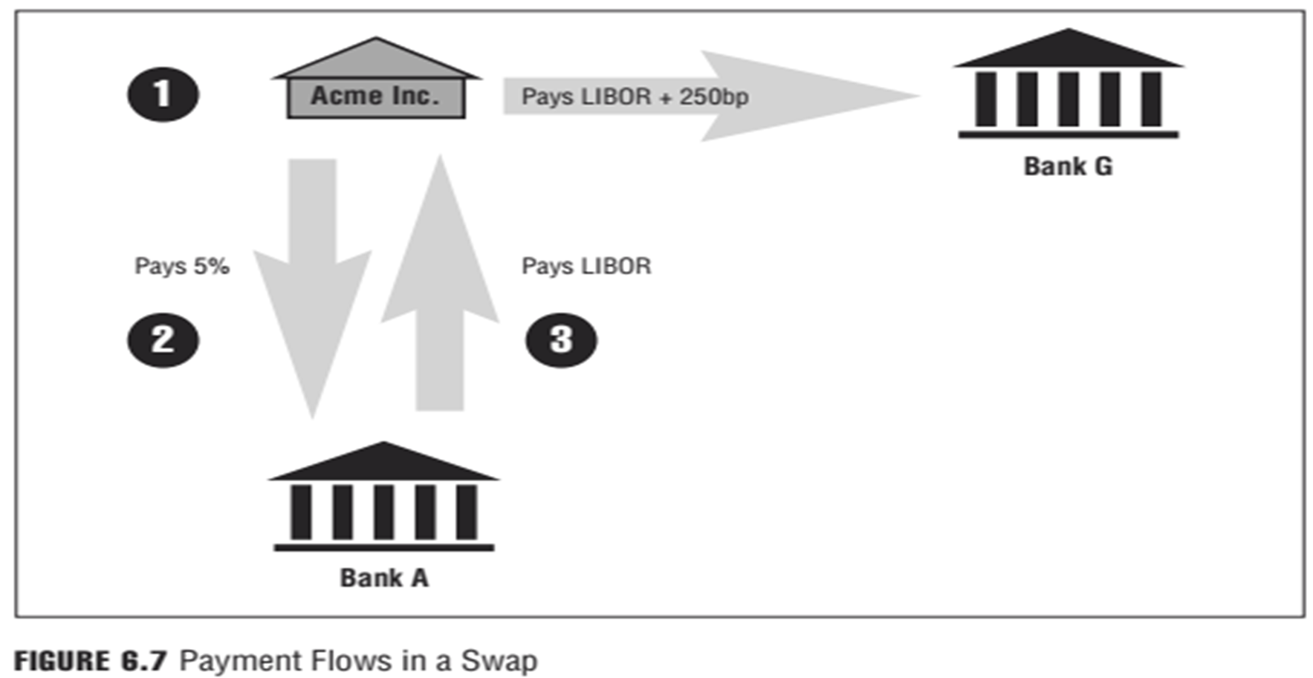

Slide 15
3. Trading:
Banks engage in trading operations and buy or sell financial instruments. In some cases, the trading is conducted on behalf of the bank’s customers—where the bank acts as an intermediary—and does not directly risk the bank’s capital. In other cases, the trading is done to benefit the bank itself by seeking short-term profits from favorable moves in the market prices. This type of trading, known as proprietary trading, puts the bank’s capital directly at risk. Currently, U.S. banks are being discouraged from conducting proprietary trading as a result of the Volcker Rule under the 2010 Dodd-Frank Act.
Trading is risky: Prices may not move in the direction the bank expects, and the value of the financial instruments may change adversely and hurt the bank. The bank must decide how much risk it is willing to assume to make a profit, usually referred to as a bank’s risk appetite. Generally, higher risk implies higher expected return. But higher risk also means that the likelihood of loss increases as well. The trade-off between risk and return is fundamental to any institution. This relationship is shown in Figure 6.8.

Slide 16
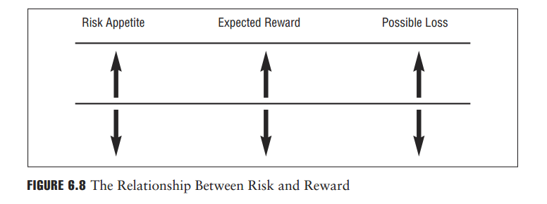

Slide 17
3.1. Fundamental Trading Positions
In financial markets, a position refers to the ownership status of a particular financial instrument. There are two fundamental trading positions: the long and the short position.
The holder of a long position bought, or owns, the financial instrument and will profit if the price of the instrument goes up or will incur a loss if the price of the instrument goes down.
The opposite position is a short position. The term short position has two different meanings, depending on whether the investor/trader is dealing in derivatives contracts or in stock, bonds, or other financial instruments.
The holder of a short position in a commodities futures contract has the obligation to deliver a commodity when the contract expires. Usually, producers of commodities sell (take short position) their future production to lock in the price of the commodity in advance. The holder of a short position will profit if the price of the commodity goes down or incur a loss if the price goes up.
In equity markets, if an investor believes that shares of a company are overvalued (i.e., too high) and thinks the price will go down in the near term, the investor can establish a short position by borrowing shares from a broker and then selling the shares. At some time in the future, the investor can buy the shares back and return them to the broker. If the investor sold the shares for more than the cost to purchase the shares, it profits; otherwise, it incurs a loss. This applies to bonds, stocks, or any other financial instruments. This process is referred to as short selling.

Slide 18
In a short sale, the short seller (1) simultaneously borrows and sells securities through a broker, (2) must return the securities at the request of the lender or when the short sale is closed out, and (3) must keep a portion of the proceeds of the short sale on deposit with the broker
Short sellers hope to profit from a fall in the price of the security or asset sold short, buying at a lower price in the future in order to repay the loan of the asset originally sold at a higher price. The repayment of the borrowed security or other asset is referred to as “covering the short position.”
In a short sale, the short seller must pay all dividends or interest that the lender would have received from the security that has been loaned to the short seller. These payments are called payments-in-lieu of dividends or interest
The short seller must also deposit the proceeds of the short sale as collateral to guarantee the eventual repurchase of the security. The broker then earns interest on these funds and may return a portion of this interest to the short seller at a rate referred to as the short rebate rate
The short rebate rate is usually only provided to institutional investors and is typically 0.1% less than overnight interest rates. If the security is difficult to borrow, the short rebate rate may be lower or negative
The difference between the interest earned on the proceeds from the short sale and the short rebate paid is the return to the lender of the securities
A short sale may also require the short seller to deposit additional margin in the form of cash or short-term riskless securities

Slide 19
Bid-Ask Spreads
In buying and selling financial instruments, traders will quote prices at which they are willing to buy or sell the financial instrument. The difference between the buy price (bid) and sell price (ask) سعر الشراء (العرض) وسعر البيع (الطلب)is called the bid-ask spread.
EXAMPLE
A trader at Bank G offers to buy stock of Acme Inc. at EUR 10.15 per share, and another trader offers to sell the same stock at EUR 10.25 per share.
The bid-ask spread is EUR 0.10. The size of the bid-ask spread is an indicator of market liquidity: The narrower the bid-ask spread, the closer the buyers and sellers are to placing a true market value on the financial instrument and the more transactional volume or liquidity the market has. This liquidity, referred to as market liquidity, is a very important component of any marketplace, and liquidity is a highly desirable market characteristic that market participants actively seek.

Slide 20
3. Exchange and Over-the-Counter Markets
Financial instruments such as foreign exchange contracts, bonds, equities, commodities, and derivatives are traded on either regulated financial markets, called exchanges, or the over-the-counter markets. An exchange is a centralized marketplace where brokers and traders meet and, on behalf of their customers or on their own account, buy and sell standardized financial instruments such as equities, bonds, commodities, options, and futures.
For any financial instrument to be traded on an exchange, it must meet both regulatory requirements imposed by the exchange’s regulator and listing requirements imposed by the exchange itself.
For instance, many stock exchanges impose listing requirements on the listed company regarding the number of shareholders, the stability of earnings, and the size of the company’s assets. Futures exchanges list standard contracts that first must be approved by a regulatory body. Any changes to the con-tract’s terms must also be approved.

Slide 21
Whether the transaction takes place on the trading floor of an exchange or in an electronic marketplace owned by an exchange, the parties to the transaction operate according to an agreed set of exchange rules, which in many cases requires clearing their trades and transactions through a clearing house that is typically affiliated with the exchange.
A clearinghouse, often referred to as the central counterparty (CCP), becomes the buyer to each seller and the seller to each buyer, effectively standing in the middle of the transaction to guarantee the financial performance of the trade as agreed by the parties to the transaction. Each clearinghouse or central counterparty has its own rules, regulations, and conventions, which may differ across the different types of financial instruments that are traded on the same exchange that the clearinghouse or central counterparty clears.

Slide 22
While exchanges offer standardized products, price transparency, clear rules that govern the transactions between the buyers and sellers, and collateral support through the clearinghouse, they do not offer the flexibility many sophisticated investors need, as such investors must individually structure the trades that they want for hedging or other purposes. These transactions are executed in the over-the-counter markets instead, where both the flexibility and the ability to customize trades and transactions exist.
The over-the-counter or OTC market does not have a physical location for its marketplace. However, there has been a major drive toward requiring the trading of OTC transactions through a centralized electronic marketplace to allow for greater transparency around the OTC marketplace, and a perceived increase in safety as it would relate to counterparty default.

Slide 23
In the OTC market, the buying and selling of financial instruments takes place directly between the two parties to the transaction through the use of phones or computer networks, with each party directly assessing and taking on the risk of the creditworthiness of the other party to the transaction. Most notably, foreign exchange, derivatives, bond, and commodity trading, and some equity trading activities are conducted in the OTC markets. Due to the general need and/or desire in the market to customize instruments and to match as closely as possible the needs and desires of the two parties to the transaction, the OTC market is significantly bigger than the exchange marketplace.
The use of collateral in the OTC market is not regulated or standardized, as it is in the exchange-traded markets. When parties to an OTC transaction demand collateral from each other, they negotiate to determine the size and quality of the specific type of collateral they would be willing to accept to ensure that performance will occur as agreed. In some limited instances, standardized OTC transactions will move to an exchange marketplace for the primary reason of using a clearinghouse to guarantee the transaction. The movement of these transactions to an exchange for this purpose of ensuring counterparty credit is developing rapidly, reflecting the interest from market participants to extend the protection offered by central clearinghouses to OTC transactions. Figure 6.10 is a general comparison.

Slide 24
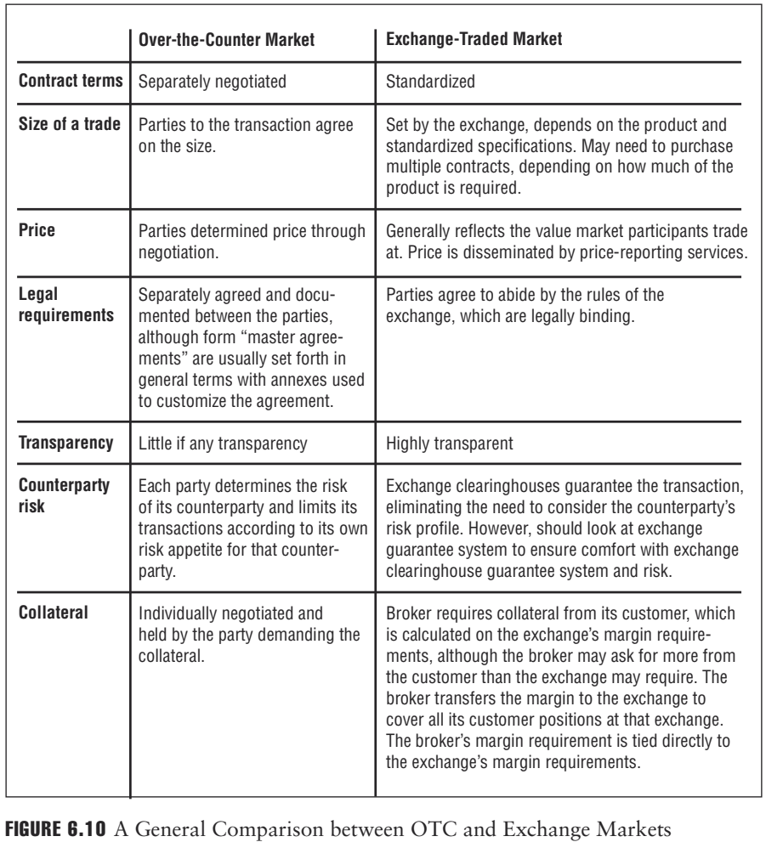

Slide 25
Reference
Foundations of Financial Risk.
An Overview of Financial Risk and Risk-Based Regulation.
Richard Apostolik
Christopher Donohue
Chapter 6

