Slide 1



Influence and Negotiation Skills
Prepared by
Dr. Bothaina Mahmoud Fouad
College of
Entrepreneurship and Innovation
Introductory Lecture

Slide 2
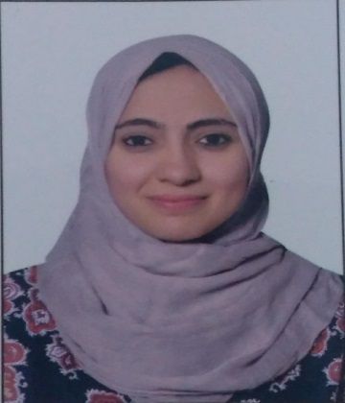
Bothaina Mahmoud Fouad
▷ EDUCATION
+201110624464 / +201097380359
Bachelor’s degree of Commerce | 2006 , Ain Shams University
Master Degree in Economics | 2013 , Ain Shams University
PH.D Degree in Economics | 2021 , Ain Shams University
bothaina.mahmoud@esu.ac.ae
bothaina9685@gmail.com
SKILL HIGHLIGHTS
Project management and excellent time management.
flexible , responsible , ambitious.
Decision maker and adopting easily to changing situations.
teaching others, helpful, cooperative & have the team spirit
▷ objective
Obtain a challenging teaching position as an Economics and Entrepreneuship lecturer utilizing creativity and a genuine desire to educate.
▷ Managerial, Academic and Research Experience
Held many leadership positions, such as Director of Research Projects Department at the Electronics Research Institute for of 7 years, and the responsibility for following up some national projects in the Arab Republic of Egypt and coordinator of International affairs with many relevant international entities specialized in Entrepreneurship activities.
Lecturer of Entrepreneurship in many universities
More than 8 years of experience in the leadership and academic field, providing feasibility studies, economic and training consultancy for many startups and technology incubators.
LANGUAGES
Arabic – Native English – V.good French– V. good
HOBBIES
Reading &Traveling
Notes:
Copyright © www.BestFreeCV.com/en

Slide 3


Slide 4

What do you think is the importance of negotiation and influencing as an entrepreneur?
In the workplace, it helps you to get the best out of deals and achieve long-term success
In your personal life, your skills can boost your creativity and decision-making ability.
It can help you learn better strategies and improve your reasoning ability

Slide 5

13 Weeks
12 Quizzes
Our roadmap
12 Live Sessions

Slide 6
Intro lec.
10 Lectures
Revision lec.
+
Final exam lec
Lectures No.

Slide 7
Our lec. time
Lectures
Live session
( office hours )
40 -50 slides
90 Minutes
every week

Slide 8

Method of teaching the course
practical part
Theoretical
Part

Slide 9
The Theoretical
Part is dividing into two parts
Develop your influencing skills
Become an effective negotiator

Slide 10
The practical part Will include some Success models and case studies

Slide 11
Success models and case studies
1
Some of role models
2
some of case studies and situations

Slide 12
Our Learning Outcomes
By the end of this course students and participants will be able to:
Demonstrate an understanding and awareness of what negotiation and influencing is.
Understand the potential strengths and weaknesses of your own negotiation and influencing style..

Slide 13
Our Learning Outcomes
By the end of this course students and participants will be able to:
Identify and understanding the required and necessary skills to be an effective negotiator and influencer
Develop general strategies for successful negotiation and influencing.

Slide 14
Our main topics
1. Demonstrate an understanding and awareness of what negotiation and influencing is.
What negotiation and influencing is and the main differences between them.
Influencing and Negotiation as an Entrepreneurial Skill
Study some Case studies and successful models.

Slide 15
Our main topics
2. Understand the potential strengths and weaknesses of your own negotiation and influencing style.
Identify a personal negotiation situation and practice it during class session.
Explain the behaviors as well as the strengths/weaknesses of each personality style.
Identify the qualities of successful and unsuccessful negotiators.

Slide 16
Our main topics
3. Identify and understanding the required and necessary skills to be an effective negotiator and influencer
Examples for Influence and negotiation skills
Case studies and successful models.

Slide 17
Our main topics
Develop general strategies for successful negotiation and influencing.
How to use negotiation and influencing strategies and techniques to engage with stakeholders successfully?
The successful strategies for negotiation
The negotiating process and needed rules

Slide 18

Course Expectations
What do you know about our topic?
What do you need to know?
What outcomes do you expect from this course?

Slide 19



Thank You

