Slide 1


Digital Leadership
Prepared by: Dr. Doaa Rady
DGM 726
Introduction
Orientation Lecture

Slide 2


Orientation Lecture
Lecture outline
Course Objectives
The syllabus
  Course Description
  Learning Outcomes
  Course Topics
Self- Assessment (Readiness for the Leadership Role)
Introduction to Leadership & Management
الاستعداد للدور القيادي

Slide 3

Welcome to Digital Leadership DGM 726 Course!

Slide 4

Self- Introduction
Name الاسم
Nationalityالجنسية
Education التعليم
Professional Experienceالخبرة
Achievementsالإنجازات
Hobbiesالهوايات

Slide 5

What Do You Expect?

Slide 6
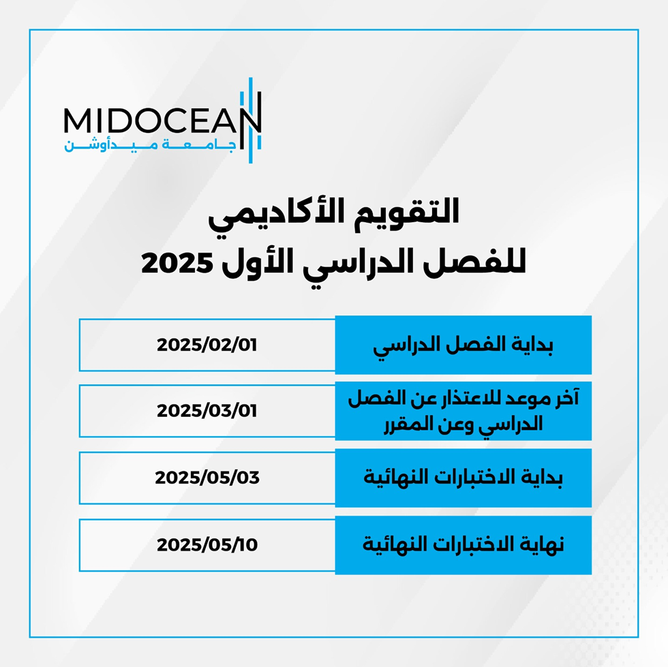

Slide 7
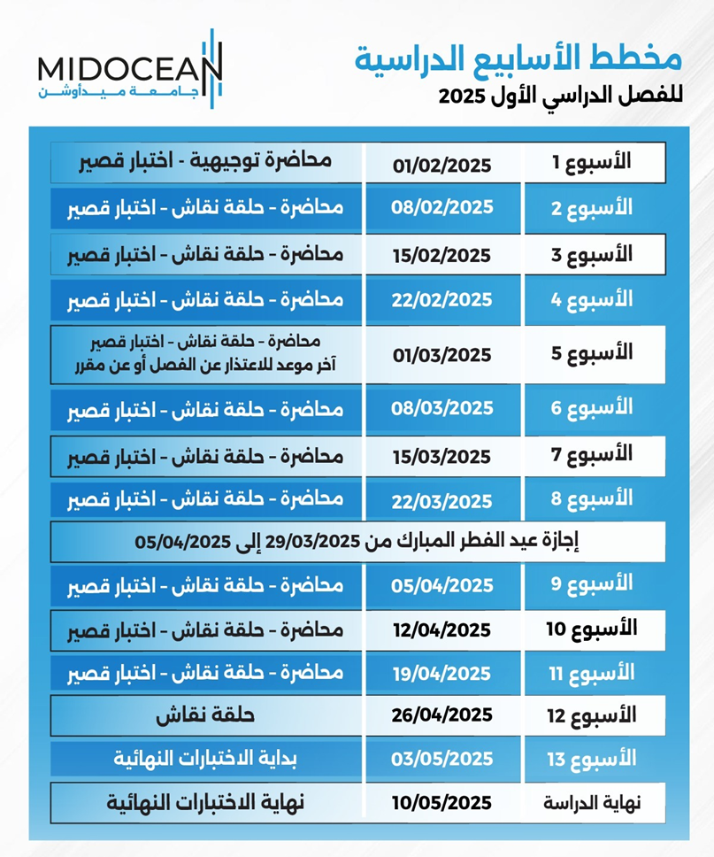

Slide 8


Slide 9





University Instructions

Slide 10




University Instructions

Slide 11
University Instructions
عزيزي الطالبـ/ـة يرجى ضرورة المحافظة على البيانات الشخصية والالتزام بتعليمات الجامعة حيث أنه يمنع منعا باتا نشر أو مشاركة أرقام الهواتف المحمولة أو أي وسيلة تواصل أخرى، ونفيد الجميع بأن مشاركة أي من تلك المعلومات عبر أي وسيلة كانت يعتبر مخالفة صريحة لتعليمات الجامعة، حيث أن وسيلة التواصل الوحيدة للجامعة هي التذاكر عبر المنصة الأكاديمية SIS، ونهيب بالجميع بأن من يقوم بإنشاء أي مجموعات بأي وسيلة كانت، سواء واتساب أو غيرها فإنه يتحمل هو والمشاركون معه المسؤولية كاملة ويعرضوا أنفسهم للمساءلة والعقوبة لمخالفتهم تلك التعليمات.

Slide 12
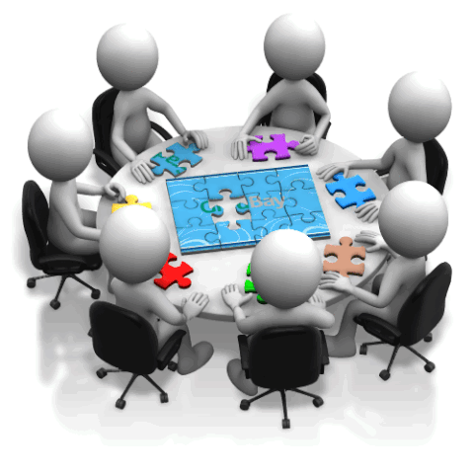
Discussion

Slide 13


Application

Slide 14


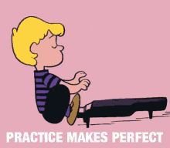
Application

Slide 15




Exams
8 Questions
8 Marks
24 Min
One week duration:
Sat 10 pm- Next Sat 9pm

Slide 16


Slide 17
Course Objectives
Orientation Lecture
The digital Leadership course aims to understand how creative leaders are leading a team or organization through digital platforms.
Furthermore, it targets knowing the tools and skills needed for a leader to tailor the goals and strategy in the digital media industry.

Slide 18
Course Objectives
Orientation Lecture
Moreover, it emphasizes understanding how to build community, grow networks, and have unique leadership philosophy.
Finally, this course includes a variety of skills and abilities, including but not limited to digital transformation, digital strategy, innovation, and ethics.

Slide 19
Orientation Lecture
Syllabus: Course Description
Digital Leadership course examines personal leadership principles and practices as applicable to digital media.
It specifically focuses on how to lead within an organization to build a diverse and high-performing team to deliver digital media initiatives that advance organizational goals المبادرات التي تعمل على تعزيز الأهداف التنظيمية..

Slide 20
Orientation Lecture
Syllabus: Course Description
We will have an opportunity to assess, develop, and practice key leadership skills including:
  setting a compelling vision; وضع رؤية مقنعة
  evaluating and onboarding an optimal mix of talent;
  communicating with clarity;
تقييم وتأهيل المزيج الأمثل من المواهب؛

Slide 21
Orientation Lecture
Syllabus: Course Description
We will have an opportunity to assess, develop, and practice key leadership skills including:
tackling ethical issues with a focus on advancing diversity, equity, and inclusion matters; التنوع والمساواة والشمول
and seeking regular feedback and input to expand influence over time and create a work environment where people thrive.

Slide 22
Syllabus: Learning Outcomes
Orientation Lecture
Learn about the different styles of leadership أنماط القيادة , determine which is appropriate for your organization, and how to choose and develop a leadership style.
Learn how to be more efficient at accomplishing your organizations goals by developing leaders.

Slide 23
Syllabus: Learning Outcomes
Orientation Lecture
Learn how to forge a group of people to act as a single unit to achieve your organizations goals.
Learn how to build trust, credibility, and respect for both you and the organization by being an ethical leader.

Slide 24
Syllabus: Learning Outcomes
Orientation Lecture
The intended subject-specific learning outcomes :
Having successfully completed this course; you should be able to:
  Evaluate personal strengths and areas for improvement as current or aspiring leaders.
Self- Assessments

Slide 25
Syllabus: Learning Outcomes
Orientation Lecture
Having successfully completed this course; you should be able to:
  Create a personal leadership philosophy based on leadership theories, principles, and styles relevant to digital media organizations.

Slide 26
Syllabus: Learning Outcomes
Orientation Lecture
Having successfully completed this course; you should be able to:
  Examine the role of the leader in promoting diversity, equity, inclusion, and access in organizations.
  Practice effective communication strategies with different stakeholders in digital media organizations.
• دراسة دور القائد في تعزيز التنوع والمساواة والإدماج والوصول في المنظمات.
• ممارسة استراتيجيات الاتصال الفعّالة مع مختلف أصحاب المصلحة في مؤسسات الإعلام الرقمي.

Slide 27
Syllabus: Learning Outcomes
Orientation Lecture
Having successfully completed this course; you should be able to:
  Develop effective and ethical leadership responses to complex challenges and opportunities in digital media environments.

Slide 28
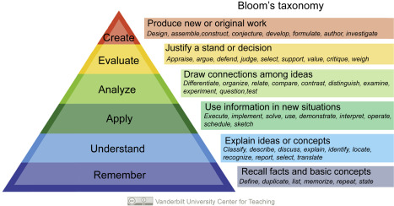
Syllabus: Learning Outcomes
Orientation Lecture

Slide 29
Syllabus: Course Topics
Orientation Lecture
Introduction to Management & Leadership (Definition, Functions, Skills)
Theories & Models of Leadership
Leaders’ traits
Leadership strengths and Influencing People
The Digital Revolution
Digital Leadership and Digital Transformations

Slide 30
Syllabus: Course Topics
Orientation Lecture
Leadership in the Digital Era and the Age of Industry 4.0
Importance of Digital Leadership
Diversity and Leadership
Leadership styles in the digital world
Collaborative Leadership & Building Teams

Slide 31
Syllabus: Course Topics
Orientation Lecture
Leaders’ skills: Communication, Negotiation, Critical Thinking, Creative Problem Solving, Time Management…etc.
Digital Skills in Improving Organizational Performance
Ethical Leadership & Digital Media Ethics
Entrepreneurship and Leadership in the Media Industry
Developing a Plan for Building Personal Leadership Philosophy

Slide 32
Orientation Lecture
Exercise 1: Leadership Self-Assessment
Readiness for the Leadership Role
Instructions: Indicate the extent to which you agree with each of the following statements, using the following scale: 1, disagree strongly; 2, disagree; 3, neutral; 4, agree; 5, agree strongly.
1، أرفض بشدة؛ 2، أرفض؛ 3، محايدة؛ 4، أوافق؛ 5، أوافق بشدة.

Slide 33
Orientation Lecture
Exercise 1: Leadership Self-Assessment
Readiness for the Leadership Role
20 Statements
Score Ranges between (20 – 100)
Scoring and interpretation: Calculate your total score by adding the numbers circled. A tentative interpretation of the scoring is as follows:
  90 – 100 high readiness for the leadership role. الاستعداد العالي
  60 – 89 moderate readiness for the leadership role. الاستعداد المعتدل
  40 – 59 some uneasiness with the leadership role. بعض عدم الارتياح
  39 or less low readiness for the leadership role. استعداد منخفض

Slide 34
Orientation Lecture
Exercise 1: Leadership Self-Assessment
Readiness for the Leadership Role
Scale Statements
It is enjoyable having people count on me for ideas and suggestions. من الممتع أن يعتمد الناس عليّ للحصول على الأفكار والاقتراحات
It would be accurate to say that I have inspired other people.
سيكون من الدقة أن أقول إنني ألهمت الآخرين.
It's good practice to ask people provocative مثير questions about their work من الممارسات الجيدة طرح أسئلة مثيرة على الأشخاص حول عملهم.
It's easy for me to compliment others من السهل بالنسبة لي مجاملة الآخرين.
I like to cheer people up even when my own spirits are down.
أحب أن أبهج الناس حتى عندما تكون معنوياتي منخفضة.

Slide 35
Orientation Lecture
Exercise 1: Leadership Self-Assessment
Readiness for the Leadership Role
Scale Statements
What my team accomplishes is more important than my personal glory. ما يحققه فريقي هو أكثر أهمية من مجدي الشخصي
Many people imitate my ideas. كثير من الناس يقلدون أفكاري
Building team spirit is important to me. بناء روح الفريق مهم بالنسبة لي
I would enjoy coaching other members of the team. سأستمتع بتدريب الأعضاء الآخرين في الفريق.
It is important to me to recognize others for their accomplishments. من المهم بالنسبة لي أن أعترف للآخرين بإنجازاتهم

Slide 36
Orientation Lecture
Exercise 1: Leadership Self-Assessment
Readiness for the Leadership Role
Scale Statements
I would enjoy entertaining visitors to my firm even if it interfered with my completing a report. سأستمتع بترفيه زوار شركتي حتى لو كان ذلك يتعارض مع إكمال تقريري.
It would be fun for me to represent my team at gatherings outside our department. سيكون من الممتع بالنسبة لي أن أمثل فريقي في التجمعات خارج قسمنا.
The problems of my teammates are my problems too. مشاكل زملائي في الفريق هي مشاكلي أيضًا.
Resolving conflict is an activity I enjoy. حل الصراع هو نشاط أستمتع به.
I would cooperate with another unit in the organization even if I disagreed with the position taken by its members. سأتعاون مع وحدة أخرى في التنظيم حتى لو اختلفت مع الموقف الذي اتخذه أعضاؤها.

Slide 37
Orientation Lecture
Exercise 1: Leadership Self-Assessment
Readiness for the Leadership Role
Scale Statements
I am an idea generator on the job. أنا مولد أفكار في العمل
It's fun for me to bargain whenever I have the opportunity. من الممتع بالنسبة لي المساومة كلما أتيحت لي الفرصة.
Team members listen to me when I speak. أعضاء الفريق يستمعون إلي عندما أتحدث.
People have asked to me to assume the leadership of an activity several times in my life. لقد طلب مني الناس أن أتولى قيادة نشاط ما عدة مرات في حياتي.
I've always been a convincing person. لقد كنت دائمًا شخصًا مقنعًا

Slide 38

Orientation Lecture
Leadership & Management

Slide 39
Leadership & Management
Orientation Lecture
Management | Leadership
Is getting things done through other people in order to achieve stated organizational objectives. | Leadership emphasizes on interpersonal behavior in a broader context. It is often associated with the willing & enthusiastic behavior of followers. It does not necessarily take place within the hierarchical structure of the organization.
السلوك الشخصي
هي إنجاز الأمور من خلال أشخاص آخرين من أجل تحقيق الأهداف التنظيمية المعلنة.
تؤكد على السلوك الشخصي في سياق أوسع. غالبًا ما ترتبط القيادة بالسلوك الراغب والمتحمس للأتباع ولا تتم بالضرورة ضمن الهيكل الهرمي للمنظمة.

Slide 40
Leadership & Management
Orientation Lecture
Managers | Leaders
Administer Maintain Focus on systems & structure Rely on control Keep an eye on the bottom line Do things right | Innovate Develop Focus on people Motivate Inspire trust Have an eye on the horizon Do the right thing
يدير
يحافظ على
التركيز على الأنظمة والهيكل
الاعتماد على السيطرة
إبقاء العين على النتيجة النهائية
فعل الأشياء بشكل صحيح
ابتكر
يطور
التركيز على الناس
تحفيز
إلهام الثقة
راقب الأفق
فعل الصواب

Slide 41
Leadership & Management
Orientation Lecture
Managers vs. Leaders
Leading Managers are
The Best of both!
Being both a good manager and a strong leader means
Being accountable and responsive to your team,
Empowering them to grow their skill sets and keep their careers on track.
إن كونك مديرًا جيدًا وقائدًا قويًا يعني أن تكون مسؤولاً ومتجاوبًا مع فريقك، مما يمكّنهم من تنمية مهاراتهم والحفاظ على مسيرتهم المهنية على المسار الصحيح.

Slide 42

Leadership & Management
Orientation Lecture
Values, Attitude & Behavior

Slide 43
Leadership & Management
Orientation Lecture
VALUES
They are the guiding principles that underpin what people believe to be important when making decisions.
They determine what people will prioritize in making a judgement, and what they need to achieve improvement.
هي المبادئ التوجيهية التي تدعم ما يعتقد الناس أنه مهم عند اتخاذ القرارات.
إنها تحدد ما هي الأولويات التي سيعطيها الناس في إصدار الحكم، وما يحتاجون إليه لتحقيق التحسين.

Slide 44
Leadership & Management
Orientation Lecture
ATTITUDE
A JUDGMENT about an object, person or event
Simply, it is our tendency that reflects a reaction to something or someone positively or negatively
e.g. ATTITUDE towards YOUR JOB.

Slide 45
Leadership & Management
Orientation Lecture
BEHAVIOR:
It is the manner of conducting oneself.
The response of an individual or group to its environment.
هو أسلوب التصرف.

Slide 46
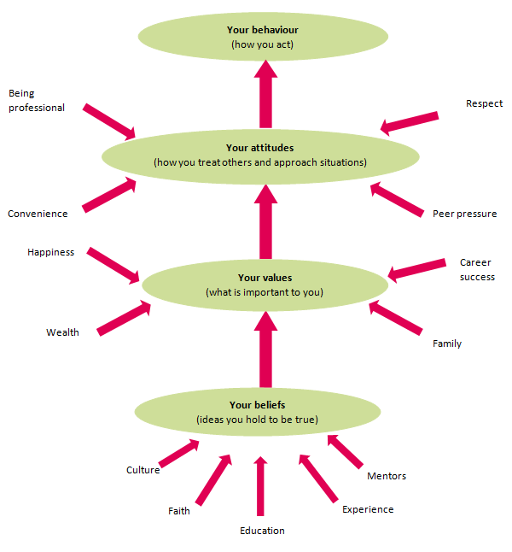
Orientation Lecture
Values,
Attitude
& Behavior

Slide 47
Leadership & Management
Orientation Lecture
Values, Attitude & Behavior:
They form the basis of
  who we are?
  how we do things?
  how we see ourselves as individuals,
  how we see others,
  how we interpret the world in general.

Slide 48
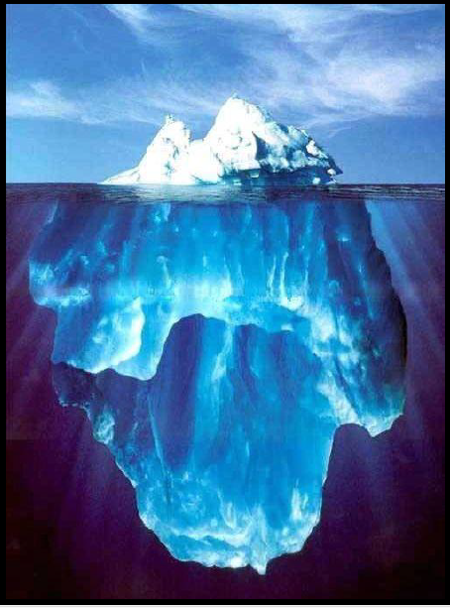
Leadership & Management
Orientation Lecture
THE ICEBERG:
  ONLY 10% OF ANY ICEBERG IS VISIBLE. THE REMAINING 90% IS BELOW SEA LEVEL.
  The Iceberg phenomena is also applicable on human beings …

Slide 49
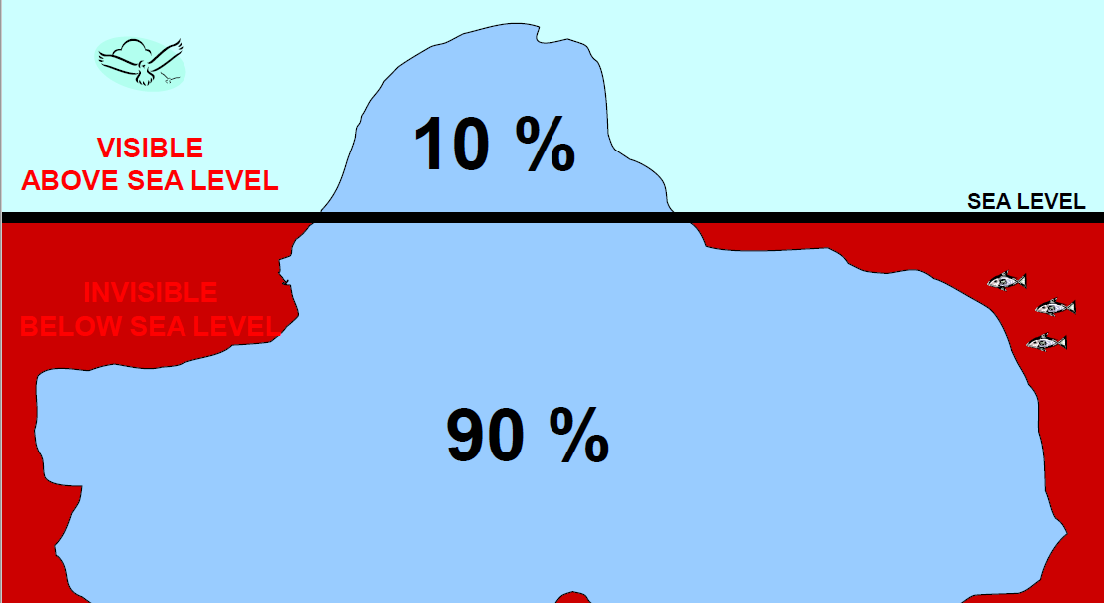
Leadership & Management
Orientation Lecture
THE ICEBERG:

Slide 50
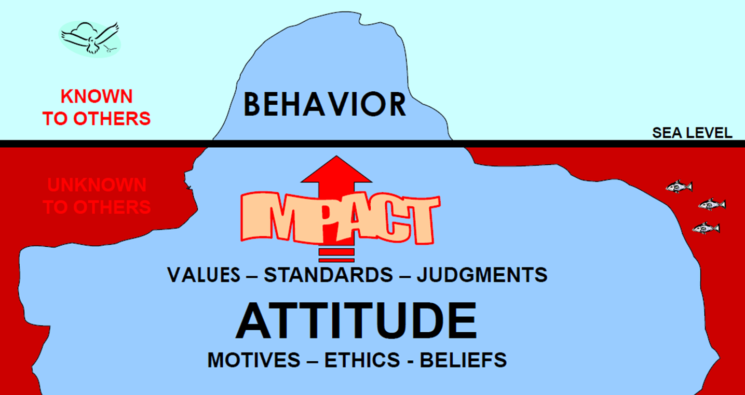
Leadership & Management
Orientation Lecture
THE ICEBERG:

Slide 51
Leadership & Management
Orientation Lecture
Importance of understanding Values, Attitude & Behavior:
  Values are linked to attitudes that a value serves as a way of organizing.
  Then, attitudes are formed by the interaction of situations, experiences, and values. Attitudes are carried into the work environment and directly affects behavior of employee.
  Attitudes are generally positive and negatives views of person, place, thing, or event.

Slide 52
Leadership & Management
Orientation Lecture
Importance of understanding Values, Attitude & Behavior:
  Company managers can improve counterproductive attitudes and gain success in marketplace through proper understanding of how people form attitudes, how those attitudes affect work behavior.
نتائج عكسية

Slide 53
We learned about
Orientation Lecture
Course Objectives
The syllabus
  Course Description
  Learning Outcomes
  Course Topics
Self- Assessment (Readiness for the Leadership Role)
Introduction to Leadership & Management
Managers vs. Leaders
Values, Attitude & Behavior

Slide 54
References
Orientation Lecture
- Bli-Group-Wp. (2011). Leadership Course material. Amideast Egypt. Business Intelligence, Training & Consulting, http://bli-group.com/
- Guith, J. (2021, February 7). The best of both worlds: Blending management and leadership skill sets. LinkedIn. Retrieved January 20, 2023, from https://www.linkedin.com/pulse/best-both-worlds-blending-management-leadership-skill-joe-guith
- Merriam-Webster. (n.d.). Behavior definition & meaning. Merriam-Webster. Retrieved January 20, 2023, from https://www.merriam-webster.com/dictionary/behavior
- OECD. (2019). Attitudes and values for 2030 - Organisation for Economic Co-operation and development. OECD. Retrieved January 20, 2023, from https://www.oecd.org/education/2030-project/teaching-and-learning/learning/attitudes-and-values/
- The individual processes: Values and attitude (organisational behaviour and design). The Individual Processes, Values and Attitude. (n.d.). Retrieved January 22, 2023, from https://www.civilserviceindia.com/subject/Management/notes/the-individual-processes-values-and-attitude.html

Slide 55



Thank You

