Slide 1


Slide 2


Slide 3


Slide 4
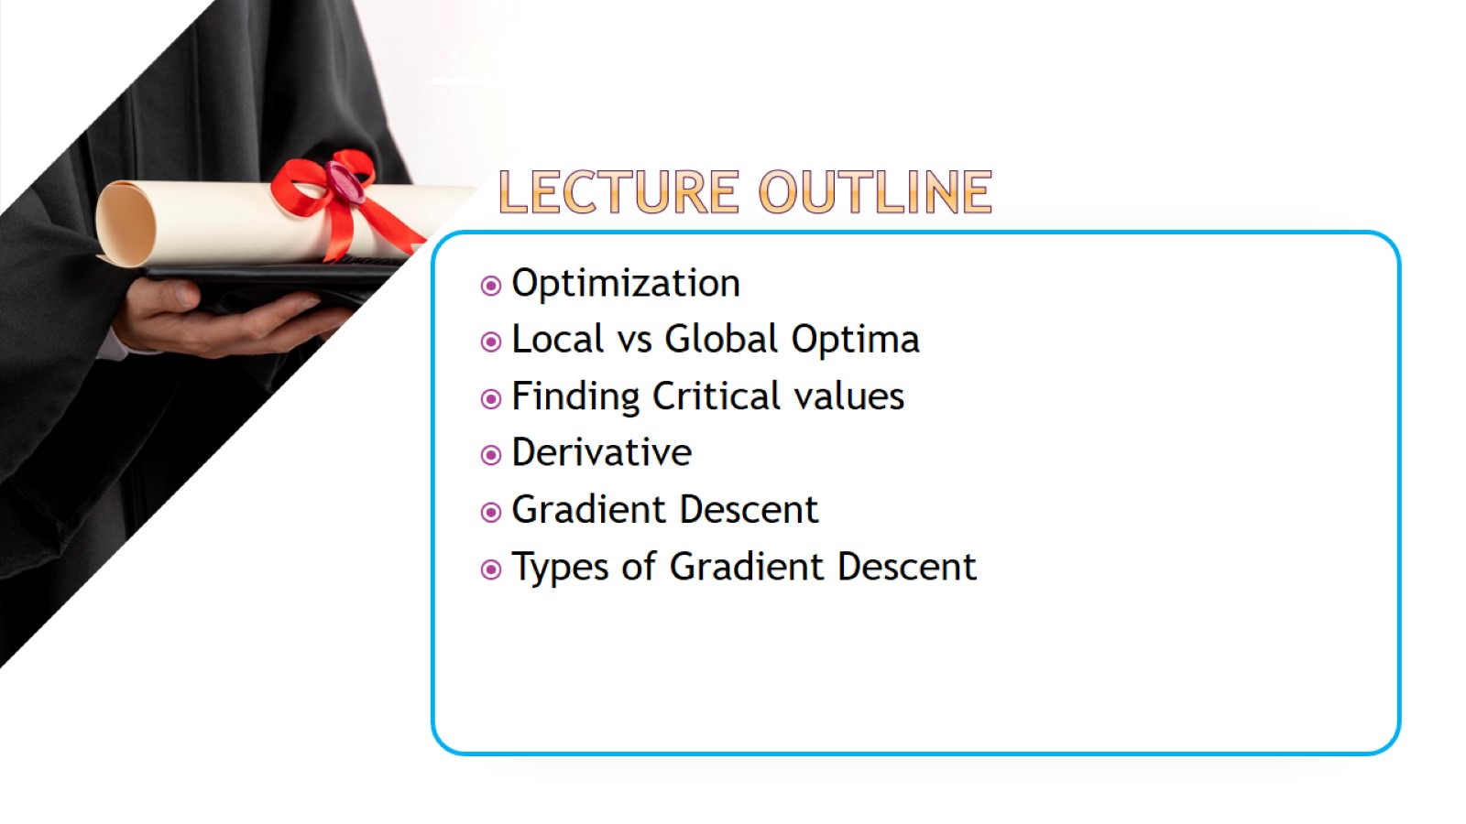

Slide 5
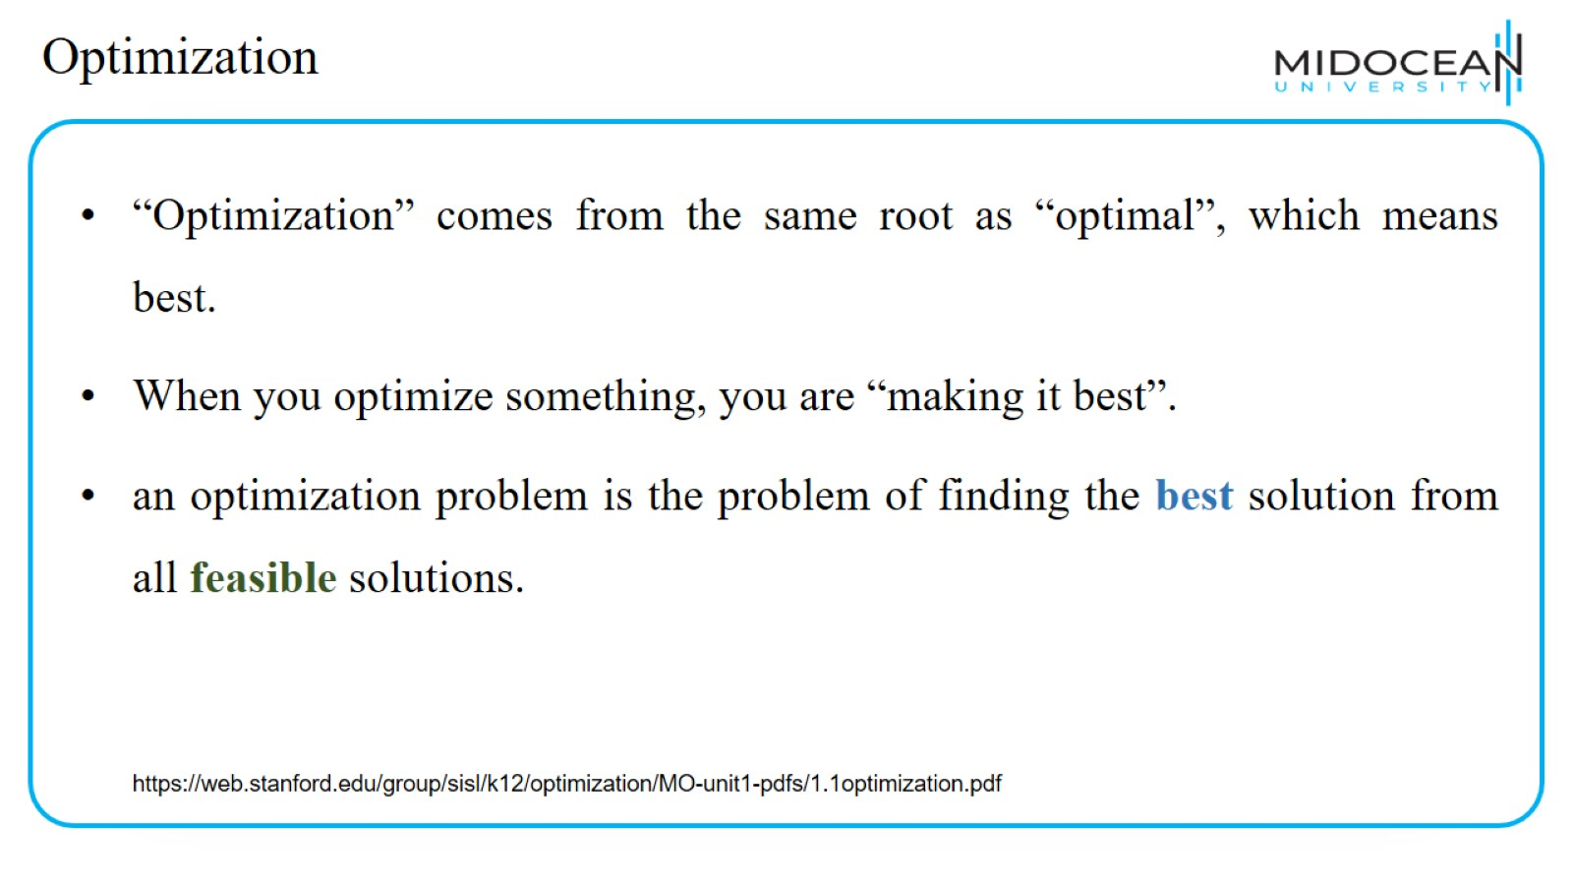
Optimization

Slide 6
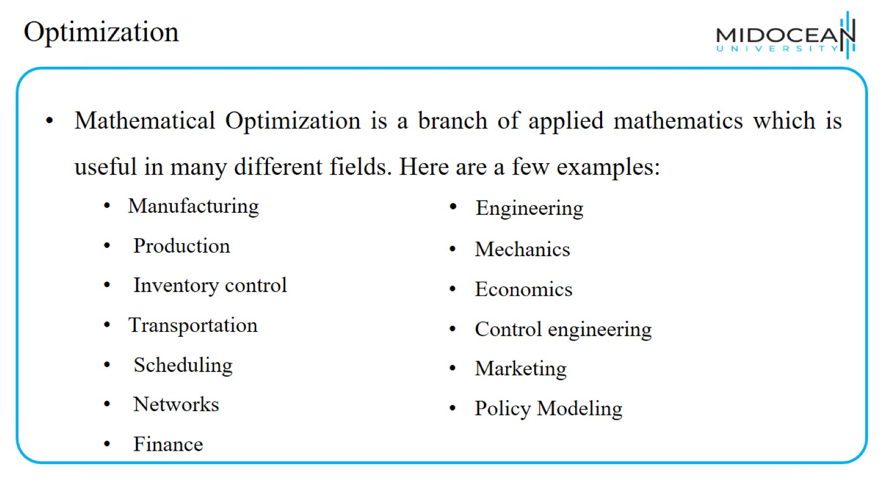
Optimization

Slide 7
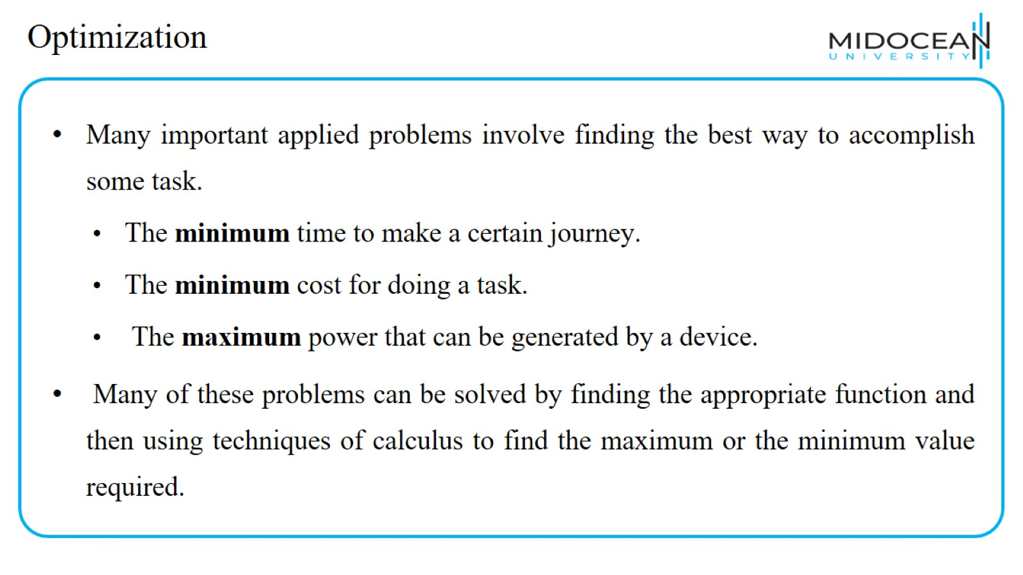
Optimization

Slide 8
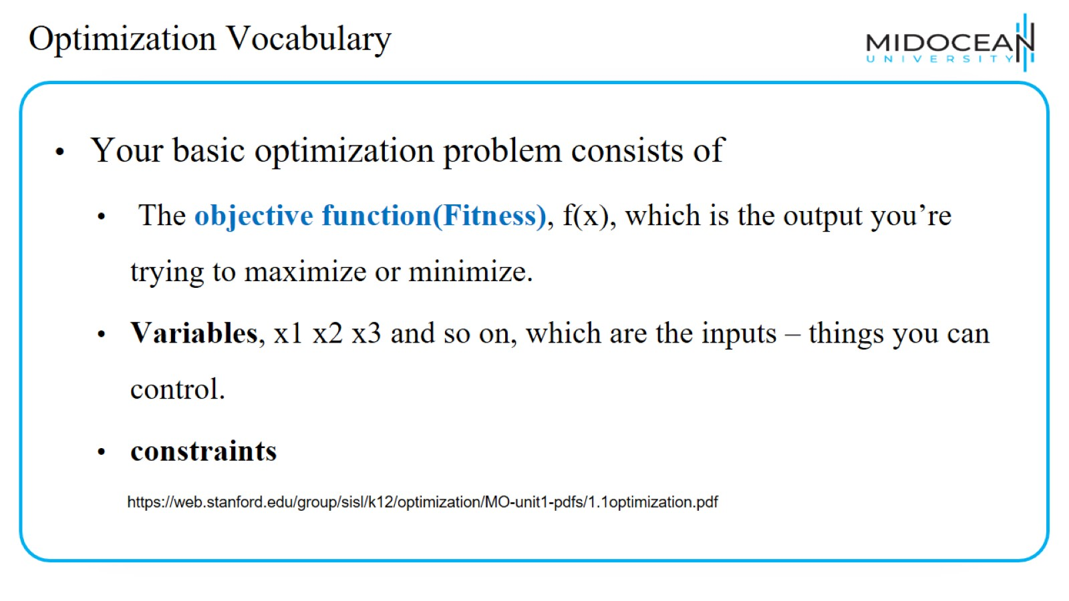
Optimization Vocabulary

Slide 9
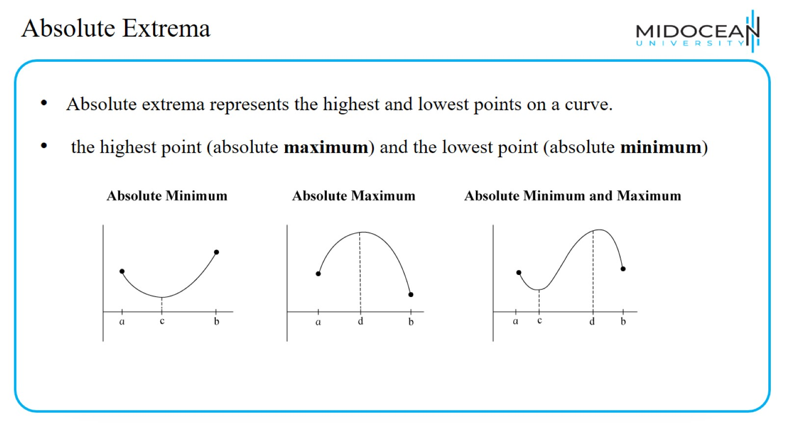
Absolute Extrema

Slide 10
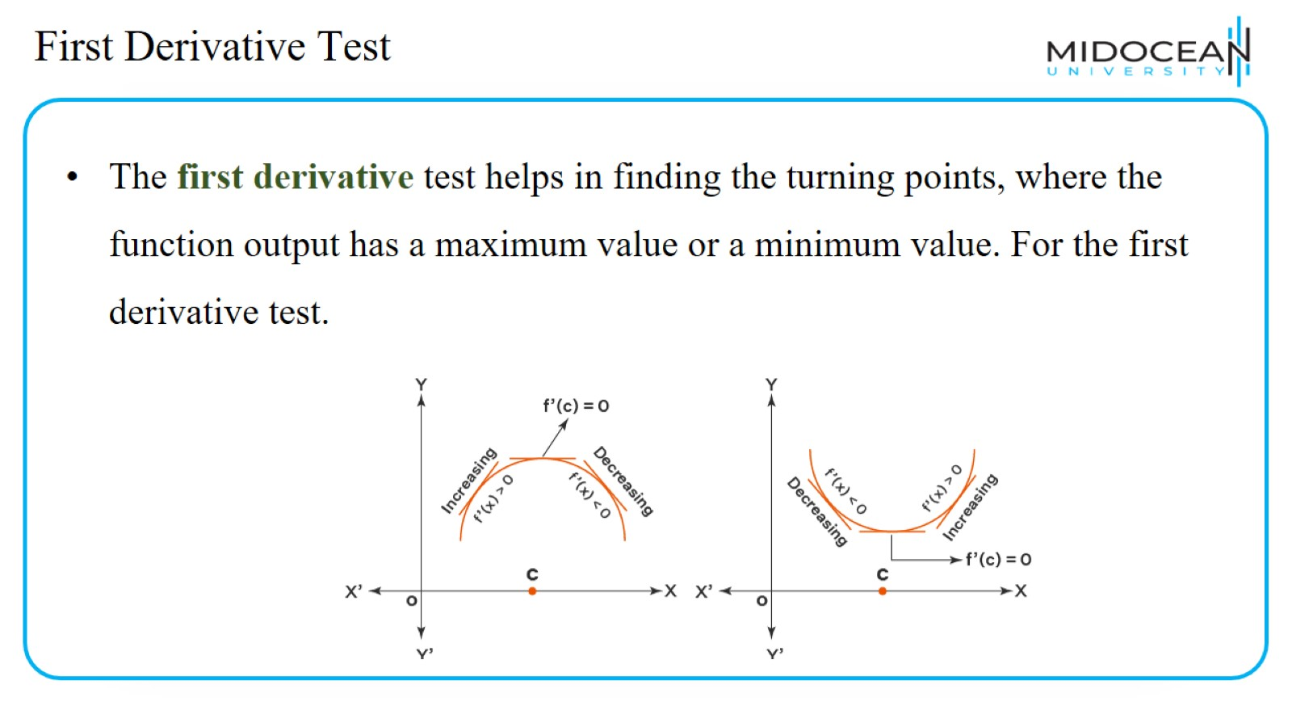
First Derivative Test

Slide 11
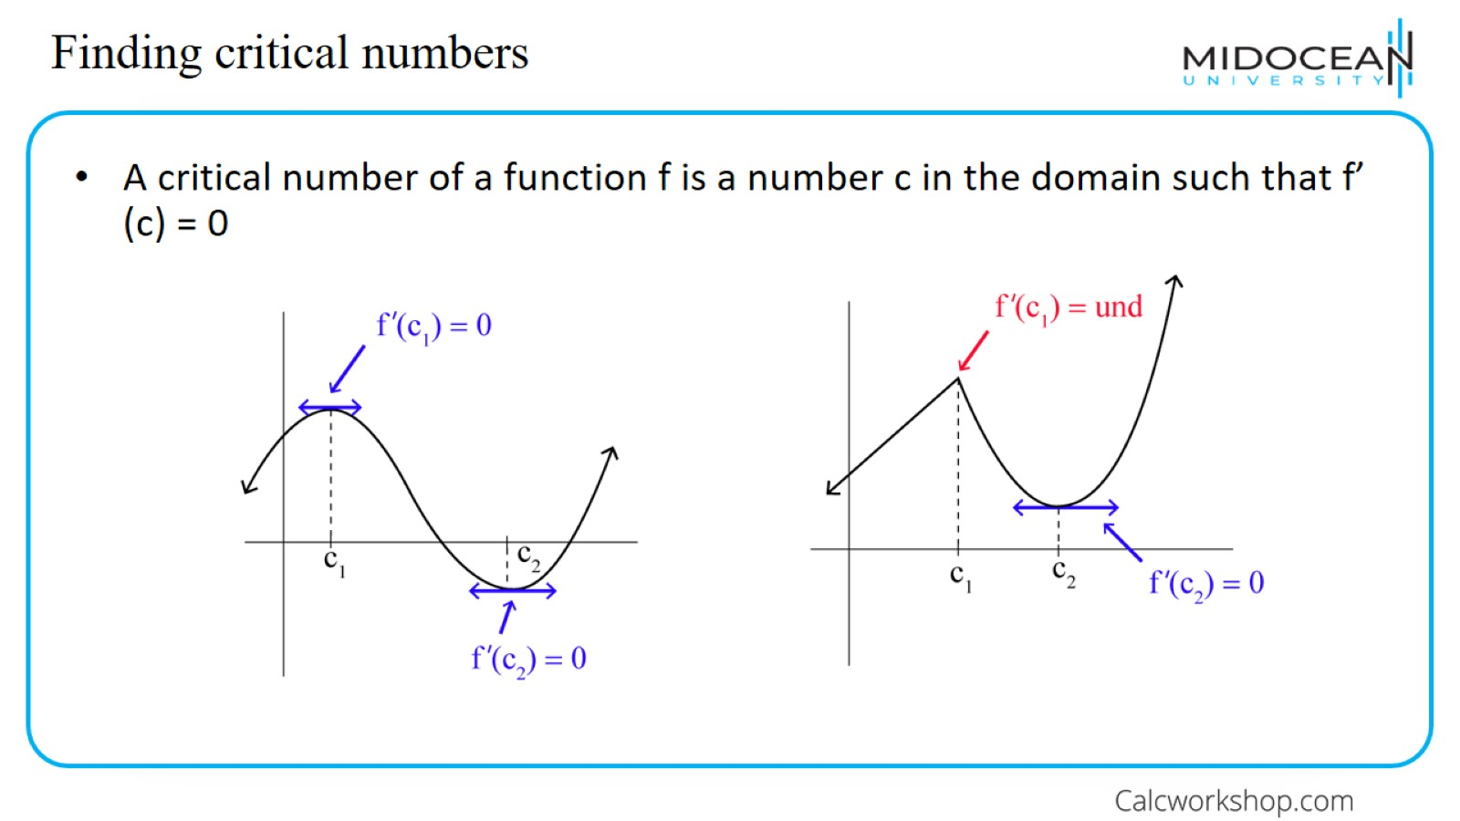
Finding critical numbers

Slide 12
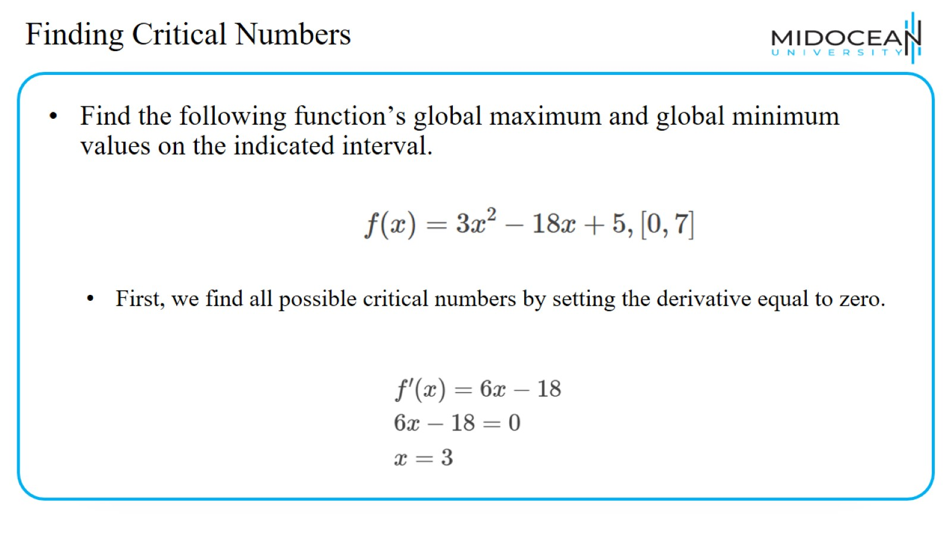
Finding Critical Numbers

Slide 13
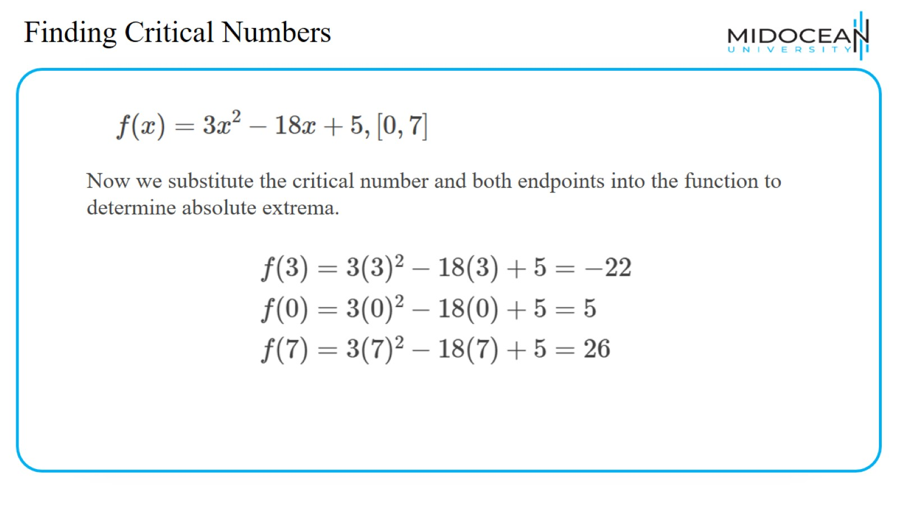
Finding Critical Numbers

Slide 14
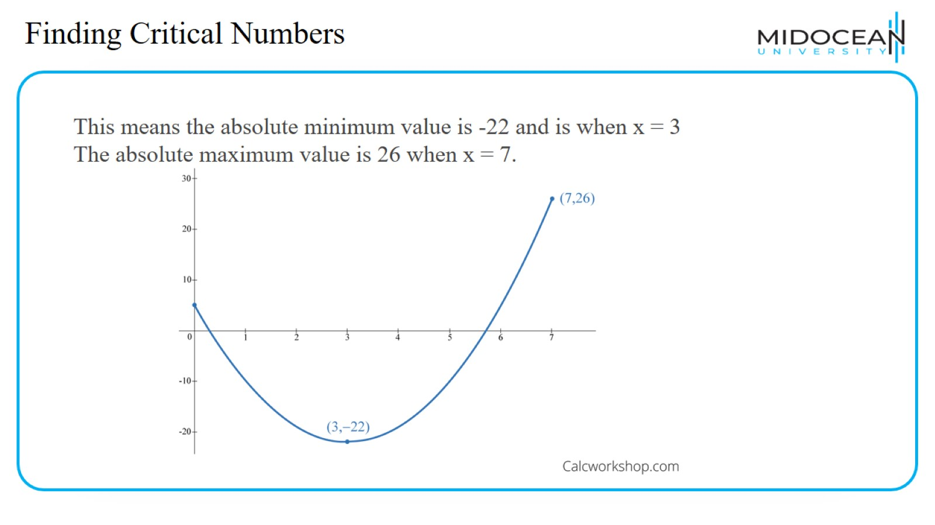
Finding Critical Numbers

Slide 15
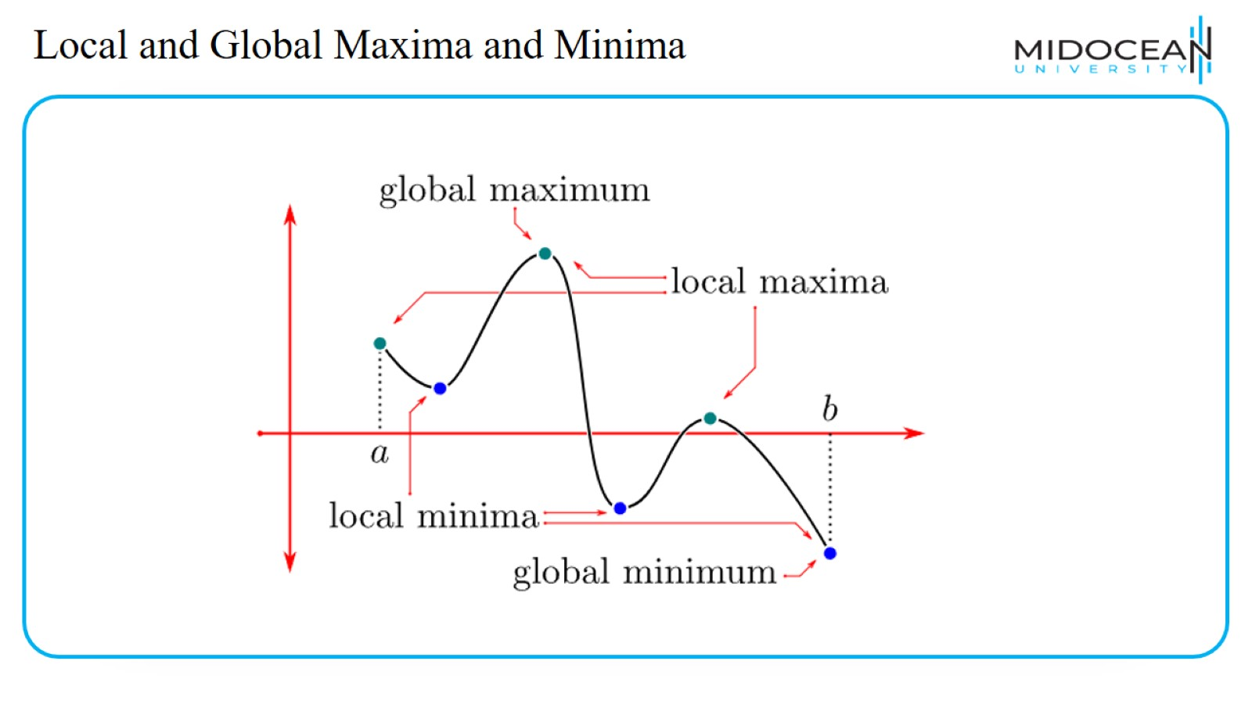
Local and Global Maxima and Minima

Slide 16
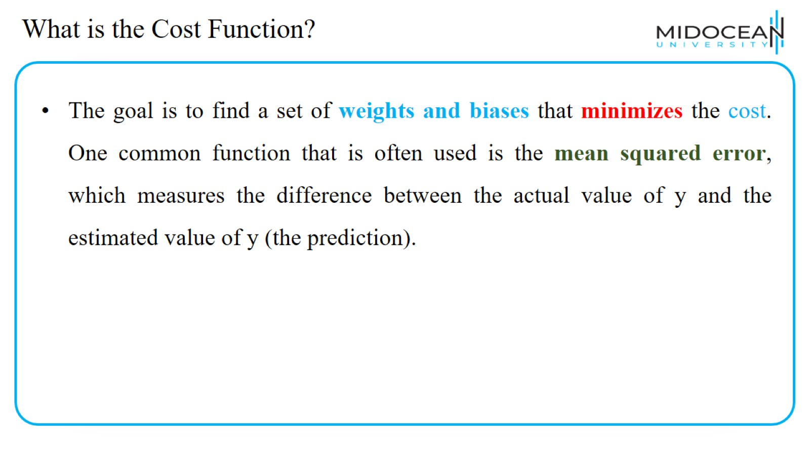
What is the Cost Function?

Slide 17
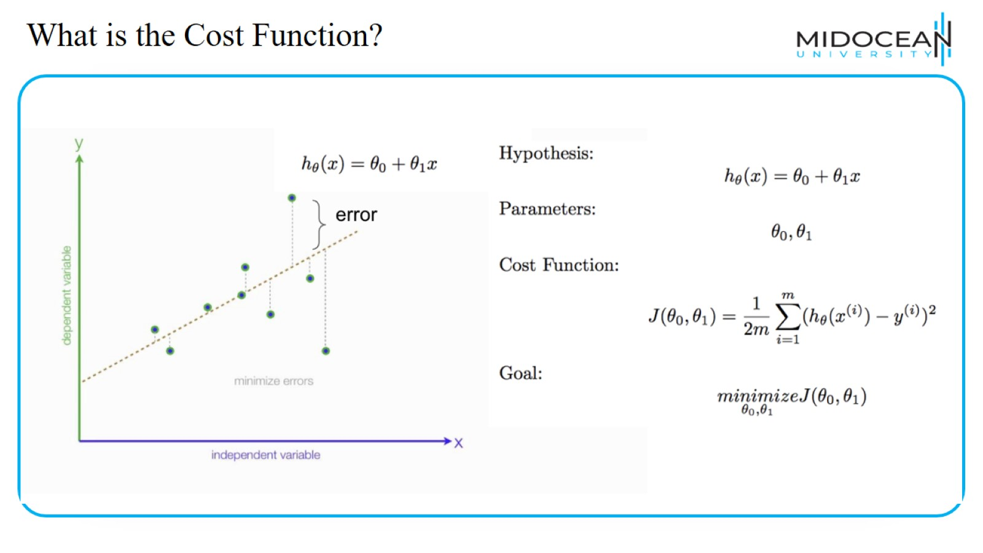
What is the Cost Function?

Slide 18
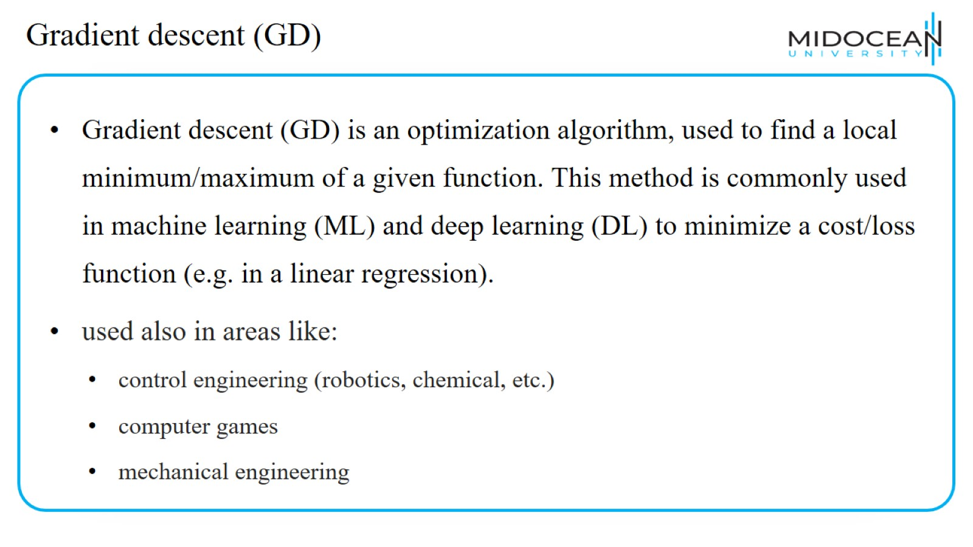
Gradient descent (GD)

Slide 19
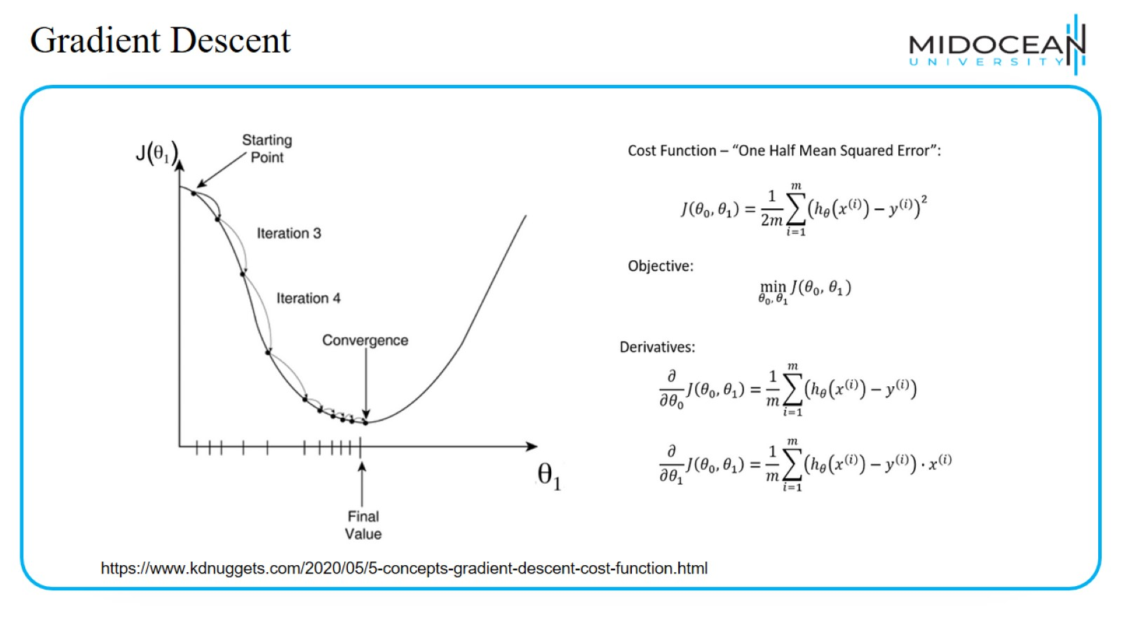
Gradient Descent

Slide 20
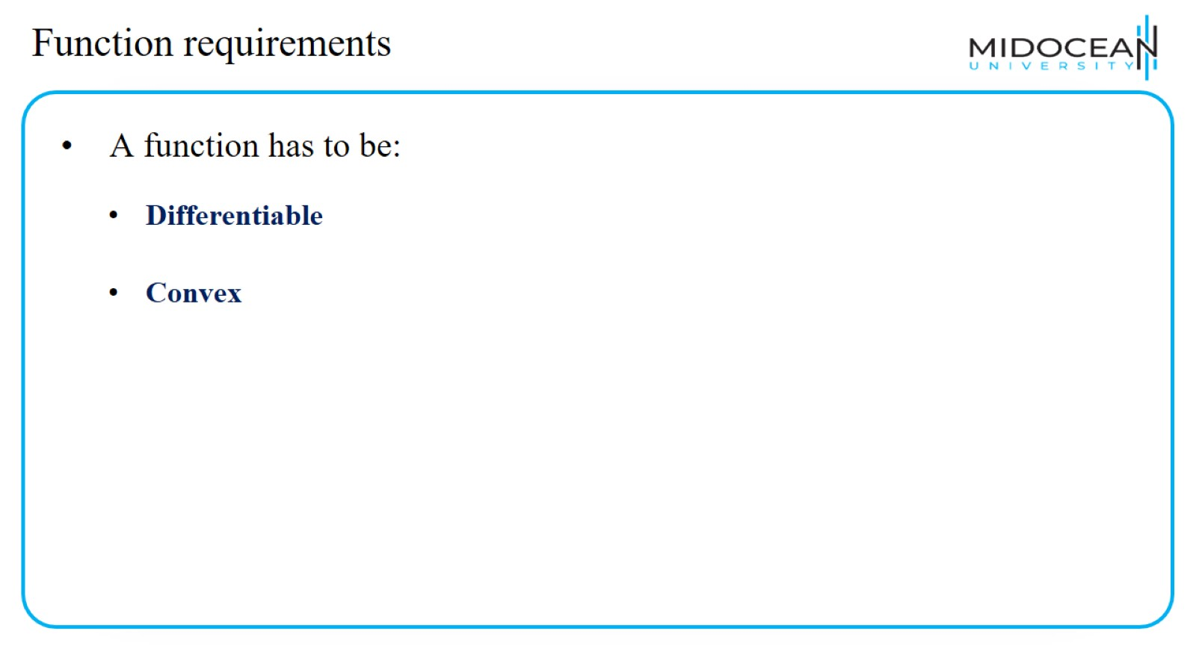
Function requirements

Slide 21
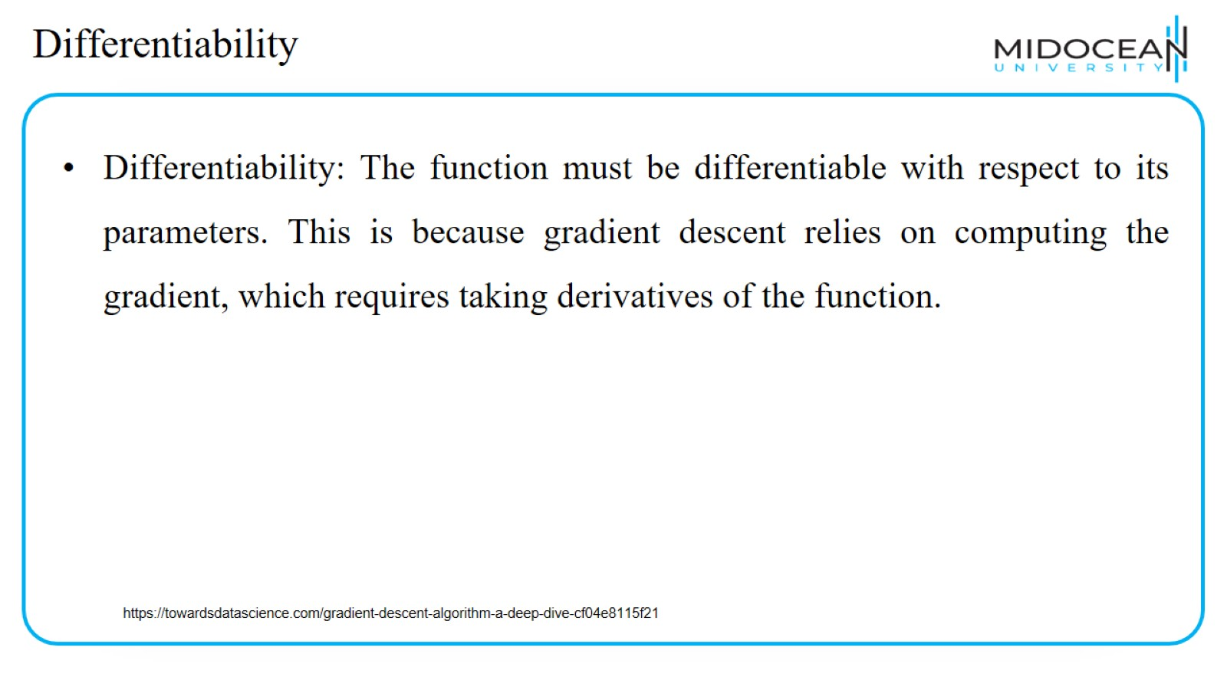
Differentiability

Slide 22
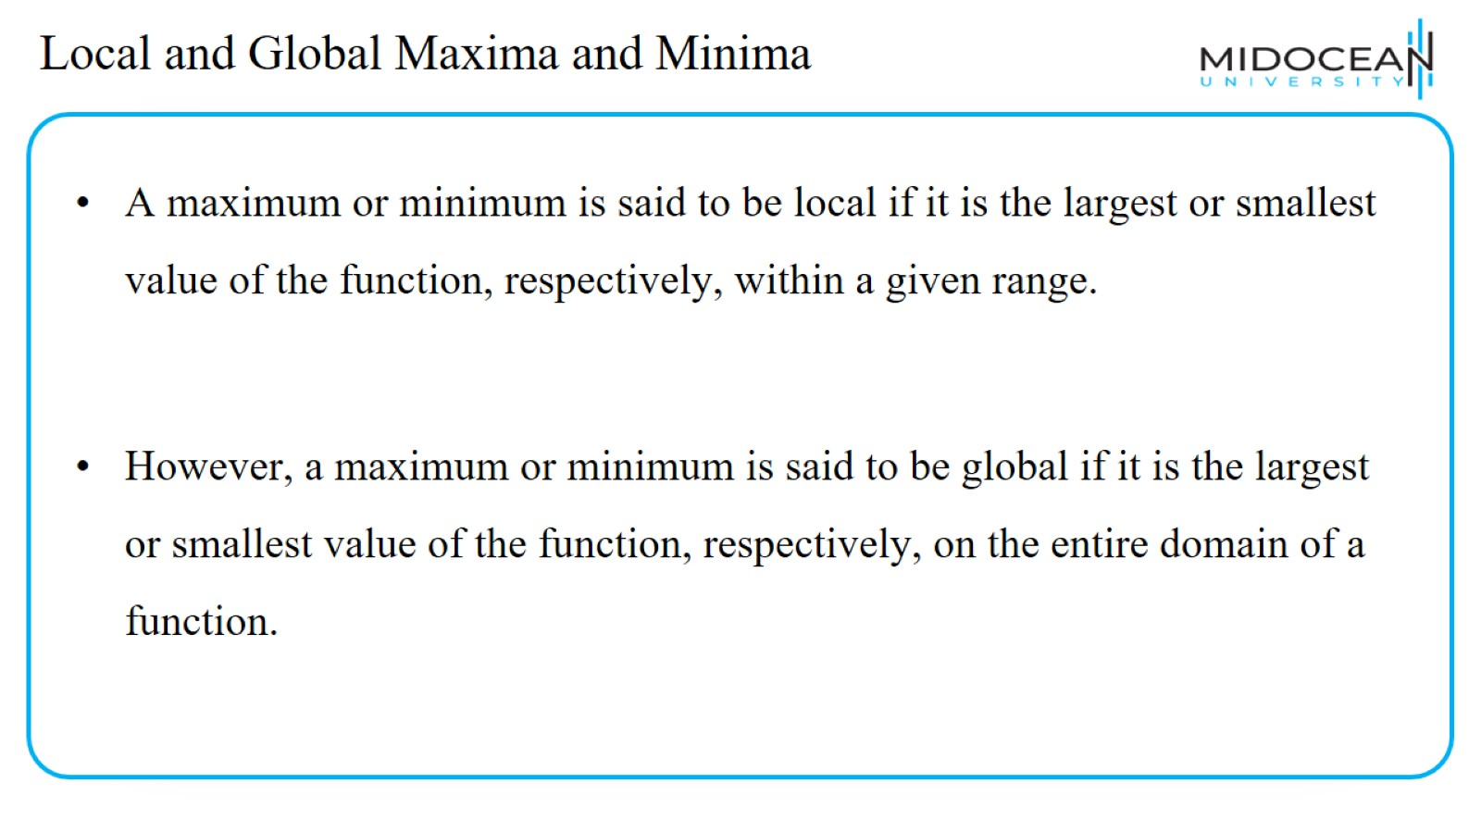
Local and Global Maxima and Minima

Slide 23
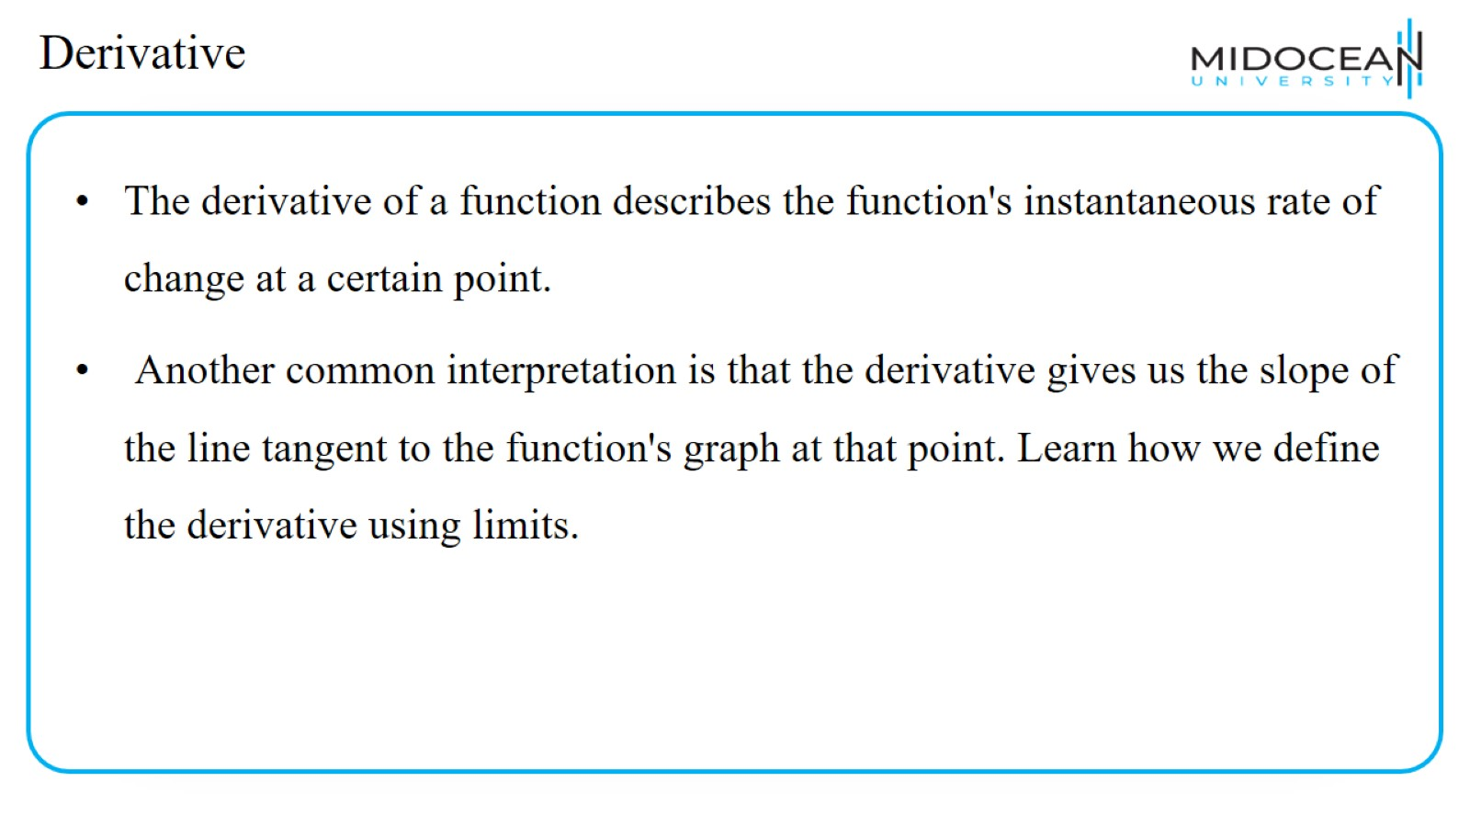
Derivative

Slide 24
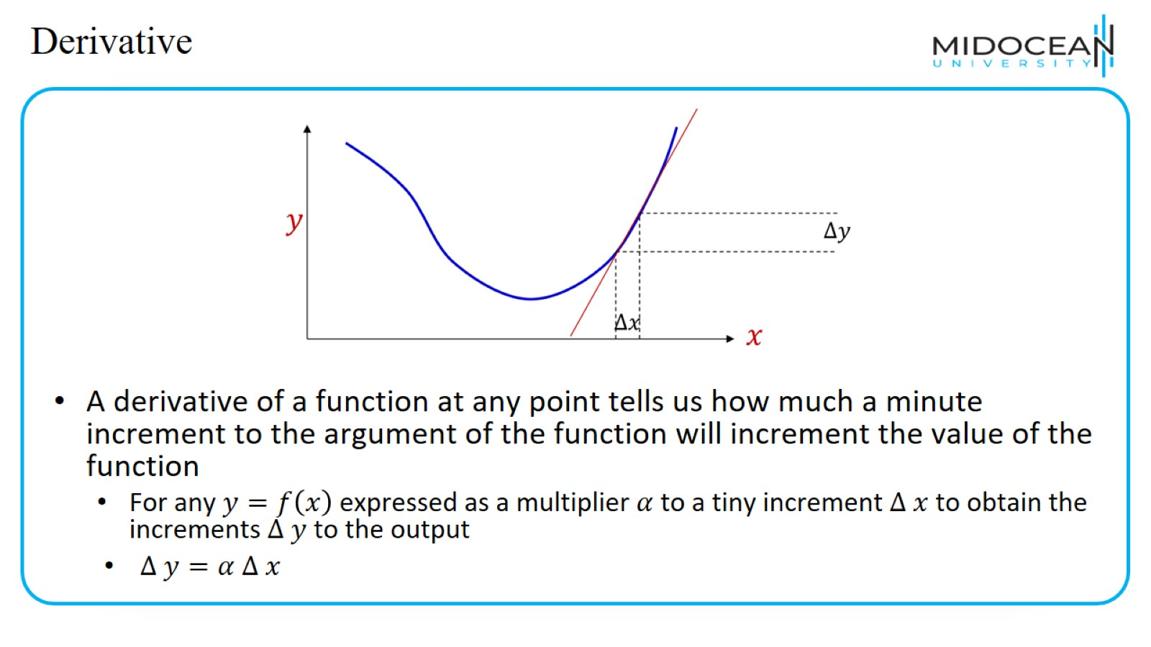
Derivative

Slide 25
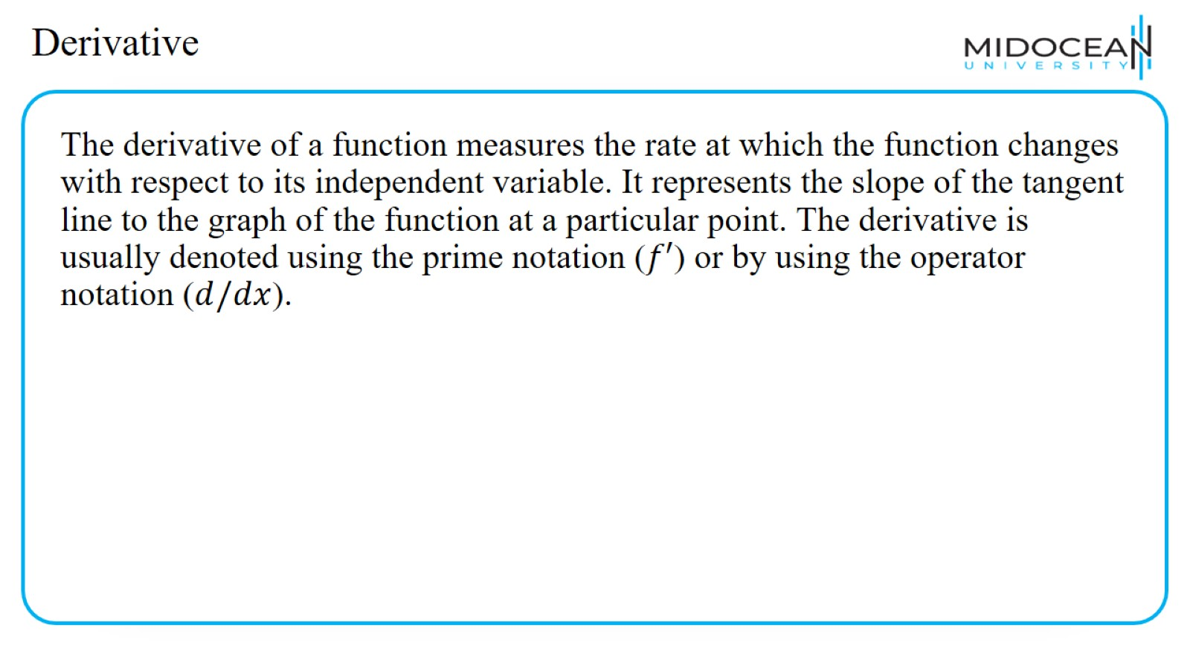
Derivative

Slide 26
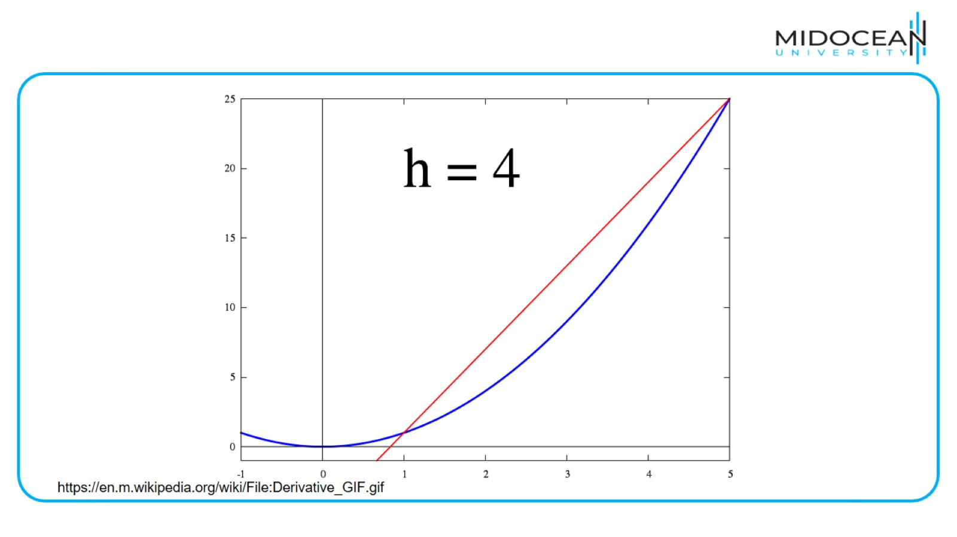

Slide 27
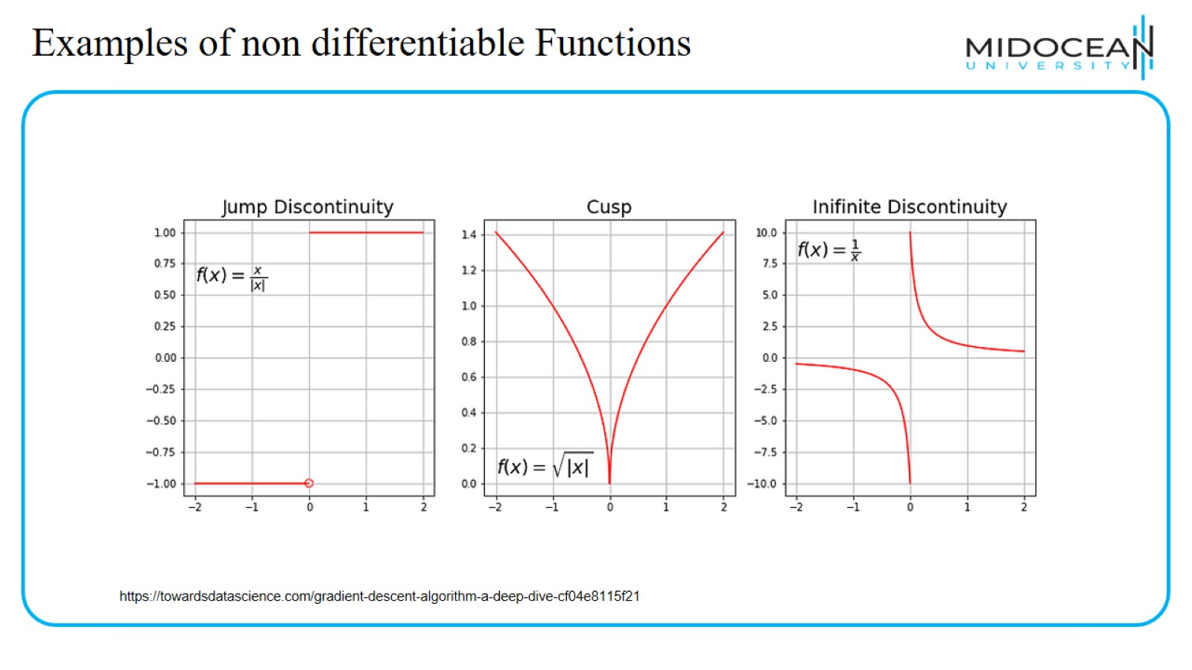
Examples of non differentiable Functions

Slide 28
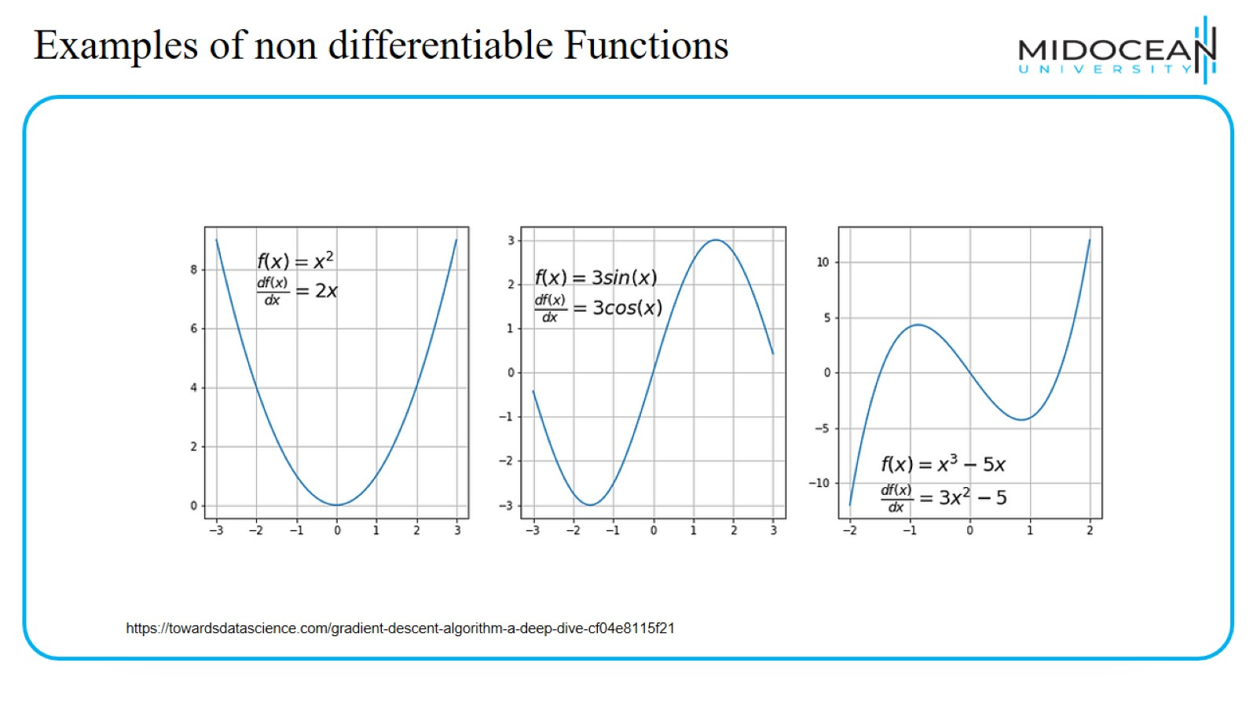
Examples of non differentiable Functions

Slide 29
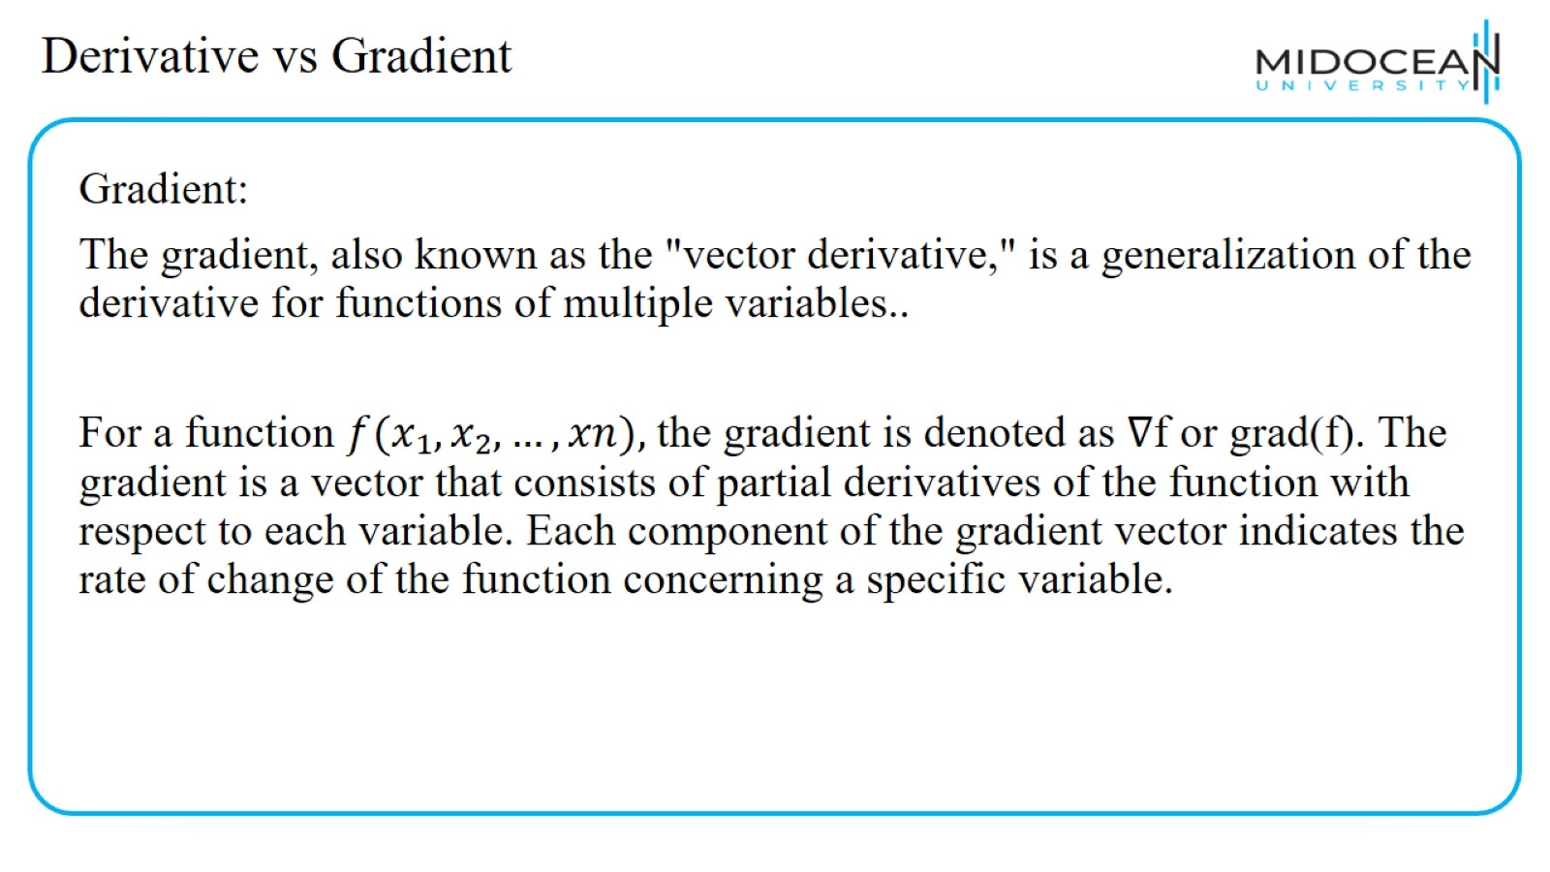
Derivative vs Gradient

Slide 30
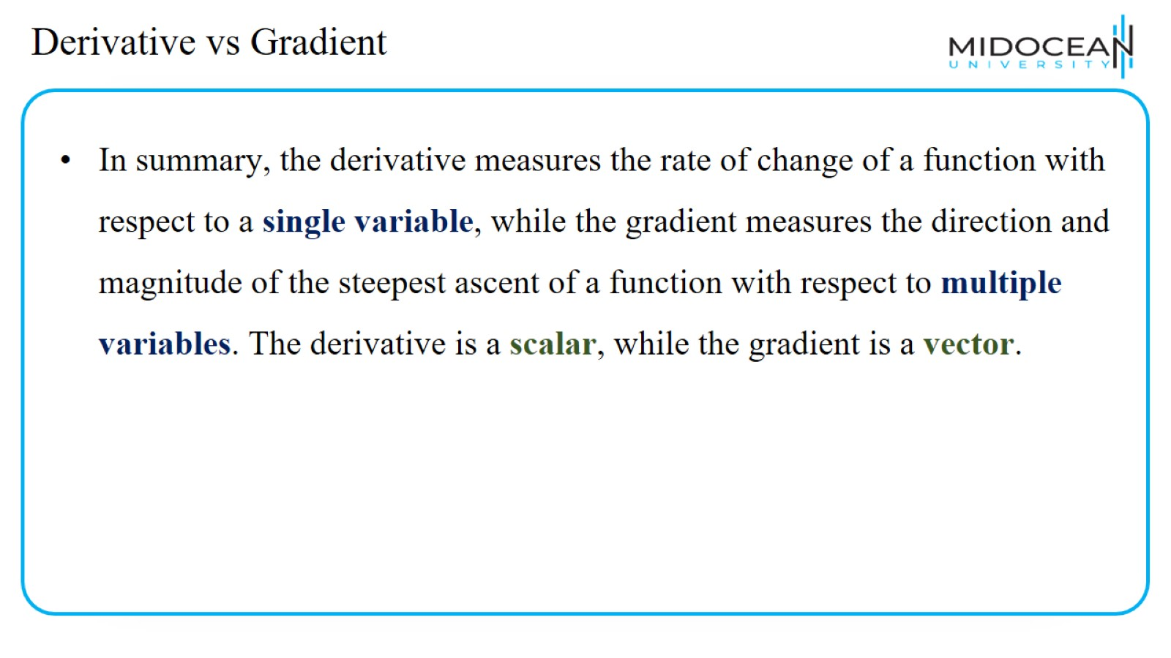
Derivative vs Gradient

Slide 31
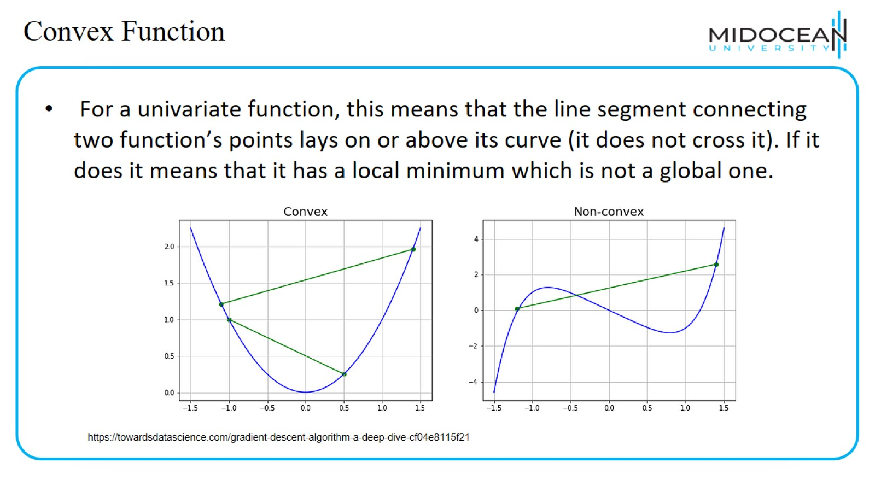
Convex Function

Slide 32
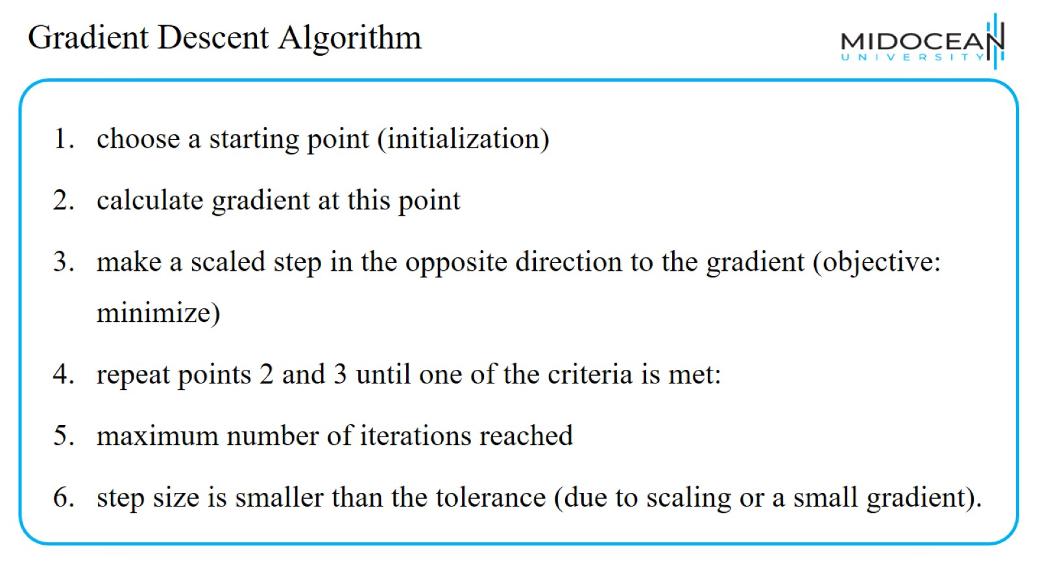
Gradient Descent Algorithm

Slide 33
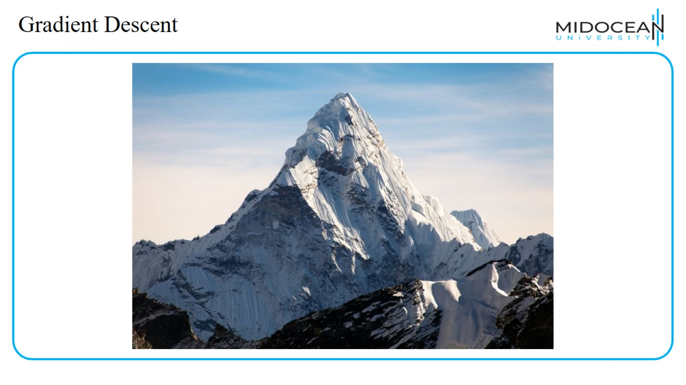
Gradient Descent

Slide 34
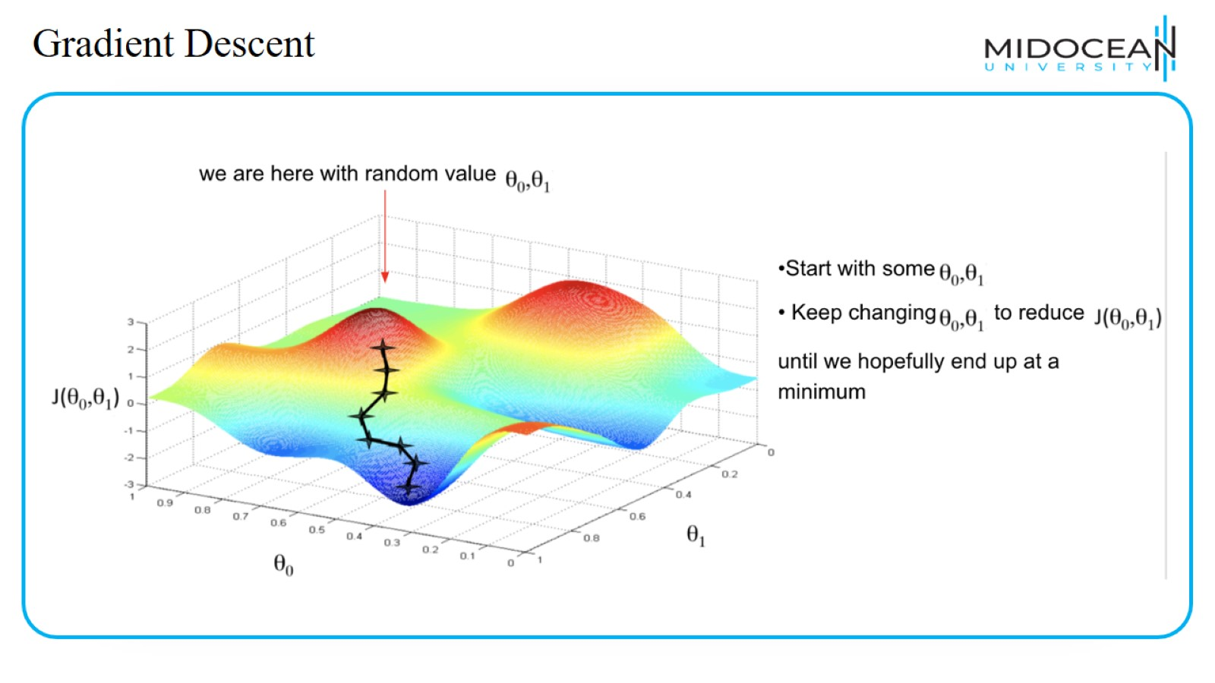
Gradient Descent

Slide 35
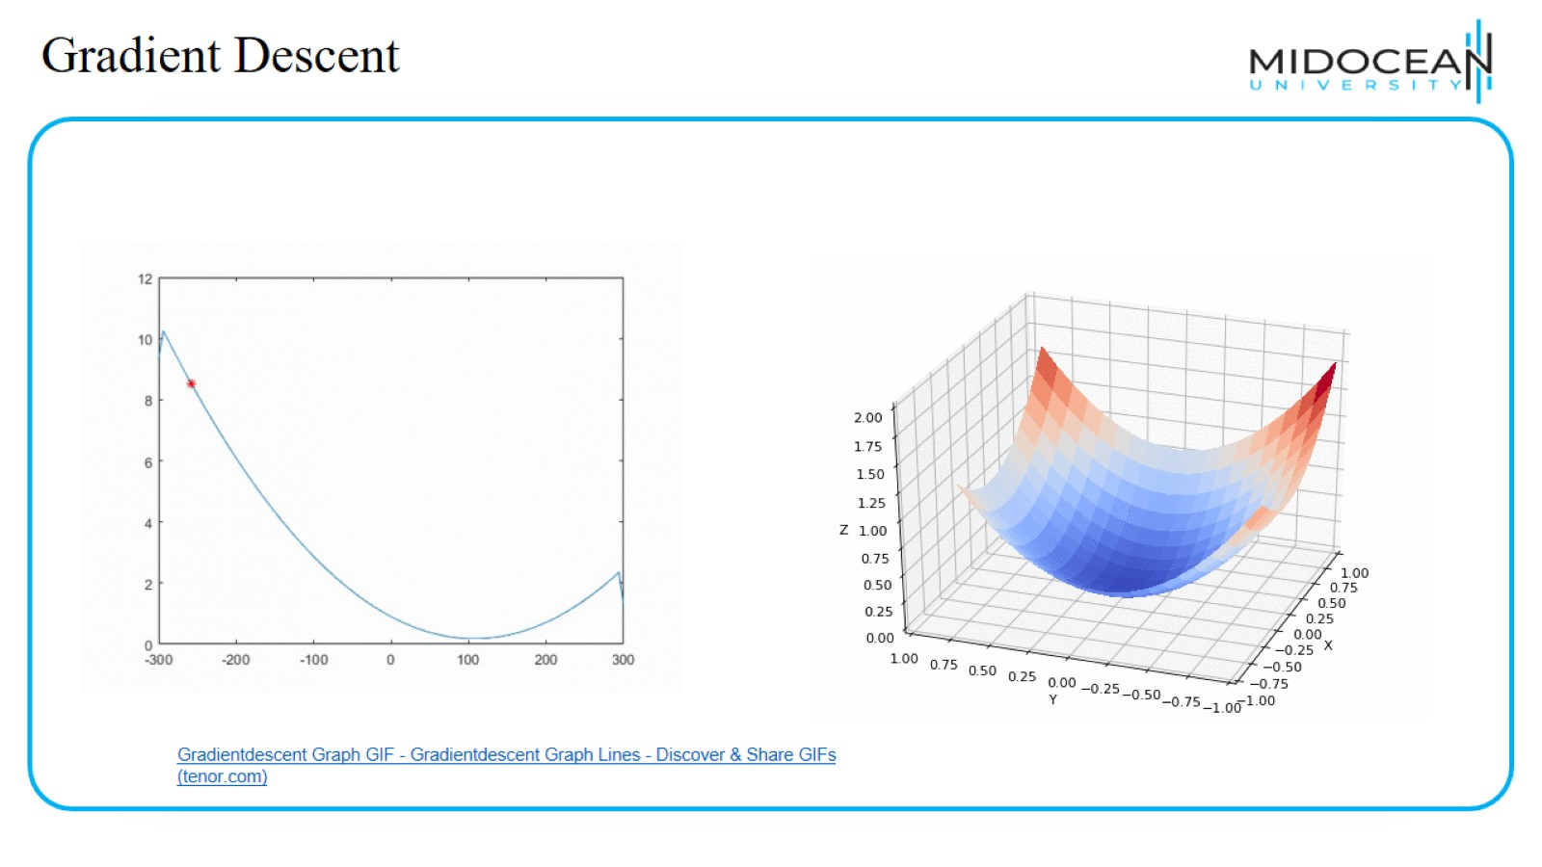
Gradient Descent

Slide 36
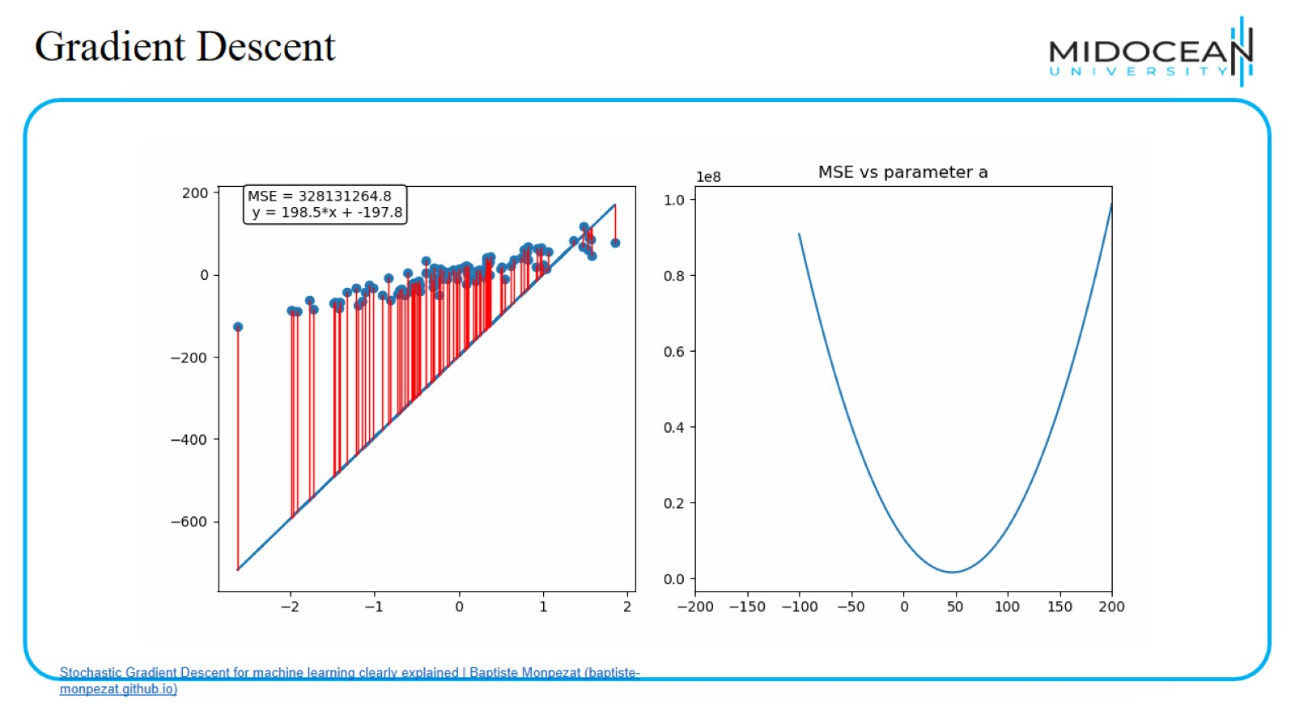
Gradient Descent

Slide 37
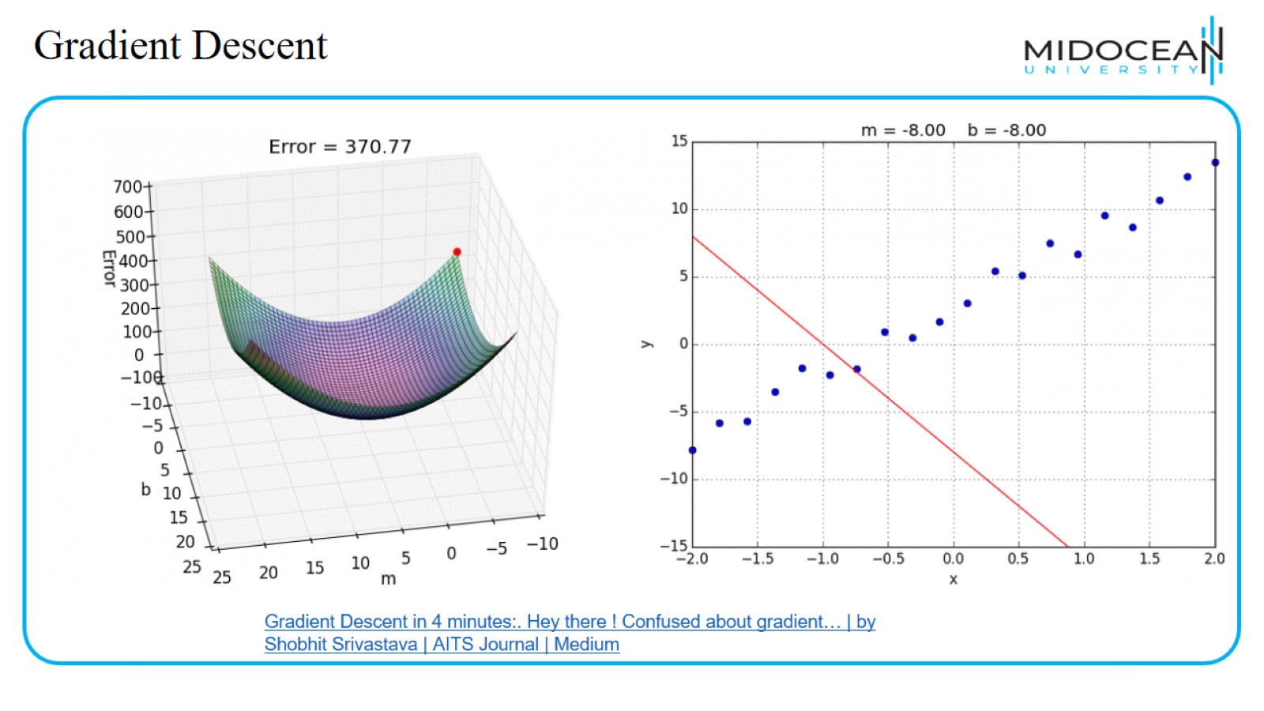
Gradient Descent

Slide 38
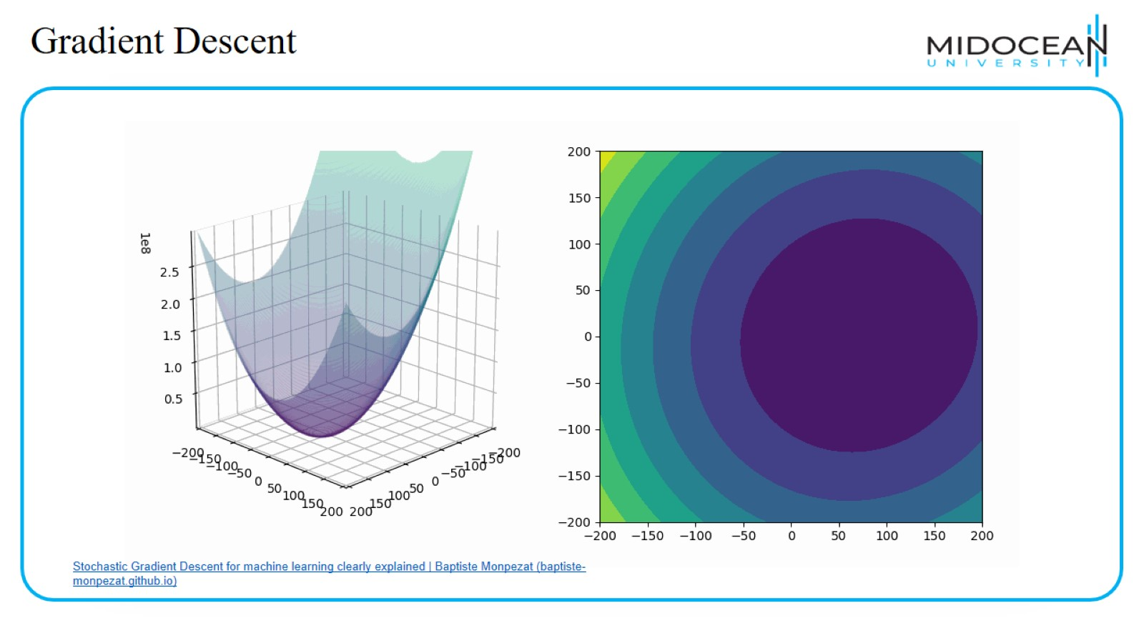
Gradient Descent

Slide 39
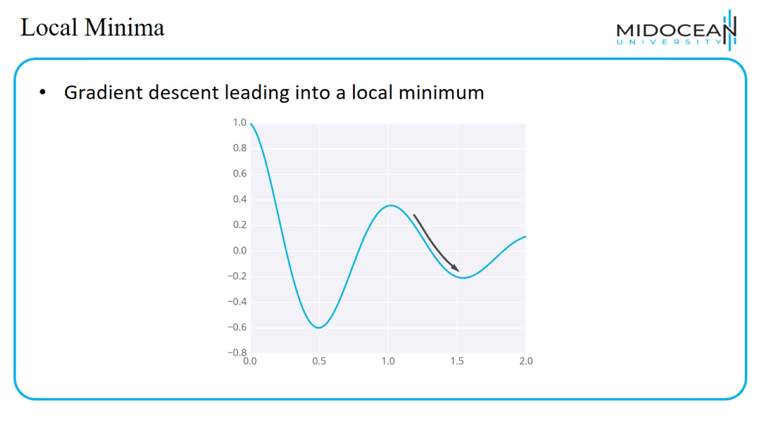
Local Minima

Slide 40
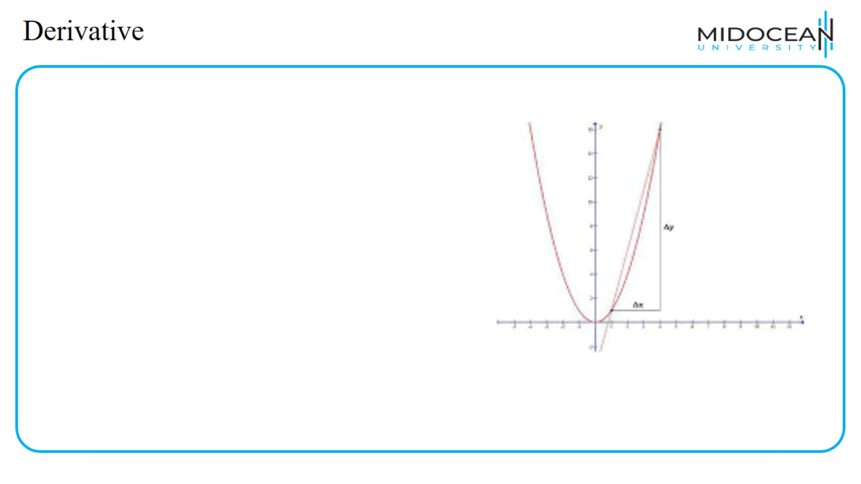
Derivative

Slide 41
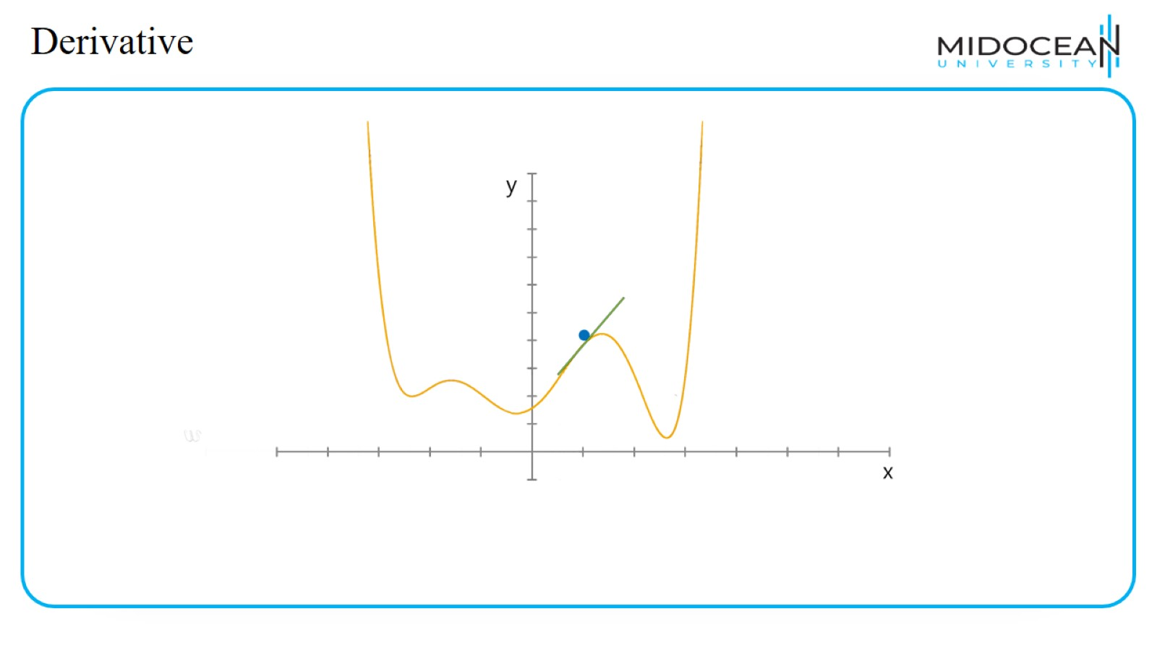
Derivative

Slide 42
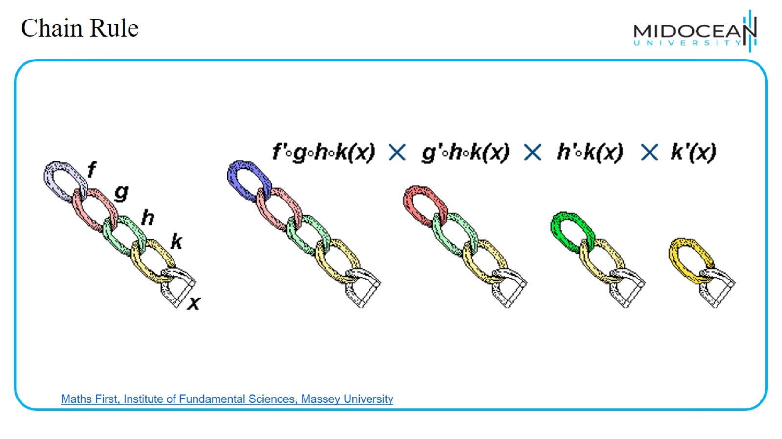
Chain Rule

Slide 43
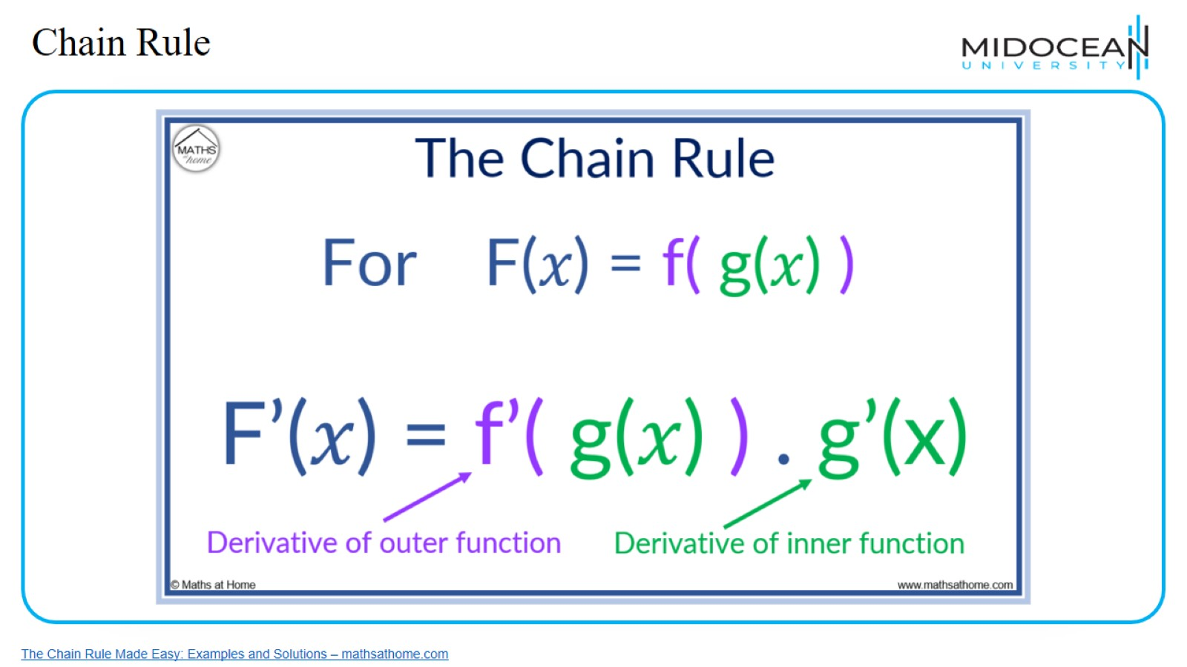
Chain Rule

Slide 44
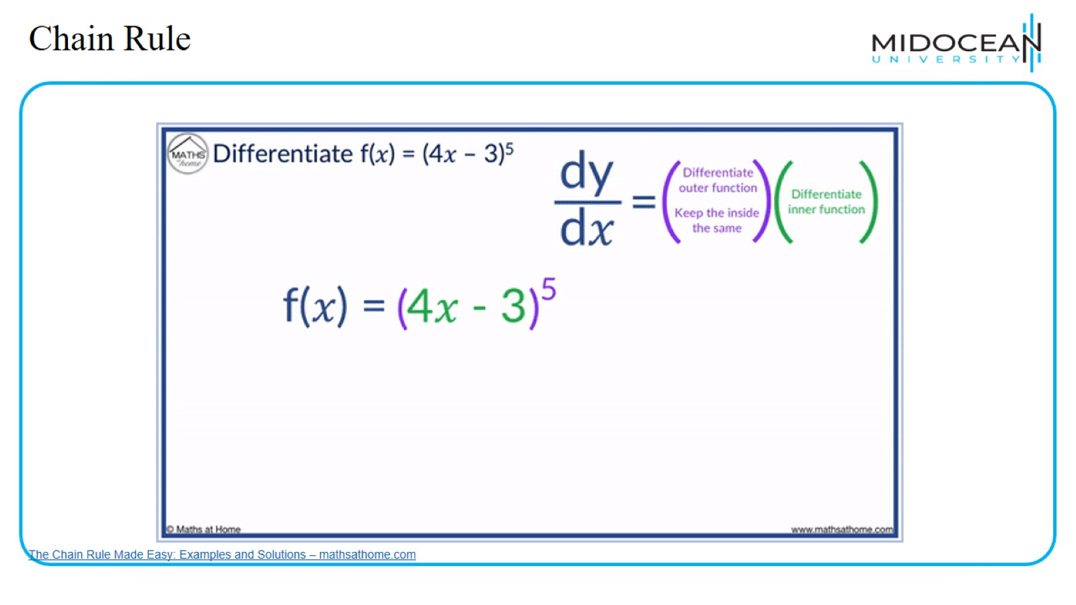
Chain Rule

Slide 45
Gradient Descent Algorithm

Slide 46
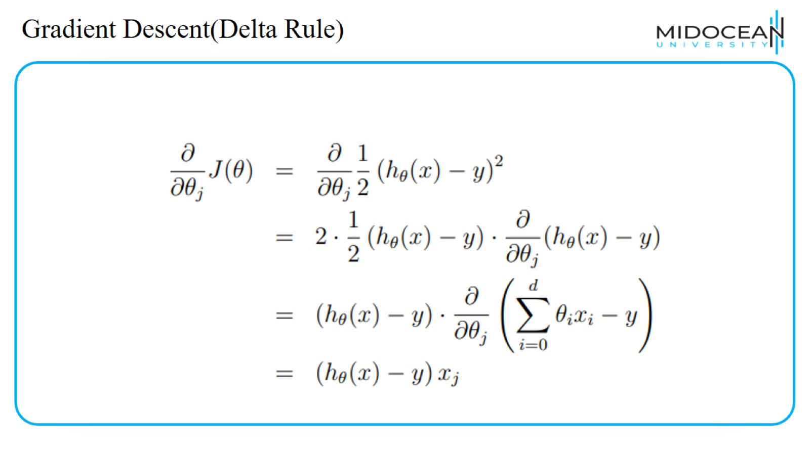
Gradient Descent(Delta Rule)

Slide 47
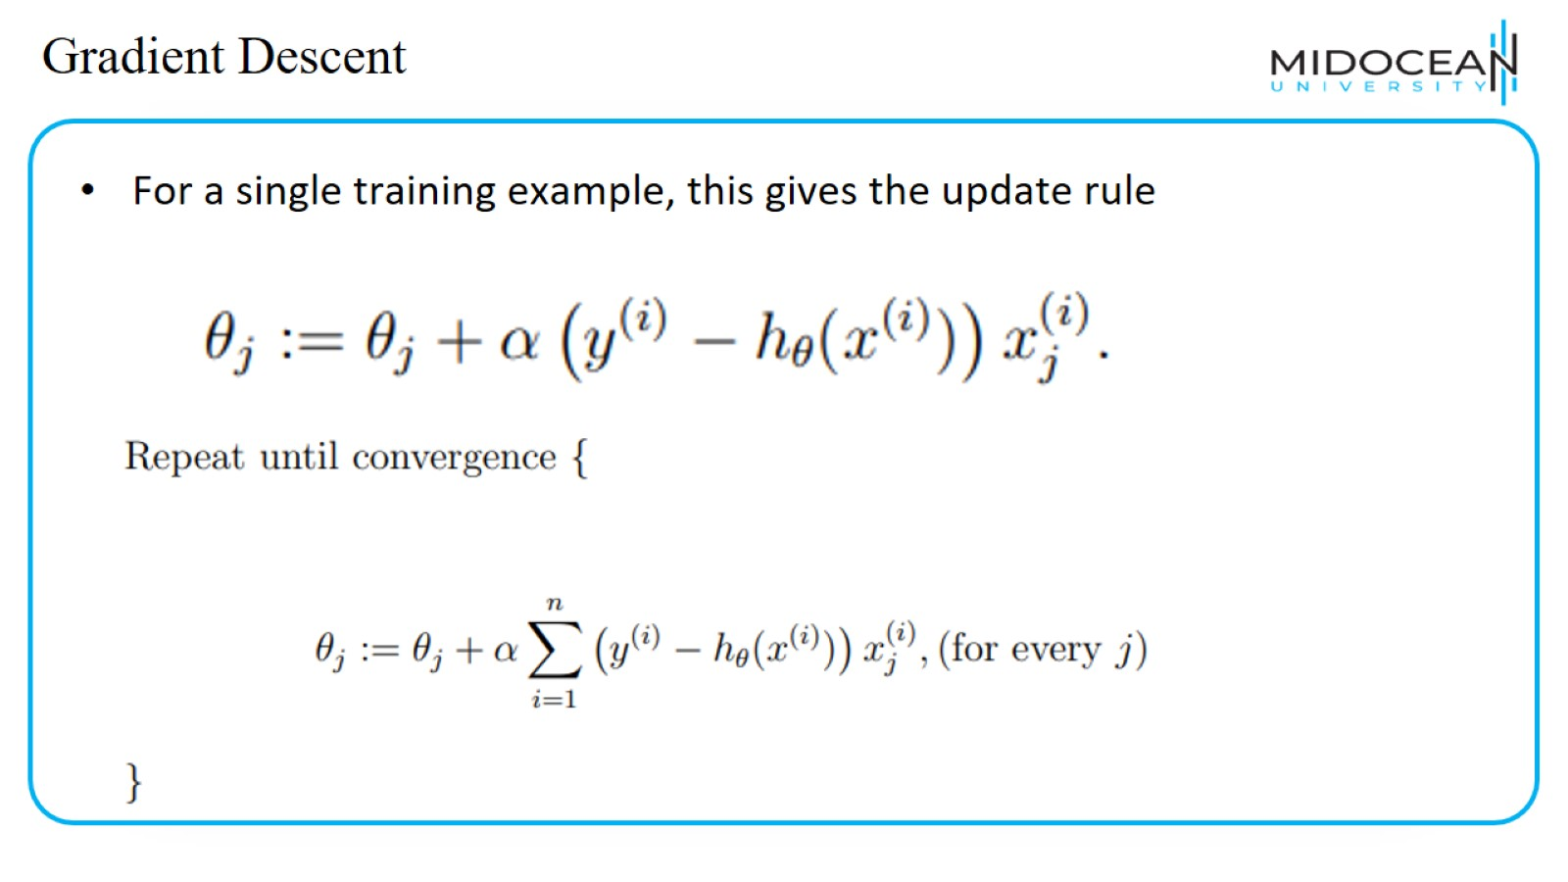
Gradient Descent

Slide 48
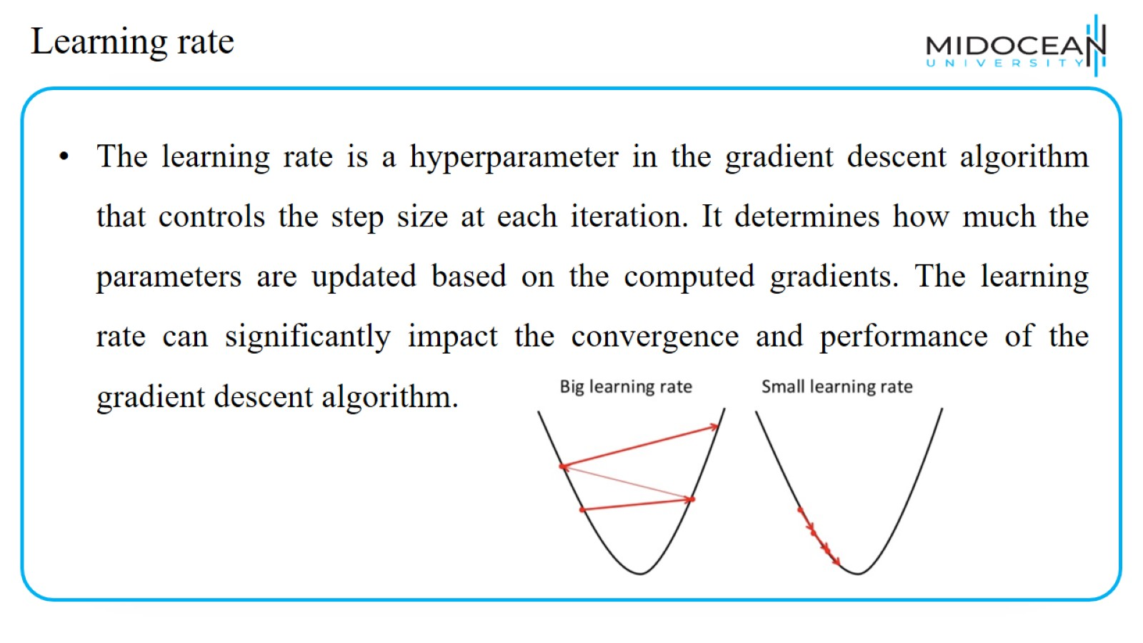
Learning rate

Slide 49
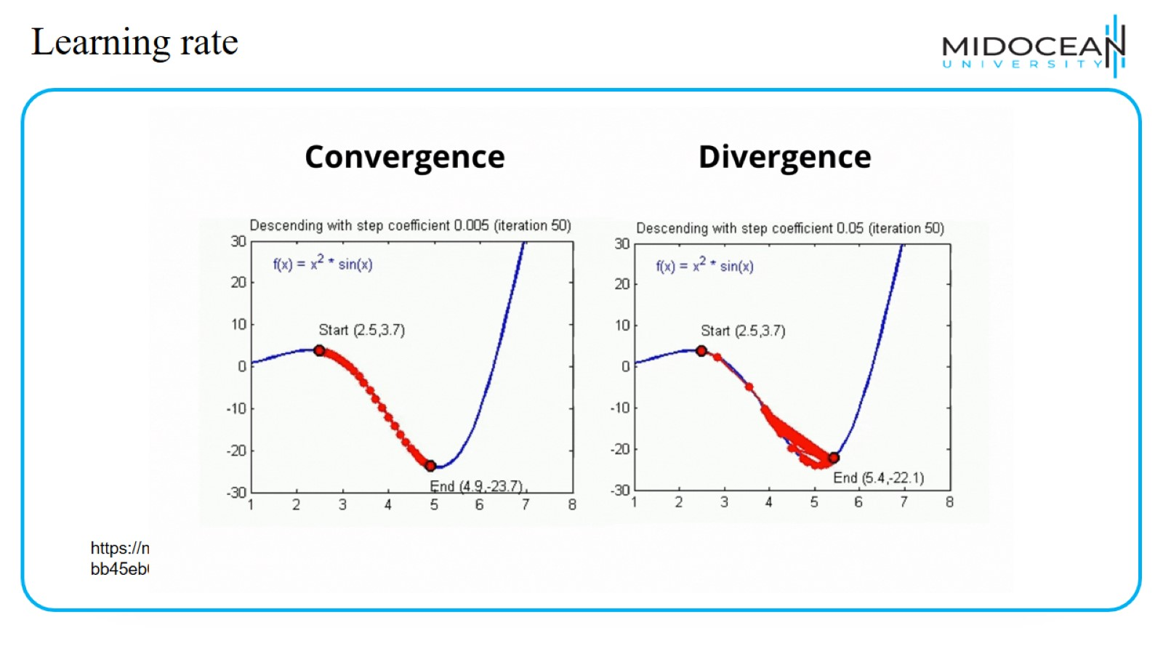
Learning rate

Slide 50
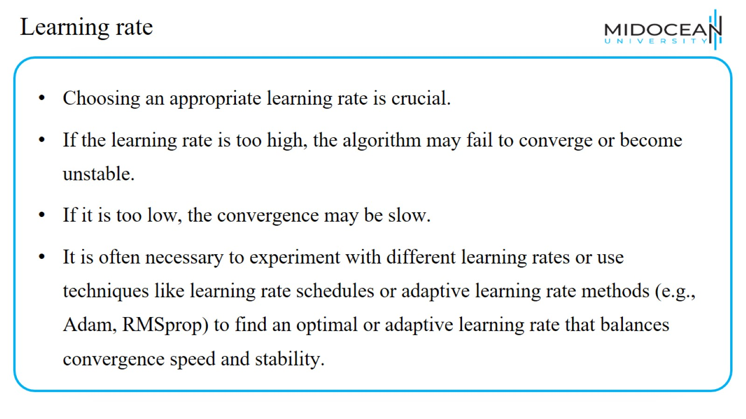
Learning rate

Slide 51
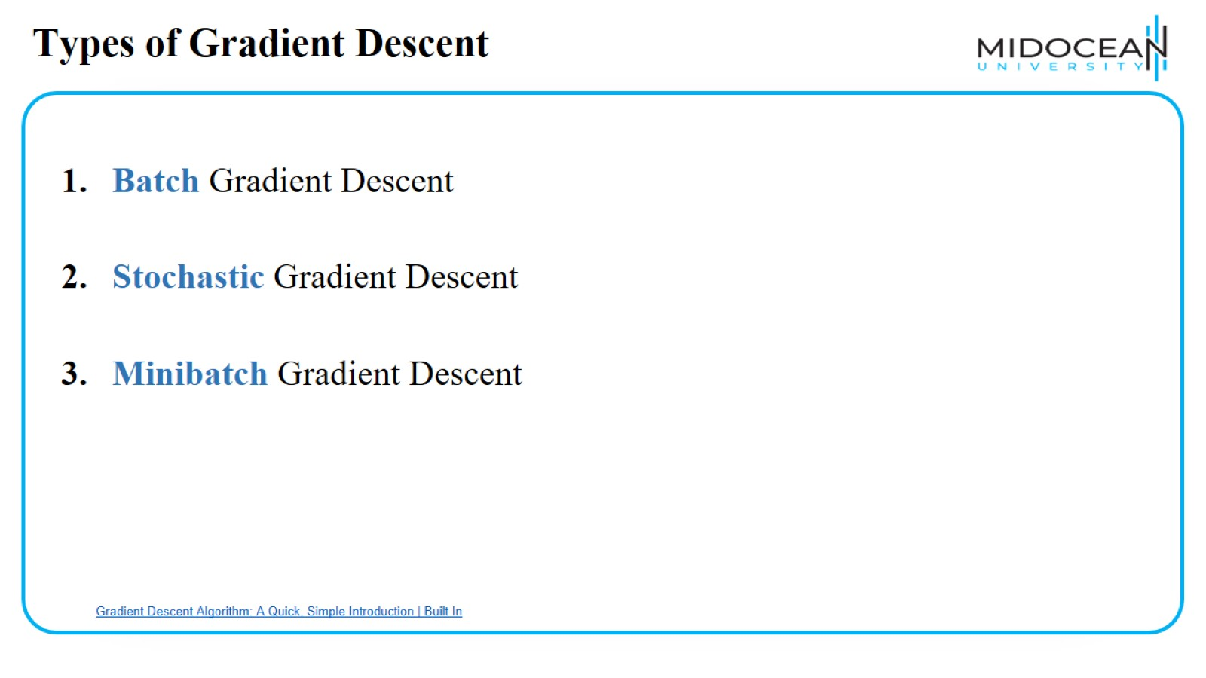
Types of Gradient Descent

Slide 52
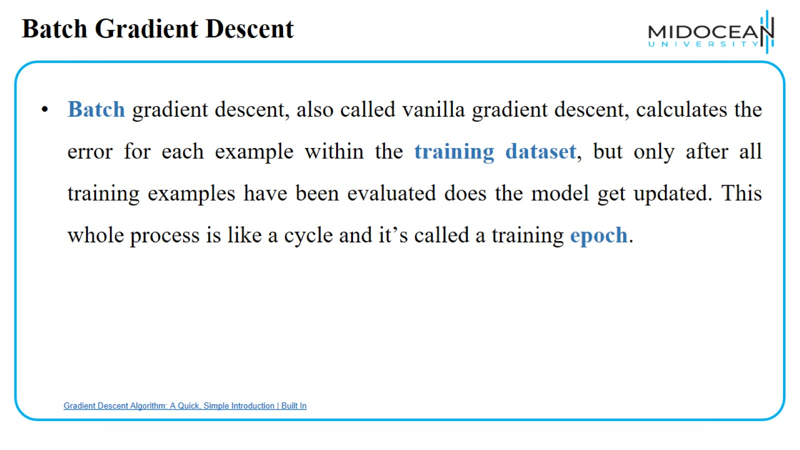
Batch Gradient Descent

Slide 53
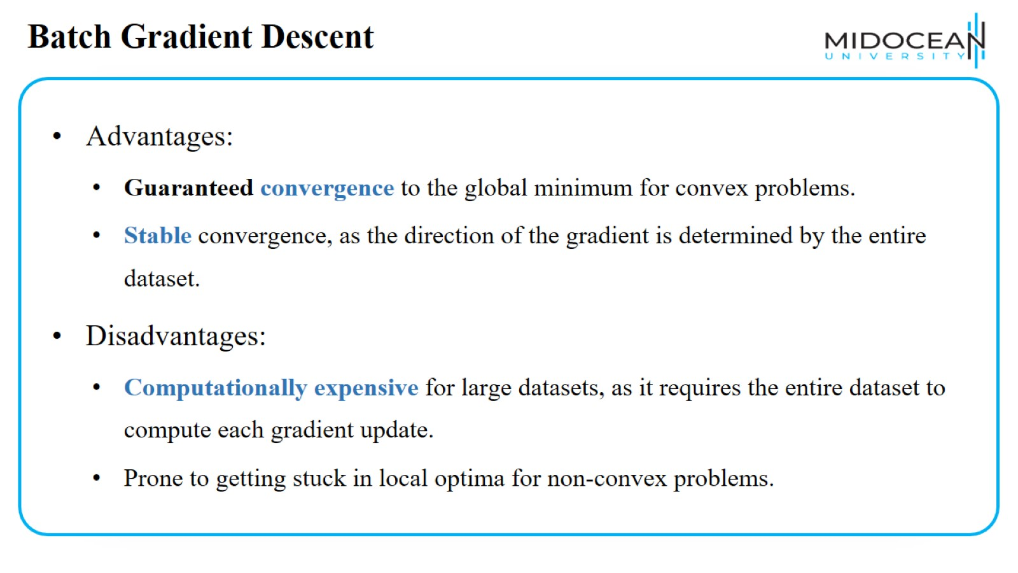
Batch Gradient Descent

Slide 54
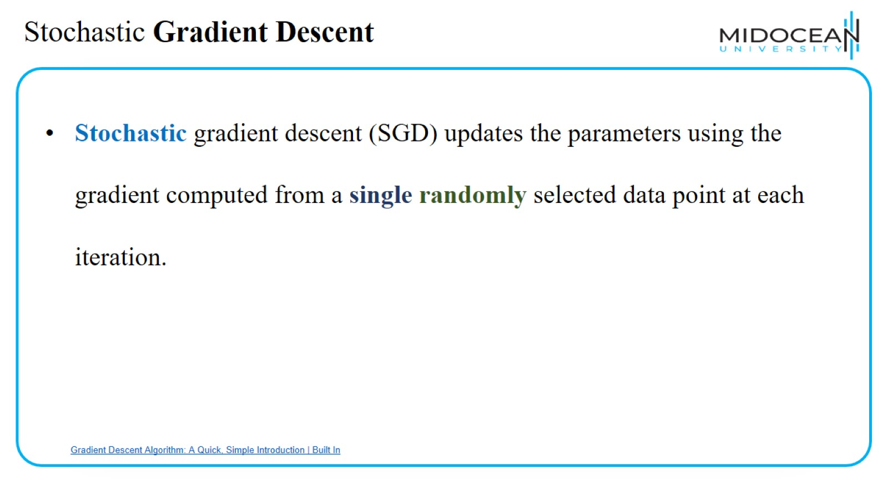
Stochastic Gradient Descent

Slide 55

Stochastic Gradient Descent

Slide 56

Mini batch Gradient Descent

Slide 57

Mini batch Gradient Descent

Slide 58

Types of Gradient Descent

Slide 59

Types of Gradient Descent

Slide 60

Types of gradient Descent

Slide 61

Scalar function of scalar argument

Slide 62

Why?

Slide 63

Numerical Example

Slide 64

Numerical Example

Slide 65

Numerical Example

Slide 66

Numerical Example

Slide 67

Numerical Example

Slide 68

When GD Stop?

Slide 69


Slide 70


