Slide 1

Operating Systems
Prepared by Dr. Alaa Mohamed
Module 5-part1
Memory Management

Slide 2

Module
5-part1
Memory Management
Objectives:
  Background
  Contiguous Memory Allocation
  Paging
  Structure of the Page Table

Slide 3
Module
5-part1
Memory Management
Topics To Be Covered:
  To provide a detailed description of various ways of organizing memory hardware
  To discuss various memory-management techniques (Paging).

Slide 4
Module
5-part1
Background
Program must be brought (from disk) into memory and placed within a process for it to be run
Main memory and registers are only storage CPU can access directly
Memory unit only sees a stream of:
  addresses + read requests, or
  address + data and write requests
Register access is done in one CPU clock (or less)
Main memory can take many cycles, causing a stall
Cache sits between main memory and CPU registers
Protection of memory required to ensure correct operation

Slide 5
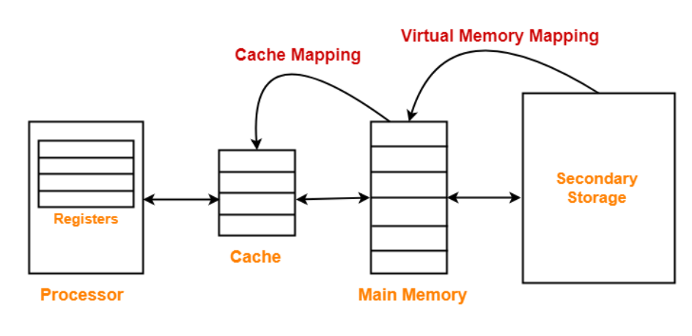
Module
5-part1
Protection

Slide 6
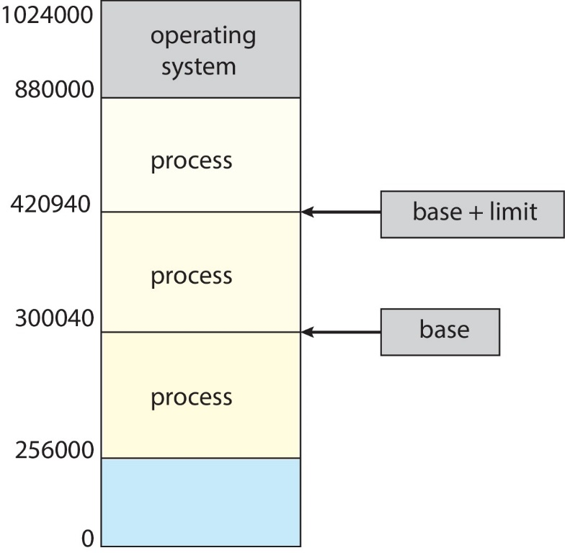
Module
05
Protection
Need to ensure that a process can access only access those addresses in it address space.
We can provide this protection by using a pair of base and limit registers define the logical address space of a process

Slide 7
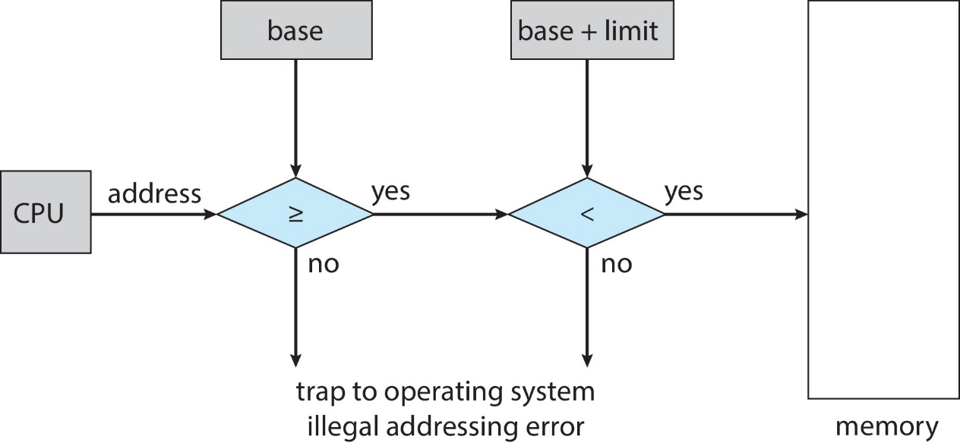
Module
5-part1
Hardware Address Protection
CPU must check every memory access generated in user mode to be sure it is between base and limit for that user
the instructions to loading the base and limit registers are privileged

Slide 8
Module
5-part1
Address Binding
Programs on disk, ready to be brought into memory to execute form an input queue
  Without support, must be loaded into address 0000
Inconvenient to have first user process physical address always at 0000
  How can it not be?
Addresses represented in different ways at different stages of a program’s life
  Source code addresses usually symbolic
  Compiled code addresses bind to relocatable addresses
    i.e. “14 bytes from beginning of this module”
  Linker or loader will bind relocatable addresses to absolute addresses
    i.e. 74014
  Each binding maps one address space to another

Slide 9
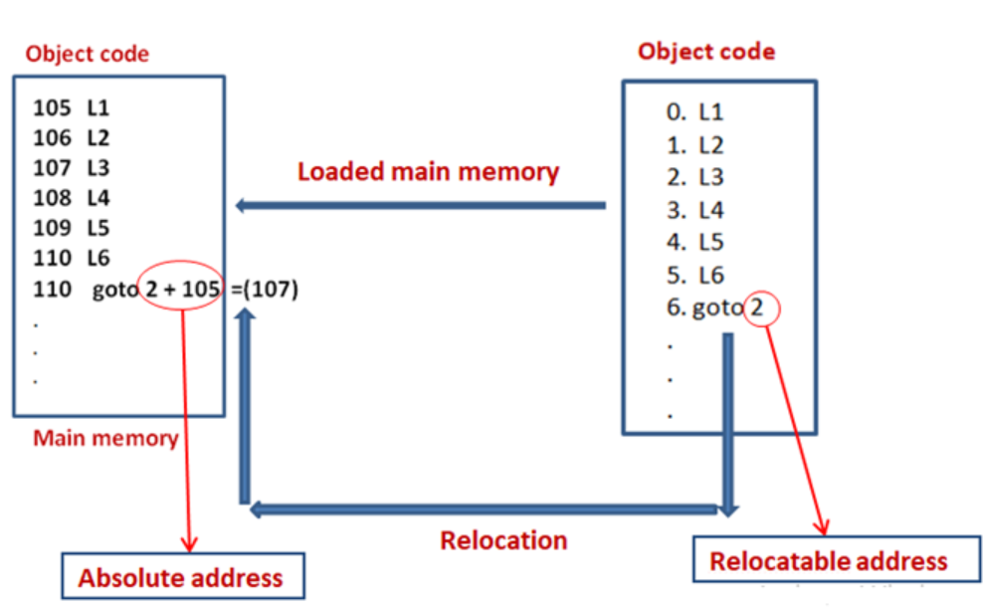
Module
5-part1
Address Binding

Slide 10
Module
5-part1
Logical vs. Physical Address Space
The concept of a logical address space that is bound to a separate
physical address space is central to proper memory management
  Logical address – generated by the CPU; also referred to as virtual address
  Physical address – address seen by the memory unit
Logical address space is the set of all logical addresses generated by a program
Physical address space is the set of all physical addresses generated by a program

Slide 11
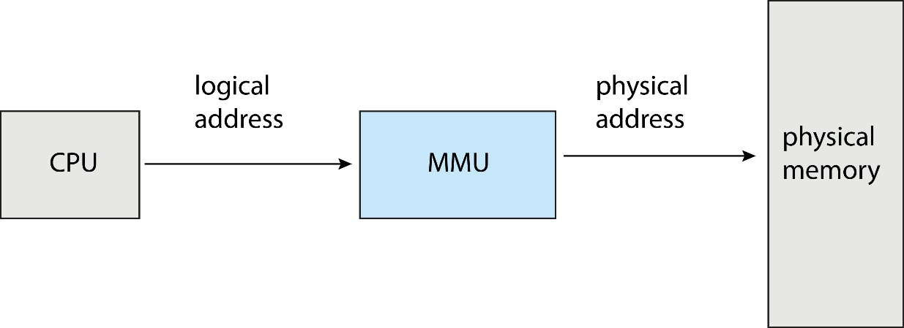
Module
5-part1
Memory-Management Unit (MMU)
Hardware device that at run time maps virtual to physical address
Many methods possible, covered in the rest of this chapter

Slide 12
Module
5-part1
Memory-Management Unit (Cont.)
Consider simple scheme. which is a generalization of the base-register scheme.
  The base register now called relocation register
The value in the relocation register is added to every address generated by a user process at the time it is sent to memory
The user program deals with logical addresses; it never sees the real physical addresses
  Execution-time binding occurs when reference is made to location in memory
  Logical address bound to physical addresses

Slide 13
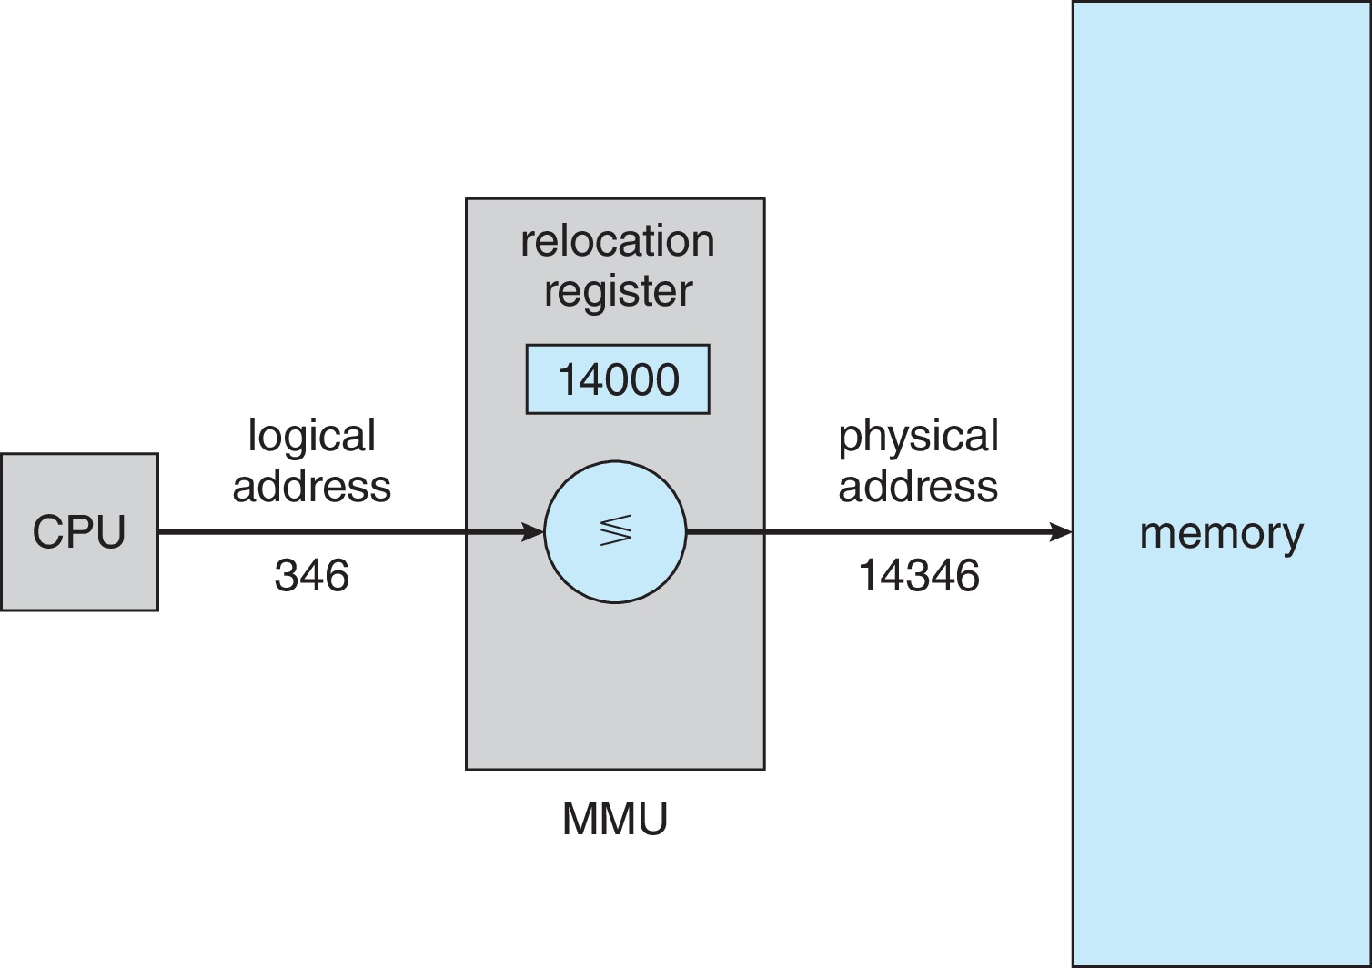
Module
5-part1
Memory-Management Unit (Cont.)

Slide 14
Module
5-part1
Contiguous Allocation
Main memory must support both OS and user processes
Limited resource, must allocate efficiently
Contiguous allocation is one early method
Main memory usually into two partitions:
  Resident operating system, usually held in low memory with interrupt vector
  User processes then held in high memory
  Each process contained in single contiguous section of memory

Slide 15
Module
5-part1
Contiguous Allocation
Relocation registers used to protect user processes from each other, and from changing operating-system code and data
  Base register contains value of smallest physical address
  Limit register contains range of logical addresses – each logical address must be less than the limit register
  MMU maps logical address dynamically
  Can then allow actions such as kernel code being transient and kernel changing size

Slide 16
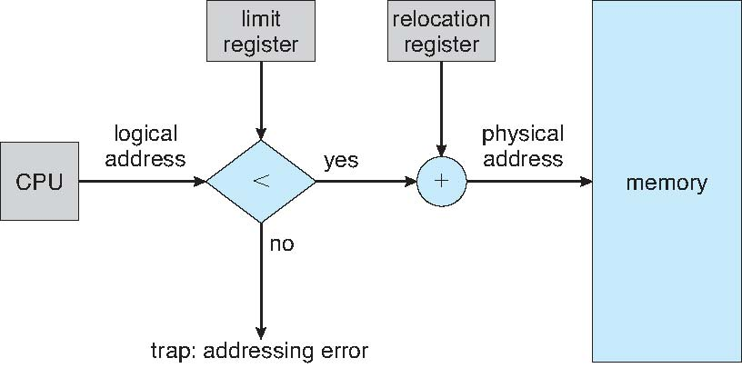
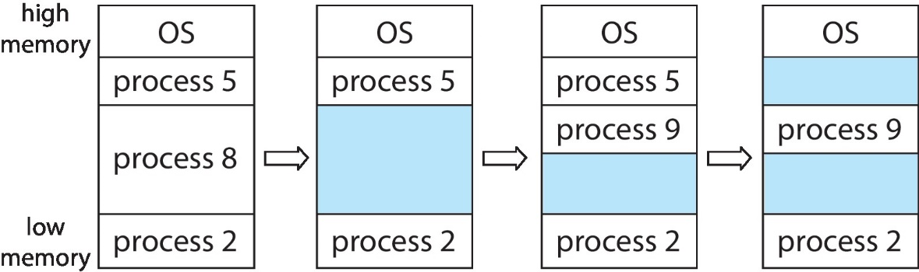
Module
5-part1
Hardware Support for
Relocation and Limit Registers

Slide 17
Module
5-part1
Dynamic Storage-Allocation Problem
How to satisfy a request of size n from a list of free holes?
First-fit: Allocate the first hole that is big enough
Best-fit: Allocate the smallest hole that is big enough; must search entire list, unless ordered by size
  Produces the smallest leftover hole
Worst-fit: Allocate the largest hole; must also search entire list
  Produces the largest leftover hole
First-fit and best-fit better than worst-fit in terms of speed and storage utilization

Slide 18
Module
5-part1
Fragmentation
External Fragmentation – total memory space exists to satisfy a request, but it is not contiguous
First fit analysis reveals that given N blocks allocated, 0.5 N blocks lost to fragmentation
  1/3 may be unusable -> 50-percent rule

Slide 19
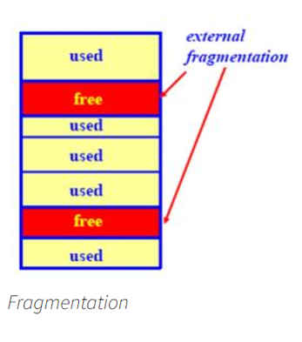
Module
5-part1
Fragmentation

Slide 20
Module
5-part1
Fragmentation
Reduce external fragmentation by compaction
  Shuffle memory contents to place all free memory together in one large block
  Compaction is possible only if relocation is dynamic, and is done at execution time
  I/O problem
    Latch job in memory while it is involved in I/O
    Do I/O only into OS buffers

Slide 21
Module
5-part1
Non- Contiguous Allocation. Segmentation
Memory-management scheme that supports user view of memory
A program is a collection of segments
  A segment is a logical unit such as:
main program
procedure
function
method
object
arrays

Slide 22
Module
5-part1
Non- Contiguous Allocation. Segmentation
Memory-management scheme that supports user view of memory
A program is a collection of segments
  A segment is a logical unit such as:
main program
procedure
function
method
object
arrays

Slide 23
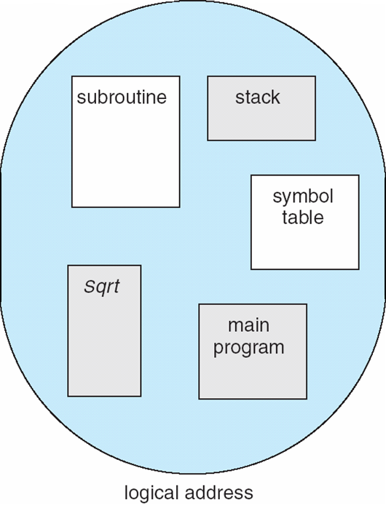
Module
5-part1
Non- Contiguous Allocation. Segmentation

Slide 24
Module
5-part1
Non- Contiguous Allocation. Segmentation
1
1
4
2
3
4
2
3
user space
physical memory space

Slide 25
Module
5-part1
Segmentation Architecture
Segment table – maps two-dimensional physical addresses; each table entry has:
  base – contains the starting physical address where the segments reside in memory
  limit – specifies the length of the segment

Slide 26
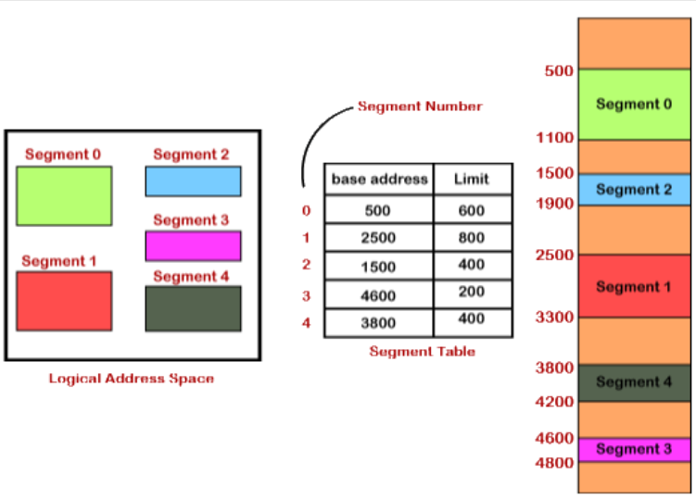
Module
5-part1
Segmentation Architecture

Slide 27
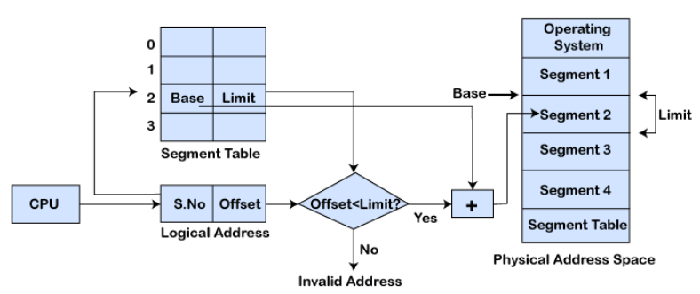
Module
5-part1
Segmentation Hardware

Slide 28
Module
5-part1
Non-contiguous Allocation: Paging
Physical address space of a process can be noncontiguous;
  Avoids external fragmentation
  Avoids problem of varying sized memory chunks
Divide physical memory into fixed-sized blocks called frames
  Size is power of 2, between 512 bytes and 16 Mbytes
Divide logical memory into blocks of same size called pages

Slide 29
Module
5-part1
Paging
Keep track of all free frames
To run a program of size N pages, need to find N free frames and load program
Set up a page table to translate logical to physical addresses
Backing store likewise split into pages
Still have Internal fragmentation

Slide 30
Module
5-part1
Paging
Operating system maintains a page table for each process
  Contains the frame location for each page in the process
  Memory address consist of a page number and offset within the page

Slide 31
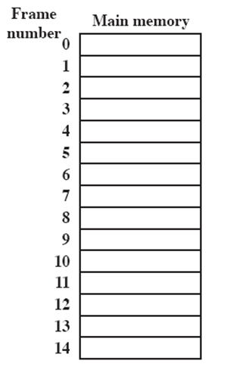
Module
5-part1
Paging
A.0
A.1
A.2
A.3
B.0
D.0
B.1
D.1
B.2
D.2
C.0
C.1
C.2
C.3
D.3
D.4

Slide 32
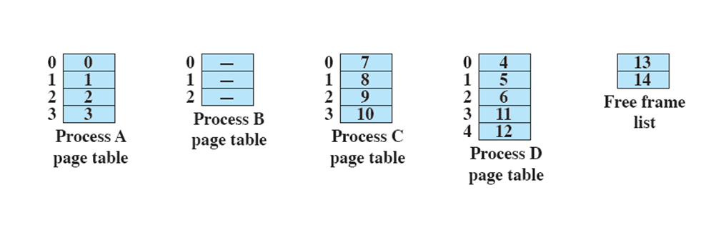
Module
5-part1
Paging Model of Logical and Physical Memory

Slide 33
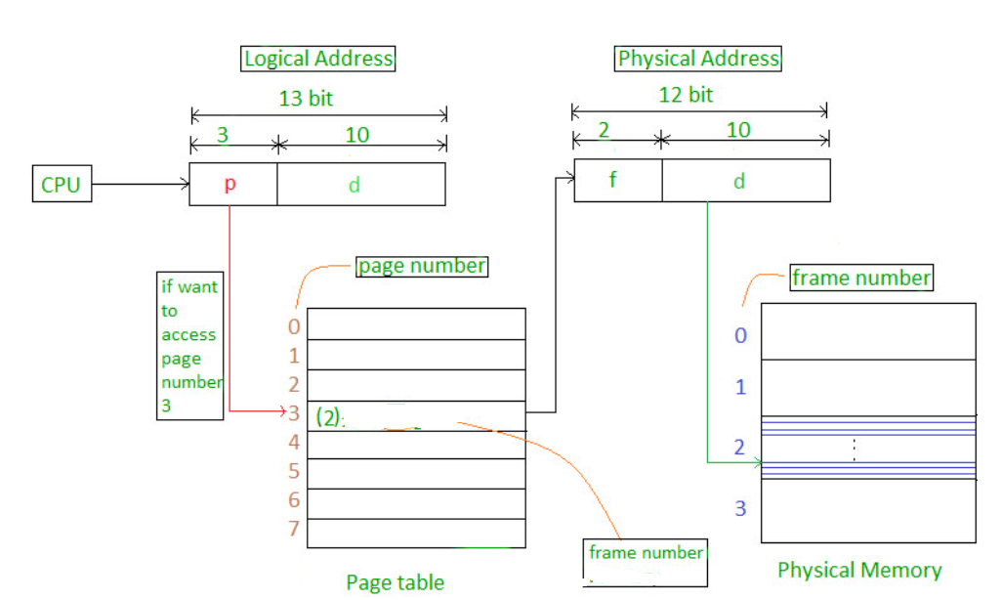
Module
5-part1
Paging Hardware

Slide 34
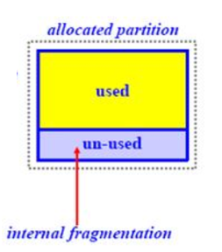
Module
5-part1
Internal fragmentation
Internal Fragmentation – allocated memory may be slightly larger than requested memory; this size difference is memory internal to a partition, but not being used

Slide 35
Module
5-part1
Paging -- Calculating internal fragmentation
Page size = 2,048 bytes
Process size = 72,766 bytes
35 pages + 1,086 bytes
Internal fragmentation of 2,048 - 1,086 = 962 bytes
Worst case fragmentation = 1 frame – 1 byte
On average fragmentation = 1 / 2 frame size
So small frame sizes desirable
But each page table entry takes memory to track

Slide 36
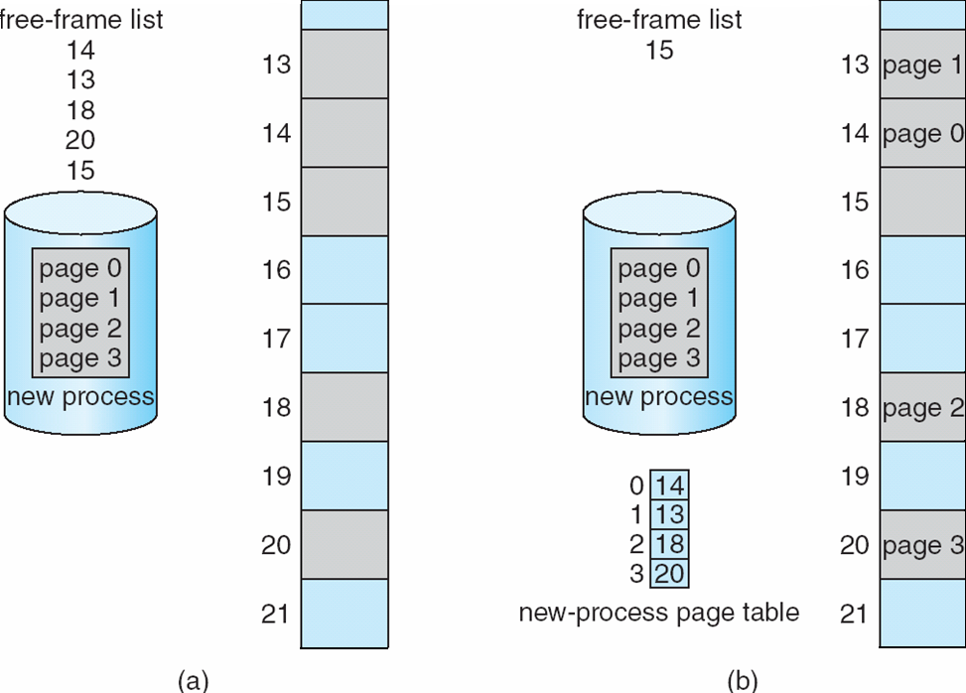
Module
5-part1
Free Frames

Slide 37
Module
5-part1
Paging VS Segmentation
Paging | Segmentation
Paging is a memory management technique. In paging, memory is partitioned into fixed-size pages. | Segmentation is also a memory management technique. In segmentation memory is partitioned into the variable size segments.
In paging, with the help of hardware page size is determine. | In segmentation, the user gives the size of the segments.
Paging is faster than the segmentation. | Segmentation is slower than the paging

Slide 38
Module
5-part1
Non- Contiguous Allocation. Segmentation
Paging | Segmentation
In paging, there may be a chance of internal fragmentation. | In segmentation, there may be a chance of external fragmentation.
In This technique, the logical address is partitioned into the page number and the page offset. | In this technique, the logical address is partitioned into the Segment number and the Segment offset.

Slide 39
Module
5-part1
Non- Contiguous Allocation. Segmentation
Paging | Segmentation
The user cannot see the paging | The user can see the paging
In this technique, the list of free frames is maintained by the operating system. | In this technique, the list of holes is maintained by the operating system.

Slide 40
Module
5-part1
End of Module 5 part1

