Slide 1

Computer Vision,
and Digital Image
Processing
Prepared by Dr. Mohamed Mostafa
AI 612
Lecture 8

Slide 2




Image Morphology
Lecture 8
AI 612
Prepared by
Dr. Mohamed Mostafa
www.midocean.ae

Slide 3

Image Morphology
Chapter
09
Resources for this lecture
Chapter 9:
Gonzalez, Rafael C. Digital image processing. Pearson education, India, 2009.
www.midocean.ae

Slide 4
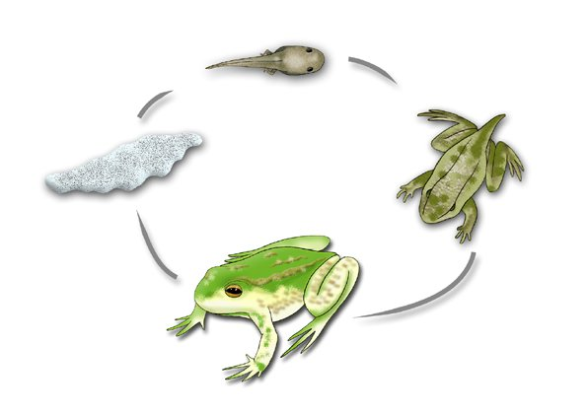
What is Morphology?
In nature, morphology refers to the study of the form and structure of organisms.
It involves the examination and analysis of physical characteristics, such as shape, size, color, and texture, as well as internal structures like organs, tissues, and cells.

Slide 5
Image Morphology
We use the same word here in the context of mathematical morphology as a tool for extracting image components that are useful in the representation and description of region shape, such as boundaries, skeletons, and the convex hull.
We are interested also in morphological techniques for pre- or postprocessing, such as morphological filtering, thinning, and pruning.
The material in the previous lectures begin a transition from methods whose inputs and outputs are images, to methods whose outputs are image attributes, for tasks such as object extraction and description.

Slide 6
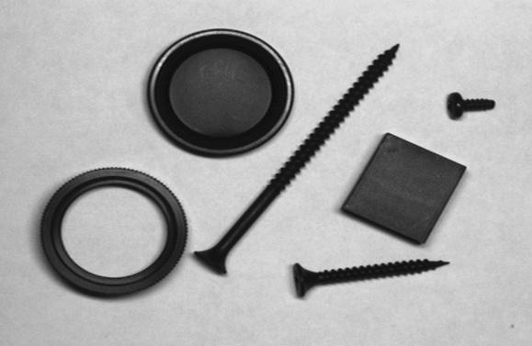

Image Morphology
Morphological operations are typically applied to remove imperfections introduced during segmentation, and so typically operate on bi-level images

Slide 7
Sets ( Z² and Z³)
The morphology is based on the Set Theory.
In binary images (0 = white, 1 = black), the sets are members of the 2-D integer space Z² .
      F(x,y)
Grayscale digital images can be represented as sets whose components are in Z³.
  F(x,y,i), where i is the “intensity”

Slide 8
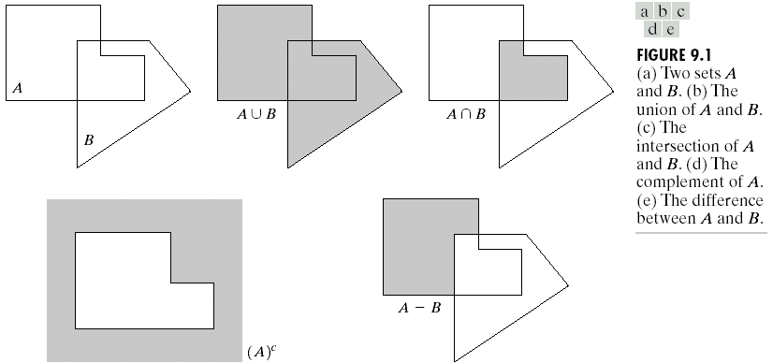
Basic Set Theory

Slide 9
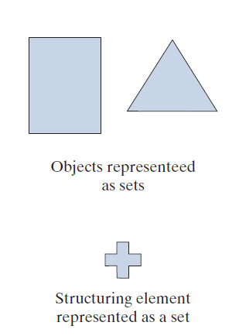
Image Morphology Mathematics

Slide 10
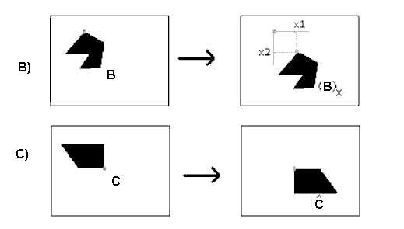
Reflection and Translation
Image Source: Researchgate

Slide 11
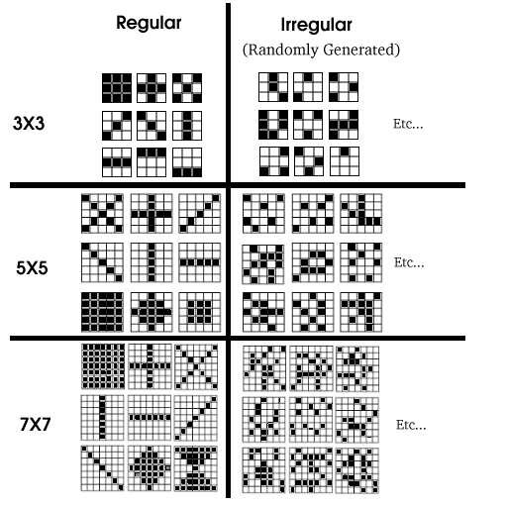
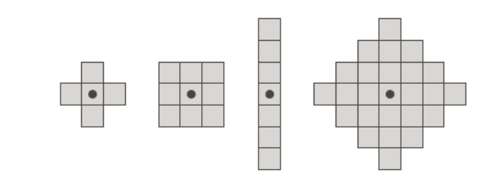
Structuring element (SE)
a shape mask used in basic morphological operations.
it can be of any size with an origin.
Unlike special kernels, SE doesn't required numerical values.
origin
Image Source: Researchgate

Slide 12
Example

Slide 13



DILATION

Slide 14
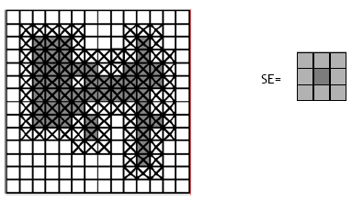
DILATION
Move the SE B over A, Like the convolution the origin over each pixel
OR-ing the SE with the pixels in A
The element is to increase (reflection) by the amount of elements above the origin pixel.
it is used for:
expanding shapes
filling small holes and gaps
The number of reflections is calculated by the number of rows and columns around the origin

Slide 15
Dilation Example
0 | 0 | 0 | 0 | 0 | 0
0 | 0 | 0 | 0 | 0 | 0
0 | 0 | 1 | 1 | 0 | 0
0 | 0 | 1 | 1 | 0 | 0
0 | 0 | 0 | 0 | 0 | 0
0 | 0 | 0 | 0 | 0 | 0
1 | 1 | 1
1 | 1 | 1
1 | 1 | 1
SE
Image

Slide 16
Dilation Example
1 | 1 | 1
1 | 1 | 1
1 | 1 | 1
0 | 0 | 0 | 0 | 0 | 0
0 | 0 | 0 | 0 | 0 | 0
0 | 0 | 1 | 1 | 0 | 0
0 | 0 | 1 | 1 | 0 | 0
0 | 0 | 0 | 0 | 0 | 0
0 | 0 | 0 | 0 | 0 | 0
Image

Slide 17
Dilation Example
1 | 1 | 1
1 | 1 | 1
1 | 1 | 1
0 | 0 | 0 | 0 | 0 | 0
0 | 0 | 0 | 0 | 0 | 0
0 | 0 | 1 | 1 | 0 | 0
0 | 0 | 1 | 1 | 0 | 0
0 | 0 | 0 | 0 | 0 | 0
0 | 0 | 0 | 0 | 0 | 0
0
Image

Slide 18
Dilation Example
1 | 1 | 1
1 | 1 | 1
1 | 1 | 1
0 | 0 | 0 | 0 | 0 | 0
0 | 0 | 0 | 0 | 0 | 0
0 | 0 | 1 | 1 | 0 | 0
0 | 0 | 1 | 1 | 0 | 0
0 | 0 | 0 | 0 | 0 | 0
0 | 0 | 0 | 0 | 0 | 0
0 | 0
Image

Slide 19
Dilation Example
1 | 1 | 1
1 | 1 | 1
1 | 1 | 1
0 | 0 | 0 | 0 | 0 | 0
0 | 0 | 0 | 0 | 0 | 0
0 | 0 | 1 | 1 | 0 | 0
0 | 0 | 1 | 1 | 0 | 0
0 | 0 | 0 | 0 | 0 | 0
0 | 0 | 0 | 0 | 0 | 0
0 | 0 | 0
Image

Slide 20
Dilation Example
0 | 0 | 0 | 0 | 0 | 0
0 | 0 | 0 | 0 | 0 | 0
0 | 0 | 1 | 1 | 0 | 0
0 | 0 | 1 | 1 | 0 | 0
0 | 0 | 0 | 0 | 0 | 0
0 | 0 | 0 | 0 | 0 | 0
0 | 0 | 0 | 0 | 0 | 0
0
1 | 1 | 1
1 | 1 | 1
1 | 1 | 1
Image

Slide 21
Dilation Example
0 | 0 | 0 | 0 | 0 | 0
0 | 0 | 0 | 0 | 0 | 0
0 | 0 | 1 | 1 | 0 | 0
0 | 0 | 1 | 1 | 0 | 0
0 | 0 | 0 | 0 | 0 | 0
0 | 0 | 0 | 0 | 0 | 0
0 | 0 | 0 | 0 | 0 | 0
0
1 | 1 | 1
1 | 1 | 1
1 | 1 | 1
Image

Slide 22
Dilation Example
0 | 0 | 0 | 0 | 0 | 0
0 | 0 | 0 | 0 | 0 | 0
0 | 0 | 1 | 1 | 0 | 0
0 | 0 | 1 | 1 | 0 | 0
0 | 0 | 0 | 0 | 0 | 0
0 | 0 | 0 | 0 | 0 | 0
0 | 0 | 0 | 0 | 0 | 0
0 | 1
1 | 1 | 1
1 | 1 | 1
1 | 1 | 1
Image

Slide 23
Dilation Example
0 | 0 | 0 | 0 | 0 | 0
0 | 0 | 0 | 0 | 0 | 0
0 | 0 | 1 | 1 | 0 | 0
0 | 0 | 1 | 1 | 0 | 0
0 | 0 | 0 | 0 | 0 | 0
0 | 0 | 0 | 0 | 0 | 0
0 | 0 | 0 | 0 | 0 | 0
0 | 1 | 1
1 | 1 | 1
1 | 1 | 1
1 | 1 | 1
Image

Slide 24
Dilation Example
0 | 0 | 0 | 0 | 0 | 0
0 | 0 | 0 | 0 | 0 | 0
0 | 0 | 1 | 1 | 0 | 0
0 | 0 | 1 | 1 | 0 | 0
0 | 0 | 0 | 0 | 0 | 0
0 | 0 | 0 | 0 | 0 | 0
0 | 0 | 0 | 0 | 0 | 0
0 | 1 | 1 | 1
1 | 1 | 1
1 | 1 | 1
1 | 1 | 1
Image

Slide 25
Dilation Example
0 | 0 | 0 | 0 | 0 | 0
0 | 0 | 0 | 0 | 0 | 0
0 | 0 | 1 | 1 | 0 | 0
0 | 0 | 1 | 1 | 0 | 0
0 | 0 | 0 | 0 | 0 | 0
0 | 0 | 0 | 0 | 0 | 0
0 | 0 | 0 | 0 | 0 | 0
0 | 1 | 1 | 1 | 1
1 | 1 | 1
1 | 1 | 1
1 | 1 | 1
Image

Slide 26
Dilation Example
0 | 0 | 0 | 0 | 0 | 0
0 | 0 | 0 | 0 | 0 | 0
0 | 0 | 1 | 1 | 0 | 0
0 | 0 | 1 | 1 | 0 | 0
0 | 0 | 0 | 0 | 0 | 0
0 | 0 | 0 | 0 | 0 | 0
0 | 0 | 0 | 0 | 0 | 0
0 | 1 | 1 | 1 | 1 | 0
1 | 1 | 1
1 | 1 | 1
1 | 1 | 1
Image

Slide 27
Dilation Example
0 | 0 | 0 | 0 | 0 | 0
0 | 0 | 0 | 0 | 0 | 0
0 | 0 | 1 | 1 | 0 | 0
0 | 0 | 1 | 1 | 0 | 0
0 | 0 | 0 | 0 | 0 | 0
0 | 0 | 0 | 0 | 0 | 0
0 | 0 | 0 | 0 | 0 | 0
0 | 1 | 1 | 1 | 1 | 0
0 | 1
1 | 1 | 1
1 | 1 | 1
1 | 1 | 1
Image

Slide 28
Dilation Example
0 | 0 | 0 | 0 | 0 | 0
0 | 0 | 0 | 0 | 0 | 0
0 | 0 | 1 | 1 | 0 | 0
0 | 0 | 1 | 1 | 0 | 0
0 | 0 | 0 | 0 | 0 | 0
0 | 0 | 0 | 0 | 0 | 0
0 | 0 | 0 | 0 | 0 | 0
0 | 1 | 1 | 1 | 1 | 0
0 | 1 | 1
1 | 1 | 1
1 | 1 | 1
1 | 1 | 1
Image

Slide 29
Dilation Example
0 | 0 | 0 | 0 | 0 | 0
0 | 0 | 0 | 0 | 0 | 0
0 | 0 | 1 | 1 | 0 | 0
0 | 0 | 1 | 1 | 0 | 0
0 | 0 | 0 | 0 | 0 | 0
0 | 0 | 0 | 0 | 0 | 0
0 | 0 | 0 | 0 | 0 | 0
0 | 1 | 1 | 1 | 1 | 0
0 | 1 | 1 | 1 | 1 | 0
0 | 1 | 1 | 1 | 1 | 0
0 | 1 | 1 | 1 | 1 | 0
0 | 0 | 0 | 0 | 0 | 0
1 | 1 | 1
1 | 1 | 1
1 | 1 | 1
Image

Slide 30
Dilation Example
0 | 0 | 0 | 0 | 0 | 0
0 | 0 | 0 | 0 | 0 | 0
0 | 0 | 1 | 1 | 0 | 0
0 | 0 | 1 | 1 | 0 | 0
0 | 0 | 0 | 0 | 0 | 0
0 | 0 | 0 | 0 | 0 | 0
0 | 0 | 0 | 0 | 0 | 0
0 | 0 | 1 | 1 | 0 | 0
0 | 1 | 1 | 1 | 1 | 0
0 | 1 | 1 | 1 | 1 | 0
0 | 0 | 1 | 1 | 0 | 0
0 | 0 | 0 | 0 | 0 | 0
0 | 1 | 0
1 | 1 | 1
0 | 1 | 0
SE
Image

Slide 31
Dilation Example
0 | 0 | 0 | 0 | 0 | 0
0 | 0 | 0 | 0 | 0 | 0
0 | 0 | 1 | 1 | 0 | 0
0 | 0 | 1 | 1 | 0 | 0
0 | 0 | 0 | 0 | 0 | 0
0 | 0 | 0 | 0 | 0 | 0
1 | 1 | 1
1 | 1 | 1
1 | 1 | 1
SE
Image

Slide 32
Dilation Example
1 | 1 | 1
1 | 1 | 1
1 | 1 | 1
0 | 0 | 0 | 0 | 0 | 0
0 | 0 | 0 | 0 | 0 | 0
0 | 0 | 1 | 1 | 0 | 0
0 | 0 | 1 | 1 | 0 | 0
0 | 0 | 0 | 0 | 0 | 0
0 | 0 | 0 | 0 | 0 | 0
Image

Slide 33
Dilation Example
1 | 1 | 1
1 | 1 | 1
1 | 1 | 1
0 | 0 | 0 | 0 | 0 | 0
0 | 0 | 0 | 0 | 0 | 0
0 | 0 | 1 | 1 | 0 | 0
0 | 0 | 1 | 1 | 0 | 0
0 | 0 | 0 | 0 | 0 | 0
0 | 0 | 0 | 0 | 0 | 0
0
Image

Slide 34
Dilation Example
1 | 1 | 1
1 | 1 | 1
1 | 1 | 1
0 | 0 | 0 | 0 | 0 | 0
0 | 0 | 0 | 0 | 0 | 0
0 | 0 | 1 | 1 | 0 | 0
0 | 0 | 1 | 1 | 0 | 0
0 | 0 | 0 | 0 | 0 | 0
0 | 0 | 0 | 0 | 0 | 0
0 | 0
Image

Slide 35
Dilation Example
0 | 0 | 0 | 0 | 0 | 0
0 | 0 | 0 | 0 | 0 | 0
0 | 0 | 1 | 1 | 0 | 0
0 | 0 | 1 | 1 | 0 | 0
0 | 0 | 0 | 0 | 0 | 0
0 | 0 | 0 | 0 | 0 | 0
1 | 1 | 1
1 | 1 | 1
1 | 1 | 1
0 | 0 | 1
Image

Slide 36
Dilation Example
0 | 0 | 0 | 0 | 0 | 0
0 | 0 | 0 | 0 | 0 | 0
0 | 0 | 1 | 1 | 0 | 0
0 | 0 | 1 | 1 | 0 | 0
0 | 0 | 0 | 0 | 0 | 0
0 | 0 | 0 | 0 | 0 | 0
1 | 1 | 1
1 | 1 | 1
1 | 1 | 1
0 | 0 | 1 | 1
Image

Slide 37
Dilation Example
0 | 0 | 0 | 0 | 0 | 0
0 | 0 | 0 | 0 | 0 | 0
0 | 0 | 1 | 1 | 0 | 0
0 | 0 | 1 | 1 | 0 | 0
0 | 0 | 0 | 0 | 0 | 0
0 | 0 | 0 | 0 | 0 | 0
1 | 1 | 1
1 | 1 | 1
1 | 1 | 1
0 | 0 | 1 | 1 | 1 | 1
Image

Slide 38
Dilation Example
0 | 0 | 0 | 0 | 0 | 0
0 | 0 | 0 | 0 | 0 | 0
0 | 0 | 1 | 1 | 0 | 0
0 | 0 | 1 | 1 | 0 | 0
0 | 0 | 0 | 0 | 0 | 0
0 | 0 | 0 | 0 | 0 | 0
0 | 0 | 1 | 1 | 1 | 1
0
1 | 1 | 1
1 | 1 | 1
1 | 1 | 1
Image

Slide 39
Dilation Example
0 | 0 | 0 | 0 | 0 | 0
0 | 0 | 0 | 0 | 0 | 0
0 | 0 | 1 | 1 | 0 | 0
0 | 0 | 1 | 1 | 0 | 0
0 | 0 | 0 | 0 | 0 | 0
0 | 0 | 0 | 0 | 0 | 0
0 | 0 | 1 | 1 | 1 | 1
0 | 0
1 | 1 | 1
1 | 1 | 1
1 | 1 | 1
Image

Slide 40
Dilation Example
0 | 0 | 0 | 0 | 0 | 0
0 | 0 | 0 | 0 | 0 | 0
0 | 0 | 1 | 1 | 0 | 0
0 | 0 | 1 | 1 | 0 | 0
0 | 0 | 0 | 0 | 0 | 0
0 | 0 | 0 | 0 | 0 | 0
0 | 0 | 1 | 1 | 1 | 1
0 | 0 | 1
1 | 1 | 1
1 | 1 | 1
1 | 1 | 1
Image

Slide 41
Dilation Example
0 | 0 | 0 | 0 | 0 | 0
0 | 0 | 0 | 0 | 0 | 0
0 | 0 | 1 | 1 | 0 | 0
0 | 0 | 1 | 1 | 0 | 0
0 | 0 | 0 | 0 | 0 | 0
0 | 0 | 0 | 0 | 0 | 0
0 | 0 | 1 | 1 | 1 | 1
0 | 0 | 1 | 1 | 1 | 1
1 | 1 | 1
1 | 1 | 1
1 | 1 | 1
Image

Slide 42
Dilation Example
0 | 0 | 0 | 0 | 0 | 0
0 | 0 | 0 | 0 | 0 | 0
0 | 0 | 1 | 1 | 0 | 0
0 | 0 | 1 | 1 | 0 | 0
0 | 0 | 0 | 0 | 0 | 0
0 | 0 | 0 | 0 | 0 | 0
0 | 0 | 1 | 1 | 1 | 1
0 | 0 | 1 | 1 | 1 | 1
0 | 0 | 1 | 1 | 1 | 1
0 | 0 | 1 | 1 | 1 | 1
0 | 0 | 0 | 0 | 0
1 | 1 | 1
1 | 1 | 1
1 | 1 | 1
Image

Slide 43
Dilation Example
0 | 0 | 0 | 0 | 0 | 0
0 | 0 | 0 | 0 | 0 | 0
0 | 0 | 1 | 1 | 0 | 0
0 | 0 | 1 | 1 | 0 | 0
0 | 0 | 0 | 0 | 0 | 0
0 | 0 | 0 | 0 | 0 | 0
0 | 0 | 1 | 1 | 1 | 1
0 | 0 | 1 | 1 | 1 | 1
0 | 0 | 1 | 1 | 1 | 1
0 | 0 | 1 | 1 | 1 | 1
0 | 0 | 0 | 0 | 0 | 0
0 | 0 | 0 | 0 | 0 | 0
1 | 1 | 1
1 | 1 | 1
1 | 1 | 1
Image

Slide 44
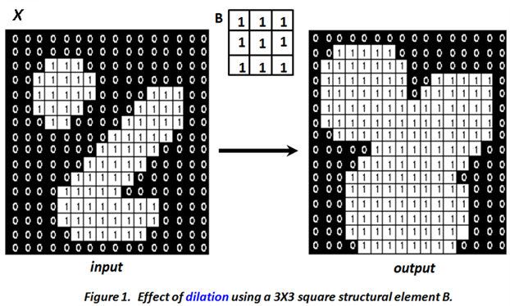
Dilation Example

Slide 45
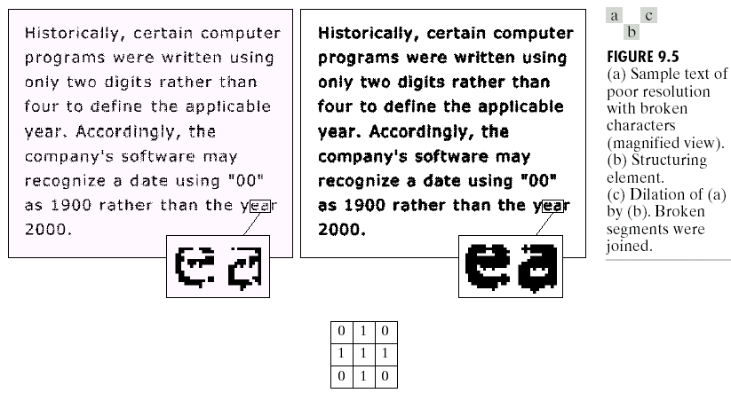
Dilation Example
Notes:
We used disc in order not to close the inside holes in characters

Slide 46
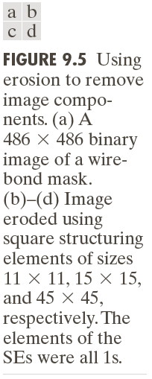

Erosion
Move the SE B over A, Like the convolution the origin over each pixel
AND-ing the SE with the pixels in A
Erosion used for:
enlarge the holes
shrink object
The amount of shrinking is subject to the SE size
Notes:
In words, this equation indicates that the erosion of A by B
is the set of all points z such that B, translated by z, is contained in A.

Slide 47
Erosion Example
0 | 0 | 0 | 0 | 0 | 0
0 | 0 | 0 | 0 | 0 | 0
0 | 0 | 1 | 1 | 0 | 0
0 | 0 | 1 | 1 | 0 | 0
0 | 0 | 1 | 1 | 0 | 0
0 | 0 | 0 | 0 | 0 | 0
0 | 1 | 0
0 | 1 | 0
0 | 1 | 0
SE
Image

Slide 48
Erosion Example
0 | 0 | 0 | 0 | 0 | 0
0 | 0 | 0 | 0 | 0 | 0
0 | 0 | 1 | 1 | 0 | 0
0 | 0 | 1 | 1 | 0 | 0
0 | 0 | 1 | 1 | 0 | 0
0 | 0 | 0 | 0 | 0 | 0
0 | 1 | 0
0 | 1 | 0
0 | 1 | 0
SE
Image

Slide 49
Erosion Example
0 | 1 | 0
0 | 1 | 0
0 | 1 | 0
0 | 0 | 0 | 0 | 0 | 0
0 | 0 | 0 | 0 | 0 | 0
0 | 0 | 1 | 1 | 0 | 0
0 | 0 | 1 | 1 | 0 | 0
0 | 0 | 1 | 1 | 0 | 0
0 | 0 | 0 | 0 | 0 | 0
Image

Slide 50
Erosion Example
0 | 1 | 0
0 | 1 | 0
0 | 1 | 0
0 | 0 | 0 | 0 | 0 | 0
0 | 0 | 0 | 0 | 0 | 0
0 | 0 | 1 | 1 | 0 | 0
0 | 0 | 1 | 1 | 0 | 0
0 | 0 | 1 | 1 | 0 | 0
0 | 0 | 0 | 0 | 0 | 0
0
Image

Slide 51
Erosion Example
0 | 0 | 0 | 0 | 0 | 0
0 | 0 | 0 | 0 | 0 | 0
0 | 0 | 1 | 1 | 0 | 0
0 | 0 | 1 | 1 | 0 | 0
0 | 0 | 1 | 1 | 0 | 0
0 | 0 | 0 | 0 | 0 | 0
0 | 0 | 0 | 0 | 0 | 0
0 | 0 | 0 | 0 | 0 | 0
0 | 1 | 0
0 | 1 | 0
0 | 1 | 0
Image

Slide 52
Erosion Example
0 | 0 | 0 | 0 | 0 | 0
0 | 0 | 0 | 0 | 0 | 0
0 | 0 | 1 | 1 | 0 | 0
0 | 0 | 1 | 1 | 0 | 0
0 | 0 | 1 | 1 | 0 | 0
0 | 0 | 0 | 0 | 0 | 0
0 | 0 | 0 | 0 | 0 | 0
0 | 0 | 0 | 0 | 0 | 0
0 | 0 | 0 | 0 | 0 | 0
0 | 0 | 1
0 | 1 | 0
0 | 1 | 0
0 | 1 | 0
Image

Slide 53
Erosion Example
0 | 0 | 0 | 0 | 0 | 0
0 | 0 | 0 | 0 | 0 | 0
0 | 0 | 1 | 1 | 0 | 0
0 | 0 | 1 | 1 | 0 | 0
0 | 0 | 1 | 1 | 0 | 0
0 | 0 | 0 | 0 | 0 | 0
0 | 0 | 0 | 0 | 0 | 0
0 | 0 | 0 | 0 | 0 | 0
0 | 0 | 0 | 0 | 0 | 0
0 | 0 | 1 | 1
0 | 1 | 0
0 | 1 | 0
0 | 1 | 0
Image

Slide 54
Erosion Example
0 | 0 | 0 | 0 | 0 | 0
0 | 0 | 0 | 0 | 0 | 0
0 | 0 | 1 | 1 | 0 | 0
0 | 0 | 1 | 1 | 0 | 0
0 | 0 | 1 | 1 | 0 | 0
0 | 0 | 0 | 0 | 0 | 0
0 | 0 | 0 | 0 | 0 | 0
0 | 0 | 0 | 0 | 0 | 0
0 | 0 | 0 | 0 | 0 | 0
0 | 0 | 1 | 1 | 0
0 | 1 | 0
0 | 1 | 0
0 | 1 | 0
Image

Slide 55
Erosion Example
0 | 0 | 0 | 0 | 0 | 0
0 | 0 | 0 | 0 | 0 | 0
0 | 0 | 1 | 1 | 0 | 0
0 | 0 | 1 | 1 | 0 | 0
0 | 0 | 1 | 1 | 0 | 0
0 | 0 | 0 | 0 | 0 | 0
0 | 0 | 0 | 0 | 0 | 0
0 | 0 | 0 | 0 | 0 | 0
0 | 0 | 0 | 0 | 0 | 0
0 | 0 | 1 | 1 | 0 | 0
0 | 0 | 0
0 | 1 | 0
0 | 1 | 0
0 | 1 | 0
Image

Slide 56
Erosion Example
0 | 0 | 0 | 0 | 0 | 0
0 | 0 | 0 | 0 | 0 | 0
0 | 0 | 1 | 1 | 0 | 0
0 | 0 | 1 | 1 | 0 | 0
0 | 0 | 1 | 1 | 0 | 0
0 | 0 | 0 | 0 | 0 | 0
0 | 0 | 0 | 0 | 0 | 0
0 | 0 | 0 | 0 | 0 | 0
0 | 0 | 0 | 0 | 0 | 0
0 | 0 | 1 | 1 | 0 | 0
0 | 0 | 0 | 0 | 0 | 0
0 | 0 | 0 | 0 | 0 | 0
0 | 1 | 0
0 | 1 | 0
0 | 1 | 0
Image

Slide 57
Erosion Example
0 | 0 | 0 | 0 | 0 | 0
0 | 0 | 1 | 1 | 0 | 0
0 | 0 | 1 | 1 | 0 | 0
0 | 1 | 1 | 1 | 1 | 0
0 | 1 | 1 | 1 | 1 | 0
0 | 0 | 0 | 0 | 0 | 0
1 | 1 | 1
SE
Image

Slide 58
Erosion Example
0 | 0 | 0 | 0 | 0 | 0
0 | 0 | 1 | 1 | 0 | 0
0 | 0 | 1 | 1 | 0 | 0
0 | 1 | 1 | 1 | 1 | 0
0 | 1 | 1 | 1 | 1 | 0
0 | 0 | 0 | 0 | 0 | 0
1 | 1 | 1
0
Image

Slide 59
Erosion Example
0 | 0 | 0 | 0 | 0 | 0
0 | 0 | 1 | 1 | 0 | 0
0 | 0 | 1 | 1 | 0 | 0
0 | 1 | 1 | 1 | 1 | 0
0 | 1 | 1 | 1 | 1 | 0
0 | 0 | 0 | 0 | 0 | 0
0 | 0 | 0 | 0 | 0 | 0
0 | 0 | 0
1 | 1 | 1
Image

Slide 60
Erosion Example
0 | 0 | 0 | 0 | 0 | 0
0 | 0 | 1 | 1 | 0 | 0
0 | 0 | 1 | 1 | 0 | 0
0 | 1 | 1 | 1 | 1 | 0
0 | 1 | 1 | 1 | 1 | 0
0 | 0 | 0 | 0 | 0 | 0
0 | 0 | 0 | 0 | 0 | 0
0 | 0 | 0 | 0 | 0 | 0
0 | 0 | 0 | 0
1 | 1 | 1
Image

Slide 61
Erosion Example
0 | 0 | 0 | 0 | 0 | 0
0 | 0 | 1 | 1 | 0 | 0
0 | 0 | 1 | 1 | 0 | 0
0 | 1 | 1 | 1 | 1 | 0
0 | 1 | 1 | 1 | 1 | 0
0 | 0 | 0 | 0 | 0 | 0
0 | 0 | 0 | 0 | 0 | 0
0 | 0 | 0 | 0 | 0 | 0
0 | 0 | 0 | 0 | 0 | 0
0 | 1
1 | 1 | 1
Image

Slide 62
Erosion Example
0 | 0 | 0 | 0 | 0 | 0
0 | 0 | 1 | 1 | 0 | 0
0 | 0 | 1 | 1 | 0 | 0
0 | 1 | 1 | 1 | 1 | 0
0 | 1 | 1 | 1 | 1 | 0
0 | 0 | 0 | 0 | 0 | 0
0 | 0 | 0 | 0 | 0 | 0
0 | 0 | 0 | 0 | 0 | 0
0 | 0 | 0 | 0 | 0 | 0
0 | 1 | 1
1 | 1 | 1
Image

Slide 63
Erosion Example
0 | 0 | 0 | 0 | 0 | 0
0 | 0 | 1 | 1 | 0 | 0
0 | 0 | 1 | 1 | 0 | 0
0 | 1 | 1 | 1 | 1 | 0
0 | 1 | 1 | 1 | 1 | 0
0 | 0 | 0 | 0 | 0 | 0
0 | 0 | 0 | 0 | 0 | 0
0 | 0 | 0 | 0 | 0 | 0
0 | 0 | 0 | 0 | 0 | 0
0 | 1 | 1 | 0
1 | 1 | 1
Image

Slide 64
Erosion Example
0 | 0 | 0 | 0 | 0 | 0
0 | 0 | 1 | 1 | 0 | 0
0 | 0 | 1 | 1 | 0 | 0
0 | 1 | 1 | 1 | 1 | 0
0 | 1 | 1 | 1 | 1 | 0
0 | 0 | 0 | 0 | 0 | 0
0 | 0 | 0 | 0 | 0 | 0
0 | 0 | 0 | 0 | 0 | 0
0 | 0 | 0 | 0 | 0 | 0
0 | 1 | 1 | 0 | 0 | 0
1 | 1 | 1
Image

Slide 65
Erosion Example
0 | 0 | 0 | 0 | 0 | 0
0 | 0 | 1 | 1 | 0 | 0
0 | 0 | 1 | 1 | 0 | 0
0 | 1 | 1 | 1 | 1 | 0
0 | 1 | 1 | 1 | 1 | 0
0 | 0 | 0 | 0 | 0 | 0
0 | 0 | 0 | 0 | 0 | 0
0 | 0 | 0 | 0 | 0 | 0
0 | 0 | 0 | 0 | 0 | 0
0 | 1 | 1 | 0 | 0 | 0
0 | 1
1 | 1 | 1
Image

Slide 66
Erosion Example
0 | 0 | 0 | 0 | 0 | 0
0 | 0 | 1 | 1 | 0 | 0
0 | 0 | 1 | 1 | 0 | 0
0 | 1 | 1 | 1 | 1 | 0
0 | 1 | 1 | 1 | 1 | 0
0 | 0 | 0 | 0 | 0 | 0
0 | 0 | 0 | 0 | 0 | 0
0 | 0 | 0 | 0 | 0 | 0
0 | 0 | 0 | 0 | 0 | 0
0 | 1 | 1 | 0 | 0
0 | 1 | 1
1 | 1 | 1
Image

Slide 67
Erosion Example
0 | 0 | 0 | 0 | 0 | 0
0 | 0 | 1 | 1 | 0 | 0
0 | 0 | 1 | 1 | 0 | 0
0 | 1 | 1 | 1 | 1 | 0
0 | 1 | 1 | 1 | 1 | 0
0 | 0 | 0 | 0 | 0 | 0
0 | 0 | 0 | 0 | 0 | 0
0 | 0 | 0 | 0 | 0 | 0
0 | 0 | 0 | 0 | 0 | 0
0 | 1 | 1 | 0 | 0 | 0
0 | 1 | 1 | 0 | 0 | 0
0 | 0 | 0 | 0 | 0 | 0
1 | 1 | 1
Image

Slide 68
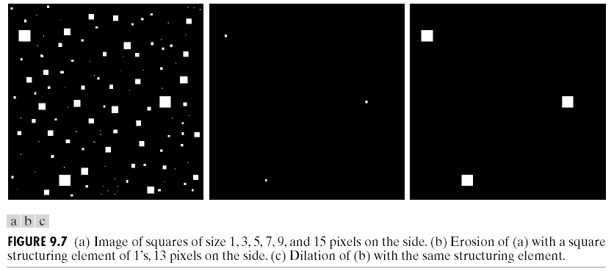
Combining erosion and dilation

Slide 69
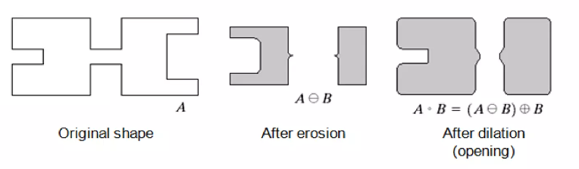
Opening
Opening generally smoothes the contour of an object, breaks narrow isthmuses, and eliminates thin protrusions
Erosion followed by Dilation, denoted by ∘

Slide 70
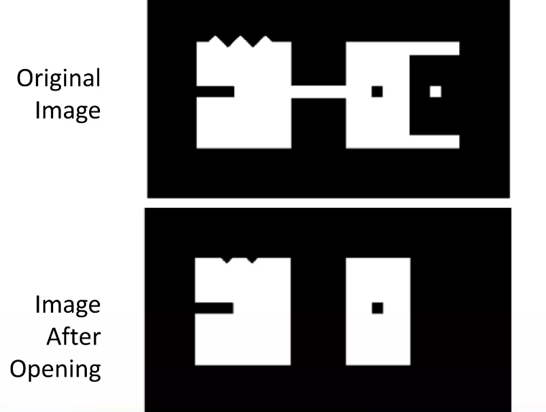
Opening

Slide 71
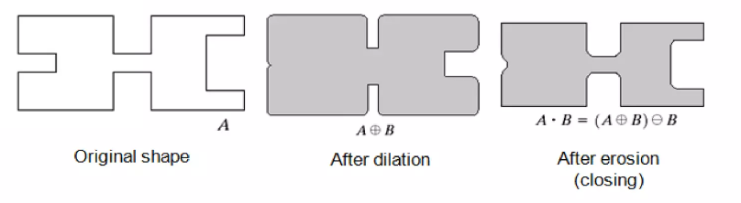
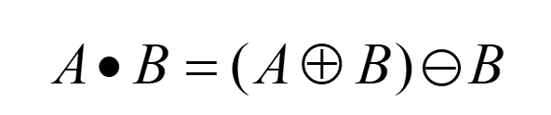
Closing
Closing is used for:
smooth contour
fuse narrow breaks and long thin gulfs
eliminate small holes
fill gaps in the contour
Dilation followed by Erosion, denoted •

Slide 72

Closing

Slide 73
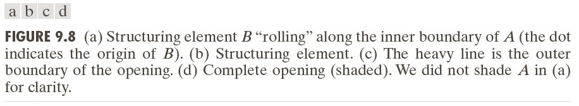
Example: Opening

Slide 74
Example: Closing

Slide 75
Opening and Closing

Slide 76
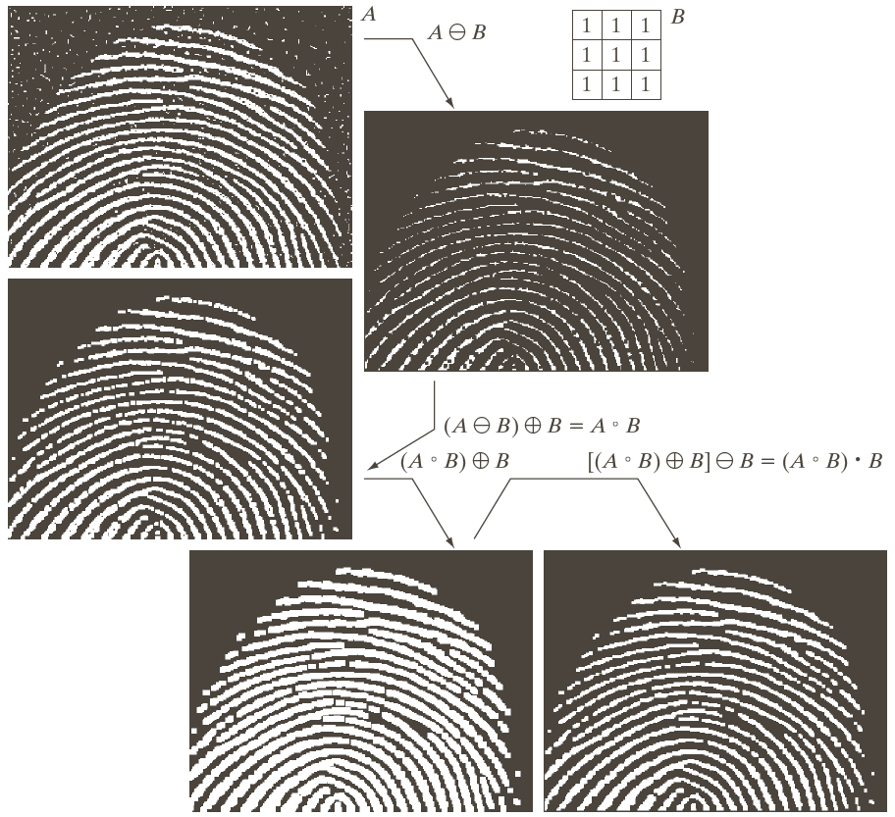
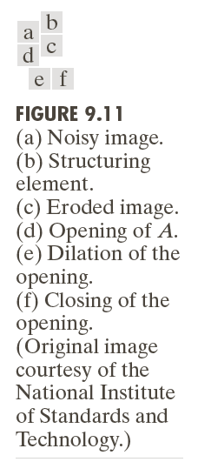
Removing noise by:
Opening followed by closing

Slide 77

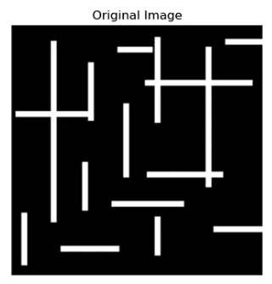
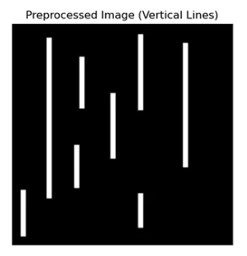
Applications of opening
SE: 3*9
SE: 9*3

Slide 78
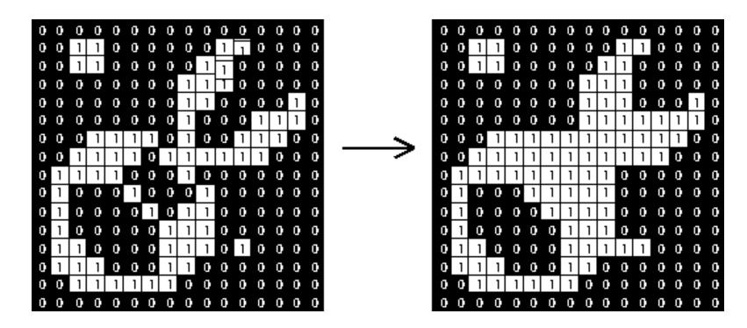
Applications of Closing
Effect of closing using a 2×2 square structuring element

Slide 79
Some Basic Image Morphology
Extraction of Connected Components
Central to many automated image analysis applications.
Let A be a set containing one or more connected components, and form an array X₀ (of the same size as the array containing A) whose elements are 0s, except at each location known to correspond to a point in each connected component in A, which is set to 1.

Slide 80
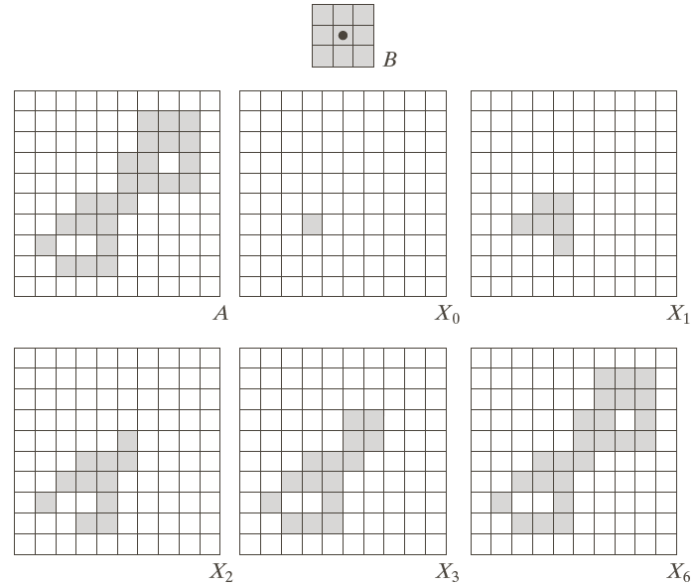
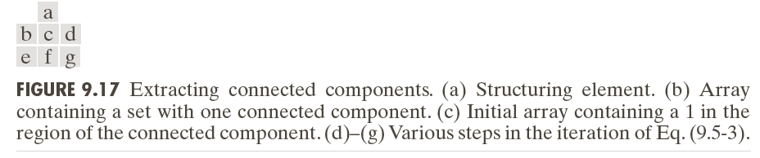

Slide 81
Some Basic Image Morphology
Extraction of Connected Components
Central to many automated image analysis applications.

Slide 82
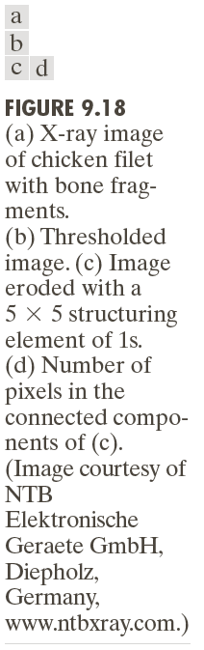

Slide 83
Some Basic Morphological Algorithms (4)
Convex Hull

Slide 84


Slide 85
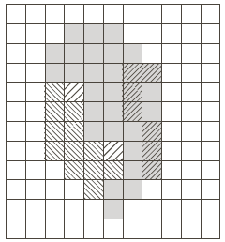
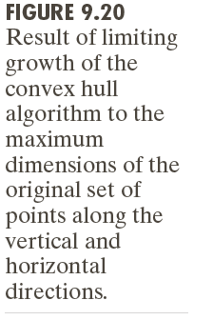

Slide 86
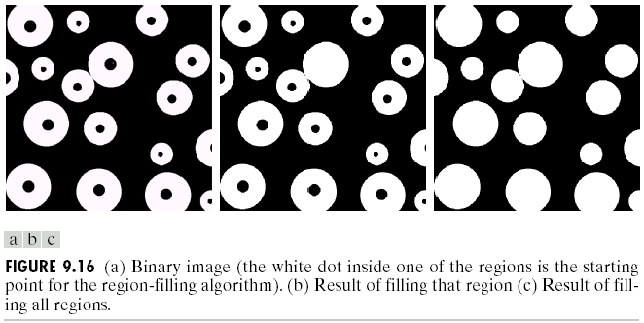
Some Basic Image Morphology
Region Filling

Slide 87
Some Basic Image Morphology
Thinning
The thinning of a set A by a structuring element B, defined
It is denoted by the and it can be defined in terms of hit-or-miss transformation

Slide 88
Some Basic Image Morphology
A more useful expression for thinning A symmetrically is based on a sequence of structuring elements:

Slide 90
Some Basic Some Basic Image Morphology
Thickening:

Slide 91
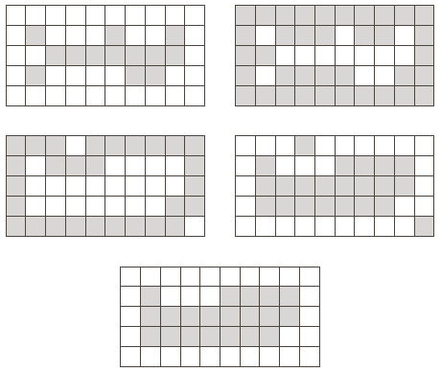

Some Basic Some Basic Image Morphology

Slide 92
Some Basic Some Basic Image Morphology
Skeletons

Slide 93
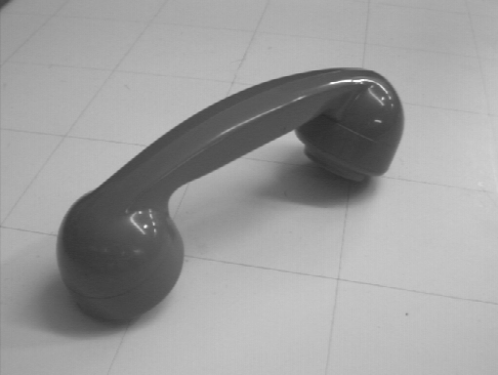


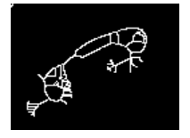
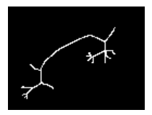
Some Basic Some Basic Image Morphology
Skeletons

Slide 94
Boundary Extraction

Slide 95
Boundary Extraction

Slide 96


Thank You

