Slide 1



HCIA-AI Huawei
Lecture 7
Deep Learning Overview
Prepared by
Eng. Eman Elgallad
www.midocean.ae

Slide 2

Lecture
07
Deep Learning
Deep learning is a subfield of machine learning, and it has gained significant importance and popularity in recent years due to its ability to tackle complex tasks that were challenging for traditional machine learning algorithms.
www.midocean.ae

Slide 3

Lecture
Traditional Machine Learning
07
Issue analysis
Problem locating
Data cleansing
Feature extraction
Feature selection
Model training
Question: Can we use an algorithm to automatically execute the procedure?
Execute inference, prediction, and identification
www.midocean.ae

Slide 4
Lecture
07
Traditional Machine Learning and Deep Learning
Traditional Machine Learning | Deep Learning
Low hardware requirements on the computer: Given the limited computing amount, the computer does not need a GPU for parallel computing generally. | Higher hardware requirements on the computer: To execute matrix operations on massive data, the computer needs a GPU to perform parallel computing.
Applicable to training under a small data amount and whose performance cannot be improved continuously as the data amount increases. | The performance can be high when high-dimensional weight parameters and massive training data are provided.
Level-by-level problem breakdown | E2E learning
Manual feature selection | Algorithm-based automatic feature extraction
Easy-to-explain features | Hard-to-explain features
www.midocean.ae

Slide 5
Why We Need Deep Learning:
1. Handling Complex Data: Deep learning excels at processing and understanding complex data types such as images, audio, text, and sequences. Which required in various applications like image recognition, speech recognition, natural language processing, and even autonomous driving.
2. Feature Extraction: In traditional machine learning, feature engineering is a manual and time-consuming process. Deep learning, on the other hand, can automatically learn relevant features from raw data, reducing the need for feature engineering.
3. Scalability: Deep learning models can scale with the amount of data and computational resources available. This scalability makes them suitable for handling large datasets and complex problems.
4. Hierarchical Representation: Deep neural networks learn hierarchical representations of data. Lower layers capture simple patterns, while higher layers combine these patterns to learn more abstract and complex features. This makes deep learning models capable of capturing intricate relationships in data.
5. State-of-the-Art Performance: Deep learning has achieved state-of-the-art performance in various tasks, including image classification, object detection, machine translation, and game playing. This has led to its adoption in industry and academia.
www.midocean.ae

Slide 6
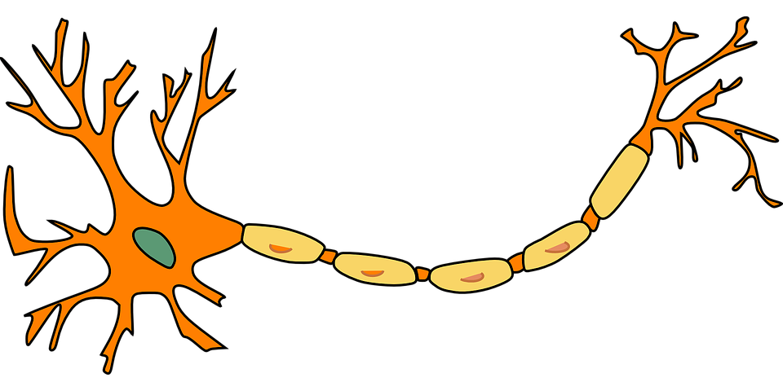
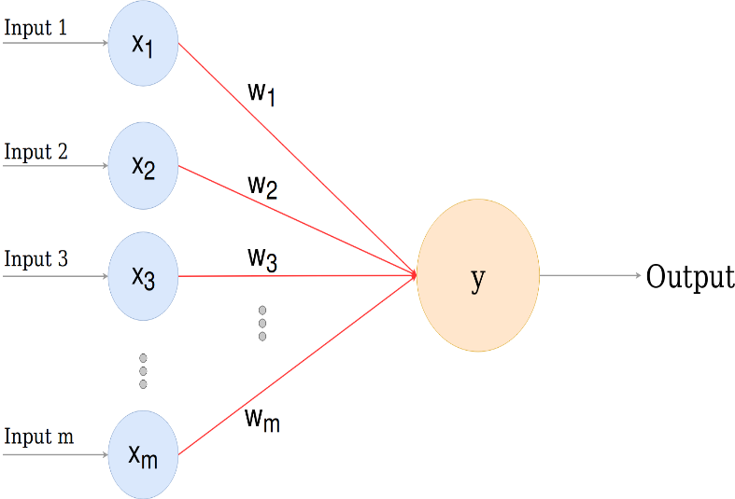
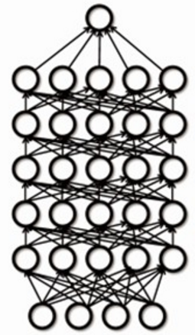
Deep Learning Is Deep?
Generally, the deep learning architecture is a deep neural network. "Deep" in "deep learning" refers to the number of layers of the neural network.
Dendrite
Synapse
Output layer
Nucleus
Hidden layer
Axon
Input layer
Human neural network
Perceptron
Deep neural network
www.midocean.ae

Slide 7
Neural Network
Currently, the definition of the neural network has not been determined yet.
Hecht Nielsen, a neural network researcher in the U.S., defines a neural network as a computer system composed of simple and highly interconnected processing elements, which process information by dynamic response to external inputs.
A neural network can be simply expressed as an information processing system designed to imitate the human brain structure and functions based on its source, features, and explanations.
Artificial neural network (neural network): Formed by artificial neurons connected to each other, the neural network extracts and simplifies the human brain's microstructure and functions.
It is an important approach to simulate human intelligence and reflect several basic features of human brain functions, such as concurrent information processing, learning, association, model classification, and memory.
www.midocean.ae

Slide 8
Development History of Neural Networks
Lecture
07
SVM
Deep network
Perceptron
XOR
MLP
Golden age
AI winter
1958
1970
1986
1995
2006
www.midocean.ae
Notes:
Development history of neural networks (milestones of deep learning):
Budding neural network (1958–1969)
In 1958, Frank Rosenblatt invented the perceptron algorithm.
In 1969, Marvin Minsky, pioneer of artificial intelligence in the US, questioned that the perceptron could handle only linear classification problems and failed to classify even the simplest XOR problems. The research on the perceptron was doomed to failure.
Developing neural network (1986–1998)
The second-generation neural network: In 1986, G. E. Hinton, a deep learning expert, developed a BP algorithm suitable for multilayer perceptron (MLP) and used Sigmoid for non-linear mapping, which solved the problem of non-linear classification and learning.
Universal approximation theorem: In 1989, Robert Hecht-Nielsen proved that a continuous function f in any closed interval could be approximated by a BP network containing a hidden layer.
Emerging neural network (since 2006)
Year 2006 is the first year of deep learning. In 2006, Hinton proposed a solution to the vanishing gradient problem in the deep neural network training: weight initialization for unsupervised pre-training+weight adjustment for supervised training.
In 2012, CNN neural network of Hinton's team overwhelmed other methods and won the first prize in the top image recognition competition ImageNet, setting off an upsurge of deep learning.
In 2016, the deep learning AI program AlphaGo developed by Google beat the Go world champion Lee Sedol who is a player of 9 dan rank, further promoting the popularity of deep learning.

Slide 9
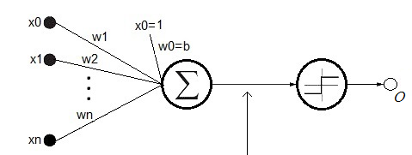




Perceptron
Lecture
07
$$x_{1}$$
First, let's take a look at the simplest neural network — single-layer perceptron.
In 1958, Frank Rosenblatt invented the perceptron algorithm. Such an algorithm coexisted with machine learning for more than a decade.
.
$$x_{2}$$
$$x_{n}$$
$$net=\sum_{i=0}^{n}{ω_{i}x_{i}}=W^{T}X$$
www.midocean.ae

Slide 10
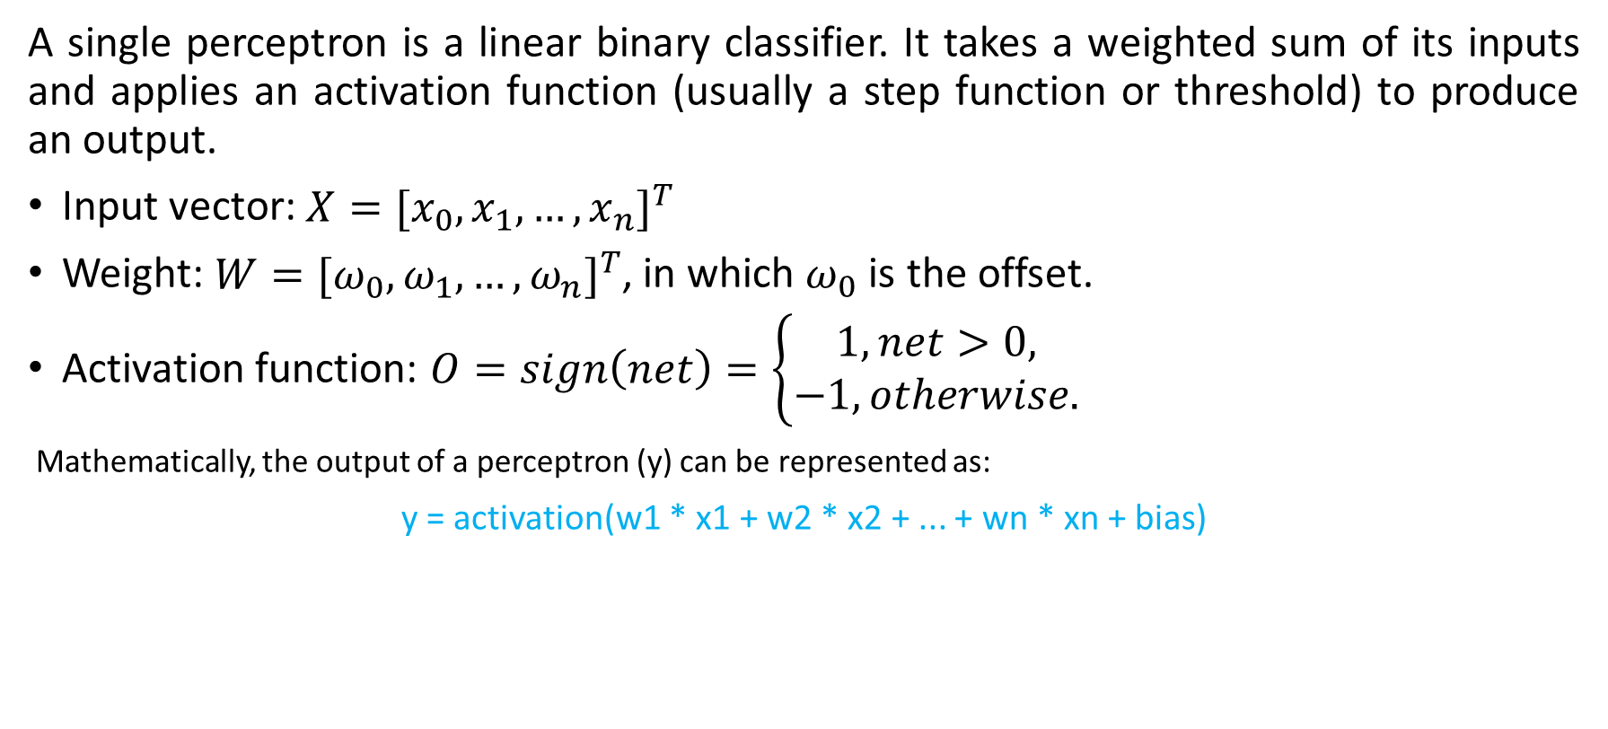
Single-Layer Perceptron
A single perceptron is a linear binary classifier. It takes a weighted sum of its inputs and applies an activation function (usually a step function or threshold) to produce an output.
Input vector: $X={[x_{0},x_{1},…,x_{n}]}^{T}$
Weight: $W={[ω_{0},ω_{1},…,ω_{n}]}^{T}$, in which $ω_{0}$ is the offset.
Activation function: $O=sign\left(net\right)=\left\{\begin{aligned}1,net>0, \\ −1,otherwise.\end{aligned}\right.$
Mathematically, the output of a perceptron (y) can be represented as:
y = activation(w1 * x1 + w2 * x2 + ... + wn * xn + bias)
www.midocean.ae
Notes:
First, let's take a look at the simplest neural network — single-layer perceptron.
In 1958, Frank Rosenblatt invented the perceptron algorithm. Such an algorithm coexisted with machine learning for more than a decade.
In 1969, Marvin Minsky, pioneer of artificial intelligence in the US, questioned that the perceptron could handle only linear classification problems and failed to classify even the simplest XOR problems. The research on the perceptron was doomed to failure.

Slide 11
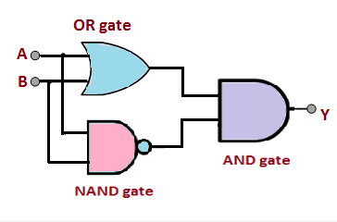
XOR
Input A | Input B | Output (XOR)
-------------------------------
0 | 0 | 0
0 | 1 | 1
1 | 0 | 1
1 | 1 | 0
In 1969, Marvin Minsky, pioneer of artificial intelligence in the US, questioned that the perceptron could handle only linear classification problems and failed to classify even the simplest XOR problems. The research on the perceptron was doomed to failure
www.midocean.ae
Notes:
First, let's take a look at the simplest neural network — single-layer perceptron.
In 1958, Frank Rosenblatt invented the perceptron algorithm. Such an algorithm coexisted with machine learning for more than a decade.
In 1969, Marvin Minsky, pioneer of artificial intelligence in the US, questioned that the perceptron could handle only linear classification problems and failed to classify even the simplest XOR problems. The research on the perceptron was doomed to failure.

Slide 12
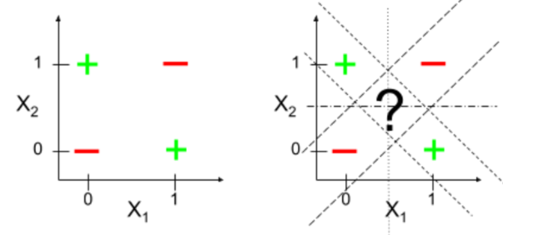
MLP
Solution: Multi-Layer Perceptron (MLPs):
To solve the XOR problem and other non-linearly separable problems, we need to use multi-layer perceptron (MLPs), also known as feedforward neural networks with hidden layers.
Hidden layers introduce non-linearity into the model by applying activation functions to their weighted sums. This allows the network to learn complex patterns and decision boundaries that single perceptron cannot capture.
By using one or more hidden layers with appropriate activation functions (such as sigmoid or ReLU), an MLP can learn to approximate the XOR function effectively, making it capable of solving this and a wide range of other non-linear problems.
www.midocean.ae
Notes:
First, let's take a look at the simplest neural network — single-layer perceptron.
In 1958, Frank Rosenblatt invented the perceptron algorithm. Such an algorithm coexisted with machine learning for more than a decade.
In 1969, Marvin Minsky, pioneer of artificial intelligence in the US, questioned that the perceptron could handle only linear classification problems and failed to classify even the simplest XOR problems. The research on the perceptron was doomed to failure.

Slide 13
Solution of XOR
w0
w1
w2
w3
w4
XOR
XOR
w5
www.midocean.ae
Notes:
First, let's take a look at the simplest neural network — single-layer perceptron.
In 1958, Frank Rosenblatt invented the perceptron algorithm. Such an algorithm coexisted with machine learning for more than a decade.
In 1969, Marvin Minsky, pioneer of artificial intelligence in the US, questioned that the perceptron could handle only linear classification problems and failed to classify even the simplest XOR problems. The research on the perceptron was doomed to failure.

Slide 14
Steps Involved in Applying Deep Learning:
Problem Definition: Clearly define the problem you want to solve. Identify the type of data you're working with (e.g., images, text, time series) and the desired outcome (e.g., classification, regression, generation).
2. Data Collection: Gather a high-quality dataset that is relevant to your problem. Ensure the data is properly labeled and preprocessed. This might involve data cleaning, normalization, and splitting into training, validation, and test sets.
3. Model Selection: Choose an appropriate deep learning architecture (e.g., convolutional neural networks for images, recurrent neural networks for sequences, transformer models for NLP). Consider factors like model size, complexity, and available computational resources.
4. Model Design: Create the neural network architecture by defining the layers, activation functions, and connections. Design the input and output layers based on your problem's requirements.
www.midocean.ae

Slide 15
Steps Involved in Applying Deep Learning cont.:
5. Training: Train the model using the training dataset. This involves forward and backward passes, gradient descent optimization, and updating the model's weights to minimize a loss function. Monitor the model's performance on the validation set to avoid overfitting.
6. Hyperparameter Tuning: Fine-tune hyperparameters such as learning rate, batch size, and regularization techniques to optimize the model's performance.
7. Evaluation: Assess the model's performance on the test dataset to ensure it generalizes well to unseen data. Use appropriate evaluation metrics for your problem (e.g., accuracy, F1-score, mean squared error).
8. Deployment: Once you're satisfied with the model's performance, deploy it in a production environment. This may involve converting the model to a suitable format (e.g., TensorFlow Saved Model, ONNX) and integrating it into your application.
9. Monitoring and Maintenance: Continuously monitor the model's performance in the real-world environment and update it as needed to adapt to changing data patterns or requirements.
www.midocean.ae

Slide 16
Lecture
Feed forward NN:
07
Input layer
Output layer
Hidden layer 1
Hidden layer 2
www.midocean.ae

Slide 17
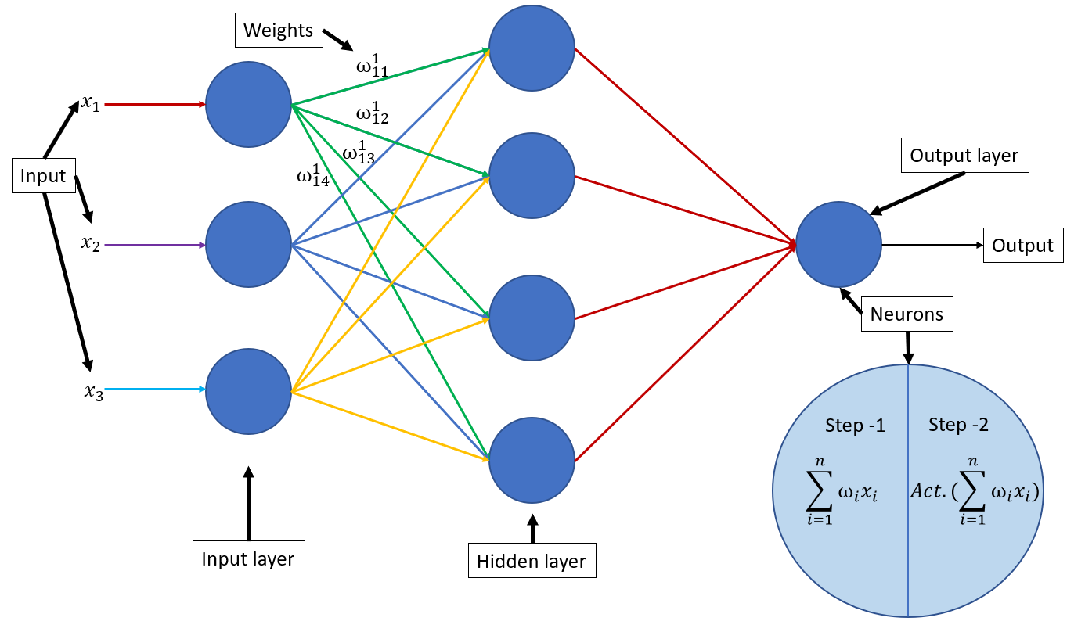
Feed forward NN:

Slide 18
Lecture
07
Feed forward NN:
The multilayer perceptron is a feedforward neural network.
It is the simplest neural network with neurons arranged in layers. It is more widely used and develops faster than other artificial neural networks.
Input nodes do not have the calculation capability and are only used to represent element values of the input vector.
The neuron having the computing capability at each layer is referred to as the computing unit. Each neuron is connected only to the neurons of the previous layer.
A unidirectional multi-layer structure is used to receive the output of the previous layer and send the output to the next layer. Each layer includes several neurons, and the neurons at the same layer are not connected to each other. Only unidirectional inter-layer information transmission is supported.
www.midocean.ae

Slide 19
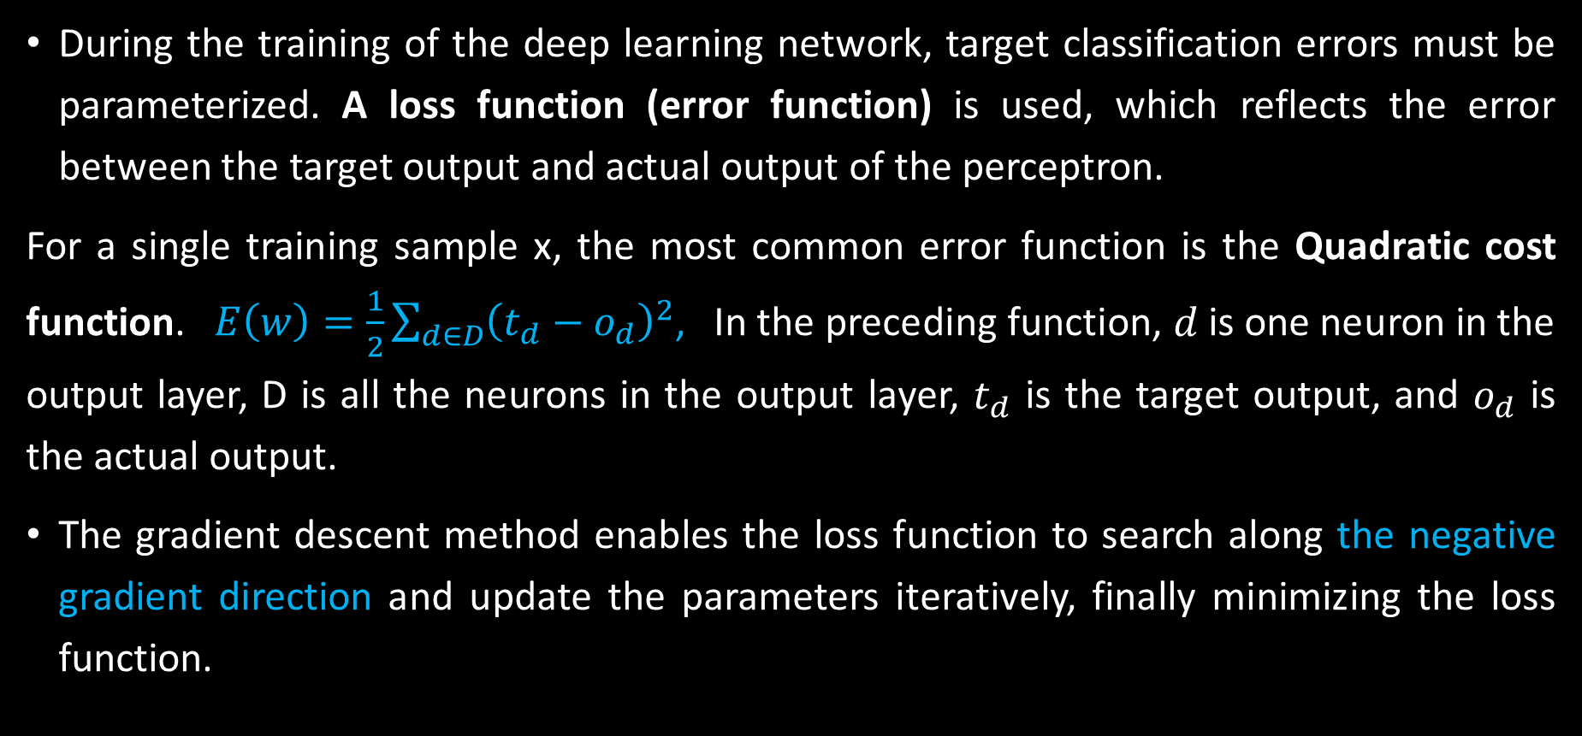
Gradient Descent and Loss Function
During the training of the deep learning network, target classification errors must be parameterized. A loss function (error function) is used, which reflects the error between the target output and actual output of the perceptron.
For a single training sample x, the most common error function is the Quadratic cost function. $E\left(w\right)=\frac{1}{2}\sum_{d∈D}{{\left(t_{d}−o_{d}\right)}^{2}}$, In the preceding function, $d$ is one neuron in the output layer, D is all the neurons in the output layer, $t_{d}$ is the target output, and $o_{d}$ is the actual output.
The gradient descent method enables the loss function to search along the negative gradient direction and update the parameters iteratively, finally minimizing the loss function.
www.midocean.ae
Notes:
This loss function has the following features:
Uses the weight vector as the independent variable.
Uses the sum of squares of the difference between the target output t_d and actual output o_d of each training sample as the main body.
There is a coefficient 1/2.
Once the training sample is given, the input and target output are constants. The actual output varies with $W$. The independent variable of the error function is $W$.
Usage of the coefficient 1/2 which is difficult to understand is as follows: When you take a derivative of $E$ with respect to the independent variable, the coefficient 1/2 is multiplied by the index 2 and the number 1 is obtained. The specific calculation will be described in the following text.

Slide 20
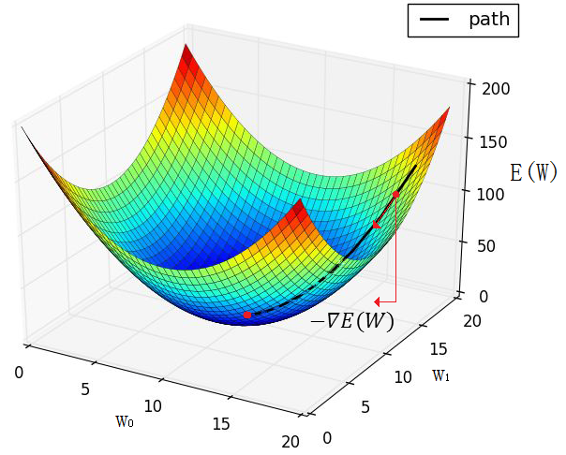

Extrema of the Loss Function
Purpose: The loss function $E(W)$ is defined on the weight space. The objective is to search for the weight vector $W$ that can minimize $E(W)$.
Limitation: No effective method can solve the extremum in mathematics on the complex high-dimensional surface of
www.midocean.ae
Notes:
Approach: The core approach of the gradient descent method is as follows: The negative gradient direction is the fastest descent direction of the function. Therefore, the minimum point of $E(W)$ is expected to exist along the −() direction.

Slide 21
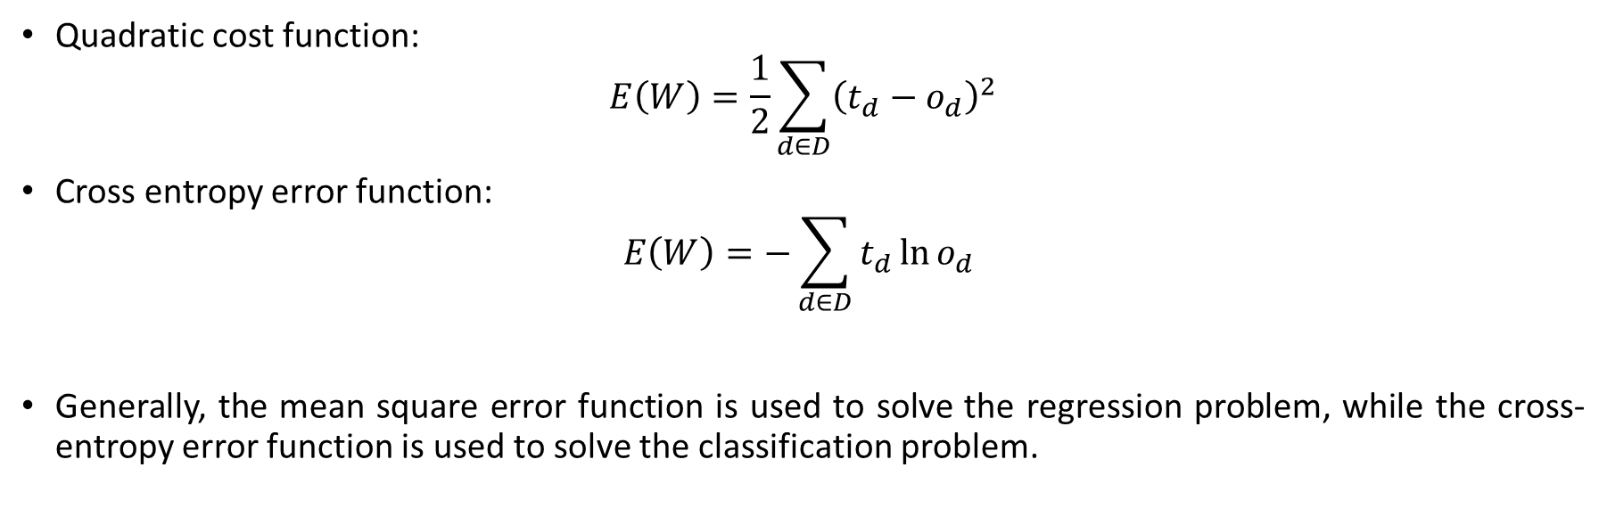
Common Loss Functions in Deep Learning
Lecture
07
Quadratic cost function:
$$E\left(W\right)=\frac{1}{2}\sum_{d∈D}{{\left(t_{d}−o_{d}\right)}^{2}}$$
Cross entropy error function:
$$E\left(W\right)=−\sum_{d∈D}{t_{d}\ln{o_{d}} }$$
Generally, the mean square error function is used to solve the regression problem, while the cross- entropy error function is used to solve the classification problem.
www.midocean.ae

Slide 22

Optimizer

Slide 23
BGD,MBGD and SGD
Gradient Descent: Most optimizers are based on the concept of gradient descent. The gradient of the loss function with respect to the model parameters indicates the direction and magnitude of the steepest increase in the loss. Optimizers use this gradient information to update the parameters in the opposite direction, effectively "descending" the loss function to reach a minimum.
Batch Gradient Descent (BGD): Computes the gradient using the entire training dataset in each iteration.
Mini-Batch Gradient Descent: Computes the gradient using a randomly selected subset (mini-batch) of the training data in each iteration.
Stochastic Gradient Descent (SGD): Computes the gradient using only one training example at a time in each iteration.
www.midocean.ae

Slide 24
Batch Gradient Descent Algorithm (BGD)
Lecture
07
Update Frequency: In BGD, the model's weights are updated only once per epoch (a complete pass through the entire training dataset).
Computational Efficiency: It can be slower for large datasets since it processes the entire dataset before updating the model.
Convergence: BGD often converges to the minimum of the cost function more accurately because it computes gradients using the entire dataset.
Stability: It tends to have more stable and smoother convergence due to its use of a consistent gradient estimate.
Memory Usage: BGD requires memory to store the entire dataset and gradients, which can be a drawback for large datasets.
www.midocean.ae

Slide 25
Stochastic Gradient Descent Algorithm (SGD)
Lecture
07
Update Frequency: In SGD, the model's weights are updated after each training example (one randomly chosen instance) or a small subset of examples.
Computational Efficiency: It is computationally efficient and often faster per iteration than BGD and mini-batch GD since it processes one or a few examples at a time.
Convergence: SGD can have a noisy and less stable convergence due to frequent updates based on individual examples. It may take longer to converge but can escape local minima better.
Stability: The noise in the updates can make the cost function oscillate, which can be mitigated with learning rate schedules or techniques like momentum.
Memory Usage: It requires minimal memory since it processes only a single example or a small subset of examples at a time.
www.midocean.ae
Notes:
This gradient descent algorithm goes to another extreme, that is, updating the weight based on each sample. Most training samples contain noises. As a result, when the extrema is approximated to, the gradient direction is oriented up and down near the extrema but difficult to converge to the extrema.

Slide 26
Mini-Batch Gradient Descent Algorithm (MBGD)
Lecture
07
Update Frequency: In mini-batch gradient descent, the training dataset is divided into smaller, equally-sized subsets called mini-batches. The model's weights are updated once per mini-batch.
Computational Efficiency: It strikes a balance between BGD and SGD, making it more computationally efficient than BGD for large datasets while maintaining some of the benefits of stochasticity.
Convergence: It converges faster than BGD since updates are more frequent, and it can escape local minima better due to the stochastic nature of mini-batch sampling.
Stability: Mini-batch updates introduce some randomness, which can help escape poor local minima, but it may also lead to more oscillations in the cost function.
Memory Usage: It requires memory to store mini-batches and gradients, which is less demanding than BGD.
www.midocean.ae
Notes:
This gradient descent algorithm considers both the efficiency and gradient stability. It is easy to overshoot the local minimum and is the most commonly used gradient descent algorithm in actual work. The value of BS varies with specific problems. Generally, the value is 128.

Slide 27
Training
www.midocean.ae

Slide 28
Backpropagation Algorithm
Lecture
07
Signals are propagated in forward direction, and errors are propagated in backward direction.
In the training sample set D, each sample is recorded as <X, t>, in which X is the input vector, t the target output, o the actual output, and w the weight coefficient.
Loss function:
Forward propagation direction
$$x_{1}$$
$$o_{1}$$
$$x_{2}$$
$$o_{2}$$
$$x_{3}$$
Output layer
Input layer
Hidden layer
Backpropagation direction

Slide 29
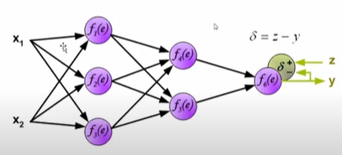
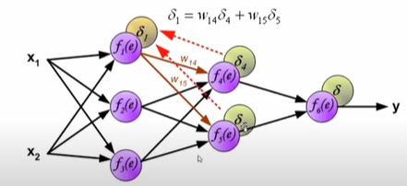
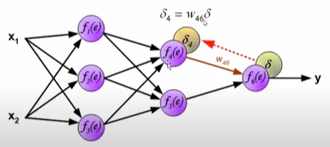
Lecture
07

Slide 30
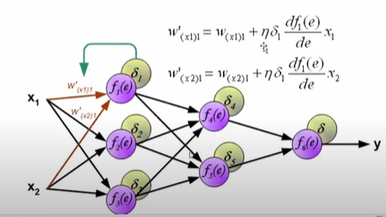
Update (W)
Lecture
07
www.midocean.ae

Slide 31
Backpropagation Algorithm
For a neural network with any number of layers, the arranged formula for training is as follows:
The BP algorithm is used to train the network as follows:
  Takes out the next training sample <X, T>, inputs X to the network, and obtains the actual output o.
  Calculates output layer δ according to the output layer error formula (1).
  Calculates δ of each hidden layer from output to input by iteration according to the hidden layer error propagation formula (2).
  According to the δ of each layer, the weight values of all the layer are updated.
www.midocean.ae

Slide 32
Activation Functions
www.midocean.ae

Slide 33
Activation Function
Activation functions are important for the neural network model to learn and understand complex non-linear functions. They allow introduction of non-linear features to the network.
Without activation functions, output signals are only simple linear functions. The complexity of linear functions is limited, and the capability of learning complex function mappings from data is low.
Activation Function
$$output=f(w_{1}x_{1}+w_{2}x_{2}+w_{3}x_{3}…)=f(W^{t}•X)$$
www.midocean.ae

Slide 34
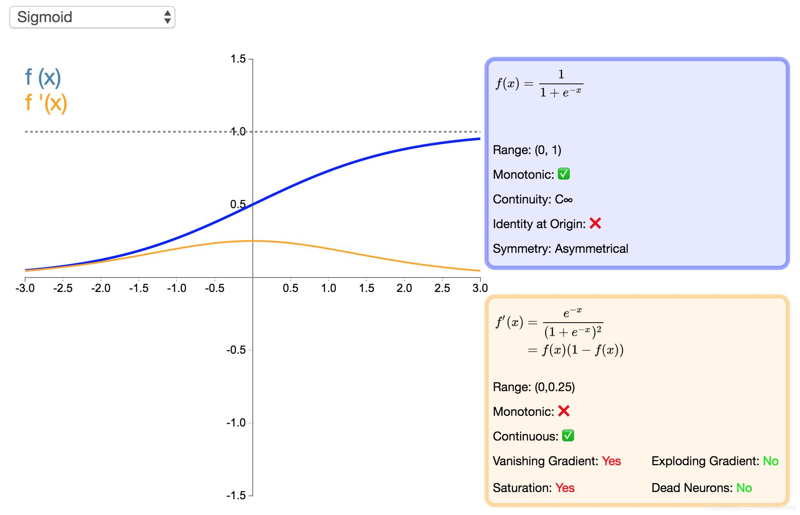

Sigmoid
$$f\left(x\right)=\frac{1}{1+e^{−x}}$$
Range: (0, 1)
Usage:
  Binary Classification: The sigmoid function is commonly used in the output layer of binary classification models. It squashes the model's output to a probability between 0 and 1, representing the likelihood of the input belonging to the positive class.
www.midocean.ae
Notes:
The sigmoid function is monotonic, continuous, and easy to derive. The output is bounded, and the network is easy to converge. However, we see that the derivative of the sigmoid function is close to 0 at the position away from the central point. When the network is very deep, more and more backpropagation gradients fall into the saturation area so that the gradient module becomes smaller. Generally, if the sigmoid network has five or fewer layers, the gradient is degraded to 0, which is difficult to train. This phenomenon is a vanishing gradient. In addition, the output of the sigmoid is not zero-centered.

Slide 35
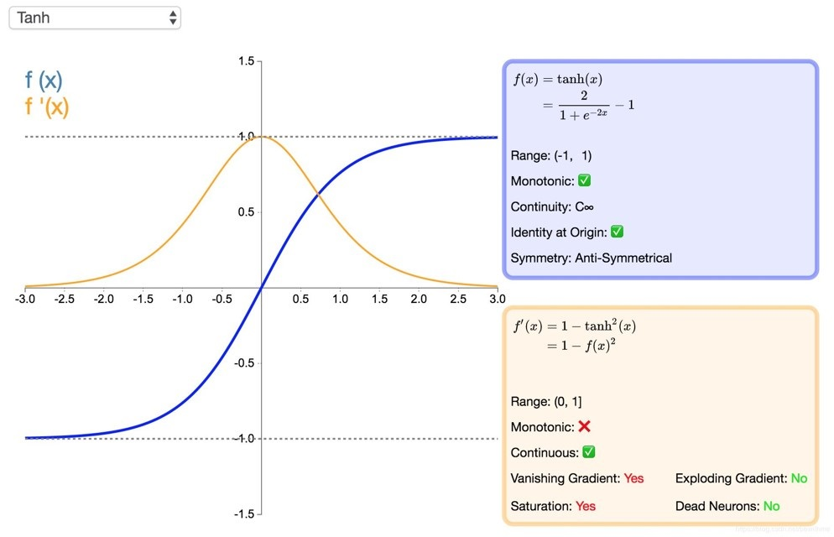

Tanh
$$\tanh{x}=\frac{e^{x}−e^{−x}}{e^{x}+e^{−x}}$$
www.midocean.ae
Notes:
Tanh function and sigmoid function have similar shortcomings. The derivative of the tanh function is nearly 0 at its extremes. However, because the tanh function is symmetric with respect to the origin, the average of the outputs is closer to 0 than that of the sigmoid function. Therefore, SGD can reduce the required number of iterations because it is closer to the natural gradient descent.

Slide 36
Tanh
Range: (-1, 1)
Usage:
Hidden Layers: Tanh is often used as an activation function in hidden layers of neural networks. Like the sigmoid, it introduces non-linearity into the model. However, because it's zero-centered (unlike sigmoid), it helps mitigate some of the issues with vanishing gradients that can occur in deep networks.
Rescaling Data: Tanh can be used to rescale and center data before feeding it into a neural network. By mapping input features to the (-1, 1) range, it can help improve the convergence and stability of the training process.
www.midocean.ae
Notes:
Tanh function and sigmoid function have similar shortcomings. The derivative of the tanh function is nearly 0 at its extremes. However, because the tanh function is symmetric with respect to the origin, the average of the outputs is closer to 0 than that of the sigmoid function. Therefore, SGD can reduce the required number of iterations because it is closer to the natural gradient descent.

Slide 37
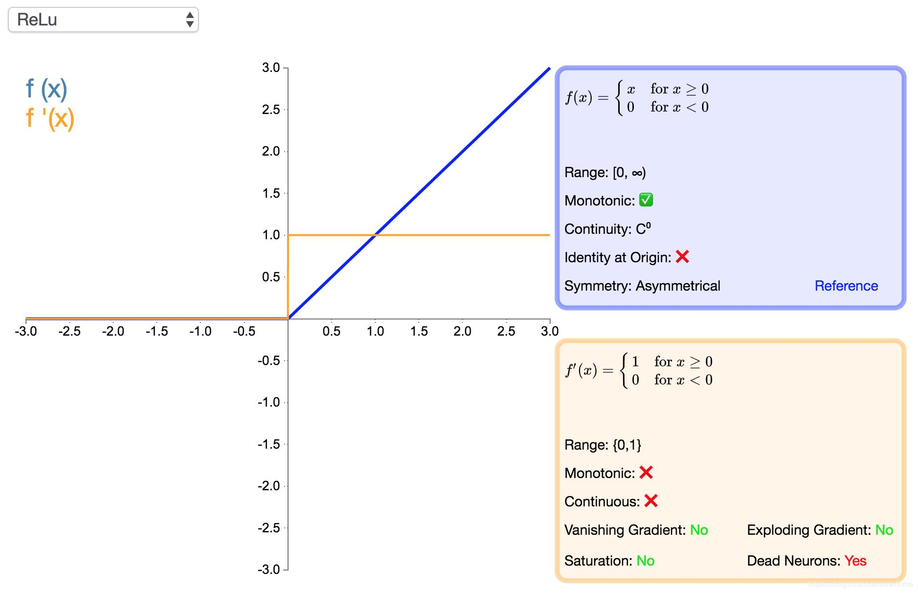

Rectified Linear Unit (ReLU)
$$y=\left\{\begin{aligned}\begin{matrix}x, & x≥0\end{matrix} \\ \begin{matrix}0, & x<0\end{matrix}\end{aligned}\right.$$
Range: [0, ∞)
www.midocean.ae
Notes:
Advantages:
Compared with sigmoid and tanh, ReLU supports fast convergence in SGD.
Compared with the sigmoid and tanh functions involving exponentiation, the ReLU can be implemented more easily.
The vanishing gradient problem can be effectively alleviated.
The ReLU has a good performance during unsupervised pre-training.
Disadvantages:
There is no upper bound, so that the training is relatively easy to diverge.
The ReLU is not differentiable at x = 0 and a derivative is forcibly defined at this point.
The surface defined at the zero point is not smooth enough in some regression problems.
Reduces the computation workload
When functions such as sigmoid are used, the activation function involves exponent operation, which requires a large amount of computation. When the error gradient is calculated through backpropagation, the derivation involves division and the computation workload is heavy. However, the ReLU activation function can reduce much of the computation workload.
Effectively mitigates the vanishing gradient problem.
The ReLU gradient is unsaturated. When the sigmoid function is close to the saturation area (far from the function center), the transformation is too slow and the derivative is close to 0. Therefore, in the backpropagation process, the ReLU function mitigates the vanishing gradient problem, and parameters of the first several layers of the neural network can be quickly updated.

Slide 38
Rectified Linear Unit (ReLU) Cont.
Usage:
  Hidden Layers: ReLU is a popular activation function for hidden layers in deep neural networks. It introduces non-linearity and helps address the vanishing gradient problem, enabling deep networks to learn complex representations efficiently.
  Sparse Activation: ReLU neurons are either fully activated (output > 0) or completely inactive (output = 0), which can lead to sparse activations, making the network more computationally efficient.
www.midocean.ae
Notes:
Advantages:
Compared with sigmoid and tanh, ReLU supports fast convergence in SGD.
Compared with the sigmoid and tanh functions involving exponentiation, the ReLU can be implemented more easily.
The vanishing gradient problem can be effectively alleviated.
The ReLU has a good performance during unsupervised pre-training.
Disadvantages:
There is no upper bound, so that the training is relatively easy to diverge.
The ReLU is not differentiable at x = 0 and a derivative is forcibly defined at this point.
The surface defined at the zero point is not smooth enough in some regression problems.
Reduces the computation workload
When functions such as sigmoid are used, the activation function involves exponent operation, which requires a large amount of computation. When the error gradient is calculated through backpropagation, the derivation involves division and the computation workload is heavy. However, the ReLU activation function can reduce much of the computation workload.
Effectively mitigates the vanishing gradient problem.
The ReLU gradient is unsaturated. When the sigmoid function is close to the saturation area (far from the function center), the transformation is too slow and the derivative is close to 0. Therefore, in the backpropagation process, the ReLU function mitigates the vanishing gradient problem, and parameters of the first several layers of the neural network can be quickly updated.

Slide 39

Softmax
Softmax function:
$${σ(z)}_{j}=\frac{e^{z_{j}}}{\sum_{k}{e^{z_{k}}}}$$
Range: (0, 1) for each element, with the sum of all elements in the vector equal to 1.
Usage:
Multi-Class Classification: Softmax is used in the output layer of models for multi-class classification tasks. It converts the model's raw scores (logits) into a probability distribution over multiple classes, allowing you to choose the class with the highest probability as the model's prediction.
Cross-Entropy Loss: Softmax is often paired with the cross-entropy loss function to train classification models effectively.
www.midocean.ae

Slide 40
Regularization
www.midocean.ae

Slide 41

Regularization
Regularization is an important and effective technology to reduce generalization errors in machine learning. It is especially useful for deep learning models that tend to be over-fit due to a large number of parameters. Therefore, researchers have proposed many effective technologies to prevent over-fitting, including:
  Adding constraints to parameters, such as $L_{1}$ and $L_{2}$ norms
  Expanding the training set, such as adding noise and transforming data
  Dropout
  Early stopping
www.midocean.ae

Slide 42

Penalty Parameters
Many regularization methods restrict the learning capability of models by adding a penalty parameter $Ω(θ)$ to the objective function $J$. Assume that the target function after regularization is $\tilde{J}$.
$\tilde{J}\left(θ;X,y\right)=J\left(θ;X,y\right)+αΩ(θ)$,
Where $αε[0,∞)$ is a hyperparameter that weights the relative contribution of the norm penalty term $Ω$ and the standard objective function $J(X;θ)$. If $α$ is set to 0, no regularization is performed. The penalty in regularization increases with $α$.
www.midocean.ae
Notes:
Generally, in deep learning, we add constraints only to affine parameter $w$ but not to biases. The main reason is that biases usually require less data for more accurate fitting. Adding constraints often leads to underfitting.

Slide 43
Dataset Expansion
The most effective way to prevent over-fitting is to add a training set. A larger training set has a smaller over-fitting probability. Dataset expansion is a time-saving method, but it varies in different fields.
  A common method in the object recognition field is to rotate or scale images. (The prerequisite to image transformation is that the type of the image cannot be changed through transformation. For example, for handwriting digit recognition, categories 6 and 9 can be easily changed after rotation).
  Random noise is added to the input data in speech recognition.
  A common practice of natural language processing (NLP) is replacing words with their synonyms.
www.midocean.ae

Slide 44
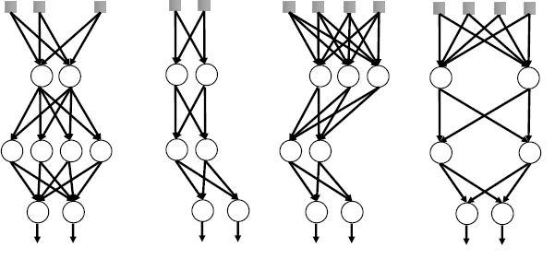
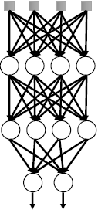
Dropout (Integration Method)
Dropout is a common and simple regularization method, which has been widely used since 2014. Simply put, Dropout randomly discards some inputs during the training process. In this case, the parameters corresponding to the discarded inputs are not updated. As an integration method, Dropout combines all sub-network results and obtains sub-networks by randomly dropping inputs. See the figures below:
Dropout in training Testing
www.midocean.ae
Notes:
The sampling probability of each entry is 0.8 for the input and 0.5 for the hidden layers.
Advantages:
Compared with weight decay and norm constraints, this strategy is more effective.
It is computationally cheap and simple and can be used in other non-deep-learning models.
However, it is less effective when the training data is insufficient.
Stochasticity is not necessary or sufficient to achieve the regularizing effect of dropout. Invariant shielding parameters can be constructed to obtain good solutions.
In addition to the preceding methods, we can also use semi-supervised learning, multi-task learning, early stopping, parameter sharing, ensemble methods, and adversarial training.

Slide 45
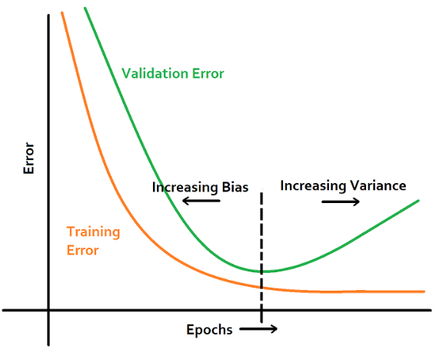
Early Stopping
A test on data of the validation set can be inserted during the training. When the data loss of the verification set increases, perform early stopping.
Early stopping
www.midocean.ae

Slide 46

Thank You
www.midocean.ae

