Slide 1


Risk Management
Prepared by Dr. Majid Saad
MGM510
INTRODUCTION TO RISK MANAGEMENT

Slide 2
Risk Management
Lecture 3

Slide 3
Risk Management
“The essence of risk management lies in maximizing the areas where we have some control over the outcome while minimizing the areas where we have absolutely no control over the outcome …”
Peter L. Bernstein
Against the Gods: The Remarkable Story of Risk

Slide 4

Lecture objectives
After this lecture, you should be able to:
Define risk management and explain the objectives of risk management.
Describe the steps in the risk management process.
Explain the major risk-control techniques, including : Avoidance ,Loss prevention ,and Loss reduction
Explain the major risk-financing techniques, including Retention , Noninsurance transfers and Insurance
Apply the principles of risk management to a personal risk management program.
www.midocean.ae

Slide 5
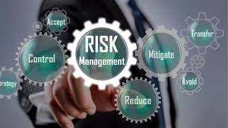
Risk management
Risk management is a process that identifies loss exposures faced by an organization and selects
the most appropriate techniques for treating such exposures
www.midocean.ae

Slide 6
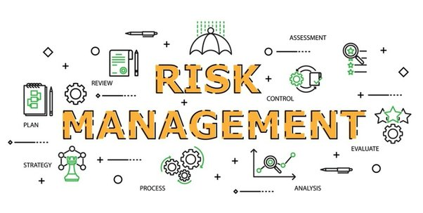
OBJECTIVES OF RISK MANAGEMENT
Risk management has important objectives. These objectives can be classified as follows:
Pre-loss objectives
Post-loss objectives
www.midocean.ae

Slide 7
Pre-Loss Objectives
Important objectives before a loss occurs include economy, reduction of anxiety, and meeting legal
obligations.
The first objective means that the firm should prepare for potential losses in the most economical
way .
The second objective is the reduction of anxiety . Certain loss exposures can cause greater worry and
fear for the risk manager and key executives.
The final objective is to meet any legal obligations . For example, government regulations may require a firm to install safety devices to protect workers from harm, to dispose of hazardous waste materials properly, and to label consumer products appropriately.
www.midocean.ae

Slide 8
Post-Loss Objectives
Risk management also has certain objectives after a loss occurs. These objectives are .
The most important post-loss objective is survival of the firm . Survival means that after a loss occurs,
the firm can resume at least partial operations within some reasonable time period.
The second post-loss objective is to continue operating . For some firms, the ability to operate after
a loss is extremely important.
The third post-loss objective is stability of earnings . Earnings per share can be maintained if the firm
continues to operate.
www.midocean.ae

Slide 9
Post-Loss Objectives
The fourth post-loss objective is continued growth of the firm . A company can grow by developing new. products and markets or by acquiring or merging with other companies. The risk manager must therefore consider the effect that a loss will have on the firm’s ability to grow.
Finally, the objective of social responsibility is to minimize the effects that a loss will have on other
persons and on society ..
www.midocean.ae

Slide 10
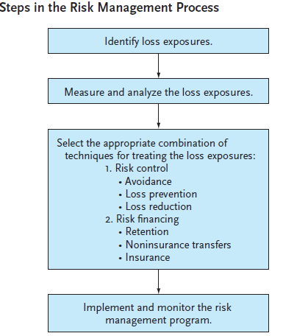
STEPS IN THE RISK MANAGEMENT PROCESS
There are four steps in the risk management process
Identify loss exposures
Measure and analyze the loss exposures
Select the appropriate combination of techniques for treating the loss exposures
Implement and monitor the risk management program
Each of these steps is discussed in some detail in the sections that follow.
www.midocean.ae

Slide 11
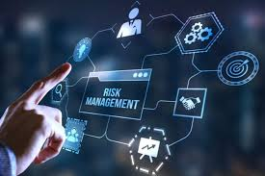
Identify Loss Exposures
The first step in the risk management process is to identify all major and minor loss exposures. This step involves a painstaking review of all potential losses. Important loss exposures include the following:
Property loss exposures
Liability loss exposures
Business income loss exposures
Human resources loss exposures
Crime loss exposures
Employee benefit loss exposures
Foreign loss exposures
Intangible property loss exposures
Failure to comply with government laws and regulations
www.midocean.ae

Slide 12
Identify Loss Exposures
A risk manager can use several sources of information to identify the preceding loss exposures. They include the following:
Risk analysis questionnaires and checklists .
Questionnaires and checklists require the risk manager to answer numerous questions that identify major and minor loss exposures.
Physical inspection .
A physical inspection of company plants and operations can identify major loss exposures.
www.midocean.ae

Slide 13
Identify Loss Exposures
Flowcharts .
Flowcharts that show the flow of production and delivery can reveal production and other bottlenecks as well as where a loss can have severe financial consequences for the firm.
Financial statements .
Analysis of financial statements can identify the major assets that must be protected, loss of income exposures, and key customers and suppliers.
Historical loss data .
Historical loss data can be invaluable in identifying major loss exposures.
www.midocean.ae

Slide 14
Measure and Analyze the Loss Exposures
The second step is to measure and analyze the loss exposures. It is important to measure and quantify
the loss exposures in order to manage them properly..
This step requires an estimation of the frequency and severity of loss. Loss frequency refers to the probable number of losses that may occur during some given time period . Loss severity refers to the probable size of the losses that may occur .
www.midocean.ae

Slide 15
Select the Appropriate Combination of Techniques for Treating the Loss Exposures
The third step in the risk management process is to select the appropriate combination of techniques
for treating the loss exposures. These techniques can be classified broadly as either risk control or risk financing.
Risk control refers to techniques that reduce the frequency or severity of losses . Risk financing refers to techniques that provide for the funding of losses . Risk managers typically use a combination of techniques for treating each loss exposure.
Risk financing refers to techniques that provide for the funding of losses . Risk managers typically use a combination of techniques for treating each loss exposure.
www.midocean.ae

Slide 16
Select the Appropriate Combination of Techniques for Treating the Loss Exposures
Risk Control As noted above, risk control is a generic term to describe techniques for reducing the frequency or severity of losses. Major risk-control techniques include the following:
Avoidance
Loss prevention
Loss reduction
www.midocean.ae

Slide 17

Select the Appropriate Combination of Techniques for Treating the Loss Exposures
Avoidance
Avoidance means a certain loss exposure is never acquired or undertaken, or an existing loss exposure is abandoned .
The major advantage of avoidance is that the chance of loss is reduced to zero if the loss exposure is
never acquired.
Avoidance has two major disadvantages.
First, the firm may not be able to avoid all losses.
Second, it may not be feasible or practical to avoid the exposure.
www.midocean.ae

Slide 18
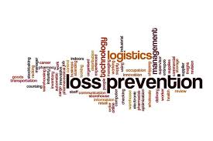
Select the Appropriate Combination of Techniques for Treating the Loss Exposures
Loss Prevention
It refers to measures that reduce the frequency of a particular loss . For example, measures that reduce truck accidents include : driver training, zero tolerance for alcohol or drug abuse, and strict enforcement of safety rules.
Measures that reduce lawsuits from defective products include installation of safety features on hazardous products, placement of warning labels on dangerous products, and use of quality-control checks.
www.midocean.ae

Slide 19

Select the Appropriate Combination of Techniques for Treating the Loss Exposures
Loss Reduction
Loss reduction refers to measures that reduce the severity of a loss after it occurs . Examples include installation of an automatic sprinkler system that promptly extinguishes a fire; segregation of exposure units so that a single loss cannot simultaneously damage all exposure units, such as having warehouses with inventories at different locations; rehabilitation of workers with job-related injuries; and limiting the amount of cash on the premises.
www.midocean.ae

Slide 20

Select the Appropriate Combination of Techniques for Treating the Loss Exposures
Risk Financing
As stated earlier, risk financing refers to techniques that provide for the payment of losses after they occur. Major risk-financing techniques include the following:
Retention
Noninsurance transfers
Commercial insurance
www.midocean.ae

Slide 21
Select the Appropriate Combination of Techniques for Treating the Loss Exposures
Retention
It means that the firm retains part or all of the losses that can result from a given loss .
Retention can be either active or passive.
Active risk retention means that the firm is aware of the loss exposure and consciously decides to retain part or all of it, such as collision losses to a fleet of company cars.
Passive retention, however, is the failure to identify a loss exposure, failure to act, or forgetting to act.
www.midocean.ae

Slide 22
Select the Appropriate Combination of Techniques for Treating the Loss Exposures
Retention can be effectively used in a risk management program under the following conditions:
No other method of treatment is available .
The worst possible loss is not serious.
Losses are fairly predictable .
www.midocean.ae

Slide 23
Select the Appropriate Combination of Techniques for Treating the Loss Exposures
Paying Losses
If retention is used, the risk manager must have some method for paying losses. The following methods are typically used:
Current net income : The firm can pay losses out of its current net income and treat losses as expenses for that year. A large number of losses could exceed current income, however, and other assets may have to be liquidated to pay losses.
Unfunded reserve : An unfunded reserve is a bookkeeping account that is charged with actual or expected losses from a given exposure.
www.midocean.ae

Slide 24
Select the Appropriate Combination of Techniques for Treating the Loss Exposures
Funded reserve :
It is the setting aside of liquid funds to pay losses. A self- insurance program (discussed later) that is funded is an example of a funded reserve. However, if not required to do so, many businesses do not establish funded reserves because the funds may yield a higher return by being used elsewhere in the business. In addition, contributions to a funded reserve are not income-tax deductible. Losses, however, are tax deductible when paid.
Credit line . A credit line can be established with a bank, and borrowed funds may be used to pay losses as they occur. Interest must be paid on the loan, however, and loan repayments can aggravate any cash-flow problems a firm may have.
www.midocean.ae

Slide 25
Select the Appropriate Combination of Techniques for Treating the Loss Exposures
Captive Insurer Losses can also be paid by a captive insurer.
A captive insurer is an insurer owned by a parent firm for the purpose of insuring the parent firm’s loss exposures . There are different types of captive insurers..
Captive insurers are formed for several reasons, including the following:
Difficulty in obtaining insurance.
Favorable regulatory environment.
Lower costs.
Easier access to a reinsurer.
Formation of a profit center
www.midocean.ae

Slide 26
Advantages of Self Insurance
A self-funded employee benefit plan has a number of advantages over a more traditional insured plan. They include:
The self-funded plan may be tailored to fit the needs of the group.
The self-funded plan has lower fixed costs than a fully insured plan. Most expenses are variable based on the actual claims.
The self-funded employer may use the independent, managed-care measures, such as preferred provider
organizations, pre-certification, and utilization review, that save the most money, rather than simply those the carrier offers.
www.midocean.ae

Slide 27
Advantages of Self Insurance
Any leftover funds in the claim account may be reconciled against future contributions.
Interest earned on the claim account is considered income to a non-qualified plan. A qualified plan may use this interest for future benefit payment.
Benefit plan administration through a professional third-party administrator is reasonably and competitively priced. Only slightly more involvement by the employer is required, such as verifying eligibility, printing employee communication materials, and distributing claim checks.
Self-funding with stop-loss coverage simplifies budgeting because the employer always knows its maximum expenditure for group health coverage.
Administrative services such as claims handling are often simpler, faster, and performed on a more personal and professional basis. Bureaucratic red tape is eliminated.
www.midocean.ae

Slide 28
Advantages of Retention
The risk retention technique has both advantages and disadvantages in a risk management program.
The major advantages are as follows:
Save on loss costs . The firm can save money in the long run if its actual losses are less than the loss component in a private insurer’s premium.
Save on expenses . The services provided by the insurer may be provided by the firm at a lower cost. Some expenses may be reduced, including loss-adjustment expenses, general administrative expenses, commissions and brokerage fees, risk-control expenses, taxes and fees, and the insurer’s profit.
Encourage loss prevention . Because the exposure is retained, there may be a greater incentive for loss prevention.
Increase cash flow . Cash flow may be increased because the firm can use some of the funds that normally would be paid to the insurer at the beginning of the policy period.
www.midocean.ae

Slide 29

Disadvantages of Retention
The retention technique, however, has several disadvantages:
Possible higher losses . The losses retained by the firm may be greater than the loss allowance in the insurance premium that is saved by not purchasing insurance. Also, in the short run, there may be great volatility in the firm’s loss experience.
Possible higher expenses . Expenses may actually be higher. Outside experts such as safety engineers may have to be hired. Insurers may be able to provide risk control and claim services at a lower cost.
Possible higher taxes . Income taxes may also be higher. The premiums paid to an insurer are immediately income-tax deductible. However, if retention is used, only the amounts paid out for losses are deductible, and the deduction cannot be taken until the losses are actually paid. Contributions to a funded reserve are not income-tax deductible.
www.midocean.ae

Slide 30
Noninsurance Transfers
Noninsurance transfers are another risk-financing technique. Noninsurance transfers are methods other than insurance by which a pure risk and its potential financial consequences are transferred to another party . Examples of noninsurance transfers include contracts, leases, and hold-harmless agreements.
In a risk management program, noninsurance
transfers have several advantages:
The risk manager can transfer some potential losses that are not commercially insurable.
Noninsurance transfers often cost less than insurance.
The potential loss may be shifted to someone who is in a better position to exercise loss control.
www.midocean.ae

Slide 31
Noninsurance Transfers
However, noninsurance transfers have several disadvantages:
The transfer of potential loss may fail because the contract language is ambiguous. Also, there may be no court precedents for the interpretation of a contract tailor-made to fit the situation.
If the party to whom the potential loss is transferred is unable to pay the loss, the firm is still responsible for the claim.
An insurer may not give credit for the transfers, and insurance costs may not be reduced.
www.midocean.ae

Slide 32

Insurance
Commercial insurance is also used in a risk management program. Insurance is appropriate for loss exposures that have a low probability of loss but the severity of loss is high.
If the risk manager uses insurance to treat certain loss exposures, five key areas must be emphasized:
Selection of insurance coverages
Selection of an insurer
Negotiation of terms
Dissemination of information concerning insurance coverages
Periodic review of the insurance program
www.midocean.ae

Slide 33
Insurance
First, the risk manager must select the insurance coverages needed .
The risk manager must also determine if a deductible is needed and the size of the deductible. A deductible is a provision by which a specified amount is subtracted from the loss payment otherwise payable to the insured .
Second, the risk manager must select an insurer or several insurers .
Third, after the insurer or insurers are selected, the terms of the insurance contract must be negotiated .
In addition, information concerning insurance coverages must be disseminated to others in the firm .
Finally, the insurance program must be periodically reviewed .
www.midocean.ae

Slide 34
Insurance
Advantages of Insurance
The use of commercial insurance in a risk management program has certain advantages:
The firm will be indemnified after a loss occurs.
The firm can continue to operate and fluctuations in earnings are minimized.
Uncertainty is reduced, which permits the firm to lengthen its planning horizon. Worry and fear are reduced for managers and employees, which should improve performance and productivity.
Insurers can provide valuable risk management services, such as risk-control services, loss exposure
analysis, and claims adjusting.
Insurance premiums are income-tax deductible as a business expense.
www.midocean.ae

Slide 35
Insurance
Disadvantages of Insurance
The use of insurance also entails certain disadvantages and costs.
The payment of premiums is a major cost because the premium consists of a component to pay losses, an amount to cover the insurer’s expenses, and an allowance for profit and contingencies.
Considerable time and effort must be spent in negotiating the insurance coverages. An insurer or insurers must be selected, policy terms and premiums must be negotiated, and the firm must cooperate with the risk-control activities of the insurer.
The risk manager may have less incentive to implement loss-control measures because the insurer will pay the claim if a loss occurs.
www.midocean.ae

Slide 36
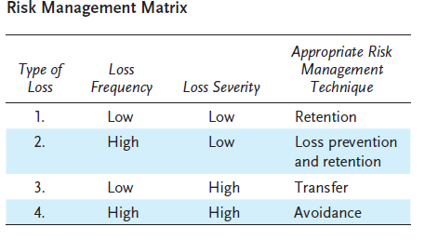
Which Technique Should Be Used?
In determining the appropriate technique or techniques for handling
loss exposures, a matrix can be used that classifies the various loss exposures according to frequency and severity.
The first loss exposure is characterized by both low frequency and
low severity of loss.
The second type of exposure is more serious.
Losses occur frequently, but severity is relatively low.
The third type of exposure can be met by transfer, including insurance.
The fourth and most serious type of exposure is one characterized by both high frequency and high severity.
www.midocean.ae

Slide 37
IMPLEMENT AND MONITOR THE RISK MANAGEMENT PROGRAM
At this point, we have discussed three of the four steps in the risk management process. The fourth step is to implement and monitor the risk management program. This step begins with a policy statement.
A risk management policy statement is necessary to have an effective risk management program.
A risk management manual may be developed and used in the program.
www.midocean.ae

Slide 38
Cooperation with Other Departments
The risk manager does not work alone. Other functional departments within the firm are extremely important in identifying loss exposures, methods for treating these exposures, and ways to administer the risk management program. These departments can cooperate in the risk management process in the following ways:
Accounting
Finance .
Marketing .
Production
Human resources .
www.midocean.ae

Slide 39
Periodic Review and Evaluation
To be effective, the risk management program must be periodically reviewed and evaluated to determine whether the objectives are being attained or if corrective actions are needed. In particular, risk management costs, safety programs, and loss-prevention programs must be carefully monitored. Loss records must also be examined to detect any changes in frequency and severity.
Retention and transfer decisions must also be reviewed to determine if these techniques are being properly used.
Finally, the risk manager must determine whether the firm’s overall risk management policies are being carried out, and whether the risk manager is receiving cooperation from other departments.
www.midocean.ae

Slide 40
BENEFITS OF RISK MANAGEMENT
The previous discussion shows that the risk management process involves a complex and detailed
analysis. Despite the complexities, an effective risk management program yields substantial benefits to
the firm or organization. Major benefits include the following:
A formal risk management program enables a firm to attain its pre-loss and post-loss objectives
more easily.
The cost of risk is reduced, which may increase the company’s profits. The cost of risk is a risk
management tool that measures certain costs.
www.midocean.ae

Slide 41

PERSONAL RISK MANAGEMENT
The principles of corporate risk management are also applicable to a personal risk management program.
Personal risk management refers to the identification and analysis of pure risks faced by an individual or family, and to the selection and implementation of the most appropriate technique(s) for treating such risks .
Personal risk management considers other methods for handling risk in addition to insurance.
www.midocean.ae

Slide 42
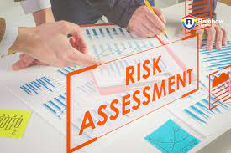
PERSONAL RISK MANAGEMENT
Steps in Personal Risk Management
A personal risk management program involves four steps:
(1) identify loss exposures,
(2) Measure and analyze the loss exposures,
(3) select appropriate techniques for treating the loss exposures, and
(4) implement and review the risk management program periodically.
www.midocean.ae

Slide 43
PERSONAL RISK MANAGEMENT
Identify Loss Exposures
The first step is to identify all loss exposures that can cause serious financial problems. Serious financial losses can result from the following:
Personal loss exposures
Property loss exposures
Analyze the Loss Exposures
The second step is to measure and analyze the loss exposures.
www.midocean.ae

Slide 44
PERSONAL RISK MANAGEMENT
Select Appropriate Techniques for Treating the Loss Exposures:
The third step is to select the most appropriate techniques for treating each loss exposure. The major methods are avoidance, risk control, retention, noninsurance transfers, and insurance.
Avoidance: Avoidance is one method for treating a loss exposure.
Risk control: Risk control refers to activities that reduce the frequency or severity of loss.
Retention: Retention means that you retain part or all of a loss. As noted earlier, risk retention can be active or passive.
Noninsurance transfers: Noninsurance transfers are methods other than insurance by which a pure risk is transferred to a party other than an insurer.
Insurance: In a personal risk management program, most people rely heavily on insurance as the major method for dealing with risk.
www.midocean.ae

Slide 45
PERSONAL RISK MANAGEMENT
Implement and Monitor the Program Periodically
The final step is to implement the personal risk management program and review the program periodically.
At least every two or three years, you should determine whether all major loss exposures are adequately covered. You should also review your program at major events in your life, such as a divorce, birth of a child, purchase of a home, change of jobs, or death of a spouse or family member.
www.midocean.ae

Slide 46



Thank You

