Slide 1



MIDOCEAN UNIVERSITY · COLLEGE OF INFORMATICS
MSc THESIS DEFENSE
AI-Powered Voice Agent for
Saudi Labor Law Inquiries
An evidence-grounded Arabic RAG voice assistant combining ASR, hybrid retrieval, reliability gating, deterministic legal computation, and TTS
Hussam Almokayed
ID 253001038
Fatimah Aldeghaither
ID 253000292
Supervisor
Dr. Hager Saleh
August 15, 2026

Slide 2


AGENDA
Introduction
Results and Discussion
01
09
09
Problem Statement
System Demonstration
02
10
10
  Related Work
Conclusion and Future Work
03
11
11
04
Research Gap
05
Objectives and Contributions
06
Proposed Methodology
07
Dataset Description
08
Experimental Setup

Slide 3




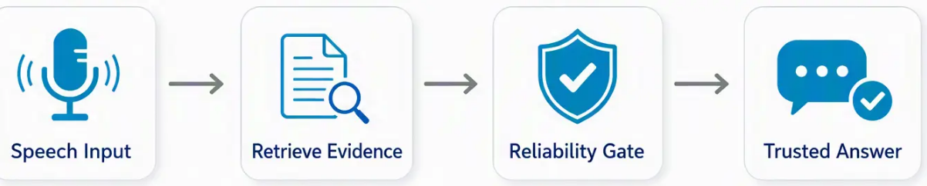


Introduction
Why Do We Need an Arabic Legal Voice Agent?
“
”
Imagine an employee asking: How much end-of-service award will I receive after seven years?
The Challenge
Our Vision
Human support is not always available
We propose an evidence-grounded Arabic AI Voice Agent that understands spoken Arabic, retrieves official legal evidence, performs deterministic legal calculations when required, and answers only when sufficient evidence exists.
FAQ systems understand
only predefined questions
2
Current support channels may involve long waiting times and an inconsistent user experience
3
Research Goal
Deliver fast, accurate, and trustworthy Arabic legal assistance
based exclusively on official Saudi Labor Law sources.
2

Slide 4
Problem Definition
The Gap in Current Solutions — and Why Ours Is Different
FAQ Menus
Human Agents
Naive AI Chatbots
Handle only predefined intents — can't parse free-form natural-language questions.
Flexible but inconsistent: accuracy and speed depend on the agent and case complexity.
Risk hallucinated legal answers with no grounding in official, current sources.
What's needed: a real-time Arabic assistant that retrieves official evidence, answers only when confident, and refuses when it isn't.
Why our project is bigger than prior studies
Arabic, not English
Almost all comparable RAG/voice systems in the literature are English-first. Ours is built for Arabic from the ground up — speech, retrieval, and generation.
Whole pipeline, not one piece
Prior work targets ASR or TTS or legal RAG in isolation. We combine speech interaction + retrieval + reliability gating + deterministic calculation in one evaluated system.
3

Slide 5
Related Work
Where Prior Systems Fall Short
Prior Work
Contribution
What's Missing
Arabic ASR [10],[11]
Whisper fine-tuning & dialect ID across major Arabic dialects
No retrieval, no legal domain
Telecom IVR [12]
Streaming ASR + RAG + quantized LLM + real-time TTS
Private telecom setting; not real legal QA
RAGentA [14]
Multi-agent attributed QA, citation-aware retrieval
Synthetic benchmark; not Arabic legal or voice-based
Moroccan RAG [15]
Arabic legal RAG for the Moroccan Family Code
Different jurisdiction; no speech, no labor-law calculation
ALARB [19]
Saudi legal-reasoning benchmark, 13,000+ court cases
No voice-agent or RAG service pipeline
These are the closest prior systems in voice and legal AI — the full 15-reference review appears in the References slide.
4

Slide 6
Related Work
The Gap — One Pipeline, Not a Fragment
Each prior system covers one or two capabilities. None covers all seven.
Arabic
ASR
RAG
Grounding
Legal
Domain
Reliability
Gating
Deterministic
Calculation
Arabic
TTS
Multilingual
Embeddings
Arabic ASR [10],[11]
✓
–
–
–
–
–
✓
Telecom IVR [12]
✓
✓
–
–
–
✓
–
RAGentA [14]
–
✓
–
✓
–
–
✓
Moroccan RAG [15]
–
✓
✓
–
–
–
✓
ALARB [19]
–
–
✓
–
–
–
–
Our System
✓
✓
✓
✓
✓
✓
✓
The closest prior systems cover at most 3 of 7 capabilities. Only our system covers all seven in one evaluated Arabic pipeline.
5

Slide 7
Objectives
Four Research Objectives
01
Build the Knowledge Base
02
Optimize Retrieval
Fact-based, version-controlled KB from Saudi Labor Law + HRSD FAQs, fully traceable to source.
Compare dense, lexical, hybrid, and reranked retrieval using recall, MRR, and nDCG.
03
Evaluate Generation
04
Test Voice & Deployment
Compare two Arabic LLMs under a shared grounded prompt and reliability gate.
Measure ASR error rate, end-to-end latency, and deterministic-calculator accuracy.
6

Slide 8
Approach
Technologies Used in This Project
A quick map of the tools behind every stage — so the terms ahead are familiar before we dive into details.
Speech Recognition
Embeddings
Vector Database
Lexical Search
Whisper-large-v3 / Whisper-small
multilingual-e5-large · bge-m3
ChromaDB
BM25
Converts spoken Arabic into text (ASR)
Turns text into vectors for meaning-based search
Stores and searches embedded legal & FAQ content
Exact-term matching alongside dense search
Reranker
Answer Generation
Text-to-Speech
Framework
bge-reranker-v2-m3
ALLaM-7B · Qwen2.5-7B
MMS-TTS-Arabic · edge-tts
Python · PyTorch · Transformers
Re-scores top candidates for precision
Arabic-capable LLMs, compared head-to-head
Converts the answer back into spoken Arabic
Core implementation stack
7

Slide 9
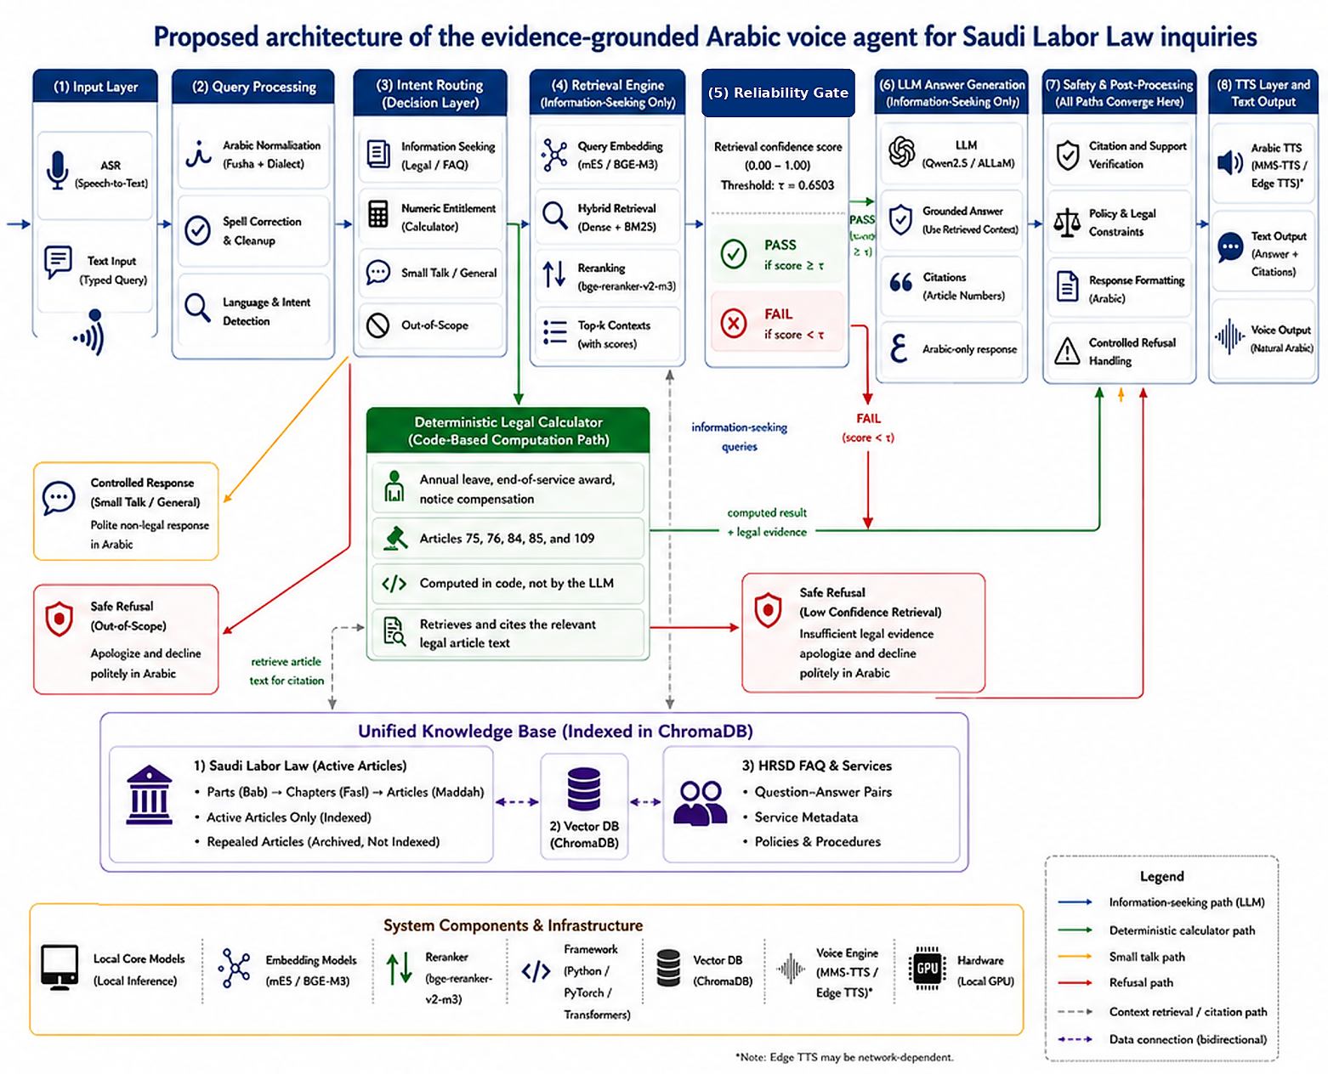
Approach
Proposed Framework — Runtime Architecture
1
Input: text or speech (Whisper ASR)
2
Normalize & detect intent
3
Route: retrieve · calculate · refuse
4
Hybrid retrieval + cross-encoder rerank
5
Reliability gate (τ = 0.6503)
6
Grounded LLM answer with citation
7
Safety & post-processing (all paths)
8
Text output + optional Arabic TTS
Deterministic legal calculation runs as a parallel branch for numeric entitlements (Articles 75, 76, 84, 85, 109) — the LLM never performs arithmetic.
8

Slide 10
Approach
From Question to Answer — A Worked Example
Example query:
“كم مكافأة نهاية الخدمة لي بعد 7 سنوات؟” (“How much is my end-of-service award after 7 years?”)
1
ASR
Whisper-large-v3 transcribes speech → Arabic text (typed input skips this step)
2
Normalize + Intent
Clean text; query-reformulation module (q*_t = Reformulate(q_t, H_{t-1})) resolves follow-ups using session memory; intent = numeric entitlement
3
Route
Numeric-entitlement + inputs present (7 yrs service) → sent to deterministic calculator, not the LLM
4
Calculate + Retrieve
Python rule for Article 84 computes the award; retrieval simultaneously fetches Article 84 text as supporting evidence
5
Safety & Formatting
Citation verified against retrieved evidence; Arabic response formatted with article number
6
Output
Written Arabic answer with citation → optionally spoken via TTS (MMS-TTS-Arabic / edge-tts)
If instead the question needs a general explanation (not a calculation), the query goes through hybrid retrieval → reliability gate → LLM generation (ALLaM-7B / Qwen2.5-7B) exactly as in the Chapter-3 architecture diagram.
9

Slide 11
Dataset
Dataset & Data Collection
Two official Saudi sources — each parsed with a different extraction strategy matched to its structure
Saudi Labor Law Pages
HRSD FAQ Portal
Article-level legal text, Royal Decree No. M/51 (as amended).
Service-oriented question–answer pairs from the Ministry portal.
EXTRACTION STRATEGY
EXTRACTION STRATEGY
Hierarchy-aware parsing — walks part → chapter → article structure so each article keeps its legal position and number.
Pair-wise extraction — each question and its answer is parsed as one independent, self-contained record with its own metadata.
249 article records
711 FAQ rows
Both sites were scraped in Python using Requests (HTTP) + BeautifulSoup (HTML/DOM parsing) — the tooling is shared, but the parsing logic is site-specific because the two page structures are fundamentally different.
Article-number normalization algorithm
Arabic ordinal titles are parsed into numeric identifiers used for citation & evaluation matching, preserving the “مكرر” (repeated-article) marker:
“المادة الحادية والخمسون بعد المائة” → 151 • “المادة الحادية والثلاثون بعد المائة مكرر” → 131مكرر
10

Slide 12
Dataset
Cleaning, Normalization & Repealed Articles
Arabic text normalization algorithm
Repealed-Article Handling
Remove diacritics (tashkeel) and tatweel elongation characters
Unify Alef, Yeh, and Ta-marbuta letter-form variants
Strip scraping artifacts and extra whitespace
Two-field design: normalized text for retrieval · original wording preserved for citation & display
Each article tagged article_status: active / repealed / amended.
211 active → indexed
38 repealed → archived, excluded from retrieval
Why exclude repealed articles?
Citing an obsolete legal provision could mislead the user and undermine the reliability of the system — repealed articles stay archived for auditability but are never retrievable as evidence.
FAQ domain filtering
Only records covering labor rights, employment contracts, termination, workplace regulations, and employment services were retained.
703
402
301
249→38
Classified FAQ entries
Retained (labor-related)
Excluded (out-of-domain)
Legal articles repealed
11

Slide 13
Dataset
Near-Duplicate Detection & Leakage-Safe Splitting
Near-duplicate detection algorithm
Exact-Duplicate Example
TF-IDF character n-grams + cosine similarity flag near-duplicate candidates. Character n-grams catch overlaps that aren't word-for-word matches.
Same question text found in faq_id 248 and faq_id 94 → 248 kept as canonical, 94 removed before scoring.
COSINE SIMILARITY
cosine_similarity(x_i, x_j) = (x_i · x_j) / (||x_i|| · ||x_j||)
400 rows → 399 unique questions
thresholds: > 0.90 auto-flag · 0.85–0.90 manual review
Leakage-safe identifier-based split
DISJOINTNESS CONSTRAINT
D_train ∩ D_val = D_train ∩ D_test = D_val ∩ D_test = ∅
records that feed the searchable index can never also serve as evaluation questions
278
41
80
24
Indexing (70%)
Validation (10%)
Held-out test (20%, unique)
Curated legal test
12

Slide 14
Dataset
Segmentation, Tokenization & Embedding
Chunking strategies (compared experimentally)
Structural Segmentation — winner
Fixed-Size Segmentation — baseline
Each law article / FAQ pair = one complete retrievable unit. Preserves legal meaning, boundaries, and metadata links.
500-word chunks, 80-word overlap. Word-based splitting can sever Arabic legal terms and article references — baseline only.
Tokenization
Embedding & indexing
Each embedding / reranking / generation model applies its own subword tokenizer (multilingual-e5-large, bge-m3, bge-reranker-v2-m3, ALLaM-7B, Qwen2.5-7B). Generation length is capped at 160 new tokens to bound latency.
Dense vectors via multilingual-e5-large & bge-m3
Stored & searched in ChromaDB (persistent vector store)
Parallel BM25 lexical index over the same units
Every segment retains: source type · article identifier · document category · section reference · parent-document ID · segment ID — enabling citation, error analysis, and reproducibility.
13

Slide 15
Experimental Setup
Retrieval Algorithms — Dense, BM25 & Hybrid Fusion
DENSE RETRIEVAL — cosine similarity
BM25 — lexical ranking
cos(q, d) = (q · d) / (||q|| · ||d||)
BM25(q,d) = Σ IDF(t)·f(t,d)(k1+1) / (f(t,d)+k1(1-b+b|d|/avgdl))
multilingual-e5-large & bge-m3; matches meaning even when wording differs
k1 = 1.5, b = 0.75; exact terms, article numbers
HYBRID FUSION
CROSS-ENCODER RERANK
HybridScore(q,d) = α·DenseScore_norm + (1-α)·BM25_norm
score = CrossEncoder(query, passage) [bge-reranker-v2-m3]
α tuned over {0.65, 0.80, 0.90} → α = 0.80 selected
jointly scores query+passage pairs; reorders, doesn't expand, the candidate pool
Final configuration
50
5
α = 0.80
155-Q
Candidate pool size
Top-k passed to generation
Hybrid dense weight
Frozen validation-ablation manifest
14

Slide 16
Experimental Setup
The Reliability Gate & Threshold Calibration
Youden's J threshold-selection algorithm
YOUDEN'S J
GATE DECISION RULE
J(τ) = Sensitivity(τ) + Specificity(τ) − 1
τ* = argmaxτ J(τ)
G(q) = Pass to LLM if score(q) ≥ τ
Safe Refusal otherwise
computed on 56 validation examples only (41 positive, 15 negative)
prevents generation when retrieved evidence is weak
τ = 0.6503
J = 0.7805
Sens. 0.7805
Spec. 1.0
Calibrated threshold
Youden's J value
TP=32, FN=9
FP=0, TN=15
Because unsupported legal generation is more harmful than a conservative refusal, the operating point favors perfect specificity on validation negatives — the threshold sits above every out-of-scope validation score, so all 15 out-of-scope validation questions were correctly refused.
15

Slide 17
Experimental Setup
Deterministic Legal Calculation Layer
Some questions need a number, not a narrative. These are computed in code — never by the LLM — then paired with retrieved legal evidence for citation.
Computation
Article
Codified Rule
Annual leave
109
21 days/yr; 30 days/yr after 5+ years of service
End-of-service award (termination)
84
½-month wage × each of first 5 years + 1-month wage × each following year
Resignation entitlement
85
Resignation fraction applied by service duration
Notice period & compensation
75–76
Depends on contract type, terminating party, wage periodicity, notice given
Triggering conditions: (1) numerical result requested · (2) covered entitlement type · (3) all required inputs available — otherwise the system asks a clarifying question instead of inventing values.
16

Slide 18
Experimental Setup
Evaluation Methodology
Retrieval
Generation
Voice & Latency
Recall@1 / @5
MRR
nDCG@5
Rubric accuracy
Exact paired McNemar test
Percentile bootstrap CI (10,000 resamples)
Word / Character Error Rate
End-to-end latency
Streaming time-to-first-response
Four independent, non-overlapping evaluation sets
24
201
80
45
Final legal
retrieval test
Supplementary
robustness set
Held-out FAQ
questions
Mixed-type
generation comparison
No human or legal-expert adjudicator participated in the reported evaluation — all scoring is automated (rubric-based and LLM-as-judge).
17

Slide 19
Results
Retrieval & Generation Performance
Knowledge base at evaluation time: 211 active articles indexed (38 repealed archived) · 278 indexed FAQ rows · 24-question legal test · 45-question generation set
Retrieval (n = 24, manually curated legal test)
87.50%
95.83%
0.9097
0.9221
Recall@1
Recall@5
MRR
nDCG@5
Answer generation (n = 45, ALLaM-7B vs Qwen2.5-7B)
ALLaM-7B: 82.22% (37/45)
Qwen2.5-7B: 71.11% (32/45)
95% bootstrap CI [0.7111, 0.9333]
95% bootstrap CI [0.5778, 0.8444]
Faithfulness 0.810 · Relevance 0.840
Faithfulness 0.908 · Relevance 0.921 (judge = Qwen — self-preference caveat)
Exact McNemar test: 31 correct/both · 6 ALLaM-only · 1 Qwen-only · 7 incorrect/both → p = 0.1250 (not statistically significant at α = 0.05)
18

Slide 20
Results
RAG Ablation, Voice Layer & Latency
Citation safety: No-RAG vs RAG (n = 24)
Voice layer & latency
No-RAG
0.209
0.0484
25.0% wrong (6/24)
ASR WER
ASR CER
RAG
4.2% wrong (1/24)
2.96 s
0.82 s
Wrong-citation rate: 0.250 → 0.042. Correct-citation rate 0.292 → 0.208 (not significant) — RAG's benefit is citation safety, not raw accuracy.
End-to-end (opt.)
Streaming TTFR
Component breakdown
ASR (large-v3)
0.68 s
ASR (small)
0.31 s
Retrieval
0.25 s
LLM (full)
1.88 s
LLM (capped)
1.23 s
TTS (edge-tts)
1.18 s
19

Slide 21
Conclusion
Limitations, Conclusion & Future Work
Limitations
Conclusion
No human / legal-expert adjudication (automated rubric + LLM-as-judge only)
Judge (Qwen2.5-7B) also served as a generator — self-preference risk
Small test sets: 24-Q legal test, 45-Q generation set, 56-example calibration
ASR tested on synthetic speech, not real Saudi-dialect speakers
Calculator covers only a subset of entitlement scenarios
Latency measured on a single workstation (RTX 5090)
A modular, evidence-first Arabic legal voice-assistance system is technically feasible under controlled conditions — but not yet fit for release as a legal service.
Future Work
Blind evaluation by qualified Saudi labor-law specialists
Real Saudi Arabic speakers, dialects & noisy environments
Fully versioned legal corpus with statutory-change regression tests
Larger held-out sets and broader model / prompt comparisons
Deployment study: usability, security, privacy, concurrency
20

Slide 22
References
Works Cited in the Related-Work Review
[10] Özyilmaz et al., “Overcoming Data Scarcity in Multi-Dialectal Arabic ASR via Whisper Fine-Tuning,” Interspeech 2025.
[11] Elleuch et al., “ELYADATA & LIA at NADI 2025: ASR and ADI Subtasks,” Proc. 3rd Arabic NLP Conf.: Shared Tasks, 2025.
[12] Ethiraj et al., “Toward Low-Latency End-to-End Voice Agents for Telecommunications Using Streaming ASR, Quantized LLMs, and Real-Time TTS,” arXiv:2508.04721, 2025.
[13] Zhang et al., “SpeechGPT: Empowering LLMs with Intrinsic Cross-Modal Conversational Abilities,” Findings of ACL: EMNLP 2023.
[14] Besrour et al., “RAGentA: Multi-Agent RAG for Attributed Question Answering,” arXiv:2506.16988, 2025.
[15] Hrimech, Mghari & Zaz, “RAG for Arabic Legal Information: The Family Code Case Study,” TELKOMNIKA, vol. 23, no. 6, 2025.
[16] Liu et al., “CTC-TTS: LLM-Based Dual-Streaming TTS with CTC Alignment,” arXiv:2602.19574, 2026.
[17] Li et al., “CM-TTS: Enhancing Real-Time TTS Efficiency via Weighted Samplers and Consistency Models,” Findings of ACL: NAACL 2024.
[18] Aloqla, Khalifa & Alghamdi, “A Review of QA Systems Using Deep Learning in the Arabic Language,” ETASR, vol. 15, no. 6, 2025.
[19] Abu Shairah et al., “ALARB: An Arabic Legal Argument Reasoning Benchmark,” Proc. 3rd Arabic NLP Conf., 2025.
[20] Al-Huwari, “NEBRAS: A RAG-Based QA System for Islamic and Legal Guidance,” Master's thesis, An-Najah National University, 2025.
[21] Seamless Communication et al., “SeamlessM4T: Massively Multilingual & Multimodal Machine Translation,” arXiv:2308.11596, 2023.
[22] AL-Smadi, “QU-NLP at QIAS 2025: Two-Phase LLM Fine-Tuning and RAG for Islamic Inheritance Reasoning,” Proc. 3rd Arabic NLP Conf.: Shared Tasks, 2025.
[23] Shikhar et al., “LLMVoX: Autoregressive Streaming TTS Model for Any LLM,” Findings of ACL 2025.
[24] Alsubhi et al., “Optimizing RAG Pipelines for Arabic: A Systematic Analysis of Core Components,” arXiv:2506.06339, 2025.
Full reference numbering matches the thesis manuscript's own bibliography (Chapter 2 and References section).

Slide 23
Thank You
Questions & Discussion
Hussam Almokayed · Fatimah Aldeghaither
Supervised by Dr. Hager Saleh
Midocean University · College of Informatics

