Slide 1




Mathematics 3 – MAT132
Dr. Israa Lewaa
Lecture 6 – Fourier Series

Slide 2



Lecture Objective
Lecture
05
Chapter Objectives
Essential information and Important notes for the Fourier series
Even function and odd function
Periodic Function
Fourier series
Extra Practice
Lecture 6 Dr. Israa Lewaa Mathematics 3

Slide 3
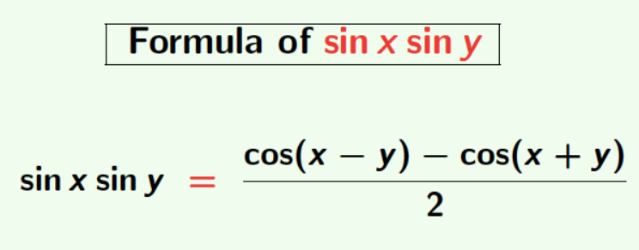
Important Notes
Lecture
05
Chapter Objectives
Lecture 6 Dr. Israa Lewaa Mathematics 3

Slide 4
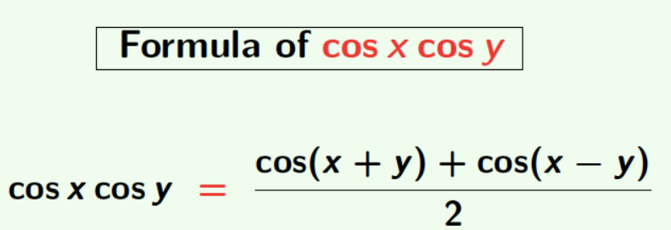
Important Notes
Lecture
05
Chapter Objectives
Lecture 6 Dr. Israa Lewaa Mathematics 3

Slide 5
Even and Odd Functions
Lecture
05
Chapter Objectives
Even and Odd functions
Lecture 6 Dr. Israa Lewaa Mathematics 3

Slide 6
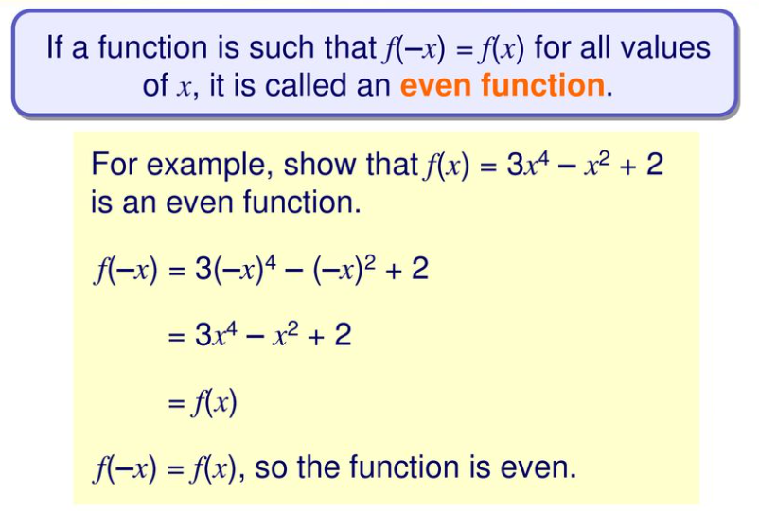
Even Functions
Lecture
05
Chapter Objectives
Lecture 6 Dr. Israa Lewaa Mathematics 3

Slide 7
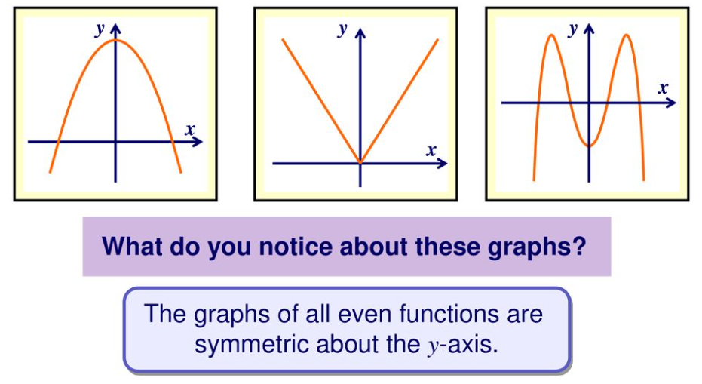
Graphs of Even Functions
Lecture
05
Chapter Objectives
Lecture 6 Dr. Israa Lewaa Mathematics 3

Slide 8
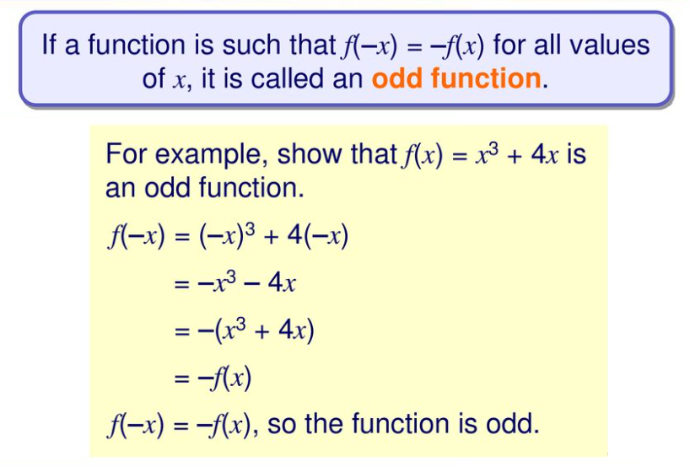
Odd Functions
Lecture
05
Chapter Objectives
Lecture 6 Dr. Israa Lewaa Mathematics 3

Slide 9
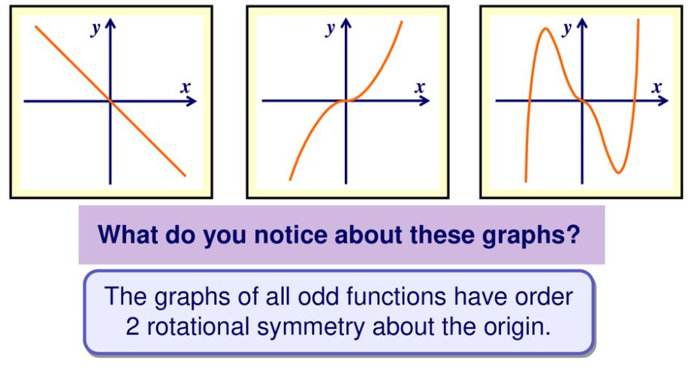
Graphs of Odd Functions
Lecture
05
Chapter Objectives
Lecture 6 Dr. Israa Lewaa Mathematics 3

Slide 10
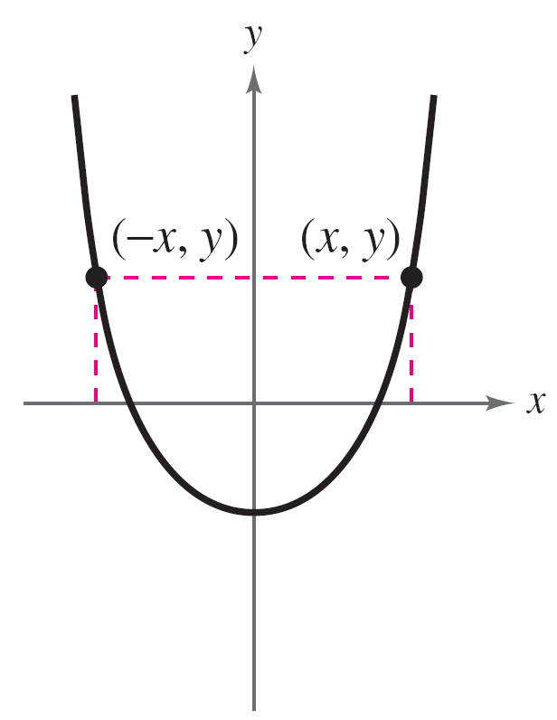
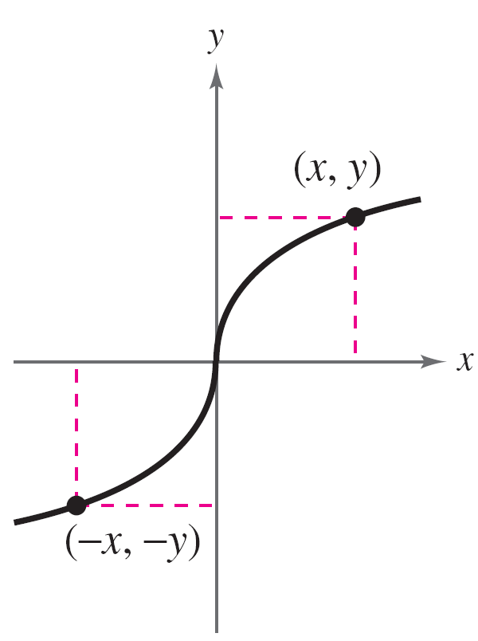
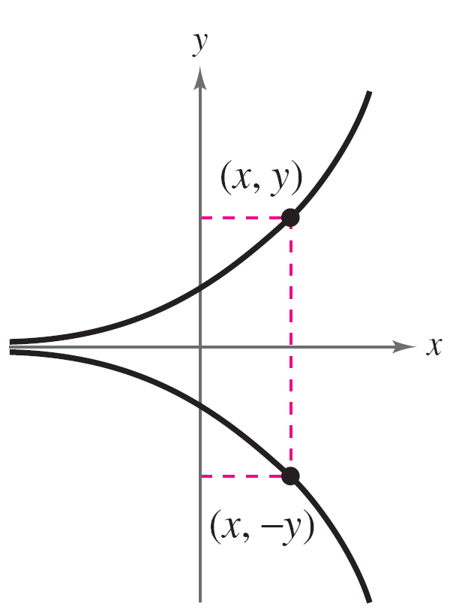
Important Notes – Even and Odd Functions
Lecture
05
Chapter Objectives
A graph that is symmetric with respect to the x-axis is not
the graph of a function (except for the graph of y = 0). These three types of symmetry
Symmetric to y-axis
Even function
Symmetric to origin
Odd function
Symmetric to x-axis
Not a function
Lecture 6 Dr. Israa Lewaa Mathematics 3

Slide 11
Properties of Even and Odd Functions
Lecture
05
Chapter Objectives
If x has an even power, this means that the function is even
If x has an odd power, this means that the function is odd
The sum of even functions gives us an even function
The sum of odd functions gives us an odd function
Lecture 6 Dr. Israa Lewaa Mathematics 3

Slide 12
Example – Even and Odd Functions
Lecture
05
Chapter Objectives
Determine whether each function is even, odd, or neither:
a. g(x) = x³ – x
b. h(x) = x² + 1
c. f (x) = x³ – 1
Lecture 6 Dr. Israa Lewaa Mathematics 3

Slide 13
Example – Even and Odd Functions
Lecture
05
Chapter Objectives
g(x) = x³ – x
x³ is an x with odd power “3”. So, it is odd function.
x is an x with odd power “1”. So, it is odd function.
So, x³ – x is odd function because The sum of odd functions gives us an odd function.
Lecture 6 Dr. Israa Lewaa Mathematics 3

Slide 14
Example – Even and Odd Functions
Lecture
05
Chapter Objectives
b. h(x) = x² + 1
x² is an x with even power “2”. So, it is even function.
1 is a constant number. So, it is even function.
So, x² + 1 is even function because The sum of even functions gives us an even function.
Lecture 6 Dr. Israa Lewaa Mathematics 3

Slide 15
Example – Even and Odd Functions
Lecture
05
Chapter Objectives
c. f (x) = x³ – 1
x³ is an x with odd power “3”. So, it is odd function.
1 is a constant number. So, it is even function.
So, x³ - 1 is NOT EVEN function OR ODD function.
Lecture 6 Dr. Israa Lewaa Mathematics 3

Slide 16
Periodic Functions
Lecture
05
Chapter Objectives
Periodic Functions
Lecture 6 Dr. Israa Lewaa Mathematics 3

Slide 17
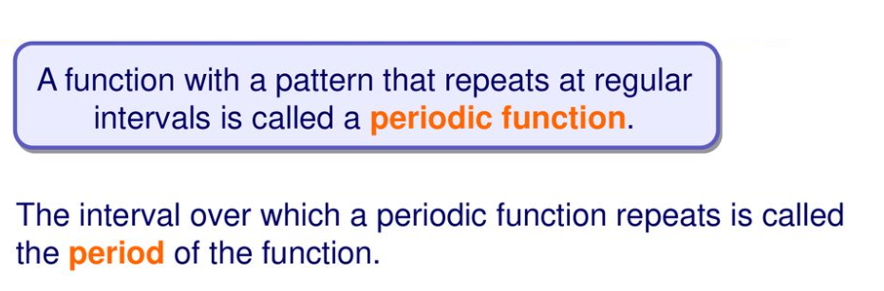
Periodic Functions
Lecture
05
Chapter Objectives
Lecture 6 Dr. Israa Lewaa Mathematics 3

Slide 18
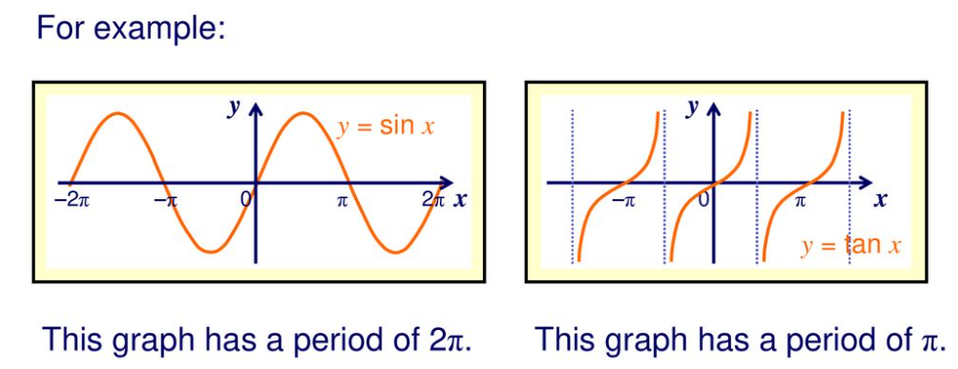
Lecture
05
Graphs for Periodic Functions
Chapter Objectives
Lecture 6 Dr. Israa Lewaa Mathematics 3

Slide 19
Fourier Series
Lecture
05
Chapter Objectives
Fourier Series
Lecture 6 Dr. Israa Lewaa Mathematics 3

Slide 20
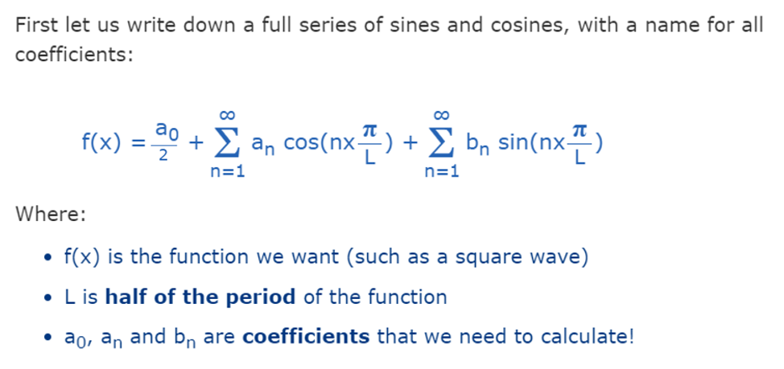
Fourier Series
Lecture
05
Chapter Objectives
Lecture 6 Dr. Israa Lewaa Mathematics 3

Slide 21
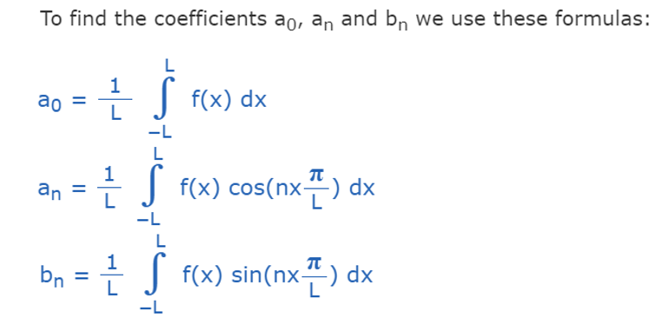
Coefficients of Fourier Series
Lecture
05
Chapter Objectives
Lecture 6 Dr. Israa Lewaa Mathematics 3

Slide 22


Note 1
Lecture
05
Chapter Objectives
If the function f(x) is even,
Lecture 6 Dr. Israa Lewaa Mathematics 3

Slide 23
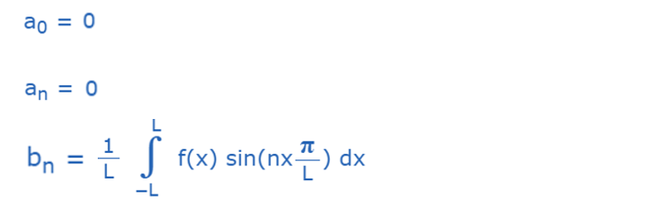
Note 2
Lecture
05
Chapter Objectives
If the function f(x) is odd,
Lecture 6 Dr. Israa Lewaa Mathematics 3

Slide 24
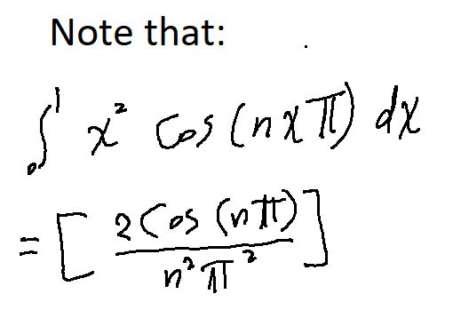
Extra Practice – Example 1
Lecture
05
Chapter Objectives
Find the Fourier series for the following function:
f(x) = x²
-1 > x> 1
Lecture 6 Dr. Israa Lewaa Mathematics 3

Slide 25
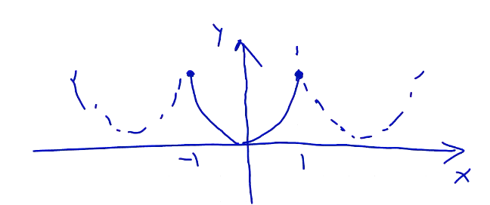
Extra Practice – Example 1 Solution
Lecture
05
Chapter Objectives
f(x) = x²
2L = 2 L = 1
Lecture 6 Dr. Israa Lewaa Mathematics 3

Slide 26
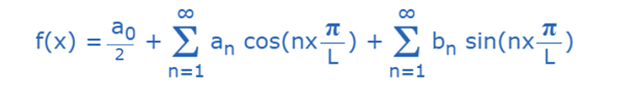
Lecture
05
Extra Practice – Example 1 Solution
Chapter Objectives
The function f(x) = x² is even
Lecture 6 Dr. Israa Lewaa Mathematics 3

Slide 27
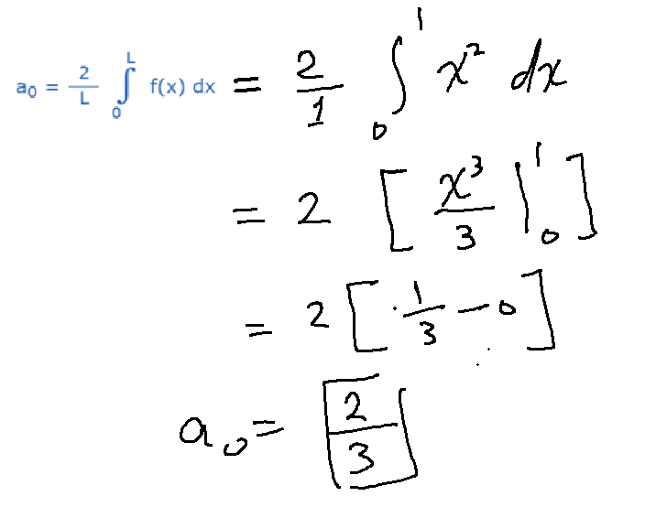
Extra Practice – Example 1 Solution
Lecture
05
Chapter Objectives
Lecture 6 Dr. Israa Lewaa Mathematics 3

Slide 28
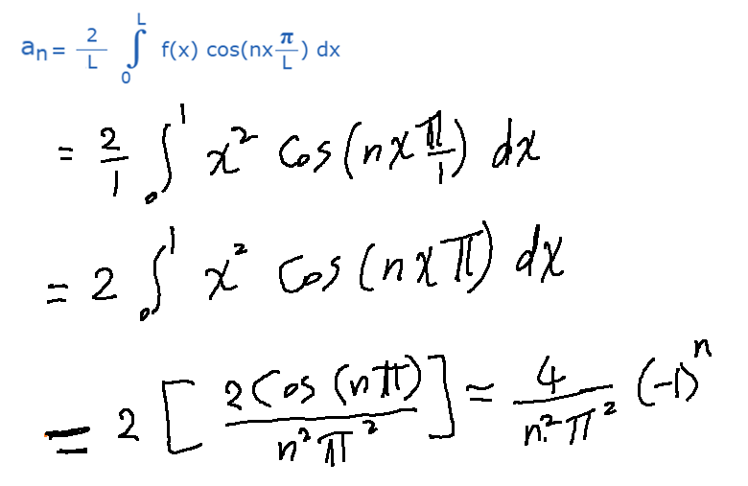
Extra Practice – Example 1 Solution
Lecture
05
Chapter Objectives
Lecture 6 Dr. Israa Lewaa Mathematics 3

Slide 29


Coefficients values
Lecture
05
Chapter Objectives
$$a_{0}=\frac{2}{3}$$
$$a_{n}=\frac{4}{n^{2}π^{2}}{(−1)}^{n}$$
Lecture 6 Dr. Israa Lewaa Mathematics 3

Slide 30
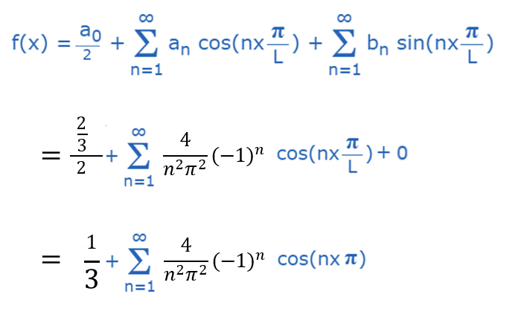
Extra Practice – Example 1 Solution
Lecture
05
Chapter Objectives
Lecture 6 Dr. Israa Lewaa Mathematics 3

Slide 31
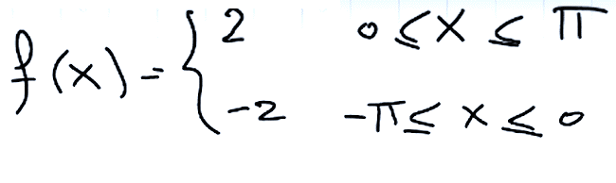
Extra Practice – Example 2
Lecture
05
Chapter Objectives
Find the Fourier series for the following function:
Lecture 6 Dr. Israa Lewaa Mathematics 3

Slide 32
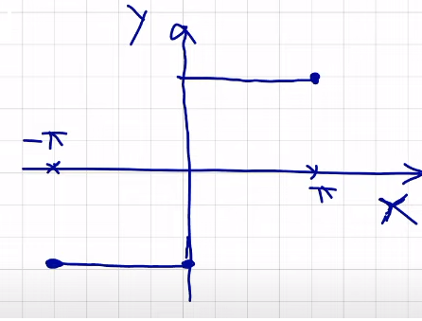
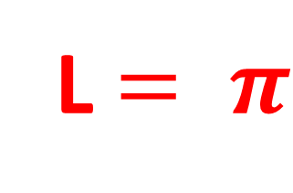
Extra Practice – Example 2 Solution
Lecture
05
Chapter Objectives
f(x) = x²
2L = 2 L = 1
L $= π$
Lecture 6 Dr. Israa Lewaa Mathematics 3

Slide 33
Lecture
05
Extra Practice – Example 2 Solution
Chapter Objectives
The function f(x) is odd
Lecture 6 Dr. Israa Lewaa Mathematics 3

Slide 34
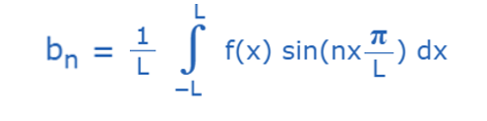
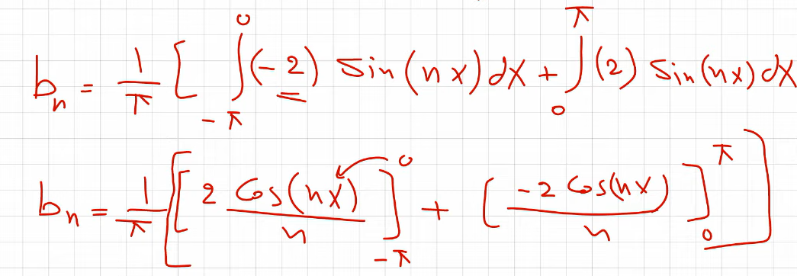
Extra Practice – Example 2 Solution
Lecture
05
Chapter Objectives
Lecture 6 Dr. Israa Lewaa Mathematics 3

Slide 35
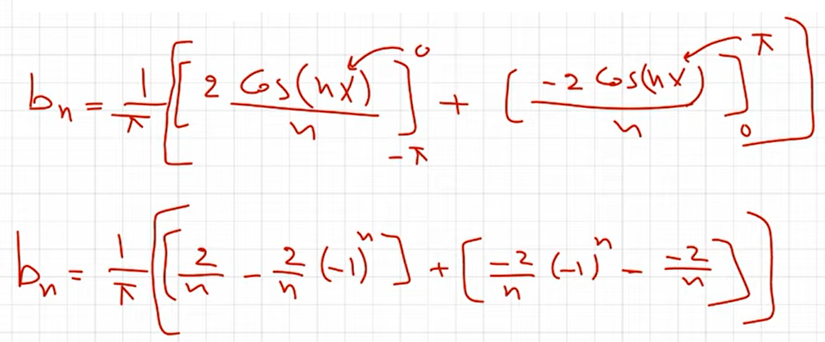
Extra Practice – Example 2 Solution
Lecture
05
Chapter Objectives
Lecture 6 Dr. Israa Lewaa Mathematics 3

Slide 36
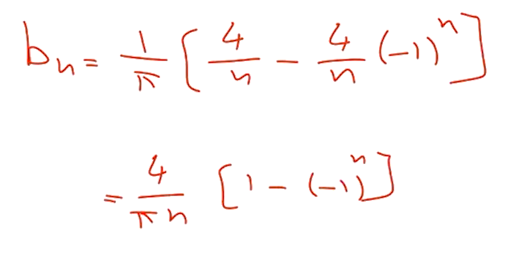
Extra Practice – Example 2 Solution
Lecture
05
Chapter Objectives
Lecture 6 Dr. Israa Lewaa Mathematics 3

Slide 37
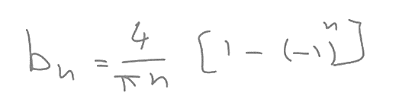


Coefficients values
Lecture
05
Chapter Objectives
$$a_{0}=0$$
$$a_{n}=0$$
Lecture 6 Dr. Israa Lewaa Mathematics 3

Slide 38
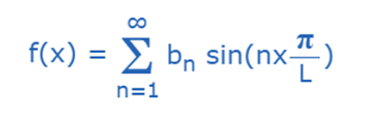
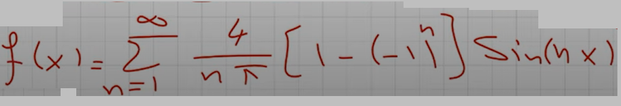
Extra Practice – Example 2 Solution
Lecture
05
Chapter Objectives
Lecture 6 Dr. Israa Lewaa Mathematics 3

Slide 39
Lecture Summary
Lecture
05
Chapter Objectives
Essential information and Important notes for the Fourier series
Even function and odd function
Periodic Function
Fourier series
Extra Practice
Lecture 6 Dr. Israa Lewaa Mathematics 3

