Slide 1


Project Cost
Management
Prepared by
Dr. Hoda Metwally
PMG 213
Lecture 3

Slide 2



Project Cost
Management
Lecture 3
PMG 213
Prepared by
Dr. Hoda Metwally
www.midocean.ae

Slide 3

Project Cost
Management
Lecture 3
Prepared by:
Dr. Hoda Metwally
www.midocean.ae

Slide 4

Construction accounting methods
As a member of the jobsite management team you are not necessarily going to be involved with the accounting processes and methods utilized by the home office accounting department and the CFO, but you should know some of the major issues. There are basically four different types of accounting processes available to construction contractors which include : cash, accrual, percentage of completion, and completed contract. They are differentiated in the processing and timing of revenue and expenditure recognition, or when they ‘account’ for money.

Slide 5
Percentage of completion
The percentage completion method is recommended for commercial contractors which have a volume greater than $10 million and/or have long-term contracts which may last longer than two years and overlap from one fiscal year into another. It is considered a more accurate and consistent indicator for recognizing income. This accounting method simply reports the percentage a construction company is complete at the end of the fiscal year with all of their construction projects.

Slide 6
This is accomplished by reporting the percent of estimated costs incurred, and the proportional share of profit earned. In the case of a construction company with more than one project this is the summary of all of its project percentages completed. In the percentage of completion accounting method, the retention is also recorded at the completion of the project, similar to accrual. Larger architects and engineers may also utilize percentage completion financial reporting.

Slide 7
Completed contract
The completed contract accounting method is even more irregular than the cash basis. In this case, contractors do not recognize any revenue or expenditures until the project has been completed and they are paid. This method may be used for small general contractors, such as those which do remodeling projects and speculative home builders, which are paid in full upon completion. Residential tract builders are contractors which build and sell homes on a speculative basis .

Slide 8
They are essentially real estate developers. In the completed contracting accounting method, jobsite administration expenses and home office overhead are proportioned to projects and expenses are reported when revenues are received, at project completion, with respect to tax implications. Because a home builder may sell ten houses in one year and only two in another, based on timing of construction starts or changes in the economy, revenues may change dramatically from one year to the next with the completed contract accounting method.

Slide 9
Internal accounting controls
There are many purposes of construction cost accounting
One major external reason of accounting for revenues and expenditures includes reporting net income and paying taxes. There are also a variety of internal reasons for accounting which assists with management of the financial affairs of the company. Those include measurement of profits and their net effect on investor’s equity; known as return on equity (ROE). As discussed, construction products are not repetitive, rather they are variable. Internal financial reports allow the contractor to perform self-diagnosis on industry specialization. Are we operating in the proper segment or focus area of the industry? Is one geographical area better for the company and our employees than another?

Slide 10
Is our focus on the proper type and size of work? Internal accounting, or audits, also allows contractors to measure the performance of their most important asset, their people. Construction is project based, and each project is staffed with a project manager and superintendent who need to return a fair profit to the company.

Slide 11
One additional reason that contractors perform internal accounting management is to ensure that jobsite and home office teams are properly managing the corporation’s money. The superintendent has several financial management responsibilities on the jobsite. Protection of construction materials from weather and external theft, and jobsite safety and security, are under the superintendent’s control. Although not always considered as financial concerns, if not addressed properly these aspects will have a negative effect on project costs. Internal financial theft is unusual, but it can happen.

Slide 12
There are several ways a contractor can ensure that there are not any internal financial thefts. Some of these include:
Separate duties assigned to separate individuals such that no one person has complete financial control.
Keep a good paper trail, even though most of the paper trail today is produced on the computer. Only appropriate persons should be issuing subcontracts and purchase orders and signing approval on invoices.
Although contractors typically do not have significant inventory or assets, what assets they have, such as construction equipment, must be tracked and accounted for.

Slide 13
Routine accounting operations include an internal financial system of checks and balances. The contractor should limit access to its financial reports to upper-management personnel only. Multiple approval signatures shall be required on as many documents as possible, especially material and subcontractor invoices. Even large contractors with substantial accounting departments will employ outside accounting assistance from CPAs to audit their own books for internal reporting as well as prepare tax reports.

Slide 14
Summary
Construction is the foundation of the built environment industry and contributes significantly to the GDP. Construction is unique from all other industries and therefore warrants a unique approach to cost accounting. Smaller contractors may employ outside accounting services which include certified public accountants. Most contractors employ a combination of internal accounting personnel but still retain the services of a certified public accountant for audits and taxes.

Slide 15
Depending upon the job size and location and contract terms, cost accounting and cost engineering may be performed either at the jobsite or in the home office. Contractors can be organized in a variety of different business formats including proprietorship, partnerships which may include general and limited partners, C and S type corporations, limited liability companies, and joint ventures. Most of the larger commercial general contractors are organized or incorporated as type C corporations. There are four different methods utilized for construction cost accounting including cash, accrual, percentage of completion, and completed contract.

Slide 16
The choice of which one to use depends upon a contractor’s size, organizational structure, and area of specialty. There is not one best legal structure or accounting system for all contractors; they all have their advantages and disadvantages under different circumstances. There are many reasons to perform cost accounting including measuring and monitoring internal financial success.

Slide 17
Chapter 3
“Introduction to construction management”

Slide 18
It is important to introduce a few additional CM terms and processes before diving deeper into the accounting of construction. Our focus here is on the relationship between project management and estimating, and other CM topics, as it relates to jobsite cost accounting and financial management. The focus of construction management here is on the role of the project manager (PM) as an individual. Many concepts and terms from one (CM or PM) apply to the other. The CM and the PM are both builders, but so are many other members of the built environment (BE) team.

Slide 19
The term ‘builder’ is too generic; everyone on the project, including the owner, architect, general contractor (GC), and the craftsmen contribute to the building process and each is a ‘builder’ . The owner-architect-GC-craftsmen were in the beginning all one and the same; they were the builder. The qualities of the ancient builders included creativity, resourcefulness, intuition, problem solving, among others. They just ‘knew’ what it took to get the job done. Later the owner and the builder, or master-builder, split into two separate functions. It was the owner who provided the need and the builder who satisfied those needs, in this case, with a building or a home. At that time the master-builder was both the designer and the builder, similar to the current design-build (DB) delivery method

Slide 20
The next split was between the builder and the designer. The builder would evolve into today’s construction management or general contractor companies. The design element would also later be split into architecture and engineering. Each of those also has many sub-divisions today and has been listed later. There are also many additional levels of specializations within the GC’s organization as discussed later. The project owner, sometimes also referred to as the client, and the lead designer or architect, and the general contractor or construction manager are the three major participants in any organization or delivery method utilized in the BE.

Slide 21
There are many other BE participants including specialty engineers and consultants such as waterproofing or elevator consultants; the list is quite extensive. Many of these are listed here:
* Structural engineer
* Civil engineer
* Mechanical engineer
Electrical engineer
* Kitchen consultant
Landscape architect
Interior designer
Elevator consultant
Accountant

Slide 22
Bank
City inspectors
Third-party inspectors
Commissioning agent
This chapter will describe the delivery and procurement methods the client chooses to use as well as pricing and contracting options which the contractor must incorporate. Different types of general construction organizations are also introduced as well as the role of project management and project managers and the risks they must evaluate when considering a potential construction project.

Slide 23

Delivery and procurement methods
The three major companies and/or individuals which are the primary responsible parties in any construction project include the project owner or client, the designer (architect or engineer), and the general contractor. The relationships among these participants are defined by the delivery method used for the project. The choice of delivery method is the owner’s, but it has an impact on the responsibilities of the contractor’s jobsite team, especially their financial responsibilities. The project owner selects a delivery method based on their experience and the risk they are willing to absorb or pass to either the GC or the design team.

Slide 24
This section examines the four most common delivery methods. Each of these different arrangements has an effect on how the GC will conduct its jobsite project management operations, including cost accounting. Basic differences in bid and negotiation procurement processes are also introduced along with the four major design phases which coincide with various delivery and procurement options.

Slide 25
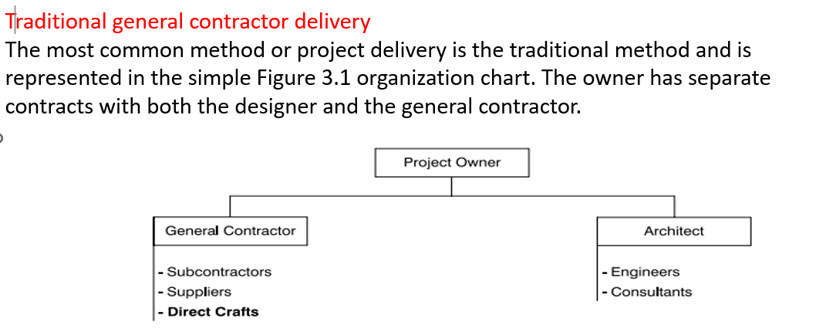

Slide 26
There is no contractual relationship between the designer and the GC. Typically, the design is completed before the contractor is hired in this delivery method. The GC’s project manager takes the point to obtain the project drawings and specifications, develop a cost estimate and construction schedule, establish a cost control system to manage construction financial activities, and manage the construction site office. A traditional GC employs a mix of subcontractors and direct craftsmen.

Slide 27
Construction management delivery
There are two basic construction management delivery methods. One is the agency CM and the other is the at-risk CM.
The agency CM does not employ any subcontractors or direct craftsmen and the pure at-risk CM employs all subcontractors and no direct craftsmen; different than the mix employed by the traditional GC as described earlier. The project owner has three separate contracts (one with the designer, one with the general contractor, and one with the construction manager) in the agency construction management delivery method as shown in Figure 3.2. The CM acts as the owner’s agent and coordinates design and construction issues with the designer and the GC. The CM usually is the first contract awarded,

Slide 28
and he or she is involved in hiring both the designer and the GC. In this delivery method the GC usually is not hired until the design is completed. The GC’s project manager has similar responsibilities to those listed for the traditional delivery method. The primary difference is that the GC’s PM interfaces with the agency CM instead of the owner, as is the case in the traditional method. The agency CM is sometimes referred to as the owner’s representative. Since the construction costs do not run through the agency CM’s accounting books, this version of the CM does not have any financial risk. In the construction manager-at-risk delivery method, the owner has two contracts (one with the designer and one with the construction manager) as illustrated in Figure 3.3. This delivery method is also known as the construction manager/general contractor (CM/GC) delivery method.

Slide 29
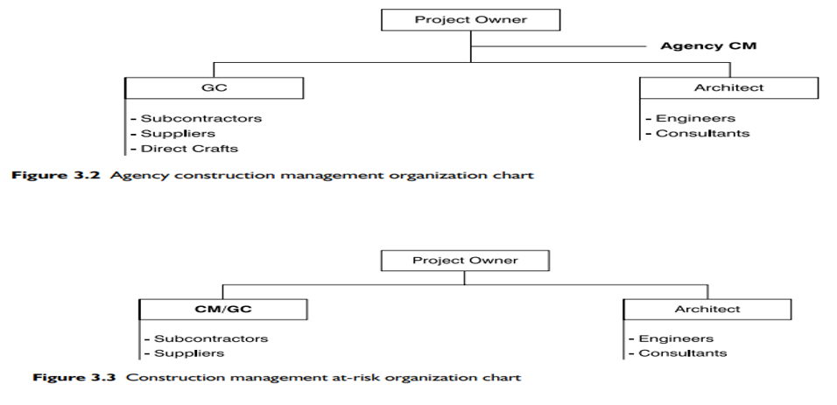

Slide 30
In this case, the designer usually is hired first, but the CM/GC is also contracted early in the design development to perform a variety of preconstruction services, such as cost estimating, constructability analysis, and value engineering studies. Once the design is completed, the CM/GC constructs the project. In some cases, construction may be initiated before the entire design is completed. This is known as fast-track or phased construction. The CM/GC’s project manager interfaces with the designer and manages the execution of preconstruction tasks and assumes similar responsibilities to those in the traditional method once construction starts.

Slide 31
Design-build delivery
The project owner has a single contract with a design-build (DB) contractor for both the design and construction of the project in the DB delivery method, as diagramed in Figure 3.4. The DB contractor may have a design capability within its own organization, may choose to enter into a joint venture with a design firm, or may hire a design firm to develop the design. Construction may be initiated early in the design process using fast-track procedures or may wait until the design is completed. In this delivery method, the GC’s project manager interfaces with the owner and manages both the design and construction. This method is very similar to the ancient master builder concept discussed earlier in this chapter. There are other versions of DB which extends the contractor’s involvement further into the life-cycle of the building, including: DBO – Design, build, and operate, DBOM – Design, build, operate, and maintain, and UÊ DBOMT – Design, build, operate, maintain, and transfer.

Slide 32
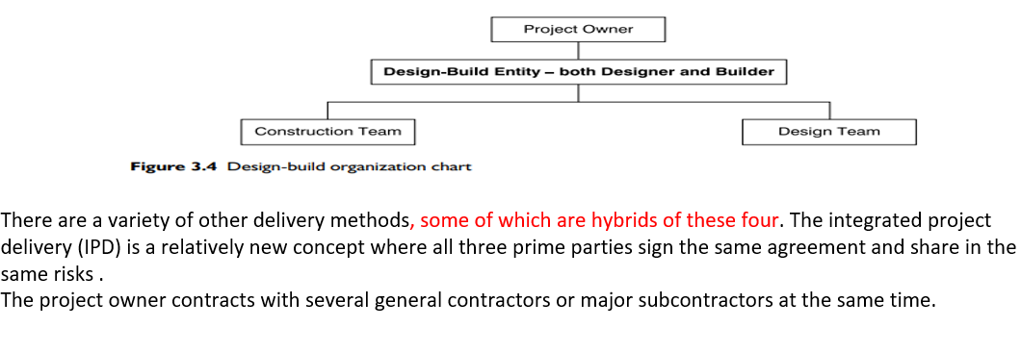

Slide 33
This often includes a site work contractor, building shell and core contractor, tenant-improvement contractor, mechanical contractor, electrical contractor, and/or others. The multiple-prime delivery method usually requires a construction-experienced project owner to act as their own construction manager.
Another alternate delivery process is known as public-private partnership (PPP or P3). This process combines the resources of a private entity, such as a real estate developer which may own a piece of property, with the needs of a public client, such as a university looking to build a research laboratory. The private developer will build and operate the facility for benefit of the university which will sign a long-term lease guaranteeing the developer’s pro forma will work out. The public client does not need to go through the sometimes complicated and often litigious lump sum bid process with the P3 delivery method.

Slide 34
Procurement
Project owners solicit or procure both construction and design team members utilizing either bid or negotiated procedures. Public project owners are often required by law to use an open bidding process to allow all contractors an even chance of successfully landing new work. Private owners can use whatever procurement method they choose, bid or negotiate, but often solicit contractors they have had good experience with in the past, and may ask a select few or even only one contractor to submit a bid or negotiated proposal. Both private and public owners may use a prequalification process to develop a short list of contractors to either bid or negotiate after they have submitted a list of qualifications which suit that specific project.

Slide 35
Prequalification helps reduce the client’s risk of an unqualified contractor submitting a bid which is too low for them to successfully complete the project.
There are risks and advantages associated with either bidding or negotiating for the owner, architect, and contractor.

Slide 36



Thank You

