Slide 1


Human Resources Management
Robert L. Mathis ⏐ John H. Jackson
Prepared by Dr. Samah Abdelfatah
MGM 243
Lecture 05

Slide 2



Part (2):Staffing the Organization
Recruiting in Labor Markets
Chapter
7
Lecture 05
MGM 243
Prepared by
Dr. Samah Abdelfatah
www.midocean.ae

Slide 3

Chapter
Learning Outcomes
07
After you have read this chapter, you should be able to:
Identify different ways that labor markets can be identified and approached.
Discuss advantages and disadvantages of internal and external recruiting.
Specify three internal sources for recruiting and issues associated with their use.
List and briefly discuss five external recruiting sources.
Explain why Internet recruiting has grown and how employers are conducting it.
Discuss three factors to consider when evaluating recruiting efforts

Slide 4
Chapter
RECRUITING
07
Recruiting: Process of generating a pool of qualified applicants for organizational jobs.
Employer should:
  Know the industry to successfully recruit qualified employees
  Identify keys to success in the labor market, including competitors’ recruiting efforts
  Cultivate networks and relationships with sources of prospective employees
  Promote the company brand so that the organization is known as a good place to work
  Create recruiting metrics in order to measure the effectiveness of recruiting efforts

Slide 5
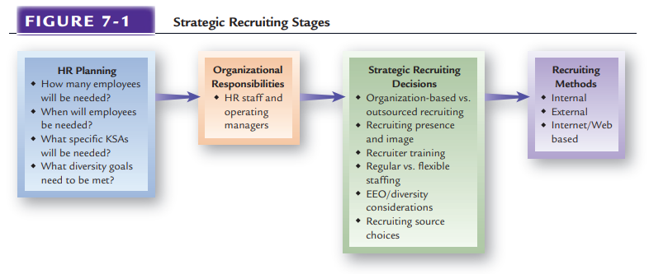
STRATEGIC RECRUITING

Slide 6
Chapter
LABOR MARKET COMPONENTS: KEY TERMS
07
Labor Markets
  The external supply pool from which organizations attract their employees
Labor Force Population
  All individuals who are available for selection if all possible recruitment strategies are used.
Applicant Population
  A subset of the labor force that is available for selection using a particular recruiting approach.
Applicant Pool
  All persons who are actually evaluated for selection

Slide 7
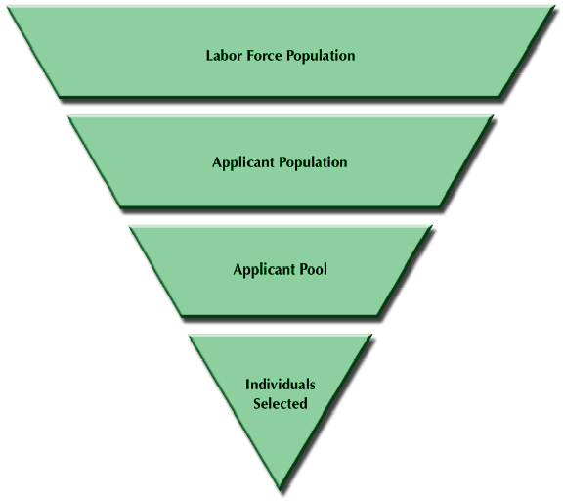

Slide 8
DIFFERENT LABOR MARKETS AND RECRUITING
Labor Markets
Geographic
Local
Regional
National
International
Industry
and
Occupational
KSAs
Educational and
Technical Qualifications

Slide 9
STRATEGIC RECRUITING DECISIONS
Organizational-Based vs. Outsourcing
Recruiting Presence and Image
Regular vs. Flexible Staffing
Strategic
Recruiting
Recruiting
Source Choices:
Internal vs. External
Training of Recruiters
Recruiting and Diversity Considerations

Slide 10
Chapter
Organizational-Based VS. Outsourcing
07
Recruiting can be outsourced in a number of ways. For example, some large employers outsource such functions as placement of advertisements, initial screening of résumés, and initial phone contacts with potential applicants. Once those activities are done, then the employer’s HR staff members take over the rest of the recruiting activities.
Outsourcing gives a firm more flexibility because a vendor may be able to fill those positions faster and cheaper than in-house recruiters can.
Professional Employer Organizations and Employee Leasing: A specific type of outsourcing uses professional employer organizations (PEOs) and employee leasing. This approach has grown rapidly in recent years.

Slide 11
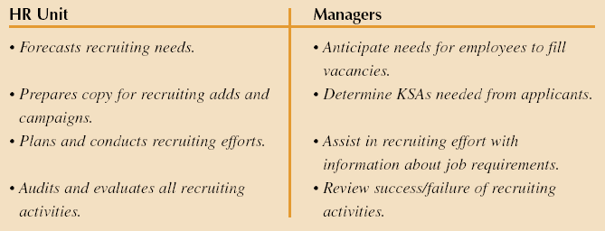
Typical Division of HR Responsibilities
Figure 7–3

Slide 12
Recruiting Presence and Image
Continuous efforts to recruit offer the advantage of keeping the employer in the recruiting market.
Intensive recruiting may take the form of a vigorous recruiting campaign aimed at hiring a given number of employees, usually within a short period of time.
Recruiting
Presence
Effective
Recruiting
The way the “employment brand” of the organization is viewed by both employees and outsiders is crucial to attracting applicants and retaining employees, who also may describe the organization in positive or negative terms to others.
Recruiting
Image

Slide 13
Training of recruiters
Training of Recruiters
They should be trained on interviewing techniques, communications skills, and knowledge of the jobs being filled, learn the types of actions that violate EEO regulations and how to be sensitive to diversity issues with applicants.

Slide 14
Chapter
Regular VS. Flexible Staffing
07
Flexible staffing Use of workers who are not traditional employees. These arrangements can use temporary workers or independent contractors.
    Temporary Workers Employers who use temporary employees can hire their own temporary staff members or contract with agencies supplying temporary workers on a rate-per-day or rate-per-week basis.
    Independent contractors Workers who perform specific services on a contract basis.

Slide 15
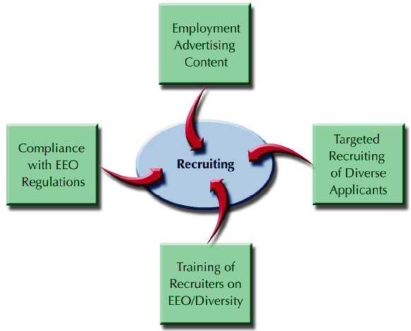
Recruiting and Diversity Considerations
Figure 7–4

Slide 16

Chapter
Recruiting Nontraditional Workers
07
Nontraditional sources may include:

Slide 17
INTERNAL RECRUITING METHODS
The increased use of HR management systems allows HR staff members to maintain background and KSA information on existing employees.
Employee Databases
System in which the employer provides notices of job openings and employees respond by applying.
Internal Recruiting
Process
Job Posting
Promotions and Transfers
Many organizations choose to fill vacancies through promotions or transfers from within whenever possible.

Slide 18
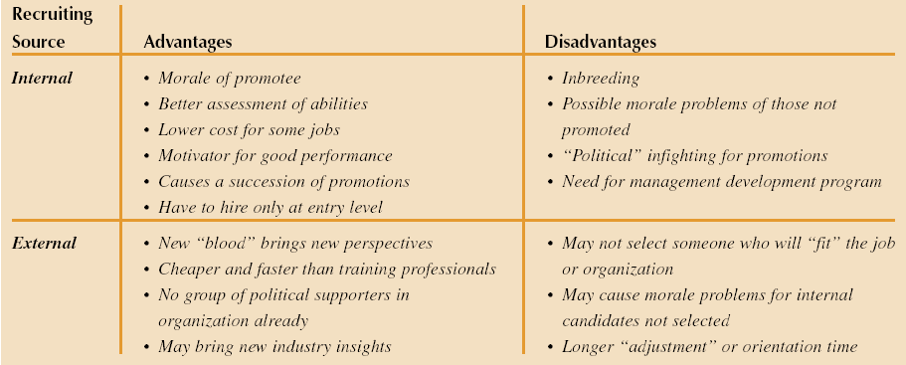
Advantages and Disadvantages of
Internal and External Recruiting Sources
Figure 7–5

Slide 19
Employee-Focused Recruiting
Current-Employee Referrals
Employee-Focused Recruiting
Re-Recruiting of Former Employees and Applicants

Slide 20
EXTERNAL RECRUITING
College and
University
Recruiting
High Schools and
Technical Schools
Media Sources
and Job Fairs
External Recruiting Sources
Labor
Unions
Competitive
Sources
Employment Agencies
and Search Firms

Slide 21
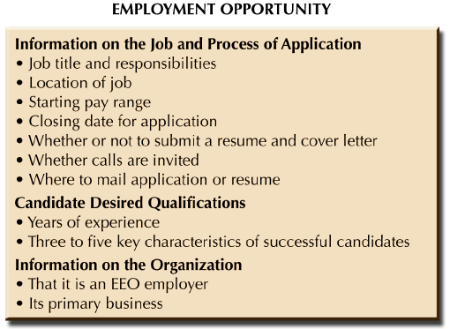
WHAT TO INCLUDE IN AN EFFECTIVE RECRUITING AD
Figure 7–6

Slide 22





INTERNET RECRUITING METHODS
Job Boards
E-Recruiting Places
Professional/
Career Web Sites
Employer Web Sites

Slide 23
INTERNET RECRUITING
Advantages
  Recruiting cost savings
  Recruiting time savings
  Expanded pool of applicants
  Morale building for current employees
Disadvantages
  More unqualified applicants
  Additional work for HR staff members
  Many applicants are not seriously seeking employment
  Access limited or unavailable to some applicants

Slide 24
EVALUATING RECRUITING
Evaluating Recruiting Efforts
Evaluating Recruiting Costs and Benefits
Evaluating Time Required to Fill Openings
Evaluating Recruiting Quality and Quantity

Slide 25
Chapter
RECRUITING EVALUATION
07
Acceptance Rate
  Percentage of rejected job offers
Success Base Rate
  Comparing percentage rate of past applicants who were good employees to that of current employees.
General Areas for Evaluating Recruiting
  Quantity of applicants
  EEO goals met
  Quality of applicants
Yield ratios
  A comparison of the number of applicants at one stage of the recruiting process to the number at the next stage.
Selection rate
  The percentage hired from a given group of candidates

Slide 26
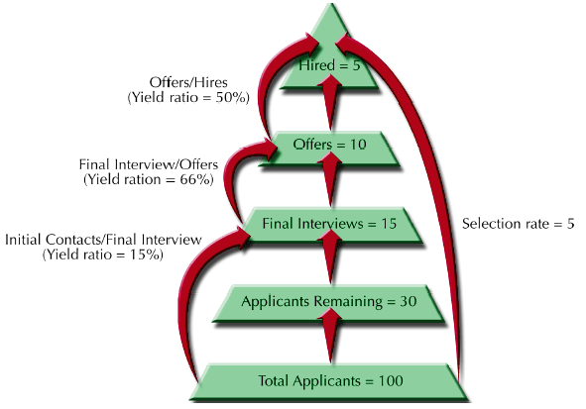
RECRUITING EVALUATION PYRAMID
Figure 7–7

Slide 27
Part (2):Staffing the Organization
Selecting and Placing
Human Resources
Chapter
8
Lecture 05
MGM 243
Prepared by
Dr. Samah Abdelfatah
www.midocean.ae

Slide 28
Chapter
LEARNING OBJECTIVES
8
After you read this chapter, you should be able to:
  After you have read this chapter, you should be able to:
  Describe why selection and placement must consider both person-job and person-organization fit.
  Diagram the sequence of a typical selection process.
  Identify three types of selection tests.
  Discuss several types of selection interviews and some key considerations when conducting these interviews.

Slide 29
SELECTION AND PLACEMENT
Selection
  The process of choosing individuals who have needed qualities to fill jobs in an organization.
  Organizations need qualified employees to succeed
    “Good training will not make up for bad selection.”
    “Hire hard, manage easy.”
Reasons for centralizing selection
  Easier to have applicants in one place.
  Contact with outside applicants is easier.
  Managers can concentrate on operating responsibilities rather than the selection process.
  Selection costs are lower with no duplicated efforts.

Slide 30
HR EMPLOYMENT FUNCTIONS
Receiving applications
Interviewing applicants
Administering tests to applicants
Conducting background investigations
Arranging physical examinations
Placing and assigning new employees
Coordinating follow-up of new employees
Exit interviewing departing employees
Maintaining employee records and reports.

Slide 31
PLACEMENT
Placement
  Fitting a person to the right job.
Person-job fit
  Matching the knowledge, skills and abilities (KSAs) of people to the characteristics of jobs (tasks, duties and responsibilities).
  Benefits of person-job fit
    Higher employee performance
    Lower turnover and absenteeism

Slide 32
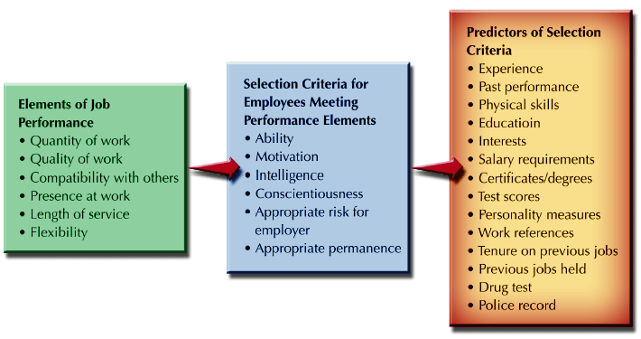
JOB PERFORMANCE, SELECTION CRITERIA, AND PREDICTORS
Selection Criterion: A characteristic that a person must have to do a job successfully
Validity: The correlation between a predictor and job performance
Reliability: The extent to which a predictor repeatedly produces the same results, over time.
Figure 8–3

Slide 33
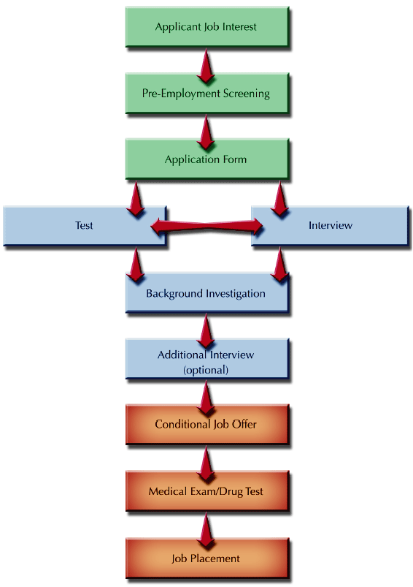
SELECTION PROCESS FLOW CHART
Figure 8–4

Slide 34
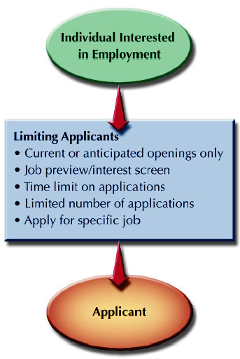
PRE-EMPLOYMENT SCREENING
LIMITING WHO BECOMES AN APPLICANT
Pre-screening interview
  Verify minimum qualifications
Electronic pre-screening
  Scanning resumes and applications
Electronic submission of applications
Figure 8–5

Slide 35
APPLICATIONS
Purposes of Applications
  Record of applicant’s interest in the job
  Provides a profile of the applicant
  Basic record for applicants who are hired
  Research effectiveness of the selection process
Application Disclaimers and Notices
  Employment-at-will
    Indicates the right of the employer or employee to terminate the employment relationship without cause or notice
References contacts
  Obtains applicant’s permission of contact references
Employment testing
  Notifies applicants of required drug tests, physical exams, or other tests.
Application time limits
  Indicates how long the application will remain active.
Information Falsification
  Indicates that false information is grounds for termination.

Slide 36
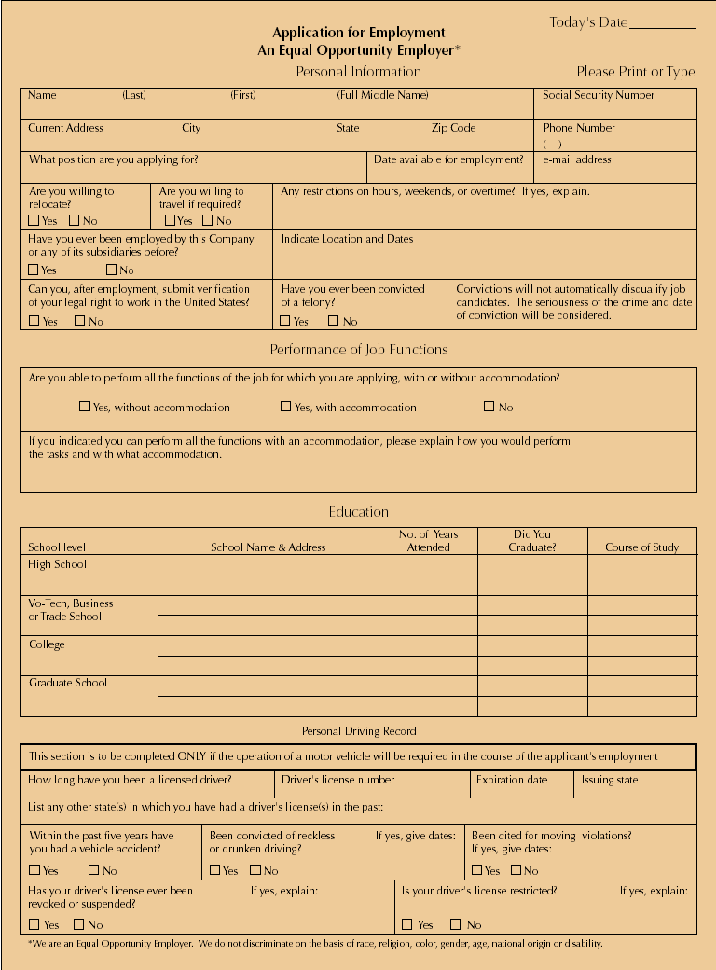
SAMPLE APPLICATION FORM
Figure 8–6

Slide 37
SELECTION AND TESTING: ABILITY TESTS
Cognitive Ability Tests
  Measure an individual’s thinking, memory, reasoning, and verbal and mathematical abilities.
Physical Ability Tests
  Measure strength, endurance, and muscular movement
Psychomotor Tests
  Measure dexterity, hand-eye coordination, arm-hand steadiness, and other factors.
Work Sample Tests
  Require an applicant to perform a simulated task.
Assessment Centers
  A series of evaluation exercises and tests used for the selection and development of managerial personnel.
  Multiple raters assess participants in multiple exercises and problems that are job content-related to the jobs for which the individuals are being screened.

Slide 38
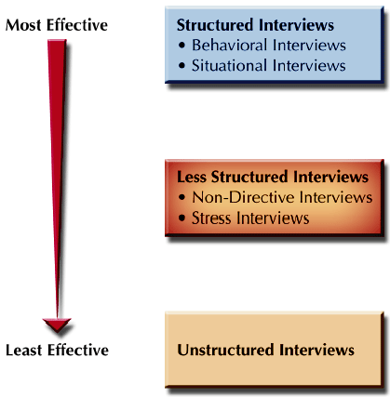
SELECTION INTERVIEWING
TYPES OF SELECTION INTERVIEWS
Concerns with Interviewing
  Identify objective job-related criteria to be sought in the interview
  Specify the decision-making criteria used
  Provide multiple levels of review for decisions
  Use structured interviews, asking the same questions of all those interviewed
Figure 8–9

Slide 39
STRUCTURED INTERVIEWS
Behavioral interview
  Applicants are asked to give specific examples of how they have performed a certain task or handled a problem in the past.
  Helps discover applicant’s suitability for current jobs based on past behaviors.
  Assumes that applicants have had experience related to the problem.
Situational interview
  Applicants are asked how they would respond to a specific job situation related to the content of the job they are seeking.
Structured Interview
  Uses a set of standardized questions asked of all job applicants.
  Useful for initial screening and comparisons
  Benefits
  Obtains consistent information needed for selection decision
  Is more reliable and valid than other interview formats
  Meets EEO guidelines for the selection process

Slide 40
LESS STRUCTURED INTERVIEWS
Nondirective Interview
  Applicants are queried using questions that are developed from the answers to previous questions.
  Possibility of not obtaining needed information.
  Information obtained may not be not job-related or comparable to that obtained from other applicants.
Stress Interviews
  An interview designed to create anxiety and put pressure on an applicant to see how the person responds.

Slide 41
WHO DOES INTERVIEWS
Individuals
Panel
Interviews
Interviews
Video
Interviewing
Team
Interviews

Slide 42
EFFECTIVE INTERVIEWING
Question types to avoid in interviews
  Yes/No questions
  Obvious questions
  Questions that rarely produce a true answer
  Leading questions
  Illegal questions
  Questions that are not job related
Conducting an Effective Interview
  Planning the interview
  Controlling the interview
  Using proper questioning techniques

Slide 43
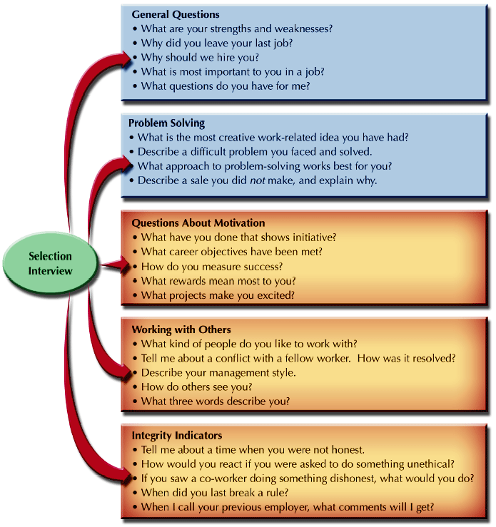
COMMON SELECTION INTERVIEW QUESTIONS
Figure 8–10

Slide 44
PROBLEMS IN THE INTERVIEW
Problems in
the Interview
Snap
Judgments
Negative
Emphasis
Halo
Effect
Biases and
Stereotyping
Cultural
Noise

Slide 45
BACKGROUND INVESTIGATION
Fair Credit Reporting Act
  Requires disclosure of a credit check
  Requires written consent of applicant
  Requires a copy of credit report be given to the applicant
Giving References on Former Employees
  Employers can incur a civil liability for statements made about former employees.
  Employers have adopted policies restricting the release of reference information to name, employment dates, and job title.
Risks of Negligent Hiring
  Employers must exercise “due diligence” in investigating an applicant’s background to avoid suits for the actions of their employees.
Falsification of Background Information
  One-third of applications and resumes contain factual misstatements or significant omissions.
Reference Checking Methods
  Telephoning the reference
  Preprinted reference forms
  Outsourcing reference checking
Legal Constraints
  Obtaining signed releases from applicants avoids problems with privacy issues

Slide 46
MAKING THE JOB OFFER
Offer Guidelines
  Formalize the offer with a letter to the applicant clearly stating the terms and conditions of employment.
  Avoid vague, general statements and promises.
  Require return of a signed acceptance of the offer.

Slide 47
Chapter
SUMMARY
7&8
Recruiting in Labor Markets
Recruiting
Labor Markets
Strategic Recruiting Decisions
Internal & External Recruiting Methods
Internet Recruiting Methods
Evaluating Recruitment
Selecting and Placing Human Resources
Selection And Placement
Job Performance, Selection Criteria, And Predictors
Selection Process Flow Chart
Applications
Selection And Testing: Ability Tests
Selection Interviewing
Effective Interviewing
Problems In The Interview
Background Investigation

Slide 48



Thank You

