Slide 1


Human Resources Management
Prepared by Dr. Samah Abdelfatah
MGM 243
Lecture 10

Slide 2



Internal Branding
Chapter
14
Lecture 10
MGM 243
Prepared by
Dr. Samah Abdelfatah

Slide 3

Chapter
Learning Outcomes
14
After you have read this chapter, you should be able to:
Provide a clear scientific definition of the concept of internal branding
Clarify the mechanisms of internal marketing and how to integrate it with HR and corporate marketing strategies.
Highlight the relationship between Internal marketing and attracting and retention of new talent within the organization.
Presenting practical case studies from global organizations to illustrate how to apply internal branding.
Derive practical and actionable recommendations to leadership, HR, and brand officials.

Slide 4

Chapter
14
Definition Of Internal Branding
01

Slide 5

A brand is the identity of a company or product as it is perceived in the minds of the public, and includes the name, logo, design, values, experience, and reputation that distinguishes it from its competitors.
It's not just a logo or a brand name, it's a promise that an organization makes to its customers about what they can expect from its products or services, and how it will make them feel when doing business with it.
BRANDING
Chapter
14

Slide 6
Chapter
The Concept of Internal Branding
14
Internal Branding is a strategic process that aims to convey the values, identity, and expected behaviors of the brand within the organization, so that each employee is able to represent the brand credibly in their interactions with customers, colleagues, and stakeholders.
In other words, it is the systematic effort to create a consensus between what the organization is telling the outside world about its brand and what employees are experiencing internally. This alignment ensures that the customer experience is identical to the branding promise that the organization proclaims.

Slide 7
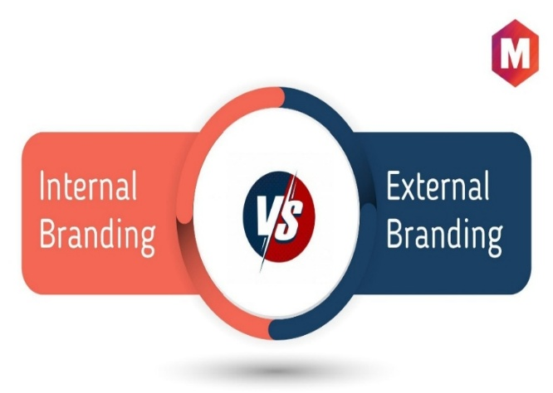
Chapter
Difference Between Internal and External Branding
14
The internal branding is targeted at employees while the external brand focuses on customers to enhance the company's image.
True success is achieved when these two images are interconnected and identical: what the organization promises externally must be reflected in its internal policies and practices.
If there is a gap between them, credibility declines and customer and employee trust is weakened.

Slide 8

The Importance of Internal Marketing and its Impact on the Employee Experience
Chapter
14
Internal marketing promotes employee satisfaction, which raises productivity and creates a positive work environment that supports the achievement of the company's goals.
Employee as Ambassador
Improve customer experience
Reduce employee turnover
Supporting the recruitment strategy

Slide 9
Chapter
Internal Marketing Deepens Employee Experience
14
Clarify expected values and behaviors.
Building innovative onboarding programs that define the employee with the organizational identity.
Create development paths and rewards consistent with the brand message.
Practical Result: More engaged, productive, and loyal employees

Slide 10

Chapter
14
The Working Mechanisms Of Internal Marketing And How To Integrate It With HR And Corporate Marketing Strategies
02

Slide 11
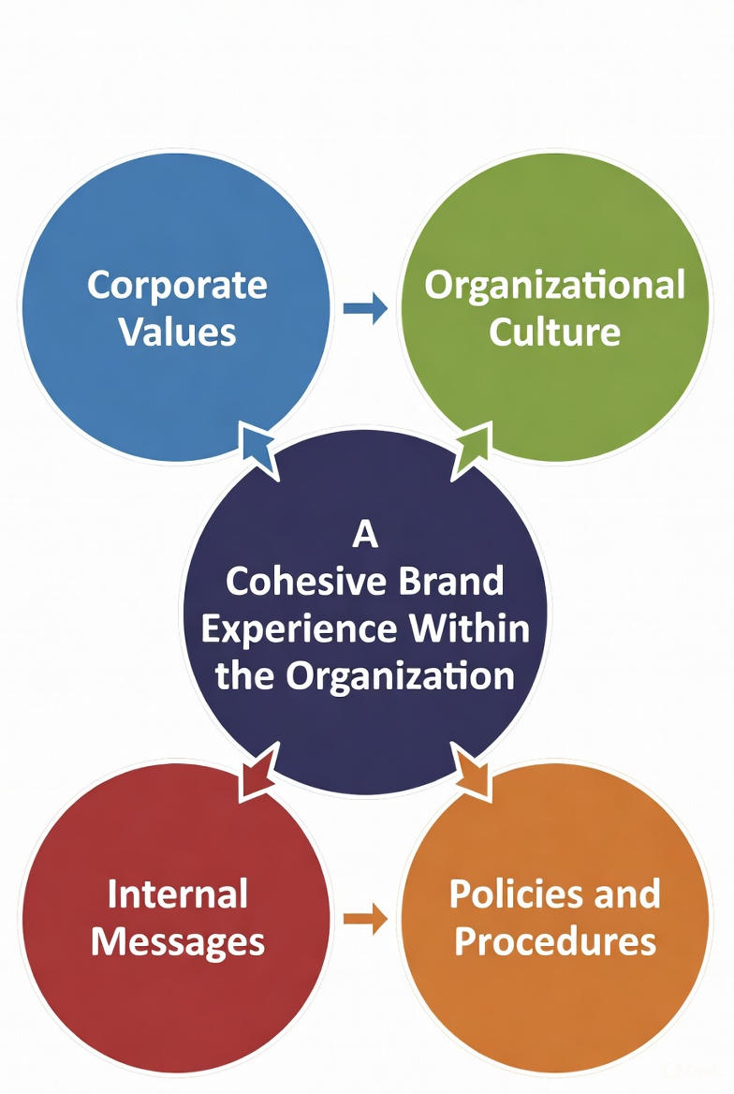
Internal marketing elements
Chapter
14
The basic elements of Internal marketing can be summarized as follows:
Corporate Values: The set of values that define an employee's behavior and attitudes.
Organizational culture: The customs, rituals, and internal language that determine how we operate.
Internal messaging: Formal and informal communications that convey the brand's insights.
Policies and procedures: Anything that supports or hinders the implementation of identity such as recruitment systems, rewards, and evaluation practices.

Slide 12

The Role of Leadership in Internal Marketing
Chapter
14
Leadership is pivotal to the success of internal marketing efforts, as leaders serve not only as communicators of the message but also as behavioral role models from whom employees learn.
Leaders' commitment to professed values strengthens the following:
Credibility of the messages.
The speed with which desirable behaviors spread.
Employee receptivity to change and new initiatives.
Without tangible support from leaders — whether through behavior or resource allocation — most Internal marketing programs fail

Slide 13
The Role of Human Resources in Internal Marketing
Building training programs focused on behaviors linked to the brand
Collaboration with Marketing Departments
Collaborating with marketing departments to ensure message consistency
Onboarding Programs
Designing onboarding programs that instill the brand identity
Reward and Recognition Systems
Developing employee skills in line with the brand identity
Enhancing organizational culture through development programs
Aligning internal communications with the external brand identity
Ensuring a harmonious experience between customers and employees
Reinforcing brand affiliation from day one
Linking recruitment procedures with corporate brand values
Redesigning reward systems to align with corporate values
Developing recognition systems that reinforce brand behaviors
Linking incentives to performance that aligns with the brand identity
Training and Development Programs
Human resources are not only implementers, but also a strategic partner in building the internal brand and designing internal marketing programs that enhance the brand's identity and corporate values.

Slide 14

Chapter
14
EMPLOYEE BENEFITS Are indirect rewards given to an employee or a group of employees for organizational membership.

Slide 15
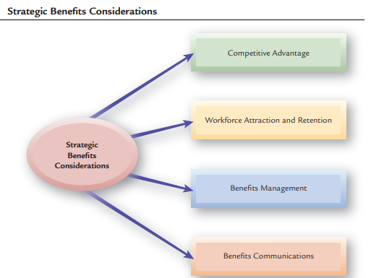
BENEFITS AND HR STRATEGY

Slide 16


Slide 17
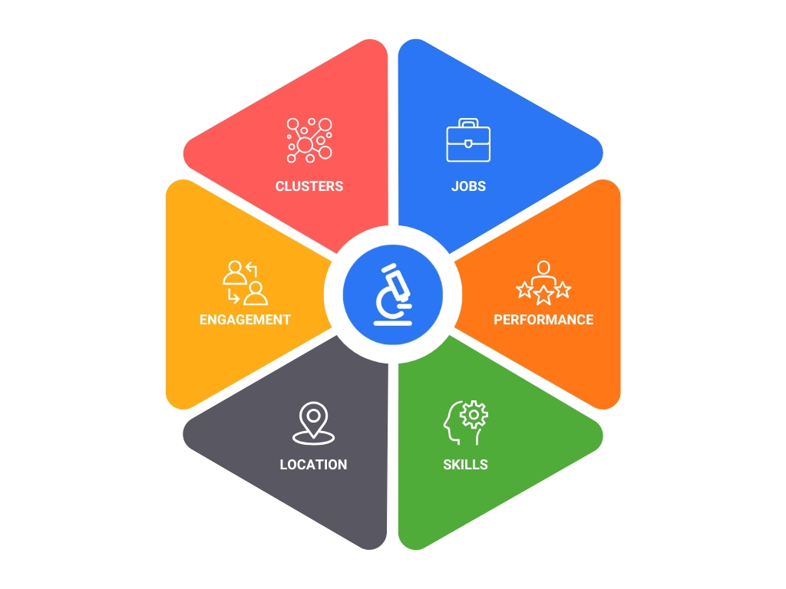
Employee Segmentation Examples
Chapter
14

Slide 18




Chapter
Chapter
ONE SIZE NO LONGER FITS FOR ALL
14
"True workforce segmentation is not the art of offering the same Employee Value Proposition to all your employees but figuring out what to offer to each of them.
It is the art of identifying and understanding the needs of your employees and creating a unique bundle of benefits that achieve employee satisfaction, profits for the organization, and benefits for stakeholders."

Slide 19
Employee Segmentation Framework
Chapter
Separate
I can do my job, but I don't have an emotional attachment to the company
Most Effective
I am very dedicated and able to work and perform to the best of my ability
Least effective
I am not dedicated, I am not able to work, and I do not achieve my full potential at work
Frustrating
I am dedicated but I face obstacles that prevent me from doing a good job
High
14
Ability to work
High
low
Engagement with the Organization

Slide 20

Linking Internal Marketing To The Organization's Strategy
Internal marketing does not work as an isolated campaign but rather should be an integral part of the corporate strategy. When planning a strategy it should include:
Clear goals for the brand as a strategic asset.
Performance metrics related to loyalty, employee engagement, and brand value.
Dedicated resources and time programs for the implementation of internal initiatives.
The linkage should ensure that the internal marketing efforts serve the organization's growth and competitiveness goals

Slide 21
Employee Engagement
Internal marketing directly contributes to raising the level of employee engagement with the organization through several tracks:
- Increased clarity of the role and tasks related to the value of the brand
- Enhance a sense of belonging and importance.
- Providing feedback channels and moral and material rewards.
According to studies, organizations that implement internal policies that are consistent with their brand have higher engagement rates and a positive impact on performance indicators.

Slide 22

Chapter
14
The Relationship Between Internal Marketing And Attracting Modern Talent And Keeping Them Within The Organization
03

Slide 23
The Impact of Internal Marketing on Talent Attraction and the Recruitment Process
Chapter
14
Internal marketing is a key element in building an organization's brand that attracts talent. When employees live the values of the organization and candidates witness success stories and positive experiences, the organization is better able to attract talent.
Insider stories and employee act as social proof for candidates, lowering the barrier of ambiguity from the real work environment.

Slide 24

Talent retention, internal communication roles, and recognition
Chapter
14
Retention is grounded in a consistent work experience, transparent communication, and continuous recognition of employee accomplishments that foster loyalty and organizational engagement.

Slide 25

Internal Branding Role In The Recruitment Process
Chapter
14
Internal branding affects every stage of employment
Posting jobs: More honest and engaging messages.
The result: reduced turnover rates after recruitment and increased quality of recruitment
Acceptance decision: Positive experiences of former employees boost trust.
Interviews: A candidate enters the interview with a realistic perception of the values and career climate.

Slide 26

Effective tools and practices to attract millennials and Gen Z
Chapter
14
Focusing on the meaning of work, professional growth, flexibility, and interactive content across job sites and social media are effective attraction tools.
Digital Internal Platforms
Employee Engagement & Innovation Programs
Flexible Benefits Platforms
Motivational Games (Gamification Tool)
Continuous Learning & E-Learning Programs

Slide 27
Effective Internal Marketing Strategies with Gen Z
Strategy | Explanation | Applied Example
1. Purpose-driven Brand | The new generations are looking for work in an organization that has a humanitarian and social purpose. | Patagonia builds its internal culture on protecting the environment, and gets its employees involved in environmental activities.
2. Transparency | Open communication about decisions, goals, and policies. | Buffer publicly publishes the salary structure and details of decisions to boost trust.
3. Flexible working environment) | Allow for remote work, flexible hours, and creative spaces. | Airbnb gives you the freedom to choose your workplace and offers a flexible youth work environment.
4. Employee Co-Creation | Allow employees to express the brand in their own style. | Adidas engages its internal teams in #Here To Create campaigns to generate content from within the organization.
5. Recognition & Appreciation | Use real-time reward systems and public recognition. | HubSpot has an in-house software called Spotlight to estimate performance via the digital platform.
6. Promoting a culture of inclusion & diversity | Create an environment that respects differences and supports diversity. | Microsoft implements Inclusion Labs programs to train employees to embrace diversity.

Slide 28

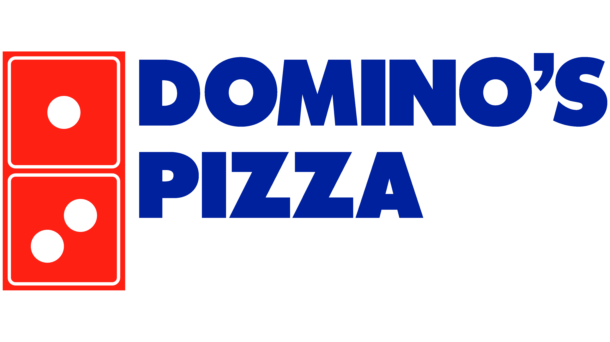



Chapter
14
Presenting Practical Case Studies From Global Organizations To Illustrate How They Apply Internal Branding
04

Slide 29
Practical Case Studies
Chapter
14
Application: Starbucks considers its employees "Partners, not just workers."
Internal Marketing: Provides intensive training programs on the brand's story and the importance of providing a warm experience for every customer.
Gives employees the freedom to choose your "own blend" of benefits that best suit their needs.Your Blend of benefits — whether educational, medical, or family — fosters brand affiliation.
The result: This alignment of internal (employees) and external (customers) values has made Starbucks a symbol of outstanding customer experience.

Slide 30

Practical Case Studies Cont
Chapter
14
Application: Google's culture is based on innovation and openness.
Internal Marketing: In-house programs such as "20% Time" are designed that allow employees to use a portion of their time for their own creative projects. Flexible Benefits include flexible work options, psychological and health support, and incentives to innovate.
Brand Linking: These practices make employees live Google's logo "Innovate and Think Differently," reflecting the brand's image of innovation externally.

Slide 31
Practical Case Studies Cont
Chapter
14
Application: After rebuilding its image in 2010, Domino's started an internal campaign called "Our Piece of the Pie" aimed at employees.
Internal marketing: Allows employees to choose their own benefits and get "choose your piece of the pie" to suit their needs. Training programs focus on connecting each employee to the concept of "Continuous Improvement."
Brand Linking: : This creates a synergy between the internal employee experience and the external customer experience that promises to always improve the product and service.

Slide 32

Practical Case Studies Cont
Chapter
14
Application: Disney's motto "Creating Happiness" starts from within.
Internal Marketing: Disney University offers to train employees on the philosophy of "Stage Performance," where every interaction with a customer is seen as a theatrical spectacle.
Brand Linking: A clear link between the internal culture (creating happiness for the employee) and the external sign (creating happiness for visitors).

Slide 33

Chapter
14
Challenges And Developments
05

Slide 34
Key Challenges in Implementing Internal Marketing
CHALLENGES
Chapter
14
Resistance to Change
Poor communication
Lack of impact measurement
Those key challenges require leadership support and clear action plans.

Slide 35

Digital Transformation and its Impact on the Internal Brand
DEVELOPMENT
Chapter
14
Digital transformation provides communication and online training platforms that facilitate content personalization and engagement tracking, but it must be humanized.
AI and employee experience personalization
AI customizes learning, analyzes employee emotions, while ensuring privacy, to enhance the human experience, not replace it.

Slide 36
Practical Recommendations for Internal Marketing
Chapter
14
Senior Leadership
Ensuring the integration between the external and internal image of the brand
Lead implementation and support initiatives internally
Human Resources
Strategic Partnership in Building the Internal Brand , Employee segmentation and value proposition (EVP)
Marketing Teams
Strengthening the brand from the inside out through storytelling
Leveraging digital transformation to enhance internal communication

Slide 37
Conclusion
Chapter
14
Internal marketing is a strategic factor for attracting and retaining talent and improving performance. It requires an effective integration of leadership, human resources, marketing and technology to ensure its success and sustainability.

Slide 38
Summary
Chapter
14
Definition of Internal Branding
The working mechanisms of internal marketing and how to integrate it with HR and corporate marketing strategies.
The relationship between Internal marketing and attracting modern talent and keeping them within the organization.
Practical case studies from global organizations to illustrate how to apply Internal Branding.
Challenges and Developments

Slide 39
References
Burmann, C., & Zeplin, S. (2005). Building brand commitment: A behavioral approach to internal brand management. Journal of Brand Management, 12(4), 279–300link.springer.com.
Bryman, A. (2013). The Disneyization of society. Sage Publicationsfruugo.us.
CIPD. (2022). Internal communication and employee engagement in the digital era. CIPD. Retrieved October 8, 2025, from https://www.cipd.org
Davidson, V., & Leinwand, P. (2016, December 30). How Starbucks’s culture brings its strategy to life. Harvard Business Review. Retrieved October 8, 2025, from https://hbr.org/2016/12/how-starbuckss-culture-brings-its-strategy-to-life hbr.org.
Deloitte. (2023). 2023 Global human capital trends: New fundamentals for a boundaryless world. Deloitte Insights. Retrieved October 8, 2025, from https://www.deloitte.com/us/en/insights/topics/talent/human-capital-trends/2023/future-of-workforce-management.html deloitte.com.
Forbes. (2021). The future of work: What millennials and Gen Z expect. Forbes. Retrieved October 8, 2025, from https://www.forbes.com
Forbes. (2021). Inside Google’s culture of innovation. Forbes. Retrieved October 8, 2025, from https://www.forbes.com
Poswolsky, A. S. (2022, June 13). Gen Z employees are feeling disconnected. Here’s how employers can help. Harvard Business Review. Retrieved October 8, 2025, from https://hbr.org/2022/06/gen-z-employees-are-feeling-disconnected-heres-how-employers-can-help hbr.org.
Internal branding and employee engagement in service firms. (2019). Journal of Brand Management.
Internal branding for generational cohesion. (2020). Journal of Brand Management.

Slide 40



Thank You

