Slide 1



Risk Management
MGM 510
Lecture 7
Prepared by
Dr. Nael Zabel
www.midocean.ae

Slide 2
Topics to Cover in Week 7
Enterprise Risk Management
Features of Enterprise Risk Management
Definition of enterprise risk management
Benefits of enterprise risk management
ERM and business continuity
Importance of Resilience

Slide 3
Enterprise Risk Management
the term enterprise or enterprise-wide risk management (ERM) that is now the most widely used and generally accepted terminology for this broader approach.
The fundamental idea behind the ERM approach is to move away from the practice of risk management as the separate management of individual risks.

Slide 4
Enterprise Risk Management
ERM takes a unifyingتوحيد, broader and more integrated approach.
The ERM approach means that an organization looks at all the risks that it faces across all of the operations that it undertakes.

Slide 5
Enterprise Risk Management
ERM is concerned with the management of the risks that can impact the objectives, key dependencies or core processes of the organization
ERM is concerned with the management of opportunities, as well as the management of control and hazard risks.

Slide 6
Enterprise Risk Management
With the ERM approach, the relationship between risks is identified by the fact that two or more risks can have an impact on the same activity or objective.
The ERM approach is based on looking at the objective, key dependency or core process and evaluating all of the risks that could impact the item being evaluated.

Slide 7
Enterprise Risk Management
Organizations practice risk management in a number of different ways.
However, there are many common features to most of these approaches.

Slide 8
Enterprise Risk Management
Following section gives an overview of the features of enterprise risk management as a comparison to the silo-based approach whereby risk management tools and techniques are applied to different types of risks independently.

Slide 9
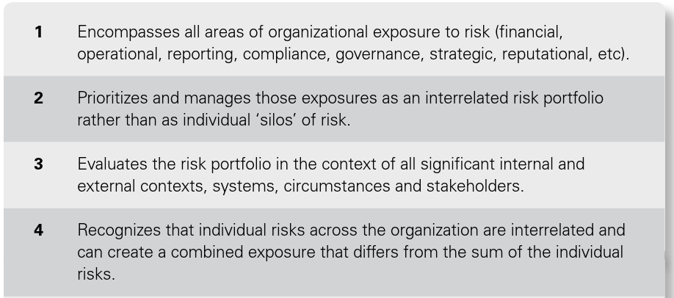
Features of Enterprise Risk Management
يشمل جميع مجالات التعرض للمخاطر (المالية ، التشغيلية ، وإعداد التقارير ، والامتثال ، والحوكمة ، والاستراتيجية ، والسمعة ، وما إلى ذلك).
تحديد أولويات وإدارة هذه التعرضات كمحفظة مخاطر مترابطة بدلا من "صوامع" فردية للمخاطر.
يقيم محفظة المخاطر في سياق جميع المخاطر الداخلية الهامة والسياقات الخارجية والنظم والظروف وأصحاب المصلحة.
يدرك أن المخاطر الفردية في جميع أنحاء المنظمة مترابطة ويمكن أن يخلق تعرضا مشتركا يختلف عن مجموع الفرد المخاطر

Slide 10
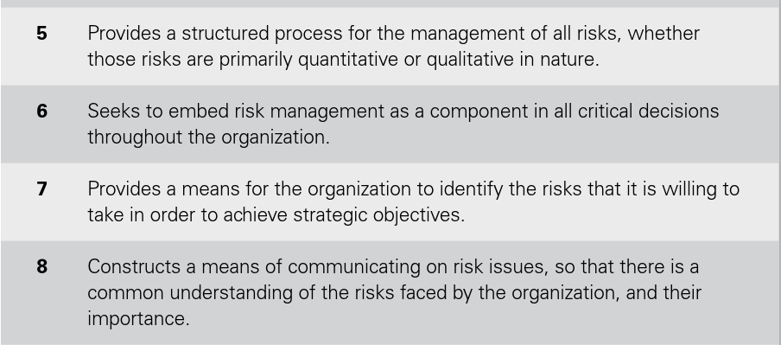
Features of Enterprise Risk Management
يوفر عملية منظمة لإدارة جميع المخاطر ، سواء وهذه المخاطر ذات طابع كمي أو نوعي في المقام الأول.
يسعى إلى تضمين إدارة المخاطر كعنصر في جميع القرارات الحاسمة في جميع أنحاء المنظمة.
يوفر وسيلة للمنظمة لتحديد المخاطر التي ترغب في القيام بها تأخذ من أجل تحقيق الأهداف الاستراتيجية.
يبني وسيلة للتواصل بشأن قضايا المخاطر ، بحيث يكون هناك الفهم المشترك للمخاطر التي تواجهها المنظمة، والمخاطر التي تواجهها اهميه.

Slide 11
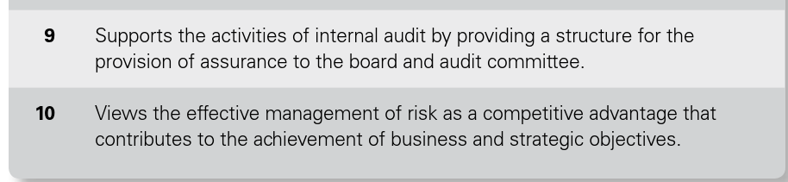
Features of Enterprise Risk Management
يدعم أنشطة التدقيق الداخلي من خلال توفير هيكل لتقديم ضمانات إلى مجلس الإدارة ولجنة التدقيق
ينظر إلى الإدارة الفعالة للمخاطر على أنها ميزة تنافسية يساهم في تحقيق الأهداف التجارية والاستراتيجية.

Slide 12

Definition of enterprise risk management

Slide 13

Definition of enterprise risk management

Slide 14
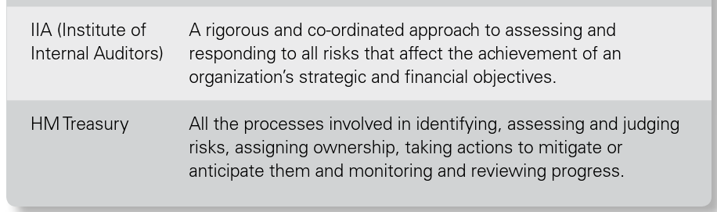
Definition of enterprise risk management

Slide 15

Benefits of enterprise risk management

Slide 16
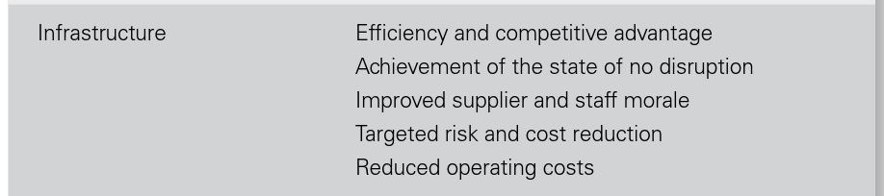
Benefits of enterprise risk management

Slide 17

Benefits of enterprise risk management

Slide 18

Benefits of enterprise risk management

Slide 19
ERM and business continuity
There is an important relationship between enterprise risk management (ERM) and business continuity management (BCM).
The risk assessment that is required as part of the risk management process and the business impact analysis that is the basis of business continuity planning (BCP) are closely related.

Slide 20
ERM and business continuity
The normal approach to risk management is to evaluate objectives and identify the individual risks that could impact these objectives.
The output from a business impact analysis is the identification of the critical activities that must be maintained for the organization to continue to function.

Slide 21
ERM and business continuity
Based on the definition of ERM set out above and the fact that it should be applied to the evaluation of core processes, it can be seen that the ERM approach and the business impact analysis approach are very similar, because both approaches are based on the identification of the key dependencies and functions that must be in place for the continuity and success of the business.

Slide 22
ERM in energy and finance
Risk management in the energy and finance sectors has become a well-developed specialist branch of the discipline. In the finance sector, the objective of an ERM initiative is to enhance shareholder value by:
●● improving capital and efficiency by providing an objective basis for allocating resources and exploiting natural hedges التحوطاتand portfolio effects;

Slide 23
ERM in energy and finance
●● supporting financial decision making by considering areas of high adverse impact and by exploiting areas of risk-based advantage;
●● building investor confidence by stabilizing results and protecting them disturbances and thus demonstrating proactive risk stewardship.

Slide 24
ERM in energy and finance
What is Basel II?
Basel II is the second set of international banking regulations defined by the Basel Committee on Bank Supervision (BCBS) لجنة بازل للرقابة المصرفية . It is an extension of the regulations for minimum capital requirements as defined under Basel I.

Slide 25
ERM in energy and finance
The Basel II framework operates under three pillars:
Capital adequacy requirementsالحد الأدنى لمتطلبات رأس المال
Supervisory reviewالمراجعة الإشرافية
Market disciplineانضباط السوق

Slide 26
ERM in energy and finance
Banks have been subjected to Basel II for some time and are preparing for implementation of the Basel III requirements by 2019.

Slide 27
ERM in energy and finance
The statement that risk management has failed in banks is more difficult to contradict.
However, the reality is that it was not the failure of risk management principles that caused the banking crisis.
It was the failure to correctly apply those principles.

Slide 28
Benefits of enterprise risk management
Many banks made two simultaneous mistakes:
●● An accurate risk and reward analysis was not undertaken, so that banks made decisions on the basis of the rewards available, rather than taking a more balanced view of the risks involved in seeking those higher rewards.

Slide 29
ERM in energy and finance
●● Quantification of the level of risk involved was not accurate, because the banks were taking such a risk-aggressive approach that certain events were considered to be so unlikely that they could be ignored.

Slide 30
Importance of Resilience
One of the best established resilience standards is the Organizational Resilience Standard (ASIS SPC.1-2009)
published by the American National Standards Institute.

Slide 31
Importance of Resilience
This ASIS standard takes an enterprise-wide view of risk management, enabling an organization to develop a comprehensive strategy to prevent when possible, prepare for, mitigate, respond to, and recover from a disruptive incident.

Slide 32
Importance of Resilience
The overall approach is that a resilient organization needs to ‘prevent, protect and prepare’ in relation to resources and assets and at the same time be able to ‘respond,
recover and review’ when a crisis occurs.

Slide 33
Importance of Resilience
The emergence of resilience is an opportunity for risk management and business continuity specialists to work together to ensure a more coordinated approach
to enterprise risk management, business continuity and crisis management.

Slide 34
Importance of Resilience
There are three behaviours that should be achieved by an organization if it is to achieve increased resilience:
●● awareness of changes in the external, internal and risk management environments, so that constant attention to resilience is ensured;

Slide 35
Importance of Resilience
●● ‘prevent, protect and prepare’ in relation to all types of resources, including assets, networks, relationships and intellectual property;
●● ‘respond, recover and review’ in relation to disruptive events, including the ability to respond rapidly, review lessons learnt and adapt.

Slide 36
Minimize compliance risks
Thank You

