Slide 1

Strategic And Operational Risk Management
PMG630
Prepared by
Dr. Ayman Hassan
  Lecture .8 “Treatment of Risk"

Slide 2


Chapter 4
Treatment of Risk
Prepared by
Dr. Ayman Hassan

Slide 3

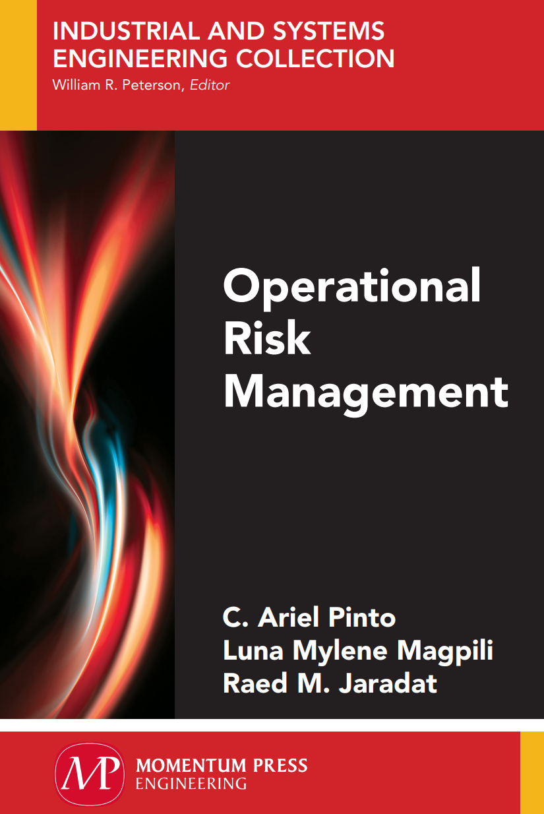
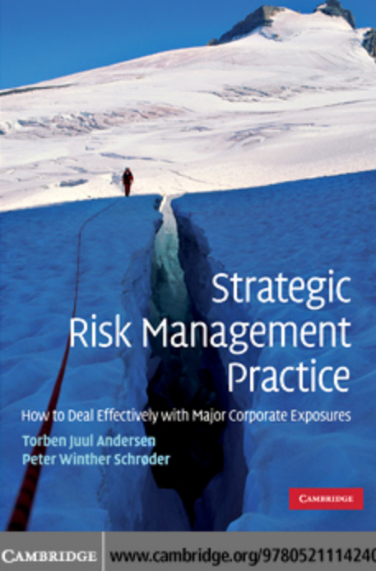
Important note, 1
r
REF, 1
REF,2

Slide 4
Lecture No.8, The Content
Summary of the previous lecture
Introduction
What are the objectives of risk management?
How can the occurrence be reduced?
Minimize consequences when risk occurs.
What is risk mitigation?
Fundamental Strategies Of Risk Treatment
Detection
Control
Recovery planning
Fundamental Steps in risk Treatment
Identify treatment options
Pay attention
References & Resources

Slide 5
Introduction
Risk treatment (including risk mitigation) is a general term to indicate modifying a system or its elements for the purpose of affecting particular risk events.
Risk treatment follows the identification and description of risks, the latter also termed as risk assessment.
According to its definition, Risk Treatment is the process of selecting and implementing of measures to modify risk.
Risk treatment measures can include avoiding, optimizing, transferring or retaining risk.

Slide 6
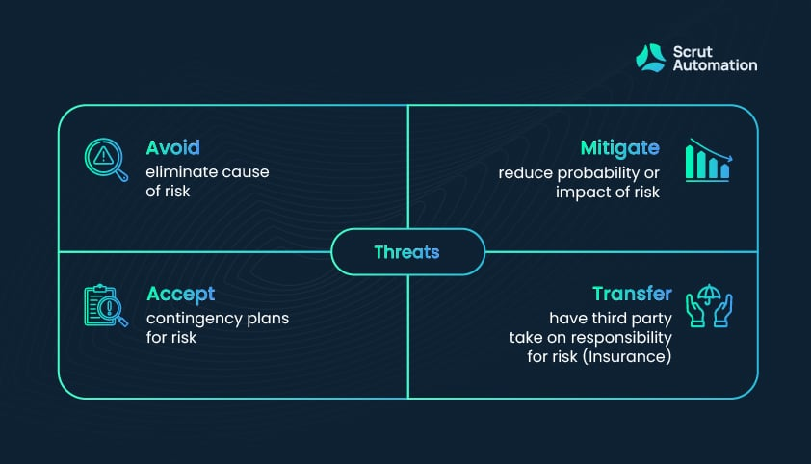
Introduction

Slide 7
What are the objectives of risk management?
Risk treatment is implemented or considered when certain risks are deemed significant enough to warrant action.
Significance typically depends on the likelihood of occurrence, the consequences of risk events, and other factors such as ethical and legal reasons.

Slide 8
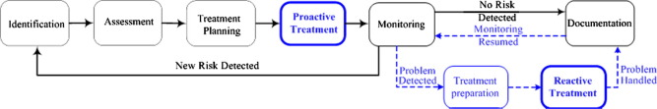
What are the objectives of risk management?
Holistic definition of risk management evolving techniques
According to the established risk management standards any risk management typically includes a series of the following tasks: (1) identification, (2) assessment, (3) treatment planning, (4) treatment, (5) monitoring, and (6) documentation as per the following Fig. 3.

Slide 9
How can the occurrence be reduced?
Reducing the chance of occurrence, also known as prevention, involves preventing the causal chain of events (or causalities) to develop or progress.
Part of risk analysis is establishing the causal chain of events that eventually lead to a particular risk event under consideration, such as those embodied in Failure Mode and Effects Analysis (FMEA), Hazard and Operability Analysis (HAZOP), and Cause and Consequences Analysis (CCA) as discussed in Chapter 3.

Slide 10
How can the occurrence be reduced?
Each part in the causal chain of events may be an opportunity to terminate the development of a risk event, thus reducing the chance of its eventual occurrence.
The important thing is to discover this part, the undesirable effect it causes, and the extent of its seriousness by measuring the effect

Slide 11
Minimize consequences when risk occurs.
Once a risk event occurs, the accrual of the consequences may be spread out over a time period rather than an instantaneous accrual.
The general objective is to slow down the accrual of the consequences and to eventually stop it as soon as possible.
This is also known as risk mitigation.
So, one of the most important methods of mitigating the impact is quickly discovering the causes and their impact and quickly treating them, so that a problem that is easy to solve does not turn into a crisis that is difficult to solve.

Slide 12
What is risk mitigation?
Risk mitigation is one of the key steps in the risk management process.
It refers to the strategy of planning and developing options to reduce threats to project objectives often faced by a business or organization.
Risk mitigation is a culmination of the techniques and strategies that are used to minimize risk levels and pare them down to tolerable levels.
By taking steps to negate threats and disasters, an organization is going to be in a strong position to eliminate and limit setbacks.

Slide 13
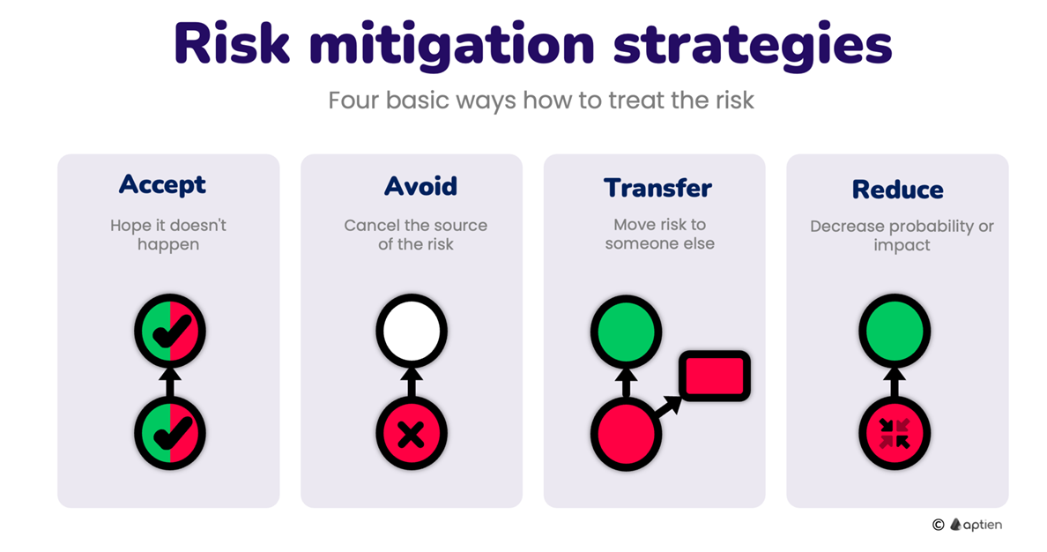
Fundamental Strategies Of Risk Treatment
There are five basic techniques of risk management
Avoidance
Retention
Spreading
Loss Prevention and Reduction
Transfer (through Insurance and Contracts)

Slide 14
Detection
Detection concerns the ability to obtain information about the presence or absence of a particular event or phenomenon, especially the events that cause and precede the hazardous events of interest (the hazardous event of interest is henceforth called the target hazard event).
Early and accurate detection of the causal chain of events provides opportunities to prevent or control the occurrence of subsequent events, essentially breaking the causal chain of events leading to the target hazard event and further advancing the sequence of events and accumulating consequences.

Slide 15
An Example
Consider the risk event of a fire that may result in injury, death, or damage to property and, in an industrial setting, may include the disruption of operation. To make risk treatment more concrete, as an example, consider an industrial fire scenario in which the causalities may follow the sequence shown in Table 4.1.

Slide 16
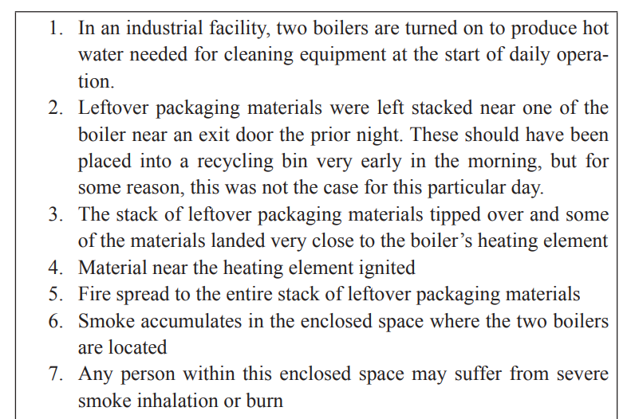
An example
Table 4.1. Example of the causal chain of events leading to injury and equipment damage and disruption in operation in an industrial facility due to fire

Slide 17
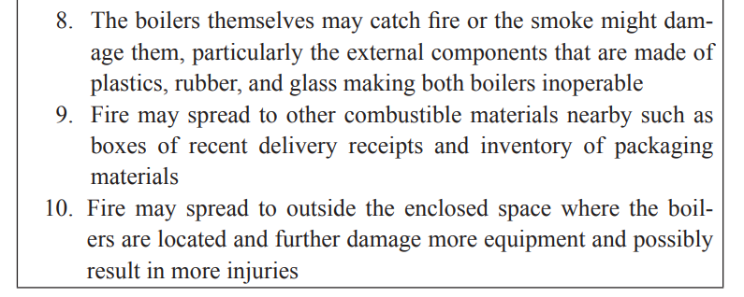
An example

Slide 18
An example
As an example, smoke detectors, whether in a household or in an industrial facility, have the primary purpose of treating the target risk event of property loss, injury, or death due to fire. A smoke detector being able to detect the presence of smoke provides opportunities to completely stop or slow down the causal chain of events that may lead to the target risk event by allowing evacuation and suppressing a fire.
From Table 4.1, designating and clearly marking of floor spaces near the boiler as a material-free zone may serve as a visual identification of any hazardous materials near the heating element; for example, detection of combustible materials near the boiler may provide opportunity to prevent segment 2 to progress further to segment 3. Furthermore, the detection of smoke before the spread to the entire stack of leftover packaging materials may have provided the opportunity to prevent segment 4 to progress further to segment 5.

Slide 19
Control
Once the causal chain of events or the target risk events are detected, the opportunity is now presented to control them if at all possible. Control may be in the form of slowing down or totally stopping the progression of the causal chain of events. Some common forms of risk control strategies are separation and suppression.
Separation pertains to the practice of increasing the spatial distance or providing barriers between hazards and the remainder of the system.

Slide 20
Control
In a household or an industrial setting, evacuation is a form of separation by providing adequate distance between the fire and humans (and other valuable movable assets). In an industrial setting, such as that described in Table 4.1, the adequate distance between combustible materials and the boiler could have been implemented by having a material-free zone around the boiler and could have prevented progression of the causal chain of events.
The evacuation of personnel after the smoke has been detected
could have also provided separation between the personnel and the hazardous smoke and heat and could have prevented injury due to smoke inhalation (i.e., segment 7). Furthermore, fire-resistant doors serving as barriers could have provided separation as part of passive fire protection, possibly controlling the spread of fire outside the enclosed area.

Slide 21
Control
Suppression pertains to the intervention to lessen the magnitude or
totally eliminate hazards that cause the target risk event. In the incident of a fire, suppression of fire using various forms of fire extinguishing mechanism may be used to lessen or eliminate the presence of fire.
For the scenario described in Table 4.1, a fire suppression system could have been used at some point in time after a smoke or fire has been detected, which could have prevented further damage to equipment.

Slide 22
Recovery planning
Recovery planning pertains to the development of a plan of actions in anticipation of the target risk events to primarily assure the continuity of operation, as well as to reduce further accrual of undesirable consequences.
These plans are also known as emergency response plans, disaster recovery plans, and may itself include detection and control, as well as risk transfer.
Parts of these plans may require actions both before and after the occurrence of risk events.

Slide 23
Recovery planning
Duplication pertains to having at least one spare or backup element that can perform the same or similar functions as a primary element that is deemed to be critical to the operation of the system.
These spare and backup elements are intended to perform the function of the primary element in case the latter cannot function due to the target risk events.

Slide 24
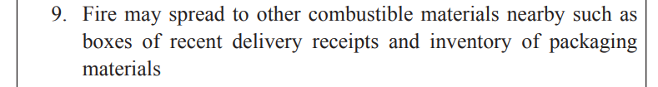
Recovery planning
As an example pertaining to segment 9 in Table 4.1, a duplicate of recent delivery receipts in another area would have provided the function of the original receipts in the continued settling of financial accounts after the fire. Otherwise, the settling of financial accounts may be disrupted while information on the receipts are recovered.

Slide 25
Recovery planning
Dispersion pertains to the separation of elements of the system performing similar functions while both of them are being utilized.
Dispersion is distinct from duplication because in dispersion, elements are not spare or backup but are rather all being utilized at the same time.

Slide 26
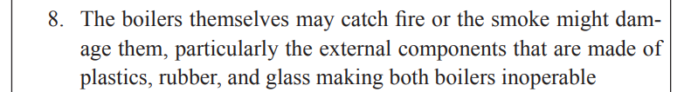
Recovery planning
As an example pertaining to segment 8 in Table 4.1, having the two boilers in two different locations could have saved one of the boiler from being damaged by the fire and may contribute toward continuous operation of the industrial facility even if not in full capacity.

Slide 27
Recovery planning
Transfer (including sharing) of undesirable consequences implies that the consequences of a risk event are either completely or partially reassigned to another entity or system.
This reassignment of the consequences is usually based on the agreement between two distinct systems rather than an actual physical reassignment.
Typical risk transfer or sharing agreements are those involved with the purchase of insurance products and services.

Slide 28
Recovery planning
For the example illustrated in Table 4.1, fire insurance could help towards repair or replacement of damaged boilers, other equipment and facility, disrupted operations, and alleviate any longer-term financial costs from the treatment of injured personnel.

Slide 29
Fundamental Steps in risk Treatment
For convenience, the 1 + 6 general guiding questions in risk management (RM) in Table 2.1 are repeated here.
0th What should go right?
1st What can go wrong?
2nd What are the causes and consequences?
3rd What is the likelihood of occurrence?
4th What can be done to detect, control, and manage them?
5th What are the alternatives?
6th What are the effects beyond this particular time?

Slide 30
Fundamental Steps in risk Treatment
The 1st, 2nd, and 3rd questions are those usually associated with risk assessment process culminating in some form of analysis, not just about particular target risk event but also a comparison among other risk events.
On the other hand, the 4th, 5th, and 6th questions are those usually associated with RM wherein actions on how to use resources for affecting risks are rationalized and justified.

Slide 31
Fundamental Steps in risk Treatment
To a great degree, the steps in designing plans on how to treat risks follows these 1 + 6 questions in parallel and can be summarized in the following four steps.
1. Identification of treatment options
2. Development of an action plan
3. Approval of an action plan
4. Implementation of the action plan

Slide 32
Identify treatment options
In the first step—identification of treatment options—we need to choose which risk events will be targeted based on their importance and identify appropriate detection and control strategies based on the causal chain of events.
The following guiding questions may facilitate identification of treatment options.
Which risk event(s) needs to be treated?
After obtaining answers to
the 1st, 2nd, and 3rd guiding questions in RM, the risk analysts can now compare the relative importance of various risk events and effectively establish prioritization among these risks as needing treatment.

Slide 33
Identify treatment options
The prioritization may be based on the combination of the chances of occurrence and degree of consequence. Oftentimes, a risk matrix similar to that in Figure 4.1 is used to compare among risk events and facilitate their ranking or prioritization.

Slide 34
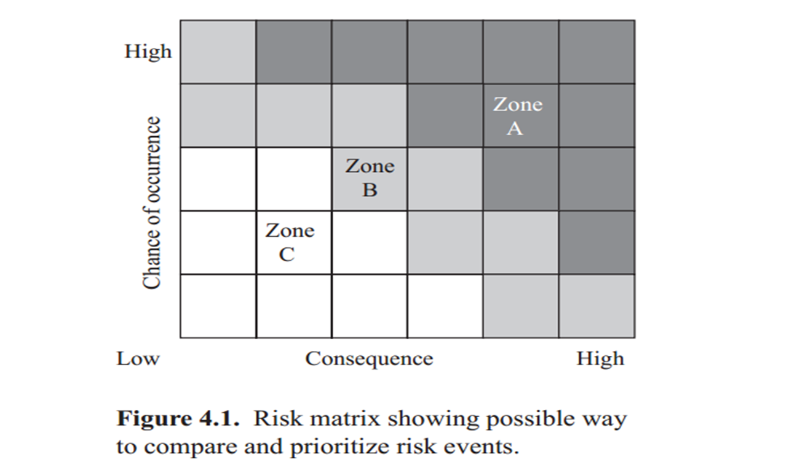
Risk Matrix
A risk event with a high chance of occurrence and high degree of consequence may be deemed of high priority, such as those that may fall in Zone A of Figure 4.1. Risk events with lower chances of occurrence and lower degree of consequence may be of the lowest priority and may fall in Zones B and C. Using a risk matrix similar to that in Figure 4.1 may be appropriate in cases where the consequences of risk events can be expressed in similar measures, such as a monetary unit.

Slide 35
Risk Prioritization
However, there may be cases where expressing consequences in the same measure may not be possible or acceptable, such as in the case of some risk events resulting in injury and some resulting in equipment damage.
Another way to compare and prioritize risk events may be based on categories rather than a matrix such as those shown in Table 4.2. Categorization

Slide 36
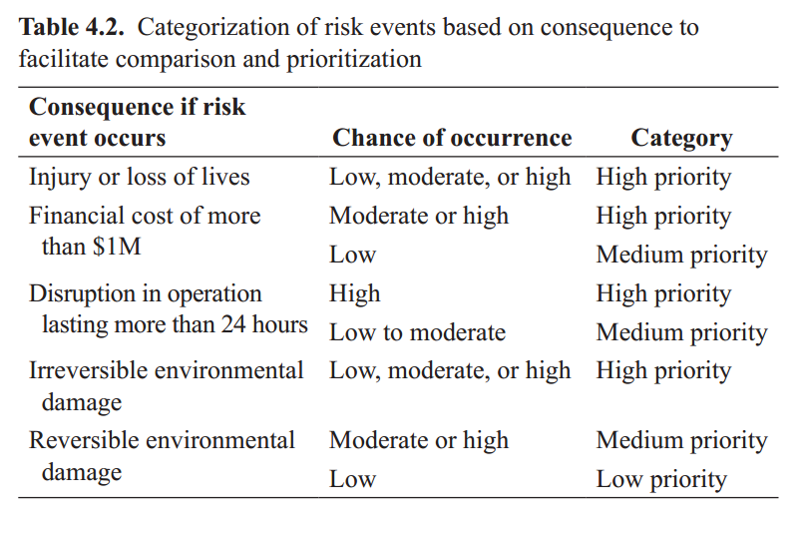
Risk Prioritization

Slide 37

Risk Prioritization
Categorization allows the analyst to distinguish among types of consequences based on criteria relevant to a particular system without the need to express them using the same measure. For example, a system that greatly values the environment may have a distinct criterion معيار متميز
for risk events that may result in environmental damage. Nonetheless, such categorization of risk events would still be based on some assessment of the chance of occurrence coupled with the consequence if they occur.

Slide 38
Risk Detection amenability
Risk Detection amenability
Which segments in the causal chain of events can be detected? Certain segments in the causal chain of events may be more amenable قابله to detection than other segments based on the mechanics of the phenomena, available technology for detections, and other factors (e.g., ethical and legal factors).
Which segments of the causal chain of events can be controlled and how?
In the same way that segments in the causal chain of events may be more amenable than others to detection, some of these segments may be more amenable to control than others.

Slide 39
Post Risk Occurrence
If the risk event happens, how can the system recover quickly?
Import-ant functions in the operation of the system are identified for the purpose of analyzing whether any of them can be duplicated or dispersed.
This applies not only to equipment and information as illustrated in Table 4.1 but also to personnel through cross-trainings.
Finally, options to purchase insurance products and services also need to be considered based on economic and legal factors.

Slide 40
Development Of Action Plan
In the second step—development of an action plan—we need to generate combinations of particular risk treatments that will be effective for a particular system and target risk event and the accountable party.
Which risk treatment strategies will work well together?
Risk treatment strategies are not mutually exclusive and effective action plans that are usually made up of combination of strategies, albeit in various degrees.
Who will be accountable for implementing the plan?
Upon determination of risk treatment strategies, the parties (individuals, job descriptions, teams, or organizations) that will be most reasonably held accountable for their implementation are identified.

Slide 41
Approval of the Action plan
In the third step—approval of the action plan—we need to obtain the approval of the action plan from the management and from responsible parties.
How much will this cost?
From the management’s perspective, there will most likely be a need to economically rationalize the choice of risk treatment strategies based on the benefit that the system will get from such plan compared to the cost of implementation.
Who will lead the implementation?
Management commitment is also needed to coordinate among the various responsible parties and assure that required resources for implementation are made available.
From the perspective of the parties responsible for the various treatment strategies, their commitment based on motivation and incentives are needed for long-term effectiveness of the plan.

Slide 42
Approval of the Action plan
A single party—individual or team—is usually assigned the accountability of assuring the plan is implemented.
This party responsible for the overall plan is usually labeled as the risk manager, safety officer, or other similar job title.

Slide 43
Finally - pay attention
Risk treatment is a general term to indicate modifying a system or its elements for the purpose of affecting particular risk events deemed important based on the chances of occurrence, the consequences if the risk events happen, and other factors.
The general objectives in risk treatments are
(a) reduction in the chances of occurrence of the risk events
(b) reduction in the consequences if the risk events occur.

Slide 44
Finally - pay attention
The fundamental steps and corresponding guide questions in developing a plan for risk treatment are as follows.
1- Identification of treatment options
Which risk event needs to be treated?
Which segments in the causal chain of events can be detected?
Which segments of the causal chain of events can be controlled and how?
If the risk event happens, how can the system recover quickly?

Slide 45
Finally - pay attention
2- Development of action plan
Which risk treatment strategies will work well together?
Who will be accountable for implementing the plan?
3- Approval of action plan
How much will this cost?
Who will lead the implementation?

Slide 46
Finally - pay attention
Implementation of action plan
How can the plan be improved?
What are the residual and emerging risks?
Finally, the systems approach needs to be considered throughout the development and implementation of risk treatment plans. Consideration needs to be placed on possible challenges brought about by the multicausal nature of risk events, synergistic effects of risk treatment strategies, resulting countervailing risks, the need to rationalize cost of treatment, estimating the benefits of risk avoidance, and economics that may allow or prevent risk transfers.

Slide 47
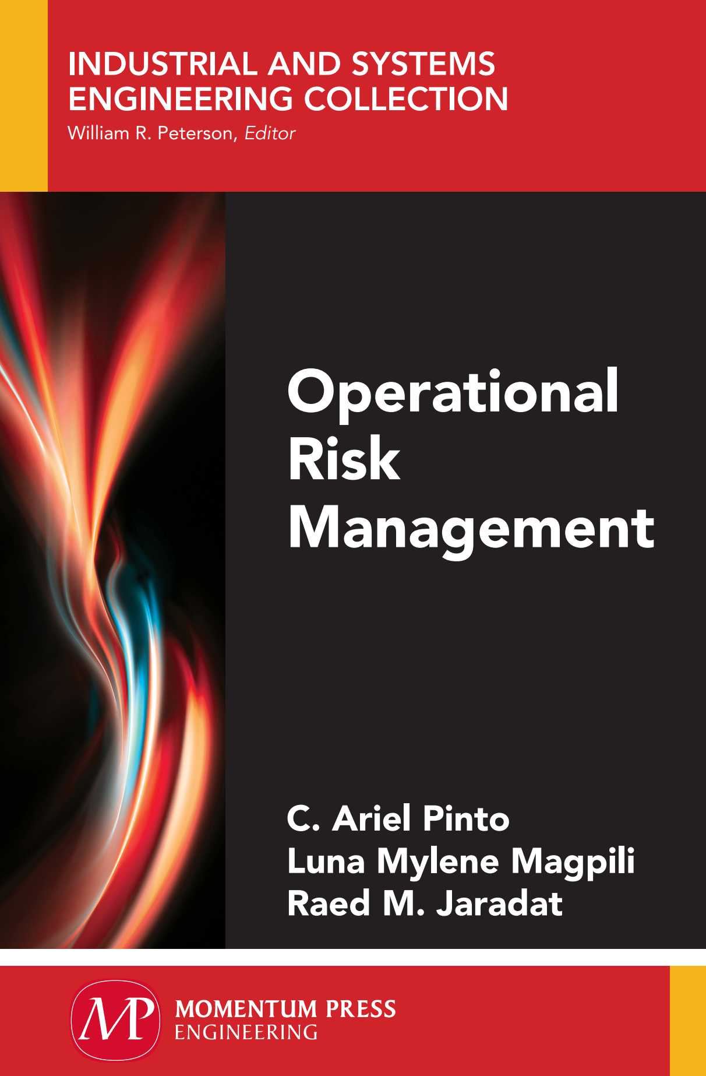
10. References & Resources
Causal Chain - Tool/Concept/Definition (thwink.org)

Slide 48

01
My Best Wishes …
* Dr. Ayman Hassan *

