Slide 1



Organizational Behavior
and Projects
PMG421
Lecture 2
Attitudes and Job Satisfaction
Prepared by: Mrs. Deena Ibraheem
www.midocean.ae

Slide 2

Attitudes and Behavior.
Job Attitudes.
Job Satisfaction .
What Causes Job Satisfaction?
Outcomes of Job Satisfaction.
The Impact of Job Dissatisfaction.
www.midocean.ae

Slide 3
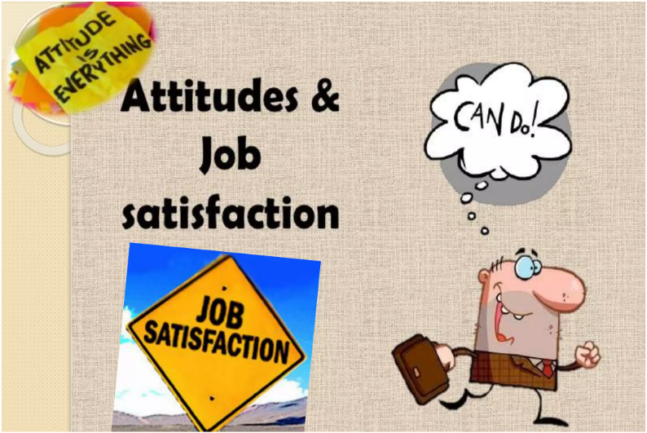
Attitudes and Job Satisfaction
www.midocean.ae

Slide 4

Attitudes,
Attitudes are evaluative statements—either favorable or unfavorable—about objects, people, or events. They reflect how we feel about something. When you say “I like my job,” you are expressing your attitude about your work.
Attitudes are complex. If you ask people about their attitude toward religion, or an organization, you may get a simple response, but the underlying reasons are probably complicated. To fully understand attitudes, we must consider their fundamental components.
www.midocean.ae

Slide 5
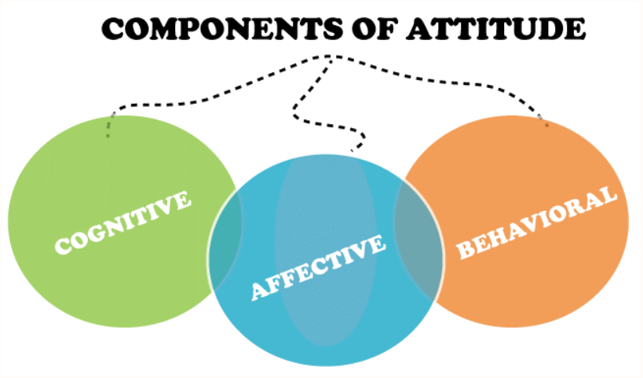
Typically, researchers assume attitudes have three components: cognition, affect, and behavior.
The statement “My pay is low” is a cognitive component of an attitude—a description of or belief in the way things are.
Affect is the emotional or feeling segment of an attitude reflected in the statement, “I am angry over how little I’m paid.” Affect can lead to behavioral outcomes.
www.midocean.ae

Slide 6
The behavioral component of an attitude describes an intention to behave a certain way toward someone as in, “I’m going to look for another job that pays better.”
Viewing attitudes as having three components—cognition, affect, and behavior—helps understand their complexity and the potential relationship between attitudes and behavior.
www.midocean.ae

Slide 7
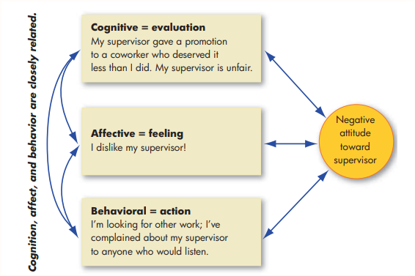
Attitudes three components:
www.midocean.ae

Slide 8
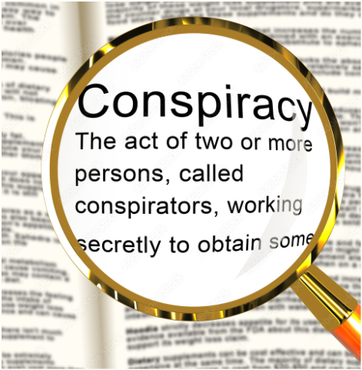
In organizations, attitudes are important for their behavioral component. If workers believe, for example, that managers, auditors, and engineers are in a conspiracy to make employees work harder for less money, we should try to understand how this attitude formed, how it impacts job behavior, and how it might be changed.
www.midocean.ae

Slide 9
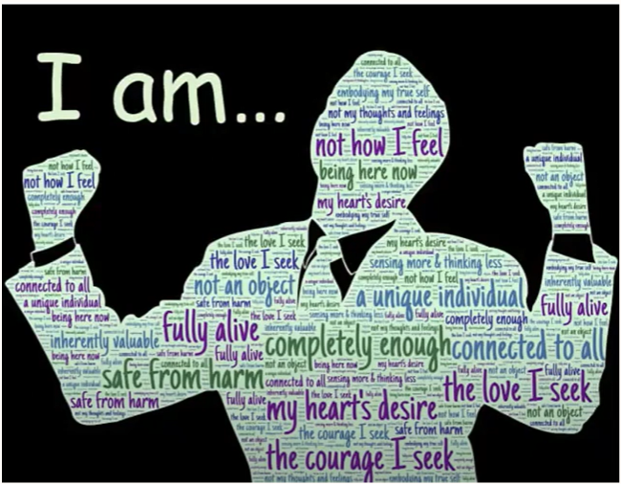
Attitudes and Behavior
www.midocean.ae

Slide 10
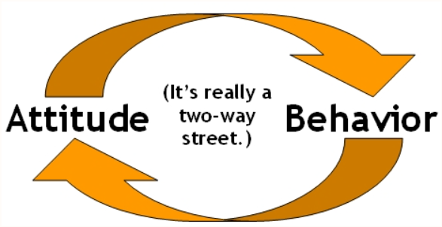
Attitudes and Behavior
Early research on attitudes assumed they were causally related to behavior—that is, the attitudes people hold determine what they do. Other researchers have agreed that attitudes predict future behavior.
www.midocean.ae

Slide 11

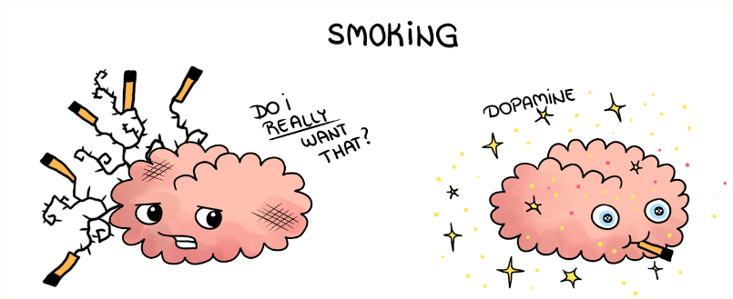
Cognitive dissonance :
Any incompatibility between two or more attitudes or between behavior and attitudes.
People seek consistency among their attitudes, and between their attitudes and their behavior. Any form of inconsistency is uncomfortable, and individuals will therefore attempt to reduce it.
www.midocean.ae

Slide 12

When there is a dissonance, people will alter either the attitudes or the behavior, or they will develop a rationalization for the discrepancy. Recent research found, for instance, that the attitudes of employees who had emotionally challenging work events improved after they talked about their experiences with coworkers. Social sharing helped these workers adjust their attitudes to behavioral expectations.
www.midocean.ae

Slide 13
The desire to reduce dissonance depends on three factors, including :
1- The importance of the elements creating dissonance and,
2- The degree of influence we believe we have over the elements.
3- The third factor is the rewards of dissonance; high rewards accompanying high dissonance tend to reduce tension inherent in the dissonance (dissonance is less distressing if accompanied by something good, such as a higher pay raise than expected). Individuals are more motivated to reduce dissonance when the attitudes are important or when they believe the dissonance is due to something they can control.
www.midocean.ae

Slide 14
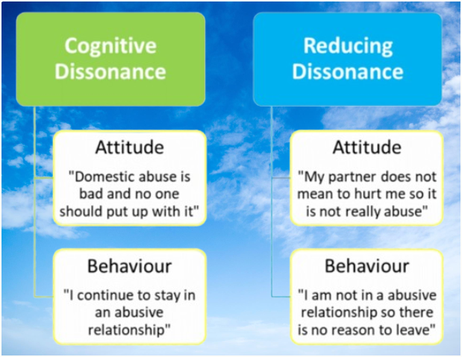
For Example:
www.midocean.ae

Slide 15
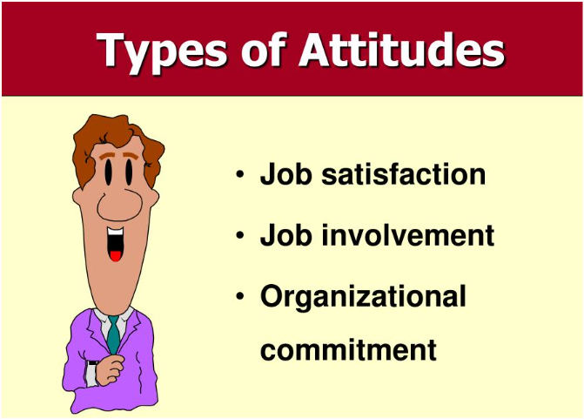
Job Attitudes
www.midocean.ae

Slide 16
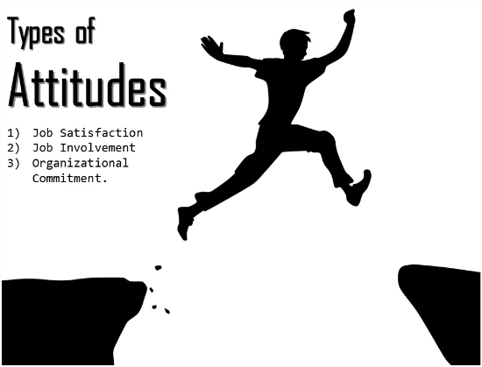
Job satisfaction and concepts related to it
We have thousands of attitudes, but OB focuses on a very limited number that form positive or negative evaluations employees hold about their work environments. Much of the research has looked at three attitudes: job satisfaction, job involvement, and organizational commitment. Other important attitudes include perceived organizational support and employee engagement.
www.midocean.ae

Slide 17
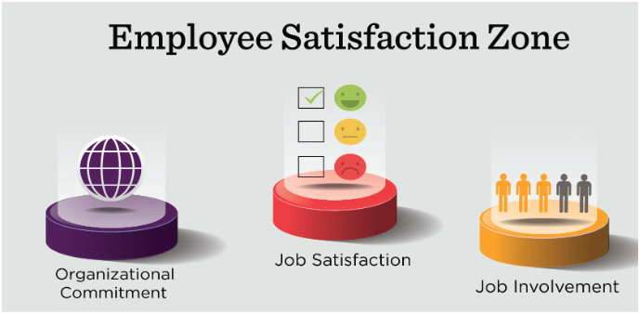
1- Job satisfaction
2- Job involvement
Job satisfaction: A positive feeling about one’s job resulting from an evaluation of its characteristics.
Job involvement: The degree to which a person identifies with a job, actively participates in it, and considers performance important to self-worth.
Psychological empowerment: Employees’ belief in the degree to which they affect their work environment, their competence, and their perceived autonomy in their work.
www.midocean.ae

Slide 18

3- Organizational Commitment
The degree to which an employee identifies with a particular organization and its goals and wishes to maintain membership in the organization. Employees who are committed will be less likely to engage in work withdrawal even if they are dissatisfied because they have a sense of organizational loyalty or attachment. Even if employees are not currently happy with their work, they are willing to make sacrifices for the organization if they are committed enough.
www.midocean.ae

Slide 19
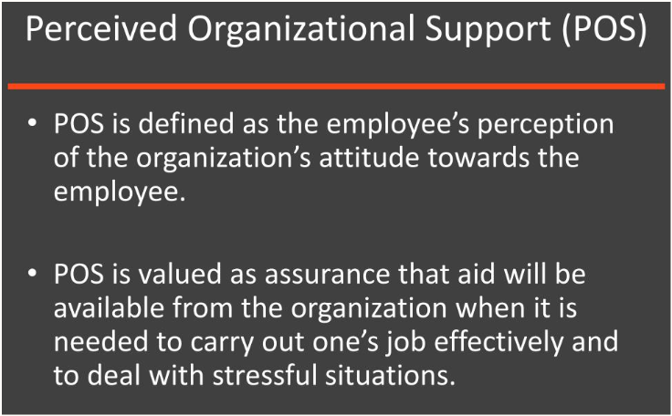
Perceived organizational support (POS)
The degree to which employees believe an organization values their contribution and cares about their well-being.
People perceive their organizations as supportive when rewards are deemed fair, when employees have a voice in decisions, and when their supervisors are supportive.
www.midocean.ae

Slide 20
POS is important , In low power-distance countries like the United States, people are more likely to view work as an exchange than as a moral obligation, so employees look for reasons to feel supported by their organizations.
In high power-distance countries like China, employee POS perceptions are not as deeply based on demonstrations of fairness, support, and encouragement.
www.midocean.ae

Slide 21
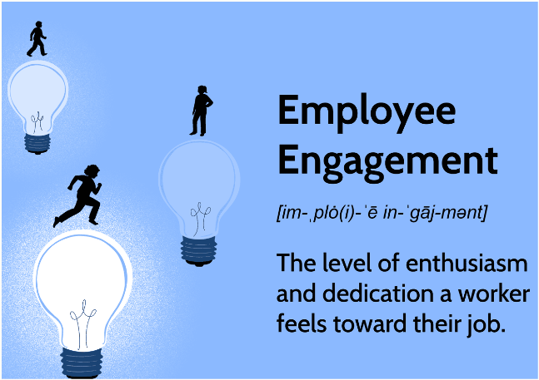
Employee engagement
An individual’s involvement with, satisfaction, and enthusiasm for the work he or she does. To evaluate engagement, we might ask employees whether they have access to resources and opportunities to learn new skills, whether they feel their work is important and meaningful, and whether interactions with coworkers and supervisors are rewarding.
www.midocean.ae

Slide 22
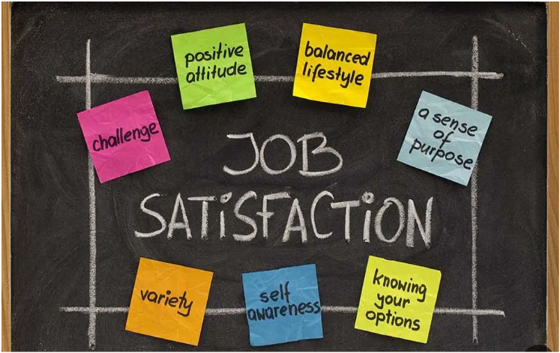
Job Satisfaction
www.midocean.ae

Slide 23
Job Satisfaction
A positive feeling about a job resulting from an evaluation of its characteristics—is broad.
A job is more than just shuffling papers, writing programming code, waiting on customers, or driving a truck. Jobs require interacting with coworkers and bosses, following organizational rules and policies, meeting performance standards, adapting to new technology, and so forth.
www.midocean.ae

Slide 24

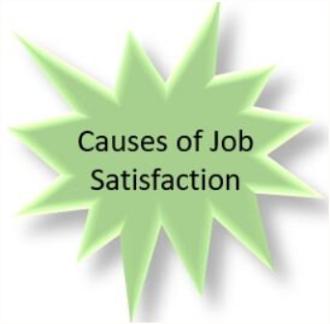
What Causes Job Satisfaction?
Job conditions.
Personality.
Pay.
Corporate social responsibility.
www.midocean.ae

Slide 25
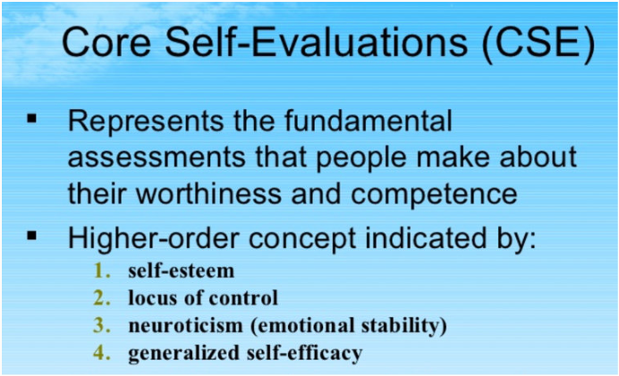
1- Job conditions: Generally, interesting jobs that provide training, variety, independence, and control satisfy most employees. Employees who feel empowered by their leaders experience higher job satisfaction.
2- Personality: personality also plays an important role. People who have positive core self-evaluations (CSEs), who believe in their inner worth and basic competence—are more satisfied with their jobs than people with negative CSEs.
www.midocean.ae

Slide 26

3- Pay: Pay does correlate with job satisfaction and overall happiness for many people, but the effect can be smaller once an individual reaches a standard level of comfortable living.
Money does motivate people. But what motivates us is not necessarily the same as what makes us happy.
4- Corporate social responsibility (CSR): An organization’s self-regulated actions to benefit society or the environment beyond what is required by law. CSR is good for the planet and good for people. Employees whose personal values fit with the organization’s CSR mission are often more satisfied.
www.midocean.ae

Slide 27

Outcomes of Job Satisfaction
www.midocean.ae

Slide 28

Outcomes of Job Satisfaction:
Job Performance.
Organizational citizenship behavior (OCB).
Customer satisfaction.
Life satisfaction.
www.midocean.ae

Slide 29
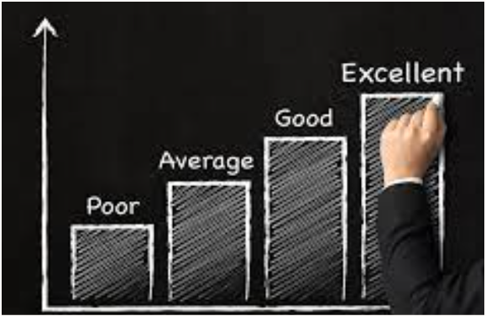
1- Job Performance: Happy workers are more likely to be productive workers. Individuals with higher job satisfaction perform better, and organizations with more satisfied employees tend to be more effective than those with fewer.
2- Organizational citizenship behavior (OCB).
OCBs include people talking positively about their organizations, helping others, and going beyond the normal expectations of their jobs.
People who are more satisfied with their jobs are more likely to engage in citizenship behavior.
www.midocean.ae

Slide 30

3- Customer satisfaction
Because service organization managers should be concerned with pleasing customers, it’s reasonable to ask whether employee satisfaction is related to positive customer outcomes. For frontline employees who have regular customer contact, the answer is “yes.” Satisfied employees appear to increase customer satisfaction and loyalty.
4- Life satisfaction
For most individuals, work is an important part of life, and therefore it makes sense that our overall happiness depends in no small part on our happiness in our work (our job satisfaction).
www.midocean.ae

Slide 31
The Impact of Job Dissatisfaction
Four employee responses to job dissatisfaction
Exit
The exit response directs behavior toward leaving the organization, including looking for a new position or resigning.
Voice Dissatisfaction expressed through active and constructive attempts to improve conditions.
Loyalty Dissatisfaction expressed by passively waiting for conditions to improve.
Neglect Dissatisfaction expressed through allowing conditions to worsen.
www.midocean.ae

Slide 32

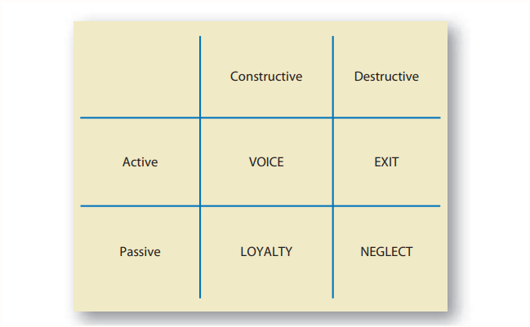
Responses differ along two dimensions: constructive/destructive and active/passive.
www.midocean.ae

Slide 33


www.midocean.ae

