Slide 1


Six-Sigma
(DMAIC Methodology)
Part II
Prepared by Dr. Hesham Mousli
MHA623
Healthcare Quality
Lecture 8

Slide 2

Intended Objectives
Chapter
08
Explain the DMAIC methodology and its phases (Define, Measure, Analyze, Improve, Control).
Apply root cause analysis tools (e.g., Cause & Effect diagrams, Why-Why analysis) to healthcare process issues.
Evaluate process capability using metrics like DPMO, Sigma Level, and Cp/Cpk indices.
Design improvement solutions using cost-benefit analysis and PDSA cycles.
Implement control strategies (e.g., control charts, FMEA) to sustain improvements.

Slide 3

DMAIC Methodology
Analyze
Chapter

Slide 4
DMAIC Methodology
Chapter
08
Analyze Phase:
  The purpose of the Analyze phase is to analyze the data collected related to the Voice of Customer (VOC) and the Voice of Process (VOP) to identify the root causes of the process problems, and to develop the capability of the process.

Slide 5
Analyze Phase
Chapter
08
The activities performed and tools applied during the Analyze phase are:
    Develop cause and effect relationships.
    Determine and validate root causes.
    Develop process capability.

Slide 6
Chapter
Analyze Phase
08
      Develop Cause and Effect Relationships: (Cause & Effect diagram):
  Effect (Problem/Outcome):
    Clearly define the issue to be analyzed.
  Main Cause Categories (Commonly Used):
    People: Human errors, training gaps, lack of communication.
    Machine: Equipment failures, maintenance issues.
    Materials: Defective inputs, supply chain issues, material shortages.
    Methods: Inefficient procedures, unclear guidelines.
    Measurements: Inaccurate data, lack of monitoring, incorrect metrics.
    Environment: External factors, workplace conditions.

Slide 7
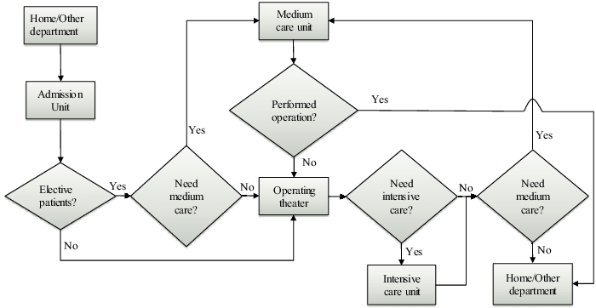
Chapter
Analyze Phase
08
      First, draw the process flowchart:
  Definition: A flowchart is a visual representation of a process using symbols to show steps, decisions, and flow.
  Purpose: Helps in process analysis, troubleshooting, and improvement by identifying inefficiencies.

Slide 8
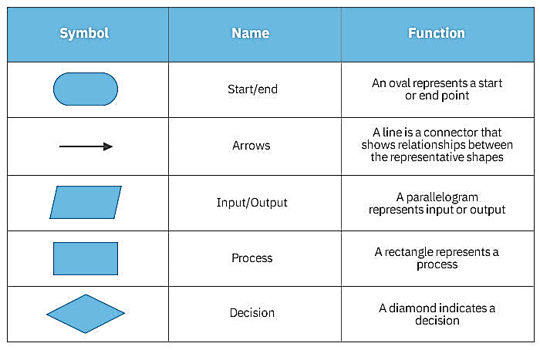
Chapter
Analyze Phase
08
      First, draw the process flowchart:

Slide 9
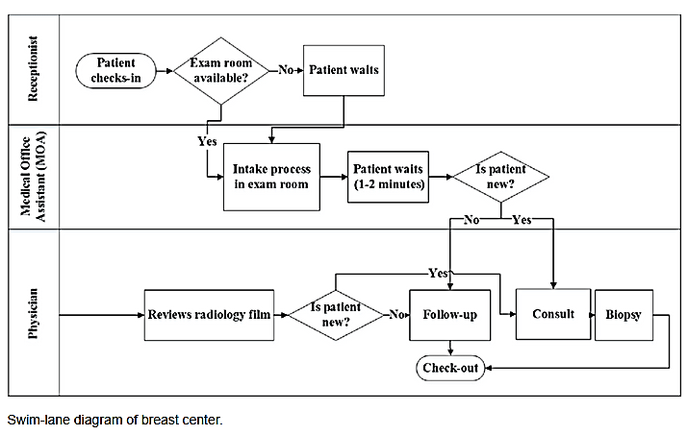
Chapter
Analyze Phase
08
      First, draw the process flowchart:

Slide 10
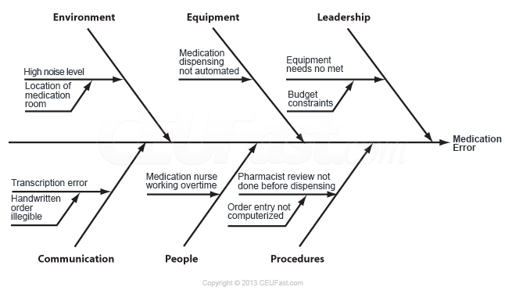

Slide 11
Chapter
Analyze Phase
08
      Develop Cause and Effect Relationships: (Why–Why Diagram):
  Steps to Apply:
    State the Problem → Write it on the left side.
    Ask "Why?" → Identify the direct cause of the problem.
    Ask "Why?" Again → Determine the cause of the previous cause.
    Repeat Until Root Cause is Found → Typically five times but can vary.
    Verify the Root Cause → Ensure it's the true underlying issue before taking corrective actions.

Slide 12
Chapter
Analyze Phase
08
      Determining & Validating Root Causes:
    Correlation Analysis:
      Purpose: Measures the strength and direction of the relationship between two variables.
      Formula: Y= F(X) → Dependent variable (Y) is a function of independent variable(s) (X).
    Correlation Coefficient (r):
      +1.0 → Perfect positive correlation
      0 → No correlation
      -1.0 → Perfect negative correlation
    Interpretation: Higher |r| value means a stronger relationship between variables.

Slide 13
Chapter
Analyze Phase
08
      Determining & Validating Root Causes:
    Linear Regression Analysis
      Purpose: Predicts the relationship between independent (X) and dependent (Y) variables.
      Equation: Y= a + bX (where a = intercept, b = slope).
    Coefficient of Determination (R²):
      Measures how well the prediction equation fits the data.
      0 ≤ R² ≤ 1 (Higher values indicate better fit).
    Application: Helps in forecasting and determining key influencing factors.

Slide 14
Chapter
Analyze Phase
08
      Process Capability Development:
  VOC (Voice of the Customer): Specification limits set by customer requirements.
  VOP (Voice of the Process): Actual process performance (variation).
  USL (Upper Specification Limit): Maximum acceptable value (from VOC).
  LSL (Lower Specification Limit): Minimum acceptable value (from VOC).
  μ (Mu / Process Mean): Average performance level of the process.
  σ (Sigma / Standard Deviation): Measure of process variation (from VOP).

Slide 15
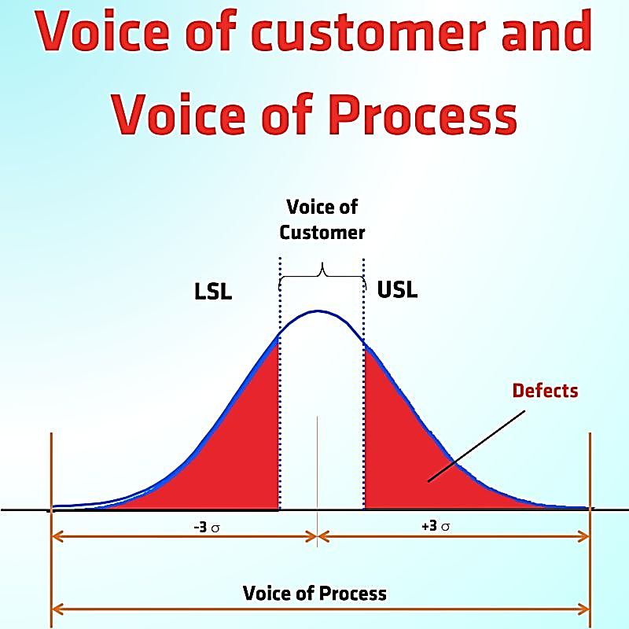
Chapter
Analyze Phase
08
      Process Capability Development:

Slide 16

Chapter
Analyze Phase
08
      Process Capability Development:
  Purpose:
    Measures how well a process meets specifications.
    Identifies areas for improvement and defect reduction.
  Key Metrics:
    DPMO (Defects Per Million Opportunities):
      Formula:
      Lower DPMO = Higher process capability.

Slide 17
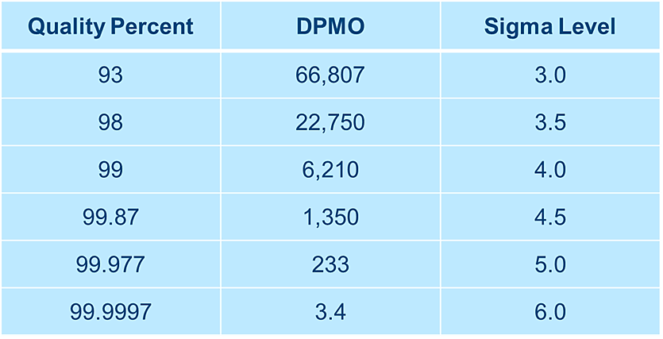
Chapter
Analyze Phase
08
      Process Capability Development:
  Sigma Level (Process Performance):
    Higher sigma level = Fewer defects.
    Common benchmarks:
      3σ (66,800 DPMO) – Average process.
      6σ (3.4 DPMO) – World-class quality.

Slide 18
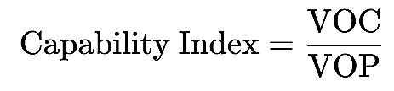
Chapter
Analyze Phase
08
      Process Capability Development:
  Capability Indices (Cp & Cpk):
    Cp: Measures potential process capability.
    Cpk: Accounts for process centering (actual capability).
    General Formula:
    Interpretation:
      Cp/Cpk ≥ 1.33 → Acceptable process.
      Cp/Cpk < 1 → Process needs improvement.

Slide 19
Chapter
Analyze Phase
08
      Process Capability Development:
        There are typically three scenarios regarding process capability:
          Process spread is less than the specification spread.
      So, The process is quite capable (Cp/Cpk > 1.33).

Slide 20
Chapter
Analyze Phase
08
      Process Capability Development:
Process spread is equal to specification spread, an acceptable situation, but there is no room for error.
If the mean shifts, or variation increases, there will be nonconforming outcomes (Cp/Cpk is between 1.00 and 1.33).

Slide 21
Chapter
Analyze Phase
08
      Process Capability Development:
Process spread is greater than the specification spread. The process is NOT capable (Cp/Cpk < 1.00).

Slide 22
DMAIC Methodology
Improve
Chapter

Slide 23
Chapter
DMAIC Methodology
08
Improve Phase:
  The purpose of the Improve phase is to identify improvement recommendations, design the future state, implement pilot projects, train, and document the new processes.

Slide 24
Improve Phase
Chapter
08
The activities performed and tools applied during the Improve phase are:
    Identify improvement recommendations.
    Perform cost/benefit analysis.
    Design future state.
    Establish performance targets and project scorecard.
    Gain approval to implement, then implement.
    Train and execute.

Slide 25
Chapter
Improve Phase
08
Improve Phase Roadmap:
  Goal: Implement solutions that eliminate root causes.
  Key Steps:
    Validate solutions with cost/benefit analysis.
    Design future-state processes.
    Pilot changes using PDSA.
  Example: Implementing barcode medication administration (BCMA) to prevent wrong-patient and wrong-medication errors in a hospital setting.

Slide 26
Chapter
Improve Phase
08
Cost-Benefit Analysis Simplified:
  Formula:
    Benefit/Cost Ratio = (Total Savings × 3 years) ÷ Implementation Cost.
  Decision Rule:
    Resulting value >1.0: Proceed
    Resulting value <1.0: Revise solution
  Case: New EHR system saved $250K/year vs. $500K implementation cost → B/C = 1.5

Slide 27
Chapter
Improve Phase
08
Future State Process Mapping:
  What it fixes:
    Bottlenecks (e.g., lab result delays).
    Redundancies (e.g., duplicate paperwork).
    Inefficient communication (e.g., delays in discharge due to waiting for physician approval).
    Manual data entry errors (e.g., transcription mistakes when transferring patient information).

Slide 28
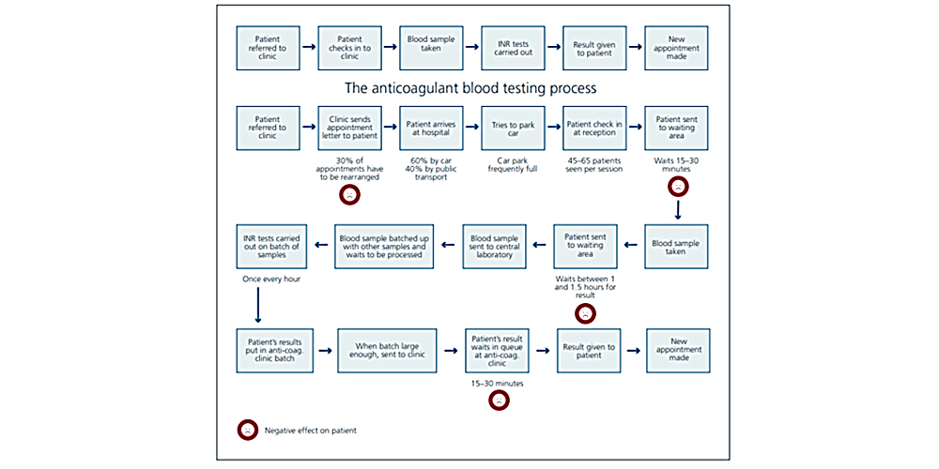

Slide 29
Chapter
Improve Phase
08
PDSA in Action (Hospital Example):
    Plan: Redesign OR turnover checklist.
    Do: Test in 1 operating room.
    Study: Measure turnover time reduction.
    Act: Expand to all ORs after 15% improvement.

Slide 30
Chapter
Improve Phase
08
Change Management Essentials:
  Critical for Success:
    Train “Improvement Champions" first (e.g., charge nurses).
  Address resistance with:
    Quick wins (show 30-day results).
    Staff feedback sessions.
  "Culture eats strategy for breakfast" Peter Drucker

Slide 31
DMAIC Methodology
Control
Chapter

Slide 32
Chapter
DMAIC Methodology
08
Control Phase:
  The purpose of the Control phase is to measure the results of the pilot projects, and manage the change on a broader scale.

Slide 33
Control Phase
Chapter
08
The activities performed and tools applied during the Control phase are:
    Monitor & Control Performance.
    Scale Validated Improvements.
    Sustain & Advance.

Slide 34
Control Phase
Chapter
08
    Monitor & Control Performance:
  Confirm Proper Execution: Verify training and implementation were done correctly.
  Gather Performance Data: Collect metrics after changes are implemented.
  Compare with Baseline: Check if improvements meet targets.
  Identify Gaps: Detect deviations and take corrective actions.

Slide 35
Control Phase
Chapter
08
Control Charts:
  Definition:
    Graphical tools in SPC to monitor process stability over time.
    Plot data points with a central line (average), upper/lower control limits.
  Purpose:
    Distinguish between common cause (expected) and special cause (unexpected) variations.
    Ensure consistent quality in healthcare (e.g., patient wait times, infection rates).

Slide 36
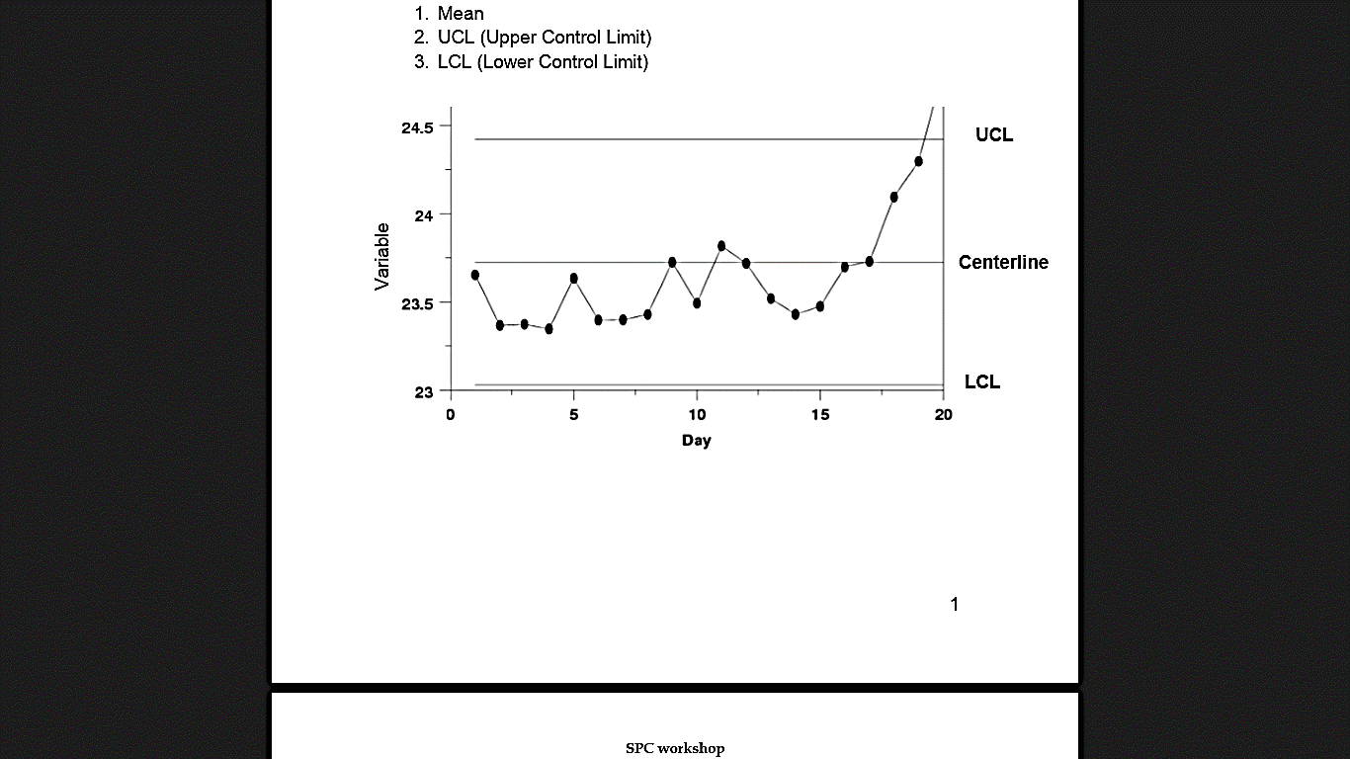
Control Phase
Chapter
08
Control Charts:
  Key Components:
    Central Line (Mean): Process average.
    Control Limits (UCL/LCL): ±3 standard deviations from mean.

Slide 37
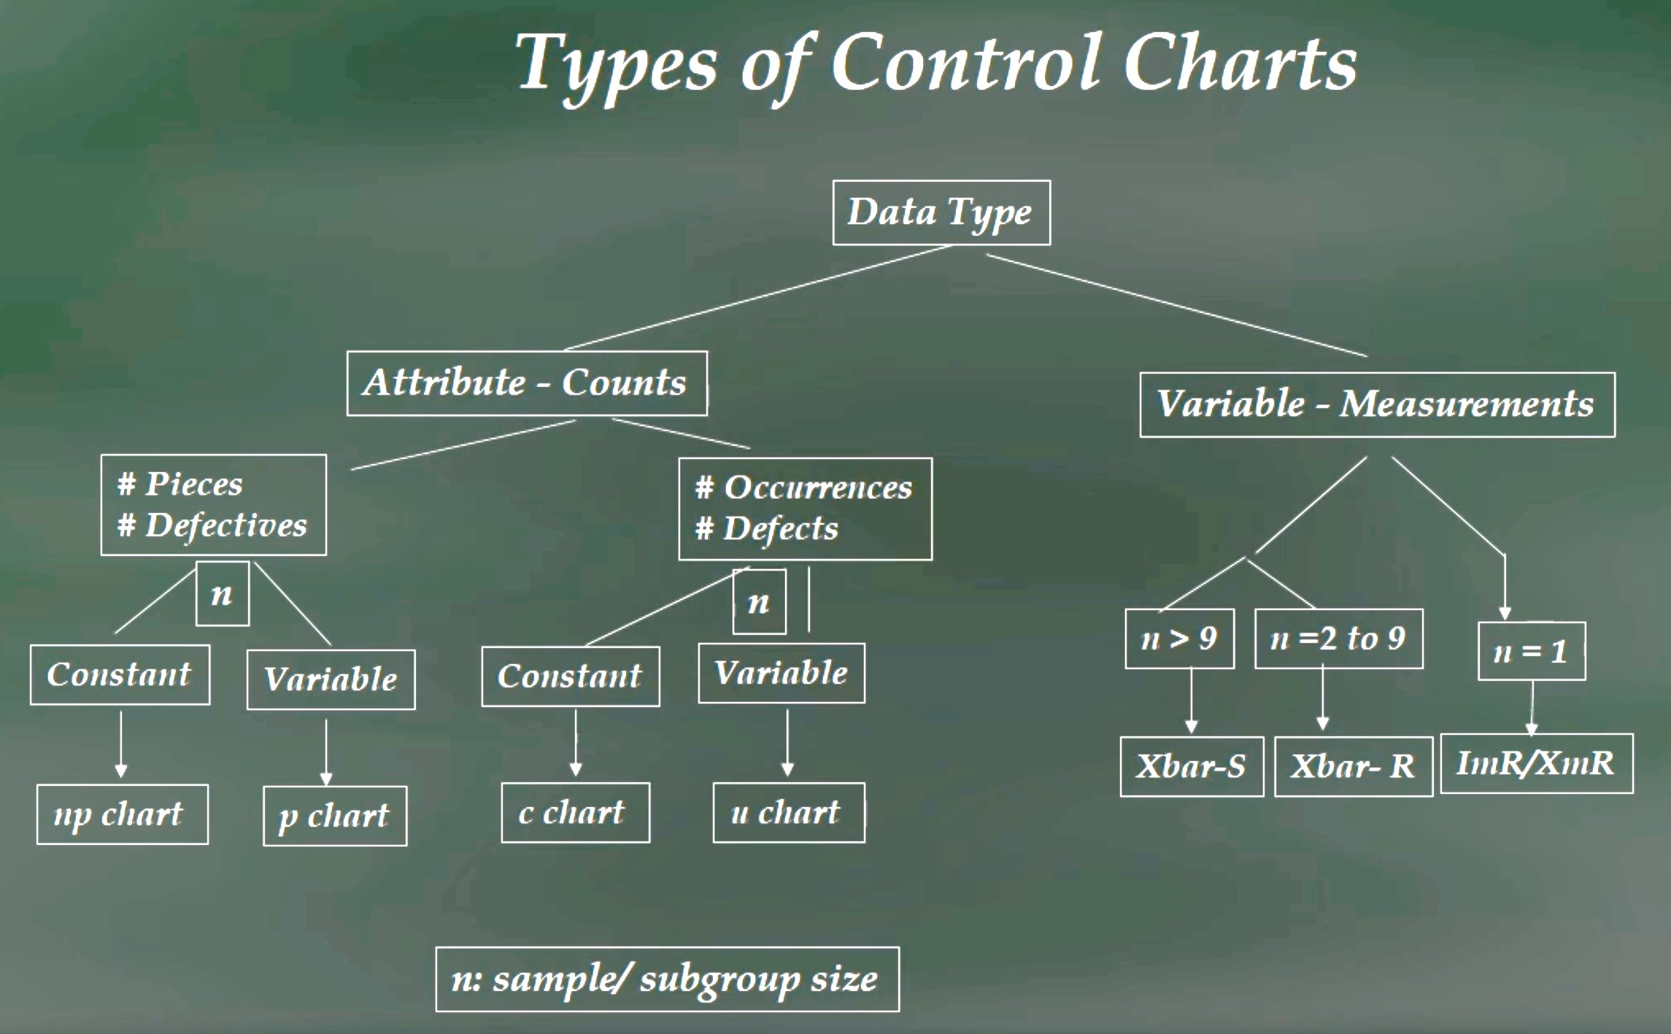
Control Phase
Chapter
08

Slide 38
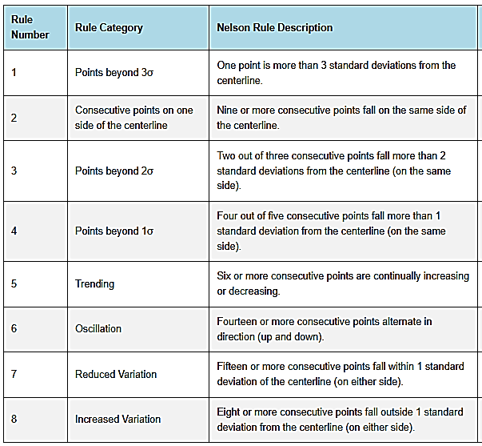
Control Phase
Chapter

Slide 39
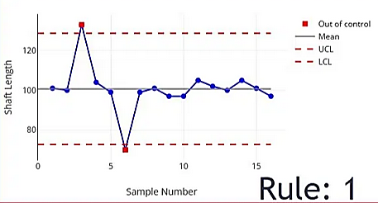
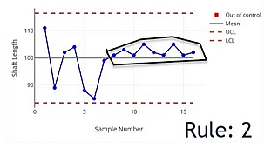
Control Phase
Chapter

Slide 40
Control Phase
Chapter
08
    Scale Validate Improvements:
  Rollout: Deploy proven solutions to new areas with phased implementation.
  Engage: Mobilize champions and address concerns through targeted communication.
  Standardize: Embed successful methods in Standard Operating Procedures (SOPs) and digital systems.

Slide 41
Control Phase
Chapter
08
Failure Mode & Effects Analysis (FMEA):
  Definition: A systematic method to:
    Identify potential failures in products/processes.
    Evaluate their risks (Severity, Occurrence, Detection).
    Prioritize and mitigate high-risk failures.

Slide 42
Chapter
Control Phase
08
Failure Mode & Effects Analysis (FMEA):
  Risk Evaluation & RPN Calculation:
    Rating Scales:
      Severity (S): 1 (minor) → 10 (catastrophic)
      Occurrence (O): 1 (rare) → 10 (inevitable)
      Detection (D): 1 (easily detected) → 10 (undetectable)
Calculate RPN (Risk Priority Number) = S × O × D
Prioritize & act on high-RPN failures.

Slide 43
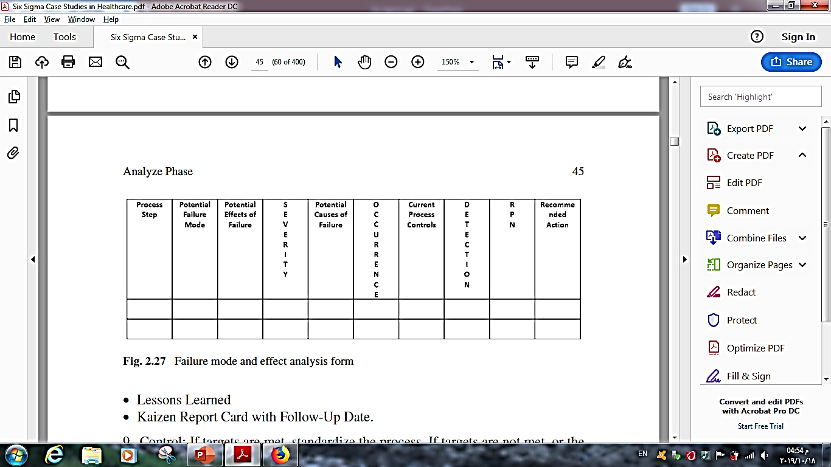
Control Phase
Chapter
08

Slide 44
Chapter
Control Phase
08
    Sustain & Advance:
  Monitor: Track performance via control charts and regular audits.
  Reinforce: Link to KPIs and recognize adoption.
  Evolve: Continuous refinement through PDSA cycles.

Slide 45
Wrap Up
Chapter
08
DMAIC is a structured framework for quality improvement, grounded in data-driven decision-making.
Root causes are identified through tools like flowcharts, correlation analysis, and regression.
Process capability is measured via VOC/VOP alignment, Sigma Levels, and capability indices (Cp/Cpk).
Improvements require validation through pilots, cost-benefit analysis, and change management.

Slide 46
Wrap Up
Chapter
08
Control tools (e.g., control charts, FMEA) ensure stability and scalability of solutions.
RPN (FMEA) prioritizes risks by scoring Severity, Occurrence, and Detection.
Sustained success depends on monitoring (KPIs, audits) and iterative refinement (PDSA).
Culture is critical—engage stakeholders early and celebrate quick wins to drive adoption.

Slide 47



Thank You

