Slide 1




HCIA Big Data
HBase — Distributed Database
Eng. Hagar Muhammed
Lecture 5

Slide 2


Types of Databases
HBase Overview
Storage Mechanism in HBase
Features of HBase
HBase Performance Tuning
Common Shell Commands of HBase

Slide 3
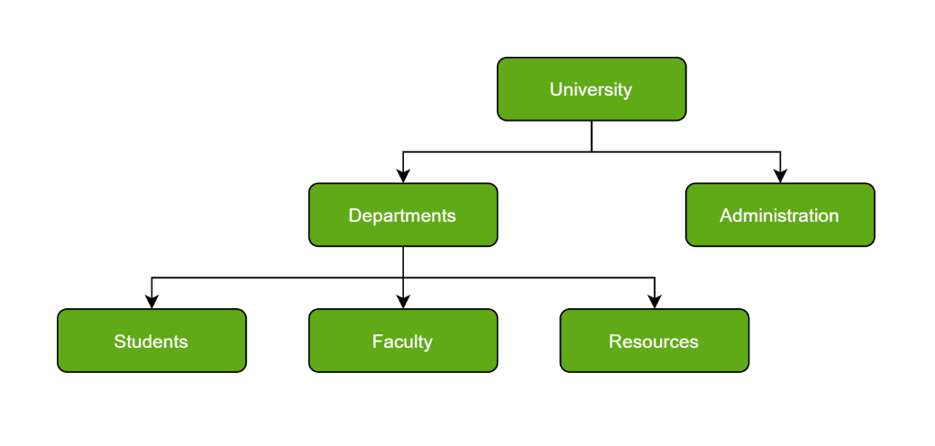
Lecture
05
Hierarchical Databases
Just as in any hierarchy, this database follows the progression of data being categorized in ranks or levels, wherein data is categorized based on a common point of linkage. As a result, two entities of data will be lower in rank and the commonality would assume a higher rank. Refer to the diagram below:

Slide 4
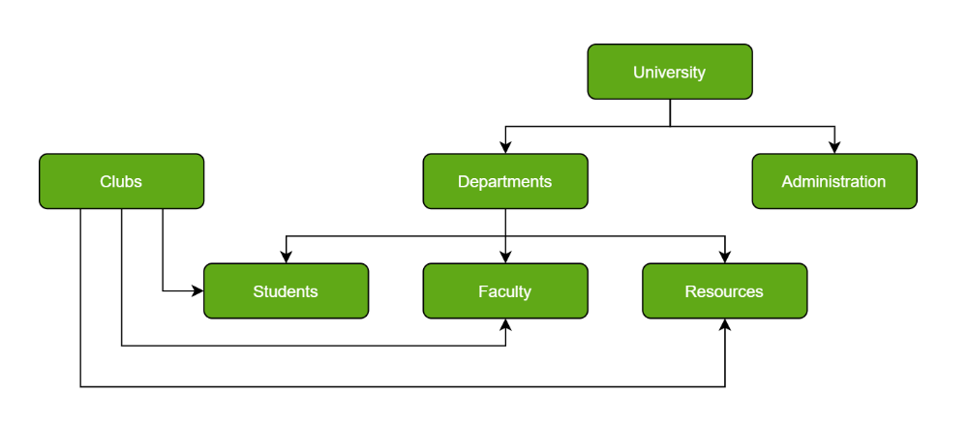
Lecture
05
Network Databases :
A network database is a hierarchical database, but with a major tweak. The child records are given the freedom to associate with multiple parent records. As a result, a network or net of database files linked with multiple threads is observed. Notice how the Student, Faculty, and Resources elements each have two-parent records, which are Departments and Clubs.

Slide 5
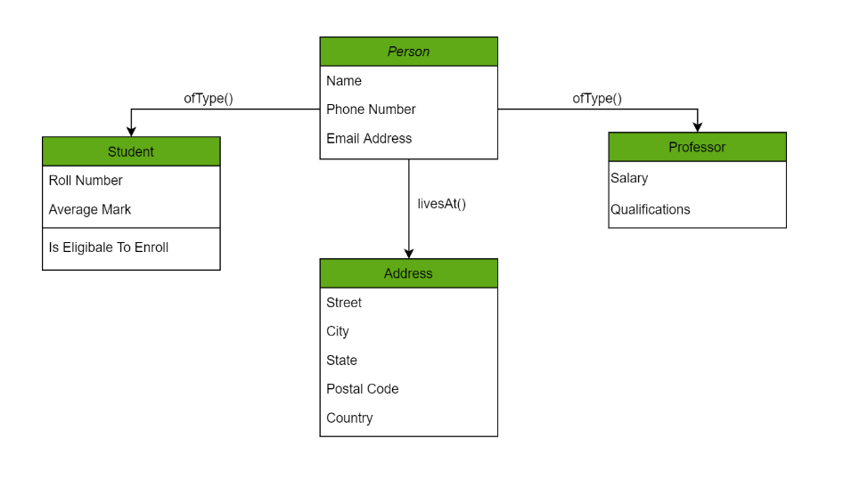
Lecture
05
Object-Oriented Databases :
Those familiar with the Object-Oriented Programming Paradigm would be able to relate to this model of databases easily. Information stored in a database is capable of being represented as an object which response as an instance of the database model. Therefore, the object can be referenced and called without any difficulty. As a result, the workload on the database is substantially reduced.

Slide 6
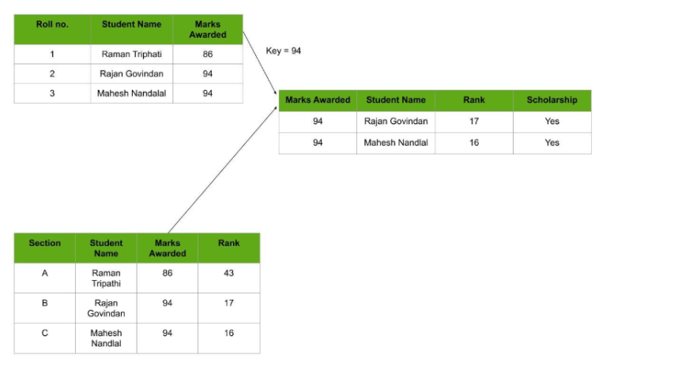
Lecture
05
Relational Database:
Considered the most mature of all databases, these databases lead in the production line along with their management systems. In this database, every piece of information has a relationship with every other piece of information. This is on account of every data value in the database having a unique identity in the form of a record.

Slide 7
Lecture
05
Column Based Databases :
A column-oriented DBMS or columnar DBMS is a database management systems(DBMS) that stores data tables by column rather than by row. Benefits include more efficient access to data when only querying a subset of columns (by eliminating the need to read columns that are not relevant), and more options for data compression. However, they are typically less efficient for inserting new data.
Practical use of a column store versus a row store differs little in the relational Database world. Both columnar and row databases can use traditional database query languages like SQL to load data and perform queries

Slide 8
Types of Databases
HBase Overview
Storage Mechanism in HBase
Features of HBase
HBase Performance Tuning
Common Shell Commands of HBase

Slide 9
Lecture
05
HBase Overview
HBase is a distributed column-oriented database built on top of the Hadoop file system. It is an open-source project and is horizontally scalable.
HBase is a data model provide quick random access to huge amounts of structured data. It leverages the fault tolerance provided by the Hadoop File System (HDFS).
It is a part of the Hadoop ecosystem that provides random real-time read/write access to data in the Hadoop File System.
Internet and Information Technology - ITC202

Slide 10
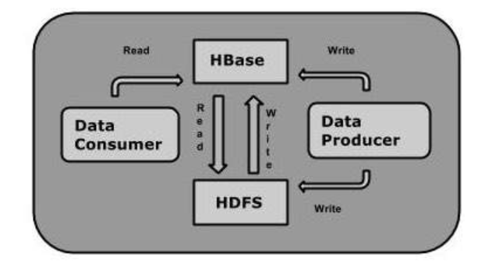
Lecture
05
Hbase Overview
The user can store the data in HDFS either directly or through HBase. Data consumer reads/accesses the data in HDFS randomly using HBase. HBase sits on top of the Hadoop File System and provides read and write access.
Internet and Information Technology - ITC202

Slide 11
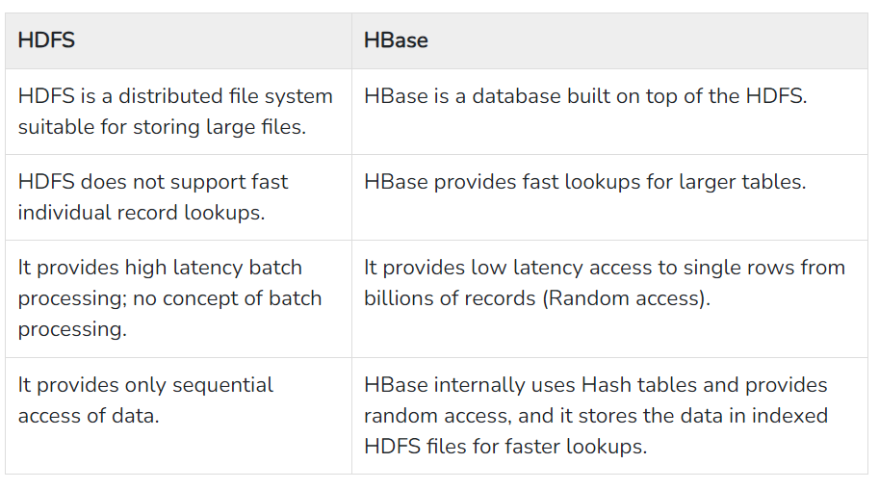

Lecture
05
Internet and Information Technology - ITC202

Slide 12
Types of Databases
HBase Overview
Storage Mechanism in HBase
Features of HBase
HBase Performance Tuning
Common Shell Commands of HBase

Slide 13
Lecture
05
Storage Mechanism in HBase
HBase is a column-oriented database and the tables in it are sorted by row. The table schema defines only column families, which are the key value pairs. A table have multiple column families and each column family can have any number of columns. Subsequent column values are stored on the disk. Each cell value of the table has a timestamp.
Internet and Information Technology - ITC202

Slide 14
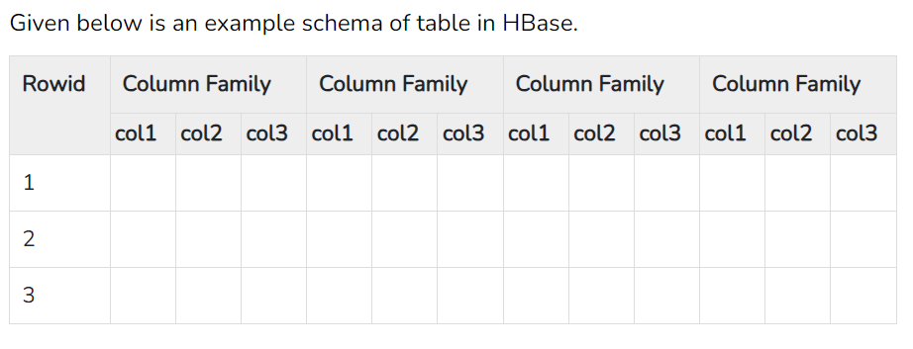
Lecture
05
Storage Mechanism in HBase
Table is a collection of rows.
Row is a collection of column families.
Column family is a collection of columns.
Column is a collection of key value pairs.
Internet and Information Technology - ITC202

Slide 15
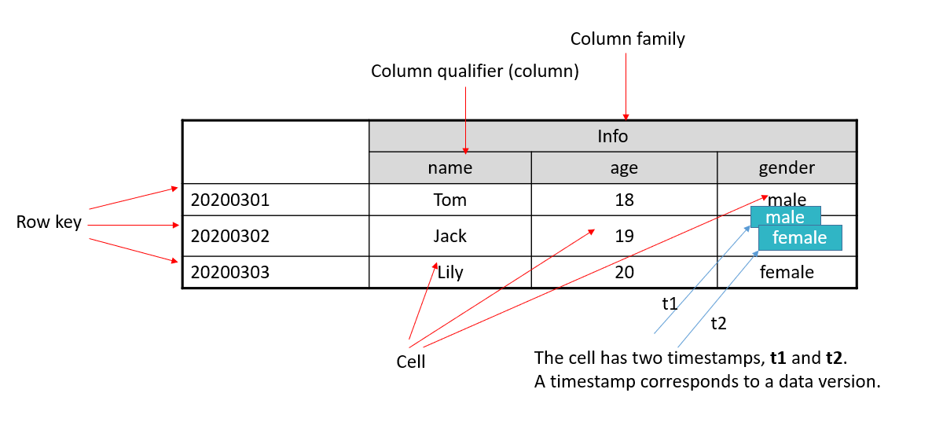
Lecture
05
HBase Table Structure
Internet and Information Technology - ITC202

Slide 16
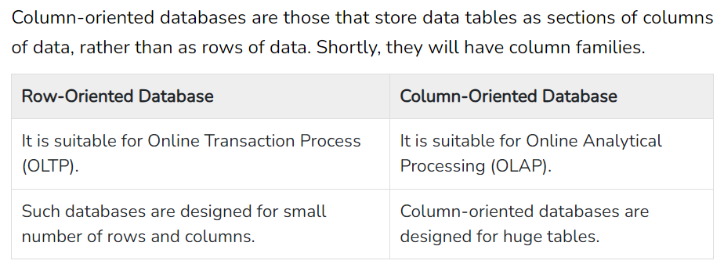
Lecture
05
Column Oriented and Row Oriented
Internet and Information Technology - ITC202

Slide 17
Types of Databases
HBase Overview
Storage Mechanism in HBase
Features of HBase
HBase Performance Tuning
Common Shell Commands of HBase

Slide 18
Lecture
05
Features of HBase
HBase is linearly scalable.
It has automatic failure support.
It provides consistent read and writes.
It integrates with Hadoop, both as a source and a destination.
It has easy java API for client.
It provides data replication across clusters.
Internet and Information Technology - ITC202

Slide 19
Use Cases of HBase
HBase scenarios
Data storage
Cube analysis
NewSQL
Feeds
Message/Order storage
Meteorological data
Time series data
User profile

Slide 20
Lecture
05
Where to use HBase
Apache HBase is used to have random, real-time read/write access to Big Data.
It hosts very large tables on top of clusters of commodity hardware.
Apache HBase is a non-relational database modeled after Google's Bigtable. Bigtable acts up on Google File System, likewise Apache HBase works on top of Hadoop and HDFS.
Internet and Information Technology - ITC202

Slide 21
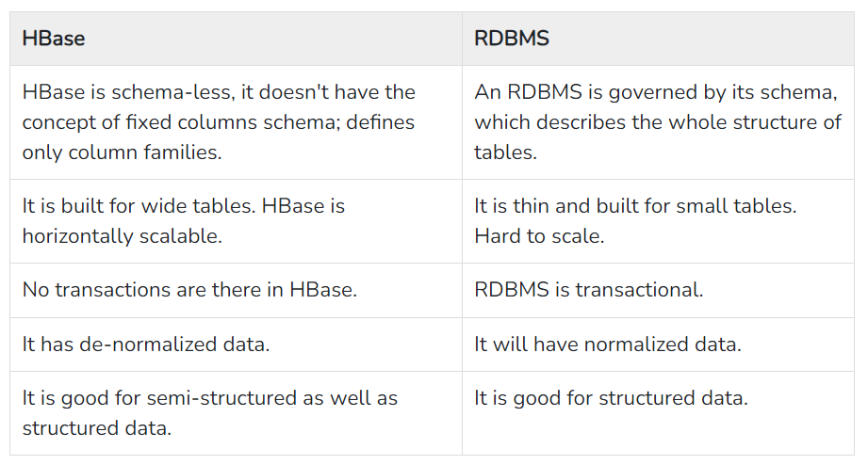
Lecture
05
HBase and RDBMS
Internet and Information Technology - ITC202

Slide 22
Row- and Column-oriented Storage
Lecture
05
Row-oriented storage refers to data stored by rows in an underlying file system. Generally, a fixed amount of space is allocated to each row.
  Advantages: Data can be added, modified, or read by row.
  Disadvantage: Some unnecessary data is obtained when a column is queried.
Column-oriented storage refers to data stored by columns in an underlying file system.
  Advantage: Data can be read or calculated by column.
  Disadvantage: When a row is read, multiple I/O operations may be required.
Row-oriented storage
ID
Name
Phone
Address
ID
Name
Phone
Address
K1
V1
K2
V2
K3
V3
K4
V4
Column- oriented storage
V5
K5
K6
V6
K7
V7
K8
V8

Slide 23
Types of Databases
HBase Overview
Storage Mechanism in HBase
Features of HBase
HBase Architecture
HBase Performance Tuning
Hbase shell commands

Slide 24
HBase Architecture
Lecture
05
Client
ZooKeeper
HMaster
HRegionServer
HRegionServer
HRegion
HRegion
HBase
Store
MemStore
Store
MemStore
Store
MemStore
Store
MemStore
HLog
StoreFile
HLog
StoreFile
StoreFile
...
StoreFile
...
...
...
...
...
...
StoreFile
StoreFile
...
HFile
HFile
HFile
HFile
HFile
HFile
...DFS Client
...DFS Client
HDFS
...
DataNode
DataNode
DataNode
DataNode
DataNode

Slide 25
Lecture
05
HMaster
Assigns regions to the region servers and takes the help of Apache ZooKeeper for this task.
Handles load balancing of the regions across region servers. It unloads the busy servers and shifts the regions to less occupied servers.
Maintains the state of the cluster by negotiating the load balancing.
Is responsible for schema changes and other metadata operations such as creation of tables and column families.

Slide 26
Lecture
05
RegionServer
Communicate with the client and handle data-related operations.
Handle read and write requests for all the regions under it.
Decide the size of the region

Slide 27
Data Read and Write Process
Lecture
05
When you write data, it is allocated to the corresponding HRegionServer for execution.
Your data is first written to HLog, then to MemStore, and finally to disks to generate a StoreFile.
The commit() invocation returns the data to the client only after the operation is written to HLog.
When you read data, the HRegionServer first accesses the MemStore cache. If the MemStore cache cannot be found, the HRegionServer searches StoreFile on the disk.

Slide 28
Cache Refreshing
Lecture
05
The system periodically writes the content in the MemStore cache to the StoreFile file on the disk, clears the cache, and writes a tag in the HLog.
A new StoreFile file is generated each time data is written. Therefore, each Store contains multiple StoreFile files.

Slide 29
Cache Refreshing
Lecture
05
Each HRegionServer has its own HLog file. Each time the HRegionServer is started, the HLog file is checked to determine whether a new write operation is performed after the latest cache refresh operation. If an update is detected, the HLog file is written to MemStore and then StoreFile to provide services for users.

Slide 30
Lecture
05
Zookeeper
Zookeeper is an open-source project .
Zookeeper has ephemeral nodes representing different region servers. Master servers use these nodes to discover available servers.
In addition to availability, the nodes are also used to track server failures or network partitions.
Clients communicate with region servers via zookeeper.

Slide 31
Types of Databases
HBase Overview
Storage Mechanism in HBase
Features of HBase
HBase Architecture
HBase Performance Tuning
Hbase shell commands

Slide 32
Compaction
Lecture
05
Read latency lengthens as the number of HFiles increases.
Compaction reduces the number of small files (HFiles) in the same column family of the same region to improve read performance.
Compaction is classified into minor compaction and major compaction.
  Minor compaction: small-scale compaction. There are limits on the minimum and maximum number of files. Typically, small files in a continuous time range are merged.
  Major compaction: all HFile files under the ColumnFamily of the region.
  Minor compaction complies with a certain algorithm when selecting files.

Slide 33
Compaction
Lecture
05
Write
put
MemStore
Flush
HFile
HFile
HFile
HFile
HFile
HFile
HFile
Minor Compaction
HFile
HFile
HFile
Major Compaction
HFile

Slide 34

OpenScanner
Lecture
05
In the OpenScanner process, two different scanners are created to read HFile and MemStore data.
  The scanner corresponding to HFile is StoreFileScanner.
  The scanner corresponding to MemStore is MemStoreScanner.
ColumnFamily-1
MemStore
  HFile-11
  HFile-12
Region
ColumnFamily-2
MemStore
  HFile-21
  HFile-22

Slide 35
BloomFilter
Lecture
05
BloomFilter optimizes random read scenarios, that is, the Get scenario. It can be used to quickly determine whether a user data record exists in a large dataset (most data in the dataset cannot be loaded to the memory).
BloomFilter can misjudge whether a data record exists. However, the judgment result of "The subscriber data XXXX does not exist." is reliable.
HBase BloomFilter data is stored in HFiles.

Slide 36
Row Key
Lecture
05
Row keys are stored in alphabetical order. Therefore, when designing row keys, you need to fully utilize the sorting feature to store frequently read data together and store recently accessed data together.
For example, if data recently written to the HBase table is most likely to be accessed, you can use the timestamp as a part of the row key. Because the data is sorted in alphabetical order, you can use Long.MAX_VALUE - timestamp as the row key.

Slide 37
Types of Databases
HBase Overview
Storage Mechanism in HBase
Features of HBase
HBase Architecture
HBase Performance Tuning
Hbase shell commands

Slide 38
Common Shell Commands of HBase
Lecture
05
create: creates a table.
list: lists all tables in HBase.
put: adds data to a specified cell in a table, row, or column.
scan: browses information about a table.
get: obtains the value of a cell based on the table name, row, column, timestamp, time range, and version number.
enable/disable: enables or disables a table.
drop: deletes a table.

Slide 39
Lecture
HBase is a distributed, scalable, and column-oriented database system that is part of the larger Apache Hadoop ecosystem. Designed for managing and storing massive amounts of data.
Key features of HBase include its horizontal scalability, allowing it to handle datasets by distributing data across multiple servers. HBase also offers impressive speed and performance, making it suitable for real-time or near-real-time applications. Its flexibility enables easy modifications to the schema and data, catering to evolving requirements.

Slide 40


