Slide 1


Machine Learning
Prepared by Dr. Yasser Abdelhamid
DS 620
Machine Learning
Lecture 0
midocean.edu.km

Slide 2

Course Outline
This course gives the student a broad introduction to supervised machine learning.
The course covers topics in
  regression,
  classification,
  neural networks,
  ensemble methods and,
  a brief introduction to deep learning and reinforcement learning.
The course introduces examples from practical applications to demonstrate how to create learning and adaptable systems.
midocean.edu.km

Slide 3
Learning Outcomes
Upon completion of this course, the student will be able to:
  Understand the advantages and disadvantages of the most widely used machine learning techniques.
  Identify the underlying problems and difficulties that machine learning process faces, such as data quality, model choice, model complexity, etc.
  Create and refine supervised machine learning models for binary classification and prediction problems, such as logistic regression.
  The ability to create and use a variety of machine learning algorithms in a variety of practical situations.
  Utilize the well-known machine learning packages NumPy and scikit-learn to create machine learning models in Python.
midocean.edu.km

Slide 4

Week | Topics
1 | Orientation week
2 | Introduction to Machine Learning
3 | Regression
4 | K-Nearest Neighbors (KNN)
5 | Logistic Regression
6 | Perceptron
7 | Support Vector Machines (SVM)
8 | Naive Bayes
9 | Decision Tree classifier
10 | Ensemble Learning
11 | Variance vs bias trade off
12 | Revision
13 | Final Exams
Course Plan
midocean.edu.km

Slide 5

Reference
  Data Mining and Machine Learning: Fundamental Concepts and Algorithms, Mohammed J. Zaki and Wagner Meira, Cambridge University Press, 2020.
midocean.edu.km

Slide 6

Tuesday, 9:00pm – 10:30pm
Office Hours
midocean.edu.km

Slide 7
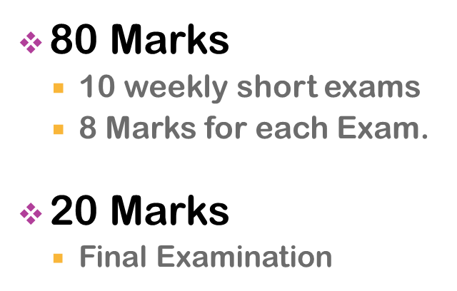

Assessment
midocean.edu.km

Slide 8


Thank You
midocean.edu.km

