Slide 1


Computer Vision,
and Digital Image
Processing
Prepared by Dr. Mohamed Mostafa
AI 612
Lecture 2

Slide 2



Digital Image Processing
Lecture 2
AI 612
Prepared by
Dr. Mohamed Mostafa
www.midocean.ae

Slide 3

Image Interpolation
Basic Relations between Pixels
Chapter
01
www.midocean.ae

Slide 4
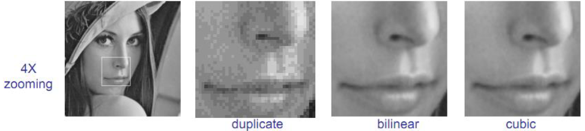
Image Interpolation
Interpolation is used in tasks such as zooming, shrinking, rotating, and geometrically correcting digital images.
Some methods used in Image Interpolation:
Pixel Replication/Nearest Neighbor
Bilinear Interpolation
Bicubic Interpolation

Slide 5
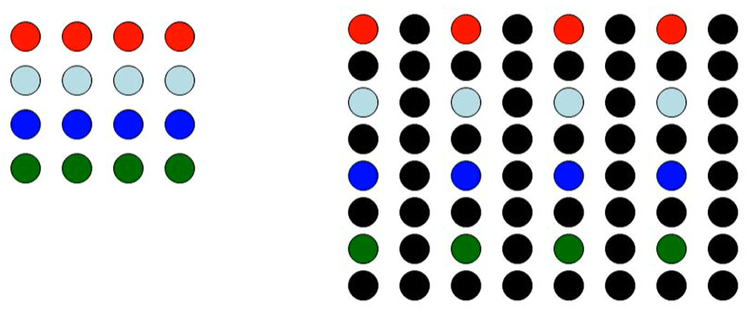
Image Interpolation
Pixel Replication/Nearest Neighbor

Slide 6
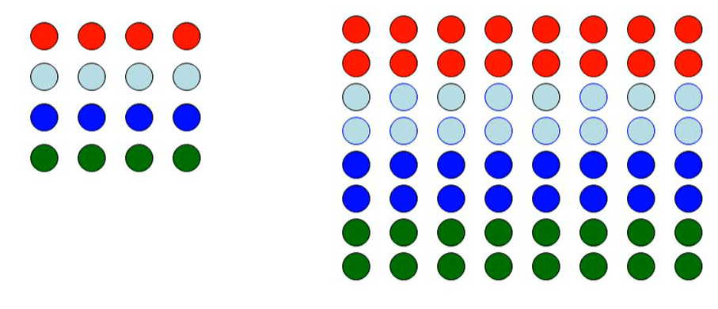
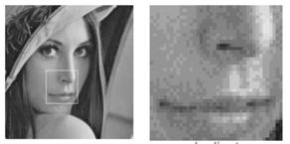
Image Interpolation
Pixel Replication/Nearest Neighbor
Checkboard Effect

Slide 7




Image Interpolation
Pixel Replication/Nearest Neighbor Example
4 x 4
30 | 85
45 | 105
2 x 2

Slide 8
Image Interpolation
Pixel Replication/Nearest Neighbor Example
4 x 4
30 | 30 | 85 | 85
30 | 30 | 85 | 85
45 | 45 | 105 | 105
45 | 45 | 105 | 105
30 | 85
45 | 105
2 x 2

Slide 9
Image Interpolation
Pixel Replication/Nearest Neighbor Example
30 | 85
45 | 105
5 x 5
2 x 2
???

Slide 10
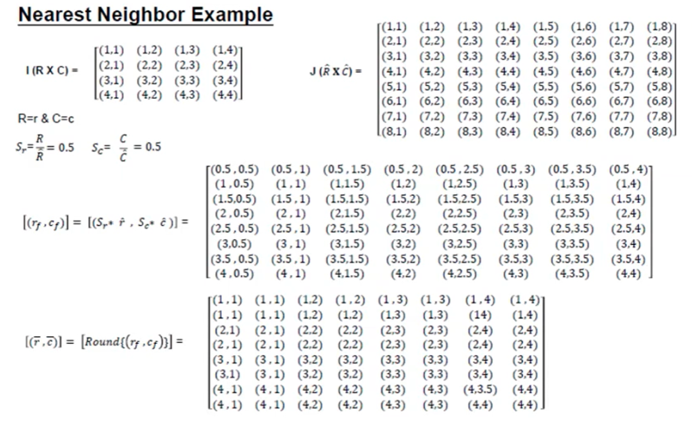
Image Interpolation
Pixel Replication/Nearest Neighbor Example
Source: ImagePrcessingJU

Slide 11

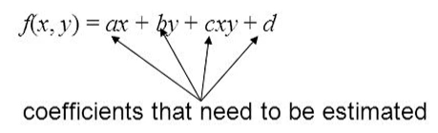
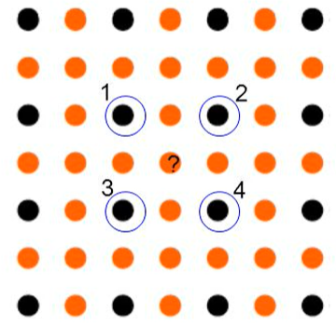
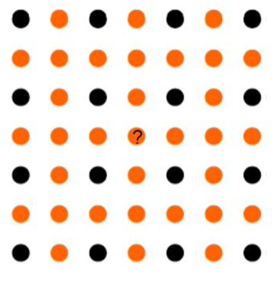
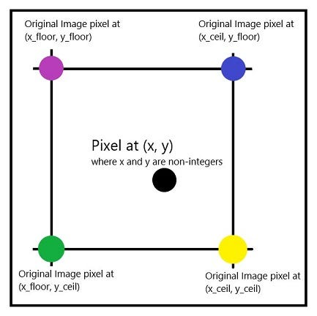
Image Interpolation
Bilinear Interpolation
We use the four nearest neighbors to estimate the intensity at a given location.

Slide 12
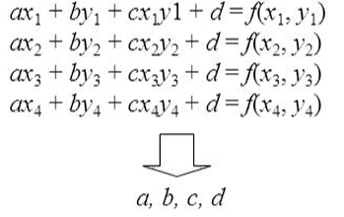
Image Interpolation
Bilinear Interpolation
We use the four nearest neighbors to estimate the intensity at a given location.

Slide 13
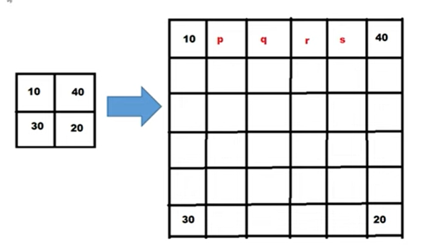
Image Interpolation
Bilinear Interpolation Example:
Suppose that 2x2 image has been enlarged by factor of 5. Use linear interpolation to find the values of p, q, r, s.
P= 10*4/5 + 40 * 1/5= 16
1/5
4/5

Slide 14
Image Interpolation
Bilinear Interpolation Example:
Suppose that 2x2 image has been enlarged by factor of 5. Use linear interpolation to find the values of p, q, r, s.
q= 10*3/5 + 40 * 2/5= 22
2/5
3/5

Slide 15
Image Interpolation
Bilinear Interpolation Example:
Suppose that 2x2 image has been enlarged by factor of 5. Use linear interpolation to find the values of p, q, r, s.
16
22
28
34
Final Solution

Slide 16
Image Interpolation
Bilinear Interpolation Example:
Suppose that 2x2 image has been enlarged by factor of 5. Use linear interpolation to find the values of p, q, r, s.
What is t, u and are required
t
u

Slide 17
Image Interpolation
Bilinear Interpolation Example:
- Scale the current image by factor of 2
30 |  |  | 85
45 |  |  | 105
30 | 85
45 | 105
Take home: Practice

Slide 18

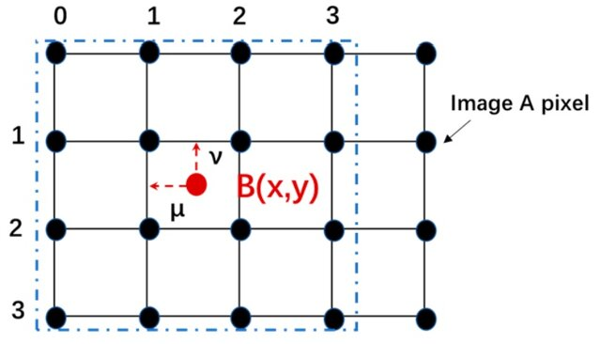
Image Interpolation
Bicubic Interpolation
Unknown pixel intensity is estimated from the sixteen nearest neighbors
(4×4 neighborhood).
Bicubic interpolation is the standard used in commercial image editing applications:
Adobe Photoshop
Corel Photopaint.

Slide 19
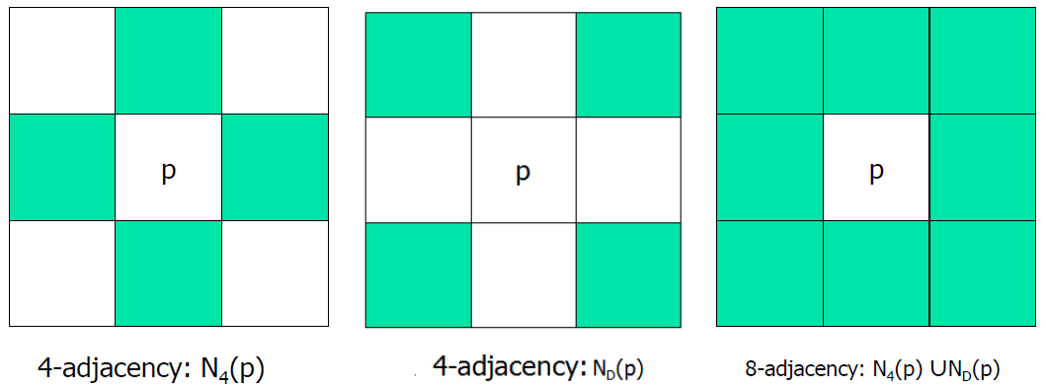
Basic Relations between Pixels
Neighbors of a Pixel
(x, y − 1)
(x-1, y − 1)
(x+1, y − 1)
(x , y)
(x , y)
(x , y)
(x − 1, y)
(x + 1, y)
(x, y + 1)
(x-1, y + 1)
(x+1, y + 1)

Slide 20
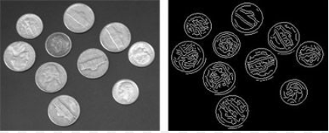
Basic Relations between Pixels
Neighbors of a Pixel
Edge Detection Algorithm Like the Sobel Operator

Slide 21
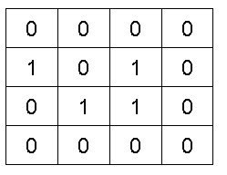
Basic Relations between Pixels
Adjacency
Two pixels that are neighbors and have the same gray level are adjacent;
Types: 4-adjacency, 8-adjacency, m-adjacency.
Binary Image
4-adjacency
intensity value, V = {1}

Slide 22
Basic Relations between Pixels
Adjacency
Two pixels that are neighbors and have the same gray level are adjacent;
Types: 4-adjacency, 8-adjacency, m-adjacency.
Binary Image
8-adjacency
intensity value, V = {1}

Slide 23
Basic Relations between Pixels
Adjacency
Two pixels that are neighbors and have the same gray level are adjacent;
Types: 4-adjacency, 8-adjacency, m-adjacency.
Gray-scale Image
30 | 10 | 57 | 8
37 | 4 | 3 | 44
45 | 70 | 2 | 105
5 | 55 | 60 | 53
Not adjacent
intensity value, V = {1, 2,…, 10}

Slide 24
Basic Relations between Pixels
Adjacency
m-adjacency.
Binary Image
0 | 1 | 1
0 | 1 | 0
0 | 0 | 1
0 | 1 | 1
0 | 1 | 0
0 | 0 | 1
0 | 1 | 1
0 | 1 | 0
0 | 0 | 1
intensity value, V = {1}
No Unique Path (ambiguity)

Slide 25
Basic Relations between Pixels
Adjacency
m-adjacency.
q is in ND(p) or the set N4(p)¨N4(q) has no pixels whose values are from V.
0 | 1 | 1
0 | 1 | 0
0 | 0 | 1
4-Adjacency
8-Adjacency
Binary Image
intensity value, V = {1}

Slide 26
Basic Relations between Pixels
Adjacency
m-adjacency.
q is in ND(p) or the set N4(p)¨N4(q) has no pixels whose values are from V.
0 | 1 | 1
0 | 1 | 0
0 | 0 | 1
4-Adjacency
8-Adjacency
√
x
Binary Image
intensity value, V = {1}

Slide 27
Basic Relations between Pixels
Adjacency
m-adjacency.
q is in ND(p) or the set N4(p)¨N4(q) has no pixels whose values are from V.
0 | 0 | 1
0 | 1 | 0
0 | 0 | 1
4-Adjacency
8-Adjacency
x
√
Binary Image
intensity value, V = {1}

Slide 28
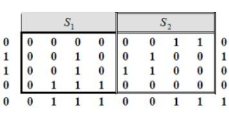
Basic Relations between Pixels
Adjacency
Practice
Consider the two image subsets, S1 and S2, shown in the following figure. For V={1}, determine whether these two subsets are
4-adjacent,
8-adjacent, or
m-adjacent.

Slide 29
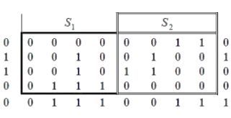
Basic Relations between Pixels
Adjacency
S1 and S2 are not 4-connected since q is not in the set N₄(p),
S1 and S2 are 8-connected, since q is not in the set N₈(p),
S1 and S2 are m-adjacent since:
  q is not in the set N_{D}(p), and
  the set of N₄(p) ∩ N₄(q) is empty.
Solution
q
p

Slide 30



Basic Relations between Pixels
Distance Measures
q(u,v)
Euclidean distance between p and q
D
p(x,y)
City-block distance between p and q (D₄)
Chessboard distance between p and q (D₈)

Slide 31
Basic Relations between Pixels
Distance Measures

Slide 32
Basic Relations between Pixels
Distance Measures
m-adjacency between p and q
- The Dm distance between two points is defined as the shortest m-path between the points.
The distance between two pixels will depend on the values of the pixels along the path, as well as the values of their neighbors.
Note:
The Path length is the number of the pixels involved within the path

Slide 33
Basic Relations between Pixels
Distance Measures
Practice
An image segment is shown below. Let V be the set of gray levels values used to define connectivity in the image. Capture D₄, D₈, and D_{m} distances between pixels 'p' and 'q' for:
1. V= {2, 3}
2. V= {2, 3, 6}
p
3 | 2 | 7 | 6
7 | 4 | 3 | 2
1 | 0 | 2 | 0
5 | 1 | 7 | 6
q

Slide 34
Basic Relations between Pixels
p
3 | 2 | 7 | 6
7 | 4 | 3 | 2
1 | 0 | 2 | 3
5 | 1 | 7 | 6
Distance Measures
Coordinates of p(x,y)= (0, 0)
Coordinates of q(u,v)= (4, 4)
q
D₄ (p, q) = |0 - 4| + |0-4| = 8 Units
D₈ (p, q) = max (|0 - 4| , |0-4| ) = 4 Units

Slide 35
Basic Relations between Pixels
p
3 | 2 | 7 | 6
7 | 4 | 3 | 2
1 | 0 | 2 | 3
5 | 1 | 7 | 6
Distance Measures
m-distance depends on the path values
X
q
let’s consider the V= {2, 3}
Question : Why we can’t go from 2 to 6 since it is in the V set !!!

Slide 36
Basic Relations between Pixels
p
3 | 2 | 7 | 6
7 | 4 | 3 | 2
1 | 0 | 2 | 3
5 | 1 | 7 | 6
Distance Measures
m-distance depends on the path values
let’s consider the V= {2, 3, 6}
q
Answer: The shorts path between p and q = 5 Units

Slide 37
Basic Relations between Pixels
p
3 | 2 | 7 | 6
7 | 4 | 3 | 2
1 | 0 | 2 | 3
5 | 1 | 7 | 6
Distance Measures
D4-path between q and p
let’s consider the {2, 3, 6}
q
Answer: There is no path between p and q dose not exist
Note that the D4 and D8 distances between p and q are independent of any paths

Slide 38
Basic Relations between Pixels
p
3 | 2 | 7 | 6
7 | 4 | 3 | 2
1 | 0 | 2 | 3
5 | 1 | 7 | 6
Distance Measures
D8-path between q and p
let’s consider the V= {2, 3, 6}
q
Answer: There is more than one path between p and q,
So we choose the shorts

Slide 39
Basic Relations between Pixels
p
3 | 2 | 7 | 6
7 | 4 | 3 | 2
1 | 0 | 2 | 3
5 | 1 | 7 | 6
Distance Measures
m-distance depends on the path values
let’s consider the V= {2, 3}
q
Answer: There is no path between p and q since 6 is not in the V set

Slide 40
Basic Relations between Pixels
Practice
let’s consider the V= {2, 3} consider the following find the relationship between p and q :
• 4-adjacency a 4-path
• 8-adjacency a 8-path
• m-adjacency a m-path
• path length ?
• Number of pixels involved

Slide 41
Basic Relations between Pixels
Practice
let’s consider the V= {2, 3} consider the following:
• 4-adjacency a 4-path
• 8-adjacency a 8-path
• m-adjacency a m-path
• path length ?
• Number of pixels involved
Answer: There is no path between p and q

Slide 42
Basic Relations between Pixels
Practice
let’s consider the V= {2, 3} consider the following:
• 4-adjacency a 4-path
• 8-adjacency a 8-path
• m-adjacency a m-path
• path length ?
• Number of pixels involved
Answer: There are many 8-path between p and q

Slide 43
Basic Relations between Pixels
Practice
let’s consider the V= {2, 3} consider the following:
• 4-adjacency a 4-path
• 8-adjacency a 8-path
• m-adjacency a m-path
• path length ?
• Number of pixels involved
Answer: There is only m-path between p and q

Slide 44


Thank You

