Slide 1




Mathematics 3 – MAT132
Dr. Israa Lewaa
Lecture 3 - Differential Equations: Part 3

Slide 2

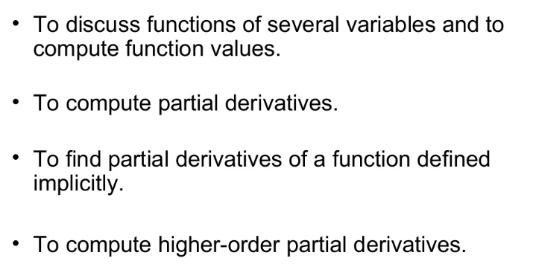
Lecture Objective
Lecture
09
Lecture Objectives

Slide 3
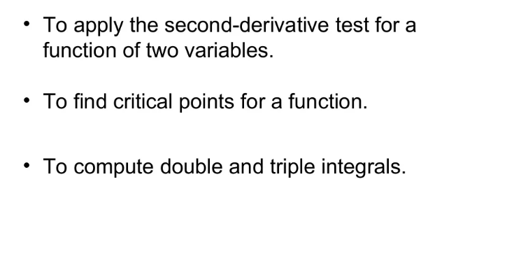
Lecture Objective
Lecture
09
Lecture Objectives

Slide 4
Lecture Outline
Lecture
09
Lecture Outline
Functions of Several Variables
Partial Derivatives
Implicit differentiation
Maxima and Minima for functions of Two Variable

Slide 5
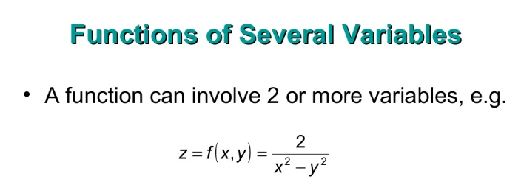
Functions of Several Variables
Lecture
09
Functions of Several Variables

Slide 6
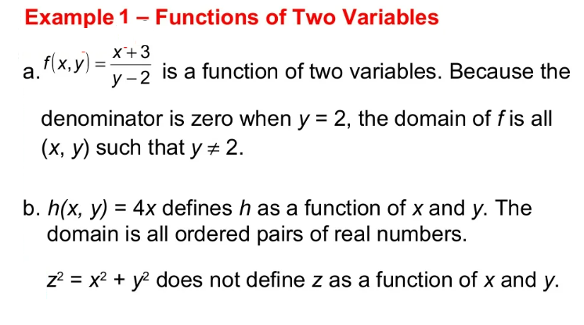

Example
Lecture
09
Example

Slide 7
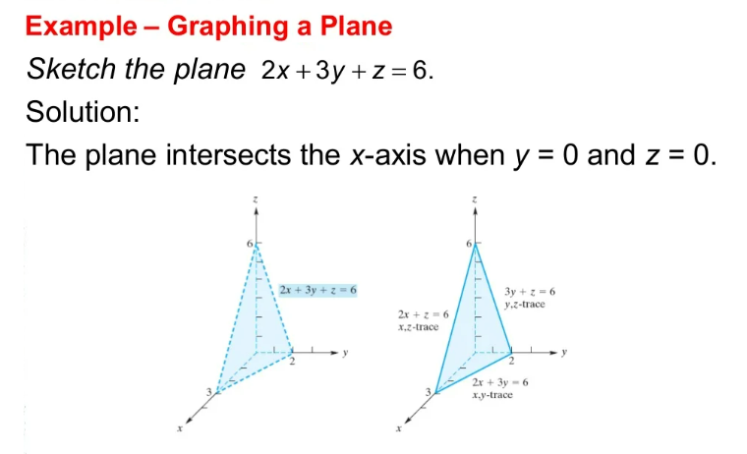
Example
Lecture
09
Example

Slide 8
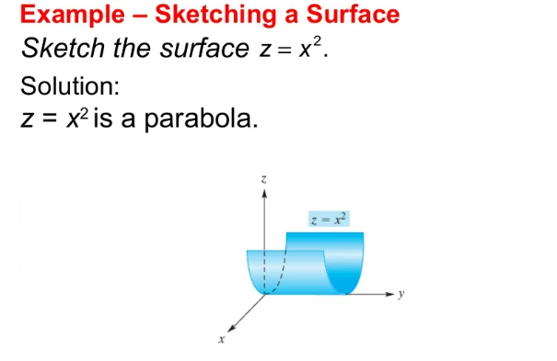
Example
Lecture
09
Example

Slide 9
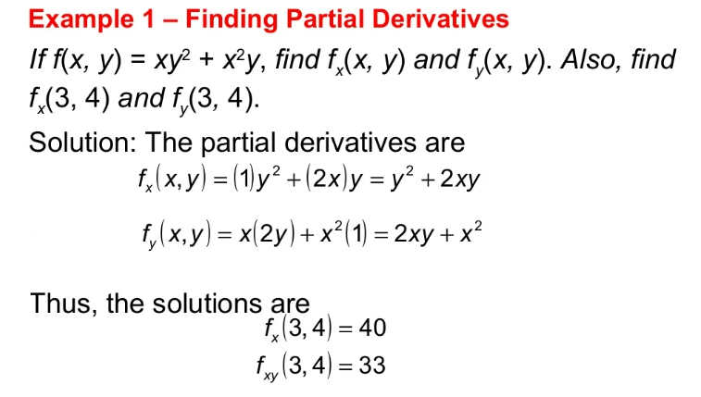
Example
Lecture
09
Example

Slide 10
Example
Lecture
09
Example

Slide 11
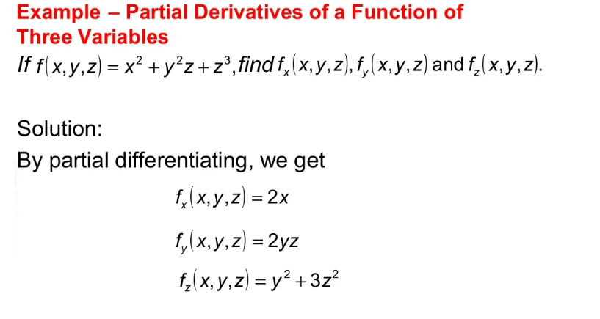
Partial Derivatives
Lecture
09
Partial Derivatives

Slide 12
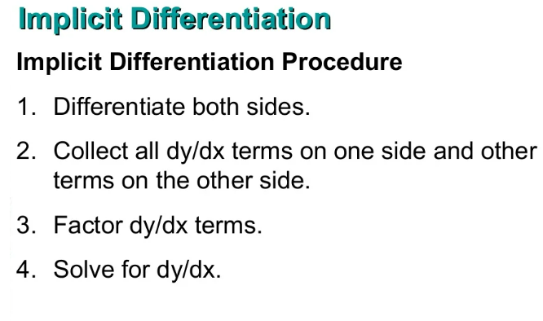
Implicit Differentiation
Lecture
09
Implicit Differentiation

Slide 13
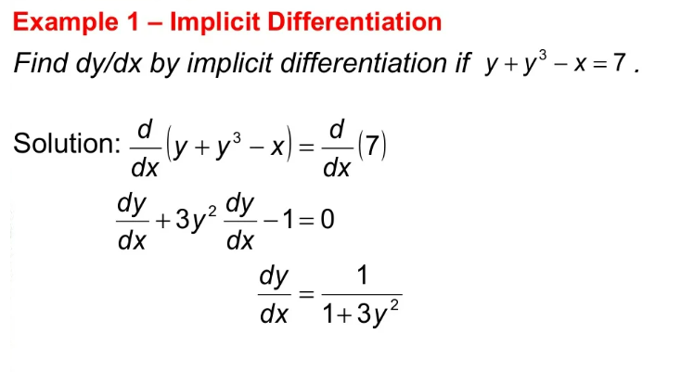
Example
Lecture
09
Example

Slide 14
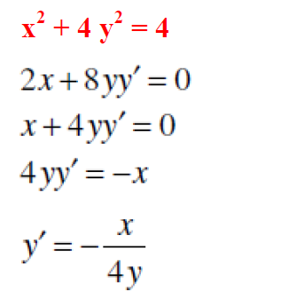
Example
Lecture
09
Example

Slide 15
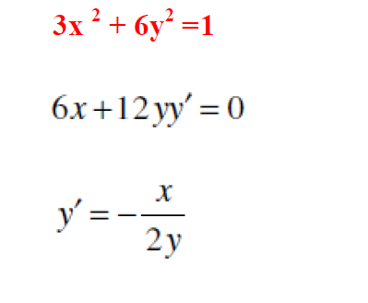
Example
Lecture
09
Example

Slide 16
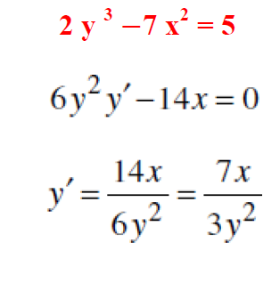
Example
Lecture
09
Example

Slide 17
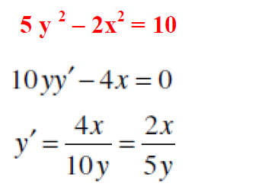
Example
Lecture
09
Example

Slide 18
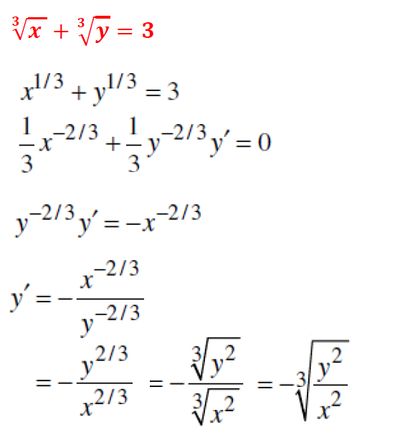
Example
Lecture
09
Example

Slide 19
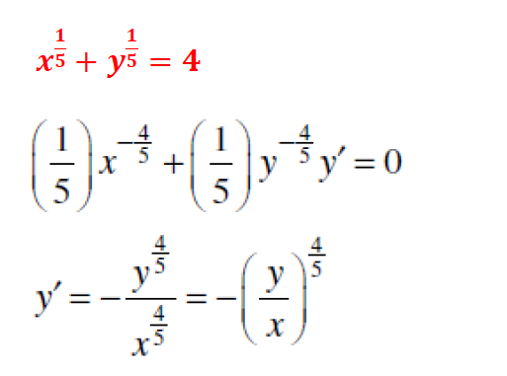
Example
Lecture
09
Example

Slide 20
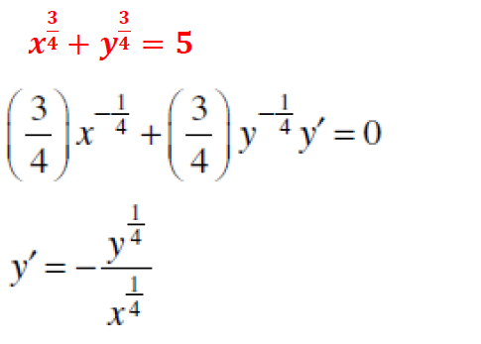
Example
Lecture
09
Example

Slide 21
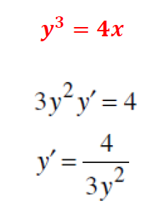
Example
Lecture
09
Example

Slide 22
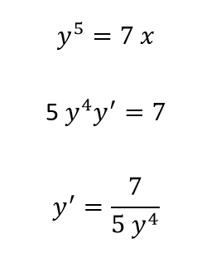
Example
Lecture
09
Example

Slide 23
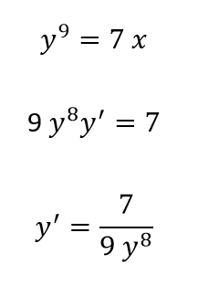
Example
Lecture
09
Example

Slide 24
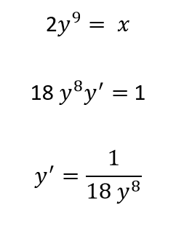
Example
Lecture
09
Example

Slide 25
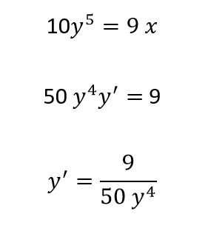
Example
Lecture
09
Example

Slide 26
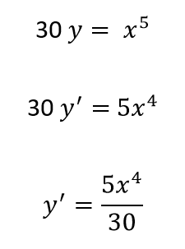
Example
Lecture
09
Example

Slide 27
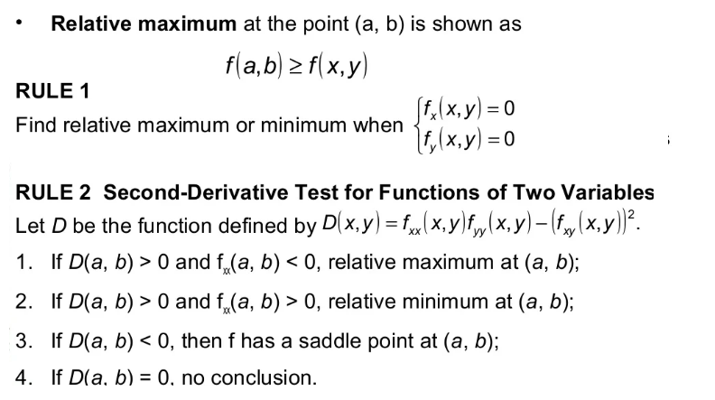
Lecture
09
Maxima and Minima for functions of Two Variable

Slide 28
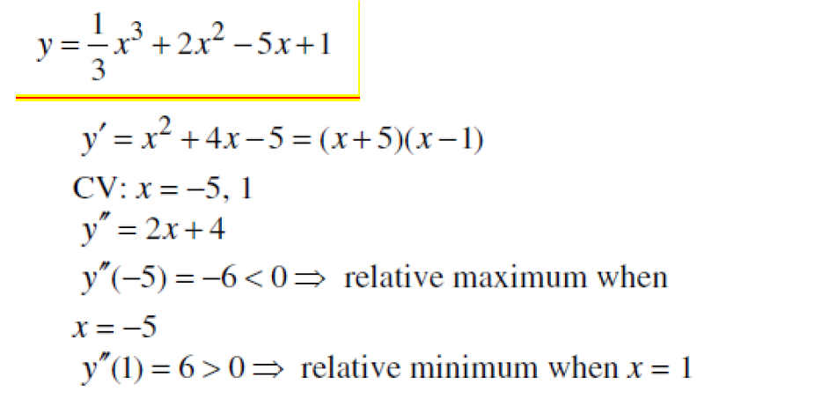
Example
Lecture
09
Example

Slide 29
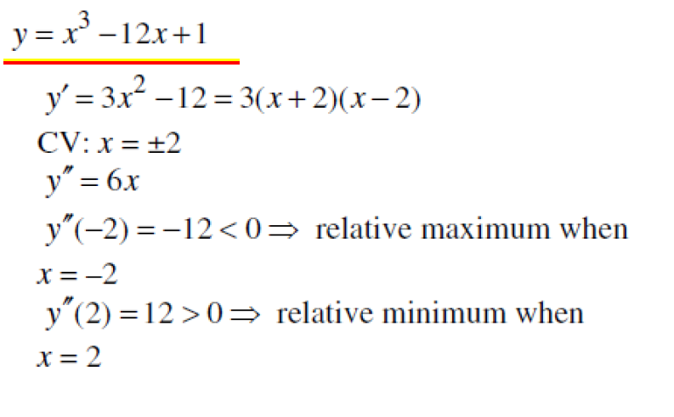
Example
Lecture
09
Example

Slide 30
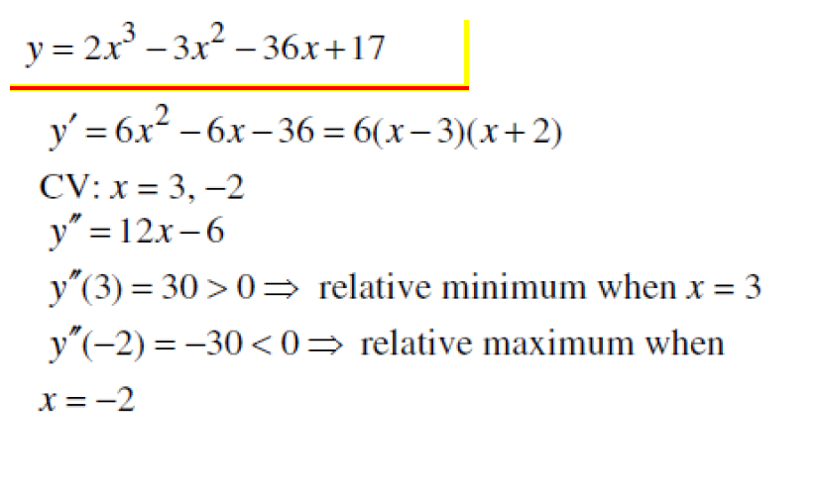
Example
Lecture
09
Example

Slide 31
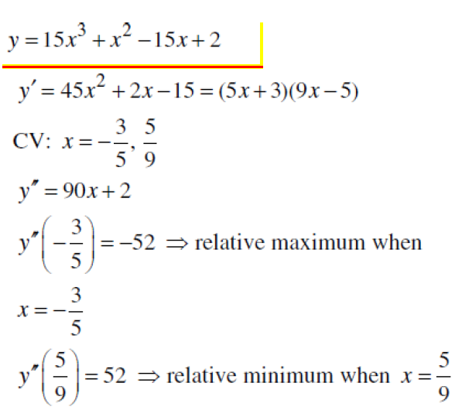
Example
Lecture
09
Example

Slide 32
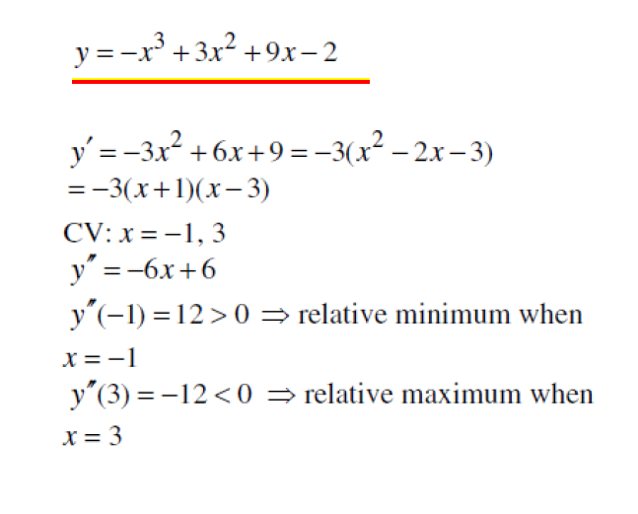
Example
Lecture
09
Example

Slide 33
Lecture Summary
Lecture
09
Lecture Summary
Functions of Several Variables

Slide 34
Lecture Summary
Lecture
09
Lecture Summary
Partial Derivatives

Slide 35
Lecture Summary
Lecture
09
Lecture Summary
Implicit differentiation

Slide 36
Lecture Summary
Lecture
09
Lecture Summary
Maxima and Minima for functions of Two Variable

