Slide 1
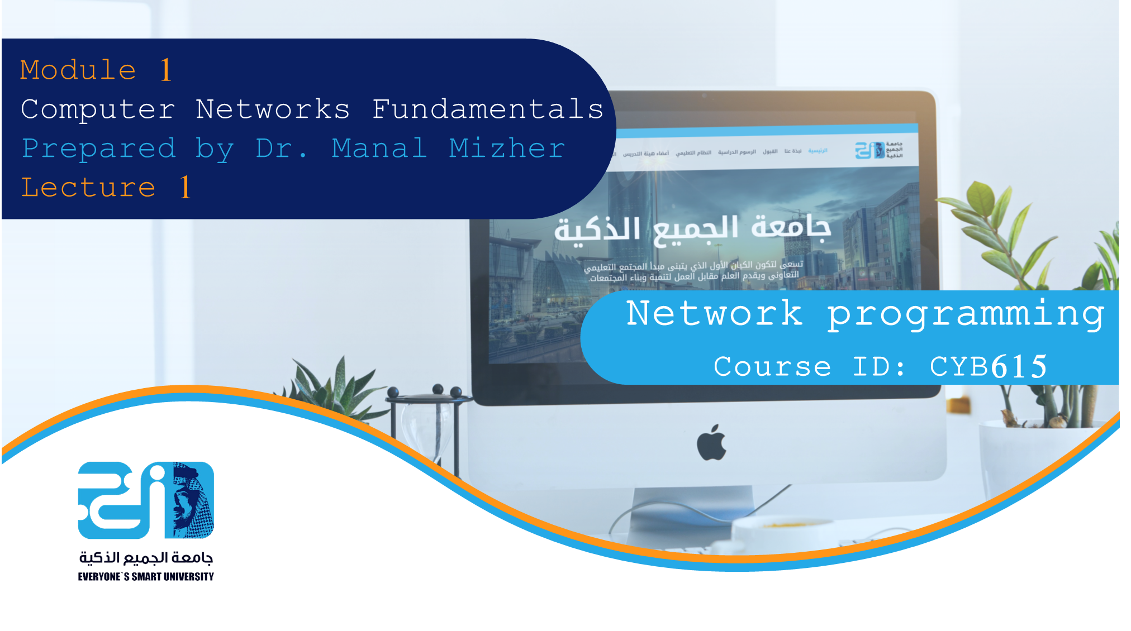

Slide 2


Module
1
Before Starting
Our course (CYB615) Topics:
      Module 1: Computer Networks Fundamentals.
      Module 2: Computer Networks Protocols (TCP/UDP/IP/ICMP).
      Module 3: Quality of Service.
      Module 4: Middleboxes.
      Module 5: Network Security.
Required Textbook: Goerzen J., Foundations of Python Network Programming,2004, Course Technology, Apress, ISBN: 978-1-59059-371-4.
References:
      • The official Python Tutorial: http://docs.python.org/tut/
      • The Python Tutorial: https://docs.python.org/3/tutorial/

Slide 3
Module
1
Before Starting
Our course (Network programming, Course ID: CYB615)
    Explores network programming in the Python language. It covers the basic concepts, modules, and third-party libraries that you are likely to use when communicating with remote machines using the most popular Internet communication protocols.
The Building Blocks: Stacks and Libraries
    Protocol stack, is a group of protocols that all work together to allow software or hardware to perform a function. The TCP/IP protocol stack is a good example.
    Using Python libraries of previously written code—whether modules from the built-in standard library that ships with Python or packages from third-party distributions that you download and install—that already know how to speak the network protocol that you want to use.

Slide 4
Module
1
So …
The major purposes of this course are:
      Introduce you to several key networking libraries available for Python.
      Teaching you about the lower-level network services on which those libraries (point.1) are built.
Benefits: Knowing the lower-level material is useful:
      understand how the libraries work.
      will understand what is happening when something at a lower level goes wrong.

Slide 5
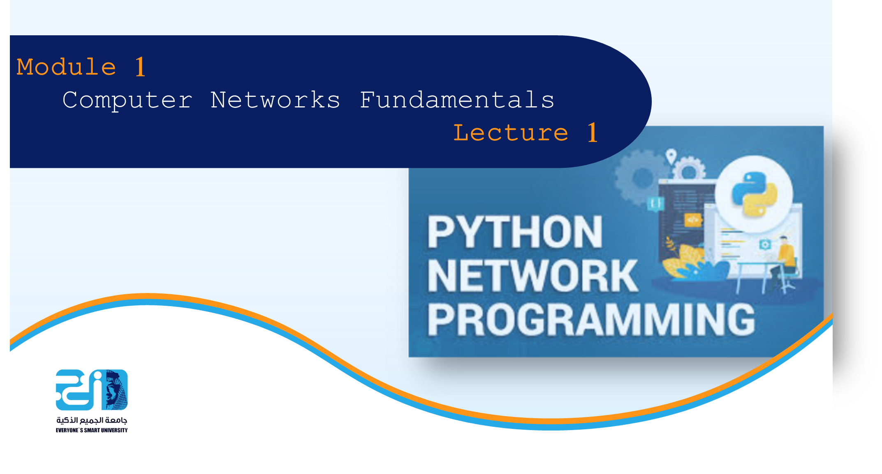

Slide 6
Module
1
Outlines
Module 1(Computer Networks Fundamentals)
          Definition of computer networks, communication
          Importance of computer networks
          Computer networks classifications(types, architectures, topologies, communications technology)
          OSI model and communication through an internet
          Mapping between OSI model and TCP/IP model
          Data encapsulation and decapsulation
          Network protocol (TCP, UDP)
          Routing, Routing table, Routing protocols
          Middleboxes
          Throughput, Bandwidth, QoS, Bottleneck
          Wireless networks (Technologies, types)
          IEEE
          Useful Windows Networking Commands

Slide 7
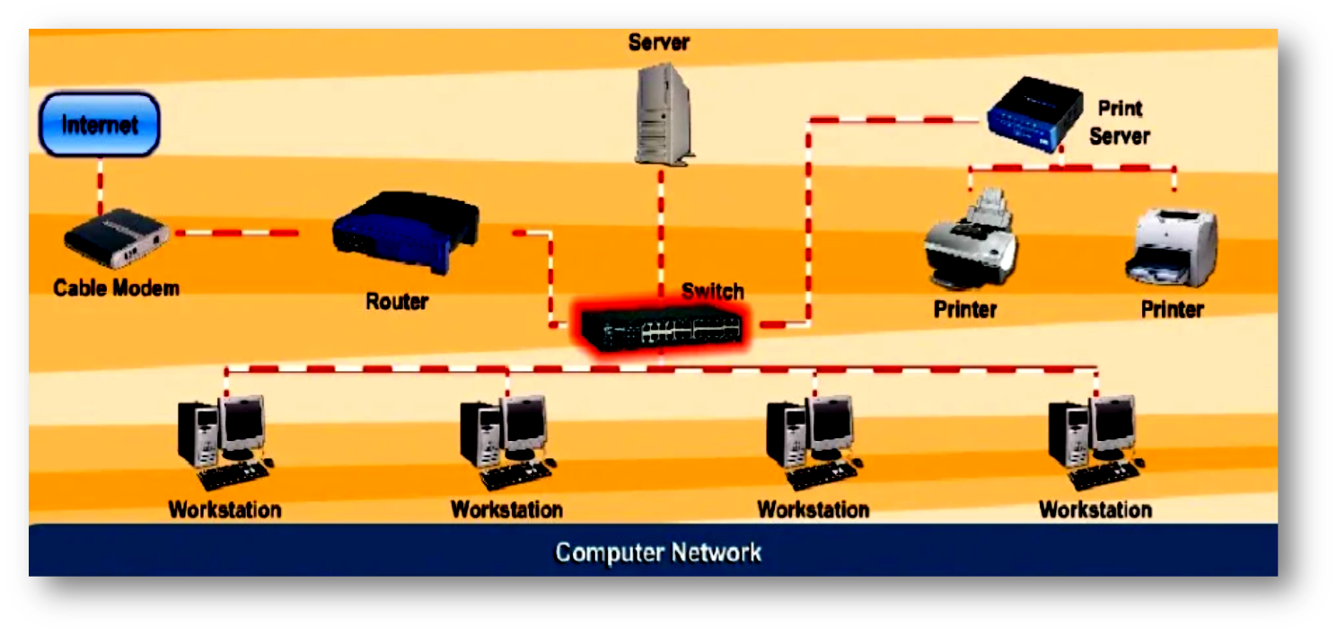
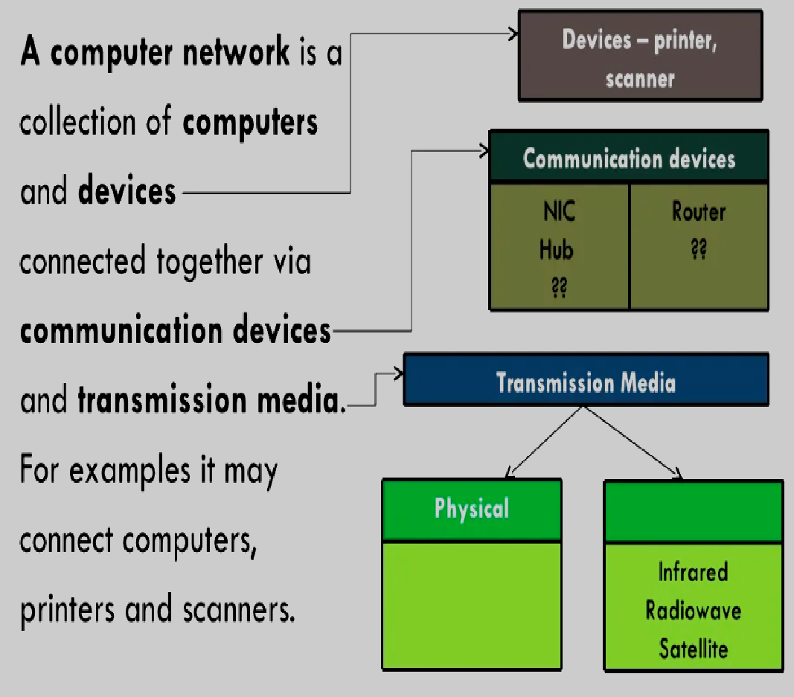
Module
1
Definition of computer networks

Slide 8
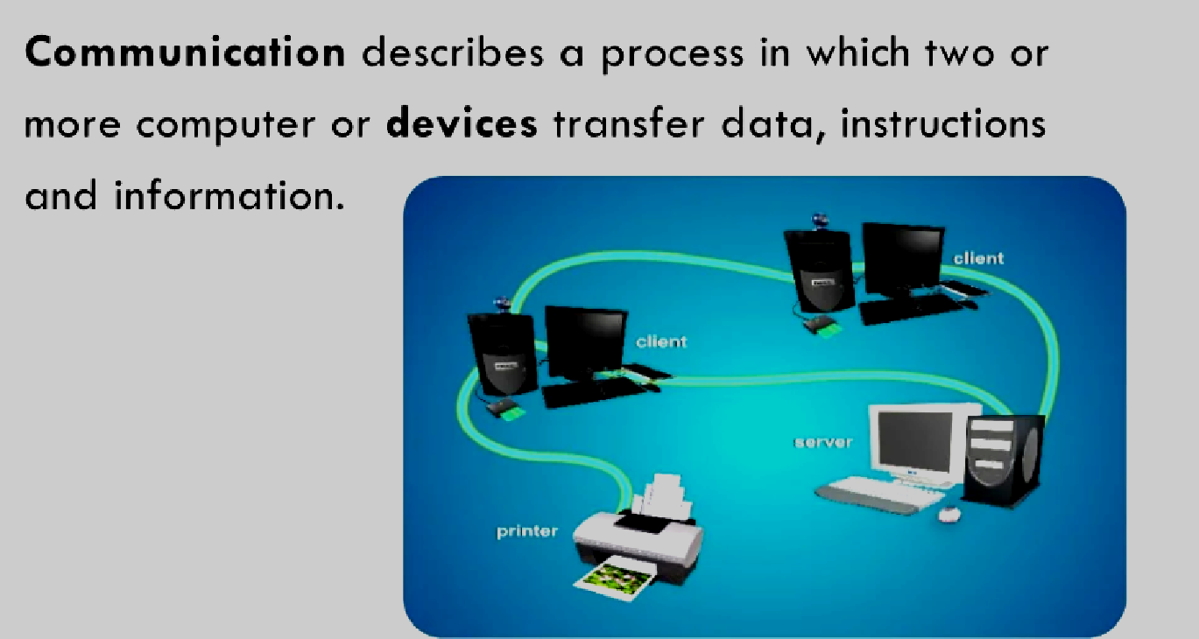
Module
1
Definition of communication

Slide 9
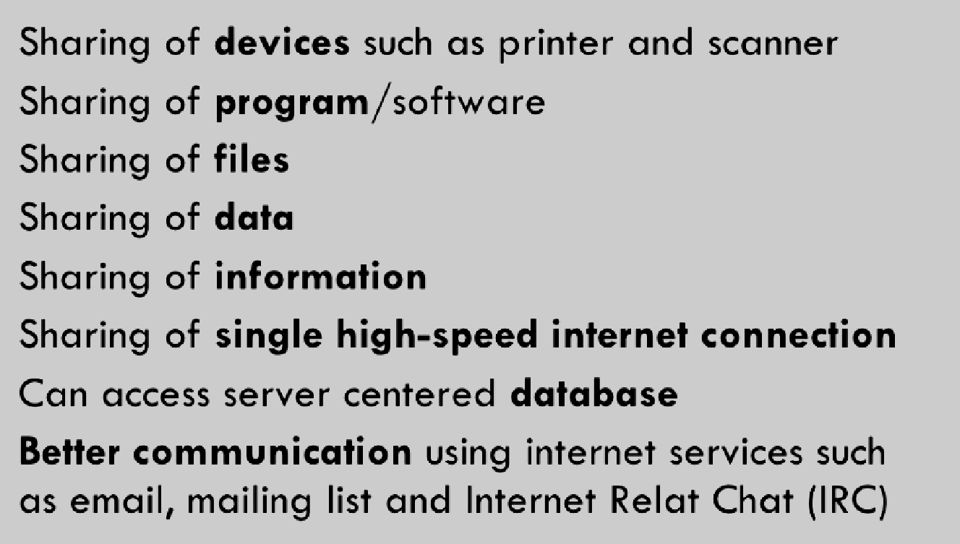
Module
1
Importance of computer networks
1.
2.
3.
4.
5.
6.
7.

Slide 10
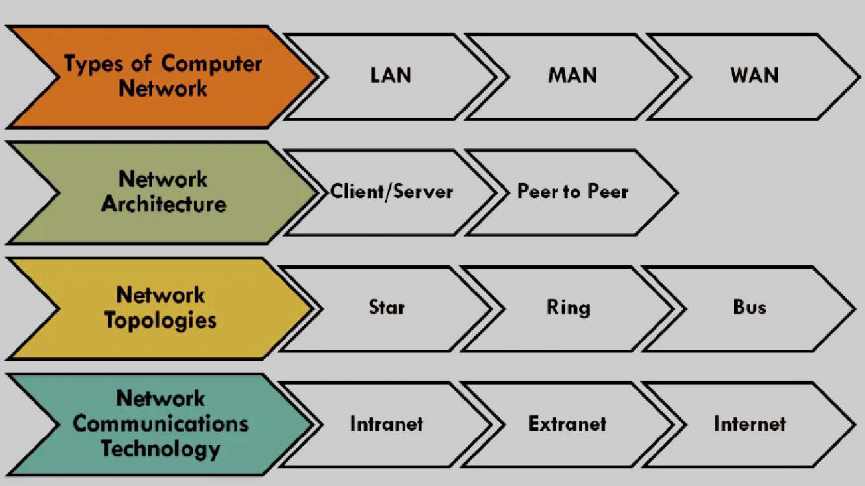
Module
1
Computer networks classifications

Slide 11
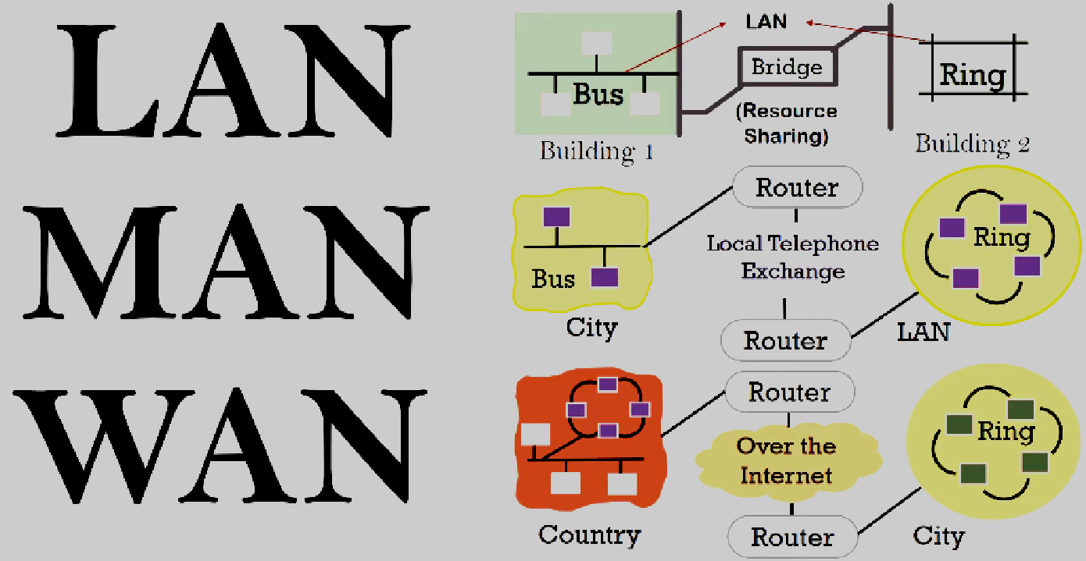
Module
1
Computer networks types

Slide 12
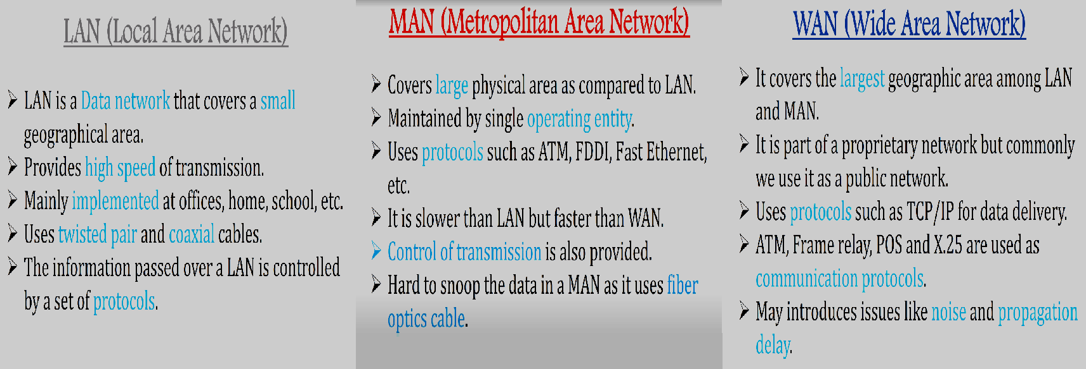
Module
1
Differences between Computer networks types

Slide 13
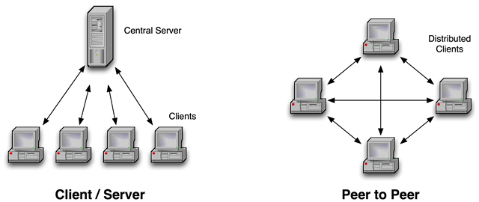
Module
1
Computer networks architectures

Slide 14
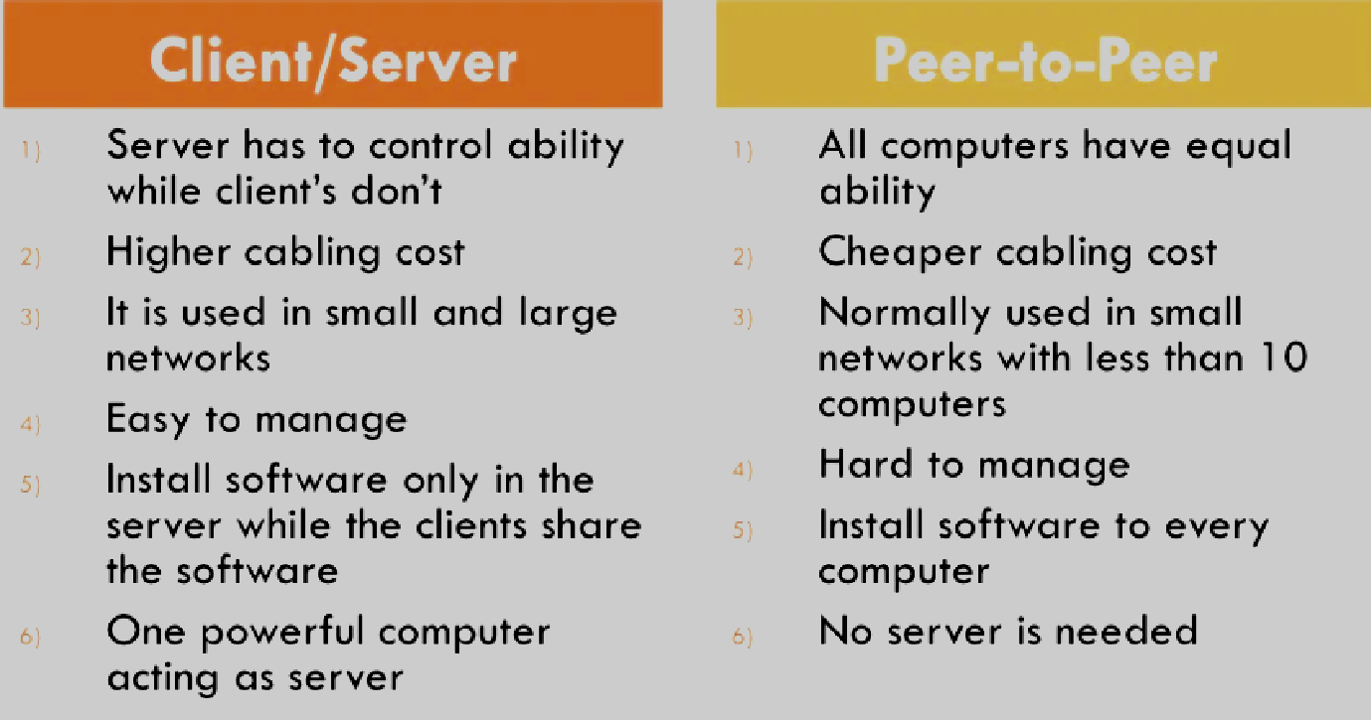
Module
1
Differences between
the two architectures

Slide 15
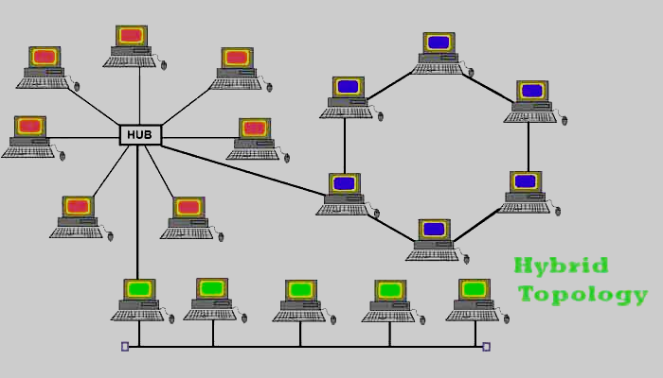
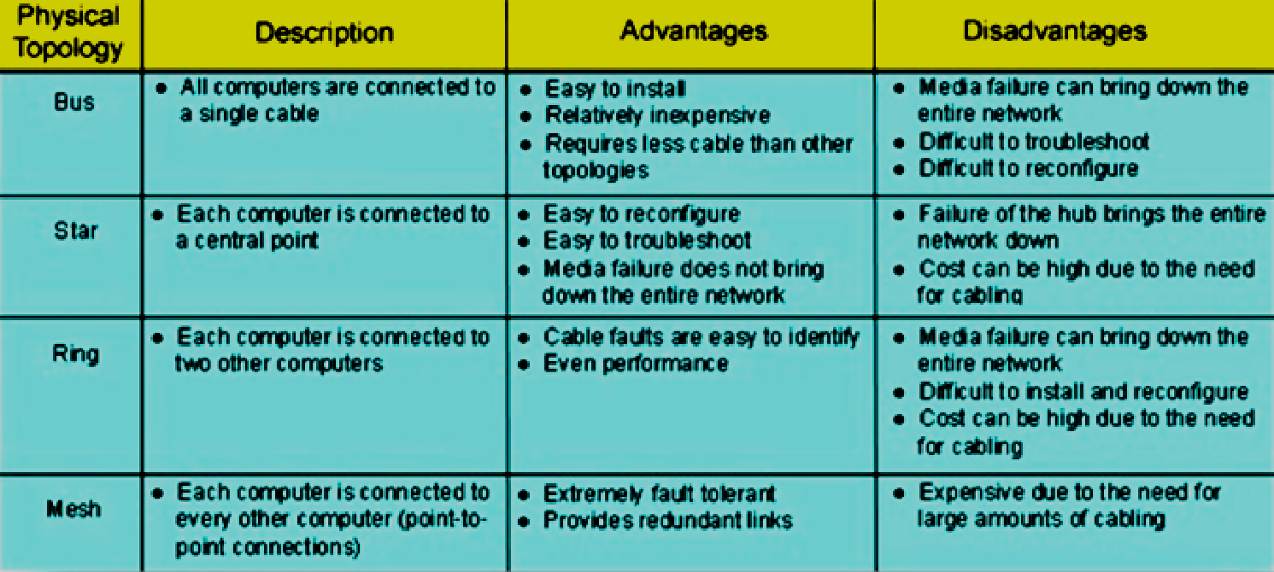
Module
1
Computer networks topologies
Star
Ring
Bus

Slide 16
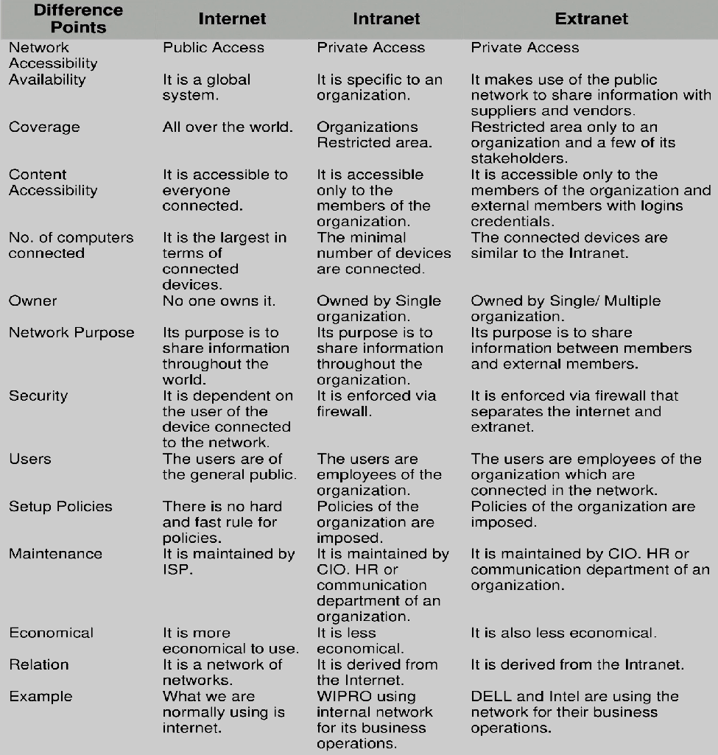
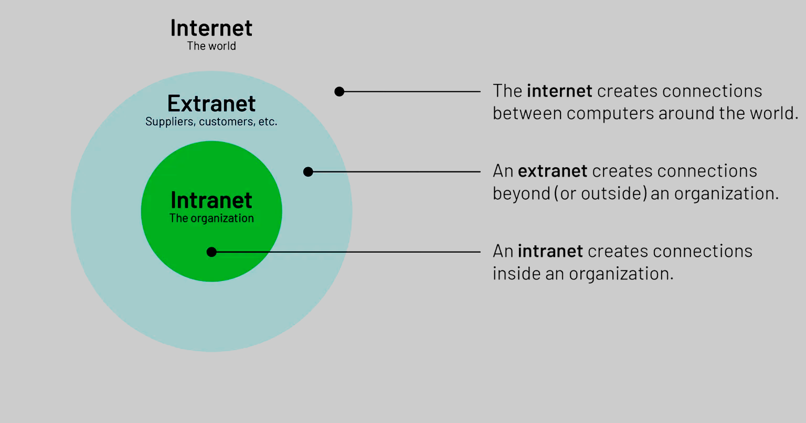
Module
1
Computer networks
communications technology

Slide 17
Module
1
OSI model
The OSI Model (Open Systems Interconnection Model)
    Was published in 1984 by the International Organization for Standardization (ISO).
    Conceptual framework used to describe the functions of a networking system (universal set of rules and protocols and requirements in order to support compatibility between different products and software).
    In the OSI reference model, the communications between a computing system are split into seven different abstraction layers.
    Still used today as a means to describe Network Architecture.

Slide 18
Module
1
Network Protocol
What is a Network Protocol?
Set of rules that governs the communications between computers on a network. These rules include guidelines that regulate the following characteristics of a network:
    Access method
    Allowed physical topologies
    Types of cabling
    Speed of data transfer.

Slide 19
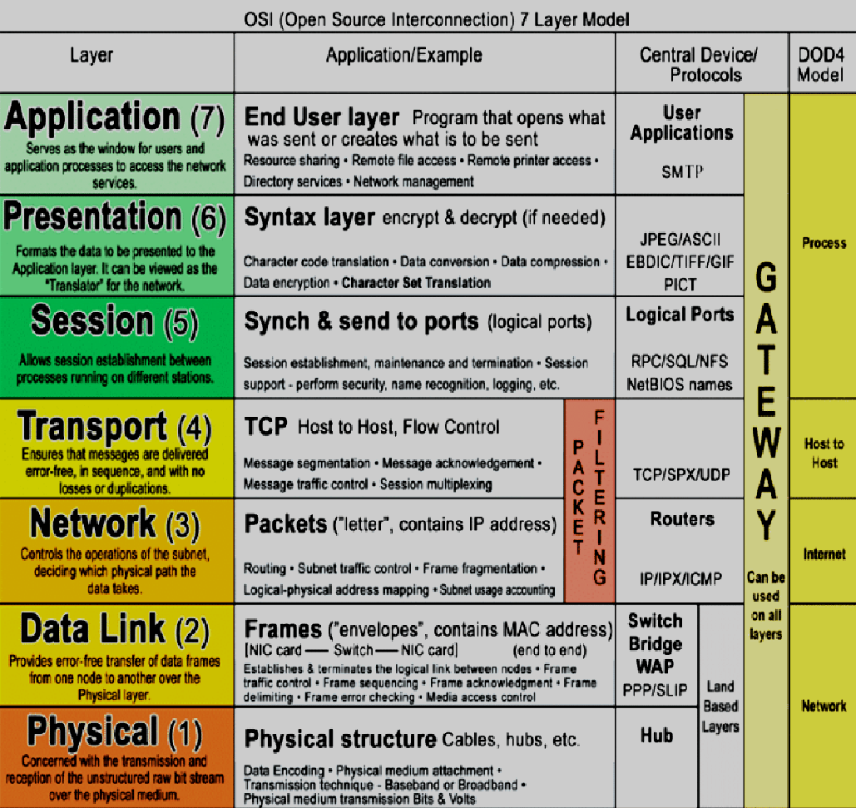
Module
1
OSI model
  Host Layers
  Media Layers

Slide 20
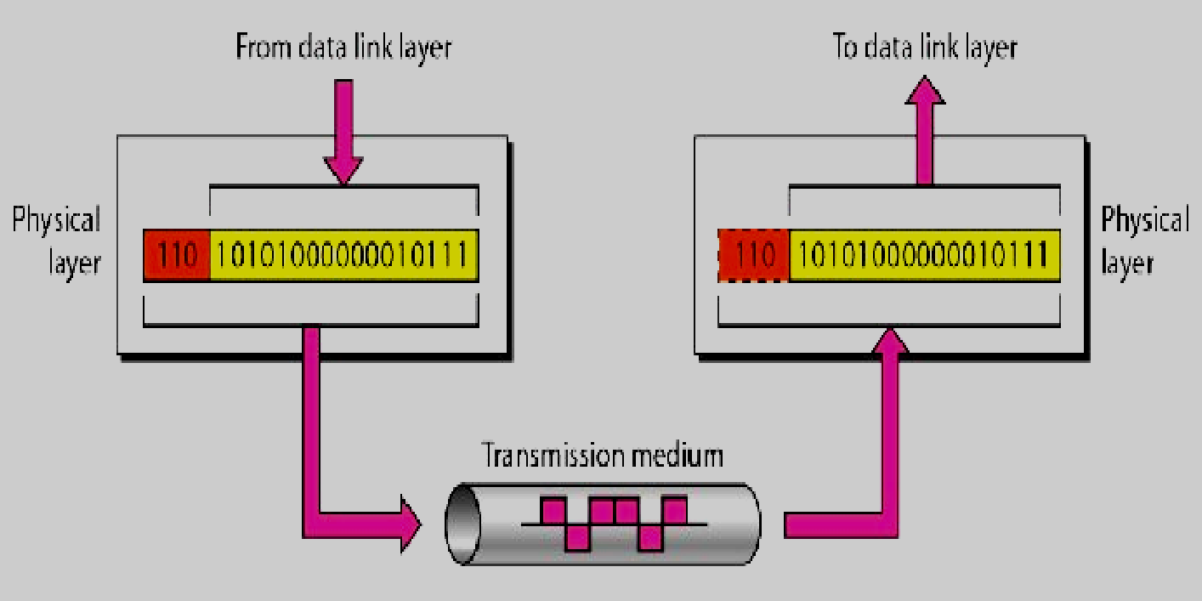
Module
1
Hidden layer
(transmission layer)
    Note: Transmission Media is another hidden layer under the Physical Layer

Slide 21
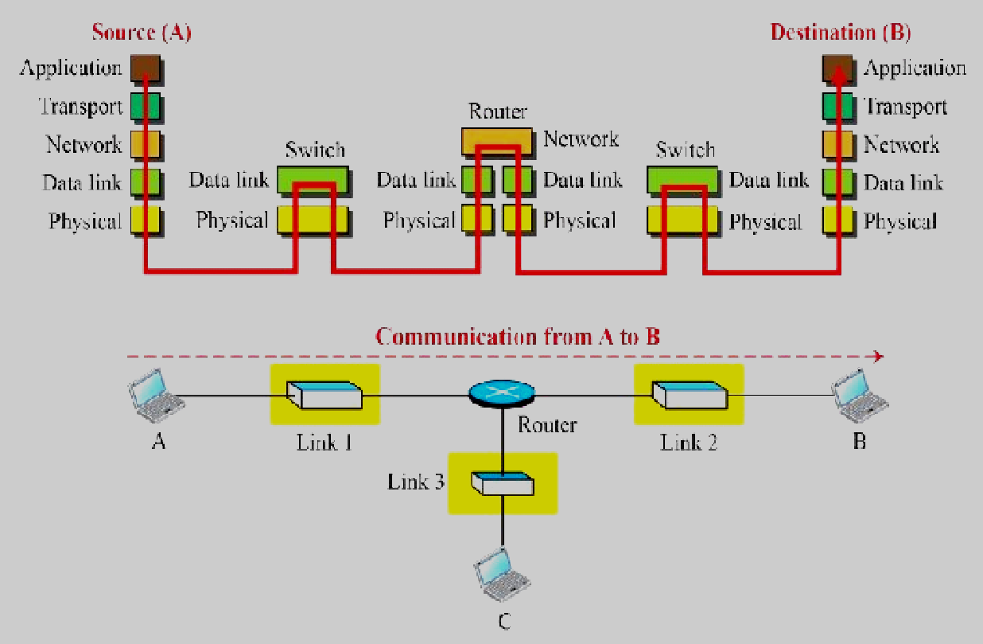
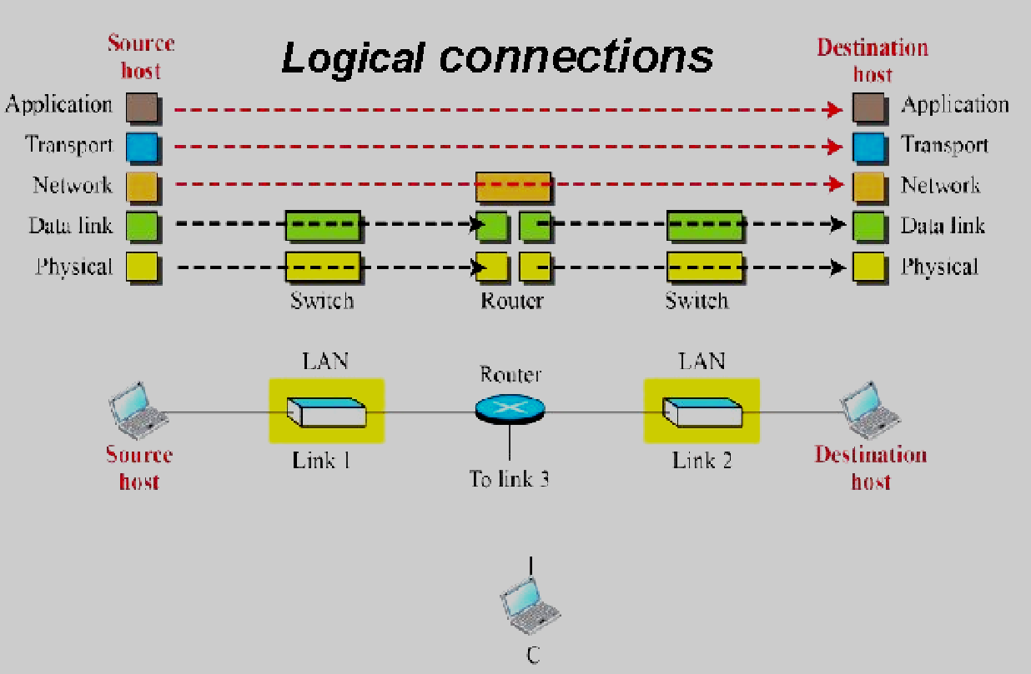
Module
1
Communication through
an internet
Remember: switches devices do not change data objects

Slide 22
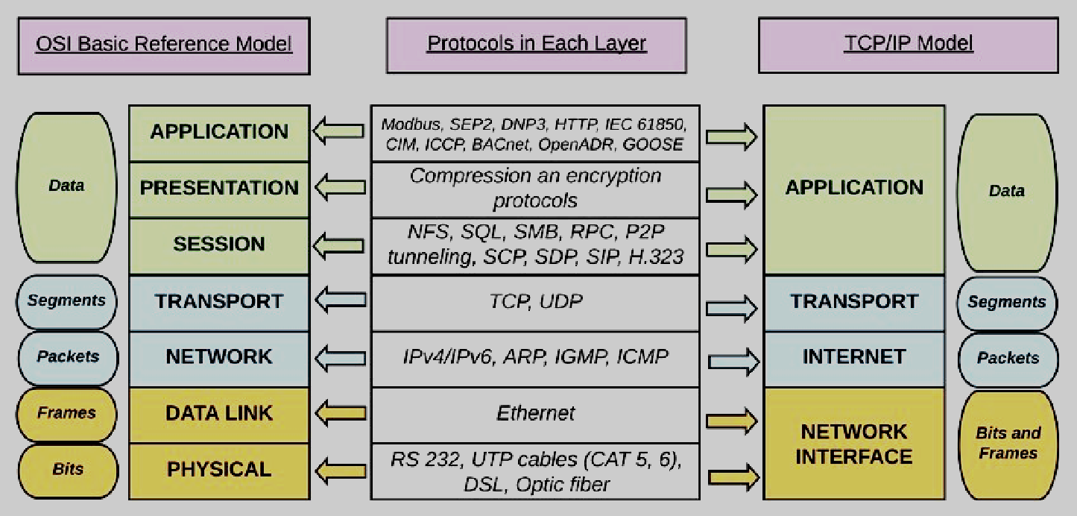
Module
1
logical mapping between
OSI model and TCP/IP model

Slide 23
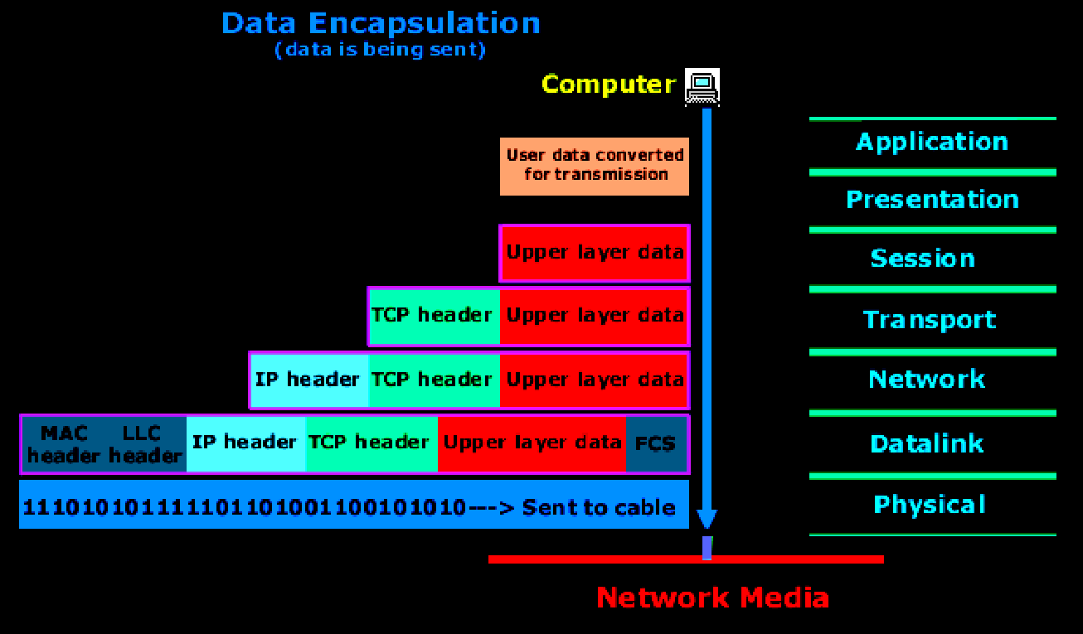
Module
1
Data Encapsulation
Segment
packet
frame

Slide 24
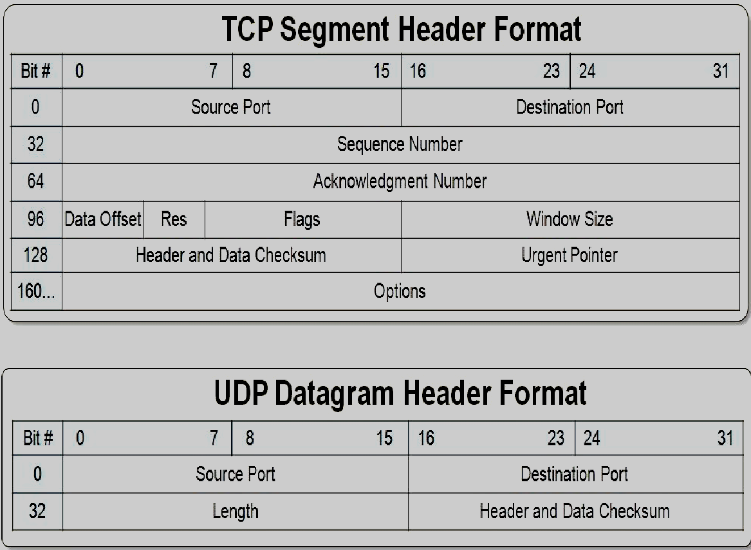
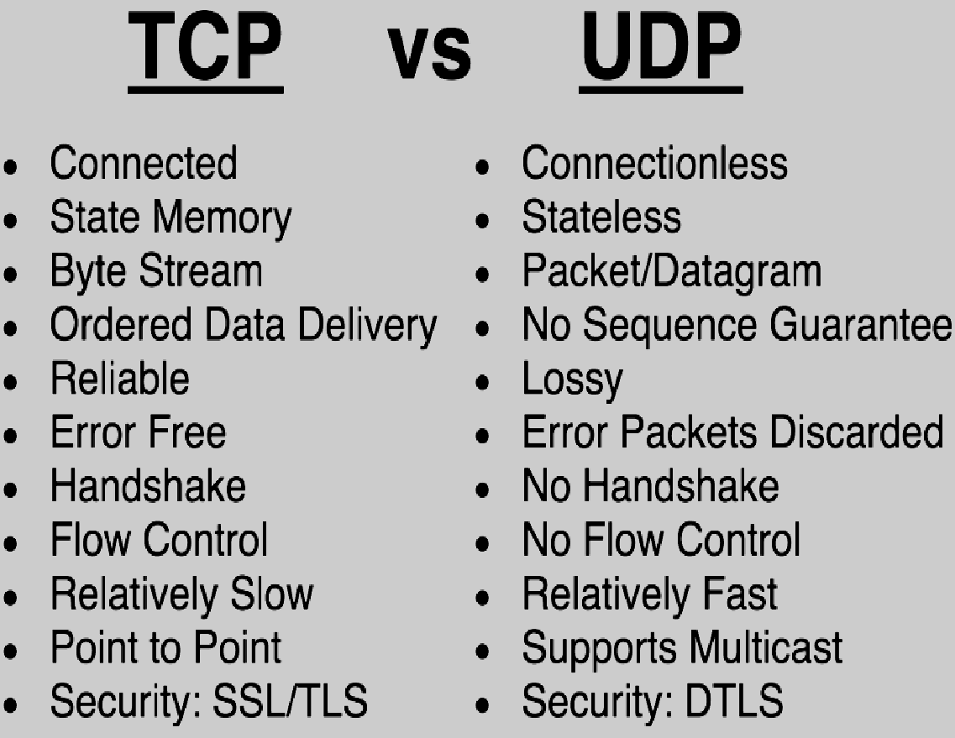
Module
1
Encapsulation headers
(TCP vs UDP)
Transmission Control Protocol
User Datagram Protocol

Slide 25
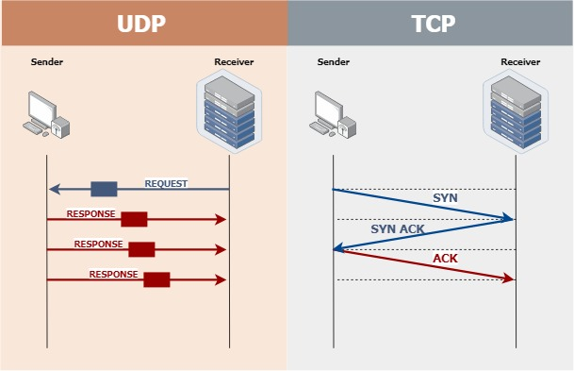
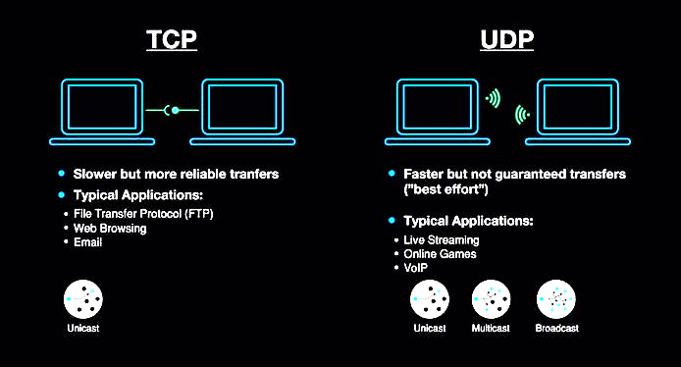
Module
1
TCP/UDP protocols
TCP three-way handshake

Slide 26
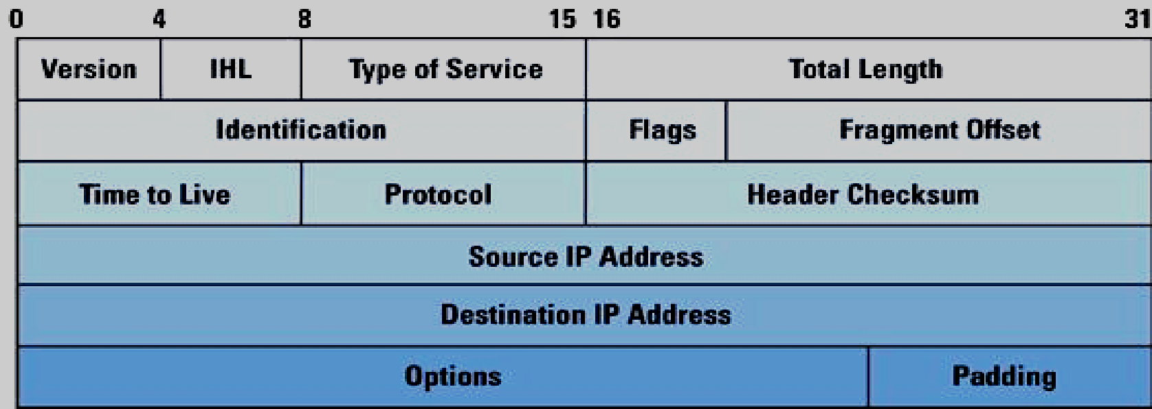
Module
1
Encapsulation headers(IP)
Internet protocol
Method that governs how computers share data across the Internet.
When one computer sends data, such as an email or a web form, its message gets parsed into small packets that contain the sending computer's Internet address, the receiving computer's address, and part of the message(packet).

Slide 27
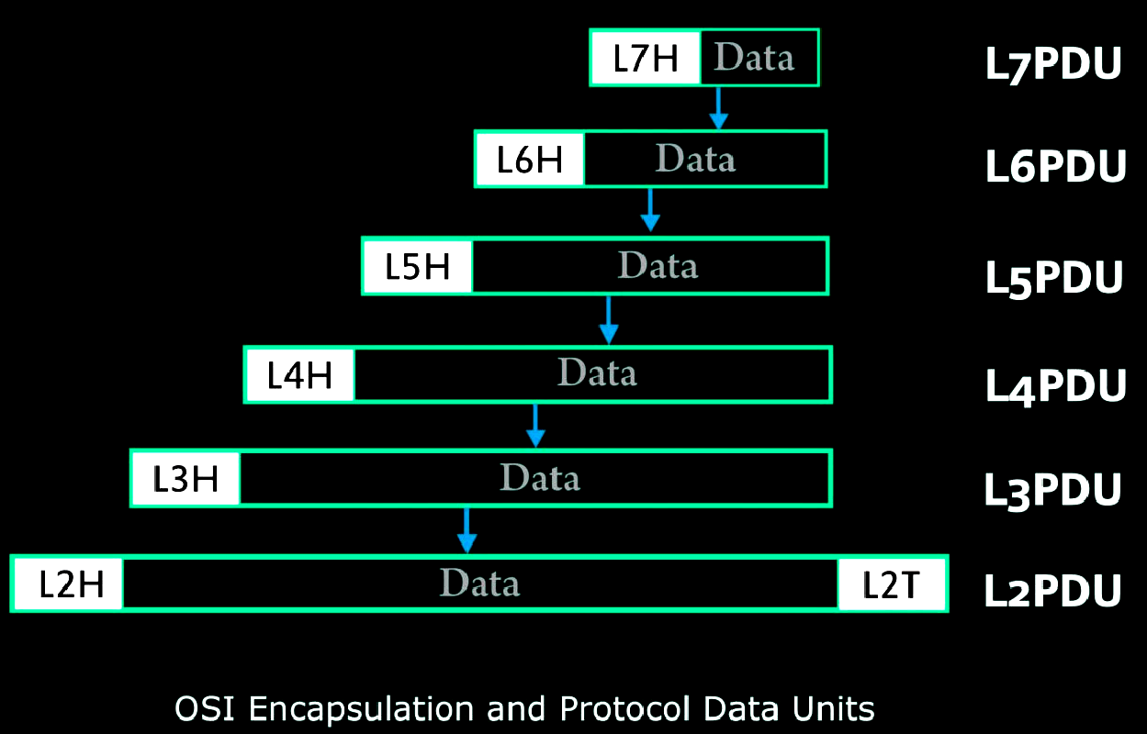
Module
1
Data Encapsulation
OSI uses a more generic term to refer to messages, rather than frame, packet, and segment. OSI uses the term protocol data unit (PDU). A PDU represents the bits that include the headers and trailers for that layer, as well as the encapsulated data.
For example: A TCP segment of data using OSI terminology, is a PDU, more specifically a layer 4 PDU (abbreviated L4PDU) because TCP is Layer 4 protocol in the OSI model. In general, OSI refers to the layer x PDU (LxPDU), with x referring to the number of the layer.

Slide 28
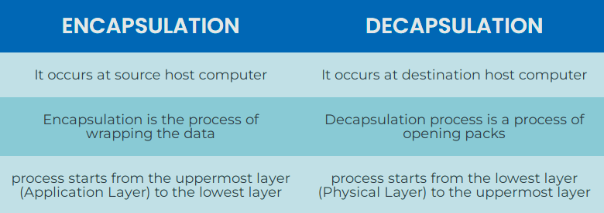
Module
1
Encapsulation – Decapsulation
comparison

Slide 29
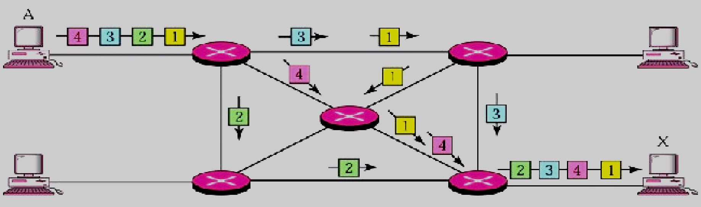
Module
1
Routing
Process of selecting a path across one or more networks. The principles of routing can apply to any type of network, from telephone networks to public transportation.
In packet-switching networks, such as the Internet, routing selects the paths for Internet Protocol (IP) packets to travel from their origin to their destination. These Internet routing decisions are made by specialized pieces of network hardware called routers.
UDP

Slide 30
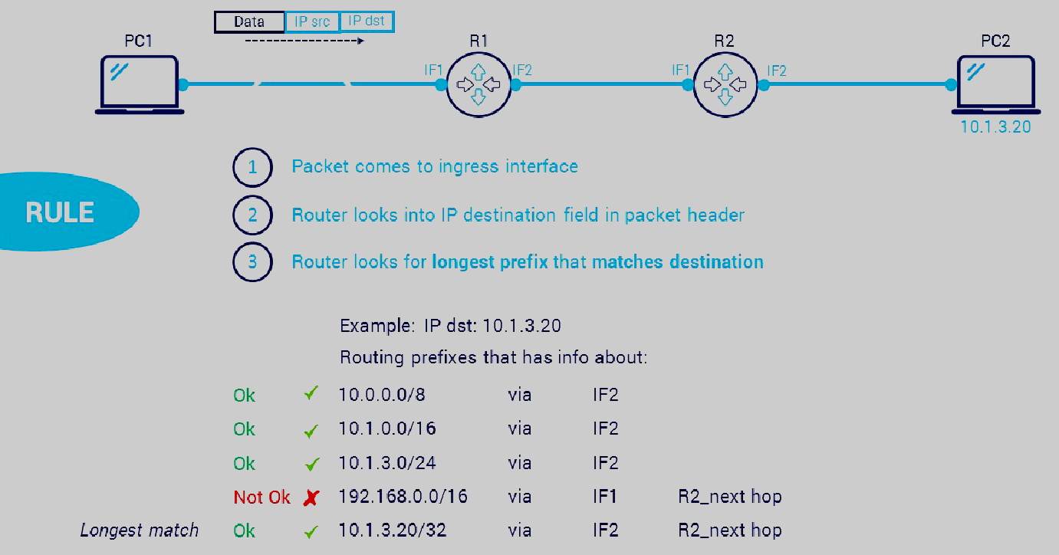
Module
1
Routing Table

Slide 31
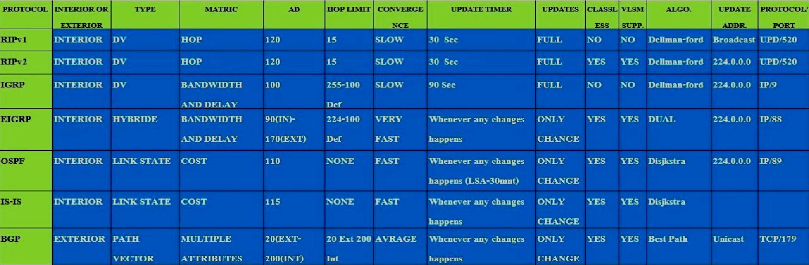
Module
1
Routing Protocols
Comparison

Slide 32
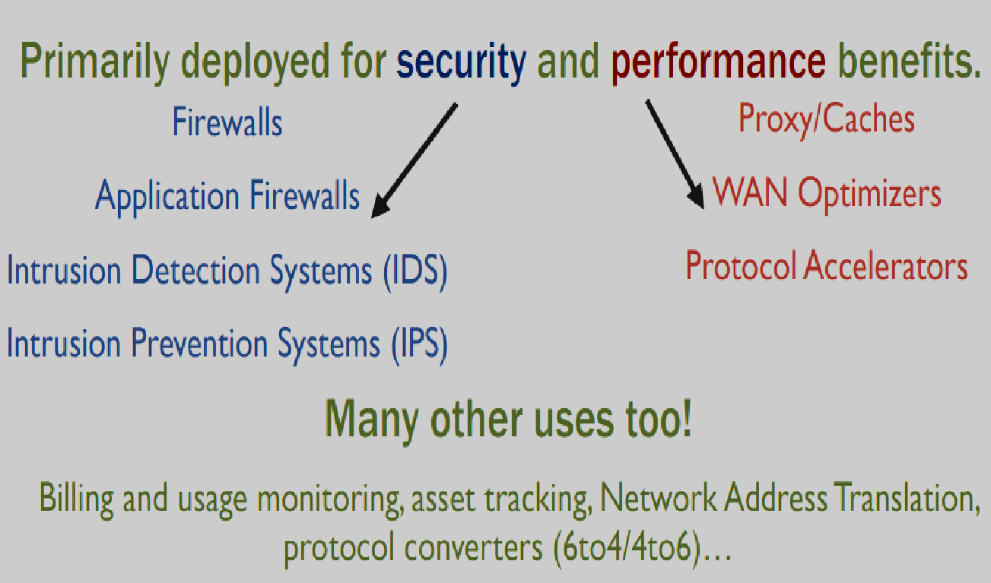
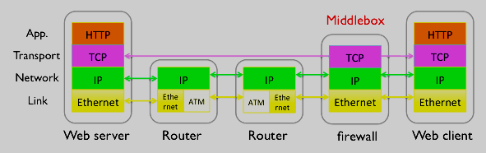
Module
1
Middleboxes
Middlebox is defined as any intermediary device performing functions other than the normal, standard functions of an IP router on the datagram path between a source host and destination host.

Slide 33
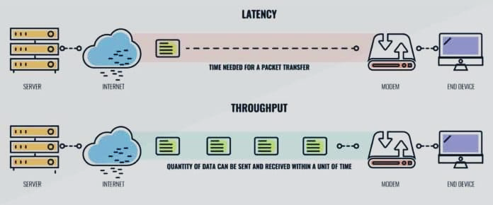
Module
1
Throughput & Bandwidth
Throughput tells you how many packets arrive at their destinations successfully at any given time. For the most part, throughput capacity is measured in bits per second, but it can also be measured in data per second.
Bandwidth tells you how much data could theoretically be transferred from a source at any given time. Bandwidth is measured in bits, megabits, or gigabits per second.
    It’s important to remember high bandwidth doesn’t necessarily equal high network performance. Substantial bandwidth won’t matter if data throughput is still being dragged down by latency, jitter, or packet loss.

Slide 34
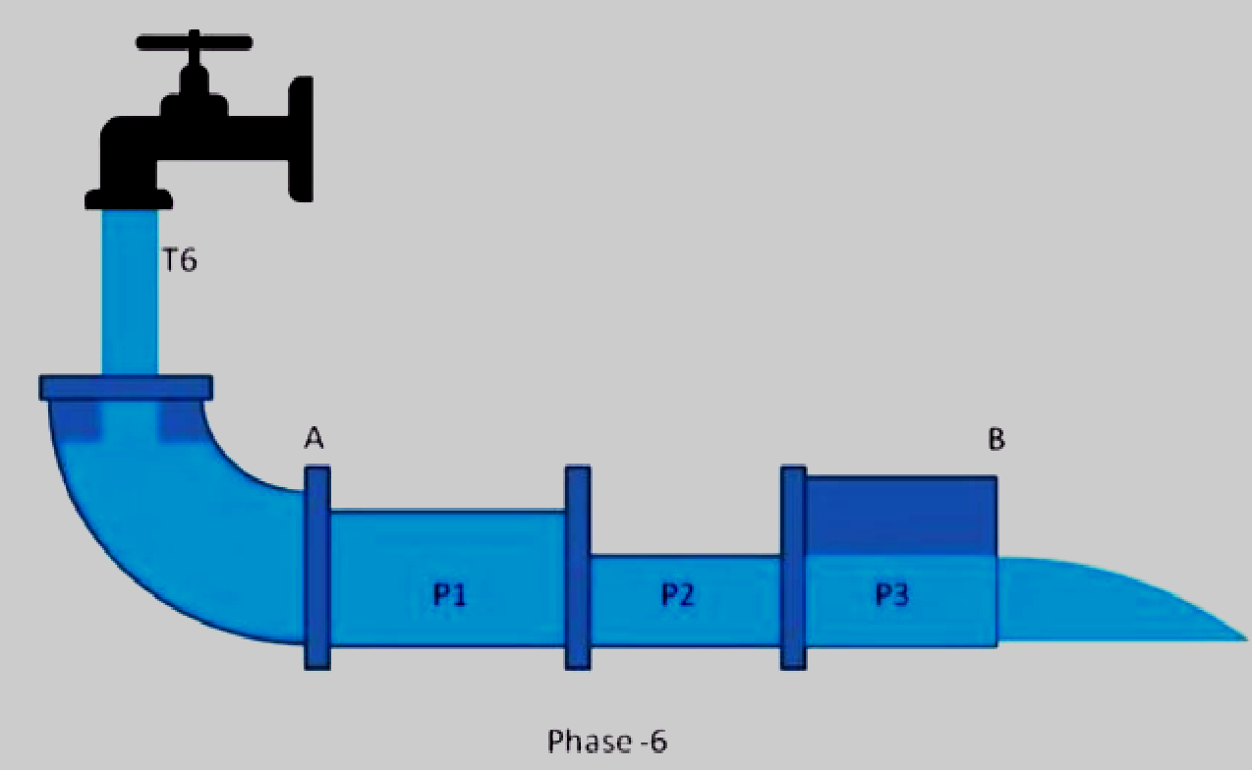
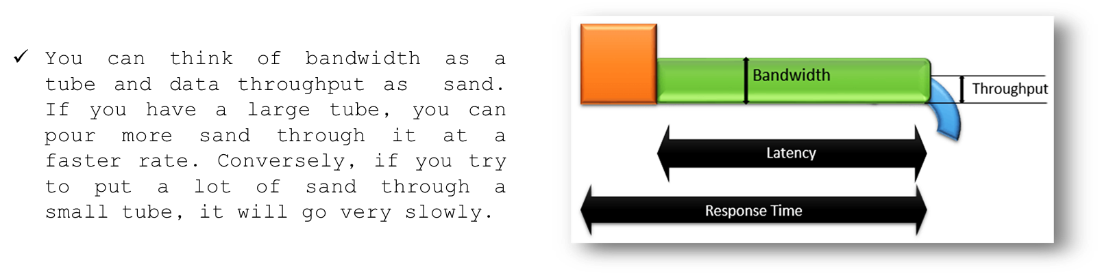
Module
1
Throughput & Bandwidth

Slide 35
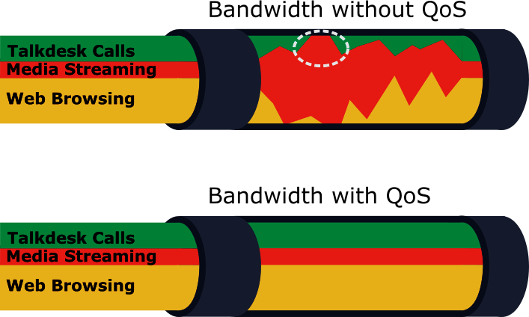
Module
1
Quality-of-Service(QoS)
Quality of Service (QoS)
set of technologies that work on a network to guarantee its ability to dependably run high-priority applications and traffic under limited network capacity. QoS technologies accomplish this by providing differentiated handling and capacity allocation to specific flows in network traffic.

Slide 36
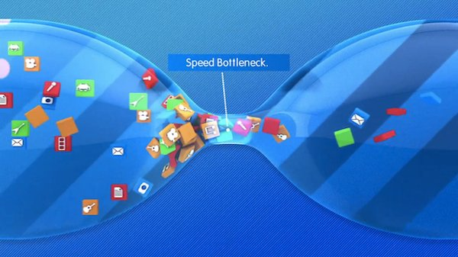
Module
1
Bottleneck
Bottleneck, in a communications context, is a point in the enterprise where the flow of data is impaired or stopped entirely. Effectively, a bottleneck results when there is not enough data handling capacity to accommodate the current volume of traffic.

Slide 37
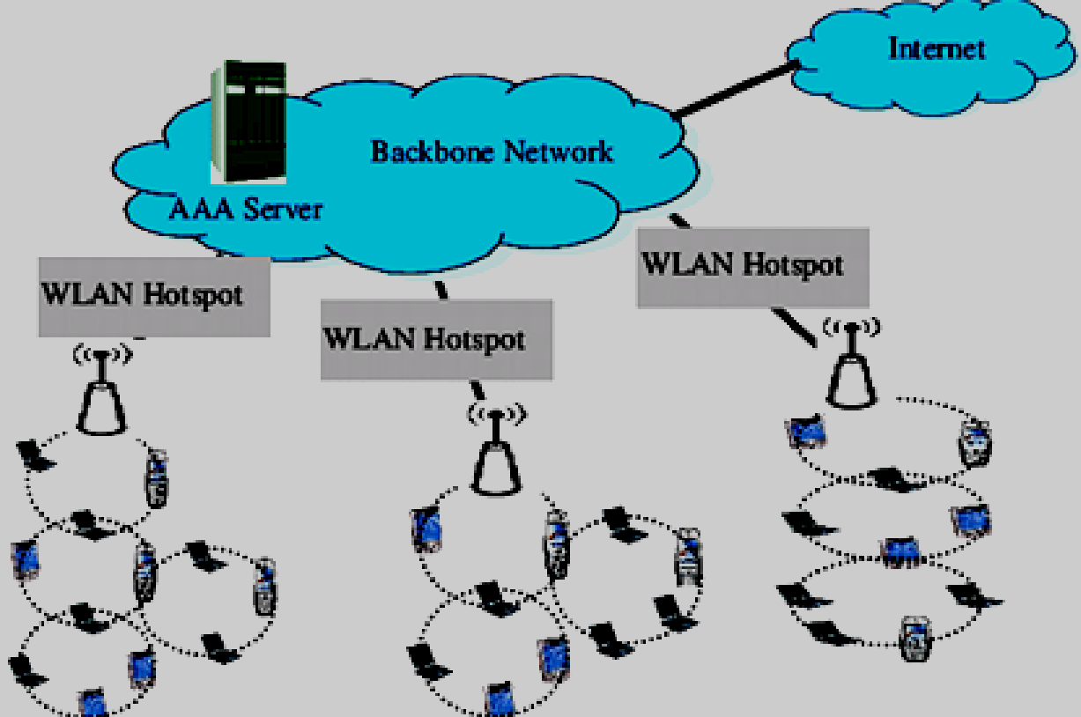
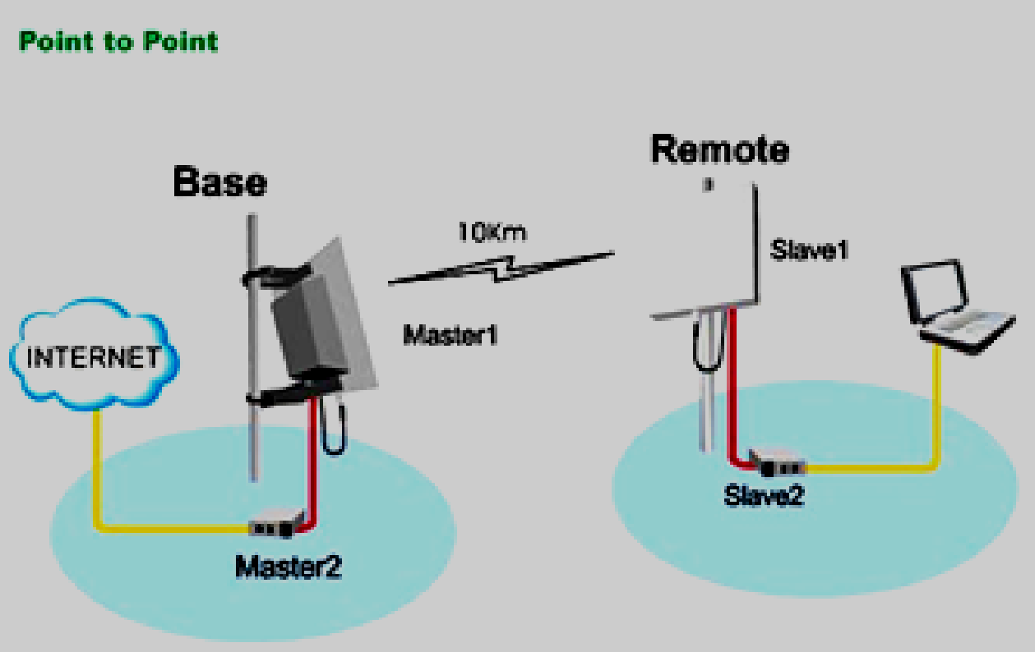
Module
1
Wireless Networks
Wireless network is a computer network that uses wireless data connections between network nodes.
  Avoid the costly process of introducing cables into a building, or as a connection between various equipment locations.
  Admin telecommunications networks are generally implemented and administered using radio communication. This implementation takes place at the physical layer of the OSI model network structure.

Slide 38

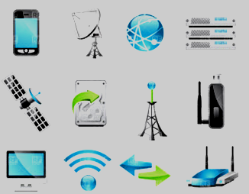
Module
1
Wireless Communication
technologies
Satellite Communication
Infrared Communication
Broadcast Radio
Microwave Communication
Wi-Fi
Mobile Communication Systems
Bluetooth Technology
Global Positioning System (GPS)
Paging
Radar
Radio Frequency Identification (RFID)

Slide 39
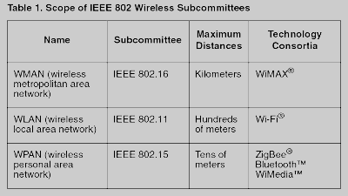
Module
1
Types of wireless networks
Wireless PAN
Wireless LAN
Wireless CAN
Wireless ad hoc network
Wireless MAN
Wireless WAN
Cellular network
Global area network
Space network

Slide 40
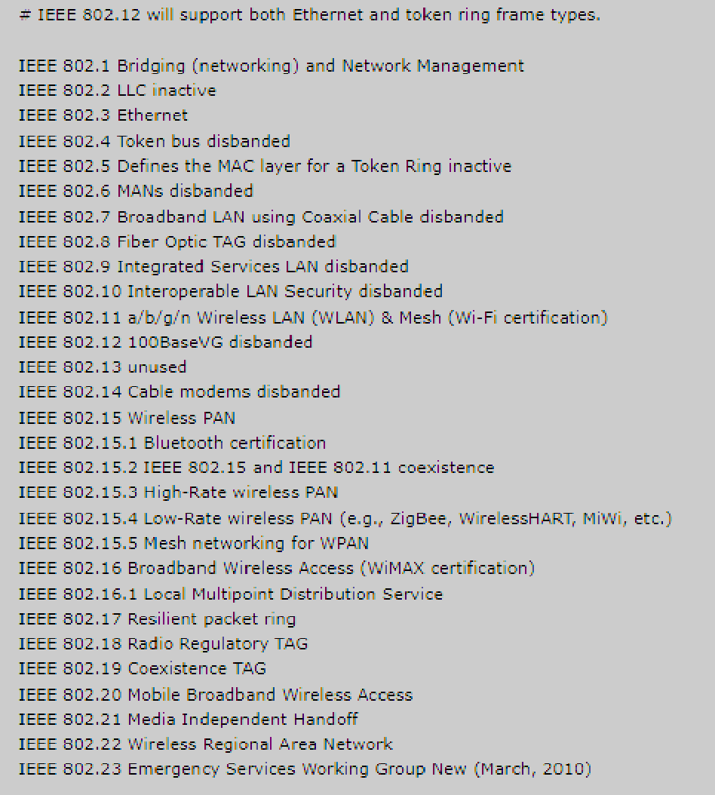
Module
1
Institute of Electrical
and Electronics Engineers (IEEE)
What Does Institute of Electrical and Electronics Engineers (IEEE) Mean?
The Institute of Electrical and Electronic Engineers (IEEE) is a global association and organization of professionals working toward the development, implementation and maintenance of technology-centered products and services.

Slide 41
Module
1
16 Useful Windows Networking Commands You Should Know
Command |  | Used For
1 | PING | Troubleshooting network connection issues. (test whether one network host is able to communicate with another)
2 | IPCONFIG | Quickly finding your IP address.
3 | GETMAC | Quickly finding your MAC address.
4 | ARP | Display and modify the Address Resolution Protocol cache; useful for resolving address resolution problems.
5 | HOSTNAME | Quickly finding your hostname.
6 | NSLOOKUP | Find the IP address of a device, find the domain name of an IP address of your device’s DNS server and find mail servers for a domain.
7 | NBTSTAT | Troubleshooting NetBIOS issues.
8 | Route | Allow you to view the device’s routing tables. To do so, simply type Route Print.

Slide 42
Module
1
16 Useful Windows Networking Commands You Should Know
Command |  | Used For
9 | NET | Displaying available Net switches. (accounts to set password and logon requirements, file to show a list of open files and sessions to list, or even disconnect, sessions on the network)
10 | NETSTAT | Displaying network statistics. NETSTAT [-a] [-b] [-e] [-f] [-n] [-o] [-p proto] [-r] [-s] [-x] [-t] [interval]
11 | NETSH | Displaying and configuring network adapters.
12 | TASKKILL | Ending processes.
13 | TRACERT | Trace the route a packet takes before reaching its destination, and see information on each “hop” along the route.
14 | PATHPING | Combine that best of both ping and tracert into a single utility.
15 | SYSTEMINFO | Displaying system information.
16 | NET VIEW | Viewing devices connected to a network.

Slide 43
Module
1
Homework 1
Q: Apply these windows networking commands, then send to me captured screen for commands (4-8) in your personal desktop computer (Pc) or laptop?
ipconfig
getmac
hostname
tracert esu.ac.ae
Ping esu.ac.ae
netstat –s
netstat –n
netstat -y

