Slide 1


Marketing Management
MGM612
Dr. Ayman Hassan
  Lecture - 5 - Consumer Buyer Behavior

Slide 2

Chapter
4
Consumer Buyer Behavior
Lecture 5
Dr. Ayman Hassan

Slide 3
Chapter
4
In the previous lecture,
We have discussed
The principles of socially responsible marketing.
The role of ethics in marketing.
The major social criticisms of marketing.
Ethical issues in marketing

Slide 4
Learning Outcomes
Chapter
4
After studying this chapter you should be able to:
Define the consumer market and construct a simple model of consumer buyer behavior
Name the four major factors that influence consumer buyer behavior
List and understand the major types of buying decision behavior and the stages in the buyer decision process

Slide 5
Chapter
4
Model of Consumer Behavior
Consumer behavior
Reflects totality of consumer’s decisions with respect to the acquisition, consumption, and disposition of goods, services, time, and ideas by (human) decision-making units (over time).
Consumer buyer behavior
refers to the buying behavior of final consumers—individuals and households who buy goods and services for personal consumption
Consumer market
refers to all of the personal consumption of final consumers

Slide 6
Chapter
4
Consumer Behavior Involves Attitudes Towards
Products
Services
Activities
People
Ideas

Slide 7
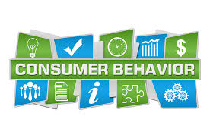
Chapter
4
Model of Consumer Behavior
  Marketing stimuli consists of the 4 Ps
  Product
  Price
  Place
  Promotion
  Other stimuli include
  Economic forces
  Technological forces
  Political forces
  Cultural forces

Slide 8
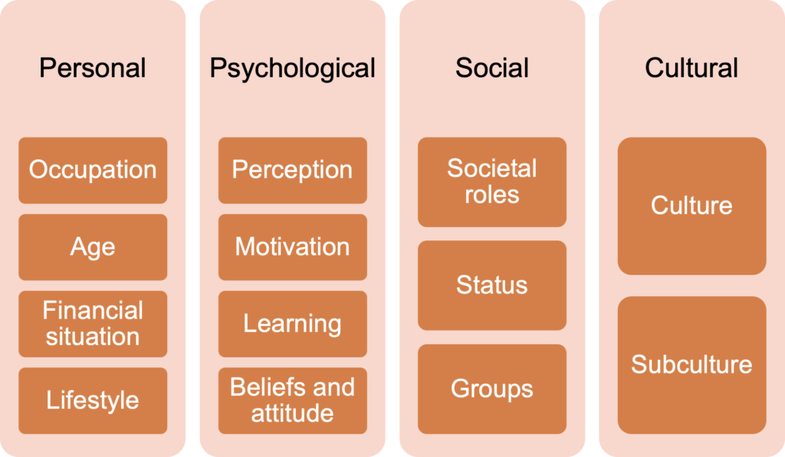
Chapter
4
Characteristics Affecting Consumer Behavior
Personal Factors
Psychological Factors
Social Factors
Cultural Factors

Slide 9
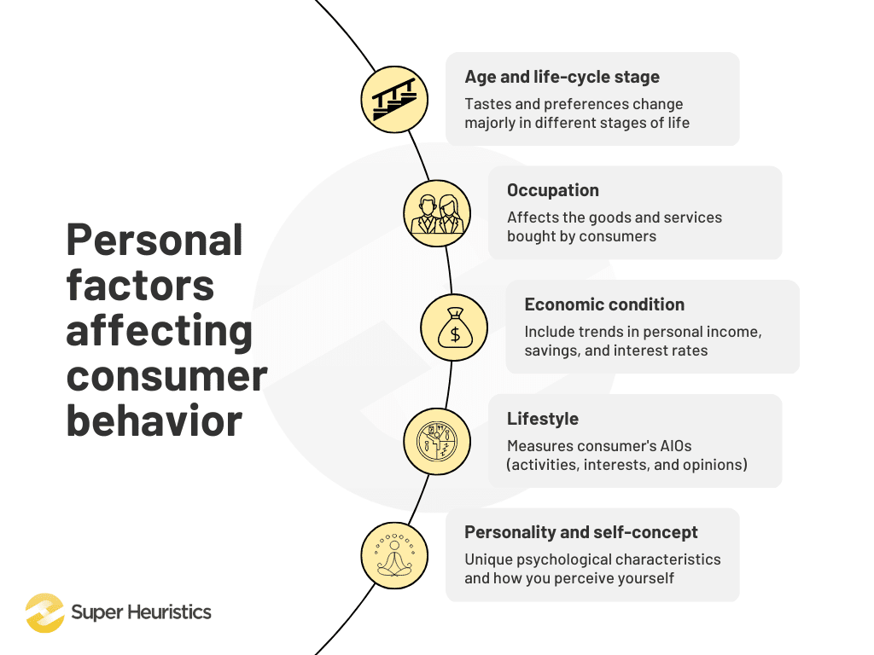
Chapter
4
C.A.C.B, Personal Factors
  Age and life-cycle stage
  Occupation
  Economic situation
  Lifestyle
  Personality and self-concept

Slide 10
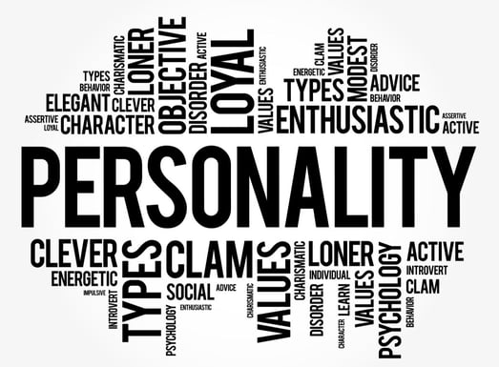
Chapter
4
C.A.C.B, Personal Factors
Personal characteristics
Age and life-cycle stage
Economic situation
Lifestyle
Personality and self-concept

Slide 11
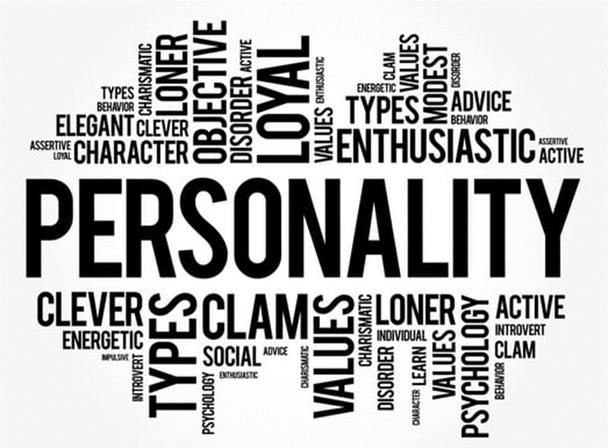
Chapter
4
C.A.C.B, Personal Factors
Age and life-cycle stage
Occupation affects the goods and services bought by consumers
Economic situation includes trends in:
Personal income
Savings
Interest rates

Slide 12

Chapter
4
C.A.C.B, Personal Factors
Lifestyle is a person’s pattern of living as expressed in his or her psychographics
Measures a consumer’s (activities, interests, and opinions) to capture information about a person’s pattern of acting and interacting in the environment

Slide 13
Chapter
4
C.A.C.B, Personal Factors
Personality and Self-Concept
  Personality
  refers to the unique psychological characteristics that lead to consistent and lasting responses to the consumer’s environment

Slide 14
Chapter
4
C.A.C.B, Personal Factors
Personality and Self-Concept
  Brand personality
  Refers to the specific mix of human traits that may be attributed to a particular brand
  Self-concept
  Refers to people’s possessions that contribute to and reflect their identities

Slide 15
Chapter
4
In General
There are four main aspects of human personality, the arrangements and combinations of which form the sixteen distinct personality types. Let us look at these four aspects first -
● Extraversion (E) or Introversion (I)?
Extroversion refers to the element in an individual’s personality that makes him or her outgoing, talkative, social in nature, lively and active. On the other hand, introversion defines the quiet, reserved, shy, passive, calm and strict nature of a person.
● Sensing (S) or Intuition (N)?
Sensing relies exclusively on the five senses (sight, hearing, smell, taste and touch) of humans and the sensory details they receive. Intuition, on the other hand, relies more on instinct or the sixth sense than anything else and is mostly unexplainable.
● Thinking (T) or Feeling (F)?
Thinking is when the brain works and logic is sifted through the test of reason. Feeling, on the other hand, is a matter of the heart where vibrations and perhaps non-verbal cues take precedence.
● Judging (C) or Perceiving (B)?
Judging is an aspect of human nature that generates structure, organization and fine calibration but may not always rely on logic and rationality. People with the ability to perceive rely on observation, spontaneity and flexibility and are therefore not fans of routine and structure.

Slide 16
Chapter
4
C.A.C.B, Psychological Factors
  Motivation
  Perception
  Learning
  Beliefs and attitudes

Slide 17
Chapter
4
C.A.C.B, Psychological Factors
Motivation
A motive
is a need that is sufficiently pressing to direct the person to seek satisfaction
Motivation research refers
to qualitative research designed to probe consumers’ hidden, subconscious motivations

Slide 18
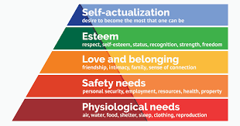
Chapter
4
C.A.C.B, Psychological Factors
Abraham Maslow’s Hierarchy of Needs
People are driven by particular needs at particular times
Human needs are arranged in a hierarchy from most pressing to least pressing
  Psychological
  Esteem
  Social(love/belonging
  Safety
  Self-actualization

Slide 19
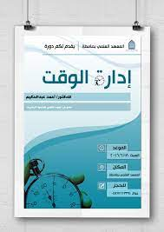

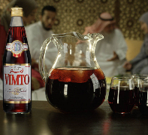



Chapter
4
What type of needs are used in each one of the following ads:

Slide 20
Chapter
4
C.A.C.B, Psychological Factors
Perception
Is the process by which people select, organize, and interpret information to form a meaningful picture of the world from three perceptual processes
Selective attention
Selective distortion
Selective retention

Slide 21

Chapter
4
C.A.C.B, Psychological Factors
Learning
Is the changes in an individual’s behavior arising from experience and occurs through interplay of:
Drives
Stimuli
Cues
Responses
Reinforcement

Slide 22
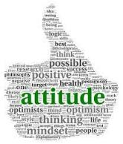

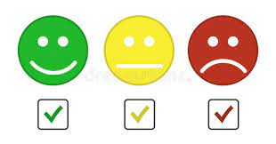
Chapter
4
C.A.C.B, Psychological Factors
Beliefs and Attitudes
Attitudes
Describe a person’s relatively consistent evaluations, feelings, and tendencies toward an object or idea
Belief
Is a descriptive thought that a person has about something based on:
Knowledge
Opinion
Faith

Slide 23
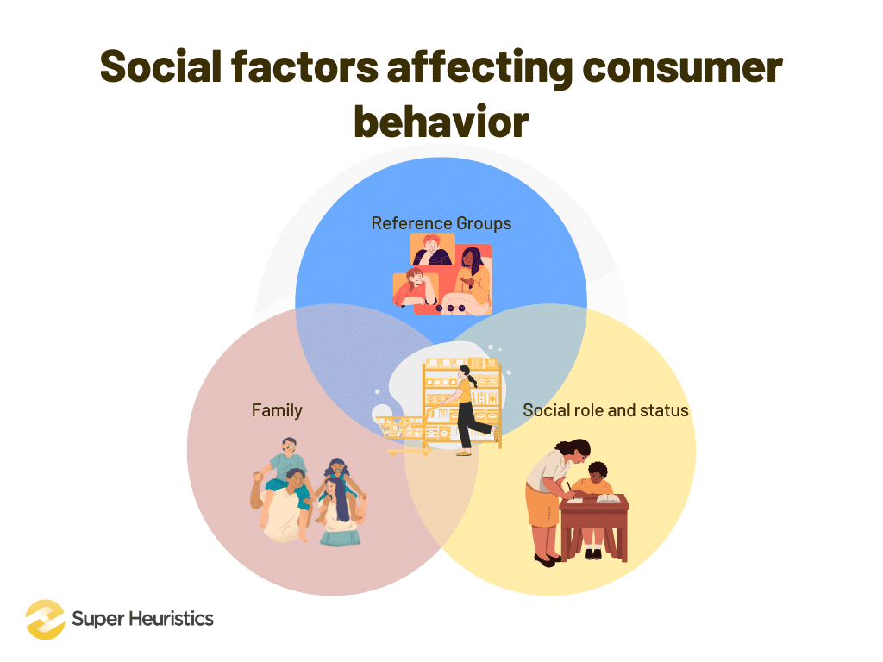
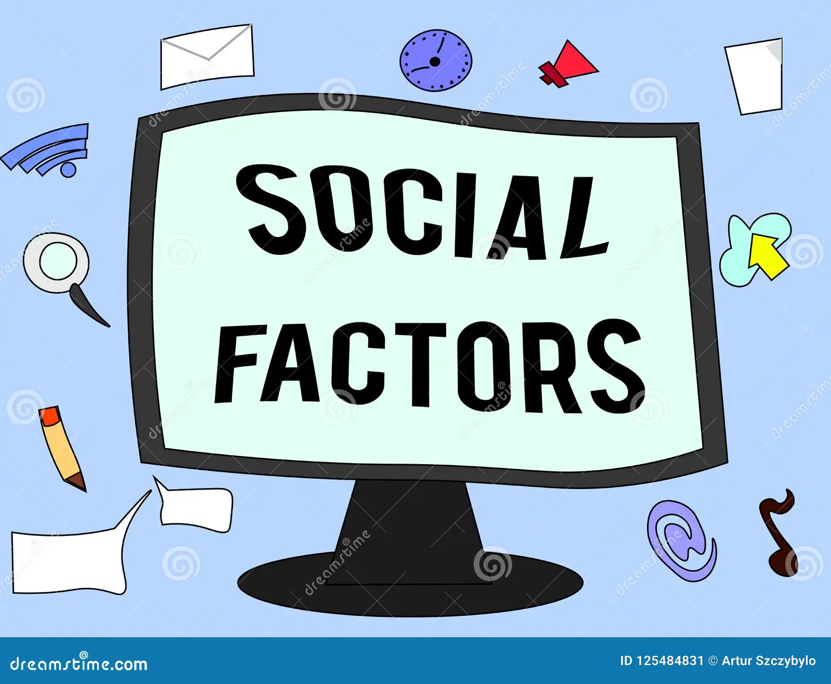
Chapter
4
C.A.C.B, Social Factors
  Reference groups
  Family
  Roles and status

Slide 24
Chapter
4
C.A.C.B, Social Factors
Groups
Reference groups
Philip Kotler defines reference groups as “groups that form a comparison or reference in forming attitudes or behavior.”
Examples of reference groups include:
relatives
neighbours
colleagues
seniors at work
your classmates, etc.

Slide 25
Chapter
4
C.A.C.B, Social Factors
There are two types of reference groups. Let us discuss them briefly.
a. Primary groups
Primary groups are the groups of people you interact with on a regular basis, like your family, friends, colleagues, etc. These groups play a huge role in influencing your consumer behavior because they talk to you directly about the products and services they consume, if they are satisfied with these products and services, if the products or services can satisfy your needs, etc.
b. Secondary groups
Includes groups with which the consumer has indirect relationships.
Unlike primary groups, secondary groups are more formal and interaction is not regular. Secondary groups include political parties, clubs, NGOs, etc.For example, you might join an online protest against a brand of instant noodles because the political party you support is trying to ban the brand.

Slide 26
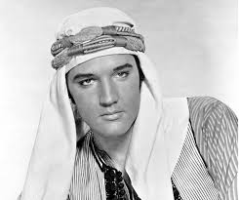
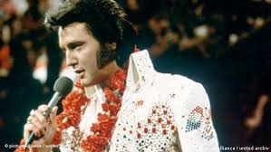
Chapter
4
C.A.C.B, Social Factors
Some other types of groups that fall under the social factors influencing consumer behavior include
C. Membership groups
According to Kotler, membership groups “have a direct influence and belong to which the person belongs.” For example, family.
Family Philip Kotler says that “family is the most important consumer-buying organization in society.”
Your family starts shaping your consumer behavior right from your childhood.
You observe the consumer behavior of your family members and try to imitate it as a child.
D. Aspirational groups.
a sub-category of a reference group, consisting of individuals (not necessarily known personally) with whom a person desires to be associated.
Are “groups to which the individual desires to belong.” For example, celebrities you admire.

Slide 27
Chapter
4
C.A.C.B, Social Factors
  Social roles and status
Philip Kotler defines social roles and status as “the influence of social class on consumer behavior.”
So, as a marketing student, you are expected to actively participate in class, participate in competitions and webinars, and take internships and projects.
As their child, your parents expect you to do well in your studies, and be a dutiful son.
As part of the circle of friends, you are expected to join your friends at their parties, throw a party on your birthday, and spend time with them.
Similarly, every other person also has multi-dimensional roles in society, depending on who the role is associated with. These roles are also part of the social factors that influence consumer behavior because an individual spends most of his time trying to successfully navigate between each of his roles.

Slide 28
Chapter
4
C.A.C.B, Cultural Factors
Cultural factors significantly influence marketing strategies as they shape consumer behaviour and preferences in different countries.
Cultural factors are a crucial aspect of the marketing mix, as they directly impact how consumers perceive and interact with a brand. These factors include language, religion, values, attitudes, customs, and social norms, which vary significantly from one country to another.
Therefore, understanding these cultural nuances is essential for marketers to effectively communicate with their target audience and influence their purchasing decisions.
For instance, colour symbolism varies across cultures. In Western societies, white is often associated with purity and innocence, while in some Asian cultures, it symbolizes mourning and death.
Therefore, a global brand would need to consider these cultural differences when designing their packaging or advertising campaigns to ensure they convey the intended message and evoke the desired emotional response.
Language is another critical cultural factor.
Religion also plays a significant role in shaping consumer behaviour. It influences dietary habits, clothing preferences, and even spending patterns. For example, in predominantly Muslim countries, products and services must comply with Islamic law (Halal)
Cultural Factors
  Buyer’s culture
  Buyer’s subculture
  Buyer’s social class

Slide 29
Chapter
4
C.A.C.B, Cultural Factors
Culture is the learned values, perceptions, wants, and behavior from family and other important institutions
Chinese and Western consumers are deeply influenced by their different cultures and have different consumption habits. Among them, in the Western worldview, individualism prevails.
Their consumption behavior is closer to their own needs.
However, Eastern consumers are deeply influenced by Confucian culture, hierarchy and collectivism, and many of their purchasing behaviors are for the purpose of revealing their social status and establishing a social image.

Slide 30

Chapter
4
C.A.C.B, Cultural Factors
Subculture
Are groups of people within a culture with shared value systems based on common life experiences and situations
Hispanic
African American
Asian
Mature consumer

Slide 31
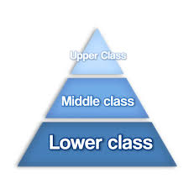
Chapter
4
C.A.C.B, Cultural Factors
Social classes
Are society’s relatively permanent and ordered divisions whose members share similar values, interests, and behaviors
Social class is measured by a combination of occupation, income, education, wealth, and other variables

Slide 32
Chapter
4
Types of Buying Decision Behavior
Complex buying behavior
Dissonance-reducing buying behavior
Habitual buying behavior
Variety-seeking buying behavior

Slide 33
Chapter
4
Types of Buying Decision Behavior
Complex Buying Behavior
When consumers are highly motivated in a purchase and perceive significant differences among brands
Purchasers are highly motivated when:
Product is expensive
Product is risky
Product is purchased infrequently
Product is highly self-expressive

Slide 34
Chapter
4
Types of Buying Decision Behavior
Dissonance-reducing buying behavior
Occurs when consumers are highly involved with an expensive, infrequent, or risky purchase, but see little difference among brands
Post-purchase dissonance
Occurs when the consumer notices certain disadvantages of the product purchased or hears favorable things about a product not purchased
Habitual buying behavior
Occurs when consumers have low involvement and there is little significant brand difference
Variety-seeking buying behavior
Occurs when consumers have low involvement and there are significant brand differences

Slide 35
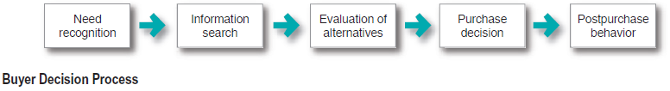
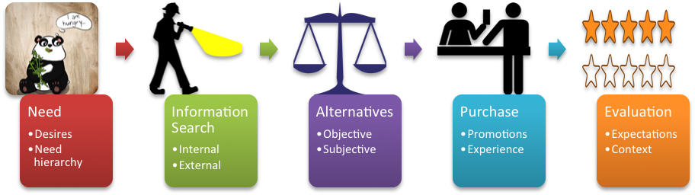
Chapter
4
The Buyer Decision Process

Slide 36
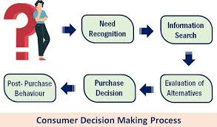
Chapter
4
The Buyer Decision Process
Five stages in the buyer decision process
Need recognition
Information search
Evaluation of alternatives
Purchase decision
Post-purchase behavior

Slide 37

Chapter
4
The Buyer Decision Process
Need Recognition
Occurs when the buyer recognizes a problem or need triggered by:
Internal stimuli
External stimuli
Information search
Is the amount of information needed in the buying process and depends on the strength
of the drive, the amount of information you start with, the ease of obtaining the information,
the value placed on the additional information, and the satisfaction from searching

Slide 38
Chapter
4
The Buyer Decision Process
Sources of information:
Personal sources—family and friends
Commercial sources—advertising, Internet
Public sources—mass media, consumer organizations
Experiential sources—handling, examining, using the product

Slide 39
Chapter
4
The Buyer Decision Process
Evaluation of alternatives
Is how the consumer processes information to arrive at brand choices
The purchase decision
Is the act by the consumer to buy the most preferred brand
The purchase decision can be affected by:
Attitudes of others
Unexpected situational factors

Slide 40
Chapter
4
The Buyer Decision Process
The post-purchase decision
Is the satisfaction or dissatisfaction the consumer feels about the purchase
Relationship between:
Consumer’s expectations
Product’s perceived performance
Post-Purchase Decision
The larger the gap between expectation and performance, the greater the consumer’s dissatisfaction
Customer satisfaction is a key to building profitable relationships with consumers—to keeping and growing consumers and reaping their customer lifetime value

Slide 41
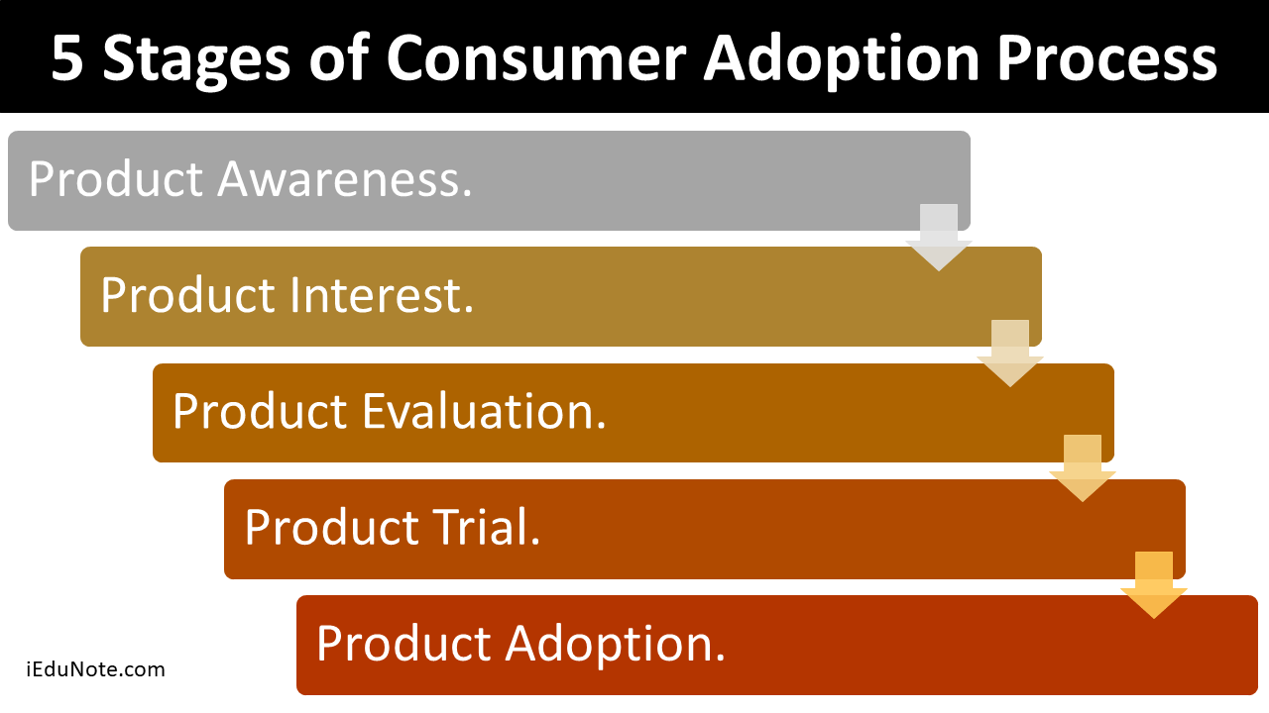
Chapter
4
The Buyer Decision Process for New Products
Stages in the Adoption Process
Awareness
Interest
Evaluation
Trial
Adoption

Slide 42
Chapter
4
Consumer Behavior Across International Borders
Differences can include:
Values
Attitudes
Behaviors
The question for marketers is whether to adapt or standardize the marketing?

Slide 43

1- Applying the decision making process “Nana”
Chapter
4
Scenario:
A college student, Nana, who has a computer that is starting to run slowly.
Nana is getting ready to start the semester and needs a computer that will efficiently help her with her assignments.
Need recognition
Recognizing unfulfilled needs Attract Customers
Arouse latent desires

Slide 44

2- Applying the decision making process “Nana”
Chapter
4
Nana, may start seeking information to help resolve her immediate problem, which is speeding up her computer.
Depending on what she finds, she may also begin searching for options for purchasing a new computer. She may ask a repairing technician, or an online community, a friend or a family member.
Information Search
Get products in front of customers eyes
Explain and convince of products benefits

Slide 45

3- Applying the decision making process “Nana”
Chapter
4
Nana, may decide that buying a new computer is the better option and might be making a comparison list of multiple computers.
The list may include prices, features, and reviews…
Evaluation of alternatives
Make information available to customers (buyer’s guide, brochures…)

Slide 46

4- Applying the decision making process “Nana”
Chapter
4
Now that Nana has decided to buy, she is likely eager to make the purchase and get her computer. She may, therefore, be more likely to buy the computer if she gets free and expedited shipping.
Will Nana buy it for sure? May be….
Purchase Decision
Make it easy to buy
Give information to corroborate buying decision (In-store (website) advertisements, salespersons pitches…)

Slide 47

5- Applying the decision making process “Nana”
Chapter
4
When Nana makes it to this phase of her buying decision process, she is using the computer and discovering what she likes and doesn’t like.
Reading resources that show her how to better utilize the computer could make her like it more.
Reduce Cognitive dissonance
Build Customer relationship
Cross-selling if possible
Post-Purchase Evaluation

Slide 48
Chapter
4
Resources and References
Chapter 4 – What are the Social Factors Affecting Consumer Behavior? - Super Heuristics
Aspirational Group - Monash Business School
What is Consumer Decision Making Process? Steps, Example - The Investors Book
5 Stages of Consumer Adoption Process [Buyer Decision Process for New Products] (iedunote.com)

