Slide 1



Discrete Mathematics
Dr. Shahira Ahmed
IT241
Lecture 4

Slide 2




Discrete Mathematics
Lecture 4
Graph Theory
www.midocean.ae

Slide 3
Lecture Outline
Graph Definition
Edge Type
Graph Type
Multiplicity
Degrees
Neighborhood
Graph Representation

Slide 4
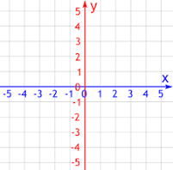
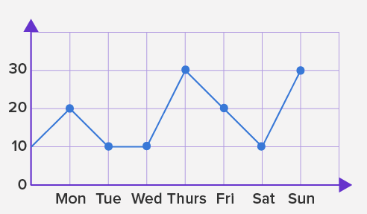
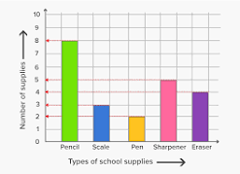
Not a Graph in discrete math
Not a Graph in discrete math

Slide 5
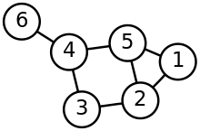
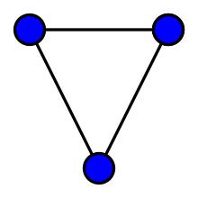
Graph
Graph in discrete math

Slide 6
Definitions - Graph
Representation: Graph G =(V, E) consists set of vertices denoted by V, or by V(G) and set of edges E, or E(G).
How many Vertex?
How many Edge?
a
b
Solution
four vertices
five edges.
d
c

Slide 7
Definitions – Edge Type
Directed: Ordered pair of vertices. Represented as (u, v) directed from vertex u to v.
Undirected: Unordered pair of vertices. Represented as {u, v}. Disregards any sense of direction and treats both end vertices interchangeably.
u
v
u
v

Slide 8
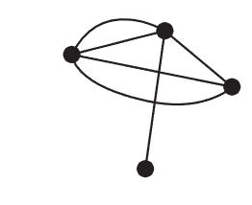
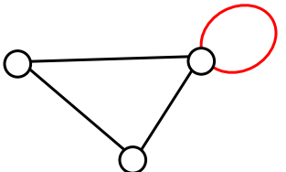
Definitions – Edge Type
Multiple Edges: Two or more edges joining the same pair of vertices.
Loop: An edge that connects a vertex to itself.
a loop (also called a self-loop) is an edge that connects a vertex to itself

Slide 9
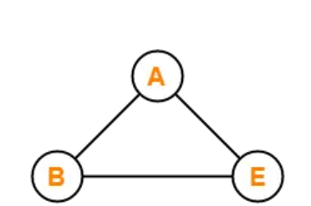
Definitions – Graph Type
A Simple graph have
  no self loops
  no multiple edges.

Slide 10
Definitions – Graph Type
Simple (Undirected) Graph: consists of V, a nonempty set of vertices, and E, a set of unordered pairs of distinct elements of V called edges (undirected)
u
v
w

Slide 11
Definitions – Graph Type
Represent graph in the opposite figure
u
v
w
G(V, E), V = {u, v, w}, E = {{u, v}, {v, w}, {u, w}}

Slide 12
Definitions – Graph Type
Simple Directed Graph: G(V, E), set of vertices V, and set of Edges E, that are ordered pair of elements of V (directed edges)
u
v
w

Slide 13
Definitions – Graph Type
Represent Graph?
u
v
w
G(V, E), V = {u, v, w}, E = {(u, v), (v, w), (w, u)}

Slide 14
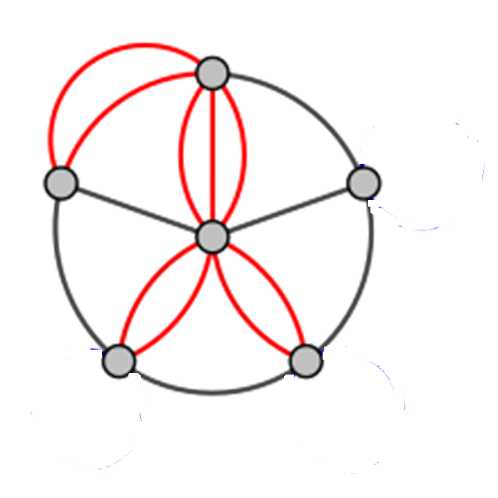
Definitions – Graph Type
Multigraph: have multiple (parallel edges)

Slide 15
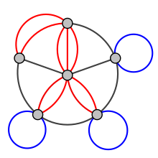
Definitions – Graph Type
Pseudograph:
  Loops allowed in such a graph
  Multiple edges.

Slide 16
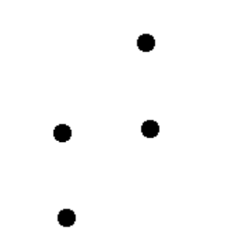
Definitions – Graph Type
A null graph is a graph in which there are no edges between its vertices.
Edge set is empty

Slide 17

Definitions – Graph Type
A trivial graph is the graph which has only one vertex.

Slide 18
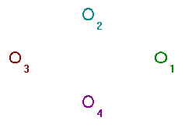

Quiz
Trivial Graph
Null Graph
Pseudo Graph
Match
Solution
  Pseudo Graph
  Null Graph
  Trivial Graph
a
b
c

Slide 19
Quiz
Trivial Graph
Null Graph
Pseudo Graph
Match
a
b
  Pseudo Graph
c

Slide 20
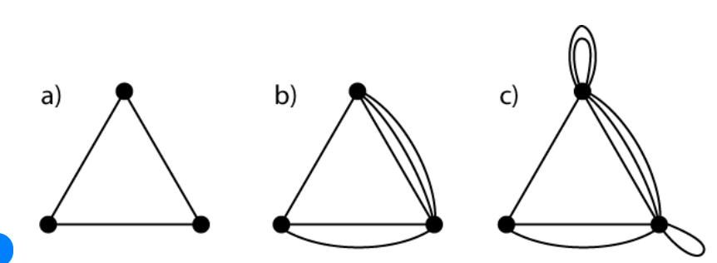
Quiz
Match
Simple Graph
multigraph
Pseudo Graph

Slide 21
Quiz
Match
Simple Graph
multigraph
Pseudo Graph

Slide 22
Graph Terminology: Summary
  Edges → undirected or directed (or both-Mixed)?
  Multiple edges →multigraph?
  Loops →Pseudo

Slide 23
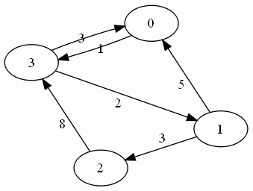
Quiz
Simple directed graph
  has no loops and no multiple edges.

Slide 24
Quiz
Pseudo graph
b
a
c

Slide 25
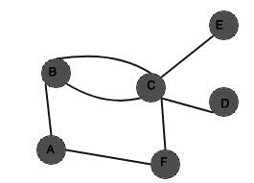
Multiplicity
Multiplicity : the number of edges between two vertices.
The multiplicity of the edge {B, C}?
The multiplicity of the edge {B, C}=2

Slide 26
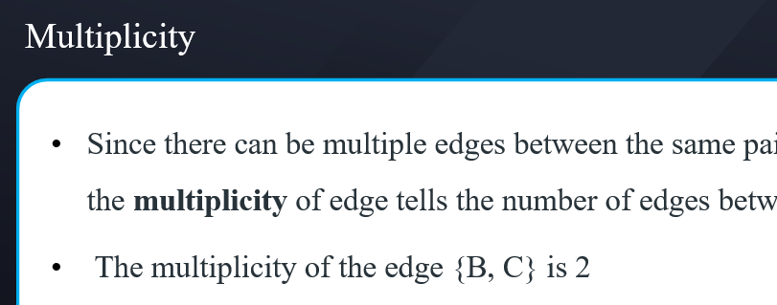
Quiz
Find
  Multiplicity of (a,b)
  Multiplicity of (b,c)
Solution
  Multiplicity of (a,b) is 1
  Multiplicity of (b,c) is 2
b
a
c

Slide 27
Basic Terminology
Adjacent (or Neighbors) in G if there is an edge e between u and v

Slide 28
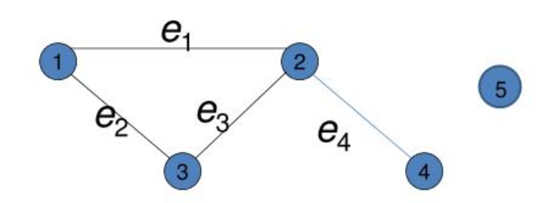
Basic Terminology
Adjacent (or Neighbors) in G if there is an edge e between u and v
  1 is adjacent to 2,3
  2 is adjacent to 1, 3, and 4
  3 is adjacent to 1 and 2
  4 is adjacent to 2
  5 is not adjacent to any vertex

Slide 29
Basic Terminology
The degree of a vertex in a undirected graph is the number of edges incident with it,
The degree of the vertex v is denoted by deg(v).

Slide 30
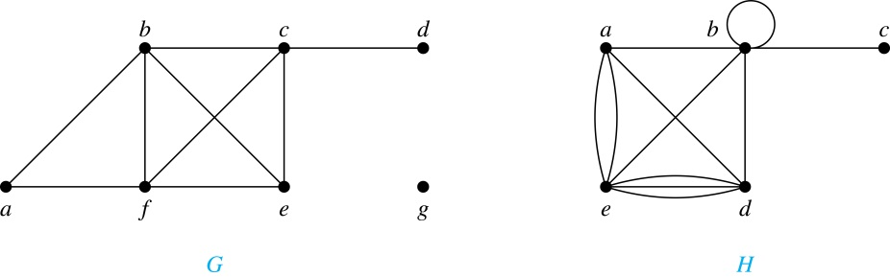
Degrees and Neighborhoods of Vertices
Example: What are the degrees of the vertices in the graphs G ?
Solution:
G: deg(a) = 2, deg(b) = deg(c) = deg(f ) = 4, deg(d ) = 1,
deg(e) = 3, deg(g) = 0.

Slide 31
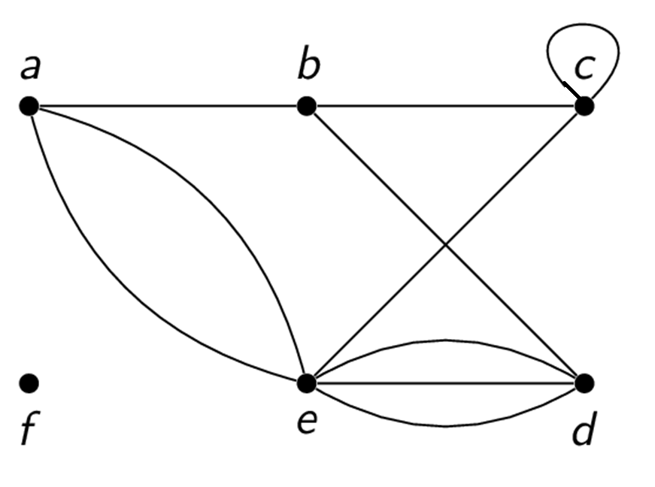
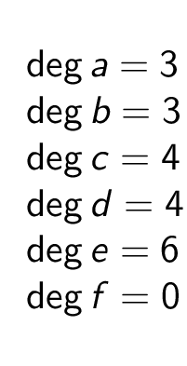
Degree of a vertex
A loop at a vertex contributes two to the degree of that vertex.

Slide 32
Degrees and Neighborhoods of Vertices
What are neighborhoods of the vertices in the graphs G ?
Solution:
G:
N(a) = {b, f }, N(b) = {a, c, e, f }, N(c) = {b, d, e, f }, N(d) = {c},
N(e) = {b, c , f }, N(f) = {a, b, c, e}, N(g) = ∅ .

Slide 33
Directed Graphs
The in-degree of a vertex v, denoted deg⁻(v), is the number of edges which terminate at v.
The out-degree of v, denoted deg⁺(v), is the number of edges with v as their initial vertex.
Loop at a vertex contributes 1 to both the in-degree and the out-degree of the vertex.

Slide 34
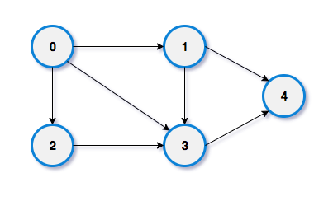
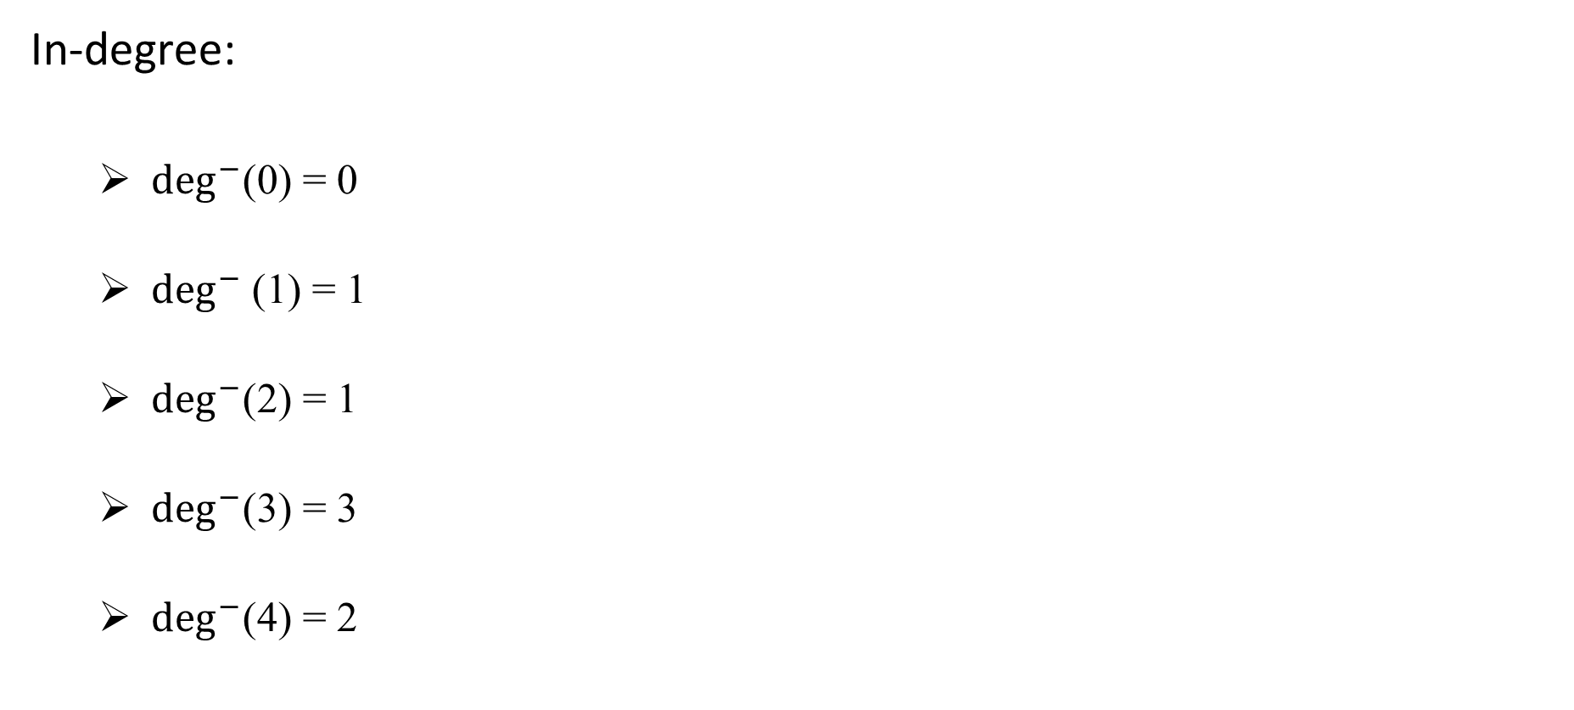
Directed Graphs
In-degree:
  $\deg^{−}$(0) = 0
  $\deg^{−}$(1) = 1
  $\deg^{−}$(2) = 1
  $\deg^{−}$(3) = 3
  $\deg^{−}$(4) = 2

Slide 35
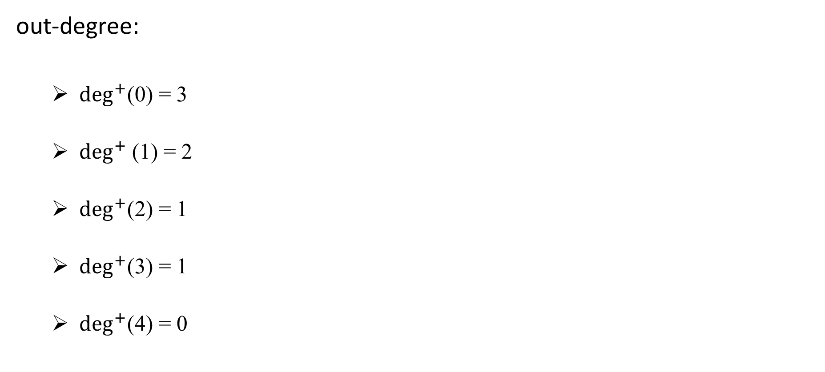
Directed Graphs
out-degree:
  $\deg^{+}$(0) = 3
  $\deg^{+}$(1) = 2
  $\deg^{+}$(2) = 1
  $\deg^{+}$(3) = 1
  $\deg^{+}$(4) = 0

Slide 36
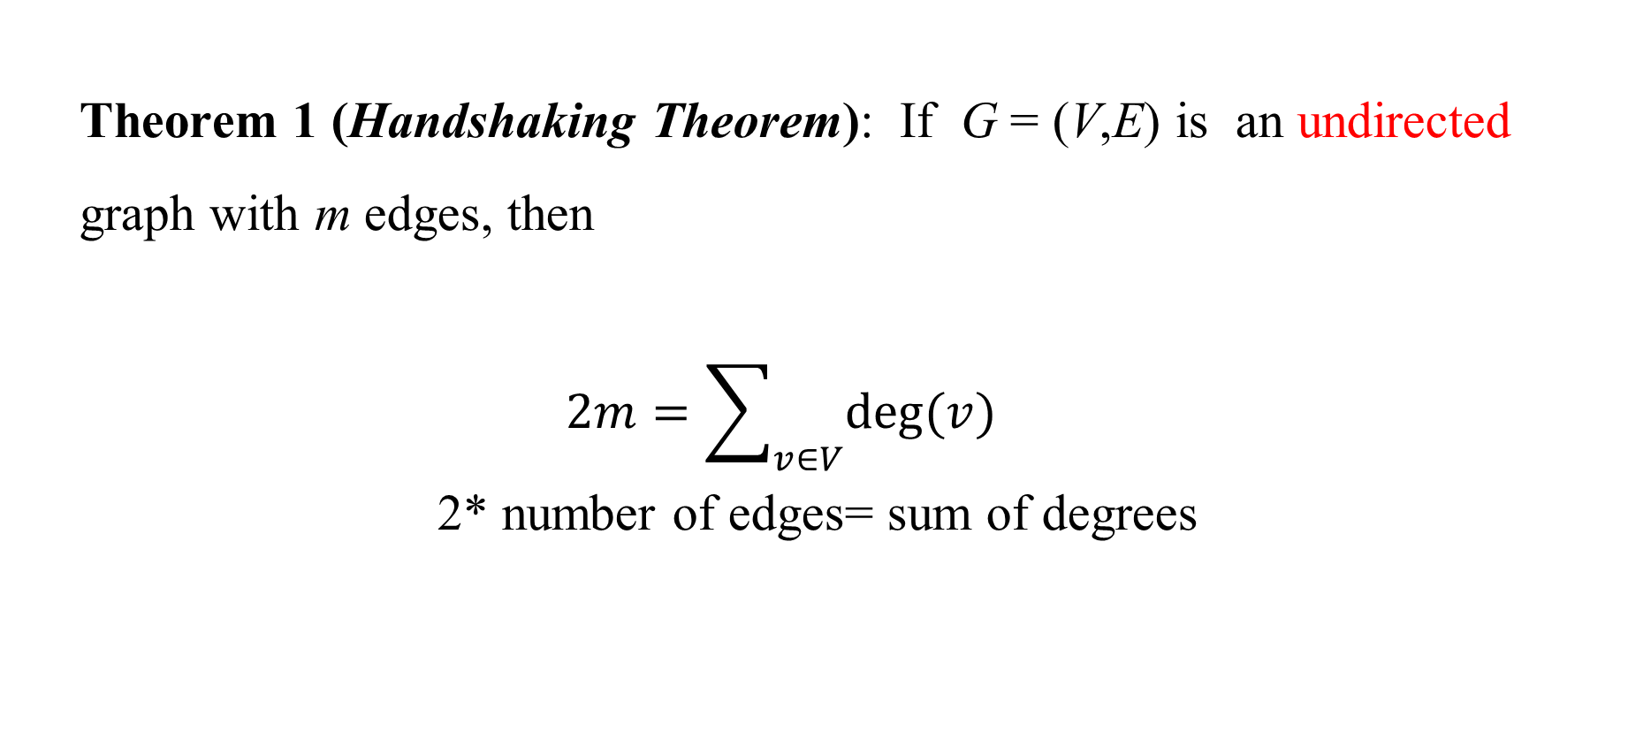
Degrees of Vertices
Theorem 1 (Handshaking Theorem): If G = (V,E) is an undirected graph with m edges, then
$$2m=\sum_{v∈V}{deg⁡(v)}$$
2* number of edges= sum of degrees

Slide 37
Handshaking Theorem
How many edges are there in a graph with 10 vertices of degree six?
Solution: Because the sum of the degrees of the vertices is 6 ⋅ 10 = 60, the handshaking theorem tells us that 2m = 60.
So the number of edges m = 30.

Slide 38
Handshaking Theorem
A simple graph G has 24 edges and degree of each vertex is 4. Find the number of vertices.
Solution:
2* number of edges= sum of degrees
2*24=sum of degrees
48=number of vertex*4
number of vertex=12

Slide 39
Graph Representation

Slide 40
Representing Graphs: Adjacency Lists
Definition: An adjacency list can be used to represent a graph with no multiple edges by specifying the vertices that are adjacent to each vertex of the graph.

Slide 41
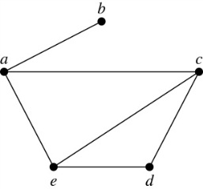
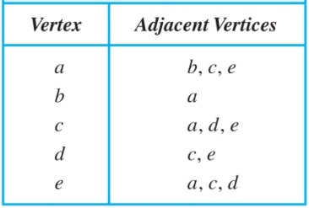
Representing Graphs: Adjacency Lists

Slide 42
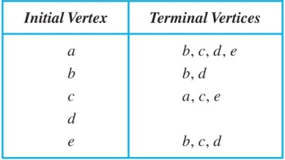
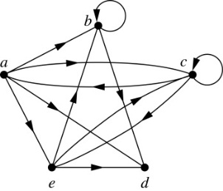
Representing Graphs: Adjacency Lists

Slide 43
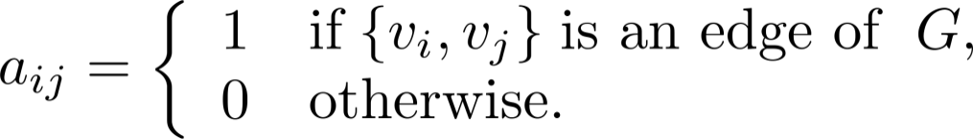
Representation of Graphs: Adjacency Matrices
Definition: Suppose that G = (V, E) is a simple graph where |V| = n. The adjacency matrix A_{G} of G the n × n zero-one matrix with:
1 as its (i, j)th entry when v_{i} and v_{j} are adjacent,
0 as its (i, j)th entry when they are not adjacent.
  In other words, if the graphs adjacency matrix is

Slide 44
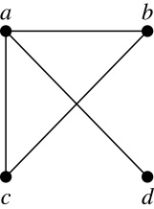
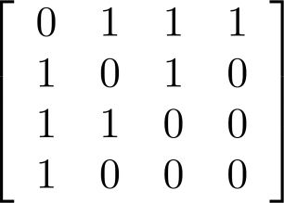
Adjacency Matrices
Represent the Following Graph using Adjacency Matrix

Slide 45
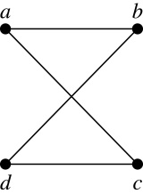
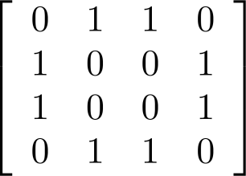
Adjacency Matrices
Represent the Following Graph using Adjacency Matrix

Slide 46
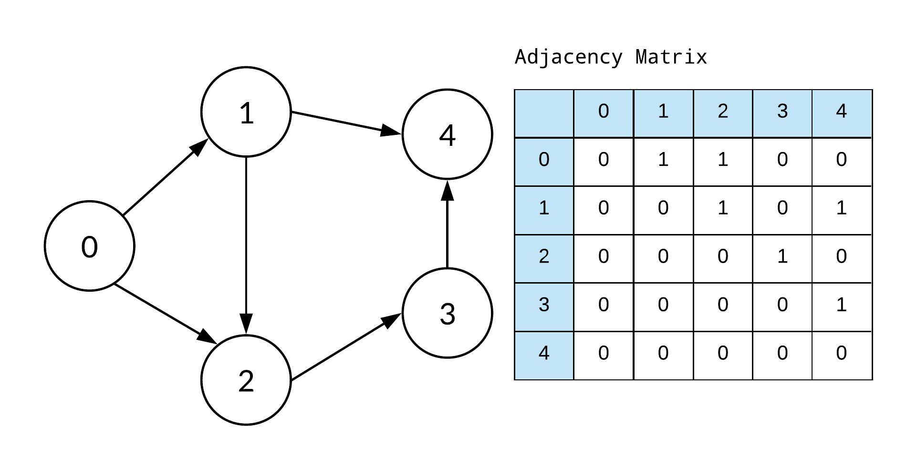
Adjacency Matrices
Represent the Following Graph using Adjacency Matrix

Slide 47
Adjacency Matrices for pseudo graph
Adjacency matrices can also be used to represent graphs with loops and multiple edges.
When multiple edges connect the same pair of vertices or if multiple loops are present at the same vertex , the (i, j)th entry equals the number of edges connecting the pair of vertices.

Slide 48
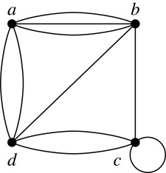
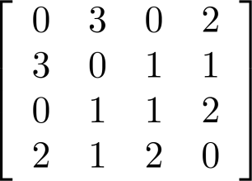
Adjacency Matrices for pseudo graph
Example: We give the adjacency matrix of the pseudograph shown here using the ordering of vertices a, b, c, d.

Slide 49
Adjacency Matrices
Graph Type

Slide 50
Adjacency Matrices
Graph Type
Multiedge
undirected
Directed
Loops

Slide 51
Recap

Slide 52
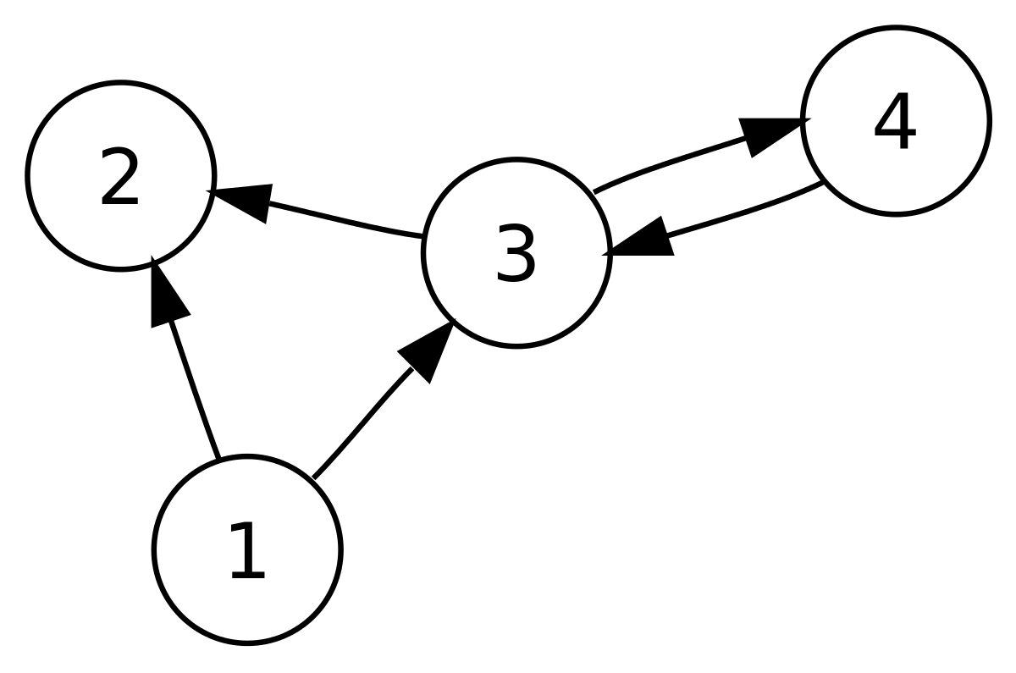
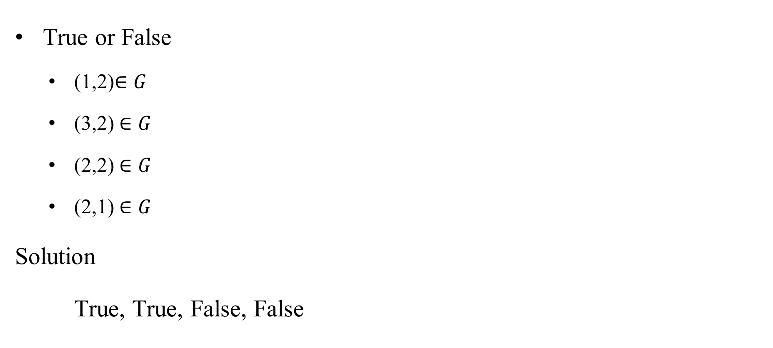
Quiz
True or False
  (1,2)$∈G$
  (3,2) $∈G$
  (2,2) $∈G$
  (2,1) $∈G$
Solution
True, True, False, False

Slide 53
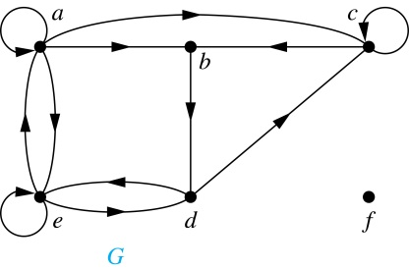
Quiz
In the graph Find all indegree and out degree for all nodes
deg⁺(a) = 4
deg⁺(b) = 1
deg⁺(c) = 2
deg⁺(d) = 2
deg⁺ (e) = 3
deg⁺(f) = 0.
deg⁻(a) = 2
deg⁻(b) = 2
deg⁻(c) = 3
deg⁻(d) = 2,
deg⁻(e) = 3
deg⁻(f) = 0.

Slide 54
Quiz
In the graph Find all indegree and out degree for all nodes
deg⁺(a) = 4
deg⁺(b) = 1
deg⁺(c) = 2
deg⁺(d) = 2
deg⁺ (e) = 3
deg⁺(f) = 0.
deg⁻(a) = 2
deg⁻(b) = 2
deg⁻(c) = 3
deg⁻(d) = 2,
deg⁻(e) = 3
deg⁻(f) = 0.

Slide 55
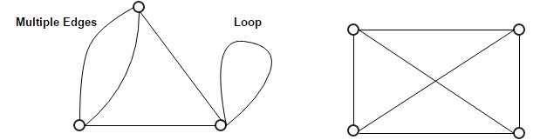
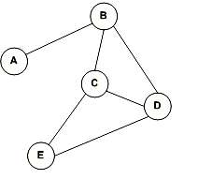
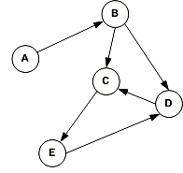
Quiz
Simple Graph or not?
Directed or undirected ?

Slide 56
Quiz
not simple graph Simple Graph
Simple Graph or not?
Directed or undirected ?
Undirected Directed

Slide 57
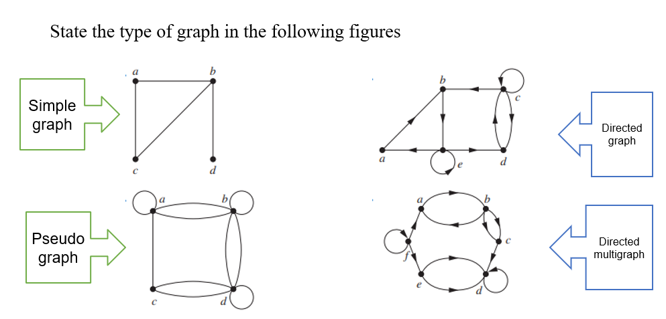
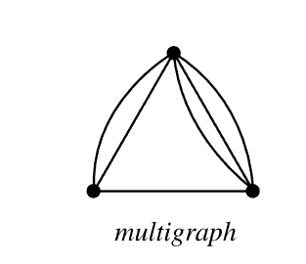
Quiz
State type of graph (Simple-multigraph-pseudograph)

Slide 58
Quiz

Slide 59
Quiz
Example: What are the degrees and neighborhoods of the vertices in the graphs H?
Solution:
deg(a) = 4, deg(b) = deg(e) = 6, deg(c) = 1,
deg(d) = 5.
N(a) = {b, d, e}, N(b) = {a, b, c, d, e}, N(c) = {b},
N(d) = {a, b, e}, N(e) = {a, b ,d}.

Slide 60
Quiz
How many edges are there in a graph with 10 vertices of degree Five?
Solution: Because the sum of the degrees of the vertices is 5 ⋅ 10 = 50, the handshaking theorem tells us that 2m = 50.
So the number of edges m = 25.

Slide 61
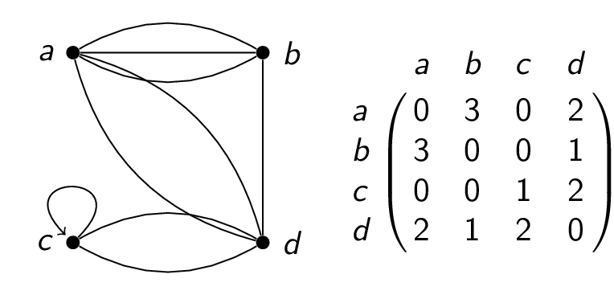
Quiz
According to Adjacency matrix, the graph is (directed-undirected-has loops-multigraph)

Slide 62
Quiz
According to Adjacency matrix, the graph is (directed-undirected-has loops-multigraph)
Multigraph loop and undirected

Slide 63
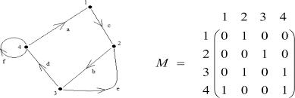
Quiz
According to Adjacency matrix, the graph is (directed-undirected-has loops-multigraph)

Slide 64
Quiz

Slide 65
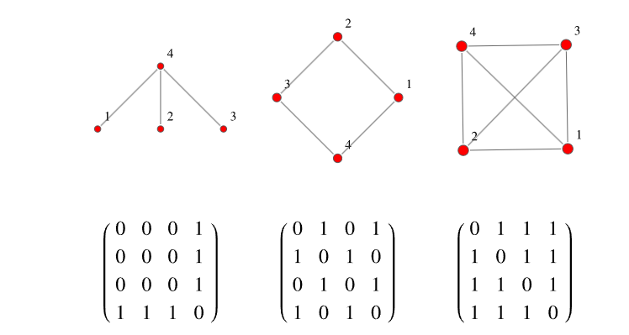
Quiz
According to Adjacency matrix, the graph is (directed-undirected-has loops-multigraph)

Slide 66
Quiz
Simple graph

Slide 67
Quiz
Complete
There are no edges between its vertices.
Edge set is empty
The graph which has only one vertex
We use ordered pair to represent ------------ graph
We use sets to represent edge ---------------graph
A loop at a vertex contributes ________to the degree of that vertex.
An adjacency list can be used to represent a graph with multiple edges?

Slide 68
Quiz
Null graph
Null graph
Trivial graph
Directed
Undirected
Two
False

Slide 69
Summary
Graph
Types of graph
Degrees
Neighborhood
Adjacency List
Adjacency Matrix

