Slide 1


MIDOCEAN University
Analyzing and Improving Student Academic Performance using AI
By Ahmed Al Moairfi &
Ibrahim Al Nakhli

Slide 2
Outlines
01
Introduction
02
Related works
03
Research Methods
04
Discussion & Conclusion
05
Future works

Slide 3
Introduction
Background
AI is the new evolution in this generation. It has led to improvement in all fields. It must be used to improve education and academic outcomes. Instead of just letting students use AI generative models, users should have a comprehensive AI system that begins by creating a measurement process, monitors student performance, enhances the results, and suggests solutions.

Slide 4
Introduction
Problem Definition
Students need guidance to cross over the changes, identify their weaknesses, and resolve them.

Slide 5
Introduction
Research Questions
How to analyze student performance using AI?
How does artificial intelligence provide suggestions to improve student performance?

Slide 6
Introduction
Research Objectives
Create a ML model that analyzes students' performance
Provide a suggested solution to enhance the weak points.

Slide 7
Related Works
Study | Key Findings/Results | Methodology | Limitations | Advantages
Artificial Intelligence (AI) Towards Students’ Academic Performance, Mallillin,2024 | AI enhance student. learning and measures student. Attitude | Quantitative research use to Measure and detect the related factors to enhance academic performance. Qualitative research is used to evaluate and analyze the AI Enhance the academic performance of students among the respondents. | The study uses a mixed-methods approach (focus groups + survey), but lacks a control or comparison group to assess the effectiveness of AI interventions versus no intervention | Targets specific learning needs for improved outcomes. And Enhances motivation and attitudes toward learning.
Prediction and Analysis of University Student Performance Based on Machine Learning, Xiaobo Zhu, 2024 | The model provide a good result for student performance R² = 0.55, RMSE = 4.68 and MAE=3.61. analysis predict the learning difficulties and curriculum enhancement. | Predictive model based on random forest that analyze student performance specifically on python course. | Limited amount of data used in the research. Not all indicators have been used in this study such as classroom interaction frequency and homework completion time | It supports detecting at-risk students, refining education programs, and raising teaching standards.
The end of multiple-choice tests: using AI to enhance assessment, Klymkowsky, 2024 | Dewey delivered a detailed analysis for students and define the miss understand concept by allowing student to explain why they choose this answer. Then the AI bot “Dewey analyze the student answers and identify misconceptions and missing knowledge | Develop a AI Bot | The current answer is unsure student understanding. Training Data: Dewey’s accuracy depends on its curated knowledge base. Adoption Barriers: Instructors must embrace formative assessment and redesign courses around feedback. Expansion Needed: Larger trials across diverse subjects and student populations. | AI analysis of student explanations gives quick, detailed feedback, helping instructors spot misconceptions in complex topics. Using AI-based formative assessments improves learning outcomes and provides a more accurate measure of student understanding than traditional multiple-choice tests.

Slide 8
Related Works
Study | Key Findings/Results | Methodology | Limitations | Advantages
Data-Driven Insights: Using AI to Analyze Student Performance in English Language Courses, Adlin Jerusha, 2024 | The study result in enhancing the performance by analyzing the the factors such as motivation and resource availability using AI. This indicates that understanding these interconnections can lead to enhance educational strategies. | The study use SPSS for quantitative analysis to study the increase in student performance in English course as a second language.by using both descriptive and inferential statistics to analyze survey data that collected from student according to their study habits, demographics and the others factors. | The study focus on English courses student only, so the generalization in this research is limited | AI enhances personalized course development for students. Identifies key factors influencing student success and performance.
Leveraging Artificial Intelligence for Student Performance Monitoring. International Journal of Research Publication and Reviews, Rajeena,M., & Quraishi, 2024 | The study focus on detecting the positive effect of AI on students outcomes and how can AI provide a real time feedback. The research found that how can AI access just handle simple management task to analyze student performance and enhance student outcome. | The study review existing researches in AI tools used in effectiveness in monitoring and evaluating student performance. Which include examining adaptive learning platforms, AI-driven tutoring systems. That will lead in detecting struggling students which will lead to enhance education outcome. | The study discuss the ethical issues and challenges related in Using AI. including privacy issues which is counted as main limitation in using AI in analyzing student performance. | Provides real-time feedback and personalized learning experiences. Enables early intervention for struggling students.
Predicting Student Academic Performance Using Neural Networks: Analyzing the Impact of Transfer Functions, Momentum and Learning Rate, Agarwal, M., & Agarwal, 2024 | The study get great result in prediction student performance. The prediction accuracy is 98% using artificial neural network. As a comparative analysis of various Machine Learning Algorithms the result the ANN achieve Better result than SVM, KNN, NB, DT and others ML algorithms indicate that ANN has the potential to improve student performance. | The study utilizes Artificial Neural Networks (ANN) as the primary method of analyzing student performance. The study used SVM DT, KNN,LR,NB as comparative research to show the superiority of ANN with a 97% accuracy rate. | The dataset of students is not large which is less than 700 student. That can not lead to generalize the result. The research omit some factors like students' social interactions, interpersonal skills and academic engagement which might indicate a gap in the understanding all variables that affect student outline | This research used artificial intelligence specifically neural networks to predict student grades with very high accuracy (98%). - Can identify struggling students early, before failure occurs.

Slide 9
Related Works
Study | Key Findings/Results | Methodology | Limitations | Advantages
Student Performance Analysis using Machine Learning. International Journal of Innovative Technology and Exploring Engineering, Kalpana et al., 2020 | Random Forest model to predict student outcomes using assessment data | Machine Learning (Random Forest) | No live classroom application; lacks qualitative evaluation | The system helps teachers detect at-risk students early using grades and behavior. It combines psychology, education, and computer science, improves communication among stakeholders, offers a user-friendly interface with auto-generated reports, and supports institutions in understanding student levels and enhancing academic programs.
Educational data mining: Prediction of students’ academic performance using machine learning algorithms, Yağcı, 2022 | Midterm scores predict final grades with 70–75% accuracy | ML (SVM, RF, NB, KNN) | Simple features; lacks full behavioral data | The model predicts final exam grades using midterm scores and faculty data, based on real data from 1,800+ students. By testing various algorithms and selecting the most accurate, it provides early detection of at-risk students and supports data-driven smart learning environments
Bridging Human and AI Explanations to Support Students’ Revisions of Open-Ended Responses. Proceedings of the 17th International Conference on Educational Data Mining (EDM 2024), | Develops explainable feedback using LLMs; taxonomy of feedback types | LLMs + Text Analysis | Still theoretical; requires real classroom deployment | Intelligent Feedback Systems (Li & Botelho, 2024) Development of explainable systems that provide human-like, precise feedback using large language models like GPT Classification of feedback types according to specific educational objectives Analysis of student-AI interactions to improve educational tools Providing individualized feedback in large classrooms, enhancing educational equity
AI for Student Assessment - Systematic Review, González-Calatayud et al., 2021 | AI mostly used in formative assessment and auto-grading | Review of 22 studies | Lack of educational/pedagogical grounding | This review of 22 studies explores AI-based student assessment, emphasizing its role in formative assessment, instant feedback, and automated grading. It contrasts AI-enabled with traditional education, highlights the need for teacher training in pedagogical use of AI, and provides recommendations for institutions adopting AI in assessment.

Slide 10
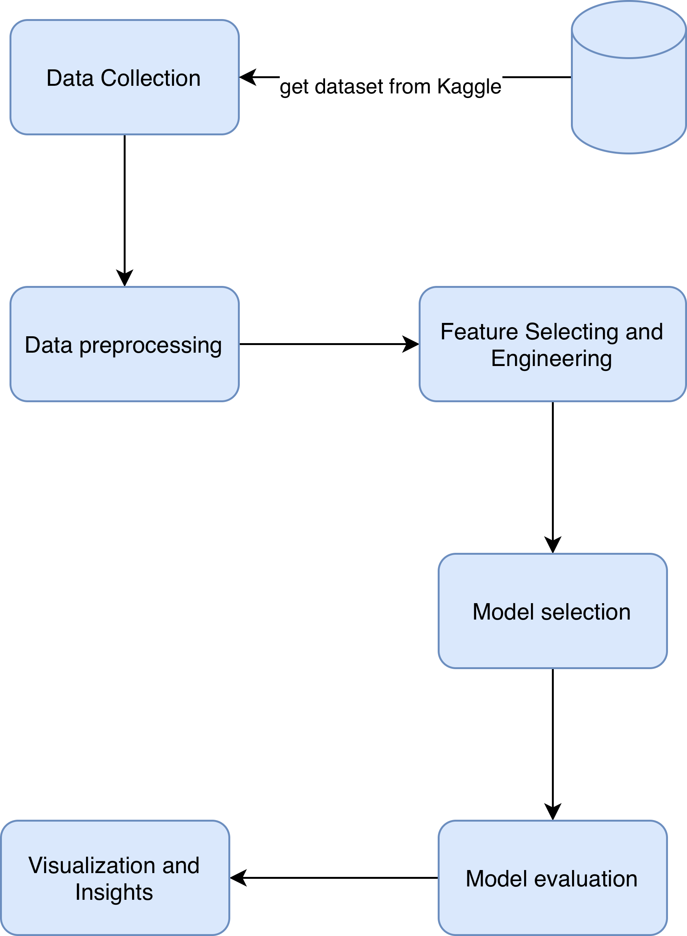
﻿Research Methods
Framework

Slide 11
﻿Research Methods
Data collection
The data source is a dataset containing records for 2392 students, with GPA and 13 additional attributes, excluding student ID.

Slide 12
﻿Research Methods
Data Preprocessing
The predefined dataset doesn’t require an emissive process. Because it’s clear of null values, missing attributes, and duplicates, all values are “numerical”; even classification, nominal, and ordinal values are converted already, and the keys of each value are provided.

Slide 13
﻿Research Methods
Model/Method Selection
In this research, we use 5 models, compare their results, and select the most accurate. The chosen models are (Random Forest Regressor, Decision Tree Regressor, K-Nearest Neighbors Regressor, XGBoost , Gradient Boosting Regressor, and RNN)
The results weren’t far from each other, except for the KNN.
The most accurate were XGBoost and KNN.
All models are regression models that predict the expected GPA value from 0 to 4.
By using the GridSearchCV tool in scikit-learn, which uses Cross-Validation to find the best.

Slide 14
﻿Research Methods
Testing and Evaluation
The neural network model was evaluated twice: once with PCA and once without.
The evaluation results are R² and the Loss value.
Other models’ evaluation result is R², MSE, RMSE, MAE
The best result across all models is achieved by: XGBoost.

Slide 15
﻿ Resources Needed
Resource Needed
Python programming language,
Pandas, Numby, Seaborn and matplotlib libraries for data analyzing
and preprocessing, Tenserflow, Pytorch, Keros and Scikit-learn for Models creation .

Slide 16
Discussion
 | DT Regressor | RF Regressor | GBR | KNN | XGBoost | RNN
MAE | 0.2246 | 0.1668 | 0.1409 | 0.3464 | 0.1383 | Loss: 0.0391
MSE | 0.0956 | 0.0491 | 0.0339 | 0.1941 | 0.0325
RMSE | 0.3092 | 0.2217 | 0.1841 | 0.4406 | 0.1804
R² Score | 0.8865 | 0.9416 | 0.9597 | 0.7694 | 0.9614 | 0.9537
The above result shows that KNN has the lowest accuracy among the models. Other models are close to each other. XGBoost is the best one; GBR and RNN are very close to it.

Slide 17
Discussion
As a result, XGBoost was the most accurate model, with an R² of 0.9614. GBR and RNN results are close to XGBoost. In contrast, the KNN accuracy result is very weak compared to the previous models.
The feature selection and filtering results were less accurate than those from the complete feature model. It is only useful when training a model with a massive amount of data.
The visualization shown in the previous section will support the analysis and help yield better results, describing the relationship between features and the target “GPA”.

Slide 18
Discussion
The experimental results support the conclusion that study habits play an essential role in student performance. The study examines features and their relationship to GPA as an indicator of student performance. We found that “Tutoral” is the most effective feature, and that “study habits” features, in general, are the most effective for GPA.
The results were obtained from different AI models and show only a limited difference, as shown above.

Slide 19
Discussion
Random Forest Regressor | Gradient Boosting Regressor | Xgboost | RNN
Tutoring | Tutoring | Tutoring | Absences
Absences | Absences | ParentalSupport | StudyTimeWeekly
Age | Extracurricular | Extracurricular | ParentalSupport
Extracurricular | Age | Music | Tutoring
ParentalSupport | ParentalSupport | Age | Extracurricular
The common ones among them are:
(Tutoring – ParentalSupport - ExtraCurricular)
After those features, “Absences” comes next.

Slide 20
Key Findings
In this research, the amount of data was 2392 records, which can be increased further as an enhancement.
The used model in this research includes (Random Forest, Decision Tree, K Nearest Neighbors, XGBoost, GradientBoostingRegressor, and Recurrent Neural Network).
The best model was XGBoost with 0.9614 accuracy.
The Study habits appear as the most affecting factor on student performance.
Also, the visualizations show the relation between student GPA and other features, especially in the heatmap

Slide 21
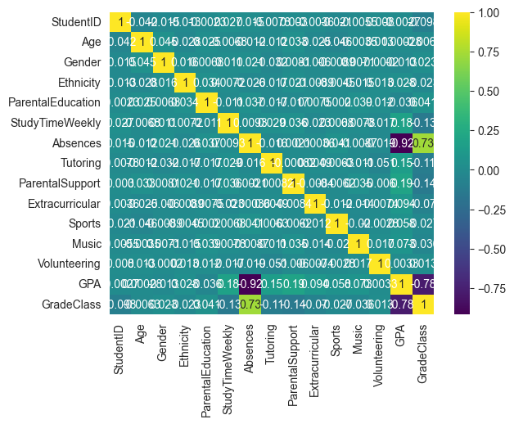
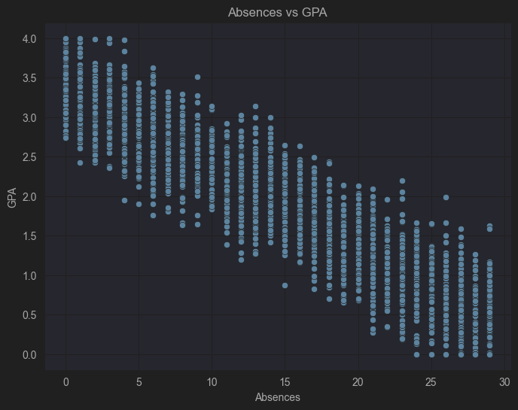
Key Findings

Slide 22
Future work
Increase the training data:
The study could be improved by incorporating a larger dataset of students from different countries to enable generalization of the results. Additionally, the features used in the prediction can be expanded to capture other factors that affect academic performance. Also, ensure that you include samples from different study levels and social classes.

Slide 23
Future work
Provide and suggest Guides to enhance the detected weak points
The next step is to provide a roadmap for each student to address the weaknesses identified that may affect their GPA and overall academic performance.

Slide 24


Question and Answer

Slide 25
Thank You

