Slide 1

CCNA (200-301) Cisco Certified Network Associate
Prepared by Eng. Taghreed Elsayed
Lecture 6
OSPF

Slide 2
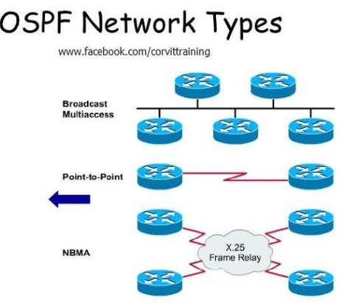
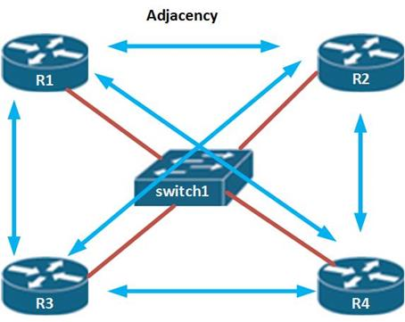

Chapter
03
OSPF (open shortest path first)

Slide 3
Chapter
03
OSPF (open shortest path first)
OSPF Network Types
1. Point to point
when serial interface use encapsulation protocols :
HDLC : High Level Data Link Control
PPP : Point to Point protocol
A Point-to-Point OSPF network type does not maintain a DR/BDR relationship.
The Point-to-Point network type has a 10 second hello and 40 second dead timer.
Point-to-Point network types are intended to be used between 2 directly connected routers.

Slide 4
Chapter
03
OSPF (open shortest path first)
2.Broadcast
When using Ethernet ports connected to Ethernet switches
DR: Designated Router BDR : Back up Designated Router
The Broadcast network type is the default for an OSPF enabled Ethernet interface.
The Broadcast network type requires that a link support Layer 2 Broadcast capabilities.
The Broadcast network type has a 10 second hello and 40 second dead timer.
An OSPF Broadcast network type requires the use of a DR/BDR.

Slide 5
Chapter
03
OSPF (open shortest path first)
2.NBMA (Non Broadcast Multi-Access)
Serial interface use Frame Relay Encapsulation
Some times require DR&BDR
When using Ethernet ports connected to Ethernet switches
DR: Designated Router BDR : Back up Designated Router
The Broadcast network type is the default for an OSPF enabled Ethernet interface.
The Broadcast network type requires that a link support Layer 2 Broadcast capabilities.
The Broadcast network type has a 10 second hello and 40 second dead timer.
An OSPF Broadcast network type requires the use of a DR/BDR.

Slide 6
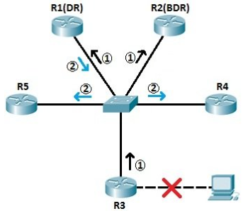
Chapter
03
OSPF (open shortest path first)
Role of Designated Router and Backup Designated Router
Based on the network type, OSPF router can elect one router to be a Designated Router (DR) and one router to be a Backup Designated Router (BDR).

Slide 7
Chapter
03
OSPF (open shortest path first)
Designated Router and Backup Designated Router Election
After all routers on a broadcast or NBMA are on two-way state , the DR and BDR elected before loading state according to :
Router with the highest interface priority is DR and the next highest priority is the BDR .
Default priority is 1 for Ethernet interface
Priority takes value (0- 255):Zero priority means router is the DR OTHER

Slide 8
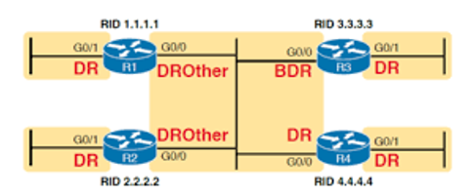
Chapter
03
OSPF (open shortest path first)
2. If there are a tie on priority , then the routers’ election s depends on :
DR : Highest router-id
BDR : Next Highest router-id

Slide 9
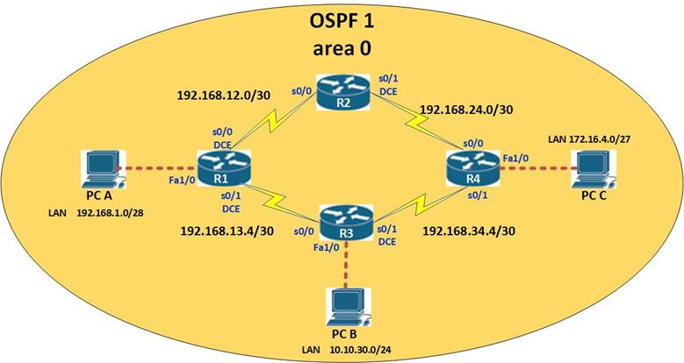
Chapter
03
OSPF (open shortest path first)
OSPF Area
It is used to reduce the size of topology table to speed up the route calculation and reduce router hardware resources.
Before using multiple Area
All routers know all topology information

Slide 10
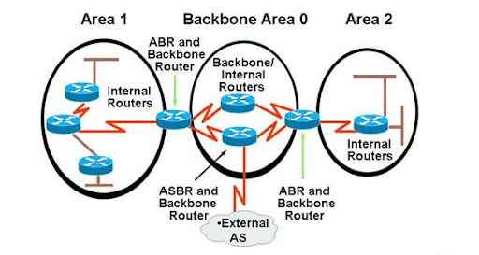
Chapter
03
OSPF (open shortest path first)
After using multiple Area
(Autonomous System)

Slide 11
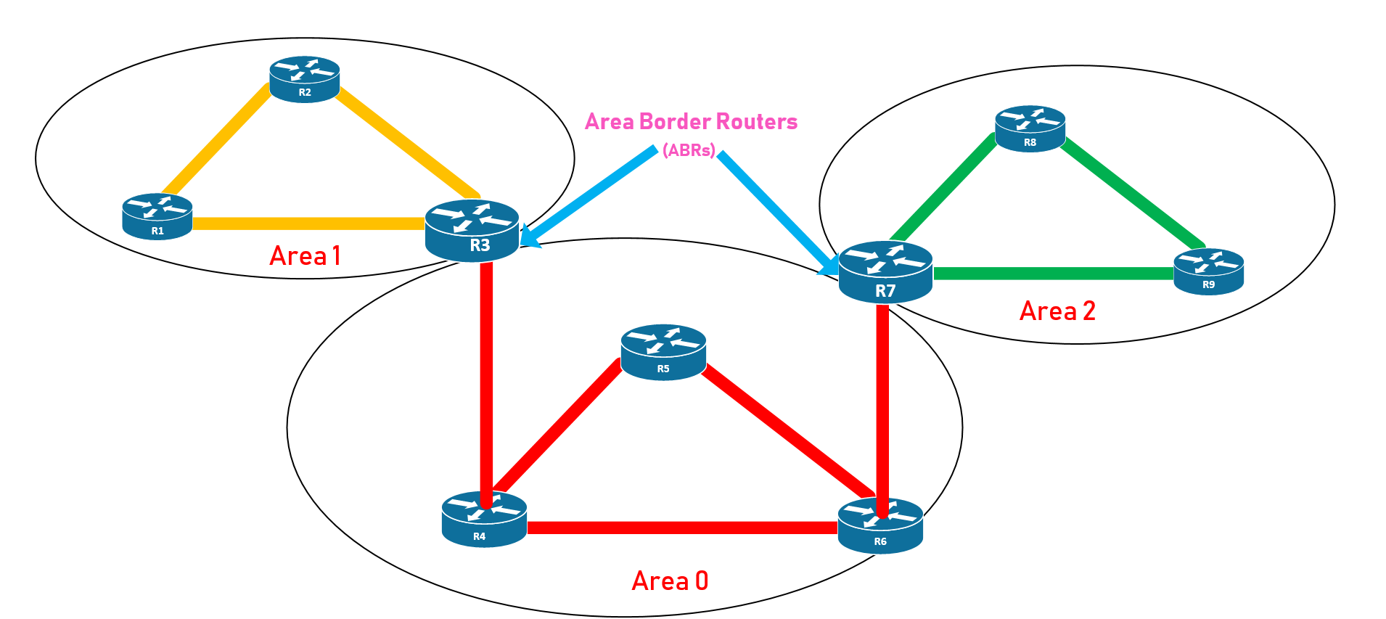
Chapter
03
OSPF (open shortest path first)
OSPF Area Design

Slide 12
Chapter
03
OSPF (open shortest path first)
OSPF Area Design
We must use central area called backbone area (Area 0)
All other areas should be around backbone area
Also areas help to organize ip structure
OSPF route types:
1.Intra Area :Routes from the same area
2. Inter Area: Routes from an other Area through ABR (Area border Router)

