Slide 1

Project Scope Management
Chapter 7
Presented by/ Dr. Walaa Mohamed
Everyone’s Smart
University
PMG101
Foundations of Project Management

Slide 2


Did your project ask for this?

Slide 3


…And end up building this instead?

Slide 4
Why does it happen?

Slide 5
Project scope management
Definitions of scope management
Why scope management is important
Elements of scope management
‘Concept development’
‘Detailed definition’
WBS
Change control

Slide 6
Project scope management
“Defining and controlling what is and what is not included in the project”.
“Project scope helps transform the idea of the project into a working concept”.

Slide 7
A change management perspective
Why do we need to manage scope?
Changes in the scope of a project affect all the other project management functions and are therefore important to all parties involved
Notes:
Let’s firstly look at why we need to focus so much on scope – many people ask why we it has to be managed as such, rather than just planned at the start….

Slide 8
Changes in scope may affect:
  the schedule (more work or less work)
  the cost (more or less resources needed, spec changes)
  the quality (changes may be unacceptable to customer)
  the human resources (more or less staff)
  Communication management (need for simple v sophisticated system)
  the risk exposure (might increase or decrease)

Slide 9
Scope Management cuts across all Phases of the Project Life cycle
Project Initiation | Project Planning | Project execution and control | Project closing
Scope identification Team set up Project definition | WBS OBS Scheduling | Network diagrams Reporting | Hand over Commission
Project life cycle
Notes:
Remember the project life cycle we talked about last week
Scope management cuts across a lot of the project life cycle –especially the first 3 phases of the project life cycle

Slide 10
Scope Management comprises:
project initiation
scope planning
scope definition
scope verification
scope change control
Concept development
Getting the detail sorted
Let’s look at what each of these terms means……
Notes:
Project initiation – committing the organisation to begin the next phase of the project
scope planning – developing a written scope statement as the basis for future project decisions
scope definition – subdividing the major project deliverables into smaller more manageable deliverables
scope verification – formalising acceptance of the project scope
scope change control – controlling changes to the project scope

Slide 11
Scope Management
Project initiation | committing the organization to begin the next phase of the project
scope planning | developing a written scope statement as the basis for future project decisions
scope definition | – subdividing the major project deliverables into smaller more manageable deliverables
scope verification | formalizing acceptance of the project scope
scope change control | controlling changes to the project scope
Notes:
These processes interact with one another and also with processes in other core areas of the company

Slide 12
Project scope management
Initiation and planning are about developing the concept of the project
Entailsيستلزم the identifying and defining the projects objectives and goals, as provided by the project sponsor or owner

Slide 13
Project Initiation
Project initiation | committing the organization to begin the next phase of the project
scope planning | developing a written scope statement as the basis for future project decisions
scope definition | subdividing the major project deliverables into smaller more manageable deliverables
scope verification | formalising acceptance of the project scope
scope change control | controlling changes to the project scope
Notes:
Let’s start with the first of these – project initiation

Slide 14
Project Initiation – step 1
One of the most important parts of project initiation is to define the project
Determines the time, cost, quality and resource requirements
Determines the scope of the project (what’s in/out)
Usually only happens after feasibility study completed
Typical inputs to project initiation:
  the product/service description
  the strategic plan of the organization
  relevant historical information about similar projects
Project Initiation | Project Planning | Project execution and control | Project closing
Scope identification Team set up Project definition | WBS OBS Scheduling | Network diagrams Reporting | Hand over Commission
Project life cycle

Slide 15
Project Initiation – step 2
Once the project definition has been completed and the scope identified, documenting and getting approval of the scope is the next stage

Slide 16
Tools and techniques
Tools and techniques for project initiation can be in the form of decision models such as:
  a) benefit measurement methods (comparative, scoring models)
  b) constrained optimization methods
      (mathematical models)
  c) expert judgement

Slide 17
Outputs from Project Initiation
The outputs from project initiation are:
the project charter
Final product description
list of assumptions and constraints
the appointment of a project manager

Slide 18
What is a Project Charter?
Document that formally recognizes the project. Includes:
  references to other relevant documents
  problem/ business needs statement
  description of the project to be undertaken
  project objectives
  constraints and assumptions

Slide 19
Creating a Project Charter
A project charter is a document that formally recognizes the existence of a project and provides a summary of the project objectives and management. It authorizes the project manager to use organizational resources to complete the project.
Contents of a Project Charter
Contents of a project charter will vary to meet individual project needs. Let’s look at the typical information that is included in a project charter;
Project title and date of authorization
Project start date

Slide 20
Contents of a Project Charter
Project finish date
Other schedule information (if available)
Budget information
Project manager (name and contact information)
Project objectives (brief description of what the main objectives are for a project)
Approach (description of how the project objectives are met, list of important assumptions, and often references to related documents).
Roles and responsibilities (names, roles, positions and contact information.
Sign-off
Comments (allows stakeholders to document important information they want to add)

Slide 21
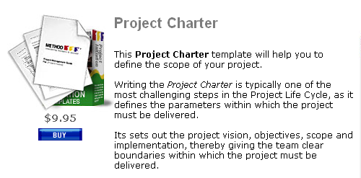
Project Charter Example?

Slide 22
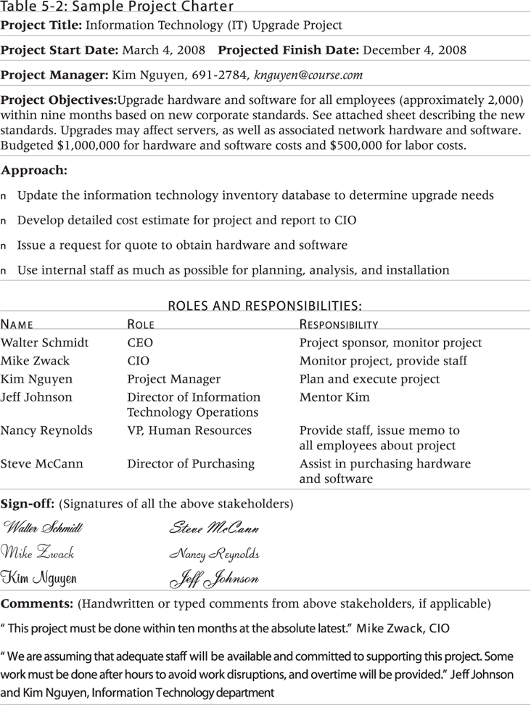
Sample Project Charter

Slide 23
Scope Planning
Project initiation | committing the organisation to begin the next phase of the project
scope planning | developing a written scope statement as the basis for future project decisions
scope definition | – subdividing the major project deliverables into smaller more manageable deliverables
scope verification | formalising acceptance of the project scope
scope change control | controlling changes to the project scope
Notes:
These processes interact with one another and also with processes in other core areas of the company

Slide 24
Scope Planning
Inputs to this stage are the outputs from the project initiation process
  the project charter
  the product description
  list of assumptions and constraints
  the appointment of a project manager

Slide 25
Tools & Techniques for Scope Planning
Product analysis: developing a better understanding of the product you want at the end of the project.
It involves examining product features, costs, availability, quality, appearance and other aspects. Product analysis is conducted by potential buyers, by product managers attempting to understand competitors and by third party reviewers.
It can also be used as part of product design to convert a high-level product description into project deliverables and requirements. It involves all facts of the product, its purpose, its operation, and its characteristics.

Slide 26
Tools & Techniques for Scope Planning
Alternatives identification – generating alternative ways of getting the solution.
Cost-benefit analysis – estimating tangible and intangible costs of the various alternatives.
Expert judgement – to assess the inputs.

Slide 27
Outputs from Scope Planning
2 main outputs
Scope statement
Scope management plan

Slide 28
Definition: Project Scope Statement
The narrative description of the project scope, including major deliverables, project objectives, project assumptions, project constraints, and a statement of work, that provides a documented basis for making future project decisions and for confirming or developing a common understanding of project scope among the stakeholders.

Slide 29
Scope Management
There will always be change in a project, and factors that you have no control over.
In a dynamic world, and a dynamic industry…
…Change is unavoidable.

Slide 30
Scope Management
Change Control is a huge responsibility of a Project Manager.
You must control changes to the project’s Schedule, Scope, and the impact on its Resources

Slide 31
Scope Management
Scope Creep is the tendency for the requirements of a project to grow past the initial Scope Statement and Verification
According to the Standish Group, it is the third most common Project Problem!

Slide 32
Scope Management
Scope Creep is one of the reasons why you must:
spend the necessary time in the definition of the project’s scope
verify the scope with the stakeholders.

Slide 33
Outputs from Scope Planning
A scope statement includes/refers to:
Project justification – the business need
Project product – the product that the project is expected to produce
Project deliverables – a list of the sub products at each of the stages in the project life cycle
Project objectives – quantifiable criteria that must be met for the project to be considered successful – cost, quality, delivery as a minimum
In many companies this is part of the project charter

Slide 34
Deliverables and millstones
Project deliverables: a list of the sub products at each of the stages in the project life cycle.
Milestones often coincide with the start or completion of project phases (such as initiation, planning, execution, and closure). A project phase may take weeks or months to complete, involving multiple tasks and team members; a milestone is a zero-time “checkmark” of major progress that is important to acknowledge and report on.
A project deliverable is a product or result, whereas a milestone is a moment in time. Deliverables are sometimes evidence of the completion of a milestone.

Slide 35
Example about difference between deliverables, millstones and tasks
Example: For a rebranding project, the initiation phase will cover many tasks, such as focus groups to gather ideas on the new branding and creative brainstorming sessions. A milestone at the end of the initiation phase would mark the team’s readiness to move to the planning phase.
Deliverables for the rebranding project could include the updated style guide PDF and associated logo files. The completion of these projects is worth noting (and even celebrating!), so the marketing manager could add a milestone denoting that achievement.

Slide 36
Outputs from Scope Planning
Scope management plan – part of the overall project plan
  Describes how the scope will be managed and how scope changes will be integrated into the project
  May be formal or informal

Slide 37
Scope Planning
Scope statement
Once the definition has been completed and the scope has been established, the documentation and approval of the project parameters are necessary.
This will serve as a control document for the duration of the project.

Slide 38
Next stage in Scope Management
Once the concept has been developed and agreed, the next stage is to put the meat on the bone….

Slide 39
Scope Definition
Project initiation | committing the organisation to begin the next phase of the project
scope planning | developing a written scope statement as the basis for future project decisions
scope definition | – subdividing the major project deliverables into smaller more manageable deliverables
scope verification | formalising acceptance of the project scope
scope change control | controlling changes to the project scope

Slide 40
Scope Definition
Scope definition involves subdividing the deliverables into smaller, more manageable components, in order to improve accuracy, controls and to allocate responsibilities
Inputs would be the scope statement, planning outputs and historical information on lessons learnt .

Slide 41
Scope Definition
– Tools & Techniques
Work breakdown structure (WBS)
Bill of Materials

Slide 42
Work Breakdown Structure
WBS = breaking down the project into a cohesive set of concurrent and specific tasks
Often you can use WBS templates from previous projects.

Slide 43
WBS
Through the use of the work breakdown structure (WBS) the project can be structured into controllable segments

Slide 44
WBS Illustrated
1.0
The project is the overall project under development
1.2
1.3
1.4
Deliverables are major project components
1.2.1
1.3.1
1.2.2
1.3.2
1.2.3
Subdeliverables are supporting deliverables
1.2.3.1
Work Packages are individual project activities
1.2.3.2
Notes:
Introduce the term work packages as sub elements of sub projects – grouped tasks

Slide 45
Example of “Having a Party”
Imagine your project is having a party
The top level is having a party
This may break down into several elements or sub-projects - including sorting out the food, sorting out the venue, inviting the guests etc
Let’s take one of these elements – sorting out the food
It can be broken down into several tasks – including baking a cake
Baking a cake can be broken down into several activities, including finding suitable dishes for baking, measuring out the ingredients, baking in the oven, removing and leaving to cool…..

Slide 46
WBS benefits
it defines and organizes the work required
it facilitates the quick development of a schedule by allocating effort estimates to specific sections of the WBS
it can be used to identify potential scope risks if it has a branch that is not well defined
it provides a visual of entire scope
it can be used to identify communication points
it can be used to show and assign accountabilities and responsibilities
it can show control points and milestones
it provides a way to estimates project costs
it ensures no important deliverables are forgotten
it can assist with resource allocation
it provides a proven and repeatable approach to planning projects
it provides a tool for team brainstorming and collaboration
it provides an opportunity to engage the team and make them feel invested in the planning

Slide 47
Your chance now……
In groups, produce a WBS for ‘producing a group assignment for the Project management class’
Assume the output for this is an assignment that meets requirements
Notes:
Get them in groups to work on a work breakdown structure for ‘producing a group assignment’ and go through on the board with them

Slide 48
Bill of materials
A bill of materials (BOM) is a formal and complete hierarchal documentation of the specific items that need to be included in a finished product. This list can include specific components, assemblies, and subassemblies. Bills of materials can be drafted at the onset of a project as part of the estimating and budgeting process and can also be used in the determination of scheduling. Bills of materials are used in a number of different industries.

Slide 49

Bill of materials
One rather simplistic example of a bill of material would be the following. In a plant devoted to the manufacture and packaging of a billiards set for retail sale, the bill of materials would include all components required to be in the final box for sale (billiards cues, billiards balls, chalk, billiards table), all of the assemblies required (assembling the pool cues, assembling the billiards table), and all subassemblies (attaching the felt surface to the billiards table, etc.). The bill of materials is typically one of the first items drafted upon project inception.

Slide 50
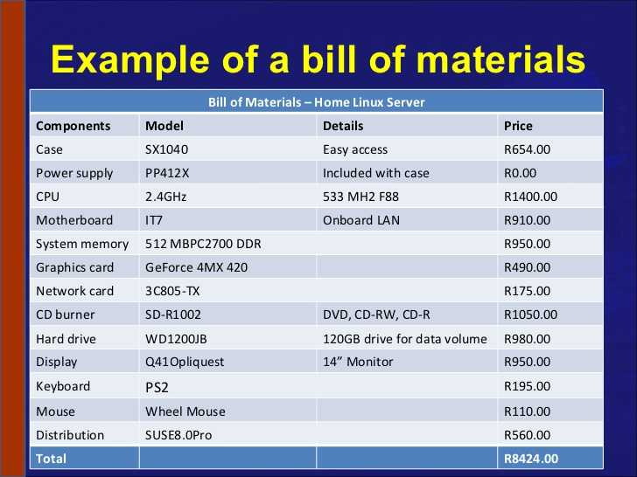

Slide 51
Scope Verification
Project initiation | committing the organisation to begin the next phase of the project
scope planning | developing a written scope statement as the basis for future project decisions
scope definition | – subdividing the major project deliverables into smaller more manageable deliverables
scope verification | formalising acceptance of the project scope
scope change control | controlling changes to the project scope
Notes:
These processes interact with one another and also with processes in other core areas of the company

Slide 52

Scope Verification
Formalising acceptance by stakeholders
Requires the outputs from the previous stages of the scope management

Slide 53

Scope Change Control
Project initiation | committing the organisation to begin the next phase of the project
scope planning | developing a written scope statement as the basis for future project decisions
scope definition | – subdividing the major project deliverables into smaller more manageable deliverables
scope verification | formalising acceptance of the project scope
scope change control | controlling changes to the project scope
Notes:
These processes interact with one another and also with processes in other core areas of the company

Slide 54
Scope Change Control
A very important part of project management
Determine and manage any changes that occur
Normally a change request is submitted to the project office

Slide 55
Exercise 1
1. Name some things in a project that could be affected by changes in scope
2. Name and describe the 2 elements of scope management that deal with concept development’?
3. Name and describe the 2 elements that deal with providing the detail?
4. What is the most common tool for helping define the detail?

Slide 56
Answers
1. Name some things in a project that could be affected by changes in scope
  the schedule (more work or less work)
  the cost (more or less resources needed, spec changes)
  the quality (changes may be unacceptable to customer)
  the human resources (more or less staff)
  Communication management (need for simple v sophisticated system)
  the risk exposure (might increase or decrease)
2. Name the 2 elements of scope management that deal with concept development’?
Project initiation – committing the organisation to begin the next phase of the project
Scope planning – developing a written scope statement as the basis for future project decisions

Slide 57
Answers
3. Name the 2 elements that deal with providing the detail?
  scope definition – subdividing the major project deliverables into smaller more manageable deliverables
  scope verification – formalising acceptance of the project scope
4. What is the most common tool for helping define the detail?
  Work breakdown structure (WBS)

Slide 58
Exercise 2
Imagine you have a project which is ‘producing a group assignment for Project Management’
Outline what would be in the Project Charter including:
  references to other relevant documents
  problem/ business needs statement
  description of the project to be undertaken
  project objectives
  constraints and assumptions

Slide 59

Thank you for your attention!

