Slide 1




Managing People
and Organizations
Lecture 3
MGM603
Prepared by
Prepared by Dr. Usama Al-Fendi
www.midocean.ae

Slide 2
Lecture
Outcomes of the chapter:
3
Explain the nature of individual differences, the concept of fit, and the role of realistic job previews.
Define personality and describe general personality frameworks and attributes that affect behavior in organizations.
Identify and discuss other important personality traits that affect behavior in organizations.
Discuss different kinds of intelligence that affect behavior in organizations.
Describe different learning styles that influence how people process information and that affect behavior in organizations.
www.midocean.ae

Slide 3
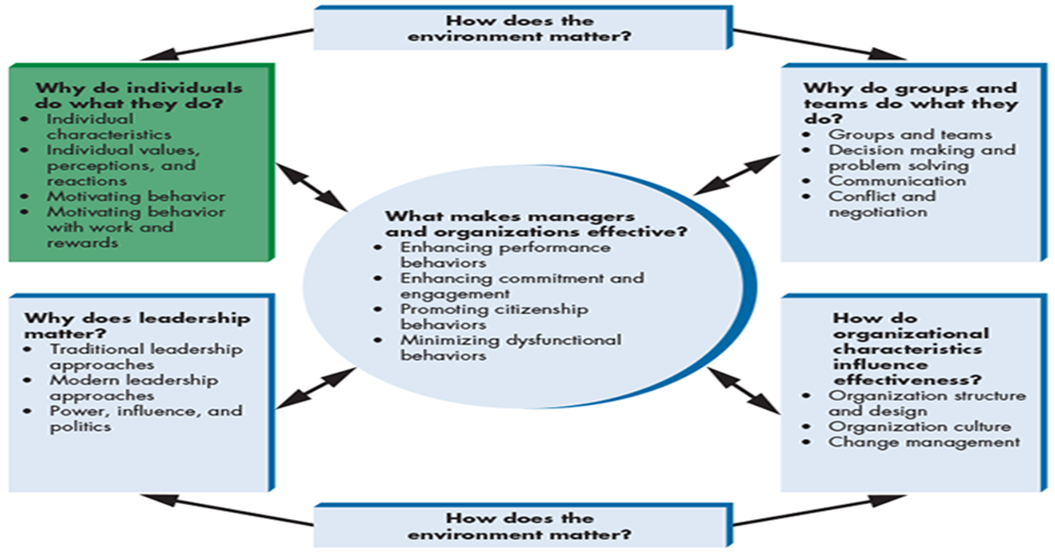
Lecture
Individual Differences
3
www.midocean.ae

Slide 4
Lecture
Individual Differences
3
Individual Differences That Make a Difference at Southwest Airlines:
Fun and friendly customer service is essential to the success of Southwest Airlines’ business strategy.
Because Southwest believes that fun is about attitude, it hires for personality and attitude
The airline wants employees who have a drive to excel and innovate, who put others first, and who take their work seriously but not themselves
www.midocean.ae

Slide 5
Lecture
Individual Differences
3
Southwest Airlines’ mission statement is “Dedication to the highest quality of Customer Service delivered with a sense of warmth, friendliness, individual pride, and Company Spirit.”
Southwest’s learning-oriented, fun culture gives employees the freedom to be themselves and become passionate about their jobs.
Southwest asks for your advice about how to better hire empathetic employees with creativity and fun-loving characteristics who fit with the company’s unique culture.
www.midocean.ae

Slide 6

Lecture
Individual Differences
3
www.midocean.ae

Slide 7

Lecture
Individual Differences
3
Think about human behavior as a jigsaw puzzle.
Puzzles consist of various pieces that fit together in precise ways. And of course, no two puzzles are exactly alike.
They have different numbers of pieces, the pieces are of different sizes and shapes, and they fit together in different ways.
The same can be said of human behavior and its determinants
www.midocean.ae

Slide 8
Lecture
Individual Differences
3
Each of us is a whole picture, like a fully assembled jigsaw puzzle, but the puzzle pieces that define us and the way those pieces fit together are unique.
Every person in an organization is fundamentally different from everyone else. To be successful, managers must recognize that these differences exist and attempt to understand them.
www.midocean.ae

Slide 9
Lecture
Individual Differences
3
Individual differences
defined as personal attributes that vary from one person to another. Individual differences may be physical, psychological, and emotional.
Categories of individual
basic categories of individual differences include personality, intelligence, learning styles, attitudes, values and emotions, perception, and stress.
The Concept of Fit
Why are some very talented people undesirable coworkers or employees despite being very talented at what they do? The answer lies in the many ways in which people need to fit with an employment opportunity to be a successful match.
www.midocean.ae

Slide 10
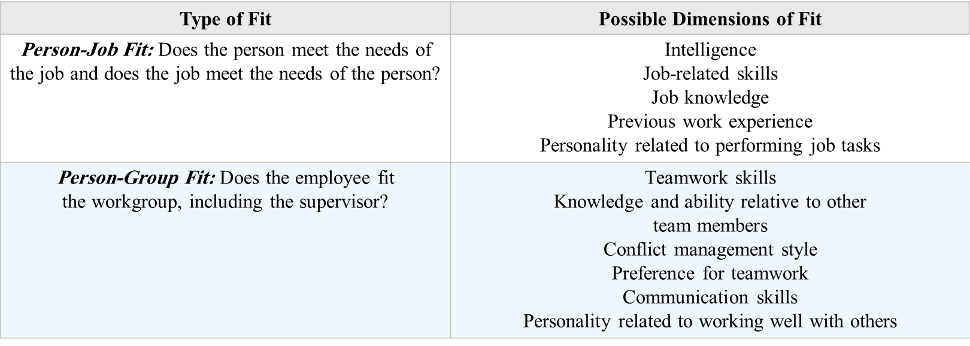
Lecture
Individual Differences
3
Dimensions of Fit
www.midocean.ae

Slide 11
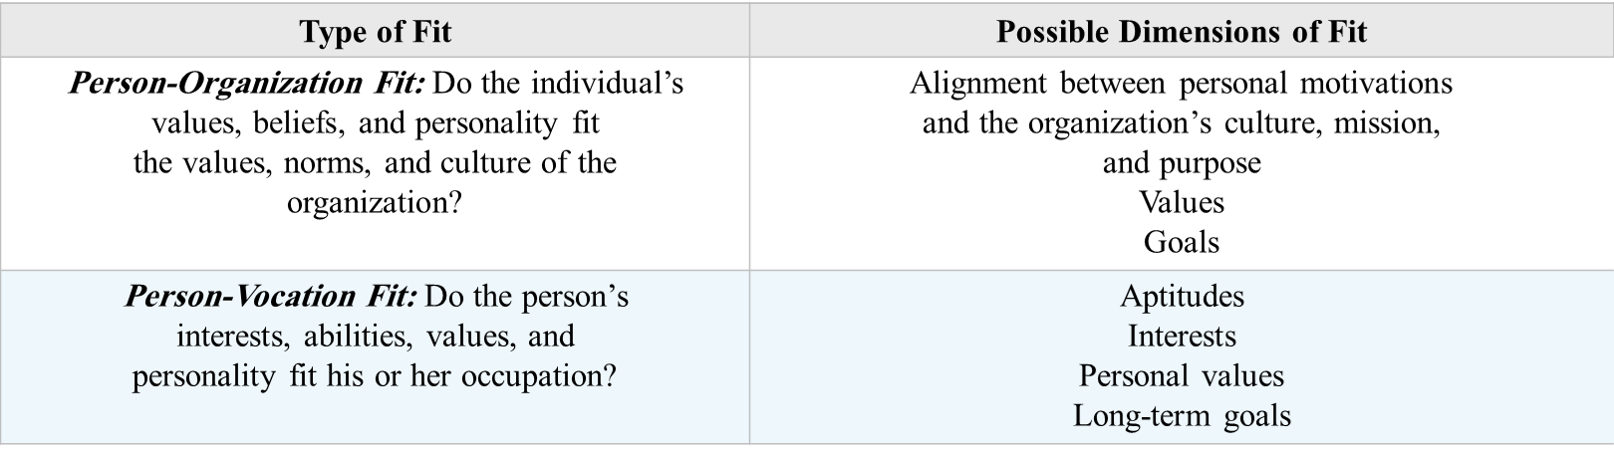
Lecture
Individual Differences
3
Dimensions of Fit
www.midocean.ae

Slide 12
Lecture
Individual Differences
3
Person-Job Fit
Is the fit between a person’s abilities and the demands of the job and the fit between a person’s desires and motivations and the attributes and rewards of a job
It is important to consider not only the fit between an individual’s talents and the job requirements, but also the fit between an individual’s motivations and the rewards offered by the job.
Research suggests that person-job fit leads to higher job performance, satisfaction, organizational commitment, and intent to stay with the company
www.midocean.ae

Slide 13
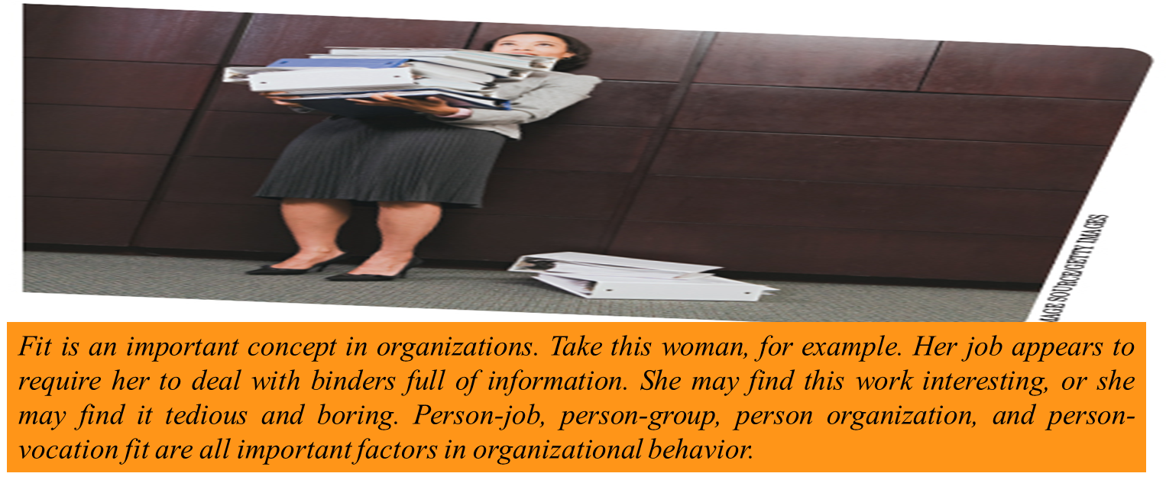
Lecture
Individual Differences
3
www.midocean.ae

Slide 14
Lecture
Individual Differences
3
Person-Group Fit
is the fit between the employee and his or her workgroup and supervisor.
Person-group fit leads to improved job satisfaction, organizational commitment, and intent to stay with the company.
Teamwork, communication, and interpersonal competencies can be as critical to team performance as team members’ ability to perform core job duties
Example: An executive at Men’s Wearhouse once terminated one of the men’s suits retail store’s most successful salesperson because he focused only on maximizing his own sales as opposed to working with the other sales staff as a team. After firing the salesperson, sales at the store where he worked increased significantly.
www.midocean.ae

Slide 15
Lecture
Individual Differences
3
Person-Organization Fit
is the fit between an individual’s values, beliefs, and personality and the values, norms, and culture of the organization.
Organizational values and norms that are important for person-organization fit include integrity, fairness, work ethic, competitiveness, cooperativeness, and compassion for fellow employees and customers.
Person-organization fit has a strong positive relationship with job satisfaction, organizational commitment, and intent to stay with the company and can influence employee attitudes and citizenship behaviors beyond the job requirements, such as helping others or talking positively about the firm
www.midocean.ae

Slide 16
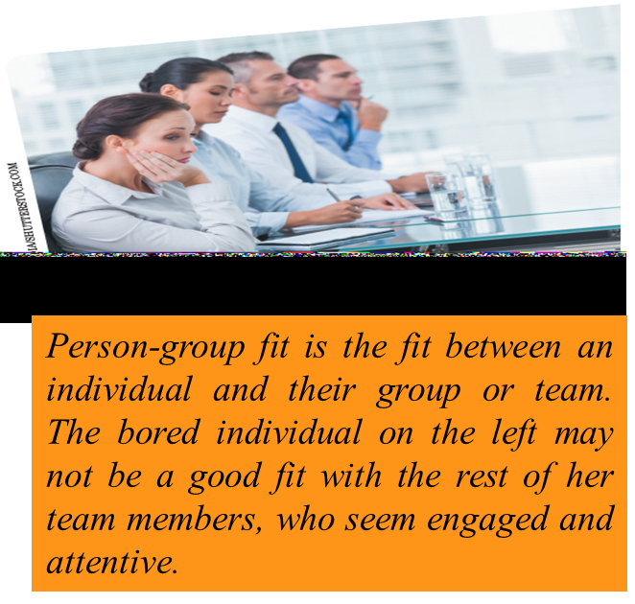
Lecture
Individual Differences
3
Person-Organization Fit
Example:
even if Maria is technically well qualified as a researcher, if she avoids risk, is indecisive, and tends to ruminate over a decision, she may be unsuccessful in an innovative, fast-paced company.
Both online retailer Amazon.com and online shoe retailer Zappos.com offer new employees thousands of dollars to quit to ensure that they are committed to their jobs and to dissuade poor fits from staying.
www.midocean.ae

Slide 17
Lecture
Individual Differences
3
Person-Vocation Fit
is the fit between a person’s interests, abilities, values, and personality and a profession.
For example, a social individual who is low in conscientiousness and dislikes working with numbers would be a poor fit with the engineering vocation.
Although individuals usually choose a vocation long before applying to an organization, understanding person-vocation fit can still be useful to organizations and managers.
Companies wanting to develop their own future leaders, or smaller organizations that need employees to fill multiple roles, may be able to use vocational interests in determining whether job applicants would be a good fit with the organization’s future needs.
www.midocean.ae

Slide 18
Lecture
Individual Differences
3
Realistic job previews (RJPs)
involve the presentation of both positive and potentially negative information to job candidates. Rather than trying to sell candidates on the job and company by presenting the job opportunity in the most positive light, the company strives to present an accurate picture through an RJP.
Giving applicants the opportunity to self-select out of the hiring process if they do not perceive themselves to be good fits with the position or organization increases the likelihood that the applicants ultimately hired will be good fits and will be better employees as a result.
If a common reason for employees leaving an organization is that the job is not what they expected, this is a good sign that the recruiting message can be improved.
www.midocean.ae

Slide 19
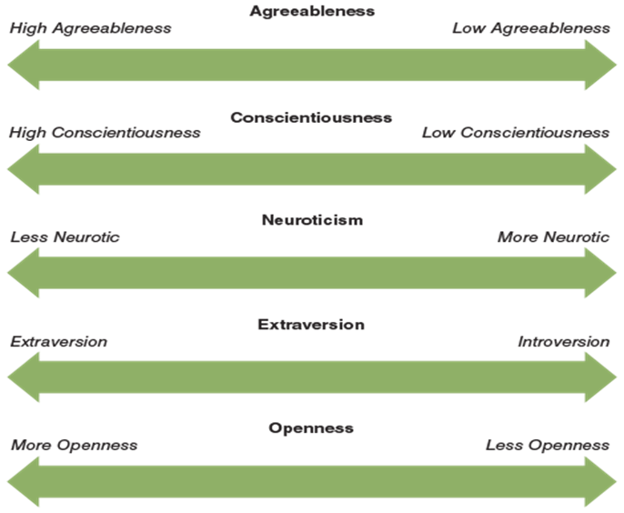
Lecture
Individual Differences
3
Personality and Individual Behavior:
1- The “Big Five” Framework:
Researchers have identified five fundamental personality traits that are especially relevant to organizations.
Figure 3.1 shows the “Big Five” personality traits. which is currently very popular among researchers and managers. These five dimensions represent fundamental personality traits presumed to be important in determining the behaviors of individuals in organizations. In general, experts agree that personality traits closer to the left end of each dimension are more positive in organizational settings, whereas traits closer to the right are less positive.
www.midocean.ae

Slide 20
Lecture
Individual Differences
3
1- The “Big Five” Framework:
Agreeableness
Agreeableness refers to a person’s ability to get along with others. Agreeableness causes some people to be gentle, cooperative, forgiving, understanding, and good-natured in their dealings with others.
Researchers have not yet fully investigated the effects of agreeableness, but it seems likely that highly agreeable people are better at developing good working relationships with coworkers, subordinates, and higher-level managers, whereas less-agreeable people are not likely to have particularly good working relationships. The same pattern might extend to relationships with customers, suppliers, and other key organizational constituents.
www.midocean.ae

Slide 21
Lecture
Individual Differences
3
1- The “Big Five” Framework:
Conscientiousness
Conscientiousness refers to the extent to which a person can be counted on to get things done. Some people, for example, are organized, detail oriented, responsible, dependable, and plan carefully to meet deadlines.
Less-conscientious people may be prone to missing deadlines, overlooking various tasks, being unorganized, and being generally less dependable. In general, research suggests that being strong on conscientiousness is often a good predictor of job performance for many jobs.
www.midocean.ae

Slide 22
Lecture
Individual Differences
3
1- The “Big Five” Framework:
Extroversion
Extroversion reflects a person’s comfort level with relationships. Extroverts are sociable, talkative, assertive, and open to establishing new relationships.
Introverts are much less sociable, talkative, and assertive and more reluctant to begin new relationships. Research suggests that extroverts tend to be higher overall job performers than introverts and that they are more likely to be attracted to jobs based on personal relationships, such as sales and marketing positions.
Introversion
introversion. An introvert tends to be less comfortable in social situations.
www.midocean.ae

Slide 23
Lecture
Individual Differences
3
1- The “Big Five” Framework:
Openness
openness reflects a person’s rigidity of beliefs and range of interests. People with high levels of openness are willing to listen to new ideas and to change their own ideas, beliefs, and attitudes in response to new information.
People with more openness might be expected to be better performers due to their flexibility and the likelihood that they will be better accepted by others in the organization. Openness may also encompass a person’s willingness to accept change; people with high levels of openness may be more receptive to change, whereas people with little openness may resist change.
www.midocean.ae

Slide 24
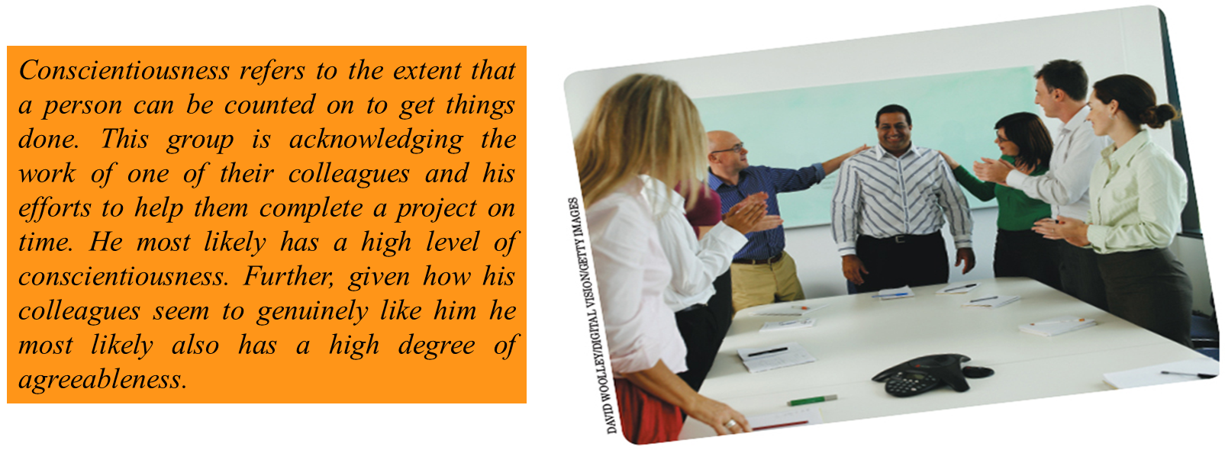
Lecture
Individual Differences
3
1- The “Big Five” Framework:
www.midocean.ae

Slide 25
Lecture
Individual Differences
3
1- The “Big Five” Framework:
Even assessment using the most rigorous and valid measures is likely to be somewhat imprecise.
There are also times when using more specific personality traits to predict outcomes such as turnover or performance are more useful than the more general Big Five traits because the more specific trait more directly influences the intended outcome.
For example, if you are trying to hire a strong team player for a diverse creative team, individual differences including a preference for teamwork and other group orientation (a preference for working with diverse others) may outperform any of the Big Five traits in predicting performance.
www.midocean.ae

Slide 26
Lecture
Individual Differences
3
1- The “Big Five” Framework:
Another limitation of the Big Five framework is that it is primarily based on research conducted in the United States. Thus, generalizing it to other cultures presents unanswered questions. Even within the United States, a variety of other factors and traits are also likely to affect behavior in organizations
www.midocean.ae

Slide 27
Lecture
Individual Differences
3
2- The Myers-Briggs Framework:
The Myers-Briggs framework is also a popular framework that some people use to characterize personality. Many people know of this framework through a widely used questionnaire called the Myers-Briggs Type Indicator (MBTI).
It is based upon Carl Jung’s work on psychological types. Psychologist Carl Jung was a contemporary of Sigmund Freud and a leading exponent of Gestalt personality theory.
The MBTI was first developed by Isabel Briggs Myers (1897–1979) and her mother, Katharine Cook Briggs, to help people understand themselves and each other so that they could find work that matches their personality.
www.midocean.ae

Slide 28
Lecture
Individual Differences
3
2- The Myers-Briggs Framework:
The MBTI uses four scales with opposite poles to assess four sets of preferences.
1- Extroversion (E)/Introversion (I): Extroverts are energized by things and people. They are interactors and “on the fly” thinkers whose motto is “ready, fire, aim.” Introverts find energy in ideas, concepts, and abstractions.
2- Sensing (S)/Intuition (N): Sensing people are detail oriented. They want and trust facts. Intuitive people seek out patterns and relationships among the facts that they have learned.
3- Thinking (T)/Feeling (F): Thinkers value fairness and decide things impersonally based on objective criteria and logic. Feelers value harmony and focus on human values and needs as they make decisions or judgments.
www.midocean.ae

Slide 29
Lecture
Individual Differences
3
2- The Myers-Briggs Framework:
4- Judging (J)/Perceiving (P): Judging people are decisive and tend to plan. They focus on completing tasks, take action quickly, and want to know the essentials. They develop plans and follow them, adhering to deadlines. Perceptive people are adaptable, spontaneous, and curious. They start many tasks and often find it difficult to complete them. Deadlines are meant to be stretched.
The possible combinations of these preferences result in sixteen personality types, which are identified by the four letters that represent one’s tendencies on the four scales. For example, ENTJ reflects extraversion, intuition, thinking, and judging.
You can complete a brief Myers-Briggs type self-assessment online at http://www.humanmetrics.com/cgi-win/JTypes2.asp.
www.midocean.ae

Slide 30
Lecture
Individual Differences
3
3- Other Important Personality Traits:
Besides these complex models of personality, several other specific personality traits are also likely to influence behavior in organizations. Among the most important are locus of control, self-efficacy, authoritarianism, Machiavellianism, self-esteem, and risk propensity
www.midocean.ae

Slide 31
Lecture
Individual Differences
3
3-1 Locus of Control:
Locus of control: is the extent to which people believe that their behavior has a real effect on what happens to them.
Some people, for example, believe that if they work hard, they will succeed.
They may also believe that people who fail do so because they lack ability or motivation. People who believe that individuals are in control of their lives are said to have an internal locus of control.
For example, an employee who fails to get a promotion may attribute that failure to a politically motivated boss or just bad luck, rather than to his or her own lack of skills or poor performance record.
People who think that forces beyond their control dictate what happens to them are said to have an external locus of control.
www.midocean.ae

Slide 32
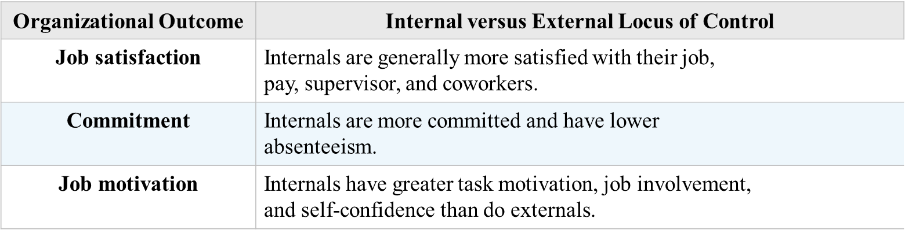
Lecture
Individual Differences
3
3-1 Locus of Control:
Effects of Locus of Control on Organizational Outcomes
www.midocean.ae

Slide 33
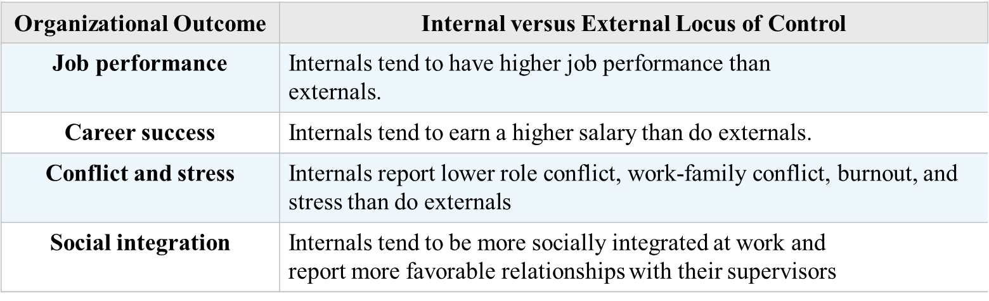
Lecture
Individual Differences
3
3-1 Locus of Control:
Effects of Locus of Control on Organizational Outcomes
www.midocean.ae

Slide 34
Lecture
Individual Differences
3
3-2 Authoritarianism:
Authoritarianism, the extent to which a person believes that power and status differences are appropriate within hierarchical social systems such as organizations
For example, a person who is highly authoritarian may accept directives or orders from someone with more authority purely because the other person is “the boss.” On the other hand, a person who is not highly authoritarian, although he or she may still carry out reasonable directives from the boss, is more likely to question things, express disagreement with the boss, and even refuse to carry out orders if they are for some reason objectionable.
Example During the aftermath of the Enron and Arthur Anderson scandals that destroyed both firms, charges were brought against some accountants who shredded important documents before they could be seized by the authorities.
www.midocean.ae

Slide 35
Lecture
Individual Differences
3
3-3 Machiavellianism:
The term “Machiavellianism” is now used to describe behavior directed at gaining power and controlling the behavior of others.
More Machiavellian individuals tend to be rational and unemotional, may be willing to lie to attain their personal goals, put little emphasis on loyalty and friendship, and enjoy manipulating others’ behavior.
Less Machiavellian individuals are more emotional, less willing to lie to succeed, value loyalty and friendship highly, and get little personal pleasure from manipulating others.
Example: By all accounts, Dennis Kozlowski, the indicted former CEO of Tyco International, had a high degree of Machiavellianism. He apparently came to believe that his position of power in the company gave him the right to do just about anything he wanted with company resources
www.midocean.ae

Slide 36
Lecture
Individual Differences
3
3-4 Tolerance for Risk and Ambiguity:
Tolerance for risk (also called risk propensity): is the degree to which a person is comfortable accepting risk and is willing to take chances and to make risky decisions.
A manager with a high tolerance for risk, for example, might experiment with new ideas and gamble on new products. Such a manager might also lead the organization in new and different directions.
A manager with low tolerance for risk might lead an organization to stagnation and excessive conservatism or might help the organization successfully weather turbulent and unpredictable times by maintaining stability and calm.
www.midocean.ae

Slide 37
Lecture
Individual Differences
3
3-4 Tolerance for Risk and Ambiguity:
Tolerance for ambiguity reflects the tendency to view ambiguous situations as either threatening or desirable.
Intolerance for ambiguity reflects a tendency to perceive or interpret vague, incomplete, or fragmented information or information with multiple, inconsistent, or contradictory meanings as an actual or potential source of psychological discomfort or threat.
Being tolerant of ambiguity is related to creativity, positive attitudes toward risk, and orientation to diversity
Managers with a low tolerance for ambiguity tend to be more directive with their staff and do not empower them to make their own decisions at work. The best managerial strategy is to place individuals with a low tolerance for ambiguity in well-defined and regulated tasks.
www.midocean.ae

Slide 38
Lecture
Individual Differences
3
4- Type A and B Traits :
The Type A personality is impatient, competitive, ambitious, and uptight.
The Type B personality is more relaxed and easygoing and less overtly competitive than Type A.
Type Bs are not without stress, but they confront challenges and external threats less frantically. Unlike Type As,
Type B personalities rarely experience a frustrated sense of wasting time when not actively engaged in productive activity
Although Type As often have higher job performance than Type Bs, Type As are also more prone to stress and coronary heart disease.
www.midocean.ae

Slide 39
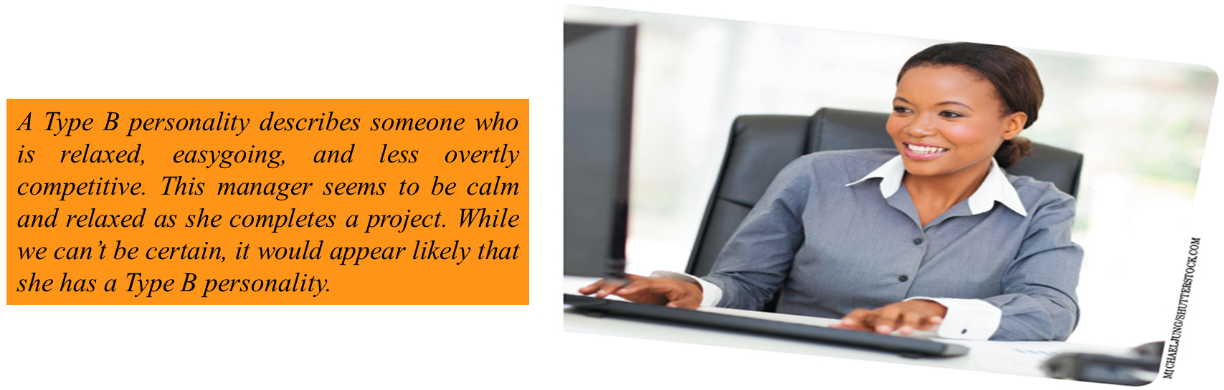
Lecture
Individual Differences
3
www.midocean.ae

Slide 40
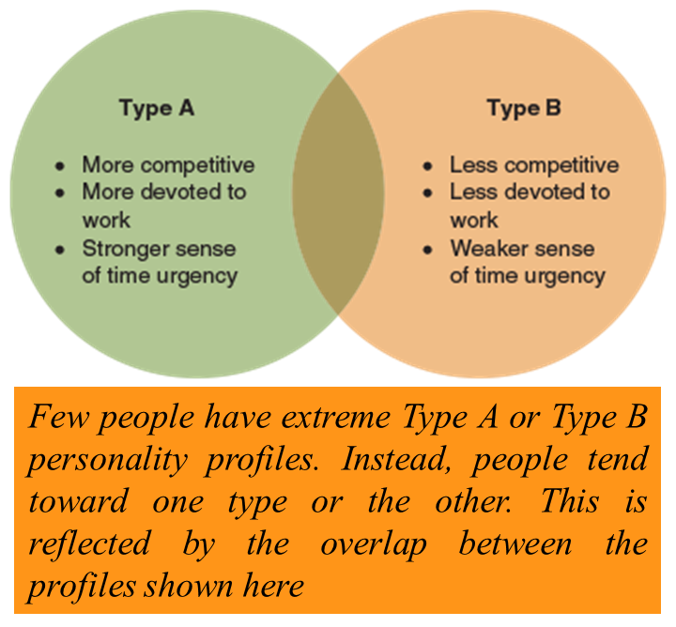
Lecture
Individual Differences
3
4- Type A and B Traits :
In managers, having a high Type A personality and an external locus of control is associated with greater levels of perceived stress, lower job satisfaction, and poorer physical and mental health compared to those with a Type B personality and an internal locus of control. Some researchers have even suggested that negative health consequences may outweigh the superficial attractiveness of the Type A personality in a managerial position.
www.midocean.ae

Slide 41
Lecture
Individual Differences
3
5- The Bullying Personality:
Workplace bullying:
Workplace bullying: is a repeated mistreatment of another employee through verbal abuse; conduct that is threatening, humiliating, or intimidating; or sabotage that interferes with the other person’s work.
Bullying costs employers through higher turnover, greater absenteeism, higher workers’ compensation costs, and higher disability insurance rates, not to mention a diminished reputation as a desirable place to work.
Who tends to become a bully? Bullying is complex and comes in a variety of forms, but common to all types is the abuse of authority and power, stemming from the bully’s need to control another person. Machiavellianism may lead to bullying.
www.midocean.ae

Slide 42
Lecture
Individual Differences
3
5- The Bullying Personality:
Workplace bullying:
If personality helps to explain why some people are bullies, can it also help us understand why some people are more likely to be targets of bullying? Although there is no clear personality profile that predicts who will be targeted, people who are more introverted, less agreeable, less conscientious, less open to experience, and more emotionally unstable seem to be more likely to be bullied
Many companies, including Berkshire Hathaway, Google, IDEO, and Barclays Capital have explicit “no jerks” policies and rules that help prevent and quickly resolve bullying issues.
www.midocean.ae

Slide 43
Lecture
Summary and Application:
3
Organizations strive to achieve an optimal person-job fit, but this process is complicated by the existence of individual differences.
Personalities are the relatively stable sets of psychological and behavioral attributes that distinguish one person from another.
The Big Five personality traits are agreeableness, conscientiousness, neuroticism, extraversion, and openness.
Myers-Briggs dimensions and emotional intelligence also offer insights into personalities in organizations.
www.midocean.ae

Slide 44
Lecture
Summary and Application:
3
Other important personality traits include locus of control, self-efficacy, authoritarianism, Machiavellianism, self-esteem, and risk propensity.
Learning styles, or individual differences and preferences in how we process information while problem solving, learning, or engaging in similar activities, are also important individual differences and preferences, and there are numerous typologies, measures, and models that capture them.
www.midocean.ae

Slide 45
Lecture
Discussion Questions:
3
What is a psychological contract? Why is it important? What psychological contracts do you currently have?
What individual differences do you feel are most important to organizations? Why?
If you were denied a job because of your score on a personality test, what would be your reaction?
If your supervisor exhibited bullying behaviors, what would you do?
Which of Gardner’s multiple intelligences do you feel are most important for managers?
Do you think emotional intelligence is important to managers? How would you assess emotional intelligence in deciding who to promote to a managerial position?
If you were a manager, what individual differences would be important to you in hiring an assistant? Why?
www.midocean.ae

Slide 46



Thank You

