Slide 1

Fake News Detection Using Machine Learning
Master of Science in Artificial Intelligence
Prepared By: Metab Jdeba
Supervisor: Dr. Ashraf Elsayed

Slide 2
Introduction
Explosion of digital news media
Rapid spread of misinformation
Fake news affects politics, health, economy, and society
Need for automated and intelligent detection systems

Slide 3
Problem Background
Traditional verification cannot keep pace with news spread
Fake news crafted to appear legitimate
Challenges include sarcasm, emotional manipulation, dataset imbalance,
AI‑generated misinformation and cross‑domain adaptation

Slide 4
Research Problem & Motivation
Problem:
Develop automated ML models to classify fake vs real news.
Motivation:
Societal risk of misinformation
Need scalable, automated detection
Support trust and information integrity

Slide 5
Research Questions
How can ML detect fake news effectively?
Which preprocessing and feature extraction methods perform best?
Which algorithms outperform others?
How can explainability enhance trust?
How can scalable real‑world deployment be achieved?

Slide 6
Research Objectives
Apply preprocessing and text normalization
Extract meaningful linguistic features (TF‑IDF / embeddings)
Evaluate ML + DL models
Compare Accuracy, Precision, Recall, F1, ROC‑AUC
Enhance interpretability and real‑world usability

Slide 7
Dataset Description – ISOT Dataset
44,898 total news articles
True: 21,417 | Fake: 23,481
Features: Title, Text, Subject, Publication Date
Dominant themes: Politics & World News
Balanced and diverse dataset

Slide 8
Data Preprocessing
Cleaning & Normalization
Tokenization
Stopword Removal
Lemmatization
Feature Representation (TF‑IDF / Embeddings)
Train‑Test Split (80/20 stratified)

Slide 9
Machine Learning Models
Logistic Regression
Support Vector Machine (SVM)
Random Forest
Trained using TF‑IDF
Hyperparameter tuning via Grid Search + Cross Validation

Slide 10
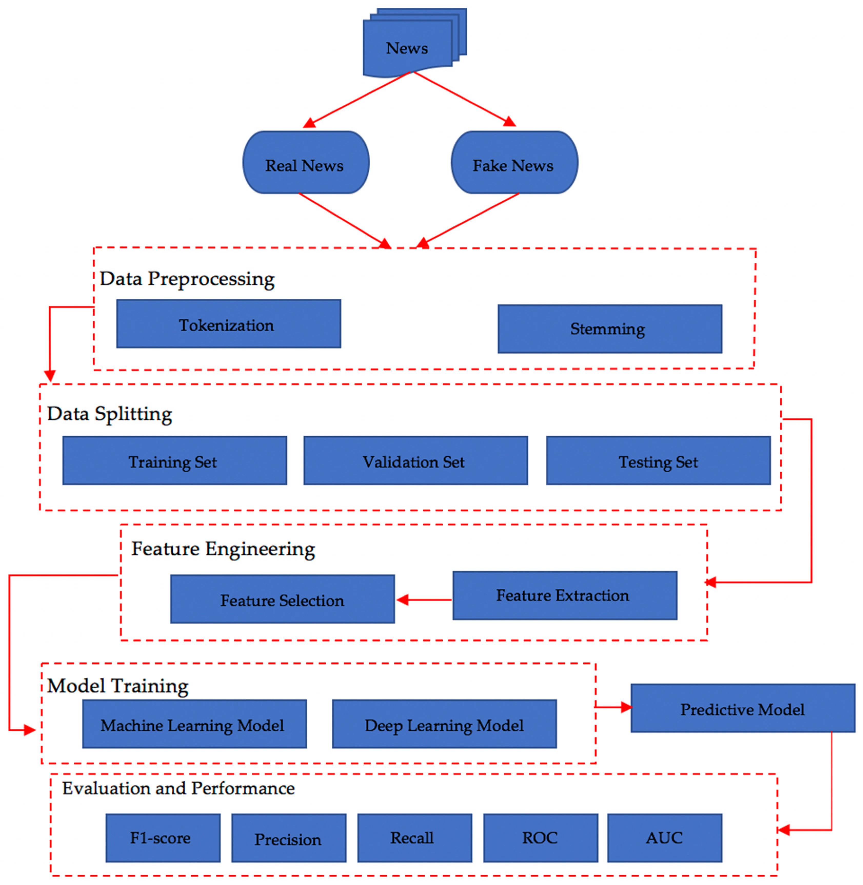
Detecting fake news using machine or deep learning algorithms

Slide 11
Expected Outcomes
Higher accuracy from DL models
SVM and Random Forest strong classical baselines
Improved generalization through preprocessing
Foundation for explainable & ethical fake news detection

Slide 12
Research Significance
Scientific:
Advances computational fake news research
Compares ML vs DL techniques
Practical:
Supports real‑world fake news monitoring
Enables AI‑assisted fact checking
Strengthens digital trust

Slide 13
Research Roadmap
Literature Review
Dataset Preparation
Model Development
Training & Evaluation
Explainability & Robustness
Documentation & Publication

Slide 14
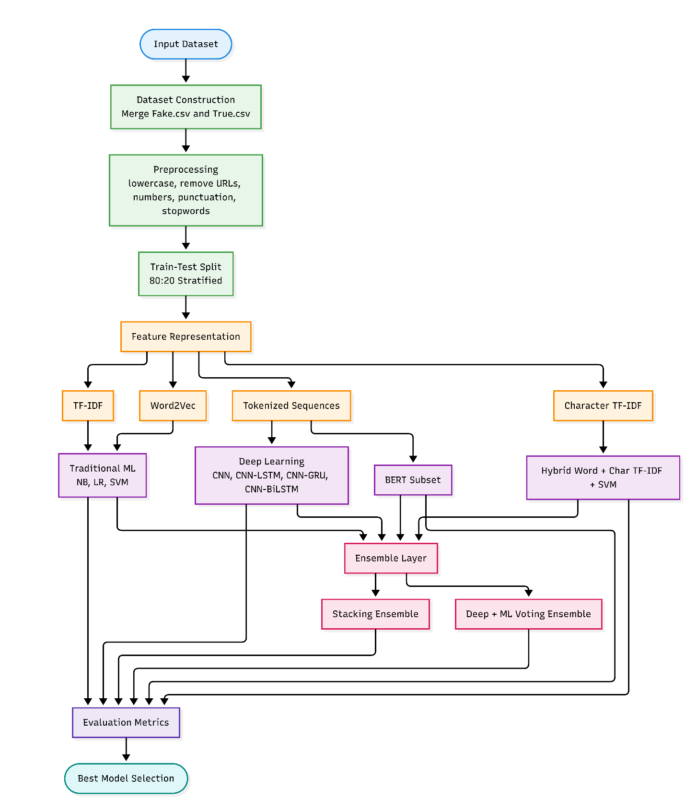
Proposed framework

Slide 15

Dataset Description
ISOT dataset (Fake.csv & True.csv)
Total samples: 44,898
Real: 21,417 | Fake: 23,481
Features: title, text, subject, date

Slide 16
Dataset Bias
Real news from Reuters (trusted source)
Fake news from flagged websites
Dominated by political and world news topics
Models may learn source/style instead of truth

Slide 17
Data Preprocessing
Lowercasing text
Removing URLs, numbers, punctuation
Tokenization and stopword removal
Lemmatization / normalization
Train-test split: 80/20

Slide 18
Feature Engineering
Word-level TF-IDF (1-2 grams)
Character-level TF-IDF (3-5 grams)
Word2Vec embeddings
Sequence encoding for deep learning

Slide 19
Models Used
Traditional ML: SVM, Logistic Regression, Naive Bayes
Deep Learning: CNN, LSTM, BiLSTM, GRU
Transformer: BERT (subset experiment)
Hybrid & Ensemble models

Slide 20
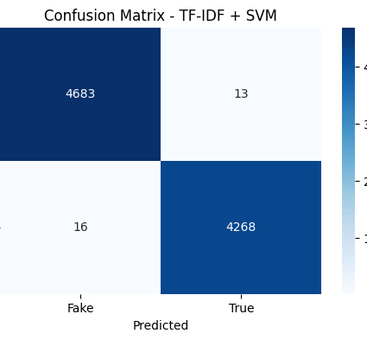
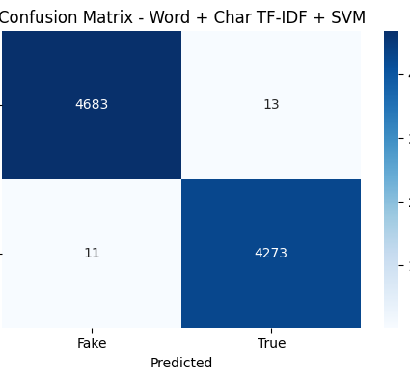

Evaluation Metrics

Slide 21
Experimental Setup Summary
Item | Value
Dataset source | Kaggle fake and real news dataset
Input files | Fake.csv and True.csv
Fake news records | 23,481
True news records | 21,417
Total dataset size | 44,898
Empty content rows | 0
Text field used for modeling | Combined title + text as content
Cleaned text field | clean_text
Train-test split | 80:20 stratified
Training samples | 35,918
Testing samples | 8,980
Word-level TF-IDF configuration | max_features=50000, ngram_range=(1,2)
TF-IDF train shape | (35,918, 50,000)
TF-IDF test shape | (8,980, 50,000)
Word2Vec configuration | vector_size=100, window=5, min_count=2
Word2Vec vocabulary size | 68,508
Word2Vec train shape | (35,918, 100)
Word2Vec test shape | (8,980, 100)
Sequence tokenizer vocabulary | 50,000 words
Maximum sequence length | 300
Padded sequence train shape | (35,918, 300)
Padded sequence test shape | (8,980, 300)
Character TF-IDF configuration | analyzer = char, ngram_range=(3,5), max_features=50000
Character TF-IDF train shape | (35,918, 50,000)
Character TF-IDF test shape | (8,980, 50,000)
BERT subset train size | 3,000
BERT subset test size | 1,000
BERT max sequence length | 256
BERT epochs | 1

Slide 22
Overall Performance Comparison of All Models
Model | Train Accuracy | Test Accuracy | Precision | Recall | F1-Score | Training Time (s)
Word + Char TF-IDF + SVM | 0.999972 | 0.997327 | 0.996967 | 0.997432 | 0.997200 | 11.299798
TF-IDF + SVM | 0.999944 | 0.996659 | 0.996730 | 0.996265 | 0.996498 | 0.568365
Stacking Ensemble | 0.999944 | 0.996659 | 0.996730 | 0.996265 | 0.996498 | 0.113705
CNN + Trainable Embedding | 0.999861 | 0.996325 | 0.995108 | 0.997199 | 0.996153 | 28.256719
BERT (subset) | — | 0.994000 | 0.991952 | 0.995960 | 0.993952 | 163.296224
Deep + ML Ensemble (SVM + CNN-BiLSTM) | 0.999109 | 0.992539 | 0.984824 | 0.999767 | 0.992239 | 0.000000
CNN + BiLSTM | 0.998998 | 0.992316 | 0.987283 | 0.996732 | 0.991985 | 79.804168
CNN + GRU | 0.998775 | 0.990200 | 0.987907 | 0.991597 | 0.989748 | 43.227098
TF-IDF + Logistic Regression | 0.994348 | 0.990089 | 0.987451 | 0.991830 | 0.989635 | 1.115155
CNN + LSTM | 0.998497 | 0.988085 | 0.988310 | 0.986695 | 0.987501 | 52.212567
Word2Vec + SVM | 0.976084 | 0.976837 | 0.972415 | 0.979225 | 0.975808 | 18.658500
Word2Vec + Logistic Regression | 0.975695 | 0.975947 | 0.971051 | 0.978758 | 0.974890 | 0.363632
TF-IDF + MultinomialNB | 0.960131 | 0.959020 | 0.959624 | 0.954248 | 0.956929 | 0.108068

Slide 23
Top-5 Model Ranking
Rank | Model | Test Accuracy | Precision | Recall | F1-Score | Training Time (s) | Note
1 | Word + Char TF-IDF + SVM | 0.997327 | 0.996967 | 0.997432 | 0.997200 | 11.299798 | Best full-dataset model
2 | TF-IDF + SVM | 0.996659 | 0.996730 | 0.996265 | 0.996498 | 0.568365 | Best traditional baseline
3 | Stacking Ensemble | 0.996659 | 0.996730 | 0.996265 | 0.996498 | 0.113705 | Matched TF-IDF + SVM
4 | CNN + Trainable Embedding | 0.996325 | 0.995108 | 0.997199 | 0.996153 | 28.256719 | Best deep learning model
5 | BERT (subset) | 0.994000 | 0.991952 | 0.995960 | 0.993952 | 163.296224 | Evaluated on subset only

Slide 24
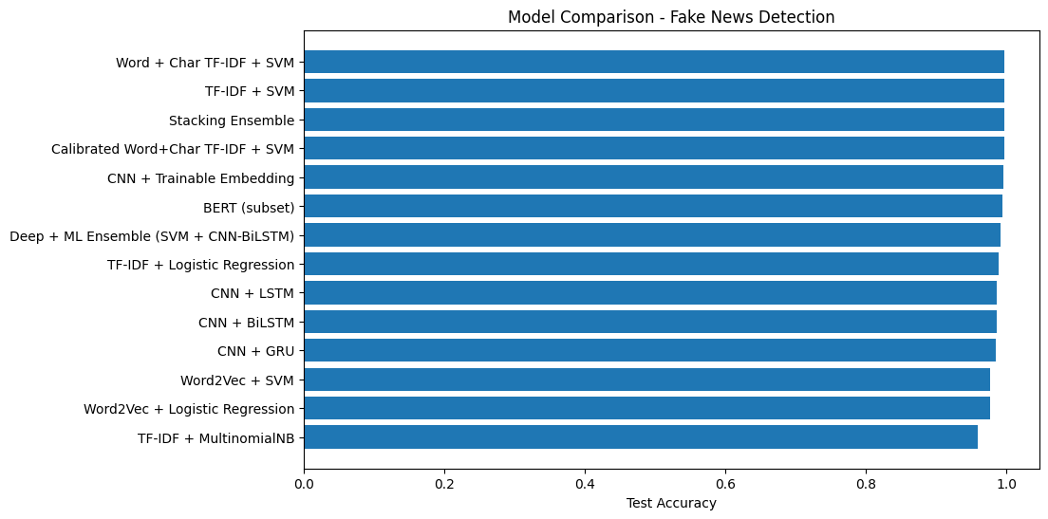
Overall Results
Best Model: Word + Char TF-IDF + SVM
Test Accuracy ≈ 99.73%
TF-IDF + SVM ≈ 99.66%
CNN ≈ 99.63%
BERT ≈ 99.4% (subset only)

Slide 25

Key Findings
TF-IDF outperformed Word2Vec
Hybrid features improved performance
Simple models can outperform complex ones
Feature representation is critical

Slide 26

BERT Experiment Limitation
Trained on subset (4000 samples)
3000 training, 1000 testing
Not directly comparable to full dataset models
High computational cost

Slide 27

Overfitting Analysis
Some results show values near 1.00
Rounded metrics may appear perfect
Dataset is highly separable
Risk of dataset-specific learning

Slide 28
Limitations
Dataset bias (source & topic)
Possible overfitting
Limited explainability
BERT trained on subset

Slide 29
Future Work
Cross-dataset evaluation
Multilingual fake news detection
Advanced explainability (SHAP, LIME)
Adversarial robustness testing
Multimodal models (text + images)

Slide 30
Conclusion
Hybrid TF-IDF + SVM achieved best performance
Classical ML remains highly effective
Deep learning competitive but not always superior
Representation is key to success

Slide 31

Thank You
Questions?

